Slide 1


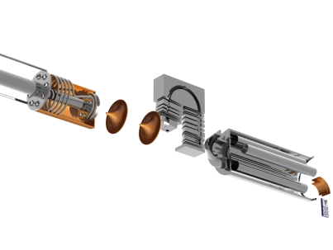
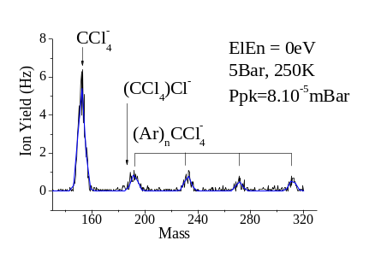
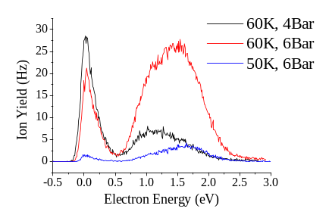
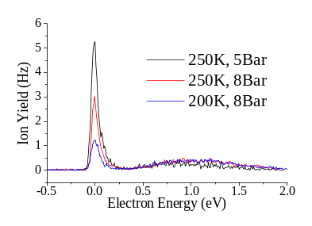
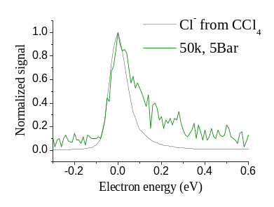
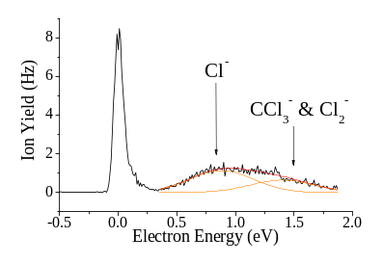
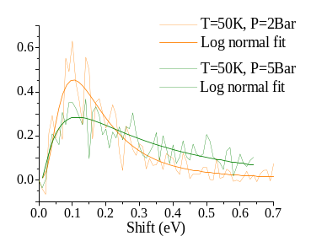

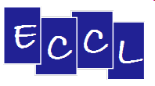


STABILISATION OF TRANSIENT NEGATIVE IONS
IN RARE GAS CLUSTERS
V. Vizcaino, L.An der Lan , S. Denifl, T.D. Märk and P. Scheier
Institut für Ionenphysik und Angewandte Physik, Universität Innsbruck,Technikerstr.25,
A-6020 Innsbruck, Austria
Introduction
Experimental apparatus
Transient Negative Ion
Low energy electrons attach to molecules at well defined energies and form transient negative ions (TNI) which, after typically 10⁻¹²s to 10⁻¹⁴s, decay either by autodetachment of the electron or through dissociation of the molecular anion.
e⁻ + AB → (AB)⁻* → A⁻ + B Dissociative Electron Attachment → e⁻ + AB Autodetachment
If the molecule is surrounded by other atoms or molecules then the TNI can be stabilized and the different dissociative processes significantly suppressed. However their signature is visible in the stabilized parent anion yield (AB)⁻.
→ In this experiment, we use Neon and Argon clusters to stabilize the parent anion CCl₄⁻.
Rare gas clusters properties
V₀ = difference between the vacuum level and the bottom of the conduction band of the solid or liquide rare gas matrix .
Hemispherical Electron
Monochromator
ElEn = 0 - 3eV
I ~ 20nA
FWHM ~ 70-100meV
Calibrated with Cl–/CCl₄
Pickup
Chamber
Transient Negative Ion
Cluster Source
Argon Neon
Ø nozzle 20 μm 10 μm
Temp. 250 K 50-60 K
Pressure 2-10 Bar 2-10 Bar
Quadrupole
Mass Spectrometer
Channeltron
Conduction Band
For V₀ > 0 (He, Ne)
the incident electron needs some extra energy to overcome the potential barrier and enter the conduction band → e- moves in a bubble due to strong repulsion.
For V₀ < 0 (Ar, Kr, Xe)
e- mobility is high
CCl₄ in the gas phase
V₀
Electron attachment to CCl₄ molecules leads, in the gas phase,
to dissociation into Cl⁻, Cl₂⁻, CCl₂⁻ and CCl₃⁻ fragments.
e⁻ + CCl₄ → (CCl₄)⁻* → Cl⁻ + … @ 0eV (s-wave) and 0.8eV
→ Cl₂⁻ + … @ 1.35eV
→ CCl₂⁻ + … @ 1.7eV and 6eV [1] → CCl₃⁻ + … @ 1.47eV
E_{vaccum}
Valence Band
CCl₄ in Argon Clusters
CCl₄ in Neon Clusters
As for Argon clusters, the 0eV peak decreases with increasing cluster size.
The pressure in the pick-up chamber is carefully adjusted in order to embed only monomers in the clusters.
For Neon, the difference between the vacuum level and the bottom of the conduction band is positive.
→ The features in CCl₄⁻ appear broadened and slightly shifted.
As the size of the Argon cluster increases, the 0eV peak decreases quite significantly.
However, the cluster is getting big enough to accomodate the excess energy and to prevent dissociation into CCl₃⁻ or Cl₂⁻
The value (V₀) varies with the cluster density [2]. The cluster size follows a log normal distribution so does the shift observed.
Acknowledgement: This work was supported by the FWF, Wien and the European Commission. V.V. and S.D. gratefully acknowledge a Lise-Meitner and an APART grant from the FWF and Austrian Academy of Sciences, respectively.
[1] T.Oster, A.Kühn and E.Illenberger, Int. J. Mass Spect., 1989, 89 1
[2] K.Martini, J.P.Toennies and C.Winkler, Chem.Phys.Letters, 1991, 178 4

