Slide 1
On Premise
Hemma/Kontor/Datahallen/Datacentret
MinDator
ApiApp
Sql Server

Slide 2
On Premise
Hemma/Kontor/Datahallen/Datacentret
MinDator
ApiApp

Slide 3
mydb
mydb
tempdb
tempdb
tempdb
tempdb
msdb
msdb
msdb
msdb
model
model
model
model
master
master
master
master
Instance: MSSQLSERVER
Instance: SHAREPOINT
Instance: MSSQLSERVER
Instance: SHAREPOINT
APP: SQL Server
APP: SQL Server
mydb
OS: Windows Server
OS: Windows Server
tempdb
msdb
model
HW / vHW
vHW
master
Instance: MSSQLSERVER
mydb
SQL Server 2017 Enterprise Windows Server 2016
On Premise
SQL Server 2017 Enterprise Windows Server 2016
Azure SQL Managed Instance
Azure SQL Database

Slide 4
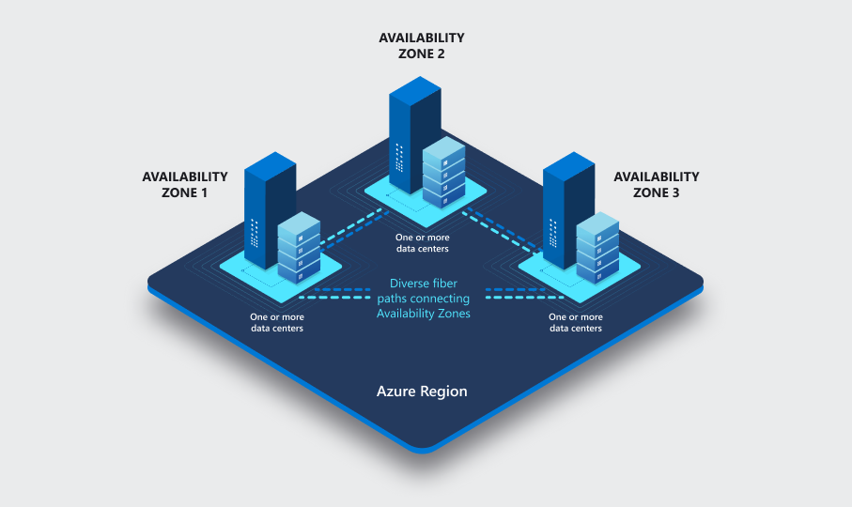
Sweden Central
West Europe
North Europe

Slide 5

LRS
Locally-redundant Storage

Slide 6
ZRS
Zone-redundant Storage

Slide 7
Primary Region
West Europé
Sweden Central
Secondary Region
North Europé
Sweden South*
GRS
Geo-redundant Storage

Slide 8
Primary Region
West Europé
Sweden Central
Secondary Region
North Europé
Sweden South*
Z-GRS
Zone Geo-redundant Storage

