Slide 1















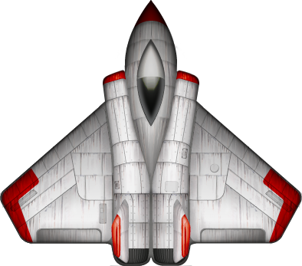

Mobile App Dev
Andreas Dietze, Manuel Schmitt

Slide 2
Presentation Agenda
Game Plot
Controls
Game Code :
Intersections
Gryo - MotionControler
Touch - Add Shot
SKActions
Workload – Andreas
Workload – Manuel
Problems – Discussion
Notes:
First have a look at the presentation agenda

Slide 3

Game Plot
Bottom to top shot em up
Game has a total of four stages which differs form each other
1. Stage: Shoot enemies to get score
2. Stage: Polor star stage → if you got hit by this object you will die instant
3. Stage: Asteroids → Your ships position is affected by a asteroid collision
4. Stage: Mixed type of all danger objects in a period sequence - infinite
1
2
3
4
Notes:
And we start with cpu, ram and flash storage.
First there is to mention, that all CPUs wich are in an Apple device are from ARM. Usually Apple names them with a own Codename, Like A4, A5, and so on
Next you can see the processor generations used, especially the amount of cores inside the cpus. Ist just a small overview to prevent huge tables, which i came up first, but that was simply to mutch data.
Thats why i decided to make it that way, and i hope it proviedes an short overview about cpus in iPhones.
Followed by the cpus and ram, we look at the Storage system used in iPhones.
So, not like in other devices where you just can extend your storage with ssd/micro ssd, Apple has fixed flash storages included,
Depending on the money you want to spent in. This means, maybe an Iphone 7 with 32 GB Flash Storage is a bit less for the acutal time.

Slide 4

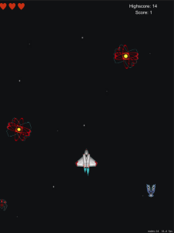
Controls
Shift the ship to move on x-axis
Ship got pushed by asteroid
Tab/Click the ship to shot
Correction via gyro sensor positive x-axis
Notes:
And we start with cpu, ram and flash storage.
First there is to mention, that all CPUs wich are in an Apple device are from ARM. Usually Apple names them with a own Codename, Like A4, A5, and so on
Next you can see the processor generations used, especially the amount of cores inside the cpus. Ist just a small overview to prevent huge tables, which i came up first, but that was simply to mutch data.
Thats why i decided to make it that way, and i hope it proviedes an short overview about cpus in iPhones.
Followed by the cpus and ram, we look at the Storage system used in iPhones.
So, not like in other devices where you just can extend your storage with ssd/micro ssd, Apple has fixed flash storages included,
Depending on the money you want to spent in. This means, maybe an Iphone 7 with 32 GB Flash Storage is a bit less for the acutal time.

Slide 5
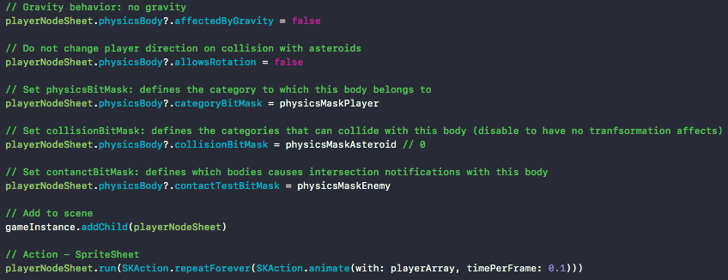
Game Code : Intersection
Part of func addPlayer(gameInstance: GameScene, physicsMasks: UInt32){…}
Notes:
On the left side you can see the release dates of all iphones and its Generation – Think like every years stands for another iPhone Generation. Its not exactly that, but it will be ok for now.
On the right you can see the proportions of the top 10 materials in a Smartphone
Around 24.88 percent of a smartphone currently consists of silicon. And even a big part consists of synthetic substances and iron, Aluminium
Another big problem which also includes other Smartphone Developers and Manufactures are the manufacturing conditions in countries like China, Korea or Taiwan.
Apple intern Routine inspection shows, that more than 127 supplier had varios shortcommings:
-First it sounds not that bad, but a deeper look into will show that’s a huge Problem, especially an image problem
-- For example, they identified ten companies which had a total of 91 underaged workes.
-- Another example are poorly installed ventilation systems, most in areas where workers have to work with toxic chemicals
-- And if you can remember, some years ago Foxcon was in the press because of the high number of suicides
As you can see, a big problem.
So lets start with hardware ^^
http://www.tech-review.de/include.php?path=content/news.php&contentid=10577

Slide 6

Game Code : Gyro – MotionControler
Part of func update(_ currentTime: TimeInterval){…}
Notes:
On the left side you can see the release dates of all iphones and its Generation – Think like every years stands for another iPhone Generation. Its not exactly that, but it will be ok for now.
On the right you can see the proportions of the top 10 materials in a Smartphone
Around 24.88 percent of a smartphone currently consists of silicon. And even a big part consists of synthetic substances and iron, Aluminium
Another big problem which also includes other Smartphone Developers and Manufactures are the manufacturing conditions in countries like China, Korea or Taiwan.
Apple intern Routine inspection shows, that more than 127 supplier had varios shortcommings:
-First it sounds not that bad, but a deeper look into will show that’s a huge Problem, especially an image problem
-- For example, they identified ten companies which had a total of 91 underaged workes.
-- Another example are poorly installed ventilation systems, most in areas where workers have to work with toxic chemicals
-- And if you can remember, some years ago Foxcon was in the press because of the high number of suicides
As you can see, a big problem.
So lets start with hardware ^^
http://www.tech-review.de/include.php?path=content/news.php&contentid=10577

Slide 7
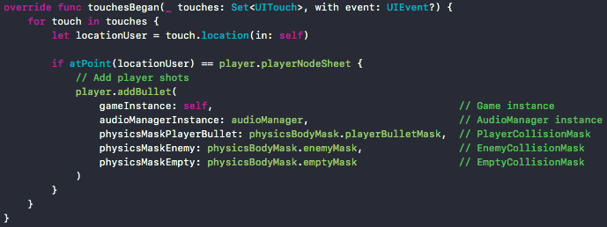
Game Code : Touch – Add Shot
Function touchesBegan update(_ touches: Set<UITouch>, with event: UIEvent?){…}
Notes:
On the left side you can see the release dates of all iphones and its Generation – Think like every years stands for another iPhone Generation. Its not exactly that, but it will be ok for now.
On the right you can see the proportions of the top 10 materials in a Smartphone
Around 24.88 percent of a smartphone currently consists of silicon. And even a big part consists of synthetic substances and iron, Aluminium
Another big problem which also includes other Smartphone Developers and Manufactures are the manufacturing conditions in countries like China, Korea or Taiwan.
Apple intern Routine inspection shows, that more than 127 supplier had varios shortcommings:
-First it sounds not that bad, but a deeper look into will show that’s a huge Problem, especially an image problem
-- For example, they identified ten companies which had a total of 91 underaged workes.
-- Another example are poorly installed ventilation systems, most in areas where workers have to work with toxic chemicals
-- And if you can remember, some years ago Foxcon was in the press because of the high number of suicides
As you can see, a big problem.
So lets start with hardware ^^
http://www.tech-review.de/include.php?path=content/news.php&contentid=10577

Slide 8
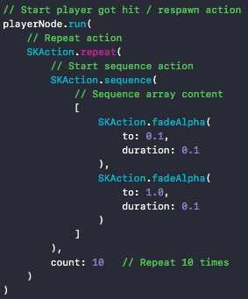
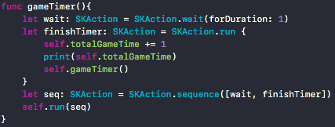

Game Code : SKActions
Part of func update() {…}
Function gameTimer() {…}
Part of func addEnemy(gameInstance: GameScene, physicsMasks: UInt32) {…}
Notes:
On the left side you can see the release dates of all iphones and its Generation – Think like every years stands for another iPhone Generation. Its not exactly that, but it will be ok for now.
On the right you can see the proportions of the top 10 materials in a Smartphone
Around 24.88 percent of a smartphone currently consists of silicon. And even a big part consists of synthetic substances and iron, Aluminium
Another big problem which also includes other Smartphone Developers and Manufactures are the manufacturing conditions in countries like China, Korea or Taiwan.
Apple intern Routine inspection shows, that more than 127 supplier had varios shortcommings:
-First it sounds not that bad, but a deeper look into will show that’s a huge Problem, especially an image problem
-- For example, they identified ten companies which had a total of 91 underaged workes.
-- Another example are poorly installed ventilation systems, most in areas where workers have to work with toxic chemicals
-- And if you can remember, some years ago Foxcon was in the press because of the high number of suicides
As you can see, a big problem.
So lets start with hardware ^^
http://www.tech-review.de/include.php?path=content/news.php&contentid=10577

Slide 9
Workload – Andreas (~60h)
Date | Content | Hours
22.02 | Initial game commit, getting more acquainted with swift and spritekit, fighting with VM (2h updates ++) | 4h + 4h vm
23.02 | Outsourced game objects (player, enemy, background) into seperate classes, added Audiomanager, shot management | 6h
24.02 | Collision tests, get familiar with SpriteKit PhysicsBodies, VM again GRRR (2h updates ++) | 2h + 4h vm made my day
25.02 | Fist game collisions with physicsMasks, simple shapes (cirles, boxes), playerBullet vs enemy vs player intersection, debug | 5h
26.02 | Final collision between player, enemy and bullets is polygone based by the shape of the non alpha texels of a texture (edge – shape), player lifes and handling, player dead animation, explosion sprites | 12h
27.02 | Protostars, asteroids, gamestages, physics settings between player and asteroids, game logics, win/lose conditions, new enemy sprite sheets | 12h
28.02 | Gyro-axis counter movment for asteroid push, debug, deploy | 10h
Notes:
And we start with cpu, ram and flash storage.
First there is to mention, that all CPUs wich are in an Apple device are from ARM. Usually Apple names them with a own Codename, Like A4, A5, and so on
Next you can see the processor generations used, especially the amount of cores inside the cpus. Ist just a small overview to prevent huge tables, which i came up first, but that was simply to mutch data.
Thats why i decided to make it that way, and i hope it proviedes an short overview about cpus in iPhones.
Followed by the cpus and ram, we look at the Storage system used in iPhones.
So, not like in other devices where you just can extend your storage with ssd/micro ssd, Apple has fixed flash storages included,
Depending on the money you want to spent in. This means, maybe an Iphone 7 with 32 GB Flash Storage is a bit less for the acutal time.

Slide 10
Workload – Manuel (52h)
Date | Content | Hours
08.02 | Put up development environment ( VMWare Player + MAC OS + Xcode + Simulators) | 10h
10.02 | Got used to Swift + SpriteKit Created initial game logic: Scrolling Background + Ship + Shot + Controls | 10h
16.02 | Got used to SKActions, SpriteKit-Physics. Got familiar with gyro. VM started to have problems with data transfer (no internet, no data transfer from vm to host or drive) | 10h
25.02 | First collision tests (physicsMasks, bounding boxes, intersections between player, bullet, enemy, asteroid) | 6h
26.02 | Added MainMenu- and Retry-Scenes to create a real game-loop (scene-management); added current- and persistent score; win/lose conditions; created different enemy spawning stages; overall bug fixes | 4h
27.02 | Created PowerUp (Health) that increases life-count (problems with didEnd not triggered); created ship-sprite-sheet for final ship animation; created random rotation for all asteroids; bug fixes (esp. sound, z-Index) | 8h
28.02 | Gyro-axis counter movment for asteroid push, debug, deploy | 4h
Notes:
And we start with cpu, ram and flash storage.
First there is to mention, that all CPUs wich are in an Apple device are from ARM. Usually Apple names them with a own Codename, Like A4, A5, and so on
Next you can see the processor generations used, especially the amount of cores inside the cpus. Ist just a small overview to prevent huge tables, which i came up first, but that was simply to mutch data.
Thats why i decided to make it that way, and i hope it proviedes an short overview about cpus in iPhones.
Followed by the cpus and ram, we look at the Storage system used in iPhones.
So, not like in other devices where you just can extend your storage with ssd/micro ssd, Apple has fixed flash storages included,
Depending on the money you want to spent in. This means, maybe an Iphone 7 with 32 GB Flash Storage is a bit less for the acutal time.

Slide 11
Problems – Discussion
VM-Ware High Sierra 10.13
IPad wurde teilweise via USB erkannt → Deploy → Updates
Kein GPU-Support in VM
Keine SpriteKitParticles
Framerate von ca 2 FPS in der VM
Datentransfer von VM aus war plötzlich nicht mehr möglich, weder in das Internet, noch in das Gast-OS oder auf eine Festplatte. Drag and Drop Datentransfer später wieder zeitweise möglich gewesen.
SpriteKit
Extrem gutes Framework für mobile 2D-Games
didEnd() wurde nicht getriggert (explosions, power up)
High end framework → low level schwer
Notes:
And we start with cpu, ram and flash storage.
First there is to mention, that all CPUs wich are in an Apple device are from ARM. Usually Apple names them with a own Codename, Like A4, A5, and so on
Next you can see the processor generations used, especially the amount of cores inside the cpus. Ist just a small overview to prevent huge tables, which i came up first, but that was simply to mutch data.
Thats why i decided to make it that way, and i hope it proviedes an short overview about cpus in iPhones.
Followed by the cpus and ram, we look at the Storage system used in iPhones.
So, not like in other devices where you just can extend your storage with ssd/micro ssd, Apple has fixed flash storages included,
Depending on the money you want to spent in. This means, maybe an Iphone 7 with 32 GB Flash Storage is a bit less for the acutal time.

Slide 12
thanks for your attention ☺
Notes:
BUSINESS TERMS

