Slide 1






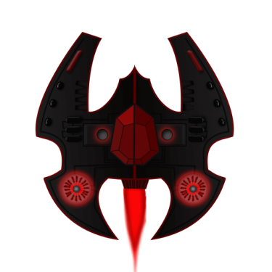

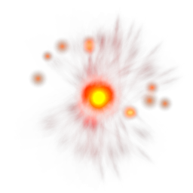
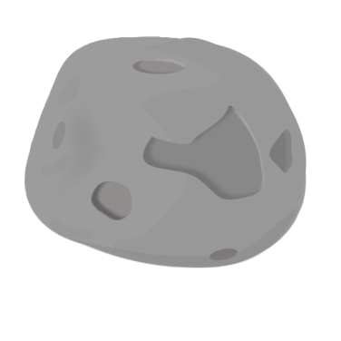





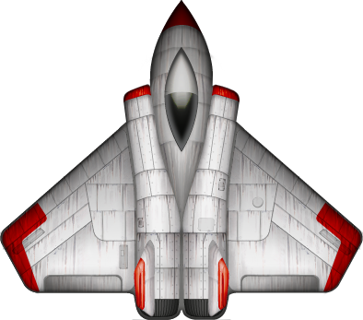
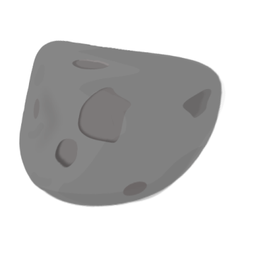
Mobile App Dev
Andreas Dietze, Manuel Schmitt

Slide 2
Presentation Agenda
Game Plot
Demo
Controls
Game Code :
Intersections
Gryo - MotionControler
Touch - Add Shot
SKActions
Problems – Discussion
Notes:
Welcome to our final presentation of our project. First have a look at the presentation agenda

Slide 3

Game Plot
Bottom to top shot em up
Game has a total of four stages which differs form each other
1. Stage: Shoot enemies to get score
2. Stage: Proto Star Stage → if you got hit by this object you will die instant
3. Stage: Asteroids → Your ships position is affected by a asteroid collision
4. Stage: Mixed type of all danger objects in a period sequence - infinite
1
2
3
4
Notes:
The gameplot itself is realy simple and should be more or less selfexplaining
It is a bottem to top shot em up and the game is seperated into 4 different phases / stages
1. In the first stage you just shoot enemies to increase your score (the main goal of the game is to score as high as possible). If you got hit by an enemy, you will lose one of your 4 lifes
2. Proto Star Stage: If you got hit by this object, you will lose alle our lifes at once and die instantly
3. Asteroid Stage: If you collide with an asteroid your ships position will be affected by the mass, speed and direction of the asteroid (like your ship got shifted by the object)
4. Mixed Stage: Mixed spawn of all different danger objects within small sequences

Slide 4
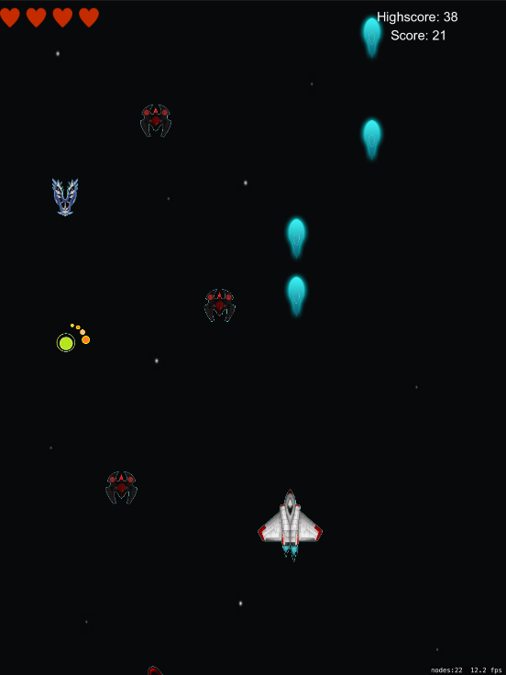
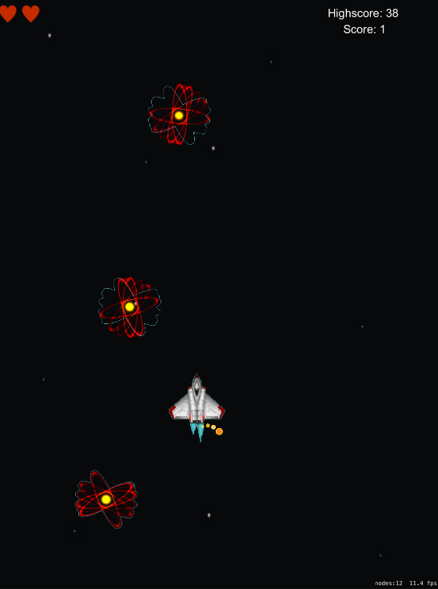
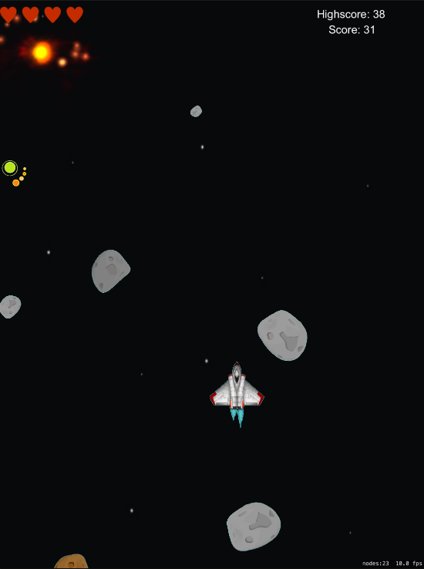
Demo
Stage One
Stage Two
Stage Three
Notes:
And we start with cpu, ram and flash storage.
First there is to mention, that all CPUs wich are in an Apple device are from ARM. Usually Apple names them with a own Codename, Like A4, A5, and so on
Next you can see the processor generations used, especially the amount of cores inside the cpus. Ist just a small overview to prevent huge tables, which i came up first, but that was simply to mutch data.
Thats why i decided to make it that way, and i hope it proviedes an short overview about cpus in iPhones.
Followed by the cpus and ram, we look at the Storage system used in iPhones.
So, not like in other devices where you just can extend your storage with ssd/micro ssd, Apple has fixed flash storages included,
Depending on the money you want to spent in. This means, maybe an Iphone 7 with 32 GB Flash Storage is a bit less for the acutal time.

Slide 5

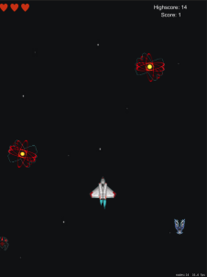
Controls
Shift the ship to move on x-axis
Ship got pushed by asteroid
Tab/Click the ship to shot
Correction via gyro sensor positive x-axis
Notes:
About the controls:
1. To move your ship you just have to shift it with your finger or mouse. With this type of controls, you can only navigate on the x-axis. 2. To shot just tab or click on the ship.
3. To avoid beeing pushed out of the viewport by an asteroid the player is able to correct the position on the y-axis by motion control via the gyro sensor. And if you got pushed out of the viewport you will also die. To correct the ships possition, you can rotate the ipad/phone to fly torwards/up -> add to y-axis

Slide 6
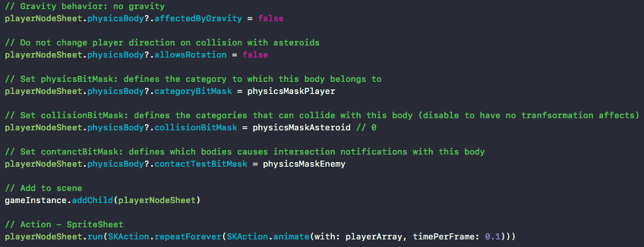
Game Code : Intersection
Part of func addPlayer(gameInstance: GameScene, physicsMasks: UInt32){…}
Notes:
Next we have some small code snippets for you which discribe how we implemented the main features of the game
First to mention is the intersection between the danger objects and the player
As shown on the slides before, there are some differente types of collision, like the player – enemy collision will deacrese your lifecount, polar stars will kill you instantly and asteroids wont hurt you, but
Affects the position of your ship.
In this snipped we show the collision settings for the player object. It is based on predefined bit masks (just a number) to assigne the collision categories
Like you can see in the snippet, the playerNode has the categorie „physicsMaskPlayer“, which is the number 0 in your case.
It can collide with the asteroids and the physics effect is computed by the framework. But you have the full control of the physics behaviour, used like a state mashine (set friction, set mass, set …), like on the top „affectedByGravity“ and so on
The contactBitMask is just to trigger notification in case of collision between player and enemy. The logic in case of a collision is handled manualy.

Slide 7
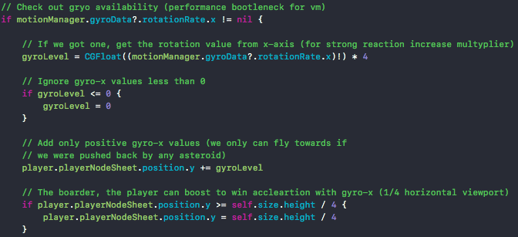
Game Code : Gyro – MotionControler
Part of func update(_ currentTime: TimeInterval){…}
Notes:
This is the main part of our motion control implementation
Short said, we first check for gyro availability and add a parameter called „gryoLevel“ to the ships y-position.
This parameter will be increased by the rotation fo the pad from 0 to 90 °. The limit of 90° is caused by the user behauviour.
The limit of the y-position is a fourth of the screen height, so screenheight divided by 4 is the max y player position.
Missing in this snipped for example is the viewport collision

Slide 8
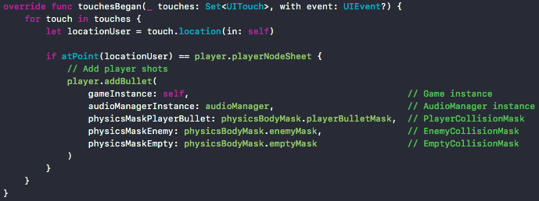
Game Code : Touch – Add Shot
Function touchesBegan update(_ touches: Set<UITouch>, with event: UIEvent?){…}
Notes:
This codesnippet shows how we handled our player shots combined with the tough control.

Slide 9
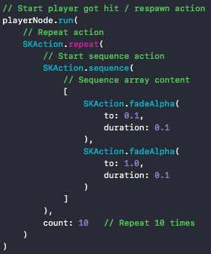
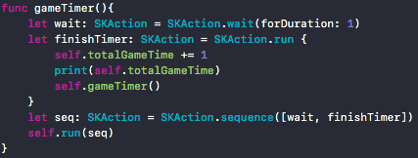

Game Code : SKActions
Part of func update() {…}
Function gameTimer() {…}
Part of func addEnemy(gameInstance: GameScene, physicsMasks: UInt32) {…}
Notes:
For the most events SKActions were used, like the player hit animation, spritsheets, the gameloop timer or the enemy spawn event.
SKActions are increadible powerfull and provide a lot of functions which allows you to handle most of your gamelogics. Can be nested/ combined with other actions.

Slide 10
Workload – Andreas (~60h)
Date | Content | Hours
22.02 | Initial game commit, getting more acquainted with swift and spritekit, fighting with VM (2h updates ++) | 4h + 4h vm
23.02 | Outsourced game objects (player, enemy, background) into seperate classes, added Audiomanager, shot management | 6h
24.02 | Collision tests, get familiar with SpriteKit PhysicsBodies, VM again GRRR (2h updates ++) | 2h + 4h vm made my day
25.02 | Fist game collisions with physicsMasks, simple shapes (cirles, boxes), playerBullet vs enemy vs player intersection, debug | 5h
26.02 | Final collision between player, enemy and bullets is polygone based by the shape of the non alpha texels of a texture (edge – shape), player lifes and handling, player dead animation, explosion sprites | 12h
27.02 | Protostars, asteroids, gamestages, physics settings between player and asteroids, game logics, win/lose conditions, new enemy sprite sheets | 12h
28.02 | Gyro-axis counter movment for asteroid push, debug, deploy | 10h
Notes:
And we start with cpu, ram and flash storage.
First there is to mention, that all CPUs wich are in an Apple device are from ARM. Usually Apple names them with a own Codename, Like A4, A5, and so on
Next you can see the processor generations used, especially the amount of cores inside the cpus. Ist just a small overview to prevent huge tables, which i came up first, but that was simply to mutch data.
Thats why i decided to make it that way, and i hope it proviedes an short overview about cpus in iPhones.
Followed by the cpus and ram, we look at the Storage system used in iPhones.
So, not like in other devices where you just can extend your storage with ssd/micro ssd, Apple has fixed flash storages included,
Depending on the money you want to spent in. This means, maybe an Iphone 7 with 32 GB Flash Storage is a bit less for the acutal time.

Slide 11
Workload – Manuel (52h)
Date | Content | Hours
08.02 | Put up development environment ( VMWare Player + MAC OS + Xcode + Simulators) | 10h
10.02 | Got used to Swift + SpriteKit Created initial game logic: Scrolling Background + Ship + Shot + Controls | 10h
16.02 | Got used to SKActions, SpriteKit-Physics. Got familiar with gyro. VM started to have problems with data transfer (no internet, no data transfer from vm to host or drive) | 10h
25.02 | First collision tests (physicsMasks, bounding boxes, intersections between player, bullet, enemy, asteroid) | 6h
26.02 | Added MainMenu- and Retry-Scenes to create a real game-loop (scene-management); added current- and persistent score; win/lose conditions; created different enemy spawning stages; overall bug fixes | 4h
27.02 | Created PowerUp (Health) that increases life-count (problems with didEnd not triggered); created ship-sprite-sheet for final ship animation; created random rotation for all asteroids; bug fixes (esp. sound, z-Index) | 8h
28.02 | Gyro-axis counter movment for asteroid push, debug, deploy | 4h
Notes:
And we start with cpu, ram and flash storage.
First there is to mention, that all CPUs wich are in an Apple device are from ARM. Usually Apple names them with a own Codename, Like A4, A5, and so on
Next you can see the processor generations used, especially the amount of cores inside the cpus. Ist just a small overview to prevent huge tables, which i came up first, but that was simply to mutch data.
Thats why i decided to make it that way, and i hope it proviedes an short overview about cpus in iPhones.
Followed by the cpus and ram, we look at the Storage system used in iPhones.
So, not like in other devices where you just can extend your storage with ssd/micro ssd, Apple has fixed flash storages included,
Depending on the money you want to spent in. This means, maybe an Iphone 7 with 32 GB Flash Storage is a bit less for the acutal time.

Slide 12
Problems – Discussion
VM-Ware High Sierra 10.13
IPad was only partially detected via USB → Deploy → Updates
No GPU-Support in VM
No SpriteKitParticles
Framerate of approx 2 FPS in VM
Data transfer from VM was suddenly no longer possible, either in the Internet, in the guest OS or on a hard drive. Drag and Drop data transfer later again temporarily possible.
SpriteKit
Very good Framework for mobile 2D-Games
didEnd() has not been triggered (explosions, power up)
High end framework → low level development hard
Deployment
Programm suddenly cannot be executed on the iPad

Slide 13
thanks for your attention ☺
? Questions ?
Notes:
BUSINESS TERMS

