Slide 1
IPN Project nr. 321559
Optimizing Marine Battery operations using 6 years’ operational data from two commercially operating vessels (OMB6)
Suggestions for UiO student project
Wei He (OMB6 Project manager)
Department of Energy Storage and Emerging Technology, Research & Technology, Equinor
Student project discussions
09:00 – 10:00 19th March 2021
(recommendation to use the round-trip efficiency of the MB system: 95%, 90% and 80% on 25th March 2021)

Slide 2
Three comments from Wei
Dear Andreas: Many thanks for your attached presentation.
I am very pleased to see your results in such short time. Great! Can I have three questions as follows? Many thanks.
Firstly, can you add a few more slides? One slide of the power output time series from each diesel generator and from the MB for one week. Another two slides to show the power output time series from each diesel generator and from the MB in short time steps (seconds or minutes). Many thanks.
Secondly, will you also have time to try the MB round trip efficiency of 90% and 80%? Many thanks.
Thirdly, for your information, the current two functions of MBs are as follows:
MB peak shaving of diesel generators: keeping diesel generators at optimal efficiency by charging/discharging MBs.
MB capacity as spinning reserve: one generator less than “normal” at any time during dynamic position (DP).
From the operational data, can you see the results of these two functions? Any improvement suggestions? What are the potential new functions of MBs? Many thanks. Regards, Wei
The battery performance data in detail is not available:
The ship owner and battery supply is working for this issue.
The suggestion is to use the round trip efficiency of the battery system:
Recommendation to use 95%, 90% and 80% for this project.
The round trip efficiency from Equinor’s Batwind project is about 80 to 85%. It is quite flat and does not vary much for different C rates.
The round trip efficiency from ABB’s indication is about 91-92%.
Notes:
2

Slide 3
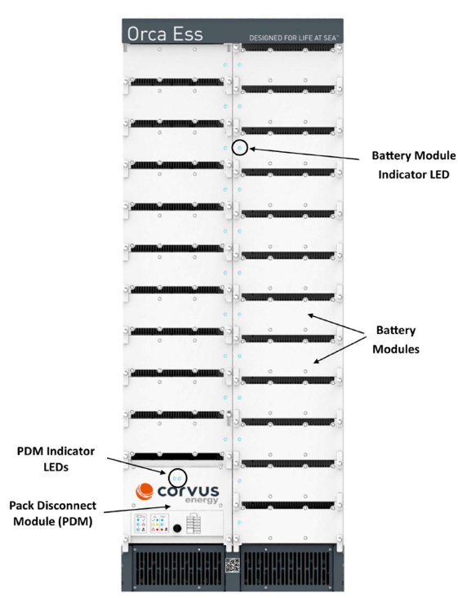
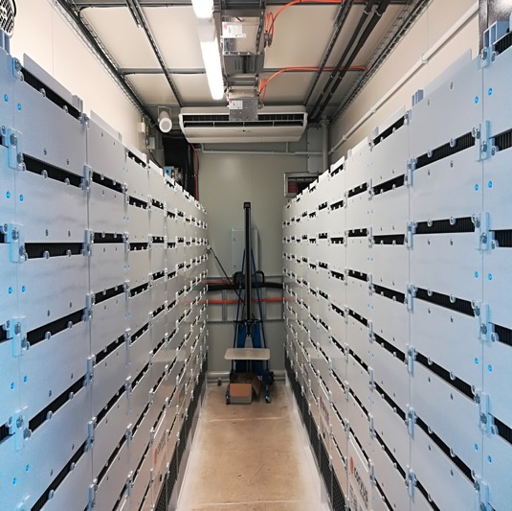
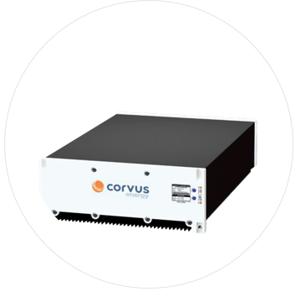
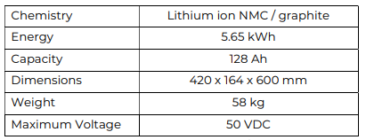
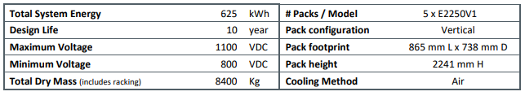
MB module & rack and MB room on vessel (Courtesy Corvus)
MB module
MB rack
MB room on vessel
One MB module specifications
One MB system (5 x 125 kW racks) specifications
Notes:
3

Slide 4
IPN project: OMB6 Initial observations & proposed research tasks
The initial observations of the two current functions of MBs from reviewing the 11-month operational data are:
MB peak shaving of diesel generators: keeping diesel generators at optimal efficiency by charging/discharging MBs:
The batteries have been used with very shallow depth of charge/discharge with cycle times less than a minute.
MB capacity as spinning reserve: one generator less than “normal” at any time during dynamic position (DP):
MBs will be in operation but it does not discharge any power.
The total number of large depth discharge cycles is very low: one or two full equivalent charge-discharge cycles in one week.
Proposed research tasks:
Re-evaluating the fuel saving from MB peak shaving of diesel generators and O&M of MBs:
i) Absorbing fast peaks (e.g. cycle times < 1 minute), ii) moving diesel generator operation to nearby higher efficiency region:
Limited fuel saving & O&M of MBs:
Reducing MB operations.
Alternative technologies including super capacitor.
iii) Stopping one engine: Significant fuel saving.Re-evaluating the fuel saving from MB peak shaving of diesel generator and O&M of MBs.
Proposing new MB functions to achieve more fuel saving.

