Slide 1
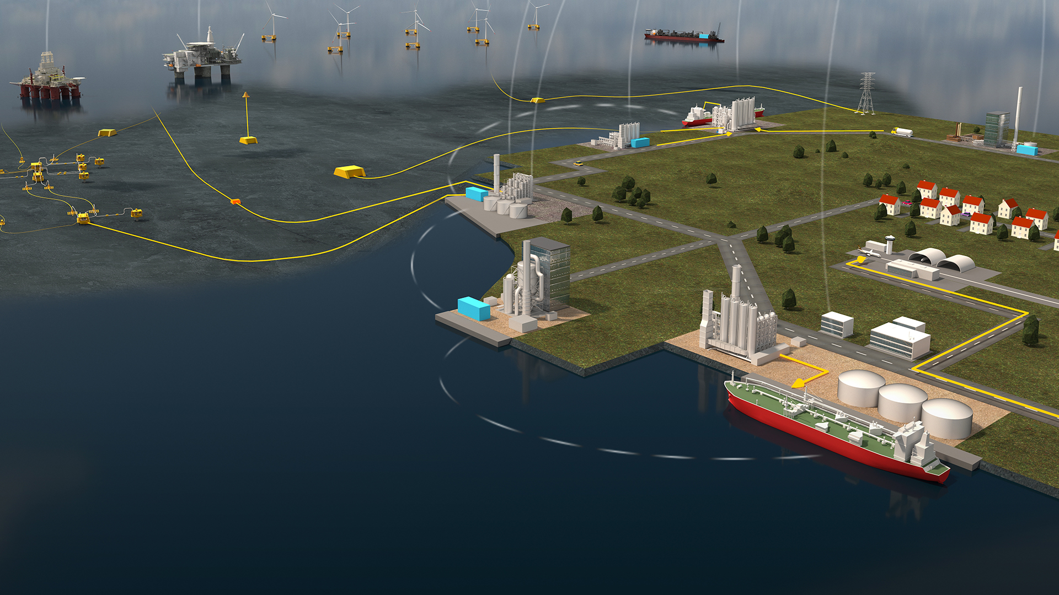
CCS in Germany
Image from: Aker Solutions
An analysis of how decreasing CCS prices affect the German electricity system

Slide 2
Motivation
Paris agreement: Emission reduction targets of 2, preferably 1.5 degrees
Targets will not be reached without negative emission technologies according to IPCC and IEA
Renewed interest in CCS and CCU as a result
Which country?

Slide 3
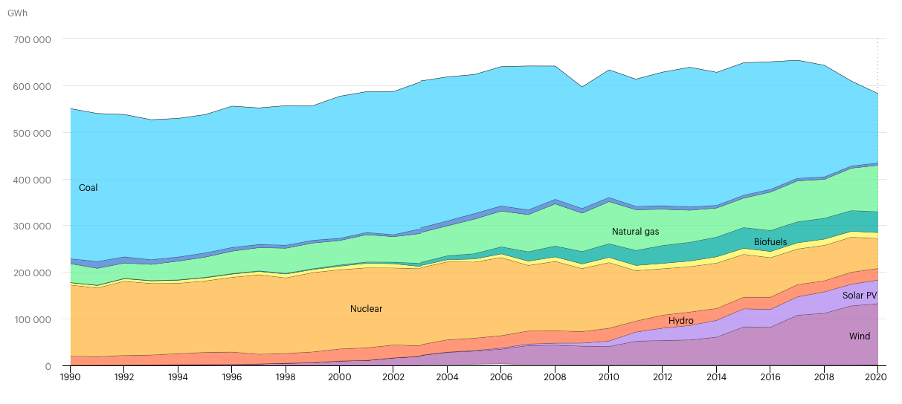
Germany

Slide 4
Future prospects
Coal and nuclear will be phased out
Gas is still required to meet base load
Goal of carbon neutrality by 2050
Climate Action Programme 2030 approved in 2019
Will set up a CCS programme

Slide 5
Research project
Make a model of new installed capacity every five years until 2050
Include CCS and predictions of technology learning (lower prices)
New generation capacity can be: Solar PV, Wind, Gas, Gas with CCS
Battery storage also included
Price of emissions included (ETS)
Evaluate installed capacities, emissions, and system cost

Slide 6
Implementation
Based on previously used model
Demand: According to the German Environmental Agency, electricity demand in 2050 will be 506 TWh, compared to 495 TWh in 2019
Increased electrification cancels with energy efficiency
Still need a lot of new capacity to replace fossil fuels
Demand will then be the current demand multiplied by the fraction of the electricity mix which is going to be replaced
Assumes no import/export, immediate phase-out
CCS implemented as a new technology: Gas with CCS
Higher costs and lower efficiency but lower emissions
Emission cost is added to the objective function to minimise
Prices based on the ETS system

Slide 7
Progress
Demand files and capacity factors have been prepared in python
Cost of emissions has been implemented into GAMS
Model runs with ”finger in the air” numbers
To do
Find data for gas with CCS (cost predictions, emissions, efficiency)
Evaluate results

