Slide 1


Slide 2
Problem
No cash -> no deal
=
No fun ☹

Slide 3
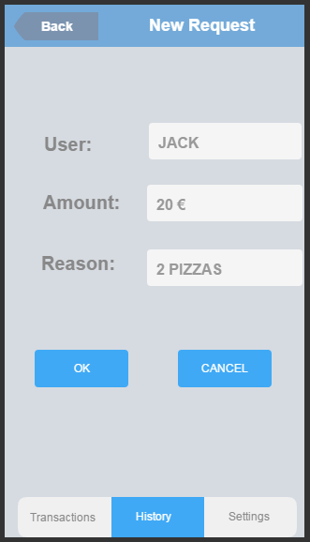
Solution

Slide 4
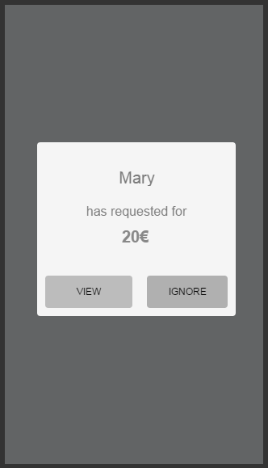

Slide 5
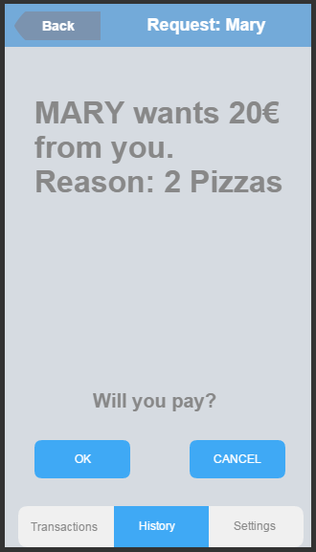

Slide 6
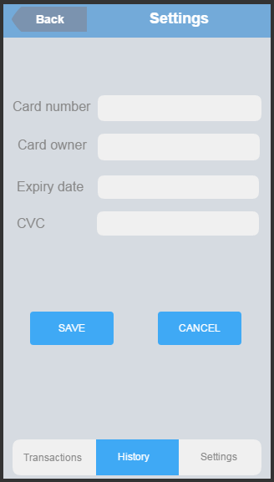

Slide 7
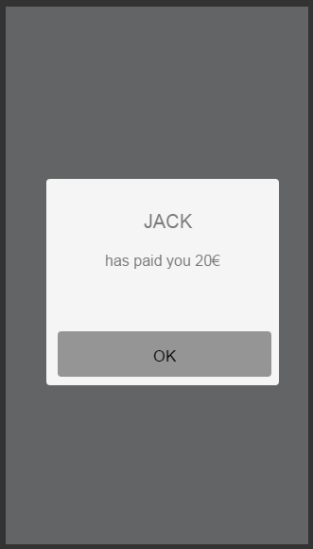

Slide 8
Metrics
GOOD
% first to third transaction
CTR
BAD
False requests/spamming
% Not completed

Slide 9
When to use?
No card payment available
Buyer has no cash

Slide 10
Market
Farmers market
Fairs
Taxis
Buses

Slide 11
Pricing
2.9% + 0.30$ - Stripe
+1.1%(excl 0.30$) or min 0.10$ - us

Slide 12
Competition
Cash
card terminals

Slide 13


