Slide 1
Projecting the selut of multiview snapshot-segmentation onto the original 3D geometry
Sand box POC

Slide 2
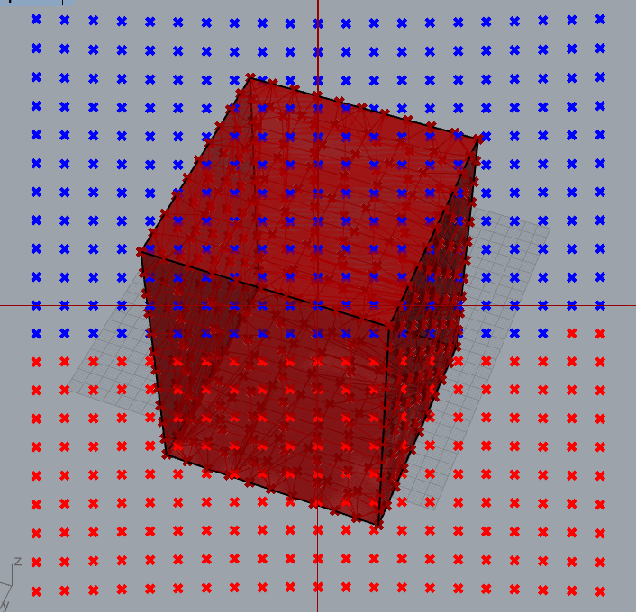
Some blue/red sample image (representing an actual pixel mask) # each dot corresponds with a pixel of the pixel-mask that represents the result of the image segmentation process (blue = lable_1, red = lable_2)

Slide 3
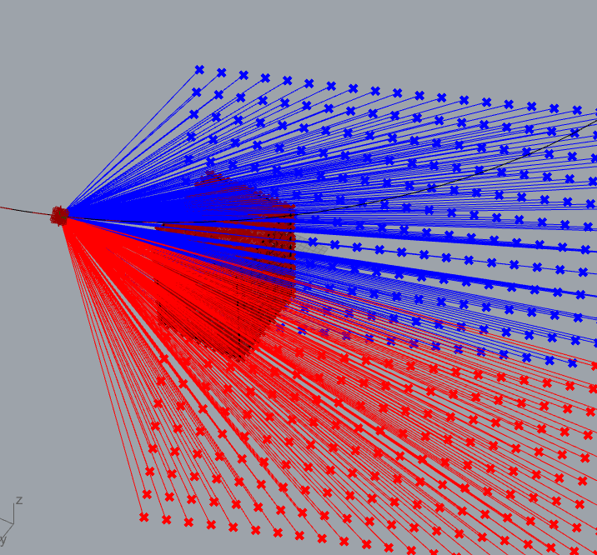
# Each dot is actually an infinite ray, linked to the pixel color and the perspective of one specific image (or it‘s pixel mask, respectivly) # The rays intersect with a mesh generated from the point

Slide 4
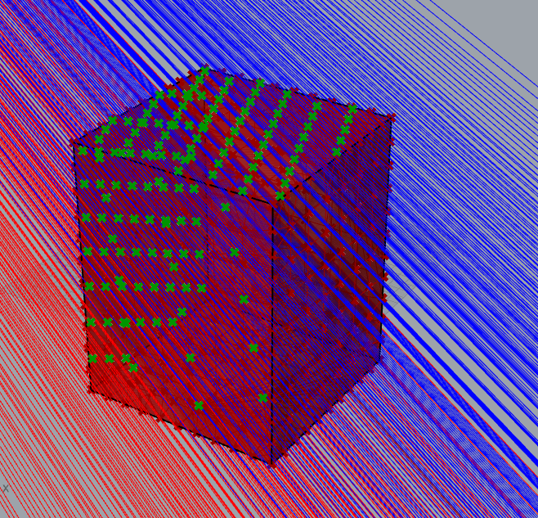
All intersection event between the rays and the 3D mesh are computed (the green dots)

Slide 5
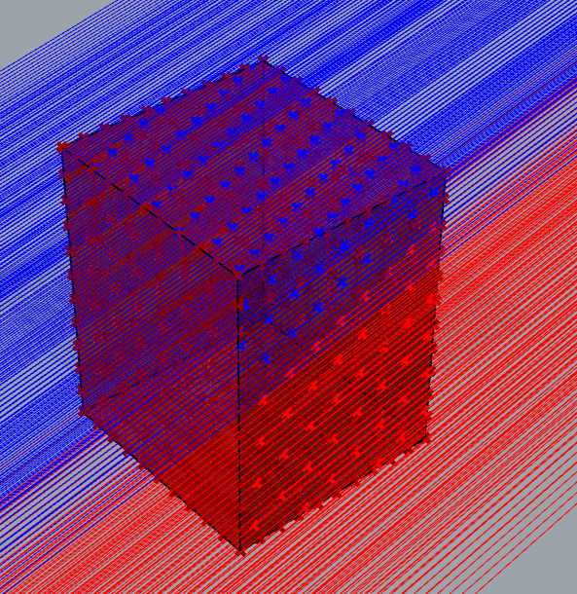
All intersection events are linked to the colors of the original rays (visualized via the blue and red dots)

Slide 6
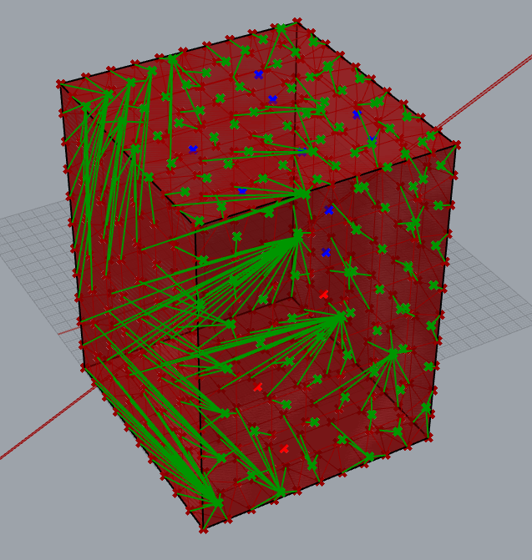
All mesh vertices (= points of the original point cloud) are linked to their neares mesh-ray-intersection event (visualized as green lines)

Slide 7
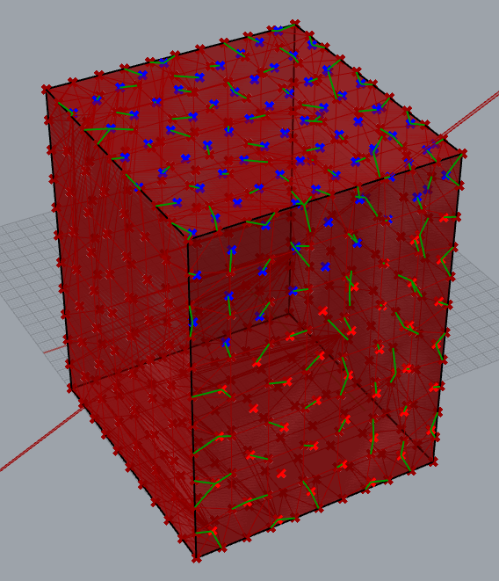
Mesh-Vertices are only linked to their nearest intersection-event if the distance is smaller than a certain threshold (only the short green lines remain) → This way we avoid linking the “backside” of the mesh geometry, which is not visible on the snapshot that was segmented

Slide 8
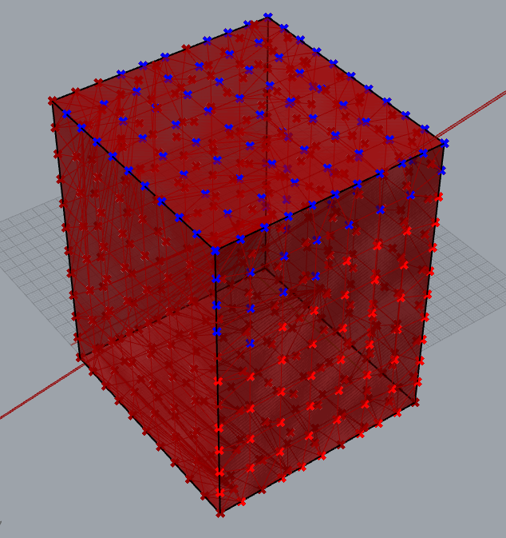
Finally, vertices are linked to the color (=label) of the nearest intersection event → The labels from the 2D snapshot are projected onto the 3D geometry (note: the “back side” of the geometry (left lower corner of this cube) is not labled during this snap shot)

Slide 9
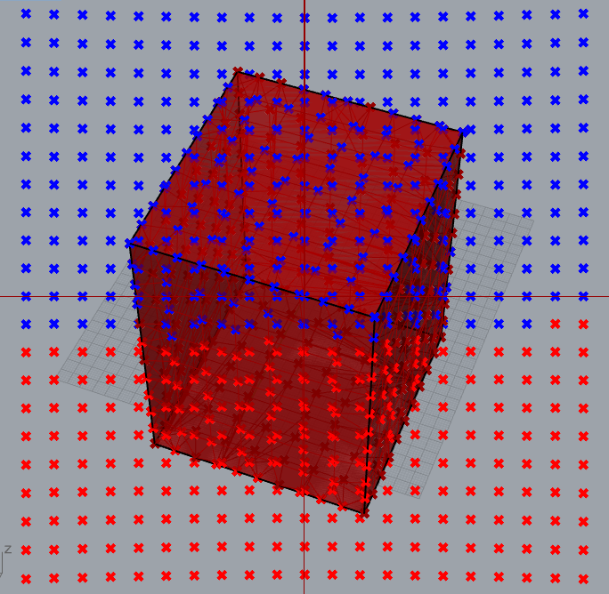
# We repeat this process for many “snapshots” of the 3D geometry # from each snapshot, a mesh vertex (= point cloud point) possibly collects a lable-vote # At the end, each vertex is linked with many (possibly different votes) # finally, a majority vote decides the actual label of the point

