Slide 1

Twitter Sentiment Analysis Project
Owen Andreasen & Justin Park

Slide 2



Project Description
In this project, we aim to conduct a sentiment analysis on Twitter data. Our primary objective is to compare traditional statistical methods against modern AI/ML techniques to evaluate tweets. We plan to analyze the sentiment of tweets stored in the PostgreSQL Twitter database using different approaches and tools.

Slide 3

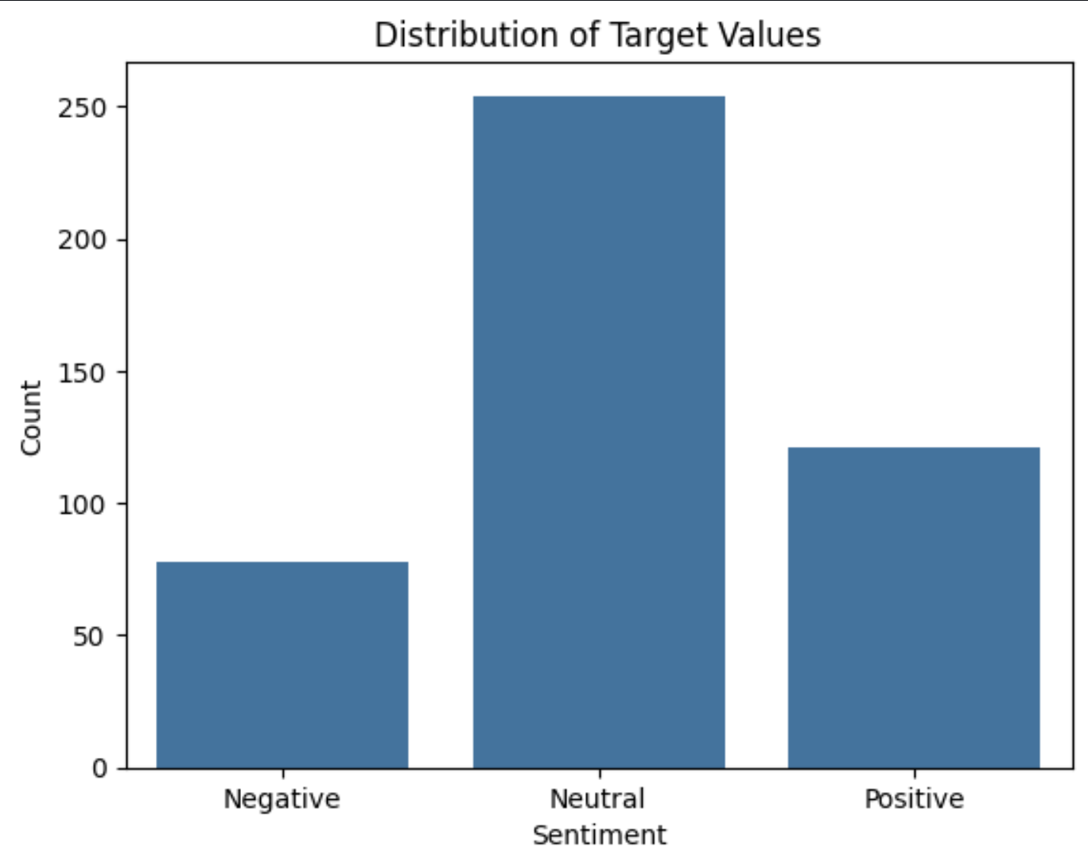
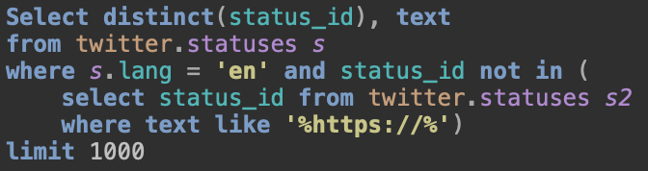
Data Source
Notes:
For this project we will be using 2 datasets
Twitter Sentiment Extraction dataset
Kaggle Lauched a competition admist the COVID-19 Scare , named Twitter Sentiment Extraction
what this competition asks for is not the sentiment scores but the part of the tweet (word or phrase) that reflects the sentiment
This is the dataset provided for the competition
27481 rows
Each row contains the text of a tweet, a sentiment label, and a word or phrase drawn from the tweet (selected_text) that encapsulates the provided sentiment
This dataset was only used for the SAS portion of the code because the naive SAS approach required more than 400 lines of data for training
Custom dataset
Twitter data sourced from the statuses table of PostgreSQL Twitter database
***Insert and talk about select statement
I built this specific query for 3 reasons.
I use distinct(status_id) to make sure there are not duplicate statuses.
important because repeated entries can lead to slight biases and inconsistencies when testing, which is especially true for a smaller dataset.
I filter on language to only include english entries
Sentiment analysis typically works better when limited to one language, and English seemed like the obvious choice since it is my native language.
I use a subquery to filter out all the statuses containing links.
I noticed while building this dataset that some statuses contain links to pictures or wesites, and some tweets contain JUST these links. Having links in the tweets will definitely throw off the accuracy of the sentiment analysis, so I left them out..
453 entries
Sentiments are hand labelled
Positive, Neutral, Negative
***Insert and talk about distribution
Prior to analysis, the data will be preprocessed to remove noise and irrelevant information.

Slide 4

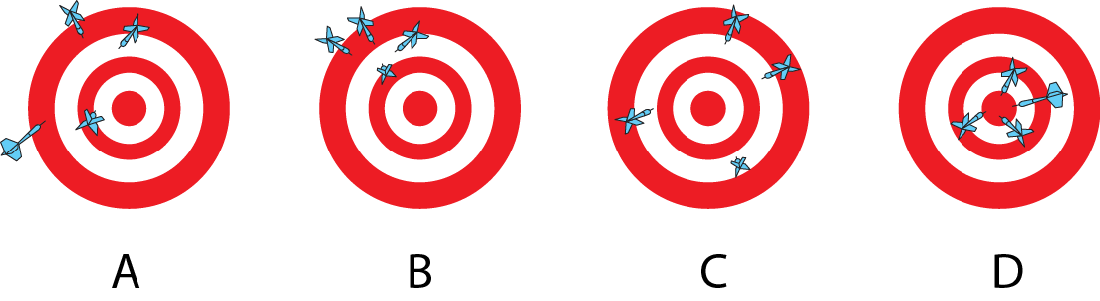
Evaluation Metrics
Accuracy: The proportion of correctly classified tweets
Recall: The proportion of true positive tweets identified by the model
Precision: The proportion of correctly classified positive tweets out of all predicted positive tweets
F1-score: Combination of Recall and Precision

Slide 5
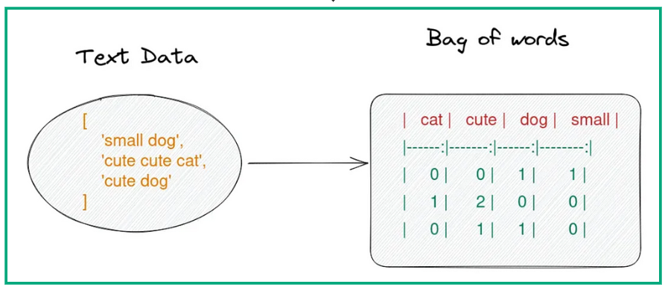
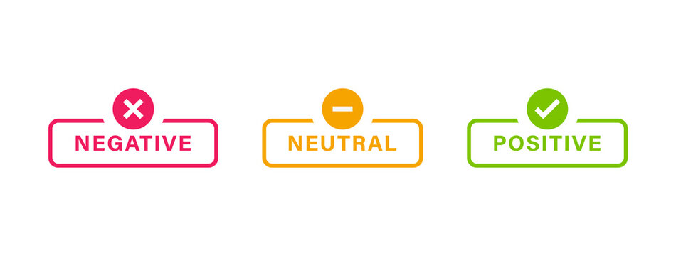
SAS
Data Import and Cleaning
Data Exploration
Text Tokenization and Vocabulary Creation
Feature Selection
Modeling
Testing

Slide 6
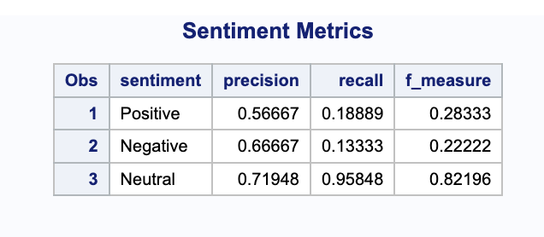

SAS Results

Slide 7
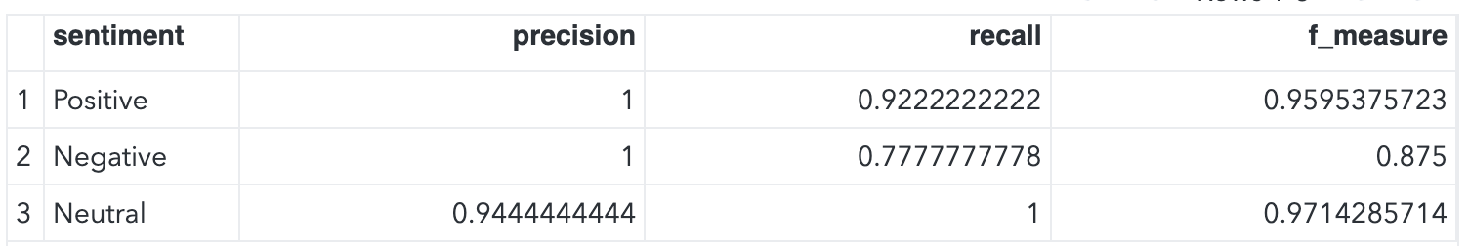
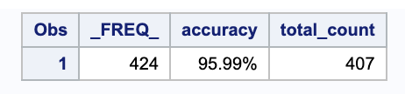
SAS result With Stop Words
Notes:
Stop words are commonly used words in any language that are often filtered out before or after processing natural language data (text). This is because stop words usually have little to no useful information for understanding the meaning of a text. They typically include articles, pronouns, prepositions, and other words that occur frequently in the language. Examples of stop words in English include "the", "is", "at", "which", and "on".
The primary purpose of removing stop words is to reduce the amount of data that needs to be processed, which can help improve the performance of various NLP tasks such as search engines, text summarizations, and sentiment analysis. By eliminating these words, algorithms can focus more on important words that give significant information about the content of the text.

Slide 8
Machine Learning Models
Preprocessing
Emoji conversion
Cleaning & Filtering
Oversampling
Naive Bayes
Bayes' Theorem
Assumes feature independence
Handles large data well
Good starting point for baseline
Read in Data
78% Accuracy
BERT Transformer
Bidirectional Encoder Representations from Transformers
Developed by Google
Pre-trained on large amounts of text
Reads text in both directions
XGBoost
Extreme Gradient Boosting
Designed for speed and performance
Builds multiple models sequentially
New models correct errors of old models
92% Accuracy
Notes:
Owen
Naive Bayes:
based on Bayes' Theorem, which uses probability to make predictions.
The "naive" aspect of the algorithm assumes that the features used to make predictions are independent of each other, which simplifies the computation
Naive Bayes is particularly popular for tasks like spam filtering, document classification, and sentiment analysis because it can handle a large volume of data with reasonable accuracy and speed.
It works by calculating the probabilities of different outcomes based on the input features and selecting the outcome with the highest probability.
The algorithm's effectiveness, despite its simplicity and the often inaccurate assumption of feature independence, makes it a widely used technique in various applications.
It's also a good starting point for more complex algorithms and a useful tool in the machine learning toolkit.
BERT
Bidirectional Encoder Representations from Transformers
natural language processing (NLP) model developed by Google.
pre-trained on a large amount of text and then fine-tuning on specific tasks
BERT is able to capture a rich understanding of language semantics
Unlike traditional models that read text sequentially, BERT reads text bidirectionally, allowing it to grasp context from both directions.
This capability makes it exceptionally powerful for tasks like sentiment analysis, question answering, and language translation.
XGBoost
Extreme Gradient Boosting
advanced implementation of gradient boosting algorithms
XGBoost was designed for speed and performance making it efficient at handling large-scale and complex data.
It builds multiple models sequentially, with each new model correcting errors made by the previous ones.
XGBoost is particularly versatile, being applicable to a wide range of regression, classification, and ranking problems across different domains.
Together, BERT's deep understanding of language nuances and XGBoost's powerful predictive capabilities make a formidable combination for tackling advanced NLP tasks, including sentiment analysis. In this project, we leverage BERT to generate embeddings that capture the contextual meanings of tweets, which are then fed into an XGBoost model to predict the sentiment expressed in each tweet.

Slide 9
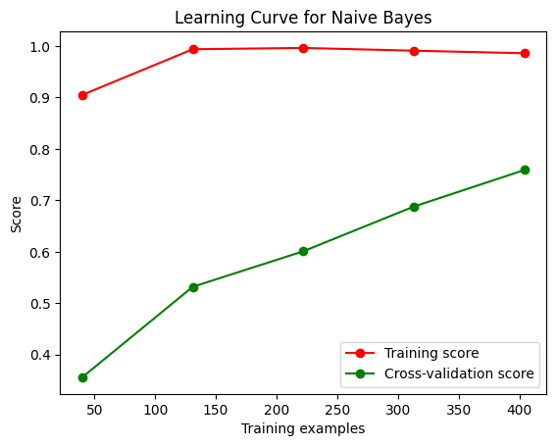
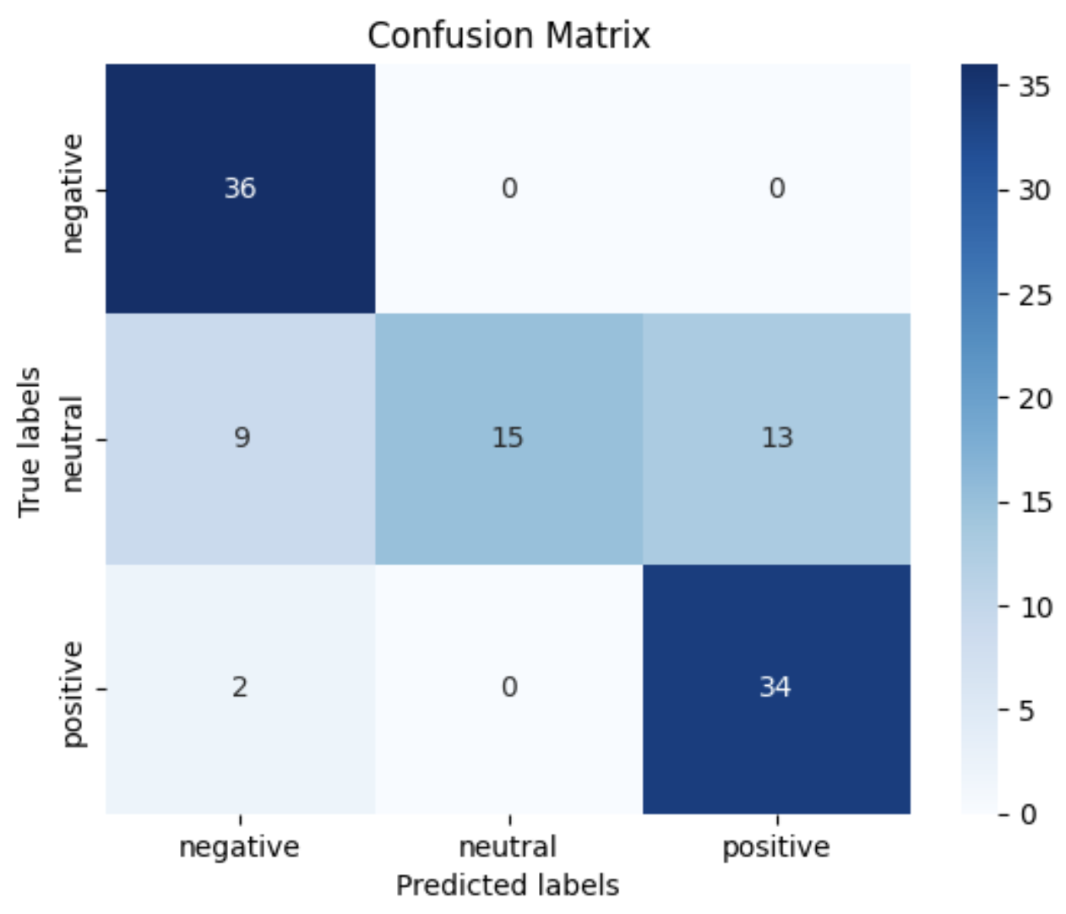
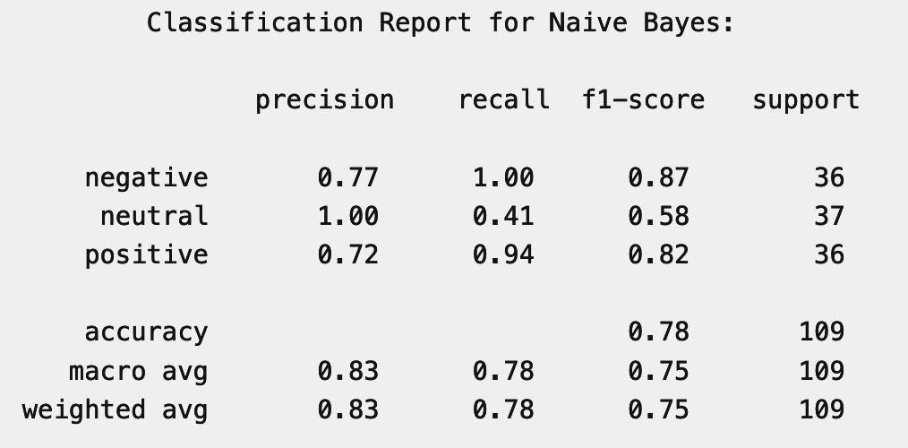
Naive Bayes Results
Notes:
Owen
Explain Learning curve
graph plots the model's performance on the training data (how well it learns the data it's trained on) and on the validation data (how well it generalizes to new, unseen data) against the amount of training iterations.
By examining the gap between the training and validation performance, you can identify overfitting (when the model performs well on training data but poorly on validation data) or underfitting (when the model performs poorly on both training and validation data).
No overfitting
training score is consistently high across the number of training examples indicating that the classifier is performing well on the training set
model is not overfitting, since the cross validation score is still increasing after all training examples.
the cross-validation scores be catching up with the training scores implies the model is generalizing better as it sees more data.
The fact that the CV score is still increasing means that there was probably not enough data and that this model would perform even better with more data
Good accuracy
75% accuracy
Good f1 scores on negative and positive
Implies that the model is very good at predicting sentiment of text when it falls under these two classes
Neutral recall is especially low
After looking at the confusion matrix, we can say that this low recall score is due to the model misclassifying true neutral labels as either positive or negative

Slide 10
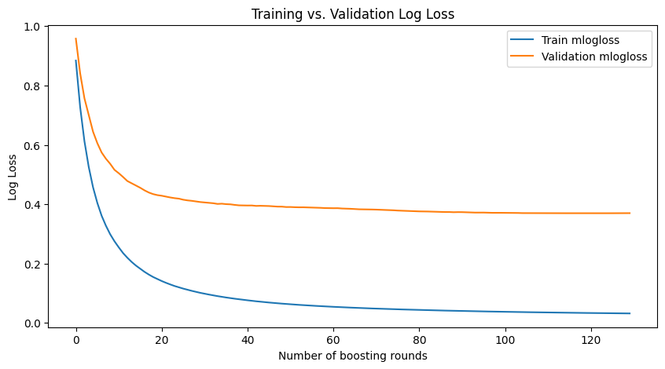
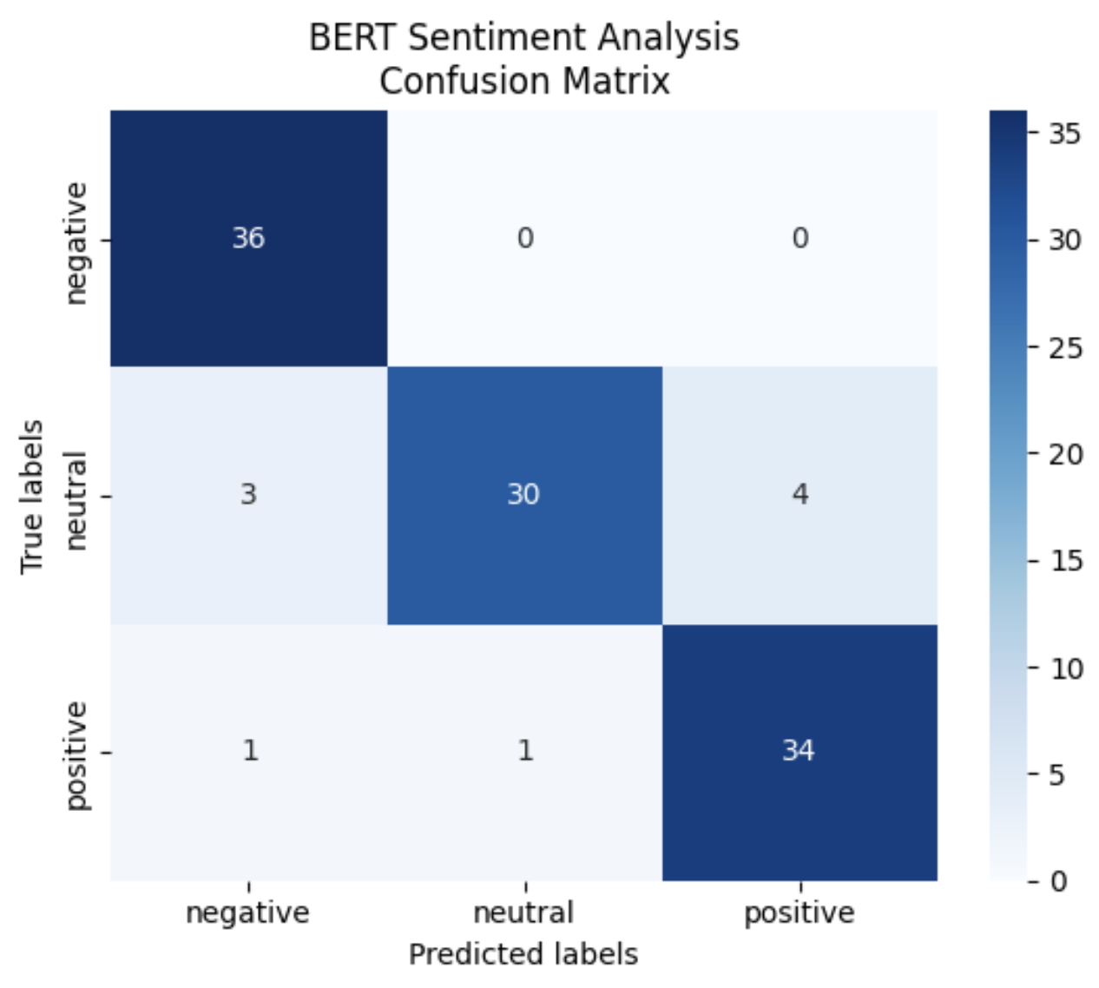
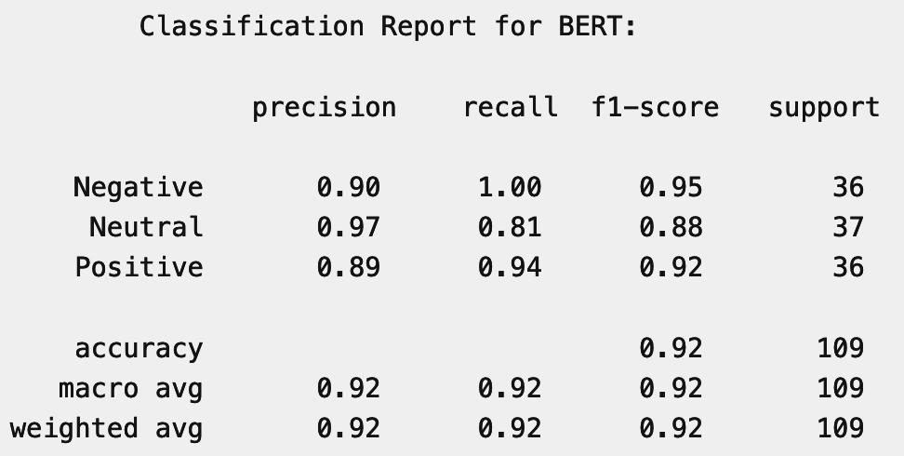
BERT+XGBOOST Results
Notes:
Owen
Explain log loss
The graph shows the log loss for a training set and a validation set across a number of boosting rounds in an XGBoost model.
Log loss is a performance metric that assesses the accuracy of a classifier by penalizing false classifications.
Lower log loss values indicate better performance.
No overfitting
training log loss starts high and quickly decreases, showing that the model is learning from the training data.
The validation log loss also decreases rapidly at the start, which means that the model initially generalizes well to unseen data.
There is also no significant gap between the training and validation log loss, which is a good sign that overfitting is minimal
The validation log loss does not increase as the number of rounds grows, which would have been a clear indicator of overfitting.
Log loss was also validated on a KFolds with 5 folds
Amazing accuracy
92% accuracy
Good f1 scores on negative and positive
Implies that the model is very good at predicting sentiment of text when it falls under these two classes
Neutral recall is slightly lower than other metrics
Similar to the Naive Bayes

Slide 11

Comparison & Discussion
“Muslim woman in Hijab makes valid points and audience members tell her to calm down Funny that Muslim woman who doesnt…”
“Please trash me on Wikipedia, I’m begging you”
"Just spilled my coffee all over my white shirt. Great start to the day! Can't wait to see what other surprises are in store for me. "
Notes:
Owen
SAS vs Machine Learning
SAS got roughly 95% accuracy
Naive Bayes got 75%
XGBOOST+BERT got 92%
My best guess for why SAS outperformed the ML models is due to a lack of training data for the models
The SAS was trained on a much larger Kaggle dataset (27k entries), whereas the ML was only trained on 400 rows of data
Sarcasm
One thing we were curious about in this project was the models ability to correctly interpret sarcasm
This can be a challenge for models because sarcasm often involves saying something but meaning the opposite
We tested the SAS model and the XGBOOST+BERT model on three different statements to view the results
Strings
“Muslim woman in Hijab makes valid points and audience members tell her to calm down Funny that Muslim woman who doesnt…”
“Please trash me on Wikipedia, I’m begging you”
"Just spilled my coffee all over my white shirt. Great start to the day! Can't wait to see what other surprises are in store for me. "
These are all strings with Negative sentiment
The XGBOOST+BERT model was able to predict all three correctly
This was a surprise to me, because I was expecting it to get at least one wrong
I want to focus on the third string because I believe it is the best example of something that would be hard to predict
It contains many positive words and almost no negative words, yet it still correctly understands that the sentiment is negative
SAS was not able to predict the sentiment correctly
Predicted the sentiment as neutral
My best guess is that a lot of sarcastic statements have similar sentence structure and use the same phrases, and the model was able to pick up on that
This is due to the fact that Machine learning models (especially Bert) can understand a word in the context of the sentence it is in, which can lead to a greater understanding of the words meaning
Ex: the word sick typically means ill or unwell, which is negative. However, if I say something like "That skateboard trick was sick!" the word "sick" is used to express admiration and positive sentiment.
This all shows for sentiment analysis, both Machine learning and statistical methods are valid choices, it just depends on the application and situation
For example, if you need something smaller and more efficient, typical statistical methods might be the right choice, but if you have a lack of data or you are particularly concerned about the correct assessment of sarcasm, metaphors, and other complex sentiments you might need to use a Machine Learning model instead

Slide 12
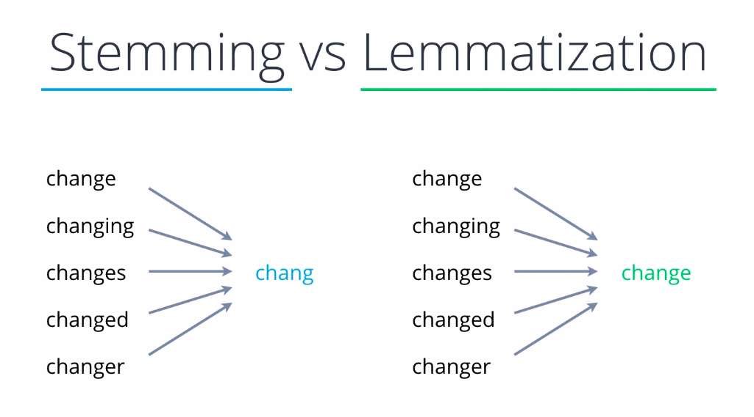
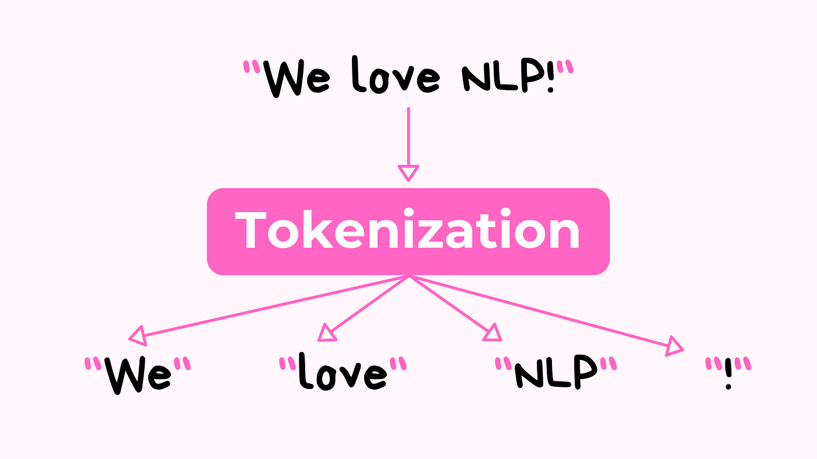
Improvements
Notes:
Owen and/or Justin
SAS:
Possible use of Lemmatization and stemming, maybe in addition to tokenization.
Lemmatization, stemming, and tokenization are all processes in natural language processing (NLP) that help in reducing words to their base or root forms and breaking text into manageable parts.
Tokenization: process of breaking up a string of text into meaningful elements called tokens.
For example, the sentence "GWU is great" would be tokenized into ["GWU", "is", "great"].
This is often the first step in NLP pipelines, as it allows algorithms to work with individual tokens rather than entire strings of text.
Stemming: cutting off the ends of words and stripping affixes from words to reduce them to their stem or root form.
Example: the words "fishing", "fished", "fisher", and "fishes" might all be reduced to the stem "fish".
This method is fast and straightforward but can lead to errors if the rules cause over-trimming or under-trimming, which results in non-words or incorrect stems.
Lemmatization: aims to remove grammatical endings only and to return the base or dictionary form of a word, which is known as the lemma.
For instance, "am", "are", and "is" are all lemmatized to "be".
Lemmatization is generally more sophisticated than stemming and uses a more informed analysis to achieve better accuracy by understanding the part of speech of a word in a sentence, as well as considering the word's meaning in the sentence
XGBOOST+BERT
The biggest improvement to be made on this model is increasing the dataset size.
The model does not overfit, generalizes well, and maintains a high accuracy on this small of a dataset; however, it would be even more robust and generalizable with a bigger dataset (at least 1000+ entries), which is clear from the Log Loss graph.
It could also be improved further by performing further training on the BERT model.
Right now, the BERT embeddings are generated using an out-of-the-box pretrained model, but if we were to train it further on tweets specifically from this PostgreSQL database, it might be able to further understand the nuances of syntax and semantics that are exclusive to twitter.
It is worth noting, however, that further training the BERT model specifically on tweets could take away from the ability to generalize to things other than tweets, as I discussed earlier.

Slide 13
Thanks!
Questions?

