Slide 1

Coffee Beans Sales Analysis
By
Thanos Chronopoulos
Andreas Gabriel
Filippos Georgiopoulos

Slide 2

Contents
Country-Product Preference Correlation by Revenue
Total Customers, Revenue & Sales Volume Summary per Coffee Type
Revenue Distribution by Month and Weekday across the years

Slide 3

Country-Product Preference Correlation by Revenue
Revenue by email domain - Loyalty Card Comparison

Slide 4
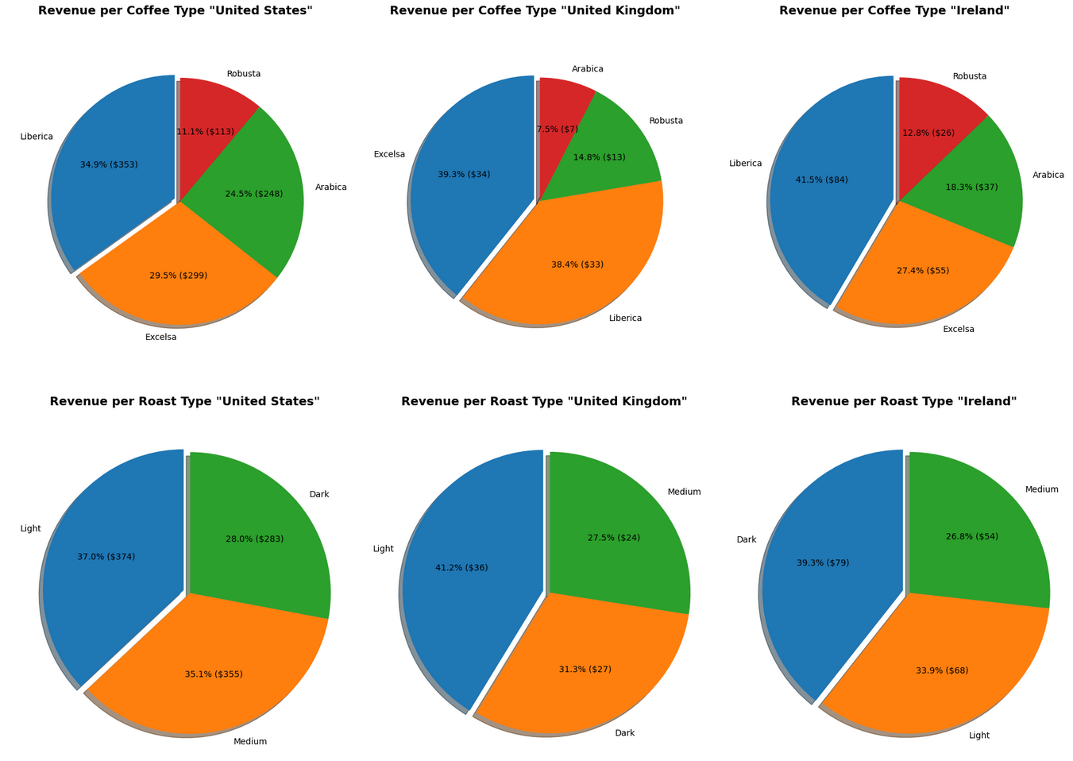
Pattern Observed:
Liberica is the highest-revenue coffee type across all three countries (United States, United Kingdom, and Ireland), consistently contributing the largest slice.

Slide 5
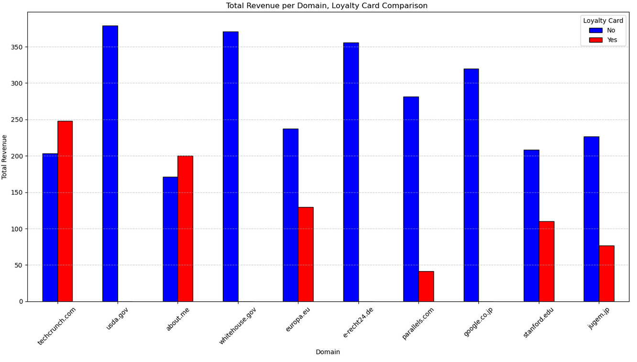
Pattern Observed:
For most high-revenue domains all or nearly all of the revenue comes from customers who do not have a Loyalty Card.

Slide 6

Total Customers, Revenue & Sales Volume Summary per Coffee Type
Year-Over-Year Coffee Revenue Performance per Country

Slide 7
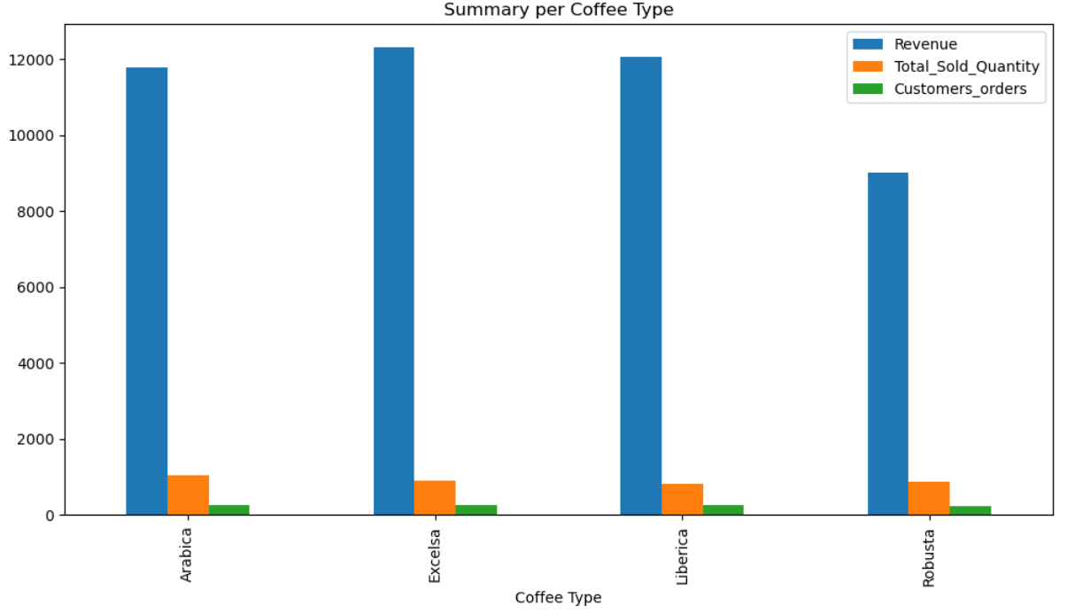
Pattern Observed:
Despite having the highest revenue, Excelsa and Liberica do not have the highest Total Sold Quantity; Arabica and Robusta have comparable or slightly higher sold quantities but generate significantly less revenue.
This makes it clear to see that Excelsa and Liberica coffees command a higher price per unit than Arabica and Robusta.

Slide 8
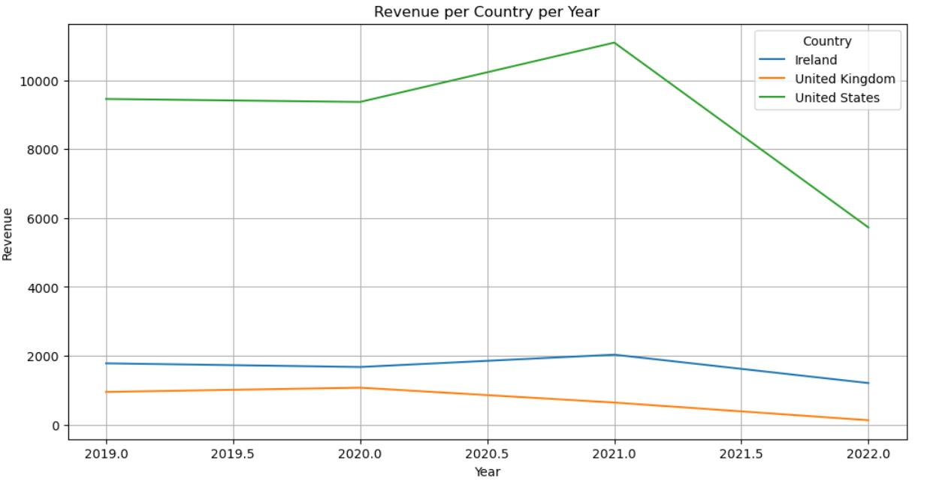
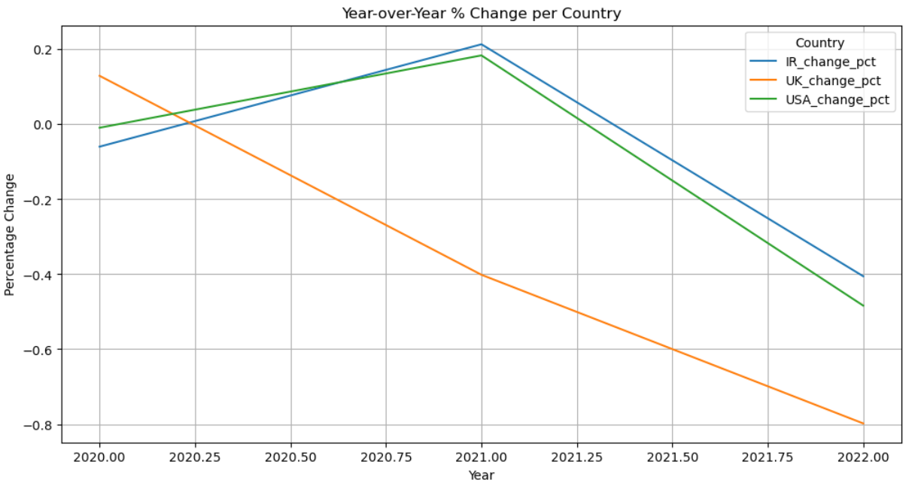
Pattern Observed:
United States: Revenue peaked in 2021 but then dropped significantly in 2022, with a ~50% year-over-year decline.
Ireland: Revenue had modest growth until 2021 but fell noticeably in 2022 (~40% decrease).
United Kingdom: Revenue was already declining since 2020 and fell dramatically in 2022 (~80% decrease).

Slide 9

Revenue Distribution by Month and Weekday across the years

Slide 10
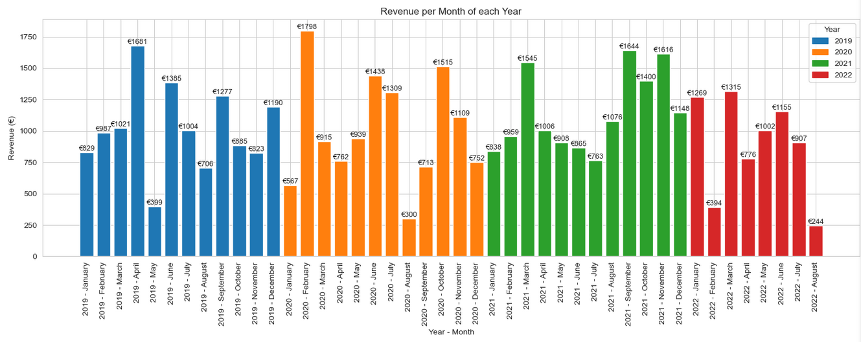
Pattern Observed:
Revenue exhibits strong seasonality with peaks in mid-to-late year (July–October).

Slide 11
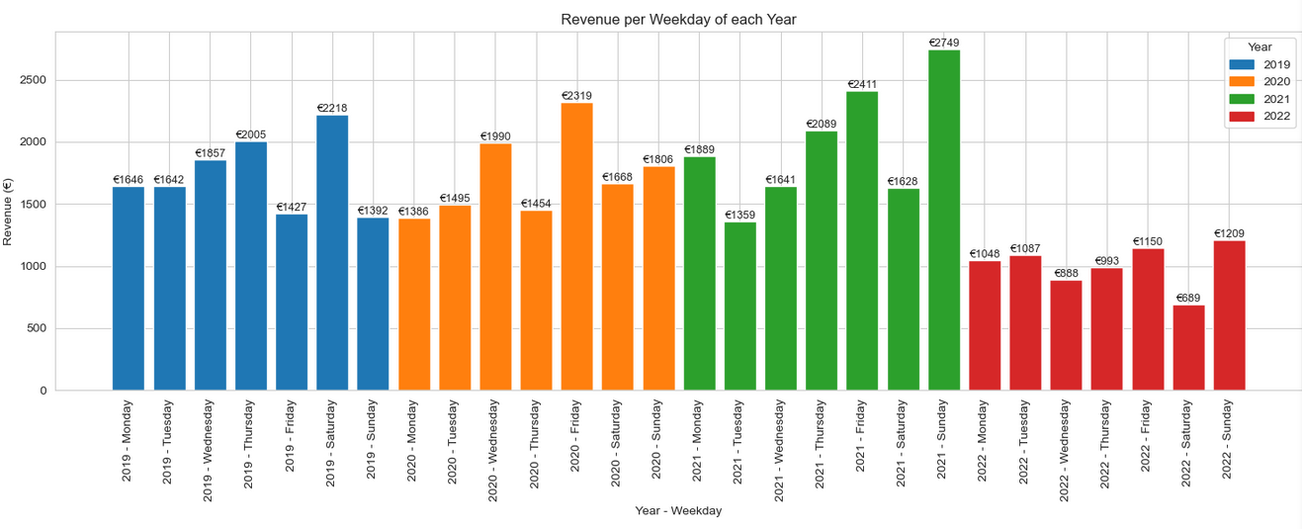
Pattern Observed:
Revenue is strongly weekend-driven, peaking on Saturdays and Sundays, with 2021 as the best performing year.

Slide 12
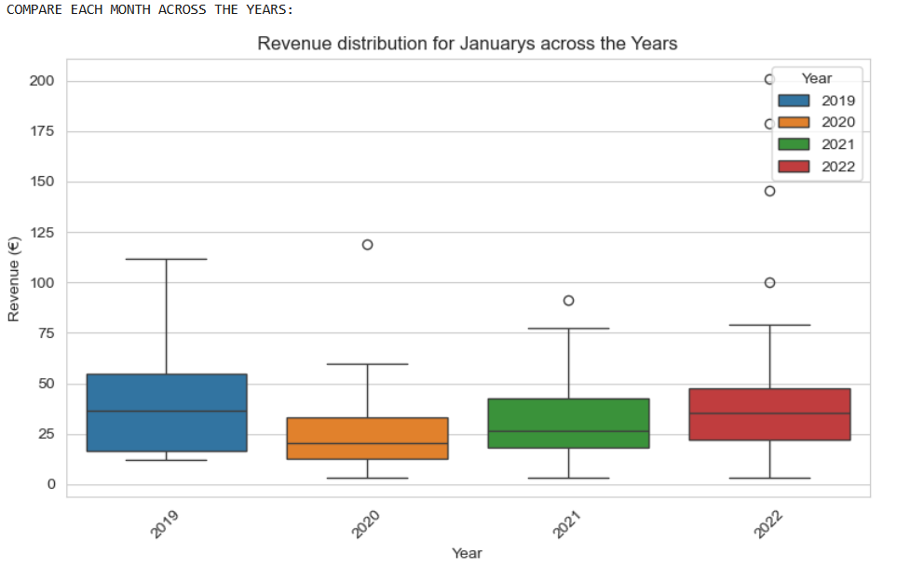
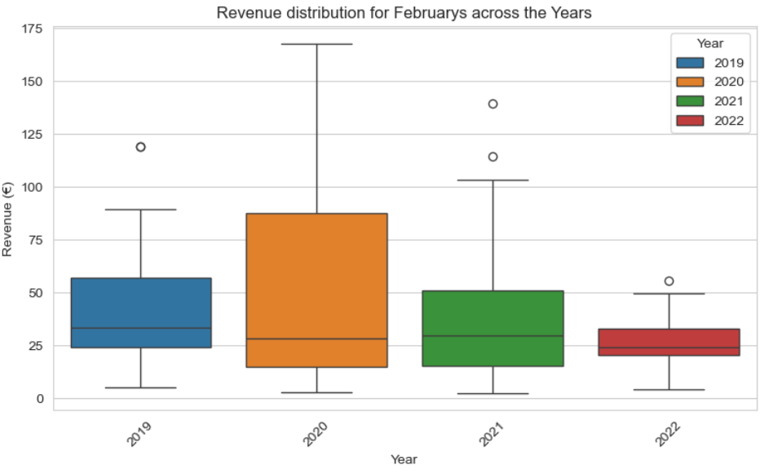
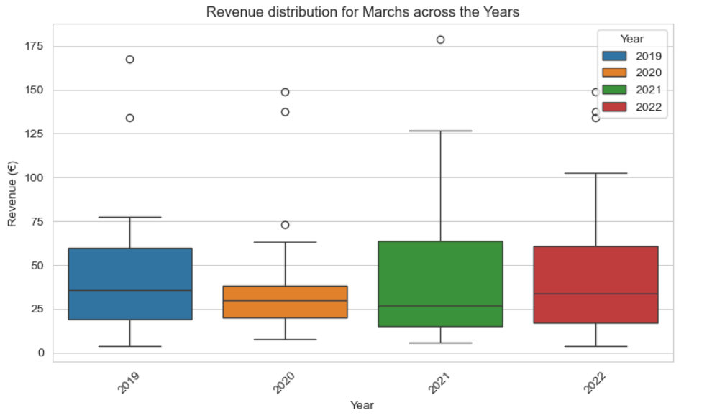
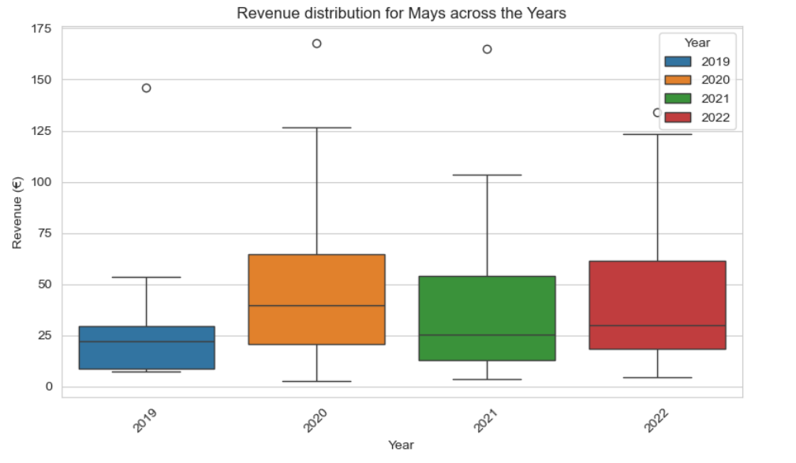
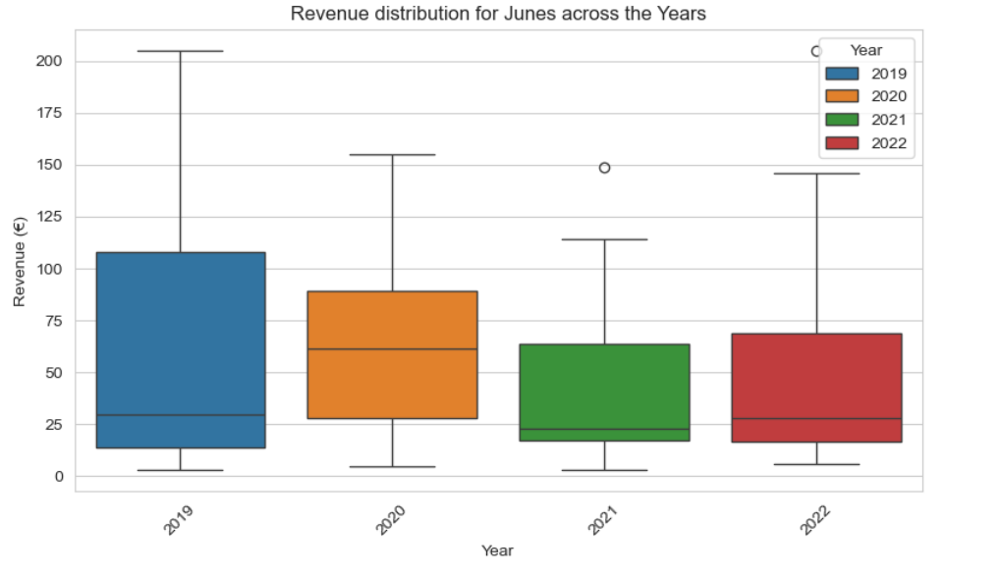
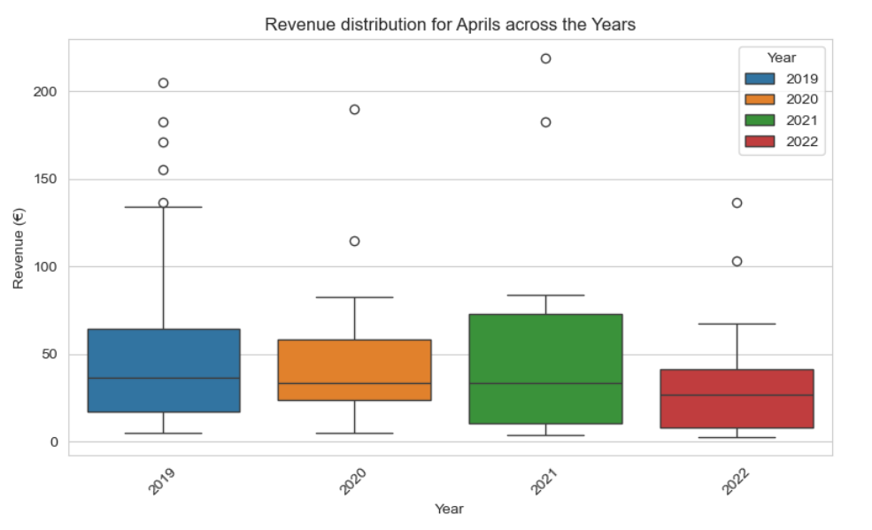
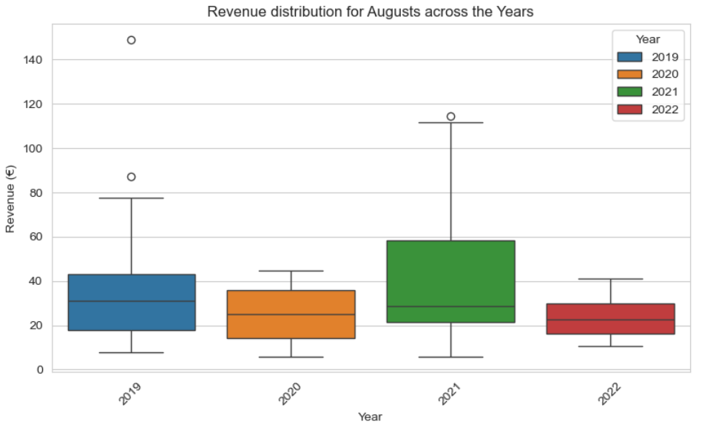
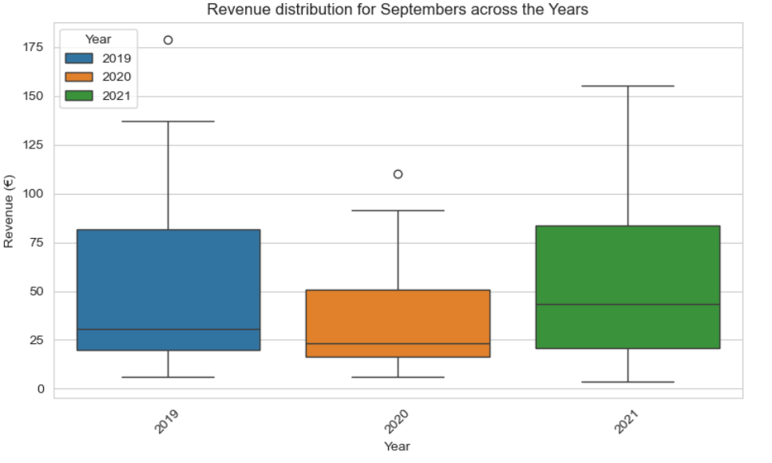
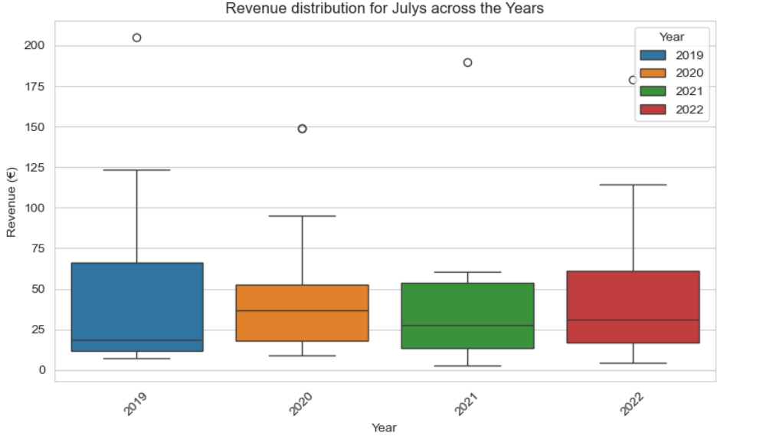
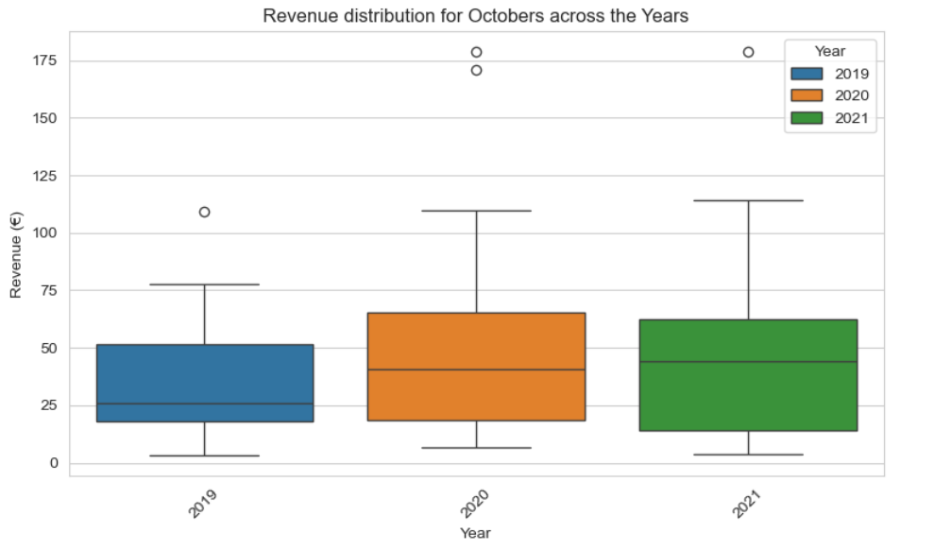
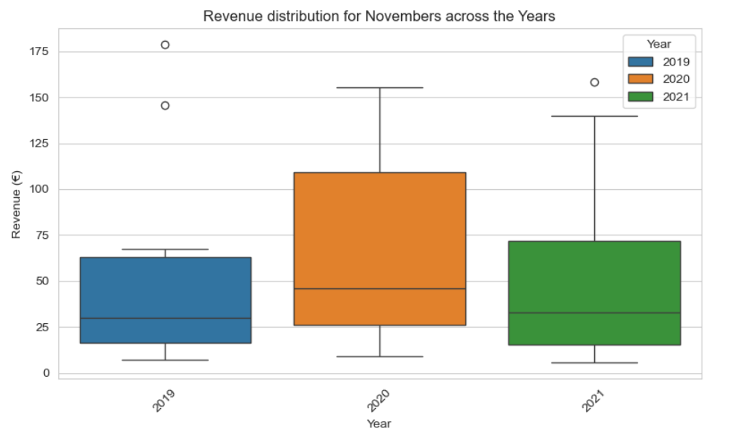
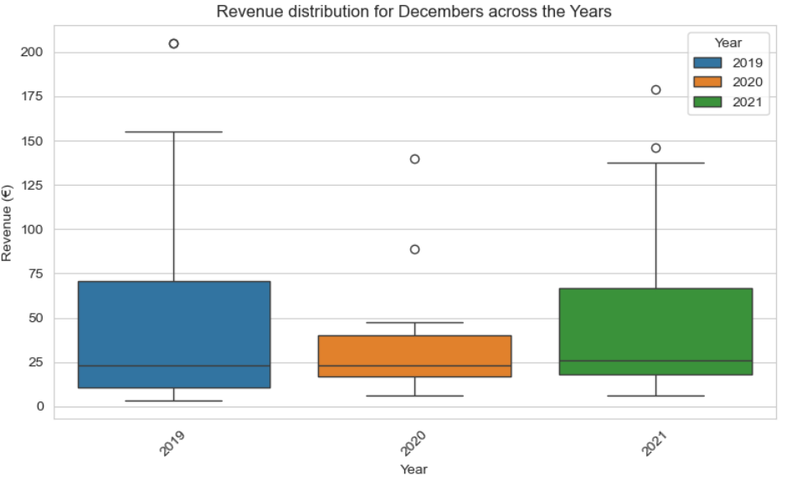
Pattern Observed:
November consistently shows the highest median revenue (the horizontal line inside the box), particularly in 2020.
August exhibits the largest range (spread) in revenue (the height of the box), especially in 2021, suggesting high volatility or successful peak performance years.
Most months in 2021 (e.g., February, March, August, September, October) show an increase in median revenue compared to 2019 and 2020.

Slide 13
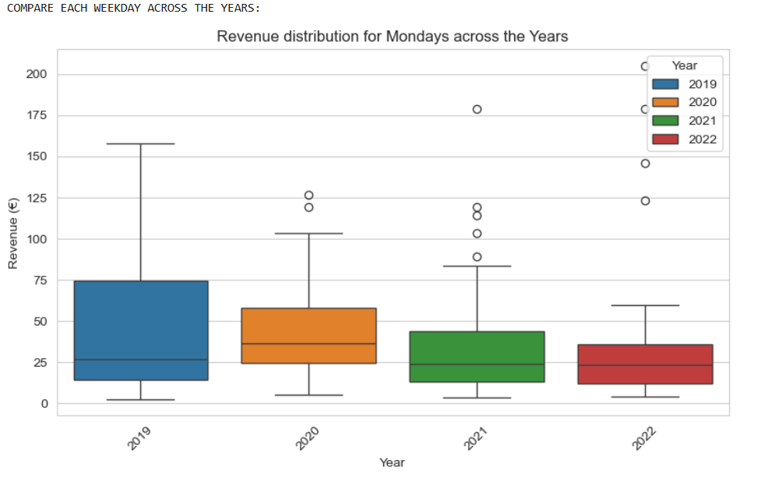
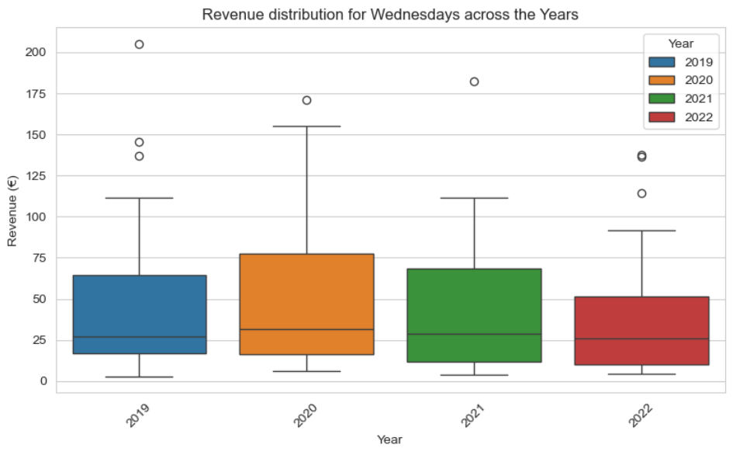
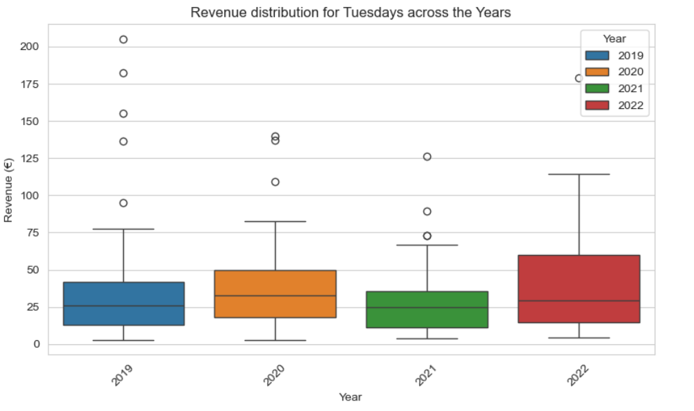
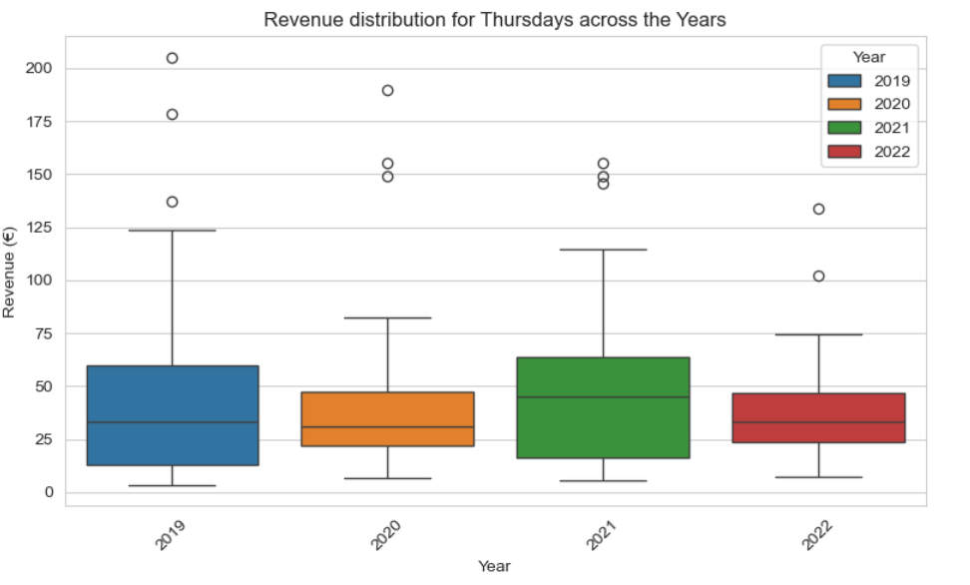
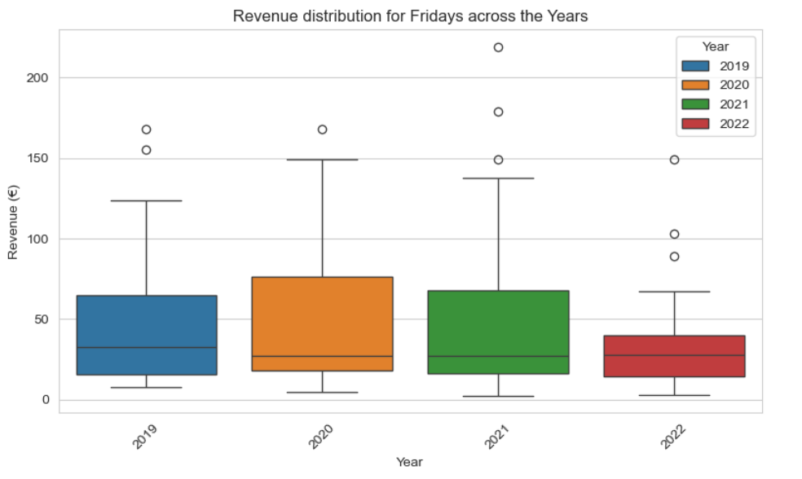
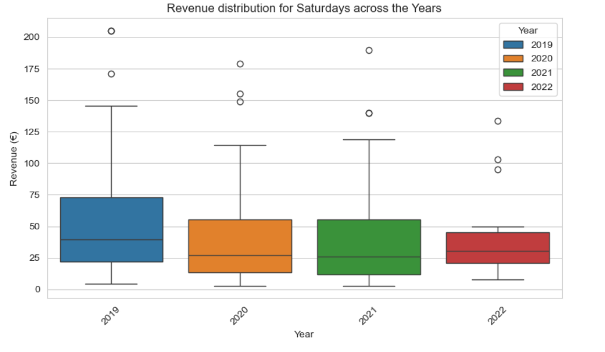
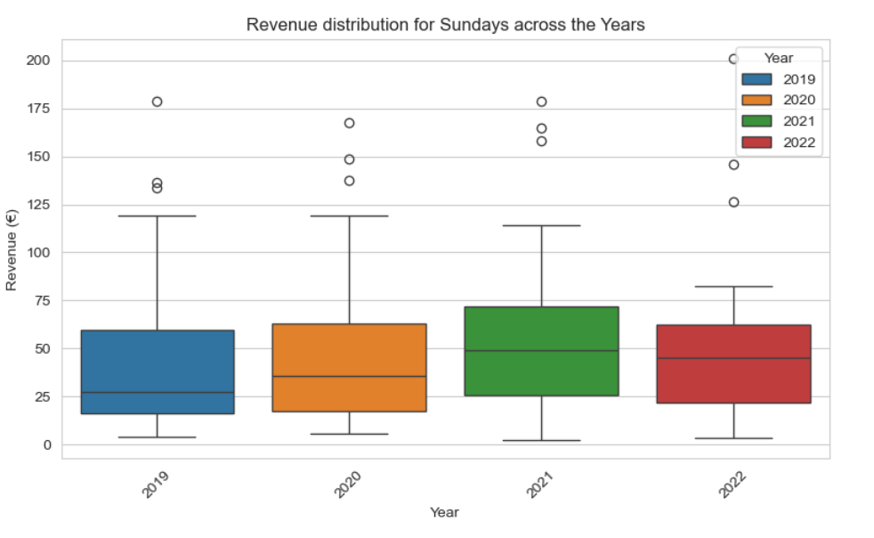
Pattern Observed:
Wednesday and Friday generally show the highest median revenue and greater revenue variability (longer boxes) across the years.
Saturdays and Sundays (especially 2022) tend to have the lowest median revenue, indicating weaker sales performance on the weekends.

