Slide 1
Bacterial Infections: TB, Pneumococcus, Staph Aureus
Unit 5
Paul Thomas
Paul.Thomas@stjude.org
Department of Immunology
St. Jude Children’s Research Hospital

Slide 2
Immune Control of Mycobacterium tuberculosis

Slide 3
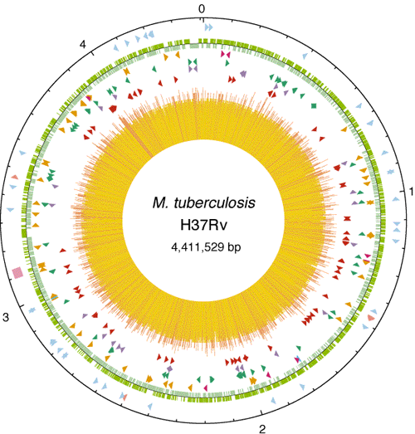
Mycobacterium Tuberculosis (Mtb)
Acid-fast, rod-shaped bacillus
Unique wax-rich cell wall composed of long chain fatty acids and glycolipids
250 genes dedicated to fatty-acid metabolism
Slow, 20 hour replication time

Slide 4
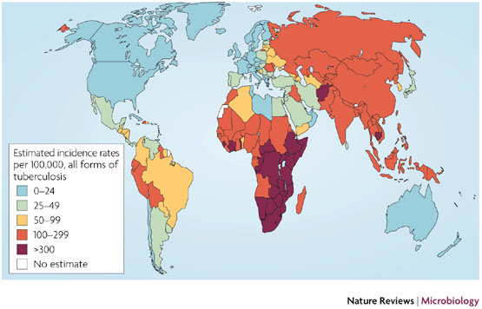
Mtb infection Worldwide

Slide 5
Mtb impact
2.2 million deaths/year
Burden of diseases in DALY (disability-adjusted life years)
Total Disability Adjusted Life Years: 45 million (3.1%).
2 billion individuals infected with M. tuberculosis
10% risk of developing disease following infection
Untreated, disease mortality is 50%
8 million new tuberculosis cases per year (1 new case every 4 seconds)
10–15 individuals infected annually by a single untreated patient

Slide 6
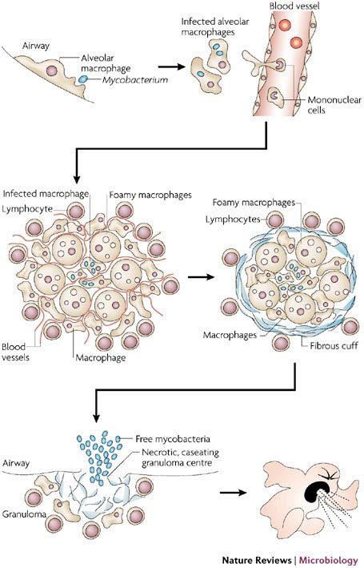
Mtb Life Cycle
MTb replicates in and accumulates in macrophages, mostly in the lung (though other tissue sites are possible)
The accumulation of infected macrophages, surrounded by other leukocytes forms a unique structure called the granuloma, the characteristic feature of MTb-associated lung damage

Slide 7
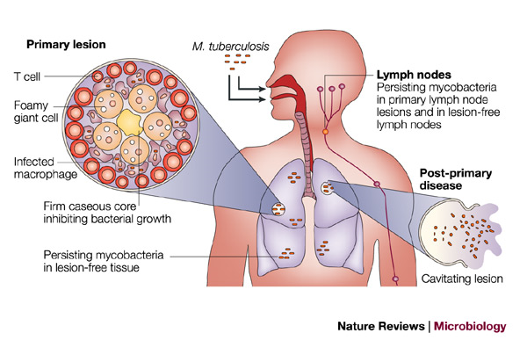
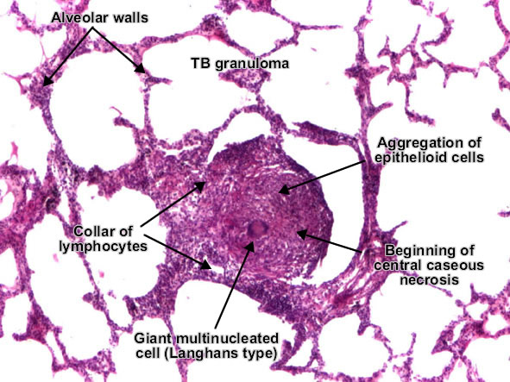
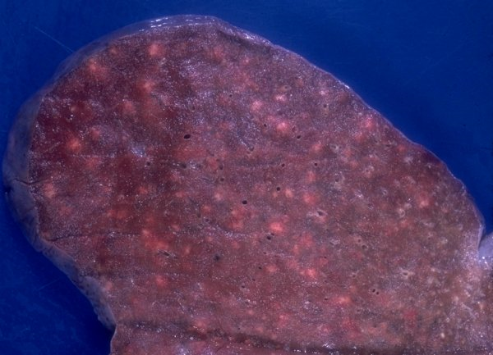
Mtb Life Cycle Part 2

Slide 8
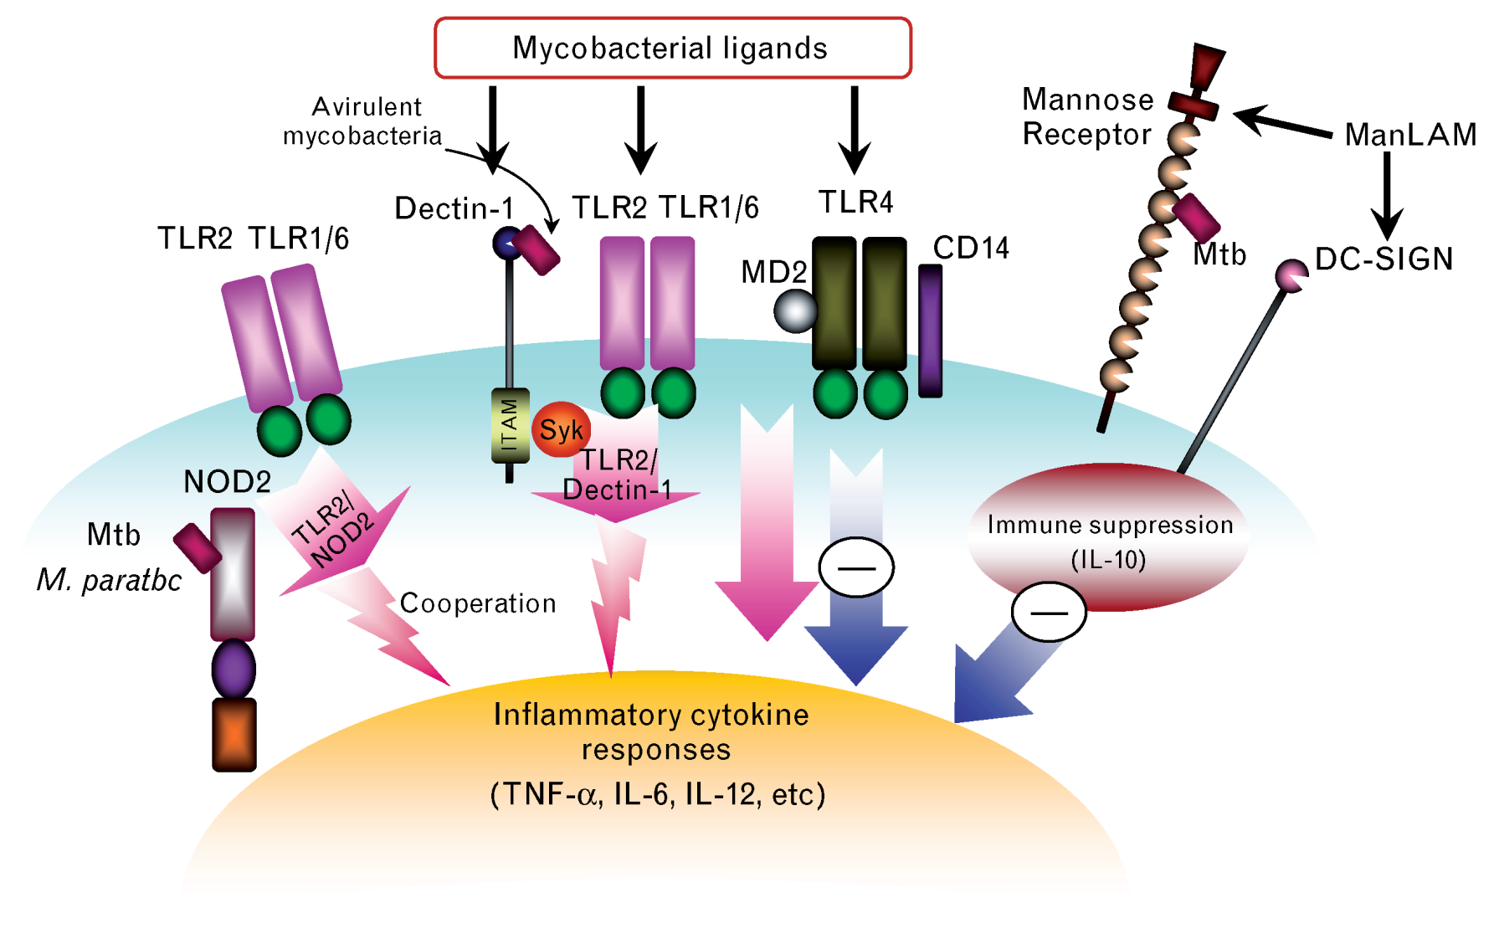
Innate Recognition of Mtb

Slide 9
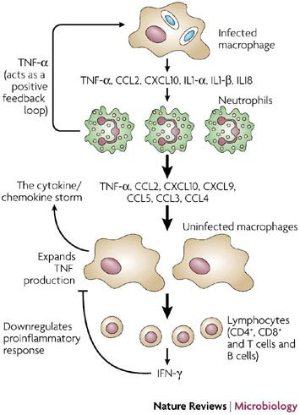
Activation of Cytokine Storm
Macrophages do respond to the infection, even if they fail to clear
Recruitment of other monocyte/macrophages/inflammatory cells to the lesion, promoting granuloma formation and enhancement of cytokine signaling
Eventually recruits adaptive response which acts through “traditional” cell-mediated clearance and regulation of macrophage effector function

Slide 10
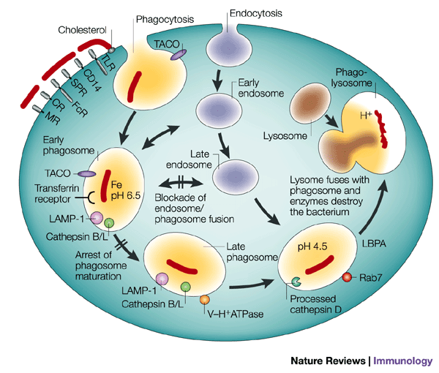
Endosomal/Lysosomal Dysregulation
After uptake by scavenger receptors, MTb arrests the maturation and fusion of the phagosome with the endosome
Highly activated macrophages (IFN-g stimulation) can complete maturation and destroy the bacteria—otherwise, the bacteria remain latent or can grow

Slide 11
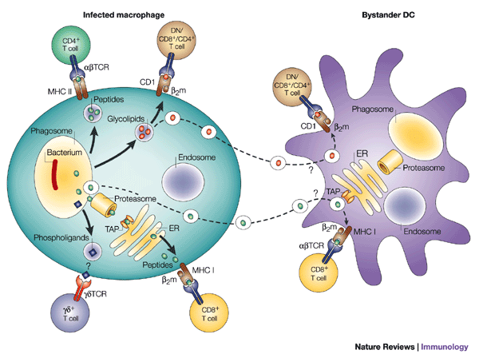
Initiation of the Adaptive Response
The cytokine storm initaited by the innate response determines the character of the ensuing adaptive response
Non-classical T cells (gamma-delta, CD1 restricted) play an important role in MTb control, but are not conserved between humans and mice, making their study difficult (one reason why guinea pigs are often used in MTb studies)
Both CD4 and CD8 functions (cytokine regulation and direct cell clearance) are associated with protection from disease

Slide 12
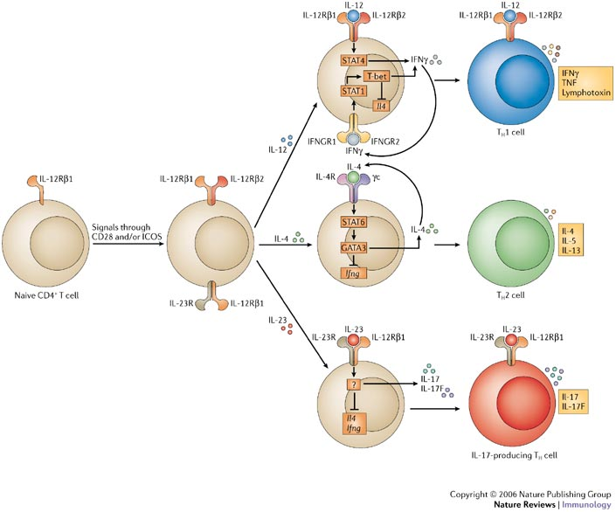

Slide 13
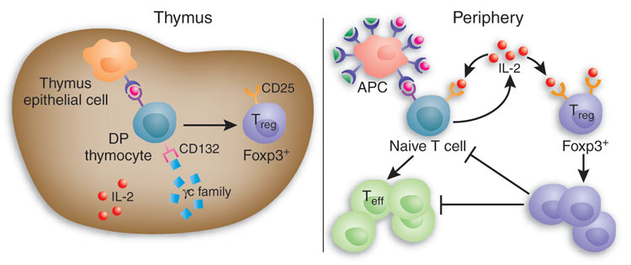
Generation of Antigen-Specific Regulatory T cells

Slide 14
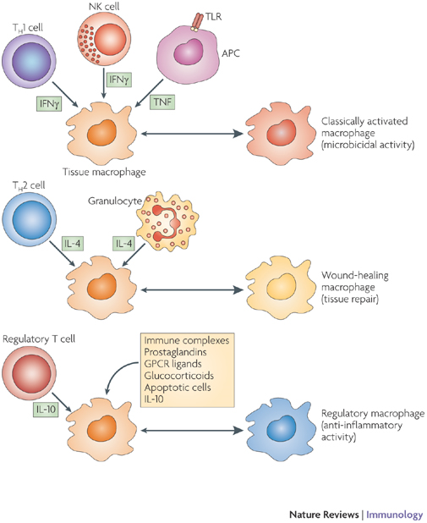
T cell regulation of Macrophage effector Function
The balance of regulatory vs. effector signals (and the various types of those signals) determine the activation mileu of the granuloma and the infected macrophage
Immune-associated pathology is also a risk, so some regulatory balance is required to maintain the lung physiology while achieving clearance or control

Slide 15
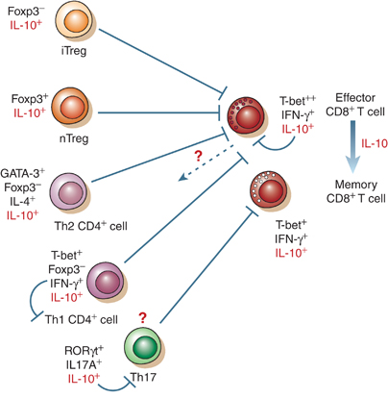
IL-10 regulation of lung pathology
IL-10 has been shown in multiple infections to be a key regulatory of pathology
In influenza, IL-10 produced by multiple cell types is required for survival in certain models of infection
The pleiotropic effects of this cytokine are still poorly understood at a mechanistic level

Slide 16
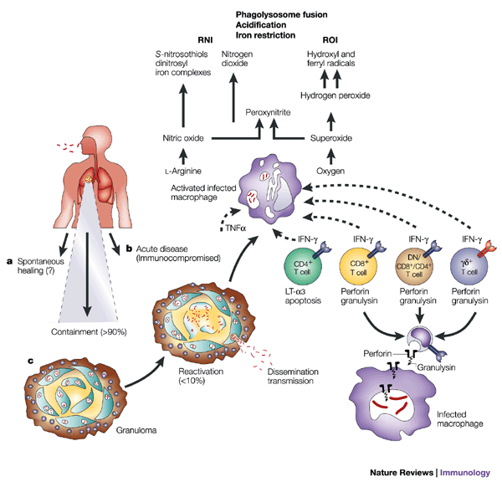
Control of Mtb

Slide 17
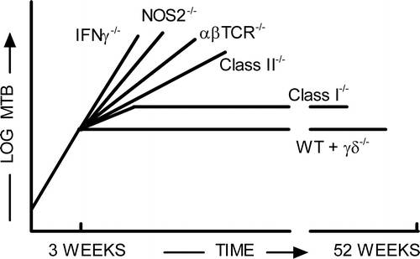
Summary of Control mechanisms
Phagolysosomal destruction is the most important mechanism for removing bacteria
IFNg stimulates the maturation of the phagolysosome, overcoming the inhibitory signals used by MTb
The most effective form of this killing involves ROI and RNI
Adaptive immunity is important for regulating the cytokine environment and, to a smaller extent, for cytolytic killing

Slide 18
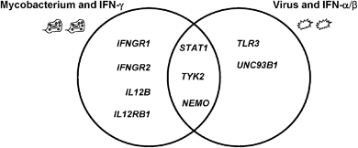
Human Genetic Deficiencies
The primary phenotype of individuals with genetics deficiencies in IFN-g signaling or activation is susceptibility to Mycobacterial disease
In contrast, deficiencies in Type I IFNs result in viral susceptibilities

Slide 19
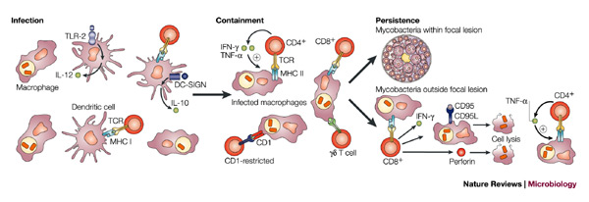
Summary and Perspectives
MTb is never completely cleared following initial infection
The primary effector mechanisms are macrophage bactericidal functions, but their success is determined by the cytokine and cellular regulatory environment
Small subtle shifts over time or dramatic short-term changes lead to reactivation and disease

Slide 20
Streptococcus Pneumoniae (Pneumococcus)

Slide 21
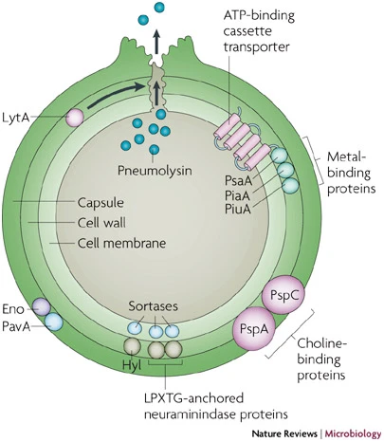
Streptococcus Pneumoniae
Gram-positive, extracellular, opportunistic pathogen
Varying degrees of carriage among population—up to 65% of children, <10% of adults (higher in schools and hospitals)

Slide 22
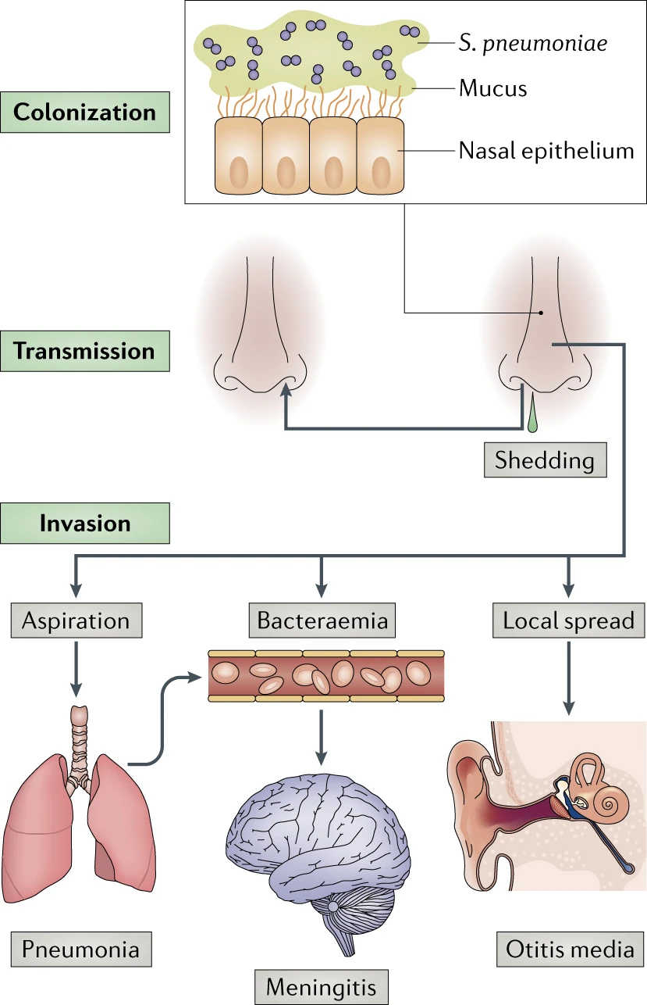
Life Cycle of Strep Pneumoniae
Colonization/carriage is a prerequisite to disease, but is not itself a disease state
Colonized individuals can transmit to others, and suffer invasive infection and subsequent disease within themselves

Slide 23
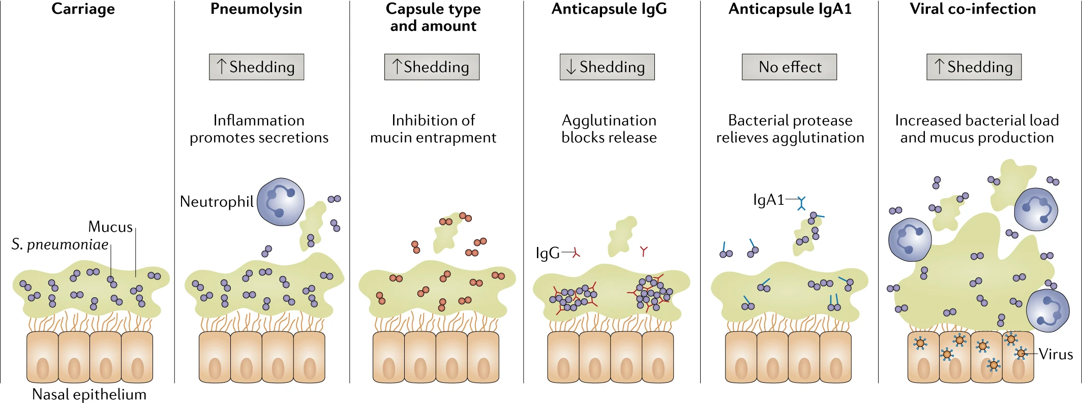
Conversion from carriage to invasion
Inflammation can cause an increase in shedding, bacterial load, and disease manifestation

Slide 24
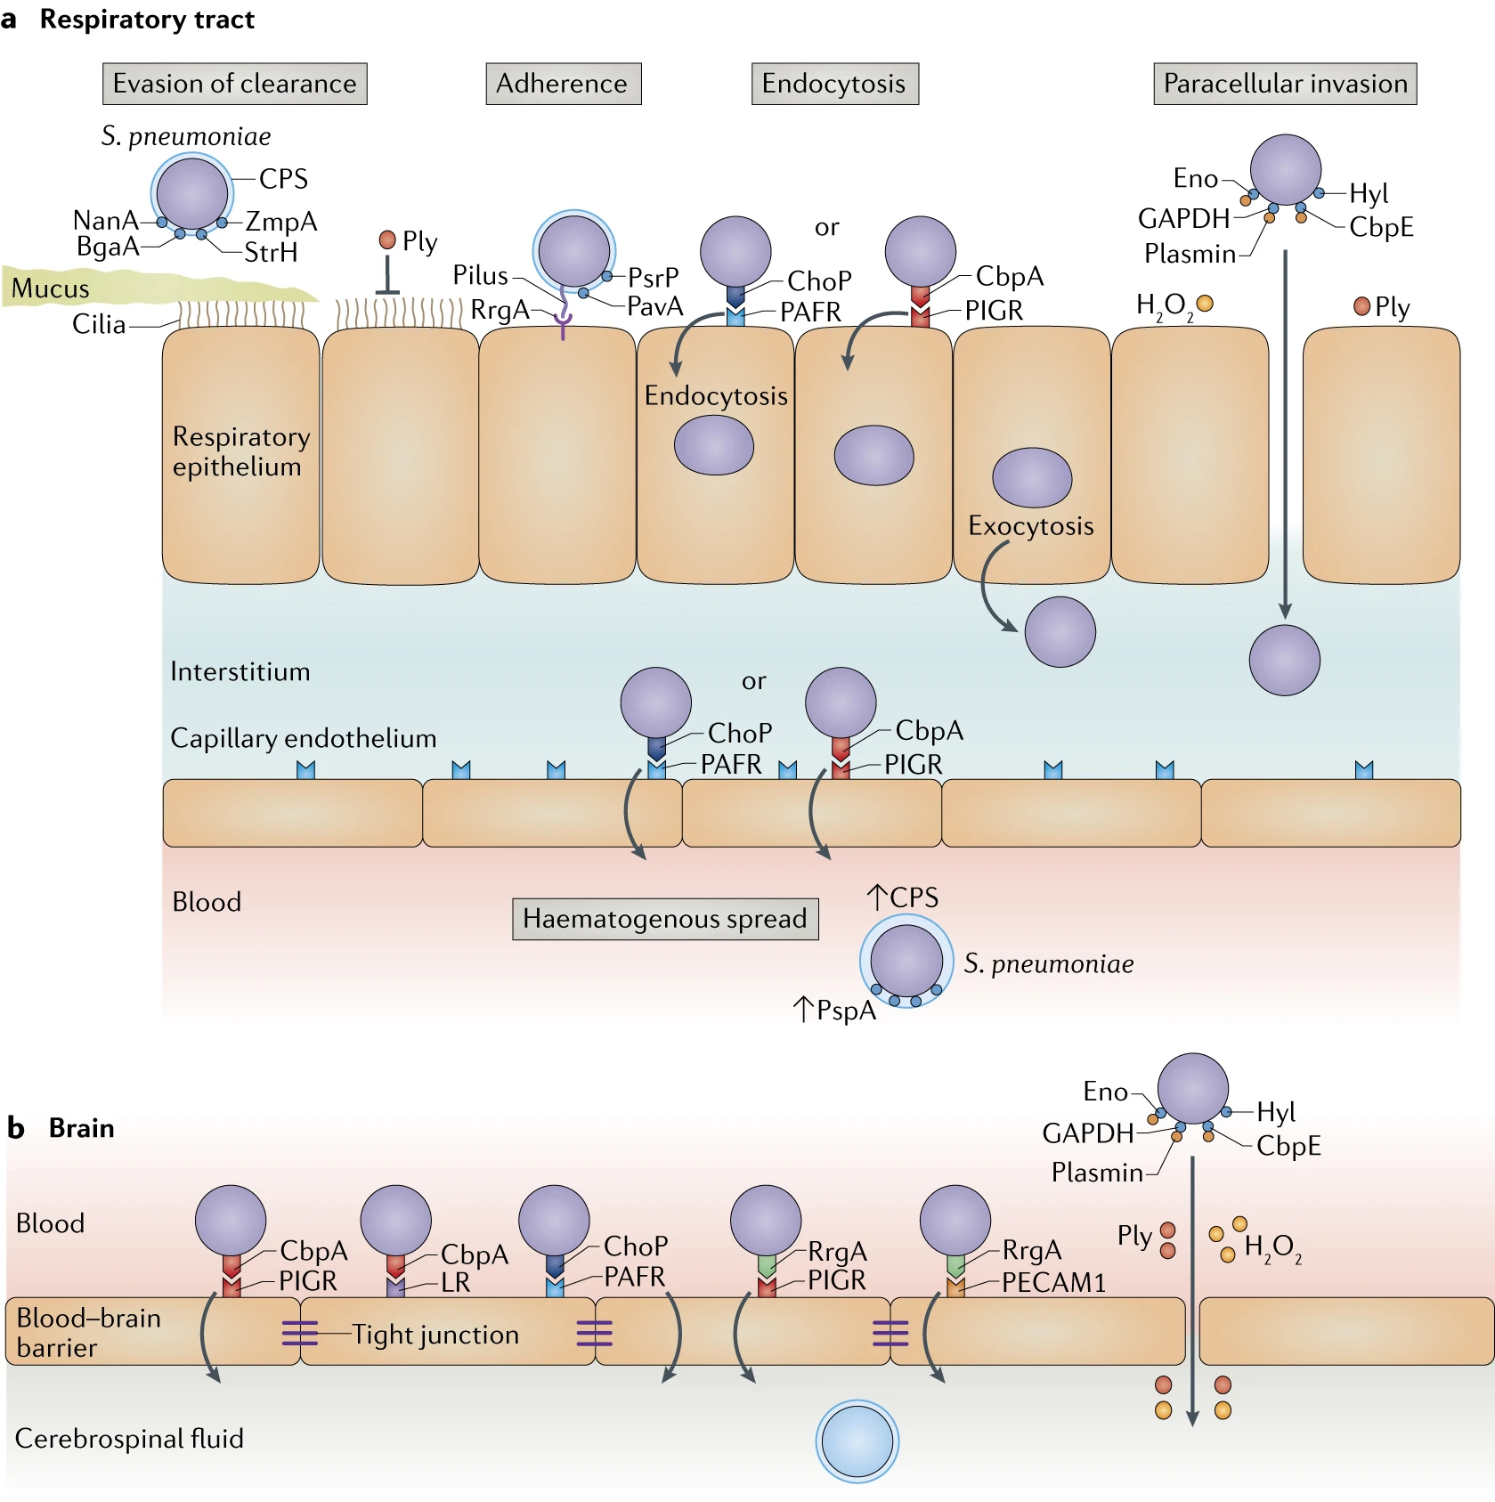
Invasion of the Bacteria
Pneumococcus evade entrapment in mucus by the charge of the capsule
Barriers (epithelial barrier, blood brain barrier) are broken down through a number of virulence factors

Slide 25

CD4 Cells Can Differentiate into multiple Types of “Helpers”

Slide 26
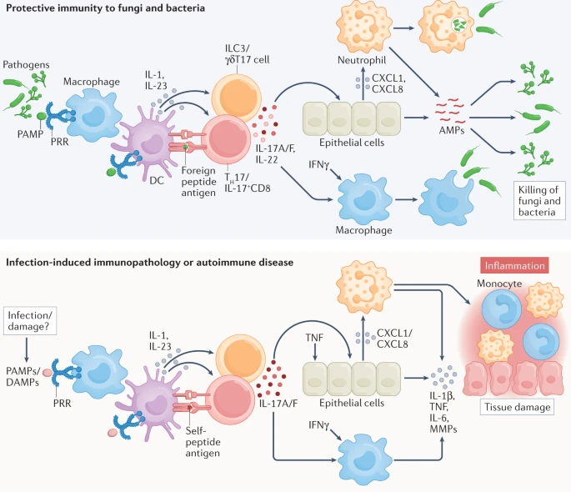
Combined innate and adaptive responses provide protection
Innate responses can be enforced and amplified by the differentiation of adaptive immune regulators

Slide 27
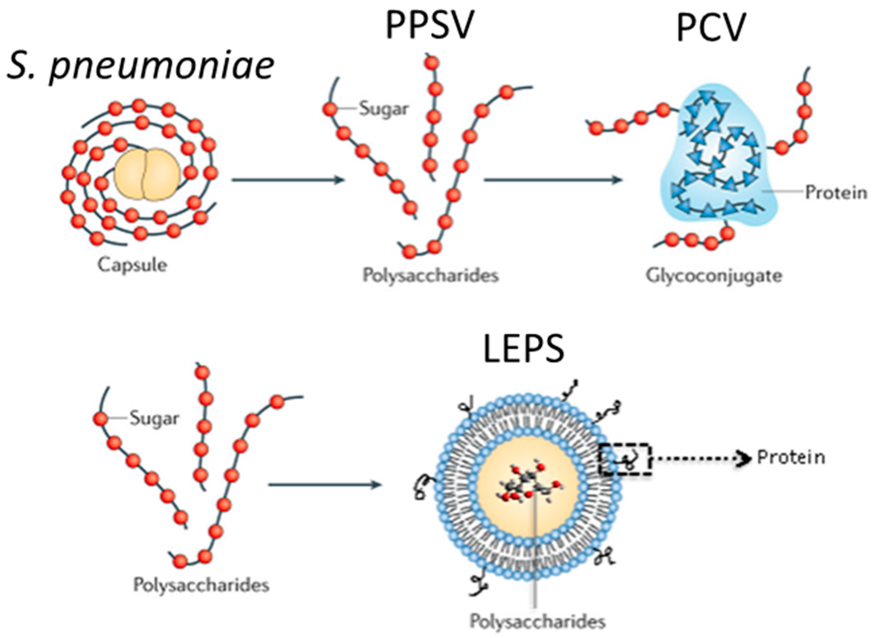
Pneumococcal vaccines rely on specific polysaccharides

Slide 28
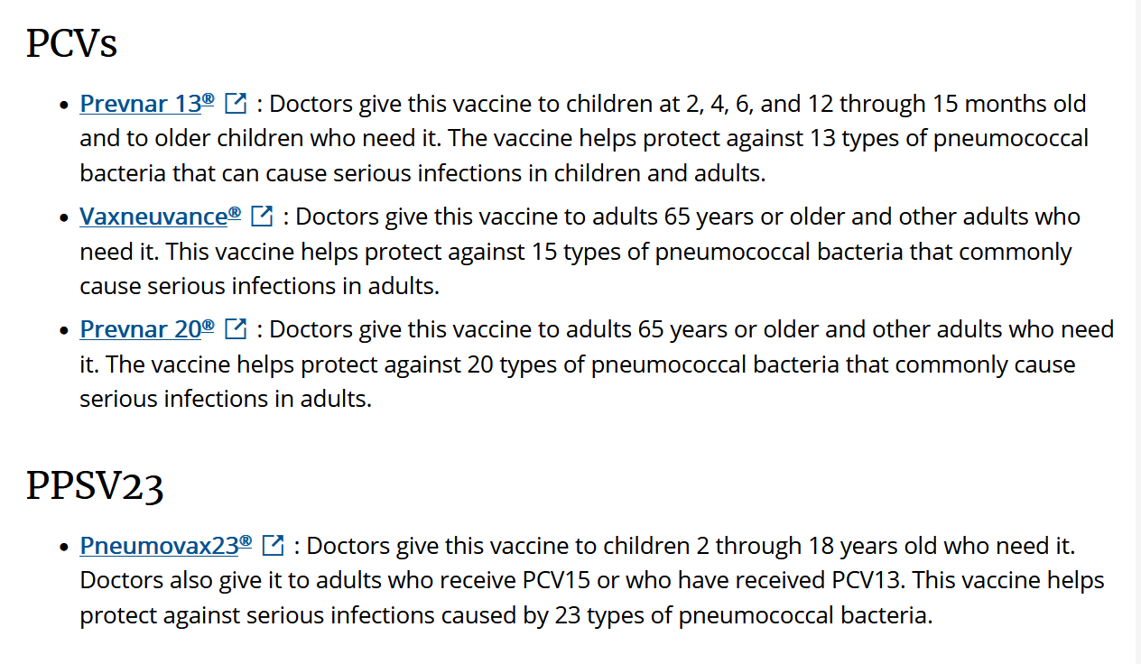
Multiple pneumococcal vaccine platforms

Slide 29
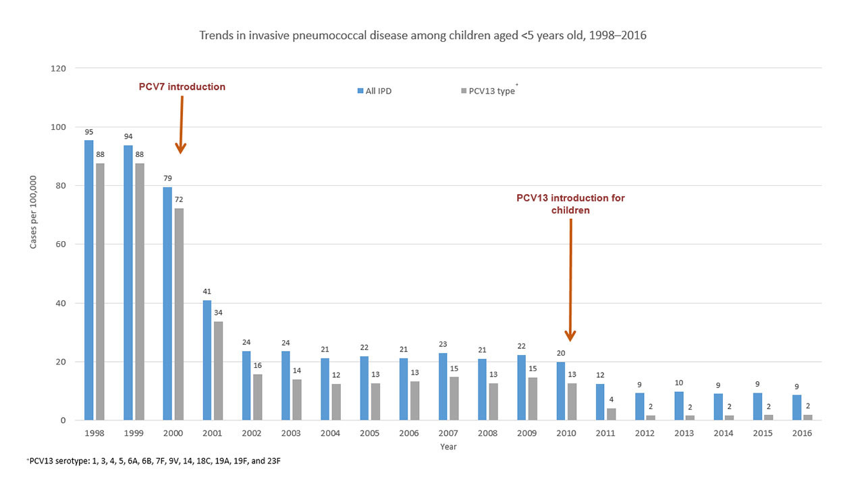
Overall Disease burden reduced, with focus on included strains

Slide 30
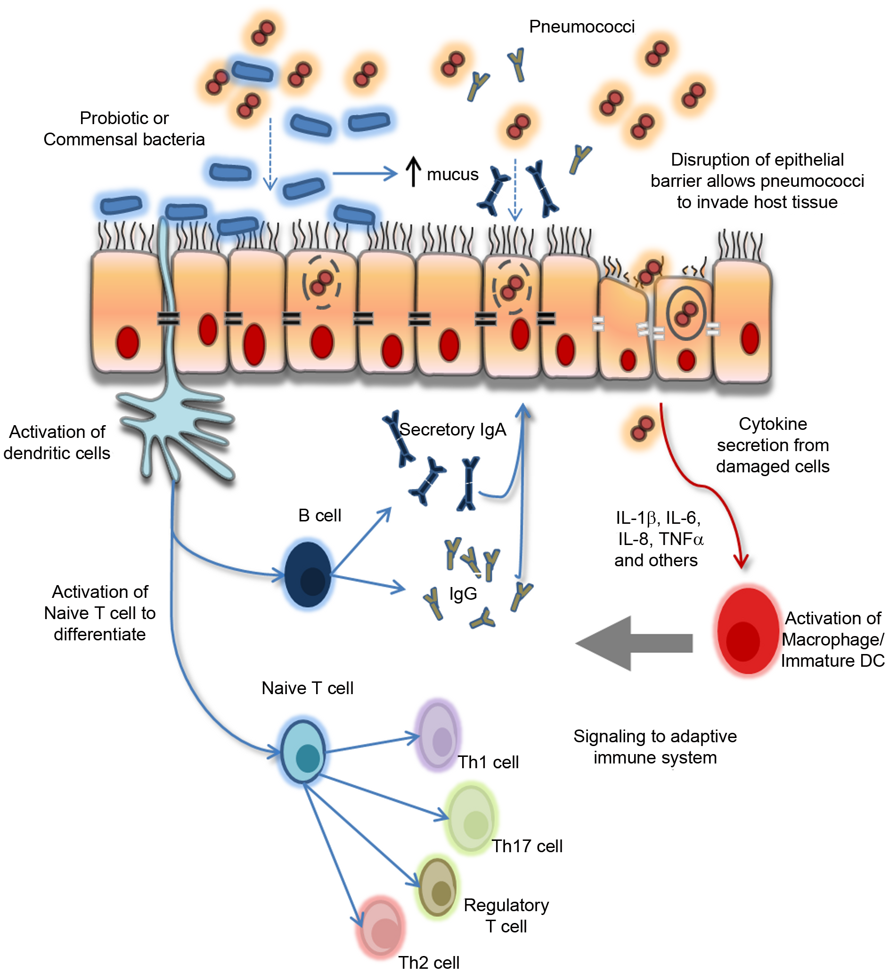
Secretory IgA molecules provide protection against invasion

Slide 31
Staphylococcus Aureus

Slide 32
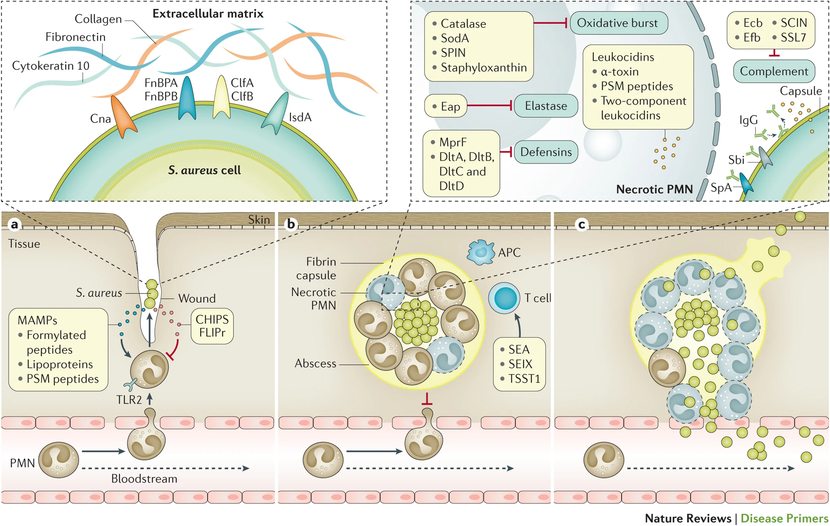
Stages of Staph Aureus infection

Slide 33
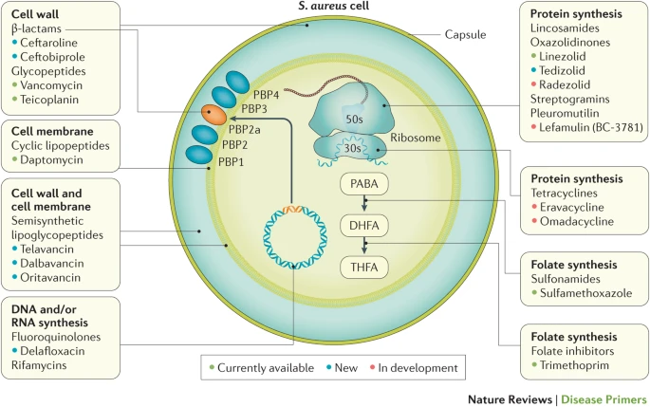
MRSA-Methicillin Resistant Staph Aureus

Slide 34
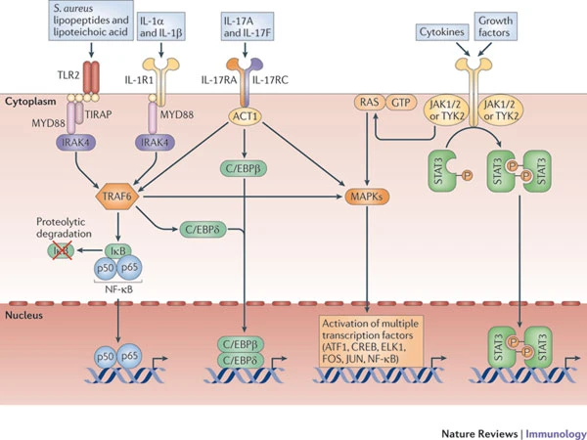
Innate Signaling is Critical for STAPH recognition

Slide 35
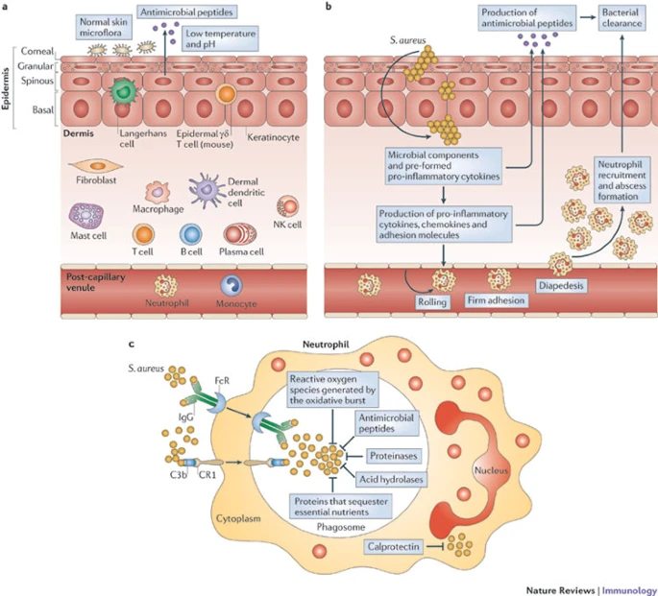
Anti-Staph Immunity in the Skin
Innate responses at mucosal surfaces are critical to limit bacterial invasion—high rates of Staph colonization!
Innate responses can be boosted by well-formed adaptive immunity

Slide 36
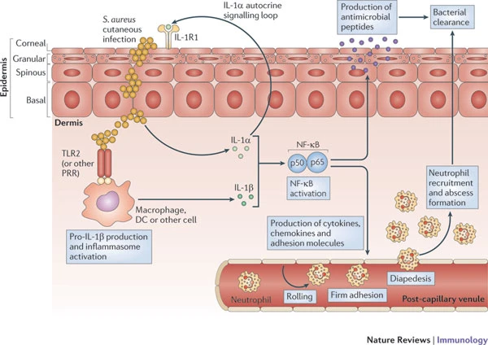
Innate Control of Staph

Slide 37
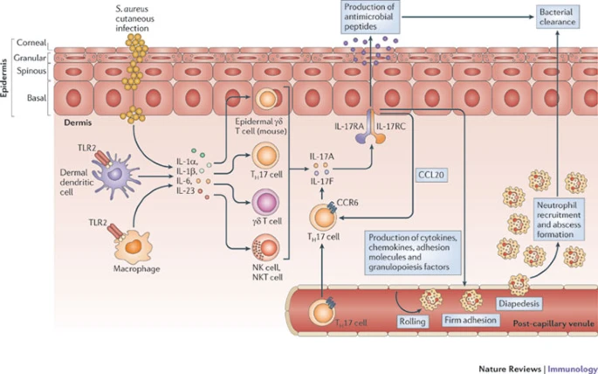
Innate-Adaptive collaboration

Slide 38
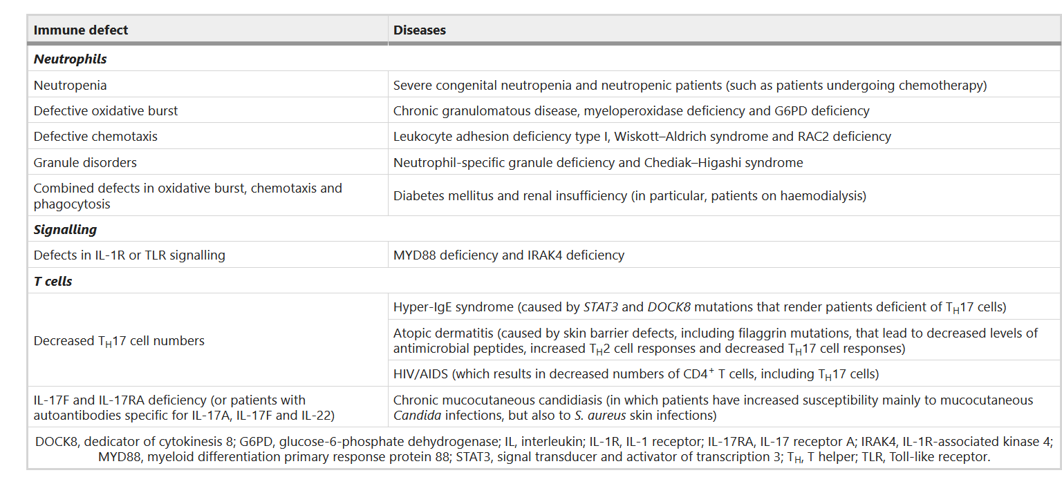
Immunological Deficiencies promote susceptibility to STAPH

Slide 39
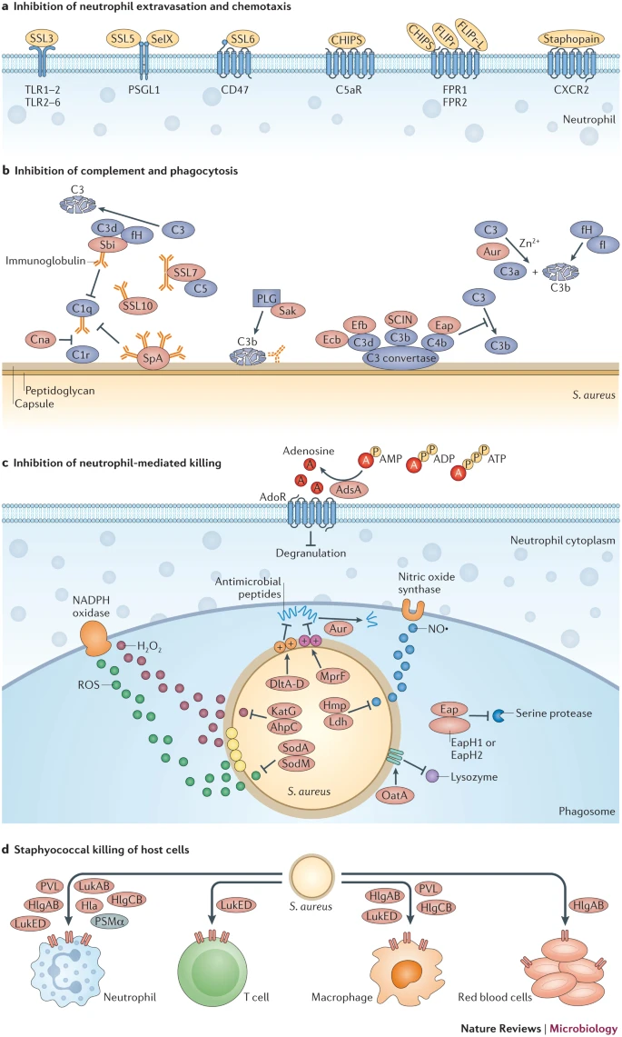
Mechanisms of Immune Evasion from Staph Aureus
Staph has multiple virulence factors to limit anti bacterial immunity
Enzymes to restrict effects of ROI/RNI
Metabolic disruptors to limit functionality of responding neutrophils
Direct mechanisms to kill host cells
Subtle disruptors of cell trafficking
Complement disruptors

Slide 40
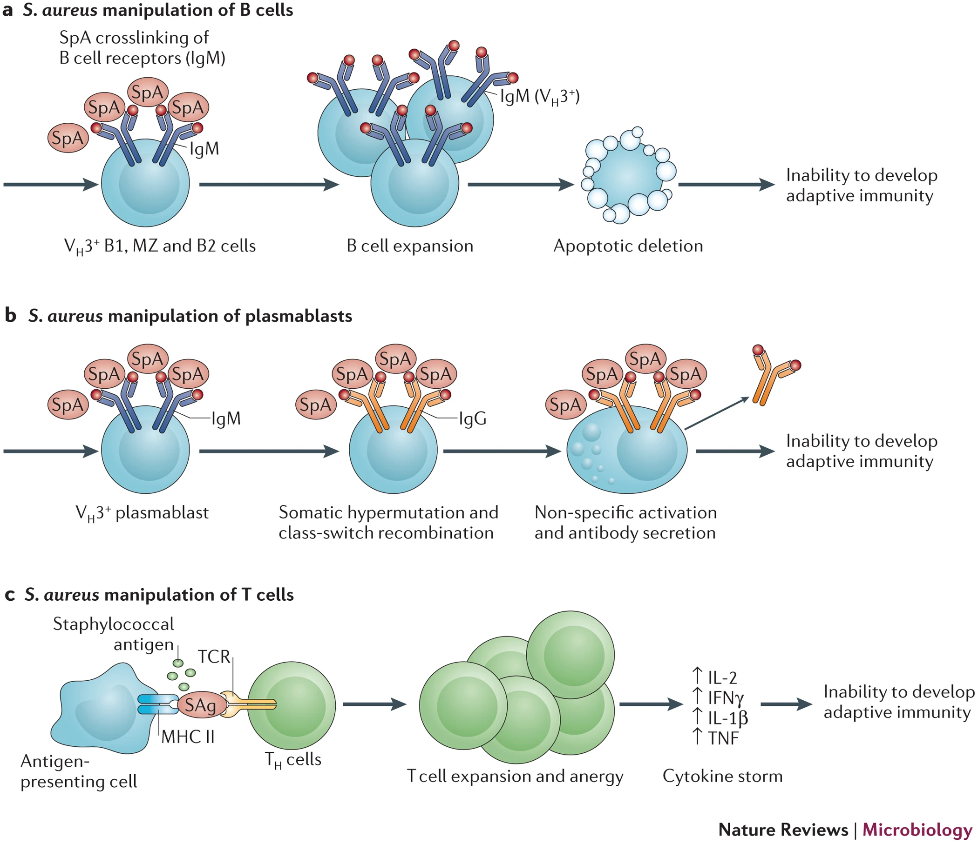
Manipulation of Host Immune responses

Slide 41
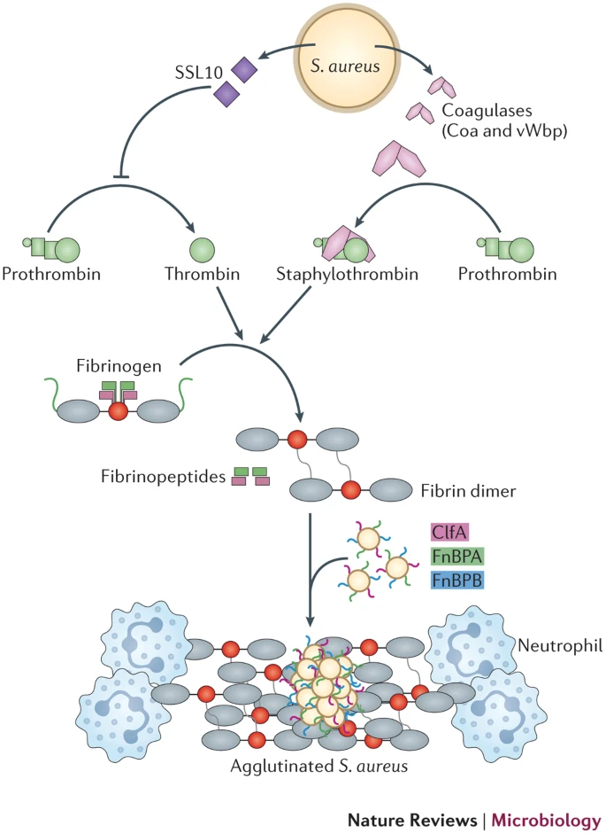
STAPH can coagulate blood
Staphs unique ability to coagulate blood creates opportunities for virulence and immune evasion
The fibrin coat acts as a shield, and the large clumps generated block efficient phagocytosis

Slide 42
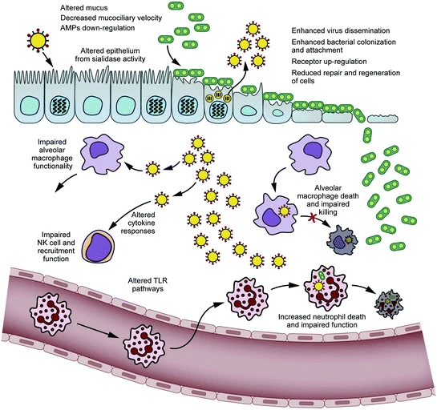
Bacterial Infections are Potentiated by Virus
Viral infections provide ideal environments for bacterial colonization to convert to invasive infection
Compromised immune function, barrier degradation, and immunoregulatory environments all contribute to decreased bacterial surveillance

