Slide 1
Drug and Vaccine Treatments
Unit 7
Paul Thomas
Paul.Thomas@stjude.org
Department of Immunology
St. Jude Children’s Research Hospital

Slide 2
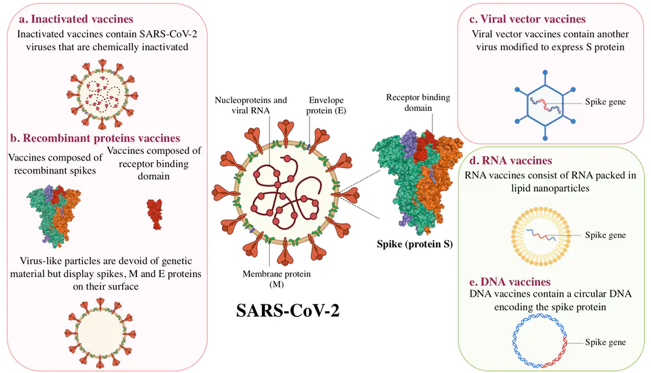
JNJ
AstraZeneca
Pfizer/BioNTech
Moderna
NovaVax
From https://theconversation.com/covid-19-vaccine-update-pfizer-may-be-the-frontrunner-but-canada-has-hedged-its-bets-149962

Slide 3
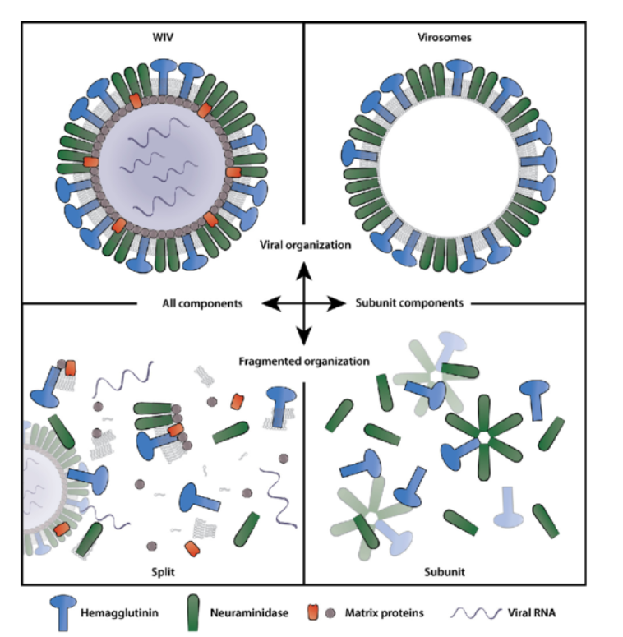
Comparison: annual “flu shot” QIV
The annual flu shot is generated by inactivating a whole, attenuated virus, fragmenting it with detergent, and reforming virosomes missing the viral RNA and most viral proteins
There is NO ADJUVANT

Slide 4
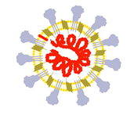

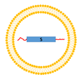

Data from Phase I/II trials
Company (reference) | Vaccine (type) | Dose range (route) | Neut. titre after prime | Neut. titre after boost | T cell response | Trial registration number
Sinovac³⁵ | CoronaVac (inactivated SARS-CoV-2 + aluminium hydroxide) | 3–6 μg (i.m.) 2x | ND | 1:30–1:60 rangeª | ND | NCT04352608
Sinopharm | Inactivated whole virus COVID-19 vaccine (inactivated SARS-CoV-2 + aluminium hydroxide) | 2.5, 5 or 10 μg (i.m.) 3x (0/28/56 or 0/28) 5ug (i.m.) 2x (0/14 or 0/21) | Not reported in detail | 1:316 (2.5 ug, 0/28/58)^{c} 1:206 (5 ug, 0/28/58)^{c} 1:297 (10 ug, 0/28/58)^{c} 1:121 (5ug, 0/14)^{c} 1:247 (5 ug, 0/21)^{c} | ND | ChiCTR2000031809
CanSino⁴⁶ | Ad5 nCoV (non-replicating AdV5 expressing spike protein) | 5 x 10¹⁰, 10¹¹ VP (i.m.) | 1:18.3–1:19.5 range^{b} | — | Yes | NCT04341389
AstraZeneca⁴⁷ | ChAdOx1nCOV-19 (non-replicating chimpanzee AdV expressing spike protein) | 5 x 10¹⁰ VP 1 x or 2´ (i.m.) | Median 1:218^{c} Median 1:51^{d} Median 1:4–1:16e | Median 1:136^{d} Median 1:29 ^{d} | Yes | NCT04324606
Moderna⁵⁹ | mRNA-1273 (mRNA) | 2x 25, 100, 250 μg (i.m.) | Low | 1:112.3 (25 μg)^{f} 1:343.8 (100 μg)^{f} 1:332.2 (250 μg)^{f} 1:339.7 (25 μg)^{g} 1:654.3 (100 μg)^{g} | Good CD4⁺ and low CD8⁺ response | NCT04283461
Pfizer⁶⁰ | BNT162b1 (mRNA) | 2x 10, 30, 100 μg (i.m.) | Low | 1:180 (10 μg)^{h} 1:437 (30 μg)^{h} | ND | NCT04368728
Pfizer⁸⁴ | BNT162b1 (mRNA) and BNT162b2 (mRNA) | 2x 10, 20, 30 μg | Low | Day 28^{h} BNT126b1 (18–55 years): 1:168 (10 μg) 1:267 (30 μg) BNT126b1 (65–85 years): 1:37 (10 μg) 1:179 (20 μg) 1:101 (30 μg) BNT126b2 (18–55 years): 1:157 (10 μg) 1:363 (20 μg) 1:361 (30 μg) BNT126b2 (65–85 years): 1:84 (20 μg) 1:147 (30 μg) | ND | NCT04368728
Novavax⁹⁰ | NVX CoV2373 (Matrix-M) Spike protein ‘rosettes’ | 2 x 2.5–25 μg (i.m. ± Matrix-M) 1x 25 μg (i.m. + Matrix-M) | 1:128 (25 μg + Matrix-M)^{i} | 1:3,906 (5 μg + Matrix-M)^{i} 1:3,305 (25 μg + Matrix-M)^{i} 1:41 (25 μg unadjuvanted)^{i} | CD4⁺ | NCT04368988

Slide 5
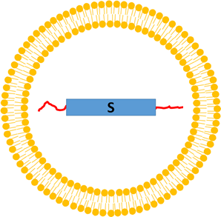

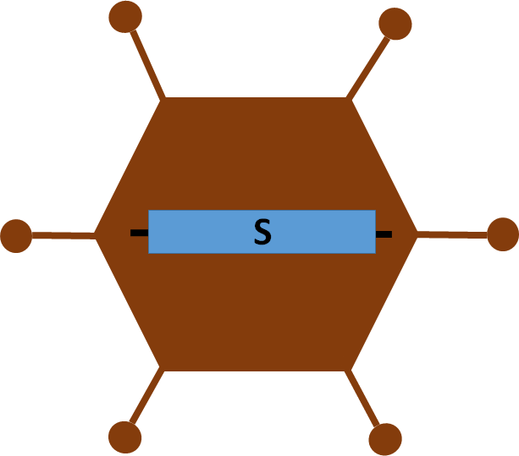
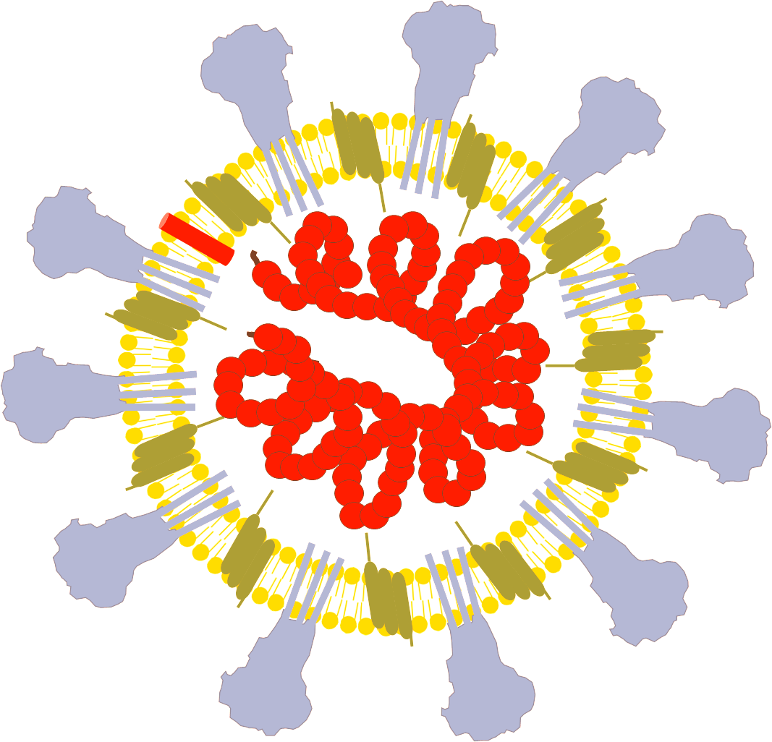
Vaccines in Phase III
Novavax (89-96%)
Gamaleya (91.6%)
Sinovac/Sinopharm (3x) (50-90%)
Cansino
Moderna (94)%
Pfizer (95%)
AstraZeneca (62-90%)
Janssen (72%)
IR
IR
IR
IR
For most of these vaccines two injections are required.
Special thanks to Florian Krammer

Slide 6

How does a Phase III study work?
Vaccine group
Conducted by independent medical centers (usually geographically distributed)
An independent committee watches the data
Analysis timepoints and success are pre-defined
Placebo control group
Special thanks to Florian Krammer

Slide 7
How does a Phase III study work?
Vaccine group
Time
COVID-19!!!
Placebo control group
Special thanks to Florian Krammer

Slide 8
What do the Pfizer results mean?
43,538 individuals are in the study
170 COVID-19 cases were recorded
162 in the placebo group (9 severe)
8 in the vaccine group (1 severe)
95% efficacy against symptomatic disease (one symptom plus PCR+, they start measuring this 7 days post dose 2)
94% efficacy in the 65-85 year old group
No significant safety concerns
The vaccine received different degrees of approval in Bahrain, the UK, Mexico, Canada, Saudi Arabia, the EU, the US etc.
Moderna data look almost identical
Special thanks to Florian Krammer

Slide 9
https://www.fda.gov/media/144245/download accessed 8Dec20
Special thanks to Florian Krammer

Slide 10
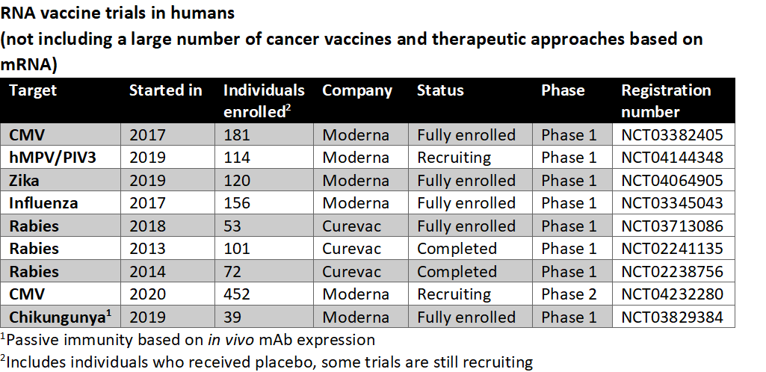
RNA vaccines are a relatively new development
Special thanks to Florian Krammer

Slide 11
What do the J&J results mean?
One dose!
43,783 individuals are in the study
USA, South Africa and Latin America
US efficacy 72% against moderate to severe COVID-19 (2 symptoms plus PCR+ was counted as moderate)
85% efficacy across all studies against severe disease
100% protection against hospitalization and death
No significant safety concerns
Some indication of reduction of asymptomatic infections
Special thanks to Florian Krammer

Slide 12
Are vectored vaccines a relatively new development?
Ad26-based Ebola vaccine licensed in the EU
Ad4 and Ad7 vaccines in use in the US military since 1971

Slide 13
Reactogenicity
Injection site pain
Headache
Fatigue
Elevated temperature
Myalgia
Mild flu-like symptoms
unpleasant, but not dangerous
AdV=mRNA>recombinant protein>inactivated vaccine
Strength of adjuvant!
Moderna/VRC mRNA 1273 via LNPs
Special thanks to Florian Krammer

Slide 14
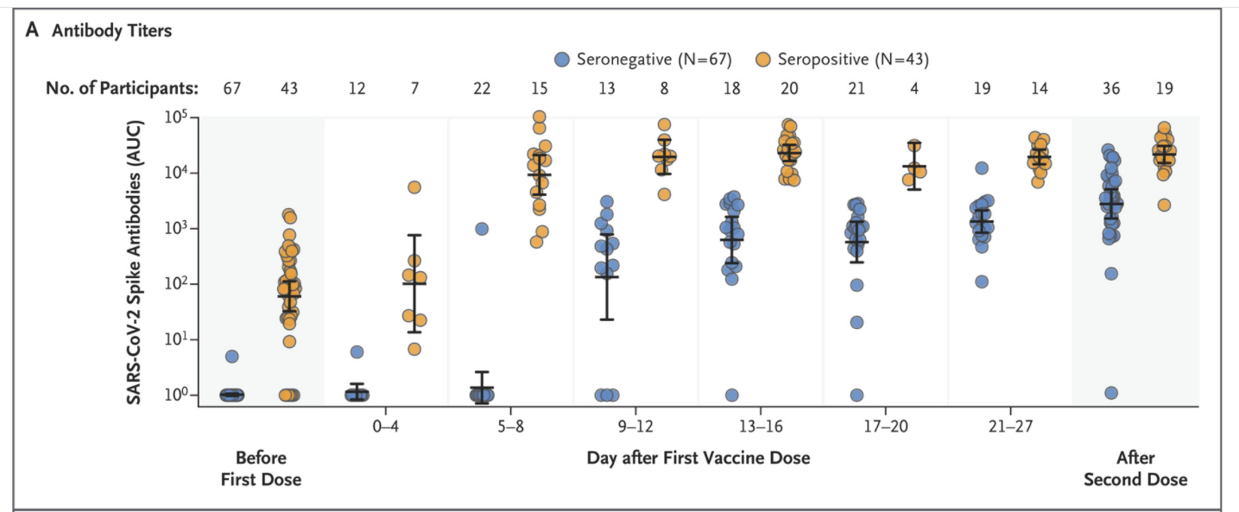
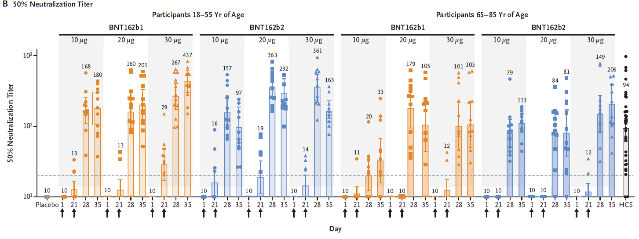
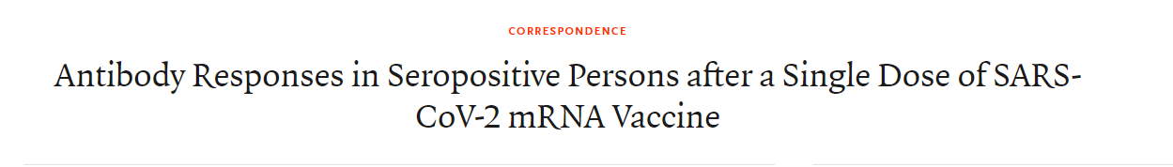
Vaccines work in older individuals and boost memory in infected individuals
Vaccines work faster in younger individuals and with lower doses
With recommended dose, older individuals still generate high levels of protective immunity
Post-infection, a single dose of the Pfizer/BioNTech vaccine was equivalent to two doses of the vaccine in naïve individuals
Still a significant boost!

Slide 15
Hepatitis C virus
Enveloped, positive strand RNA virus, Flaviviridae
Isolated in 1989, treatments first emerged in early 1990s
~120 million-200 million infections worldwide, number one indication for liver transplant in the U.S.
10¹² viral particles produced/day, ½ life 3 hours in circulation
Six major genotypes, 3 dominate in the U.S. (1, 2, 3)
30-50% genetic variation among genotypes
1-5% variation among viruses within a single patient
Replicates via negative-stranded RNA in membranous web in cytoplasm

Slide 16
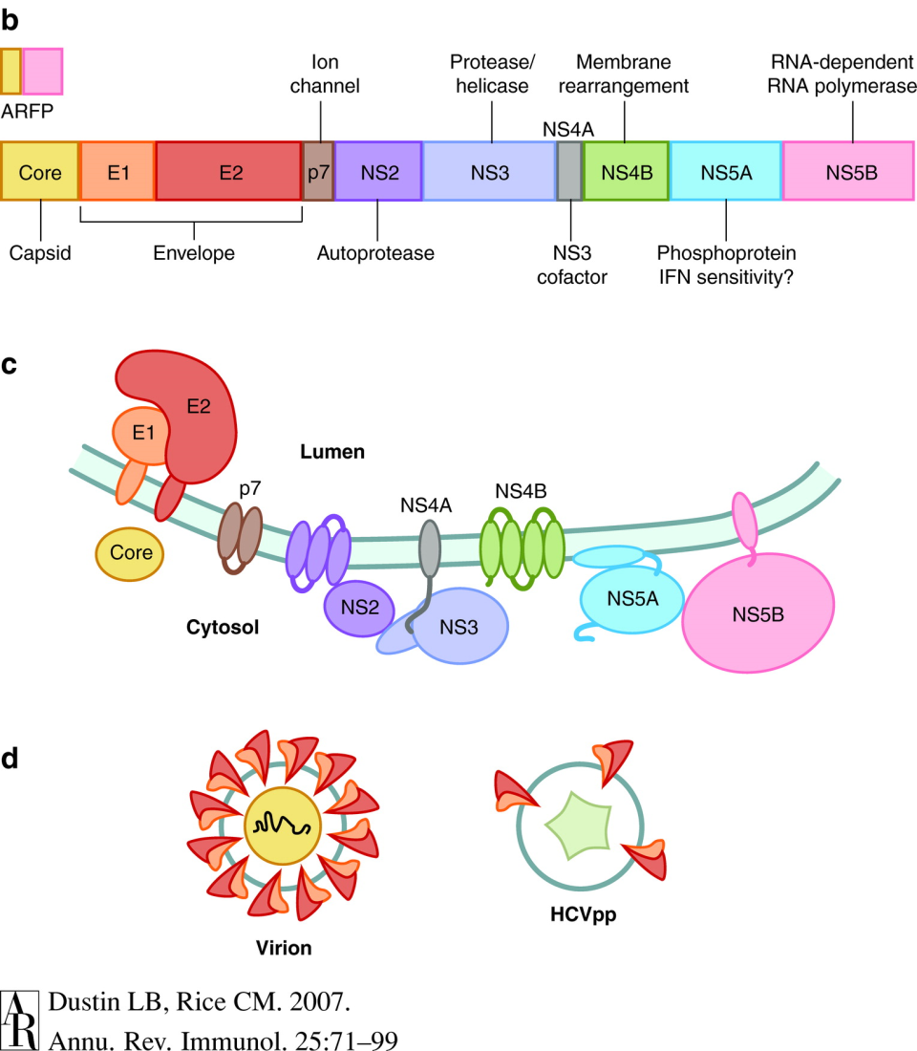
HCV Structure

Slide 17
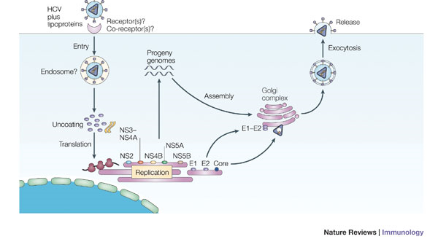
HCV life cycle

Slide 18
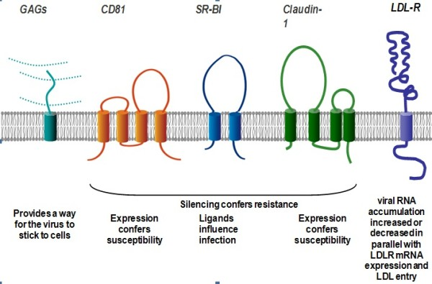
Receptors for Viral entry
HCV receptors for cell entry.
Ashfaq et al. Virology Journal 2011 8:161 doi:10.1186/1743-422X-8-161

Slide 19
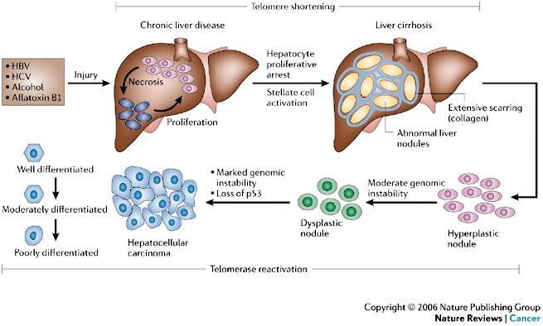
HCV Life Cycle 2
HCV-associated disease results from viral persistence leading to long term inflammation and cell turnover

Slide 20
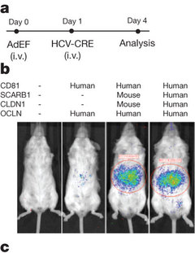
Mouse model of HCV replication
Previous models relied human liver transplant into immunodeficient mice—limited usefulness
Transgenic approach using four known entry factors—Occludin, CD81, SCARB and claudin 1
A genetically humanized mouse model for hepatitis C virus infection
Nature 474, 208–211 (09 June 2011)

Slide 21
What Arms of the immune response are useful against HCV?
Innate immunity
Antiviral effectors such as IFN that act on host cells, regulating key components of cell biology to limit viral growth and spread
Antibody-mediated clearance
In principle, antibodies should be able to remove virus as it spreads from cell to cell
In practice, the correlation of antibody with HCV clearance and outcome is controversial or lacking
Patients with high levels of neutralizing antibodies nevertheless maintain chronic infection, indicating that neutralizing antibodies are not sterilizing
Cell-mediated clearance
Infected cells can be killed before releasing progeny virions
Thought to be the primary means of long term control in HCV infection

Slide 22
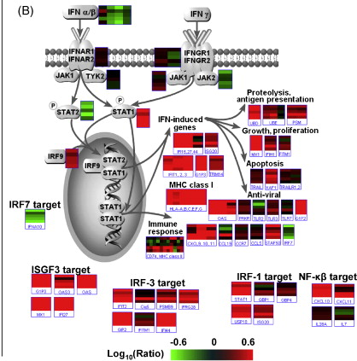
Induction of innate Immunity in Patients
IFN-induced genes interfere with viral replication directly:
Reducing protein synthesis by inhibiting initiation factors (PKR, ISG56)
Targeting of viral RNA (OAS, RNAseL)
Innate responses can enhance or initiate adaptive resposnes
MHC I expression
Chemokine secretion and recruitment of responder cells

Slide 23
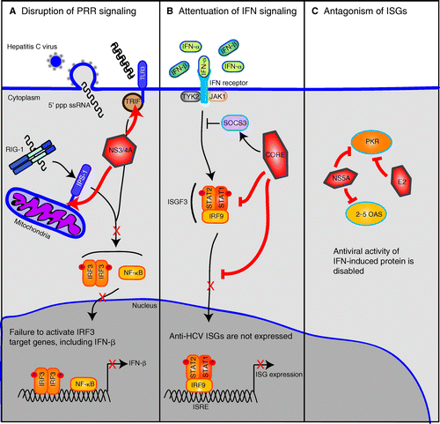
Innate Recognition of HCV
The generation of dsRNA structures in HCV replication leads to recognition by multiple innate pathways
HCV subverts these pathways by sequestering or cleaving key components of innate recognition
The effects are both qualitative and quantitative on the ensuing innate response
Stacy M. Horner, Michael Gale. Journal of Interferon & Cytokine Research. September 2009, 29(9): 489-498

Slide 24
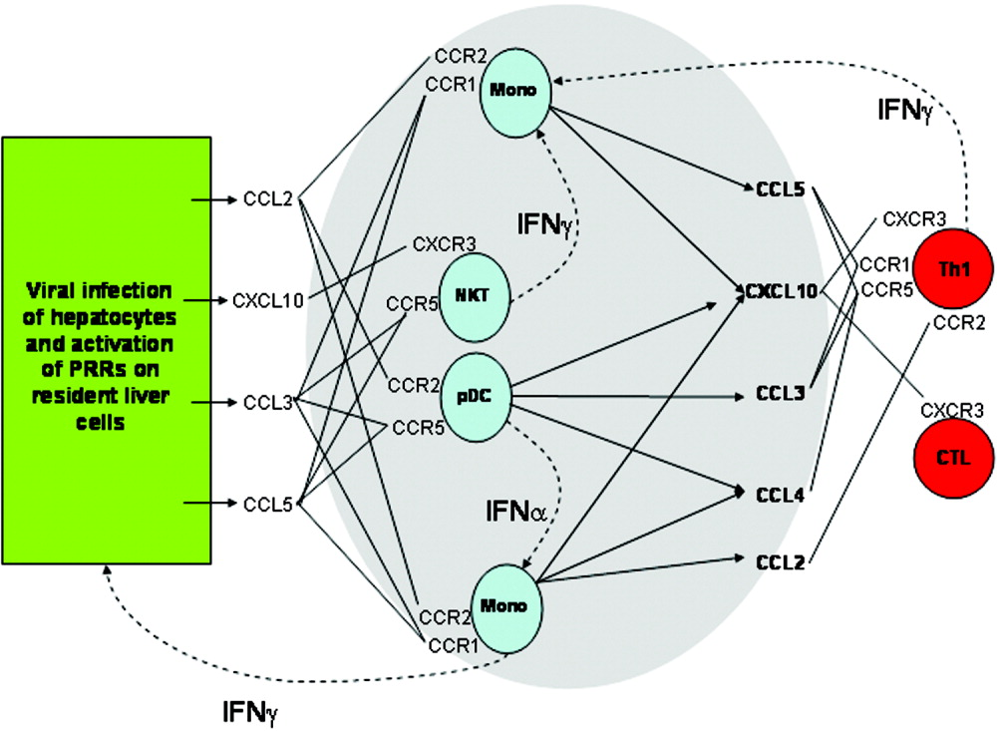
Innate activation of adaptive responses
The innate response results in the recruitment and “biasing” of key innate and adaptive cell types, including NK cells, NKT cells, antigen-presenting cells (monocytes/macrophages) and ultimately CD4 T cells that will orchestrate the adaptive response

Slide 25
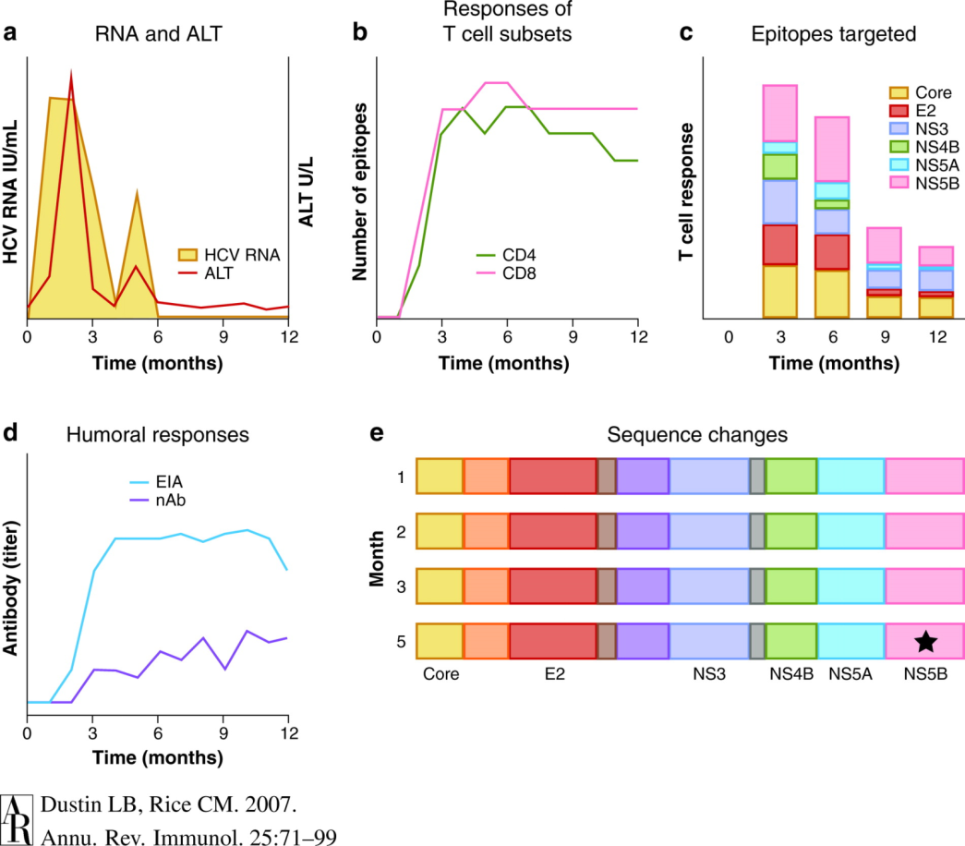
Successful HCV Control (Sustained Virological Response) is mediated by Robust Adaptive Immunity
Broad-based immunological repertoires (targeting multiple epitopes with diverse populations) control acute and prevent the development of chronic infections—particularly CD4 and CD8 cells (the role of antibody is controversial)

Slide 26
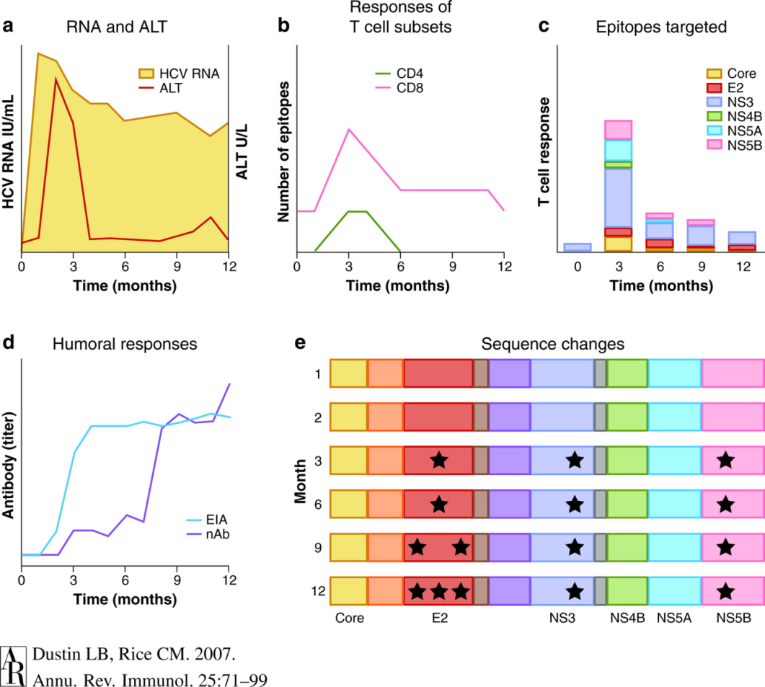
Chronic HCV infections result from poor T cell control, epitope escape and Limited Repertoires
Limited TCR diversity, restricted epitope targets and dysfunctional T cell regulation result in weak T cell responses that are unable to avoid immunological escape

Slide 27
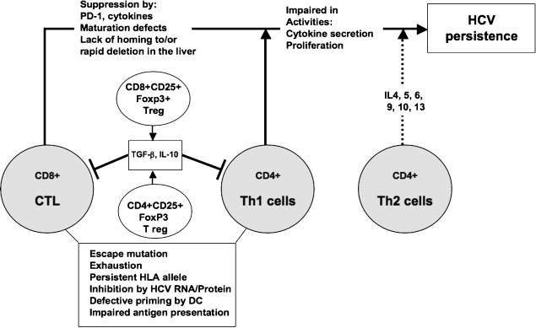
Chronic infections and Immunosuppression
Th2 biasing or immune senescence result in the downregulation of aggressive immunological control by CTL, providing the opportunity for viral escape and establishment of chronic infection

Slide 28
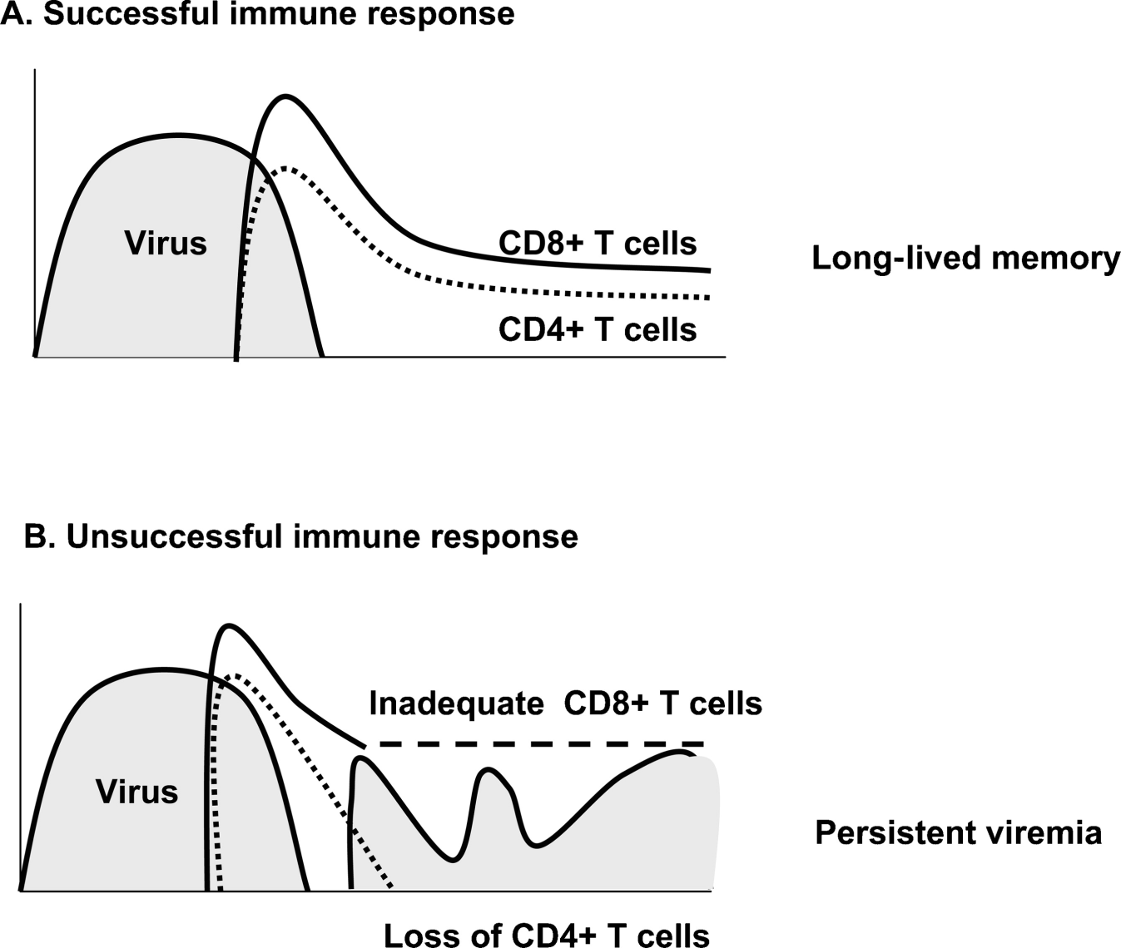
Sustaining an effective cellular Response is more important than Peak response numbers

Slide 29
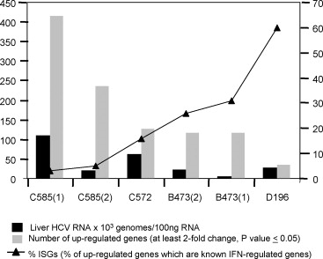
Control of Acute infection correlates with Interferon-Induced Genes

Slide 30
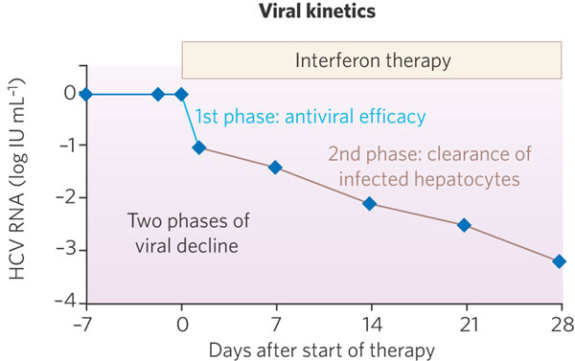
Treatment: Type I Interferon
First therapy introduced for HCV
Full mechanism of action unclear—presumably enhances the “normal” interferon response pathways
Genotype of virus, low baseline levels of HCV RNA and stage of infection are the strongest correlates of efficacy
Suggestions that immunomodulation may play a role and that high dose-inteferon may overcome some of the “regulatory” negative feedback loops active in the infected host
Overall, the specific mechanism has not been clearly demonstrated biologically

Slide 31
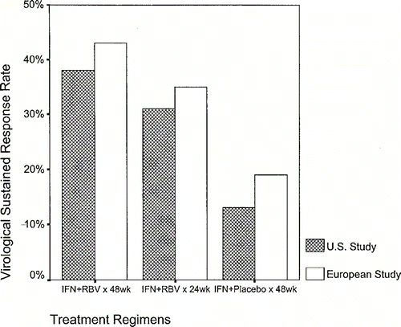
Combination Therapy is significantly more effective
Inteferon alone only yields a 20-25% response rate following a 12-18 month course
Combination therapy with the “broad based” antiviral ribavirin results in 40% of individuals with SVR (30% genotype 1, 65% genotype 2 or 3)

Slide 32
How does ribavirin work against HCV?
Ribavirin was initially designed as a nucleoside analog and developed as an anti-influenza drug, but failed to receive FDA approval or show significant efficacy in humans
It has been used to treat hemorraghic fevers, RSV and is again under consideration as combination therapy for influenza
Proposed Mechanisms:
1) Immunomodulatory properties
2) Inhibition of the inosine monophosphate dehydrogenase (IMPDH)
3) Direct inhibition of the HCV-encoded NS5B RNA polymerase
4) Induction of lethal mutagenesis
5) Modulation of interferon-stimulated gene (ISG) expression

Slide 33
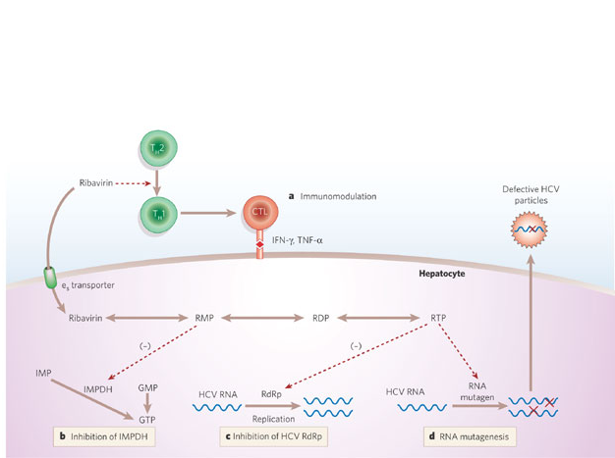
Possible Mechanisms for Ribavirin mode of action

Slide 34
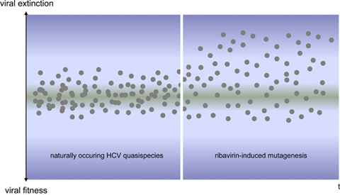
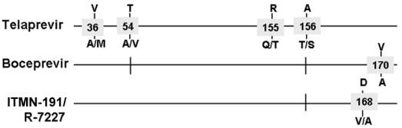
What data would help resolve ribavirin’s mechanism?
Interferon reduces viral production--given the proposed mechanisms, how should ribavirin work?
1) Immunomodulatory properties—Should act independently of interferon
2) Inhibition of the inosine monophosphate dehydrogenase (IMPDH)—Should reduce viral production, be guanosine dependent
3) Direct inhibition of the HCV-encoded NS5B RNA polymerase—Should reduce viral production, put pressure on polymerase to mutate
4) Induction of lethal mutagenesis—Viral production maintained, infected cell number maintained (clearance by decay), new cells infected at a lower rate
5) Modulation of interferon-stimulated gene (ISG) expression—Direct antiviral effects like interferon, should shift ISG expression from negative feedback pathways and be synergistic with poor interferon responders.

Slide 35
Determining an antivral treatment’s mode of action
Biological in vitro experiments with HCV have been difficult to perform as a result of the limited nature of developed culture systems
Alternative drugs that perform a single “ribarvirin function” do not recapitulate ribarvirin efficacy, suggesting that multiple pathways may be acting together
Biological mechanisms can often seem plausible, but can be difficult to prove conclusively that they play an important role (particularly when the drug is “reverse engineered” to the pathogen)
Mathematical modeling from real infection data provides a compelling argument for the viral life cycle stage(s) that might be affected

Slide 36
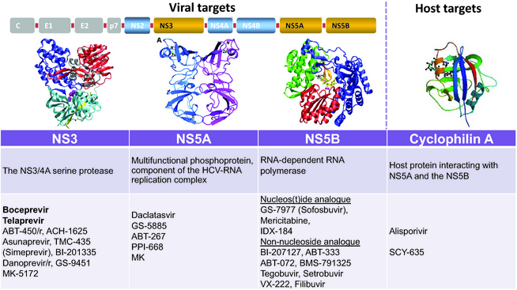
New Drug Treatments for HCV
Liver International
Volume 34, Issue Supplement s1, pages 18–23, February 2014

Slide 37
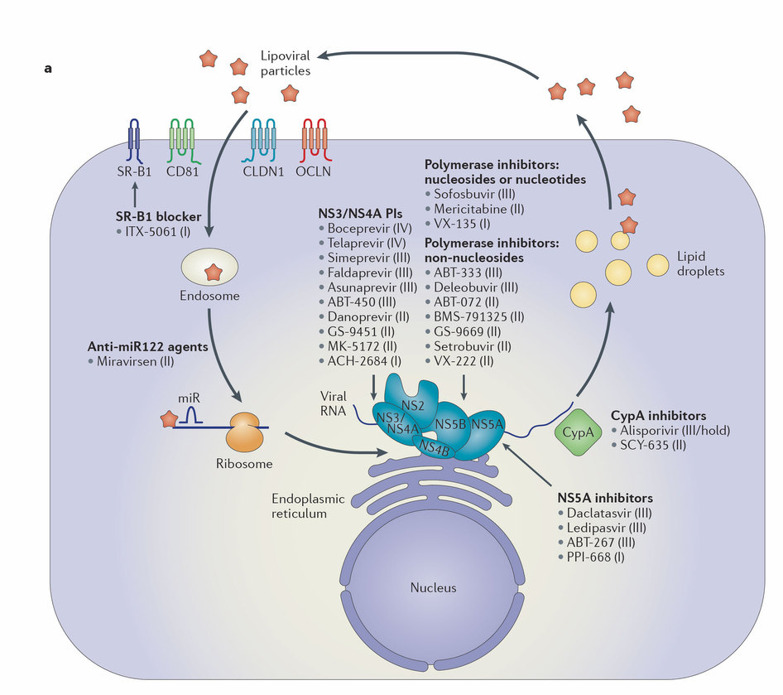
Novel therapies for hepatitis C — one pill fits all?
Michael P. Manns & Thomas von Hahn
Nature Reviews Drug Discovery 12, 595–610 (2013) doi:10.1038/nrd4050

Slide 38
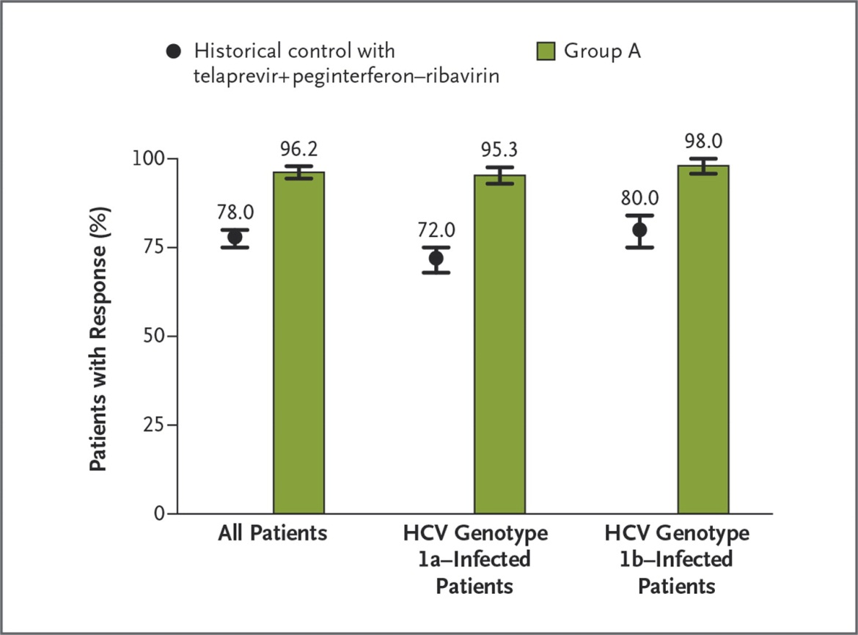
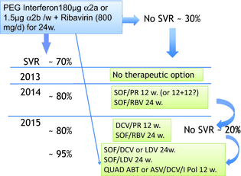

Rates of Sustained Virologic Response among All Patients and According to HCV Genotype in the Historical Control Group and in Group A.
Feld JJ et al. N Engl J Med 2014;370:1594-1603.
Notes:
ABT-450 is an inhibitor of the HCV nonstructural 3/4A (NS3/4A) protease, which is administered with ritonavir (ABT-450/r). Ritonavir is a pharmacoenhancer that inhibits ABT-450 metabolism. Administration of ritonavir with ABT-450 increases peak and trough drug exposures, allowing for once-daily dosing.11 Ombitasvir (also known as ABT-267) is an HCV NS5A inhibitor; dasabuvir (also known as ABT-333) is a nonnucleoside HCV NS5B RNA polymerase inhibitor.12,13

Slide 39
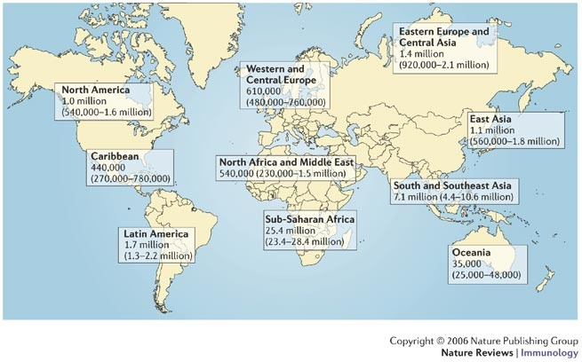
Prevalence of HIV Infection

Slide 40
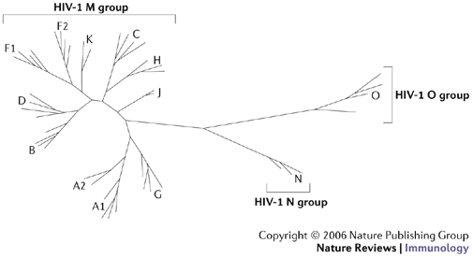
Genetic Diversity of HIV-1
Within HIV-1, a large sequence diversity exists with viral clades being geographically isolated
Several studies have suggested that the clades have different biological characteristics, including disease pathogenicity and transmissibility

Slide 41
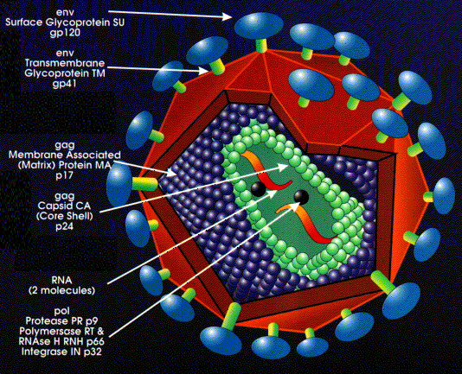
Virion Structure

Slide 42
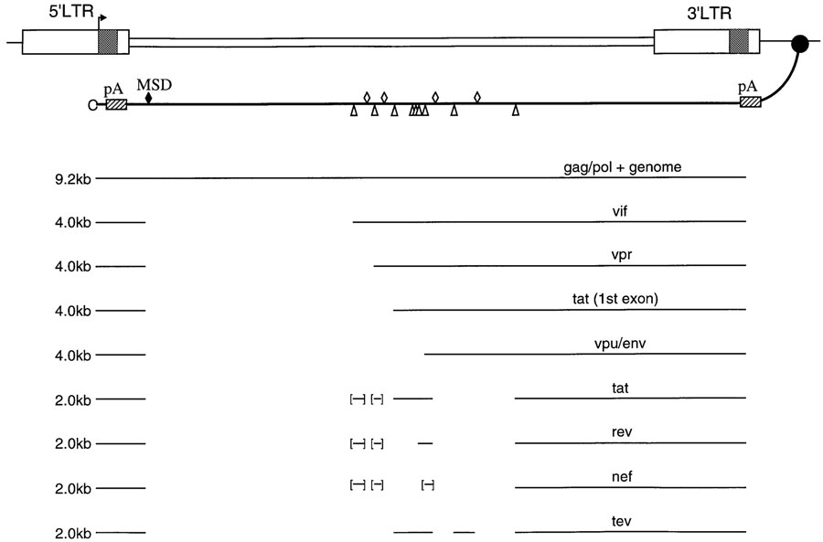
Single Stranded Genome, Multiple messages From alternative splicing

Slide 43
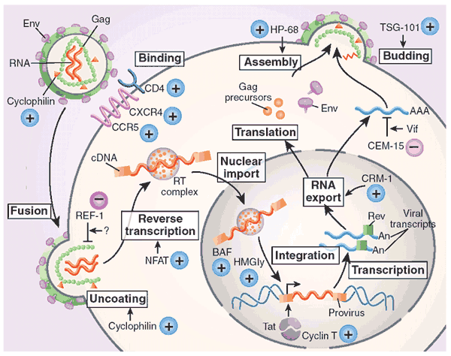
Viral Life cycle
As a retrovirus, HIV replicates by making a DNA copy of itself that is inserted into the host genome
Thus, an infected cell can become a stable reservoir for the long term production of viral particles

Slide 44
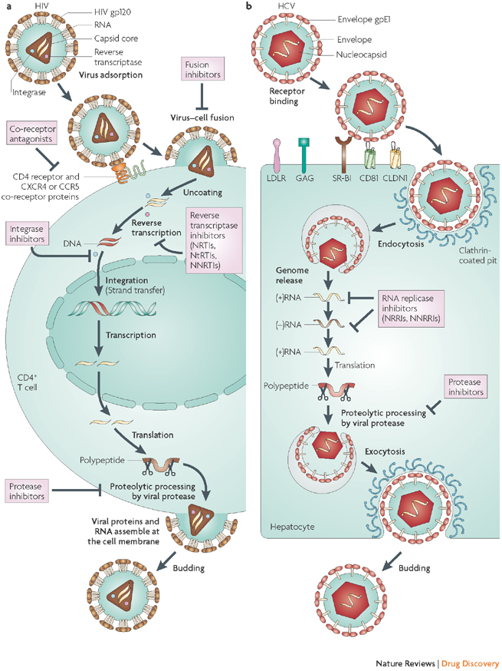
Comparison of HIV and HCV
HIV and HCV both produce chronic infections, but are biologically very different viruses
HIV has a DNA intermediate that become heritably integrated
HCV is a purely RNA virus

Slide 45
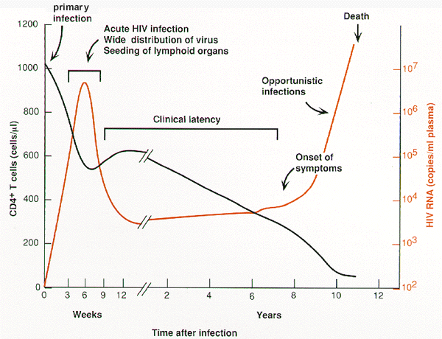
Clinical course of infection

Slide 46
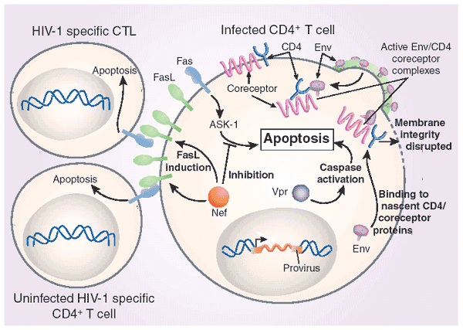
Mechanisms of Cytopathogenicity
Viral envelope fusogenicity (ER compromised)
Vpr activates caspases
Nef contributes indirectly to apoptosis via FasL

Slide 47
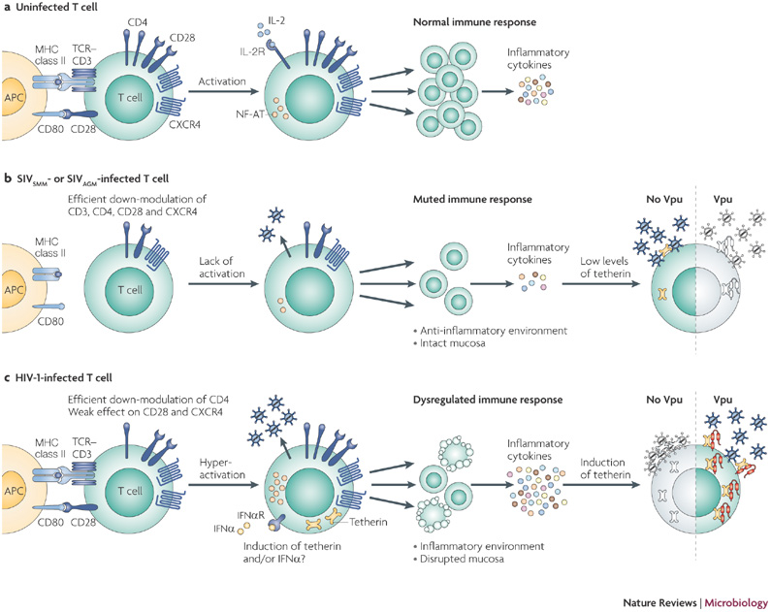
Mechanisms of Immune Dysregulation

Slide 48
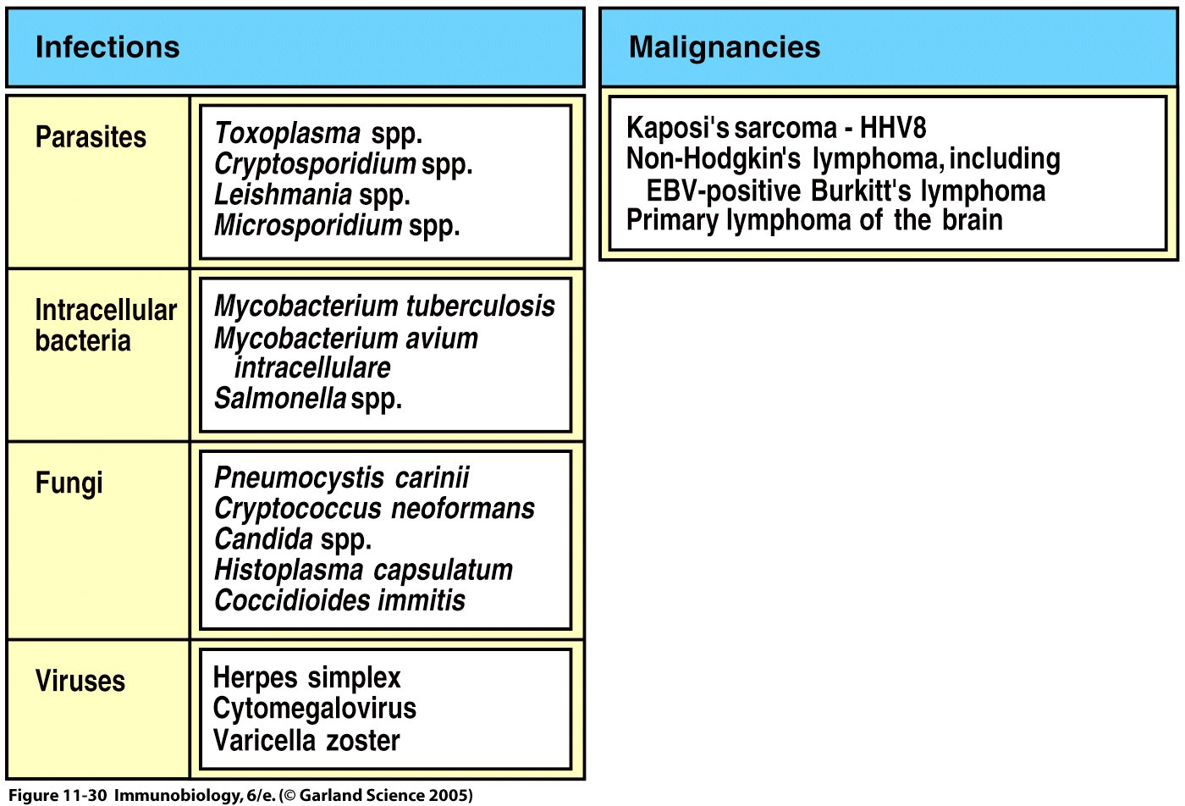
What makes HIV lethal?

Slide 49
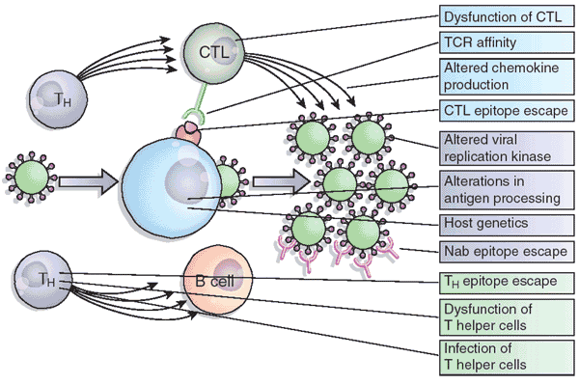
Why is HIV unlike any other chronic infection?
A combination of “traditional” immune evasion mechanisms (CTL escape, antigen masking) and non-traditional (attacking immune function and cell compartments directly

Slide 50
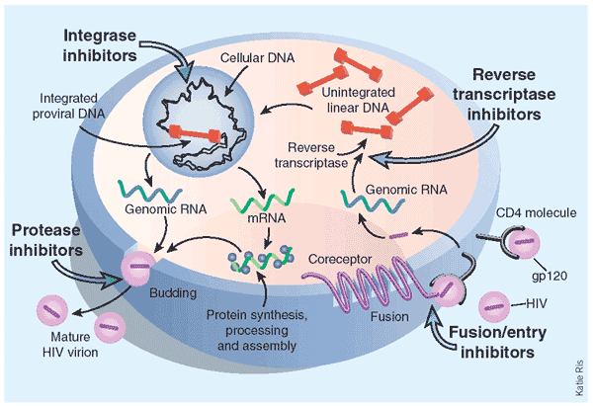
Can infection be effectively controlled?

Slide 51
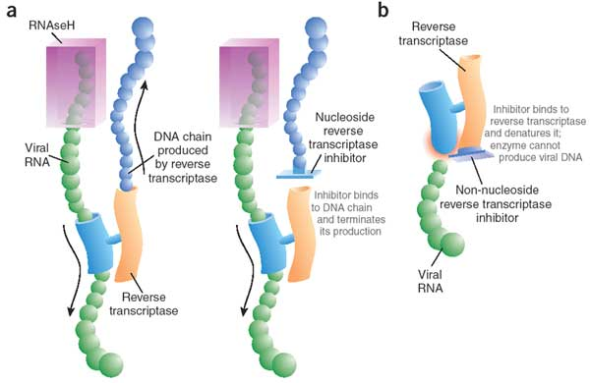
Mechanisms of RT Inhibitors

Slide 52
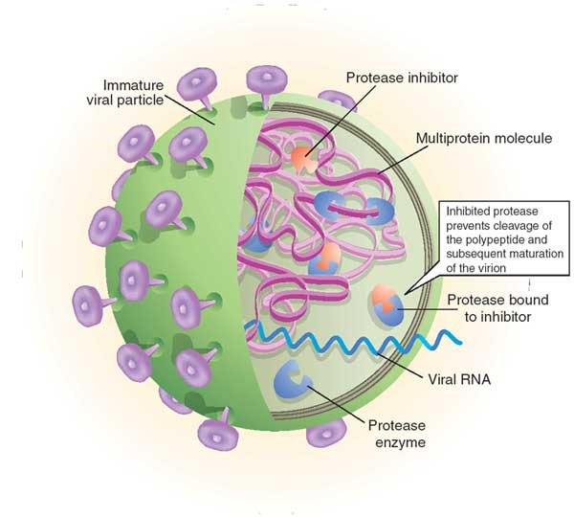
Mechanism of Protease Inhibitors

Slide 53
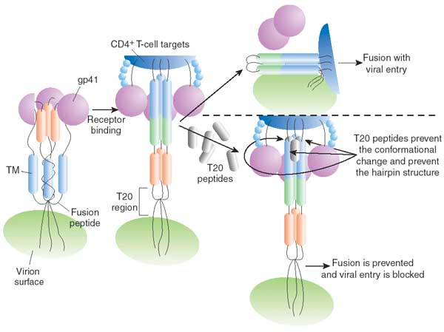
Fusion Inhibitors

Slide 54
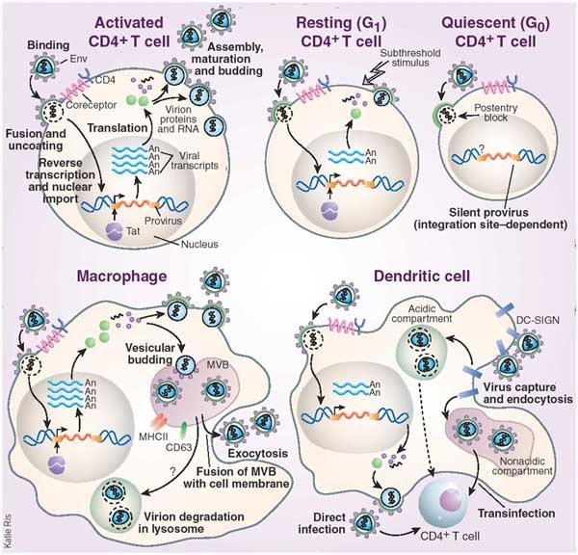
Latent Reservoirs of Virus
Multiple cell types can serve as latent reservoirs
“Quiescence” of infected cells constrains the possibility total viral elimination

Slide 55
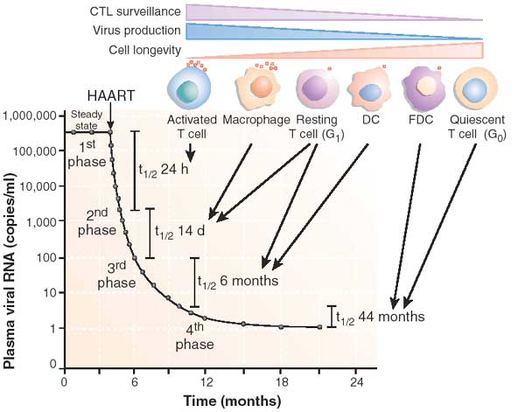
Contribution of Individual Reservoirs
Steady-state virus levels result from the relative contributions and turnover of each reservoir compartment
After viral inhibition by HAART, plasma viral RNA decays in four distinct phases allowing a dissection of each reservoir’s individual contribution

Slide 56

Can the Immune system be used to Prevent or Clear infection?

Slide 57


Summary of Vaccine Trials in 2006
Letvin Nature Reviews Immunology 6, 930–939 (December 2006) | doi:10.1038/nri1959

Slide 58

Mechanisms of Immune protection
“Standard” immunological protection mechanisms, including antibody, clearance by phagocytic cells and Fc receptors, and cytotoxic killing of infected cells all function to limit infection and control long-term viral loads
The loss of effective immune control is what leads to the development of AIDS, therefore the immune response in principle is an effective tool for viral control and clearance

Slide 59

CD8 T cells provide significant Viral control during the chronic phase of infection
CD8 depletion in SIV-infected animals leads to rapid increase in viral titers and pathogenesis of disease

Slide 60

Viral Immune Escape mechanisms
“Antigenic drift” from the very high rate of mutation of the RT enzyme allows rapid escape from individual antibody and CTL responses
Epitopes are constrained by structural/functional requirements

Slide 61

How do we assay for T cell responses in HIV infected individuals?

Slide 62

Immunodominant epitope escape can lead to loss of viral control

Slide 63


Recent Reports Relating MHC Haplotype to HIV control
Nature 465, 350–354 (20 May 2010) Effects of thymic selection of the T-cell repertoire on HLA class I-associated control of HIV infection
Andrej Košmrlj, Elizabeth L. Read, Ying Qi, Todd M. Allen, Marcus Altfeld, Steven G. Deeks, Florencia Pereyra, Mary Carrington, Bruce D. Walker & Arup K. Chakraborty
Relating the breadth of the TCR repertoire (how many different T cell receptors does the body make?) to the MHC haplotype (the more self peptides available for negative selection, the narrower (and less “cross-reactive” the TCR repertoire)
Less cross-reactive TCR repertoires are then associated with poor control

Slide 64

Vaccine Expectations
Since viral load “set point” is a key predictor of disease progression and pathogenesis, even a suboptimal vaccine could be of use in highly endemic areas to protect against disease and spread (we’ll talk more about this when we get to malaria)

Slide 65

The Merck Vaccine
Use of a viral vector has been shown experimentally to boost cellular responses, by delivering more antigen with the proper innate/PAMP signals

Slide 66

Merck Vaccine Failure
Not only did the Merck Vaccine fail to protect, there appeared to be an enhancement of infection in vaccinees who had relatively higher pre-existing antibody titers to the viral vector
This failure led to the cancellation of other vaccine trials based on a similar approach
HVTN-505 just halted in April 2013—also Ad5 based (41 vacc inf, 30 placebo)

Slide 67

A Protective Vaccine? RV144 Trial
ALVAC/AIDSVAX Prime boost-boost vaccine (canarypox followed by protein boost, gp120 based)
16,402 vaccinees
Vaccine efficacy was 31.2%
No mitigation of viral load in those that did become infected

Slide 68

Immune correlates of HIV RISK

Slide 69
Points for Discussion
HIV is a unique pathogen in that it targets the immune system directly—playing “offense”—killing or dysregulating the cells that specifically target it and “defense”, employing more conventional immune escape mechanisms
Despite this, the immune response, both antibody and CTLs, provide an important level of control over the virus for an extended period of time, keeping the reservoir relatively stable
Vaccines could in principle employ similar strategies, but drugs are still the most effective treatment tool

