Slide 1
An Introduction to Immunology
Paul Thomas
Unit 1
Department of Immunology
St. Jude Children’s Research Hospital

Slide 2
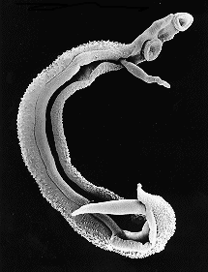
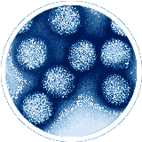
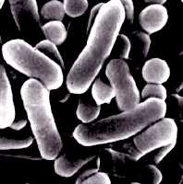
Categories of Pathogens
Viruses (~0.2 microns)
Bacteria (1-2 microns)
Parasites (Millimeters)

Slide 3
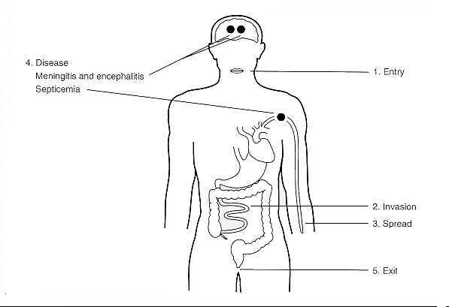
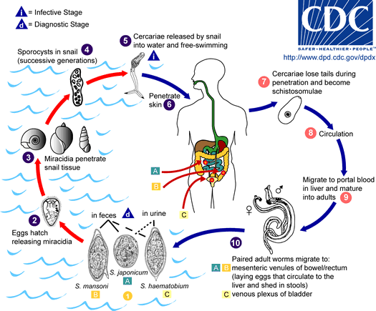
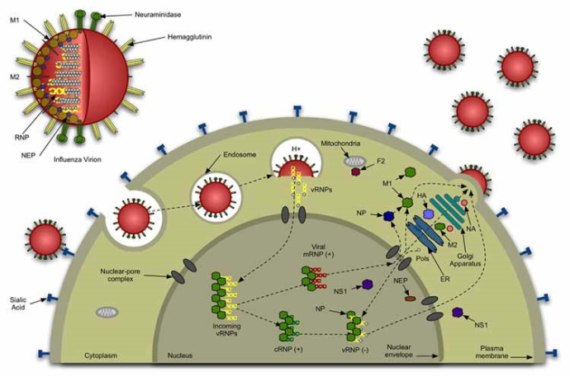
Pathogen Lifestyles

Slide 4
“Questions” answered by the Immune System
When should I respond?
Is this infectious (not self)?
Is this a threat?
How should I respond?
What’s the most effective means of control?
How do I limit damage?

Slide 5
Immunological Themes
Generalized inflammation followed by a specific, pathogen-directed response
Communication via soluble mediators—cytokines and chemokines
Feedback regulation to limit hyperinflammatory responses
Multiple modes of recognition and specificity determination
NOT centrally organized
Not always clear what is essential, what is redundant, and what is irrelevant

Slide 6
Pathogen-specific approaches
Some pathogens must be eliminated for host survival—usually small, rapidly growing, with limited genomes
Primary goal is to win a race—grow quickly enough to transmit before host death or clearance
No sophisticated “biosensing” apparatus
Viruses like influenza, ebola, RSV
Some pathogens are acute or chronic depending on the host situation
Usually more complicated
Host genetic and environmental factors might determine susceptibility and permissiveness for chronic vs. acute infection
Bacteria (TB) and viruses (HCV)
Some pathogens are almost exclusively chronic
Sophisticated genomes, large size (but not always)
Not fully understood in every circumstance—host may simply not have a mechanism for effective clearance
Usually not acutely lethal
Parasitic worms, HIV

Slide 7
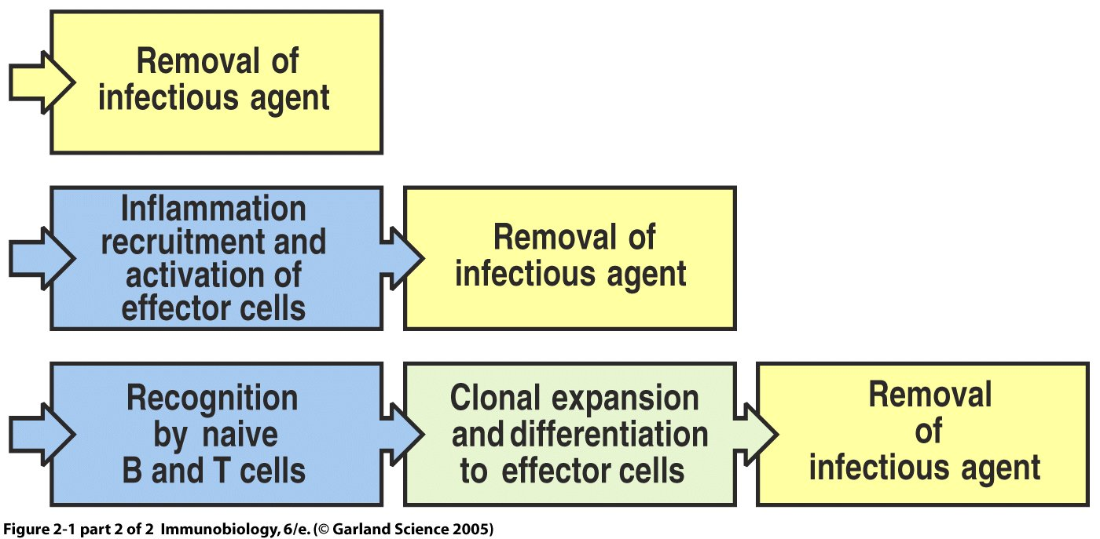

Slide 8
Stages of an Immune response
Physical prevention of infection (skin, mucus, surfactants, cilial beating)
Innate epithelial inflammation (defensins, interferons)
Professional innate cell recruitment (phagocytosis, amplification of direct effectors, including defensins and reactive oxygen species)
Generation of adaptive response and clearance by antibody, CD8 T cell killing or CD4 T cell modulation of environment (either extracellular or intracellular)

Slide 9
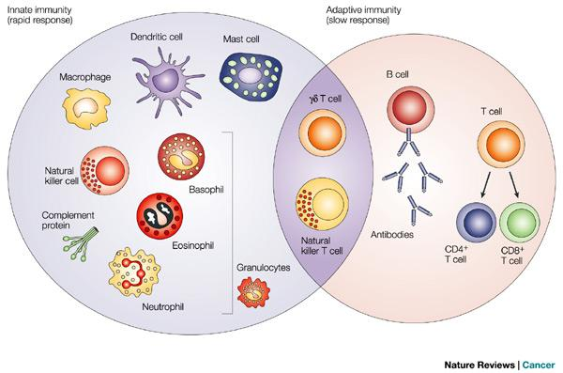

Slide 10
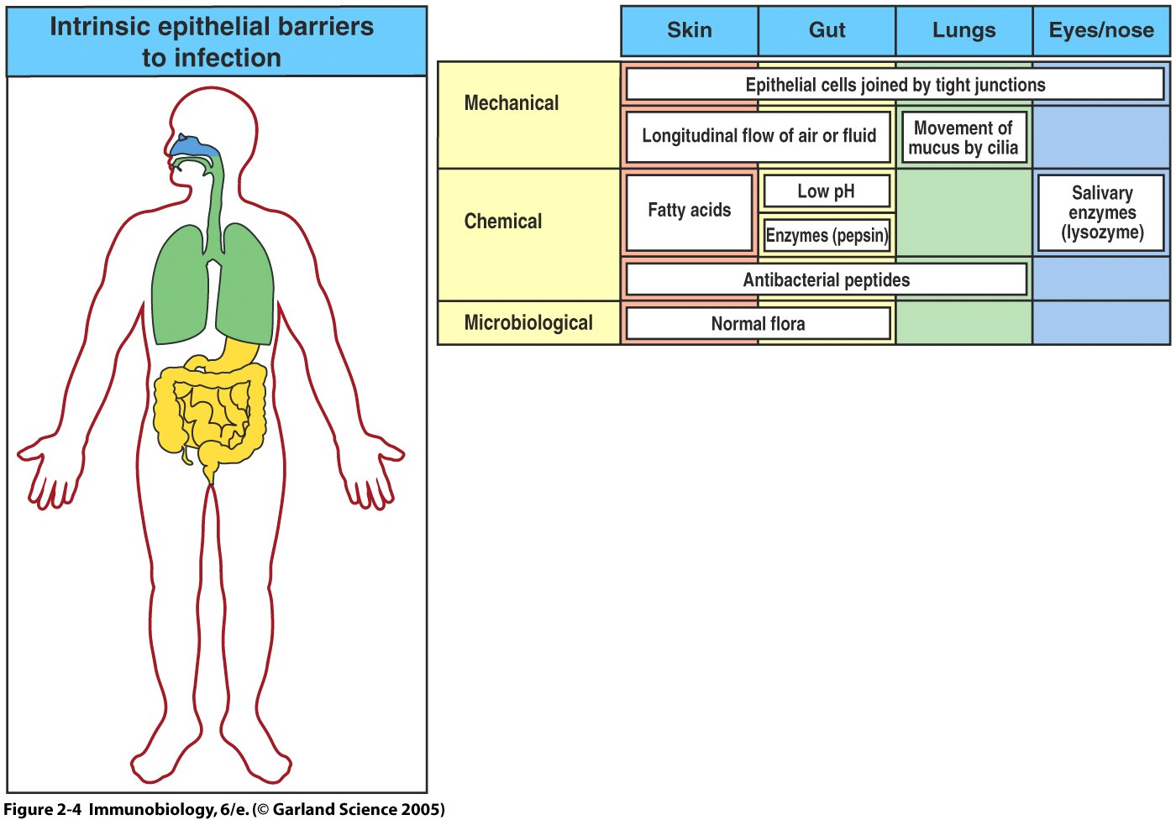

Slide 11
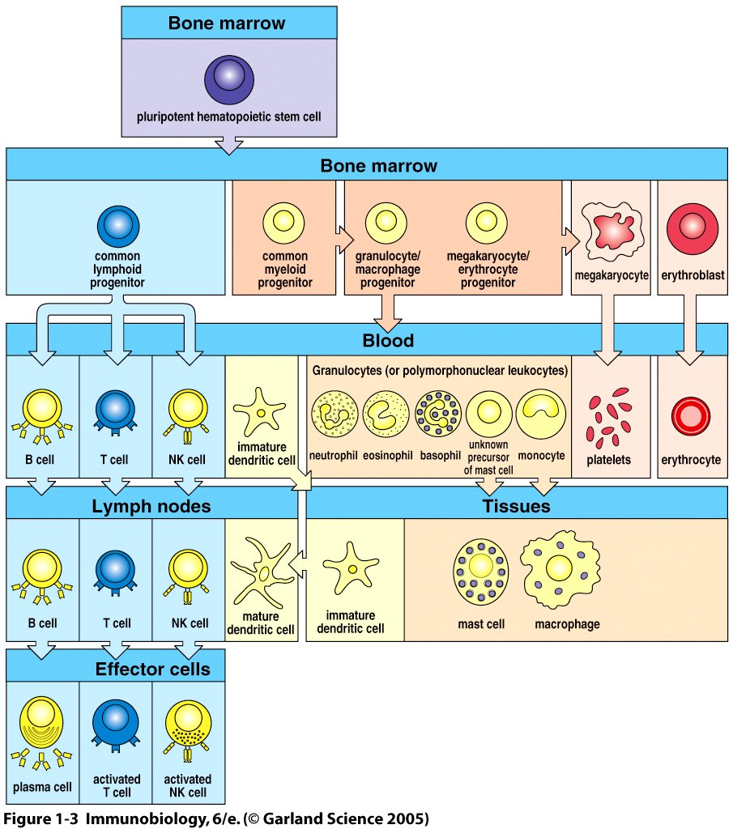

Slide 12
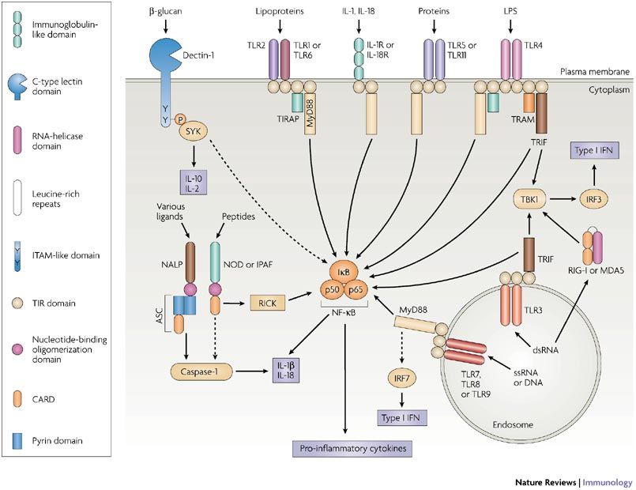
Innate Immune Pattern Recognition
Initial responses mediated by three major families of innate receptors: TLRs, RLRs, and NLRs
TLR: cell surface or endosomal
NLR and RLR: cytoplasmic
All 3 activate distinct, but overlapping, host response pathways

Slide 13
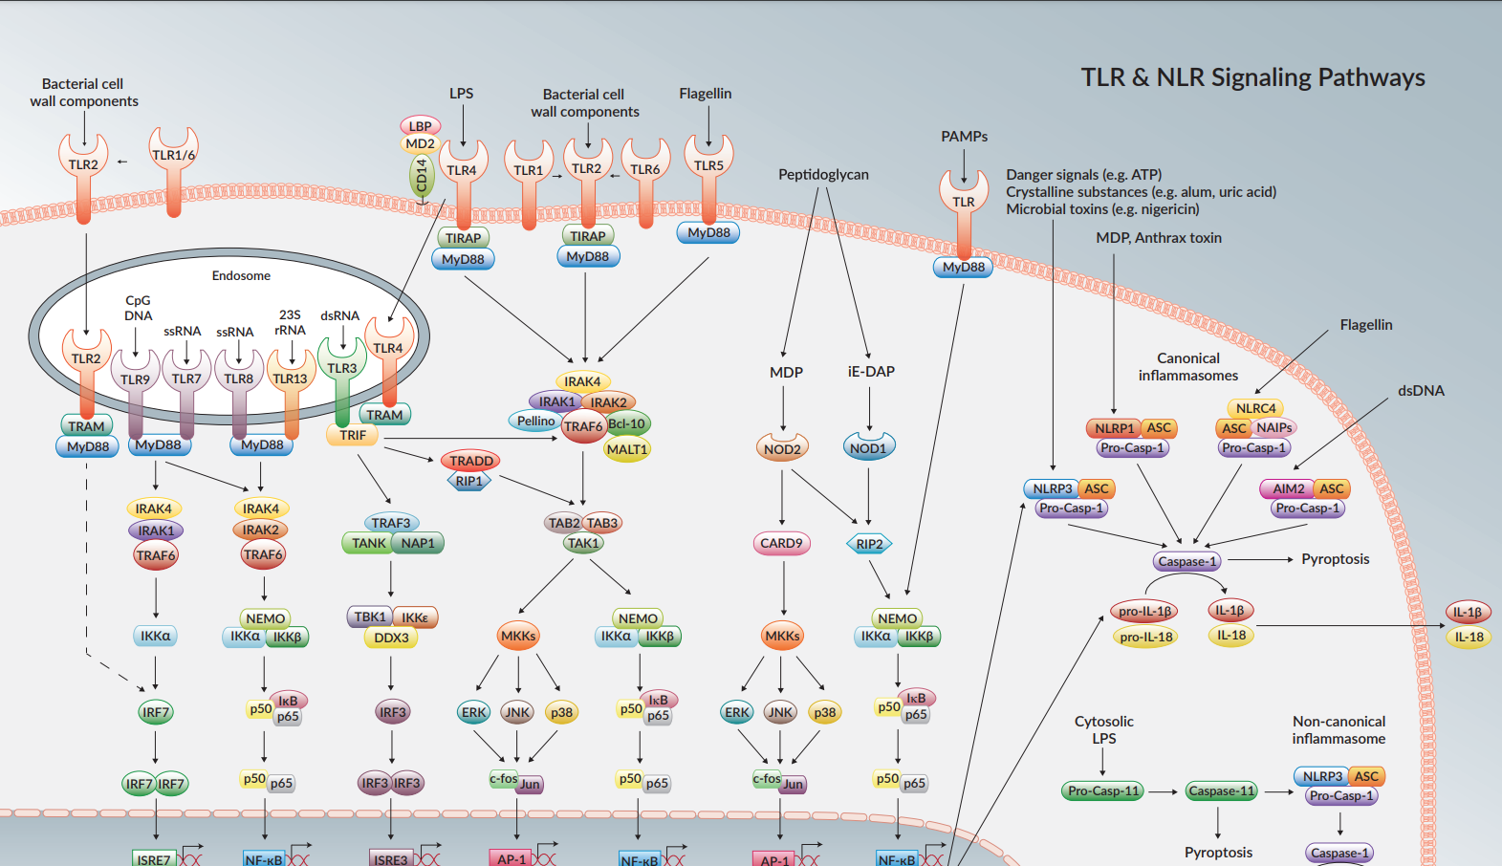
Expanding Complexity

Slide 14
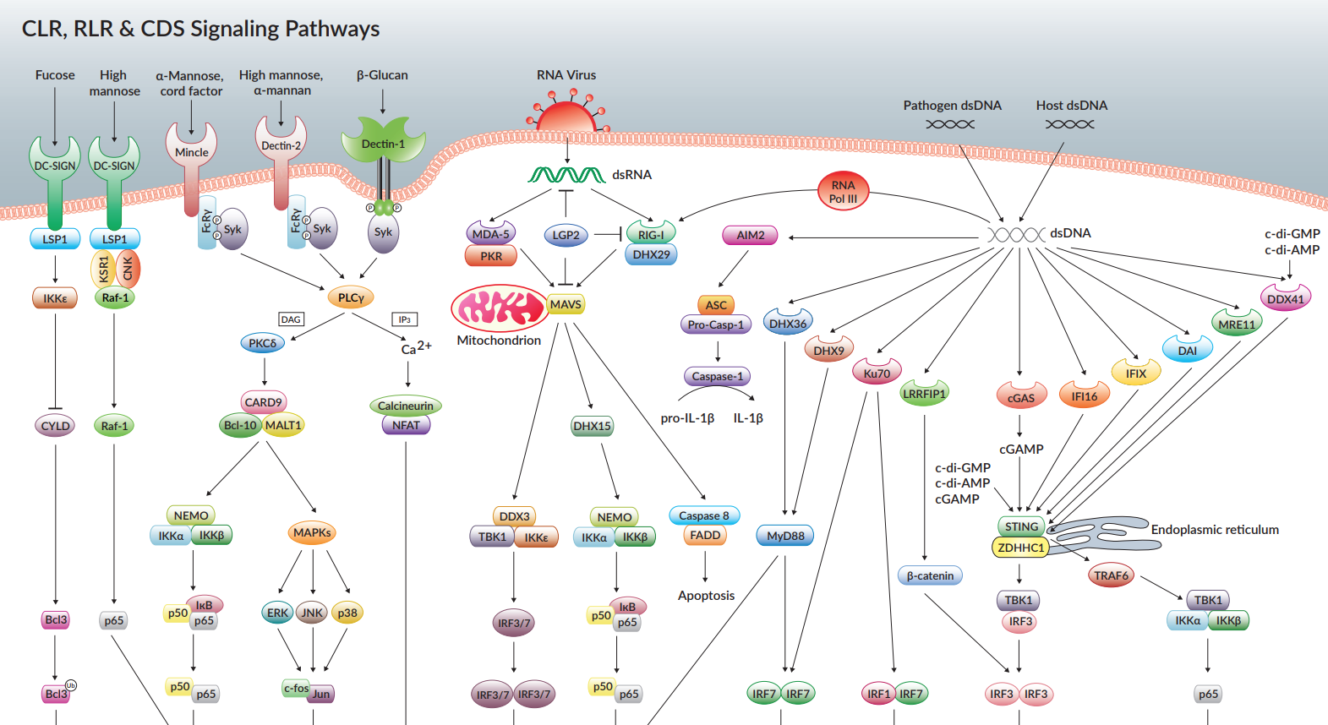
Unconventional Nucleic acid recognition
ZBP-1

Slide 15
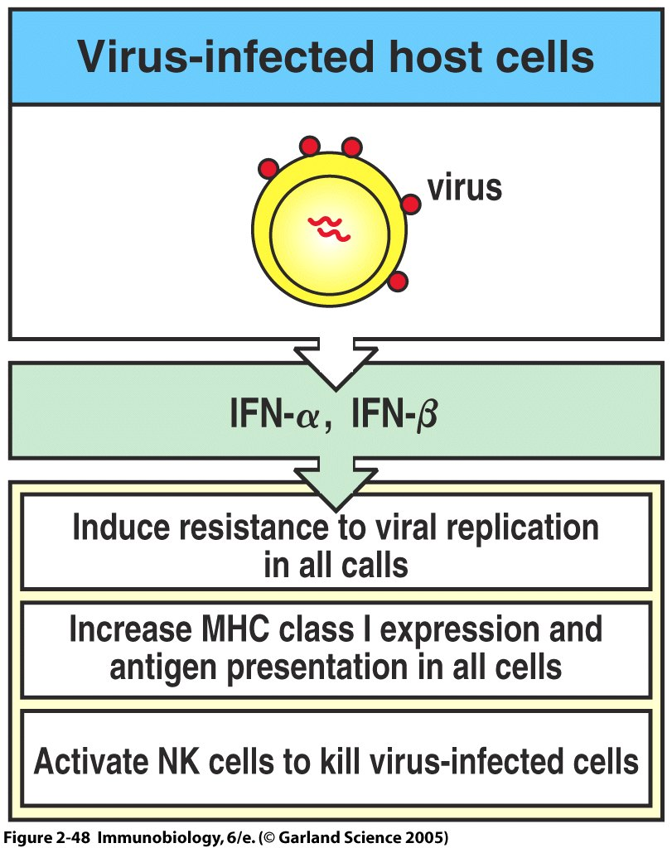
Figure 2-48

Slide 16
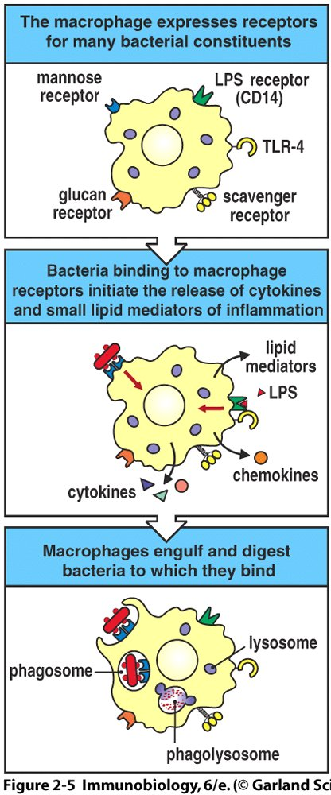
Effector mechanisms of the innate response: digestion and chemical destruction
Innate activation can lead to direct killing by a phagocytic cell engulfing the pathogen
Chemical destruction occurs after acidification of the phagosome by endosomal fusion
Reactive oxygen and nitrogen intermediates (ROI and RNI) are also effective mediators of pathogen killing—all components available internally in innate cells

Slide 17
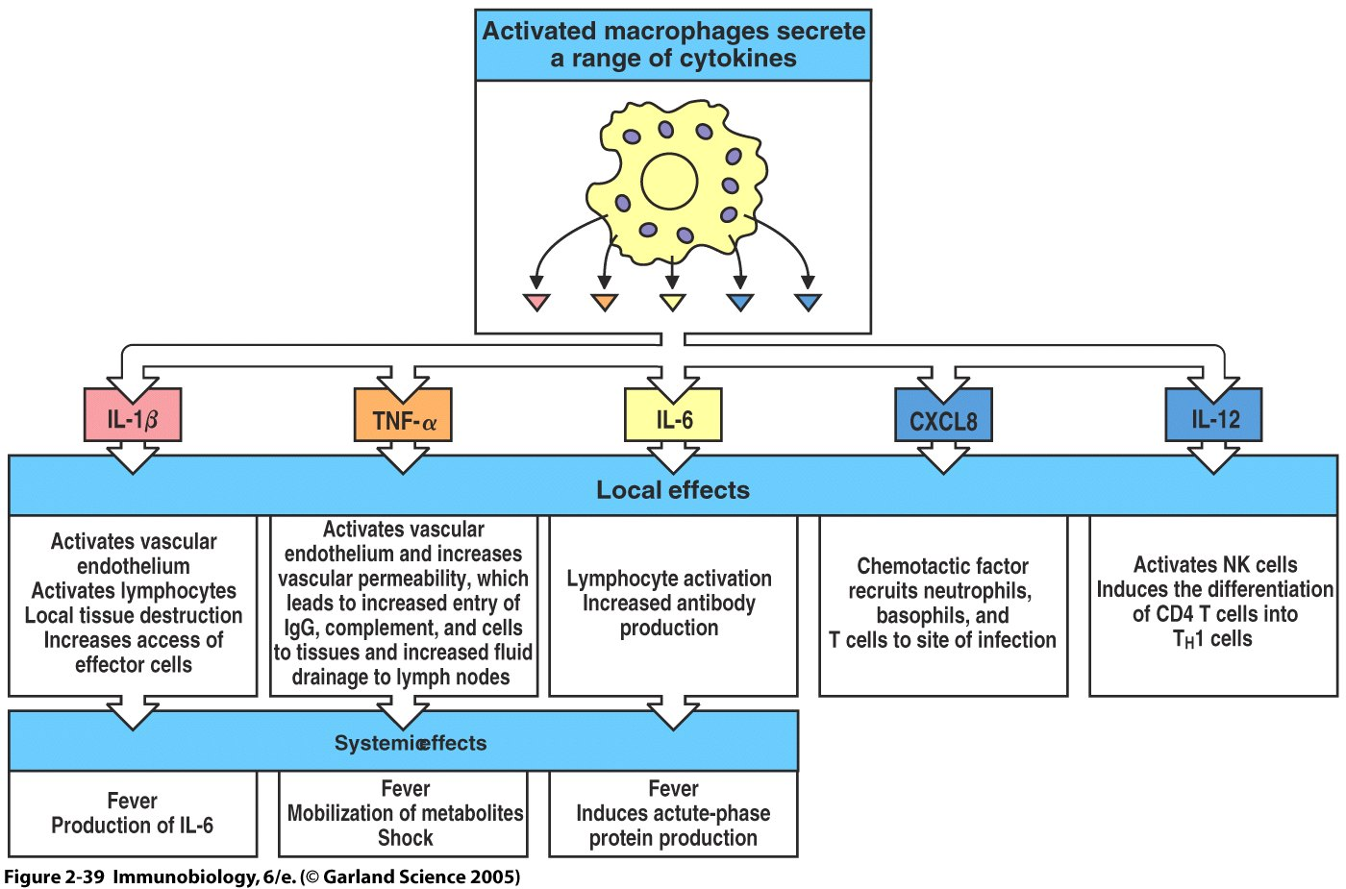
Figure 2-39

Slide 18
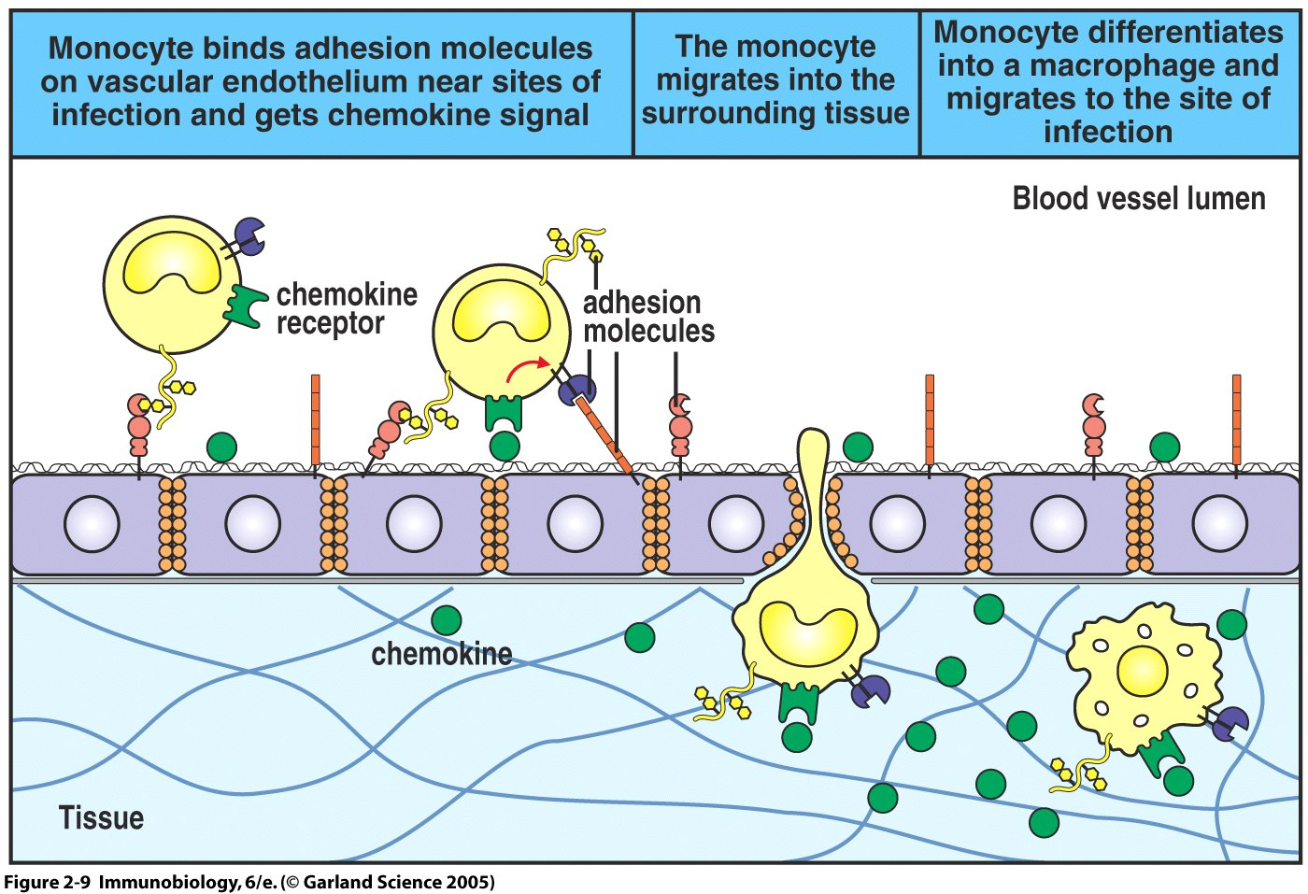

Slide 19
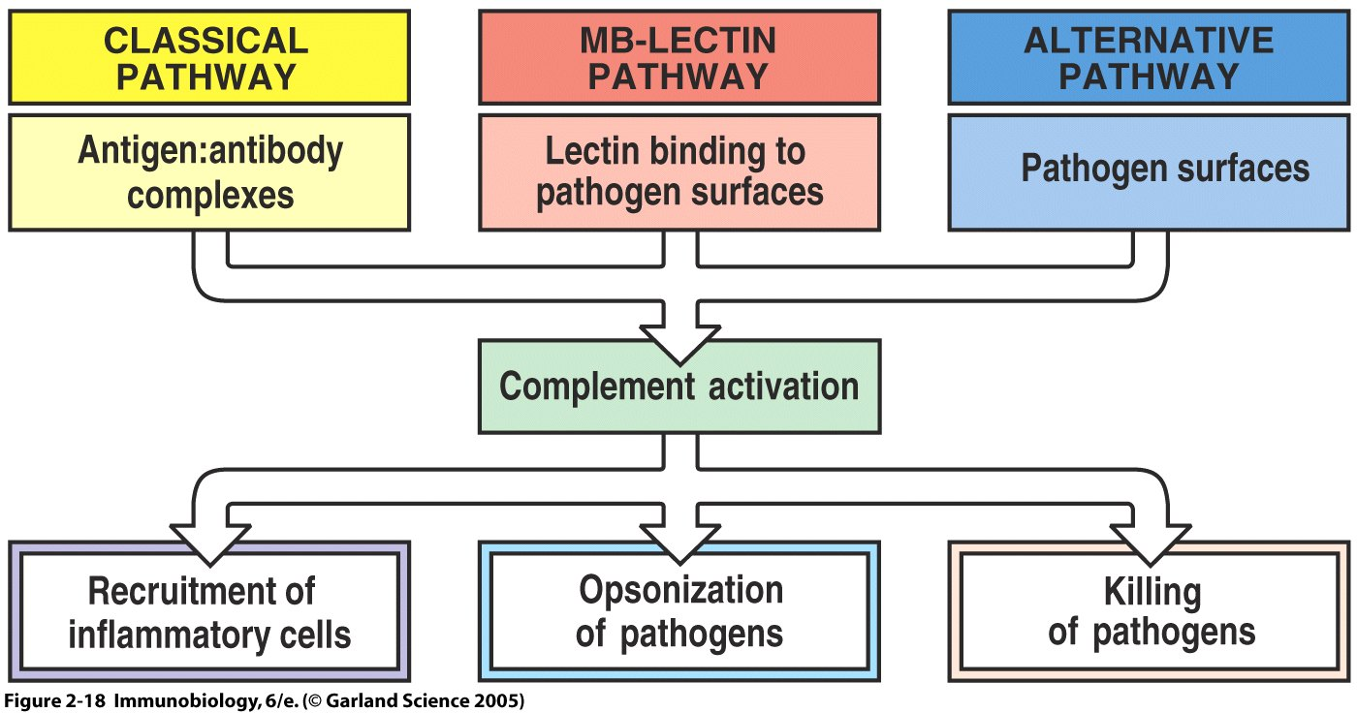
Effector mechanisms of the innate reponse: complement

Slide 20
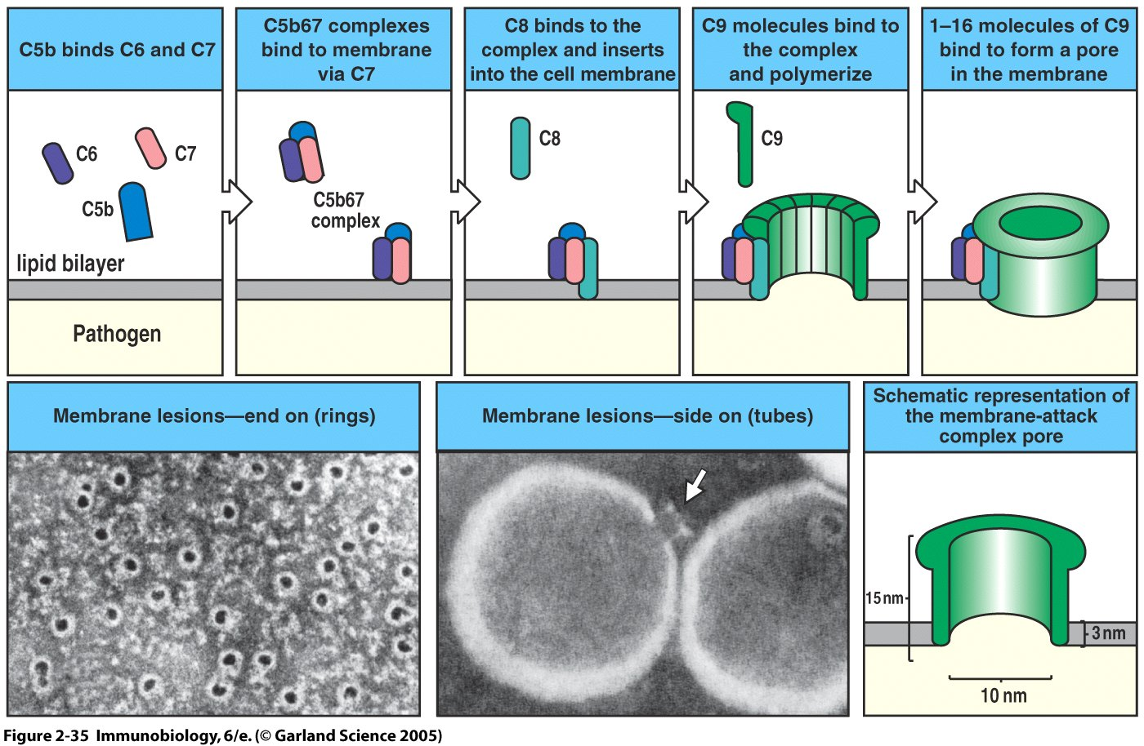

Slide 21
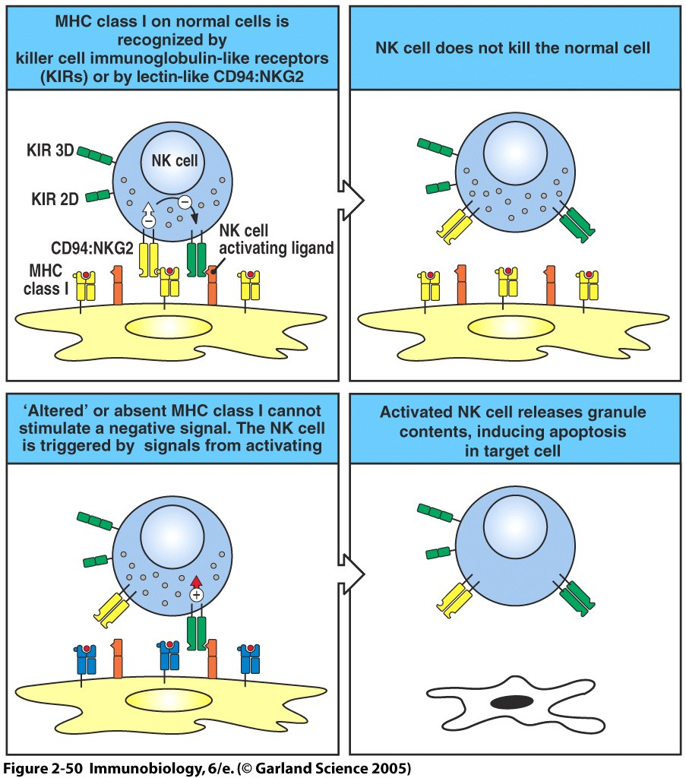
Effector mechanisms of the innate response: “natural” killing

Slide 22
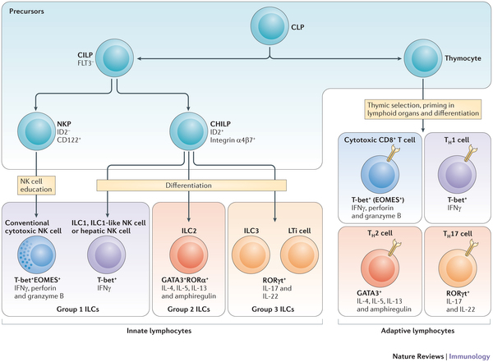

Slide 24
ADAPTIVE IMMUNITY

Slide 26
B cell and T cells are the effectors of Adaptive Immune Responses
Three broad arms of adaptive immunity
B cells make antibodies, soluble effector molecules (extracellular pathogen removal)
CD4 T cells induce other host cell responses, are required for activation and differentiation of CD8 cells and B cells in some situations—the “quarterbacks” of the immune system
CD8 cells directly kill infected cells (intracellular pathogen removal)
All three have memory

Slide 27
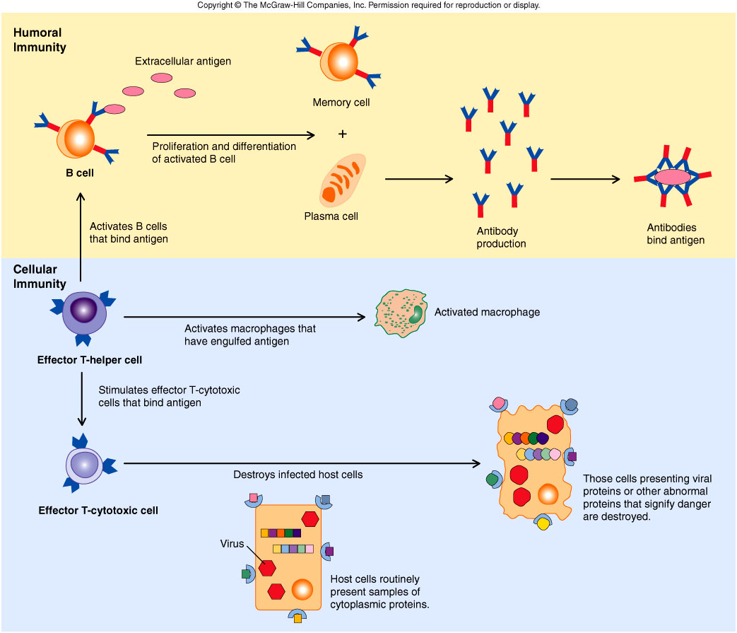

Slide 28
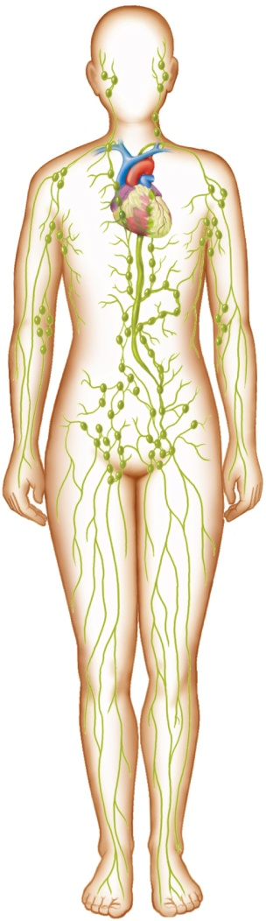
Locations of Lymph Nodes
Lymph nodes are found in groups or chains along the paths of the larger lymphatic vessels throughout the body, including the:
Cervical region
Axillary region
Supratrochlear region
Inguinal region
Pelvic cavity
Abdominal cavity
Thoracic cavity
Copyright © The McGraw-Hill Companies, Inc. Permission required for reproduction or display.
Thoracic
lymph
node
Cervical
lymph
node
Axillary
lymph
node
Supratrochlear
lymph node
Abdominal
lymph node
Inguinal
lymph
node
Pelvic lymph
node

Slide 29
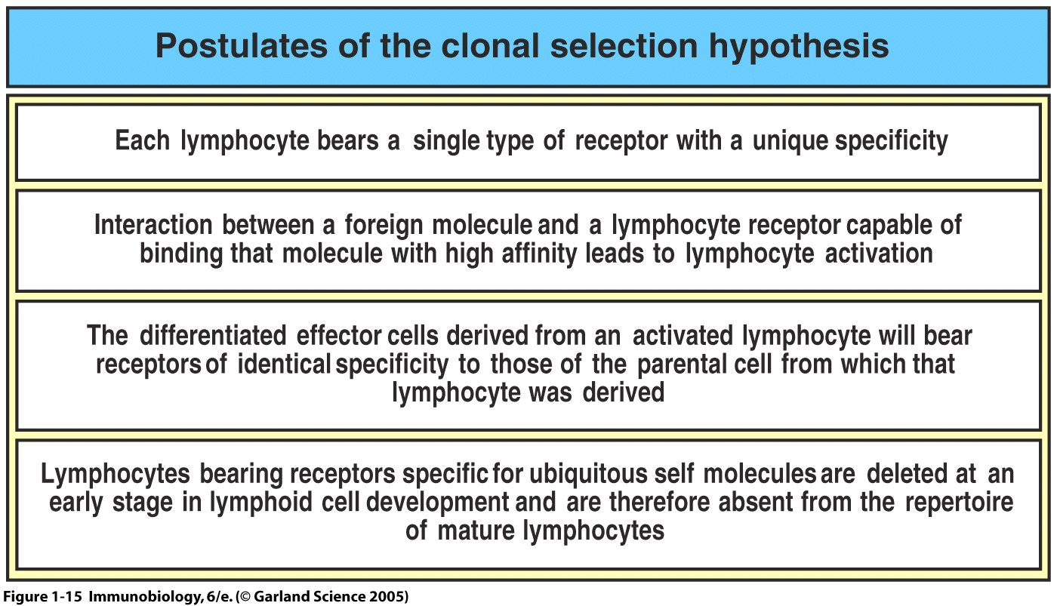
Figure 1-15

Slide 30
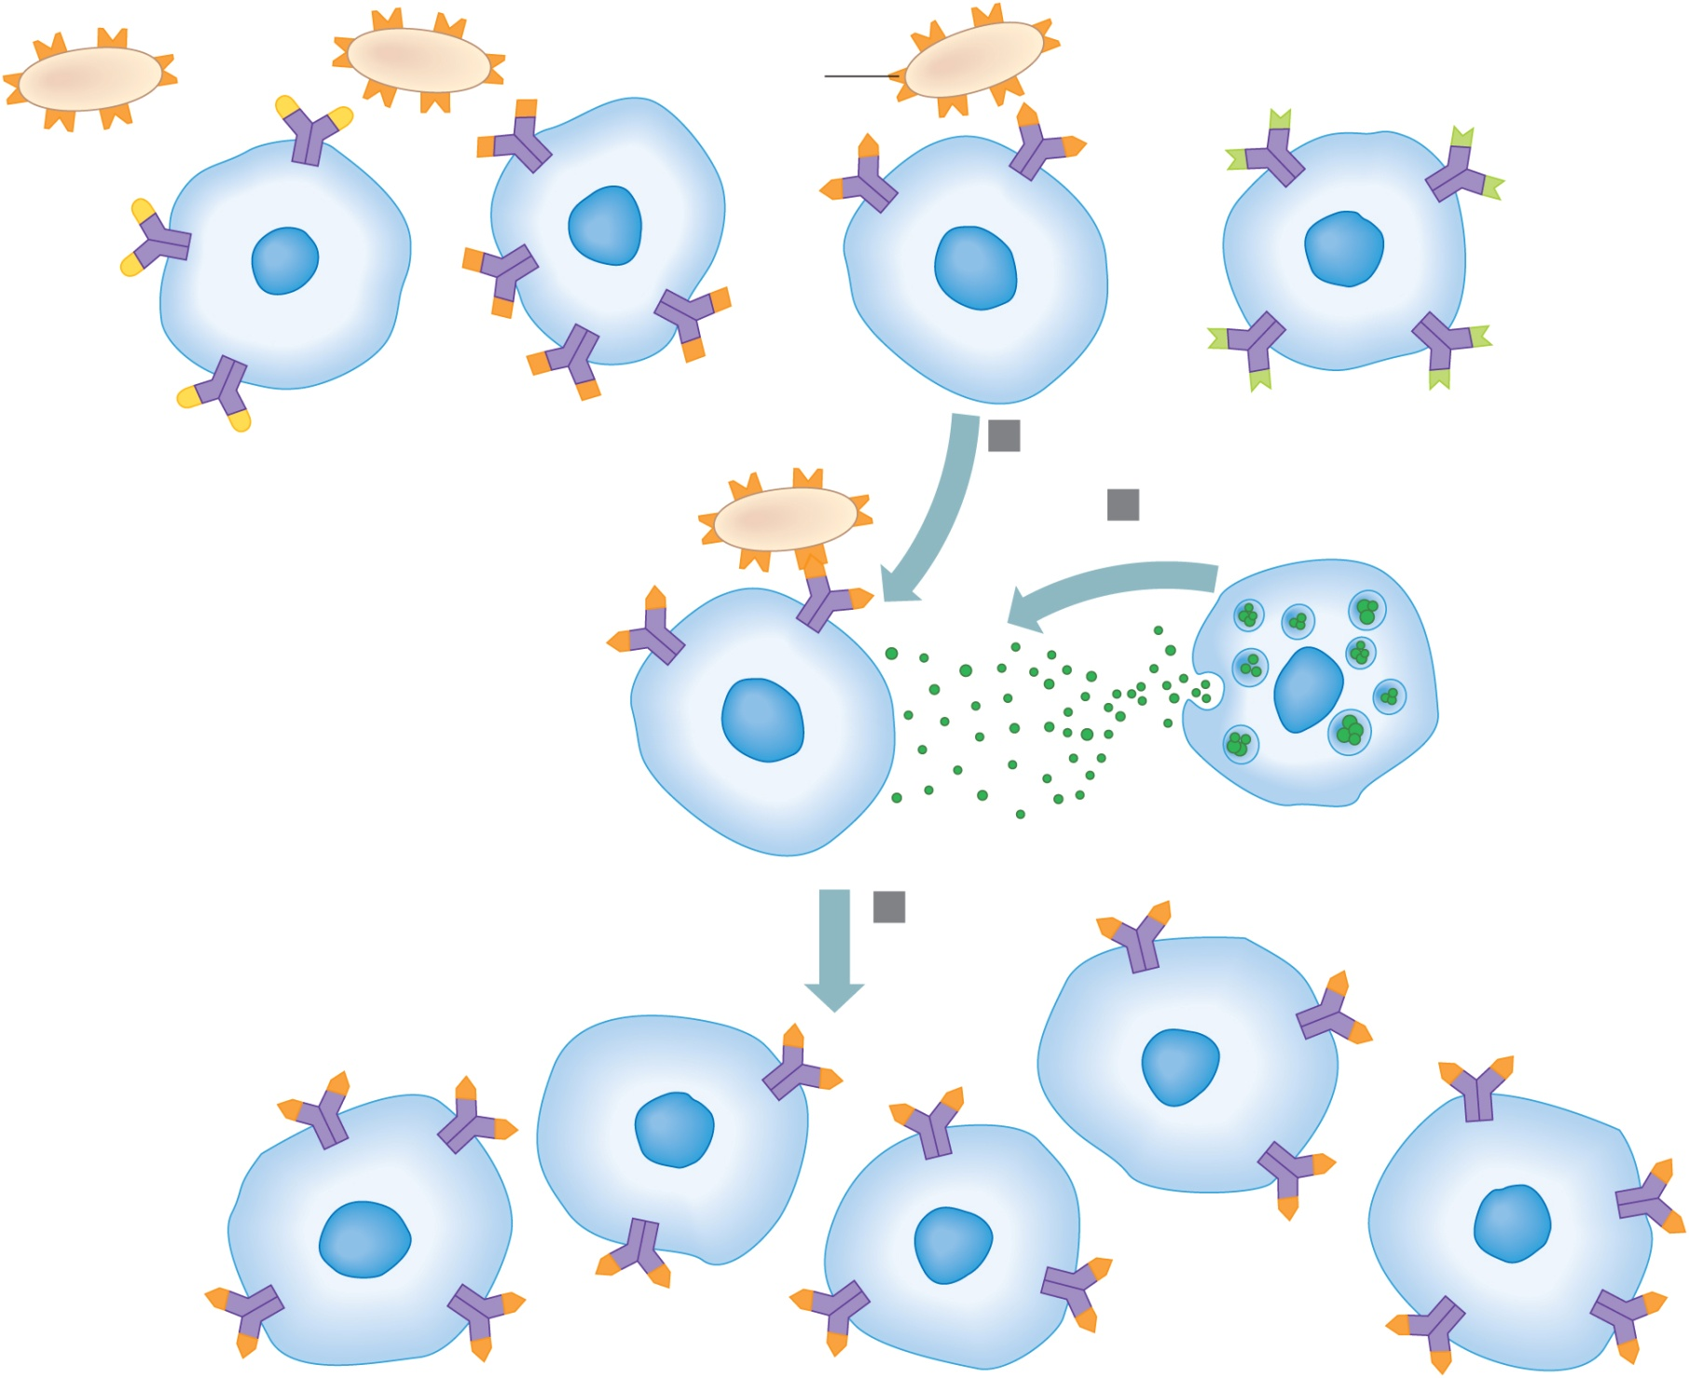
Copyright © The McGraw-Hill Companies, Inc. Permission required for reproduction or display.
Antigen
Antigen
receptor
B cells
1
Activation
2
Stimulation by
activated helper T cell
Activated B cell
Cytokines
3
Proliferation
Clone of
B cells
30

Slide 31
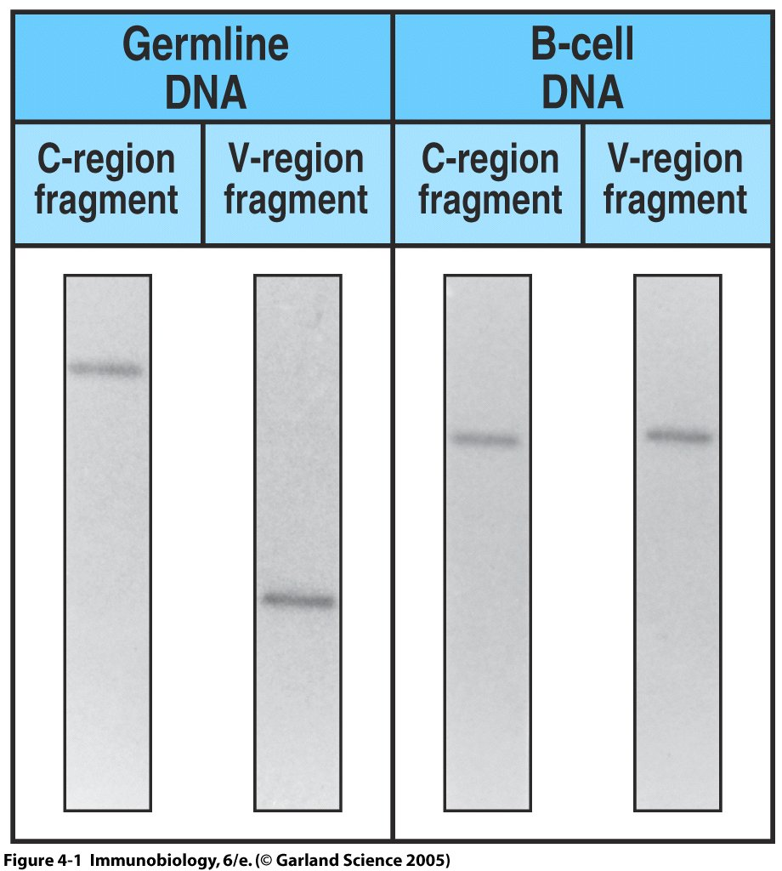
Figure 4-1

Slide 32
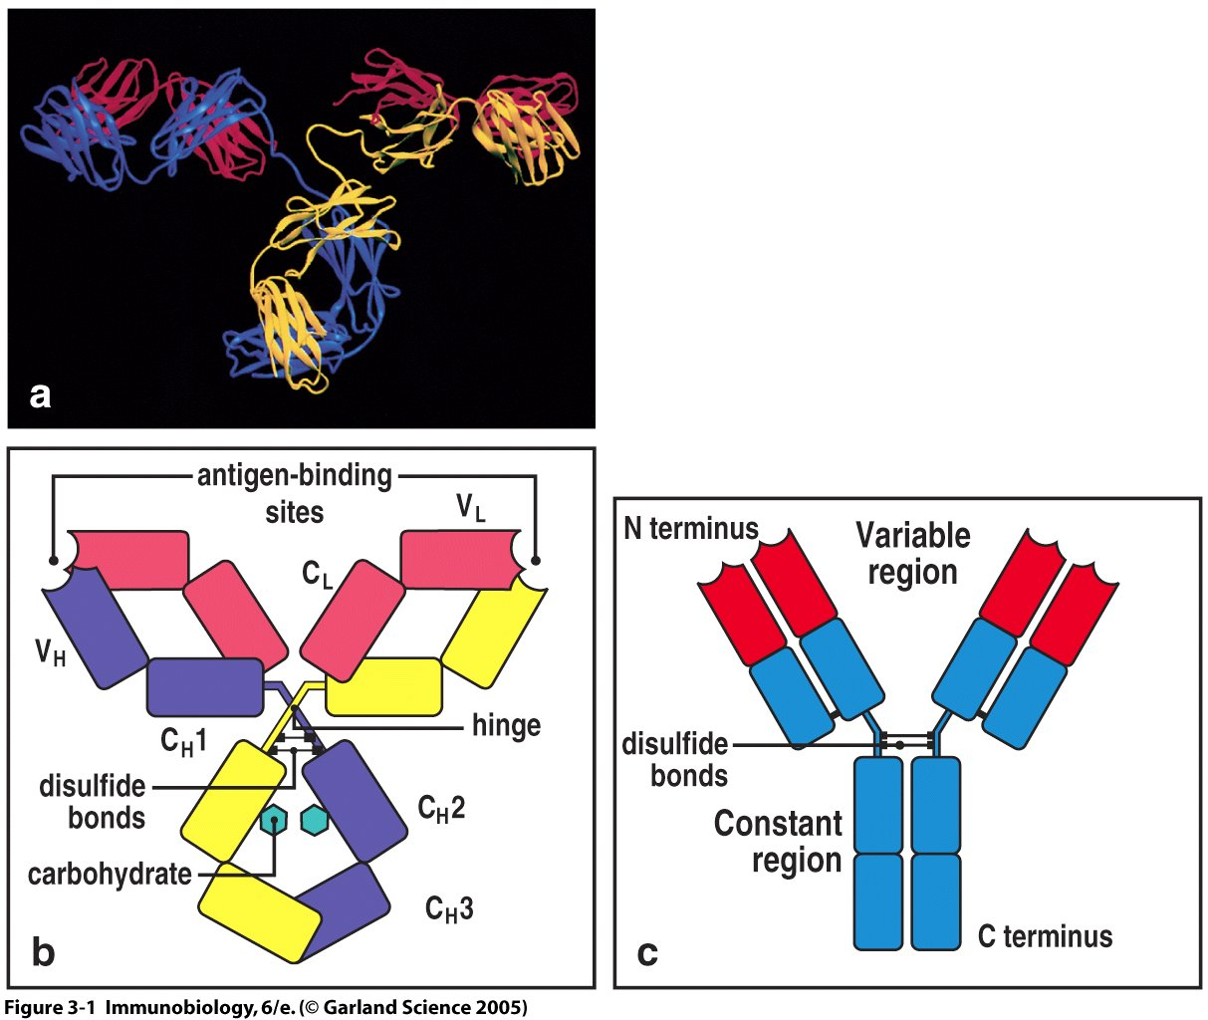

Slide 33
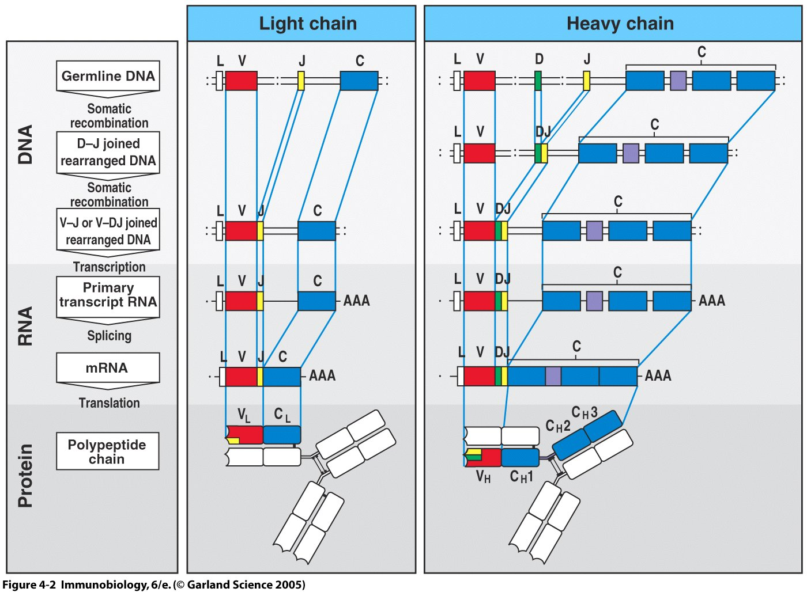

Slide 34
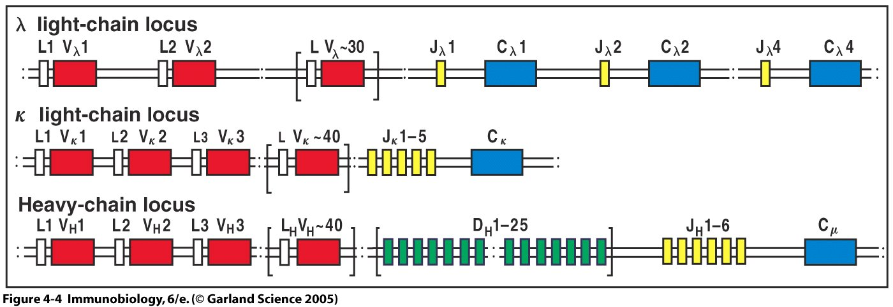
Figure 4-4

Slide 35
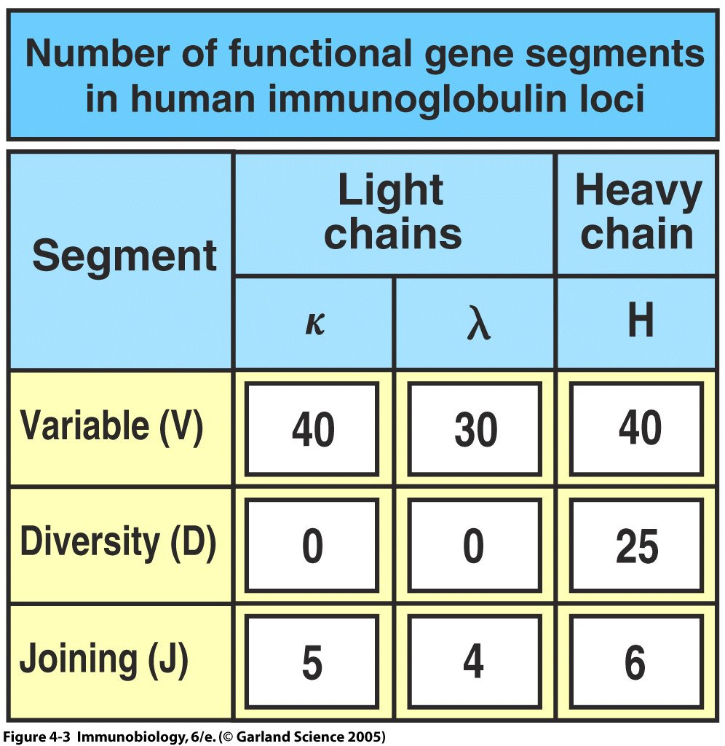
Figure 4-3

Slide 36
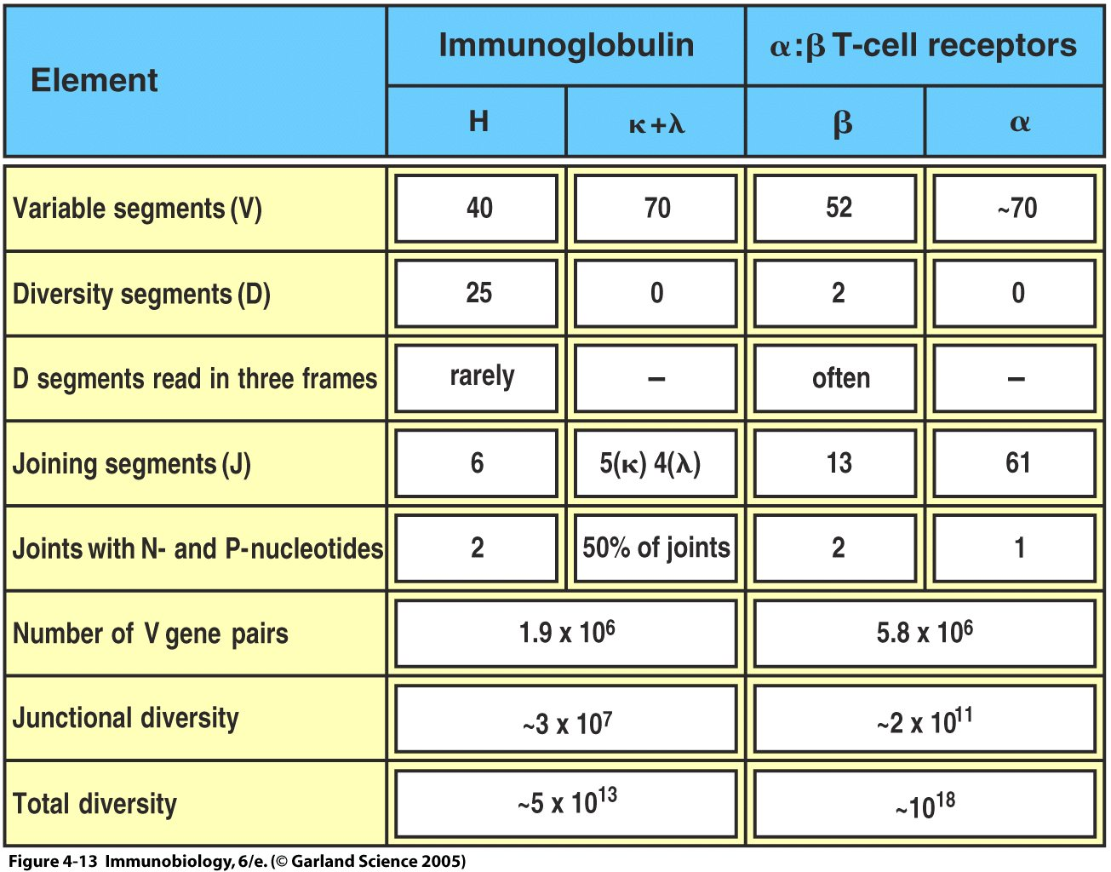
Figure 4-13

Slide 37
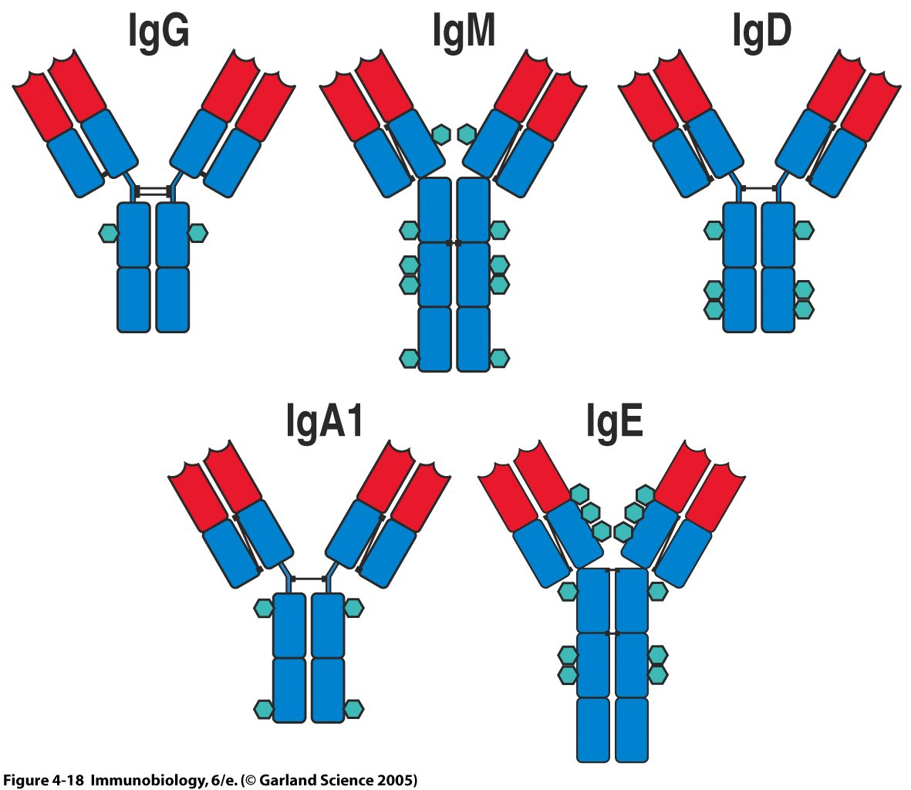
Figure 4-18

Slide 38
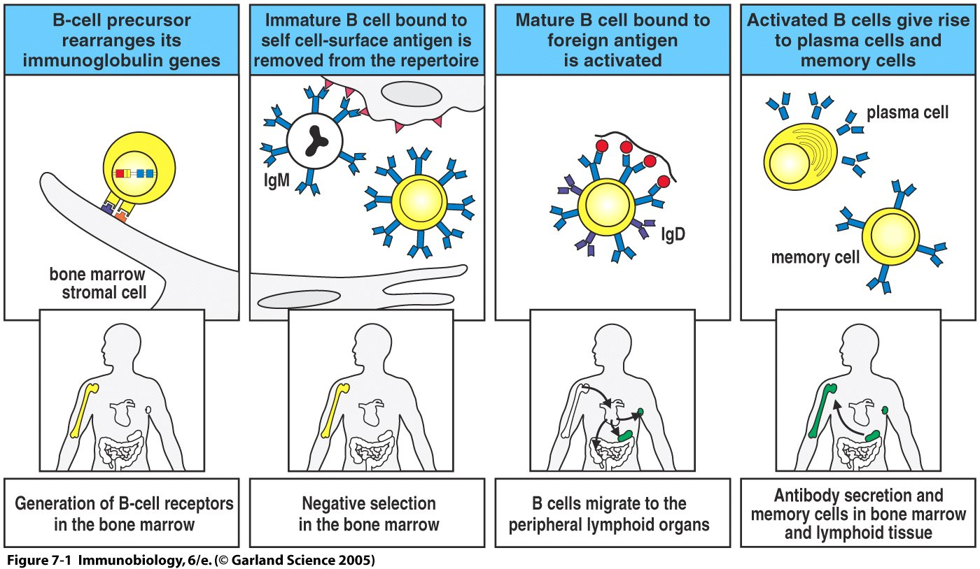
Figure 7-1

Slide 39
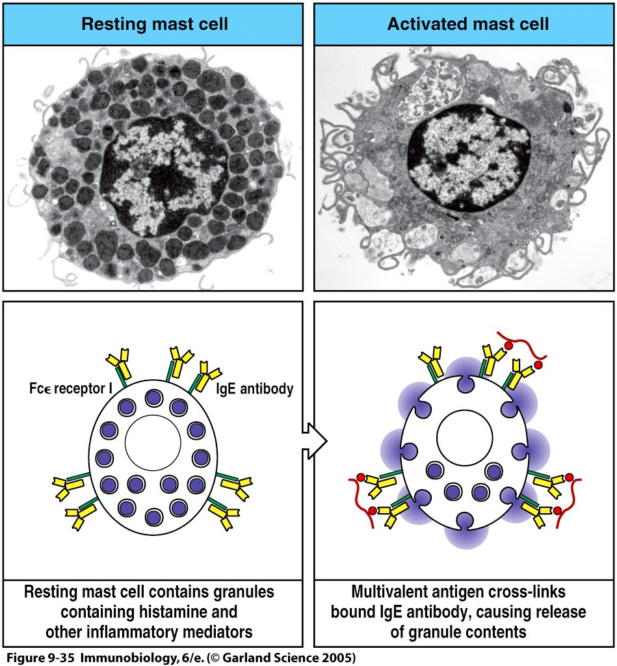
Figure 9-35

Slide 40
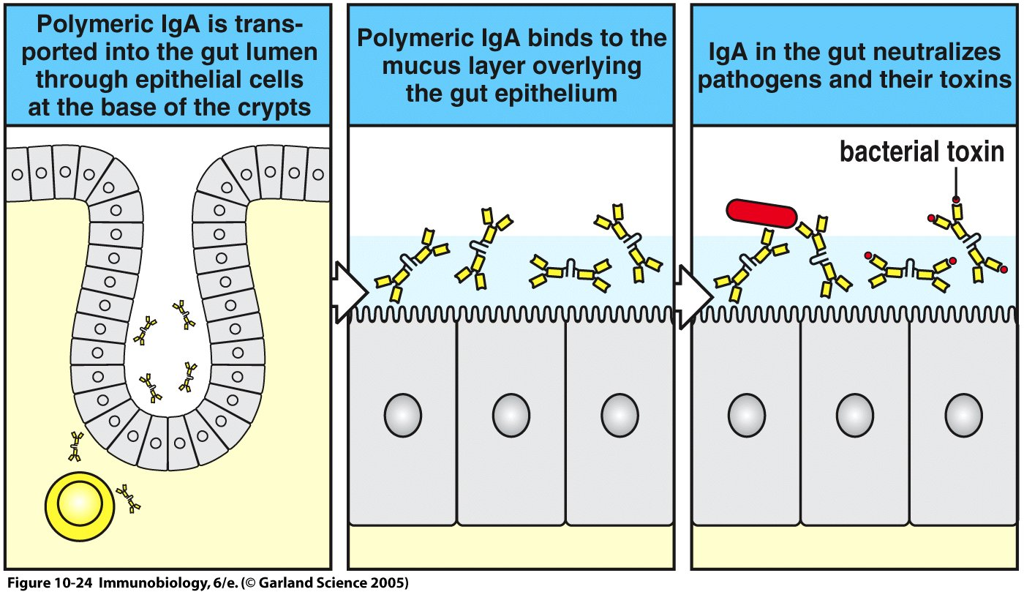
Figure 10-24

Slide 41
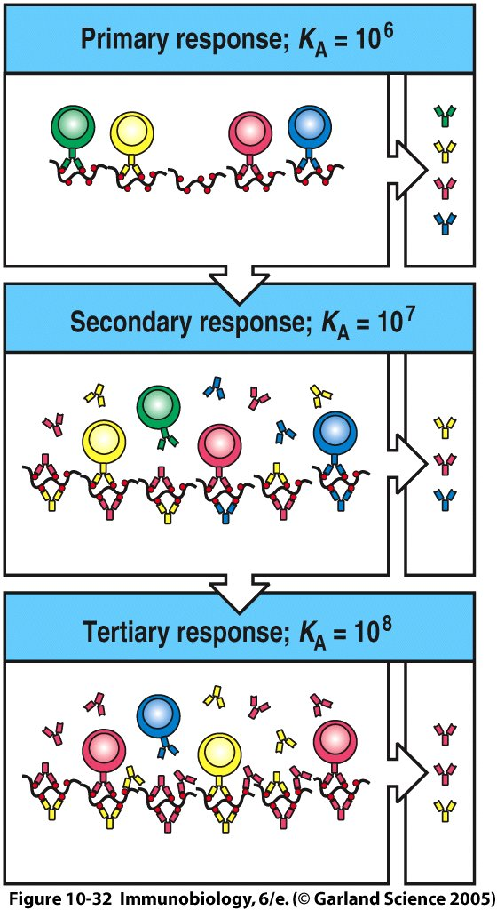
B cell Memory Quality is enhanced by affinity maturation
Antigen-specific B cells can mature in a cellular structure called the “germinal center”, where they are given stimulation by CD4 T cells and antigen, leading to new mutations in the CDR regions of the genomic DNA encoding the antibody
Cells that increase affinity for antigen survive and continue rearrangements
Cells that lose affinity either rearrange to higher affinity or die
During this period, antibody is not secreted

Slide 42
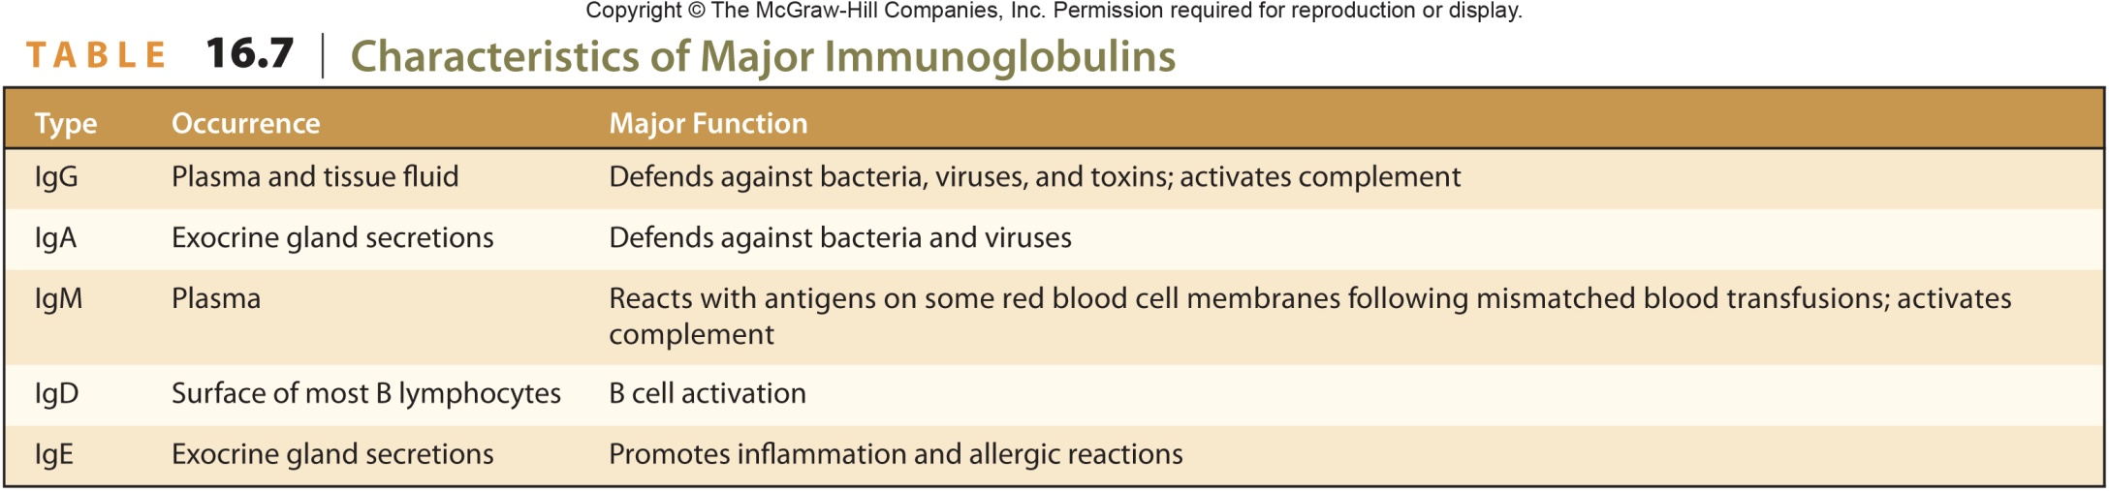
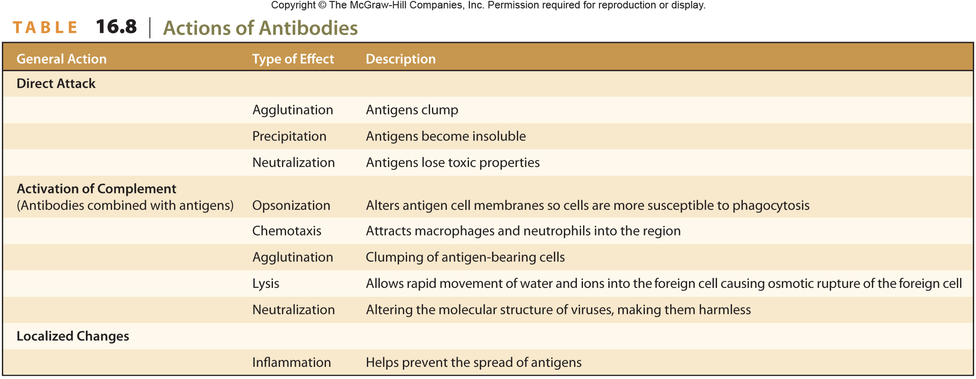
42

Slide 43
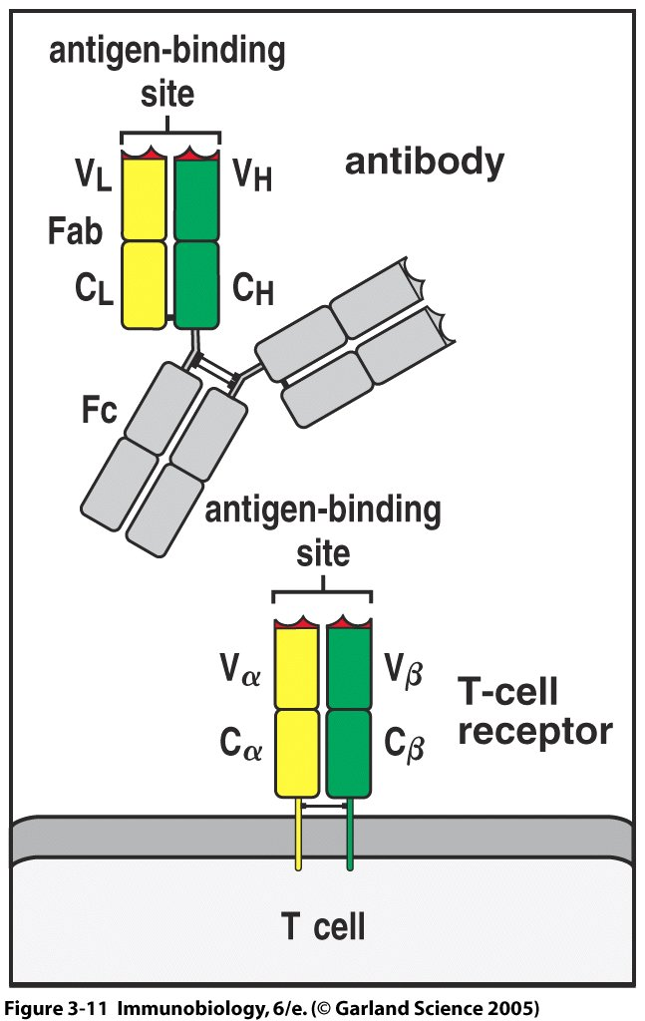
T-cell mediated recognition
The T-cell receptor is very similar in structure to an antibody, with a highly variable antigen-binding site formed by V(D)J recomination
However, it is solely membrane bound and is restricted in the types of antigens it recognizes

Slide 44
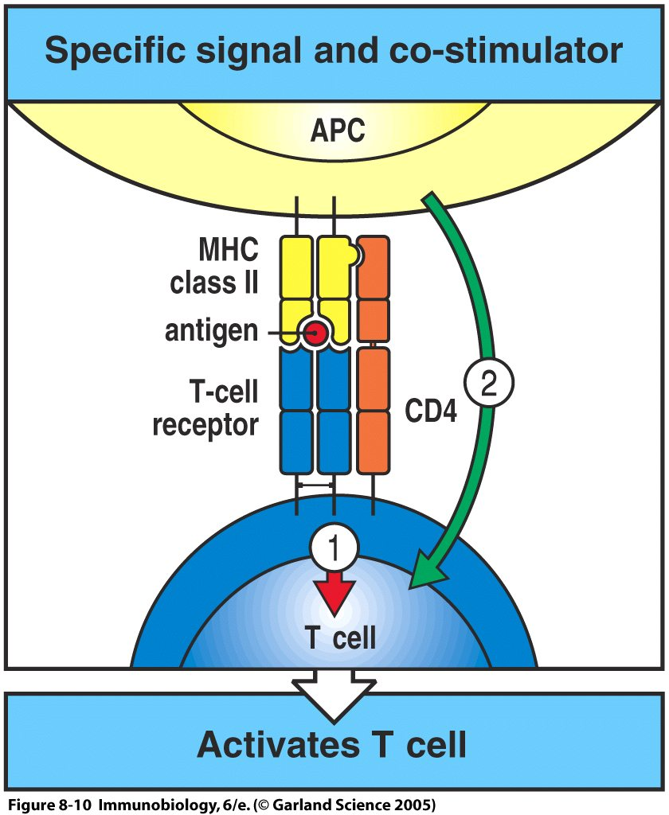
T cells Are activated by Specific Antigen and Co-stimulation (Non-specific, Downstream of Innate activation)

Slide 45
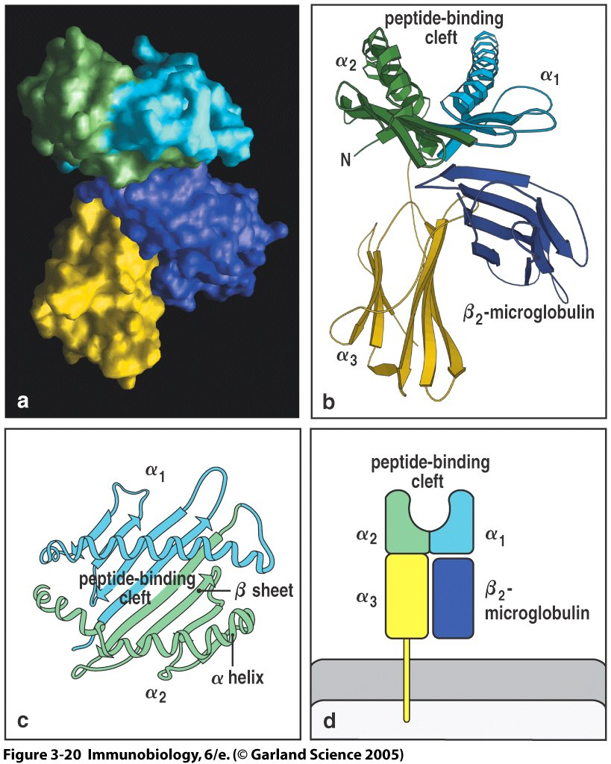
MHC molecules are compartments for holding peptide antigen
MHC molecules are cell surface receptors that contain a peptide-binding cleft
Small protein pieces (8-20 aa long, depending on the MHC molecule)
First identified as transplant compatibility antigens (more on this later)

Slide 46
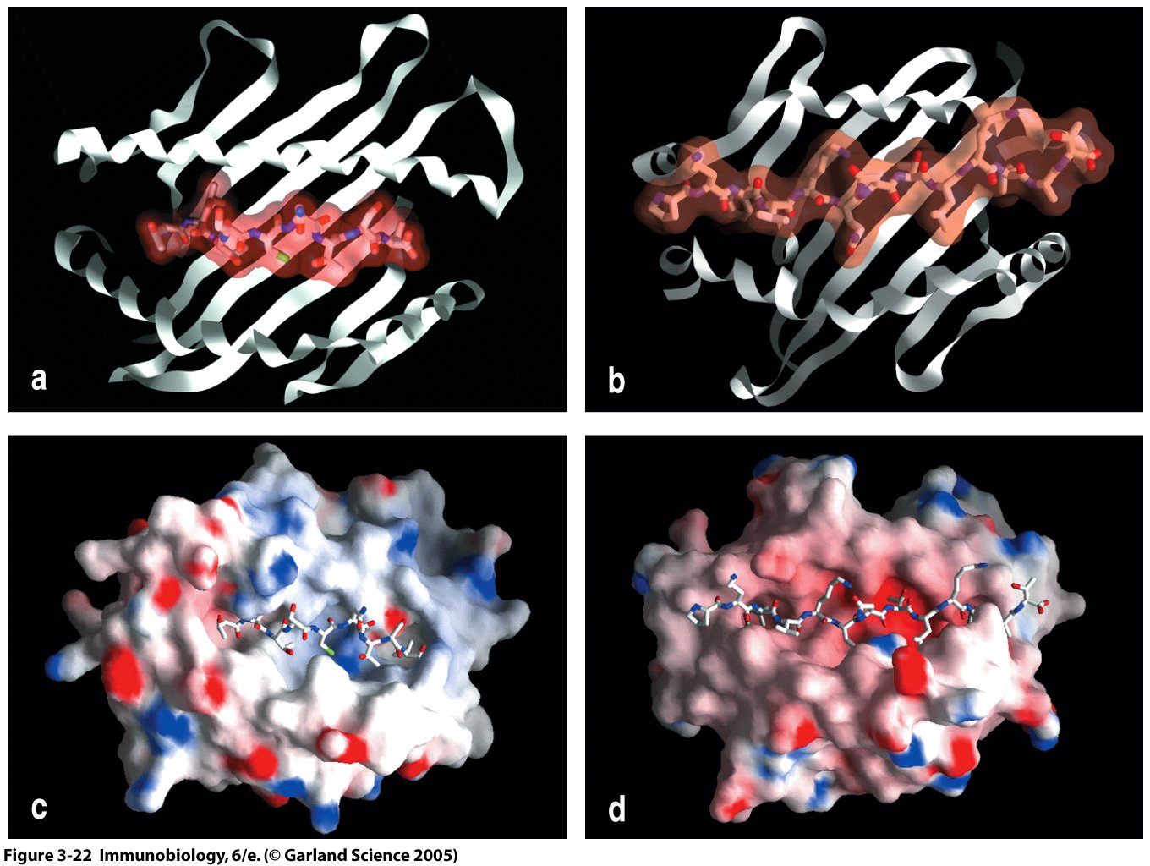
Figure 3-22

Slide 47
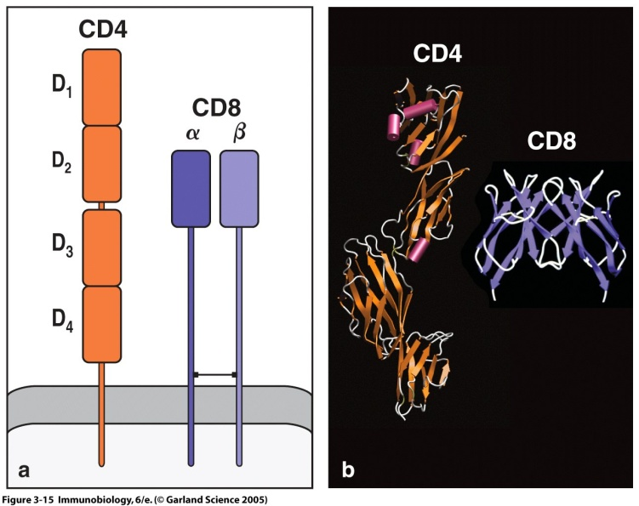
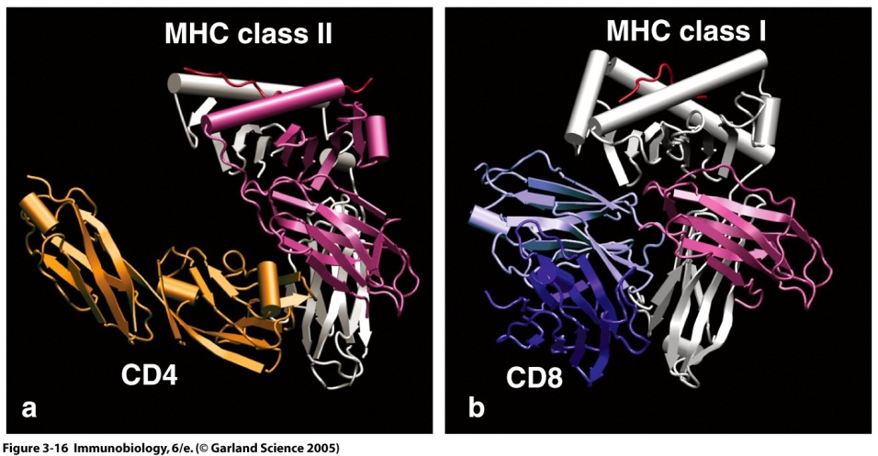
T cell Lineages Determine MHC Restriction
CD4 and CD8 molecules both expressed during development—whether a T cell becomes CD4 or CD8 positive in maturity is dependent on the “restriction” of its TCR—whether it preferentially interacts with Major Histocompatibility Complex I (MHCI) or MHCII molecules

Slide 48
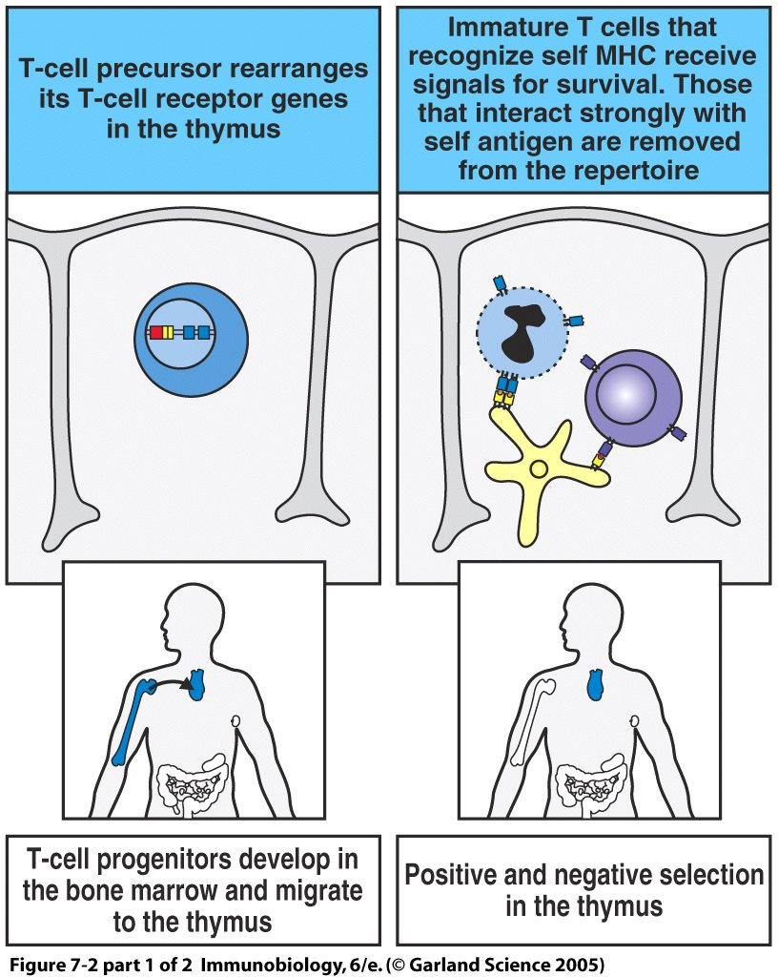
Thymus Selection Restricts MHC recognition and removes autoreactive cells

Slide 49
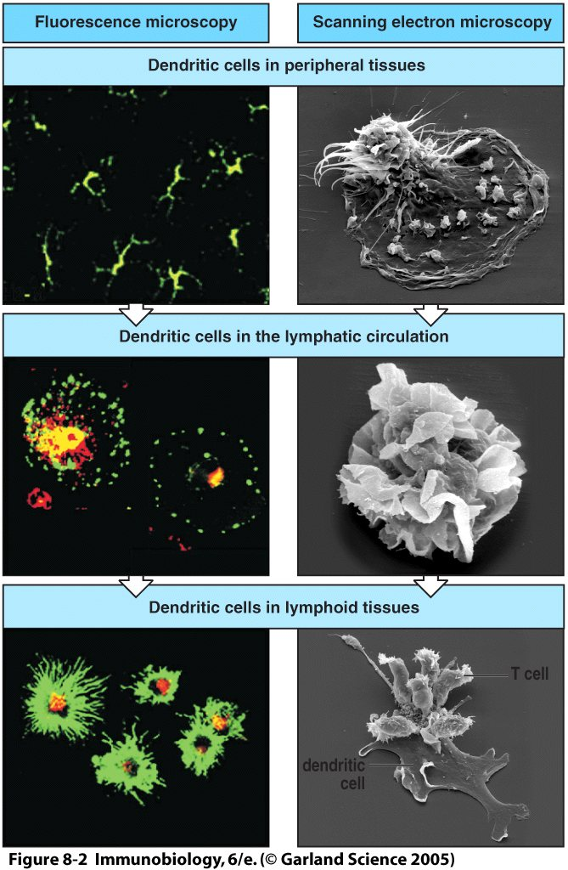
Dendritic Cells are the most efficient Antigen-Presenting Cells and are generally required for the initiation of Adaptive Immunity

Slide 50
T cells Are activated by Specific Antigen and Co-stimulation (Non-specific, Downstream of Innate activation)

Slide 51
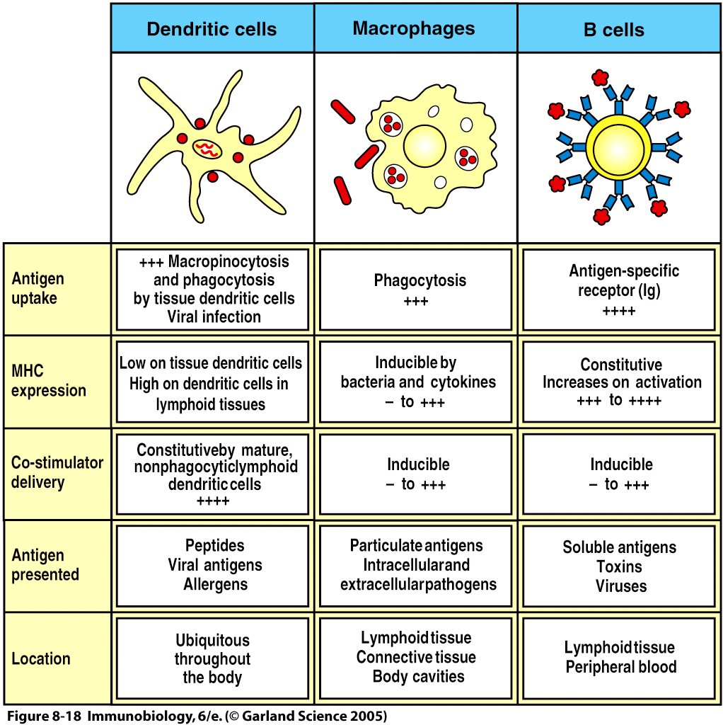
Figure 8-18

Slide 52
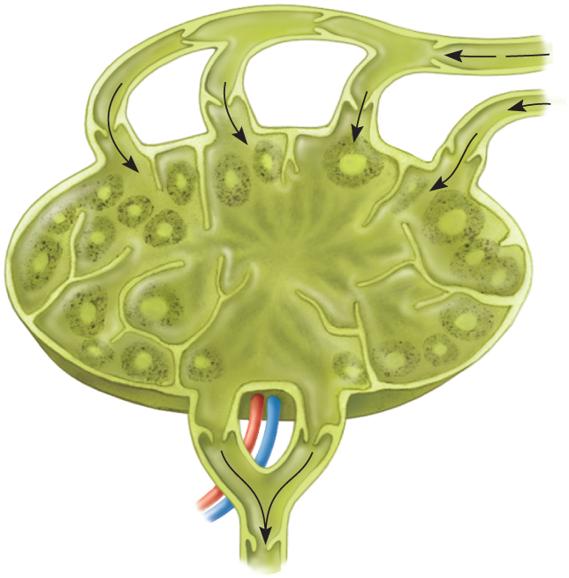
Structure of a Lymph Node
Copyright © The McGraw-Hill Companies, Inc. Permission required for reproduction or display.
Afferent
lymphatic
vessel
Subcapsule
(macrophages, B cells)
Lymph flow
Medulla
(macrophages, T cells)
Germinal
center
(B cells)
Sinus
Capsule
Nodule
Hilum
Artery
Lymph flow
Vein
Efferent
lymphatic
vessel
(a)

Slide 53
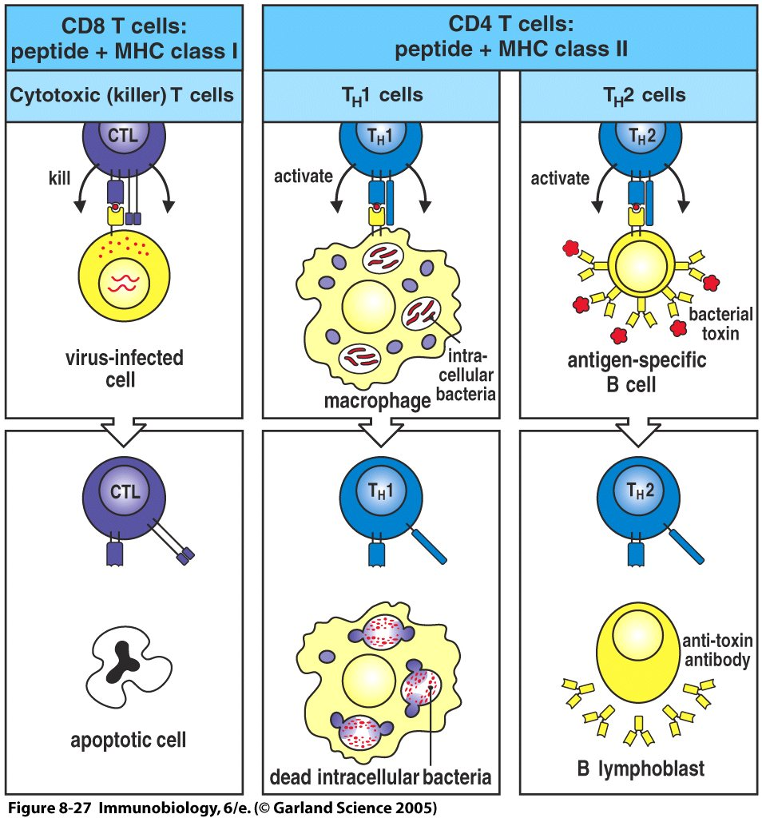
Figure 8-27

Slide 54
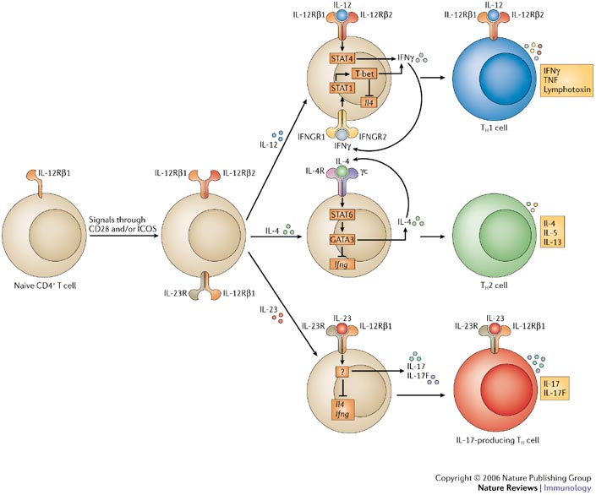
CD4 Cells Can Differentiate into multiple Types of “Helpers”

Slide 55

Activated Cells are now Licensed to Seek out Targets and Kill them For CD8 T cells, Numbers are Critical

Slide 56

Figure 8-31

Slide 57

Specific Clearance Mechanisms For Pathogen Classes (keep in mind redundancy)

Slide 58
Last question?
When do I shut off?
Regulation by specialized cells via direct contact and secreted cytokines
Inhibition loops within cells along cytokine cascades
Multiple mechanisms with diverse consequences
Autoimmunity
Asthma and allergy

Slide 59


Slide 60


Slide 61

Thanks for the Memories…

Slide 62

Memory
After contraction, memory CD8 numbers are maintained (active process) while CD4 cells slowly decline
Higher precursor numbers are a key feature of memory
Memory cells more rapidly acquire effector function and have lower thresholds of activation

Slide 64
Evolutionary Development of Immunity
Viruses (~0.2 microns)
Bacteria (1-2 microns)
Parasites (Millimeters)

