Slide 1
Viral Infections
Unit 3
Paul Thomas
Paul.Thomas@stjude.org
Department of Immunology
St. Jude Children’s Research Hospital

Slide 2
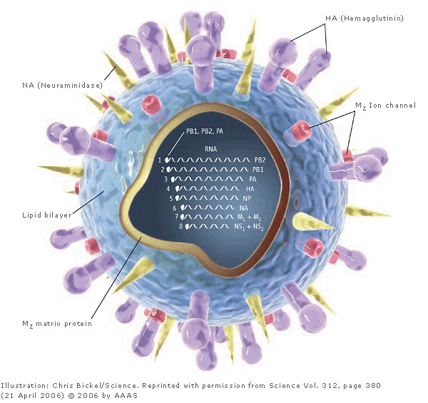
Influenza A Virus
Negative sense, segmented RNA virus
Orthomyxoviridae
Eight genes, 11 proteins (three alternate reading frames)
Two non-structural proteins (NS1 and PB1-F2)
Surface proteins HA and NA determine serotype
(HA) Hemagglutinin
NA (Neuraminidase)
Modified from: Kaiser. Science 2006, 312:380-382.

Slide 3

Influenza A HA and NA Subtypes
H1
H2
H3
H4
H5
H6
H7
H8
H9
H10
H11
H12
H13
H14
H15
H16
N1
N2
N3
N4
N5
N6
N7
N8
N9
Other Animals
Other Animals
Other Animals
Other Animals
Other Animals
Other Animals
3
Notes:
3
This figure illustrates the range of species that Influenza A sub-type viruses can infect. Some species that specific HA subtype viruses have infected are listed on the left, and some species that specific N1 subtype viruses have infected are listed on the right.
The currently circulating strain is a novel H1N1 strain.

Slide 4
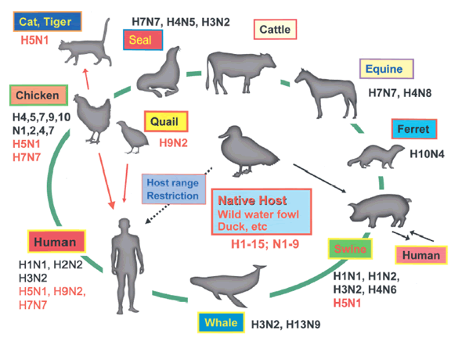
Diverse Host tropism allows restriction and recombination

Slide 5
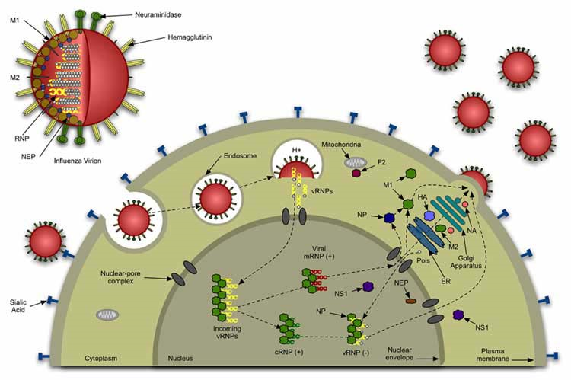
Influenza Life cycle

Slide 6
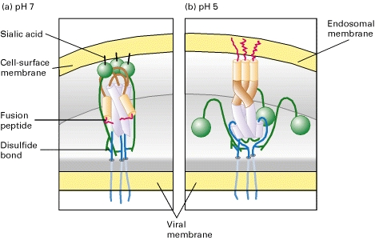
HA is required for Cell Entry
HA binding to sialic acid on the surface of cells mediates initial attachment
Virus is endocytosed, where the endosome is acidified
This triggers a conformational change in the virus, resulting in membrane fusion
For HA to be active, it needs to be cleaved by a protease into two pieces—this protease is generally restricted to the respiratory epithelium

Slide 7
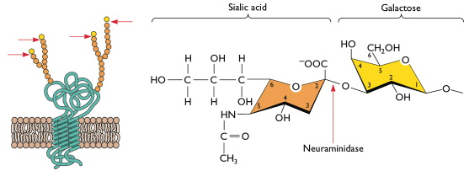
Neuraminidase acts to cleave the sialic acid receptors from the cell surface
IAV must balance the binding and entry activity of HA with the sialic acid cleavage activity of NA so that virus efficiently enters and buds from the cell surface—thus HA and NA are often “matched” for activity

Slide 8
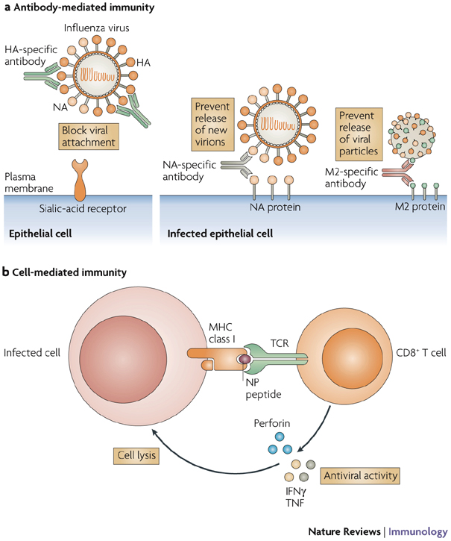
Immune Mechanisms of Protection
Antibody mediated immunity exerts the most pressure on the virus, leading to seasonal antigenic drift and pandemic strains of antigenic shift
Internal proteins are relatively conserved allowing heterologous cellular protection
Mutation of dominant CD8 epitopes over time suggests that CTLs provide immunological pressure

Slide 9
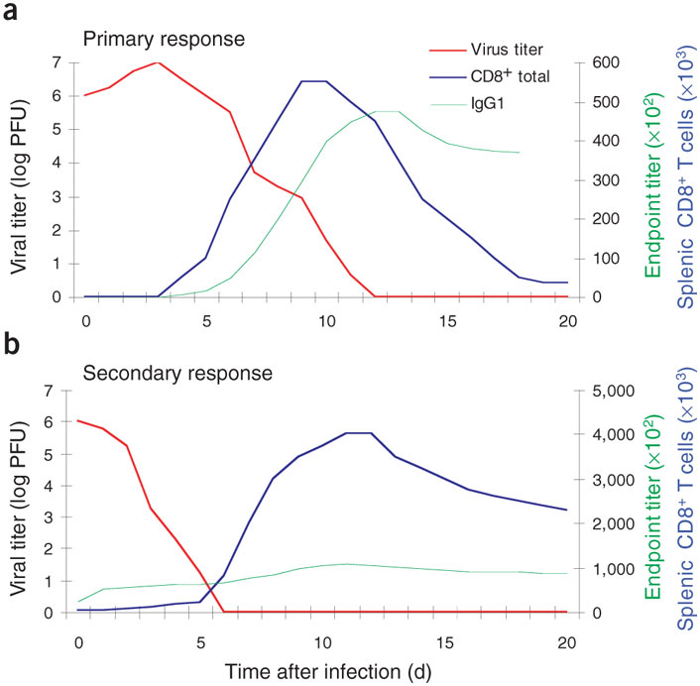
Immune Course of influenza infection
Influenza is initially controlled by antibody and CD8+ T cells
Secondary infection with heterologous virus is cleared with CD8+ T cell activity much more rapidly
Homologous infection can be prevented by antibody (sterilizing immunity)

Slide 10
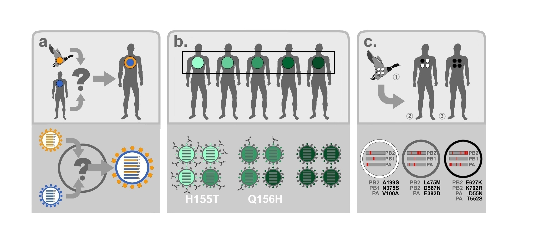
Influenza evolution

Slide 11
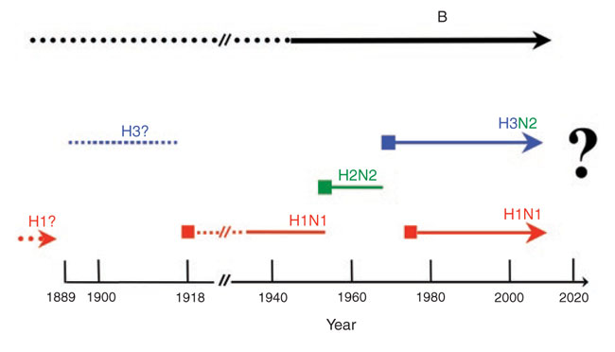
Human influenza pandemics

Slide 12
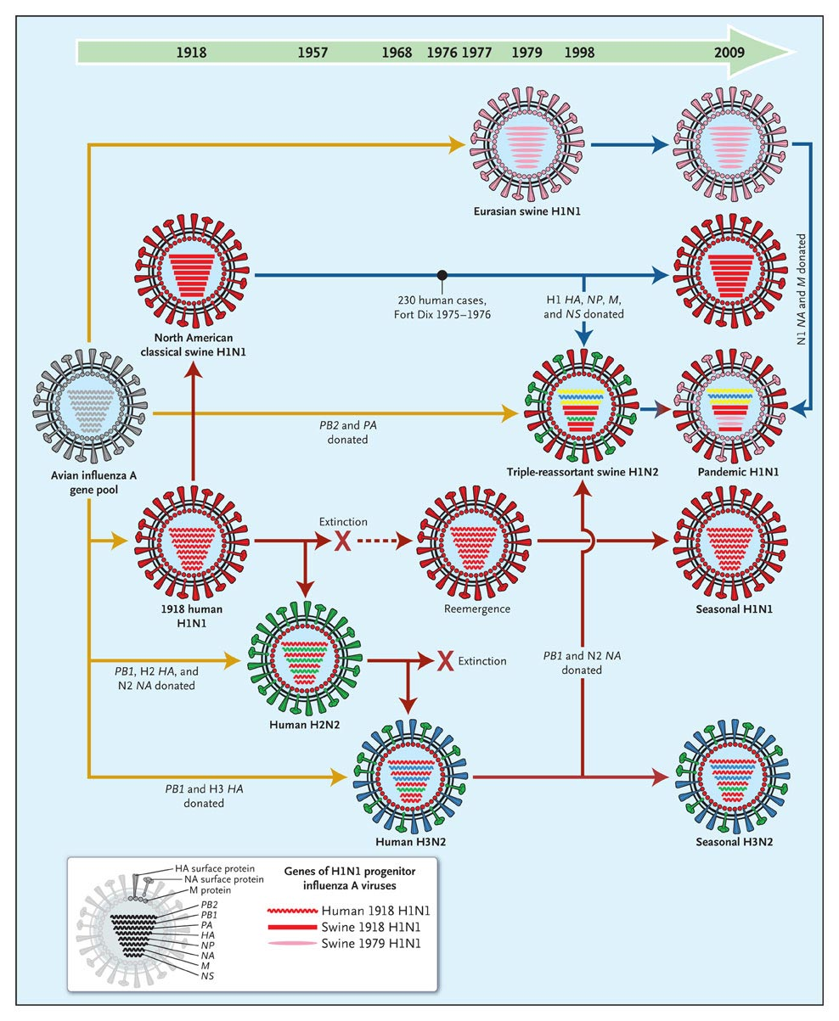
Evolution of Human Influenza from 1918
All current human influenza is majority-derived from the 1918 pandemic
Distinct reservoirs have allowed evolution to occur with varying pressures, providing diverse sources for new gene introductions into the human pool

Slide 13
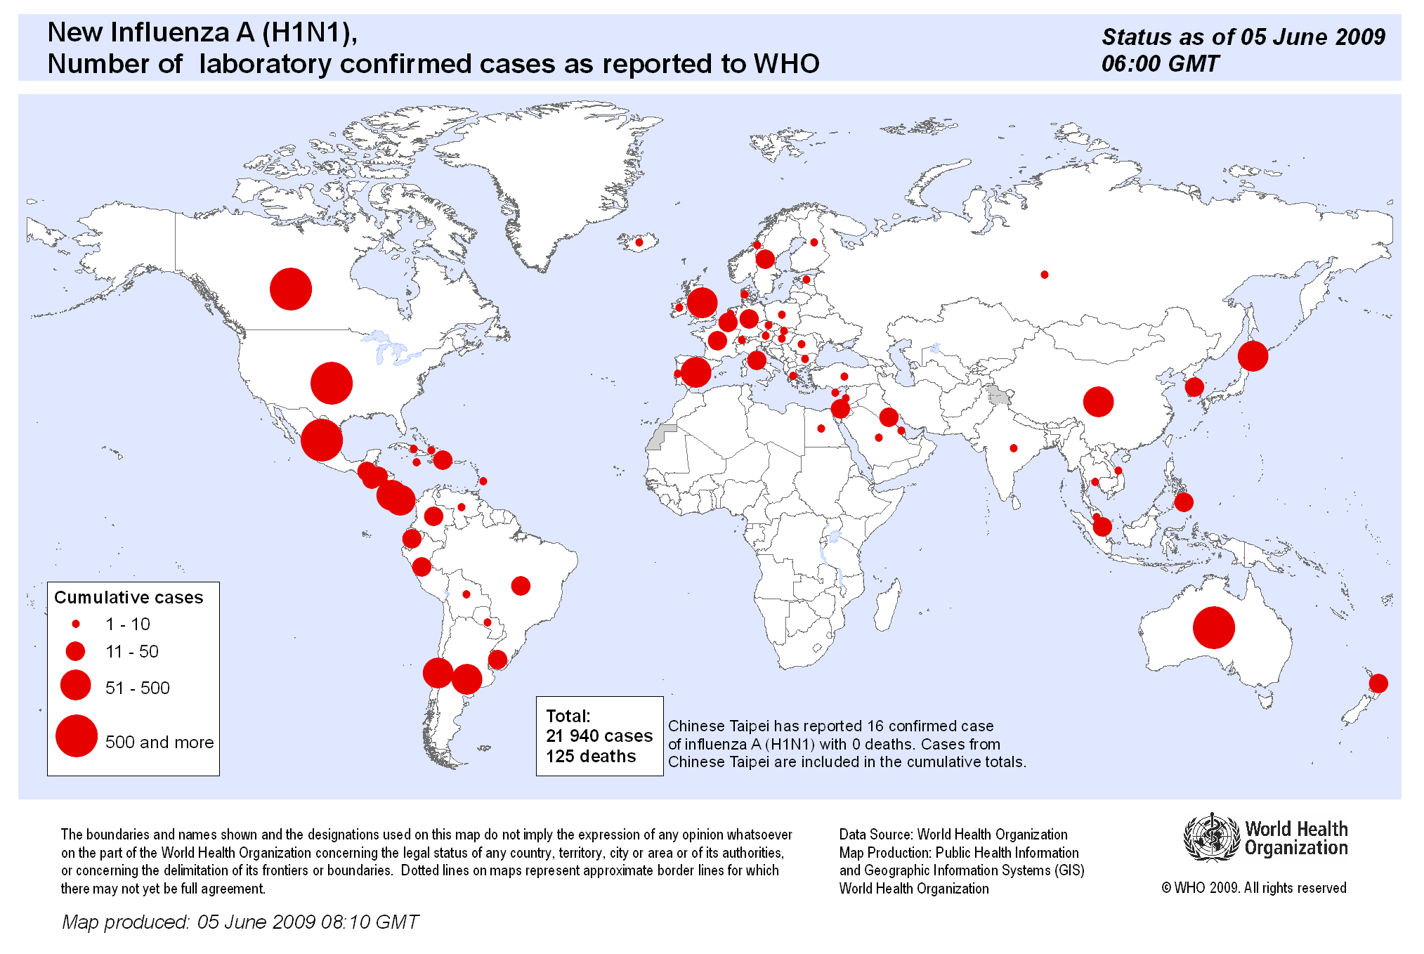
Swine-Origin H1n1 Incidence

Slide 14
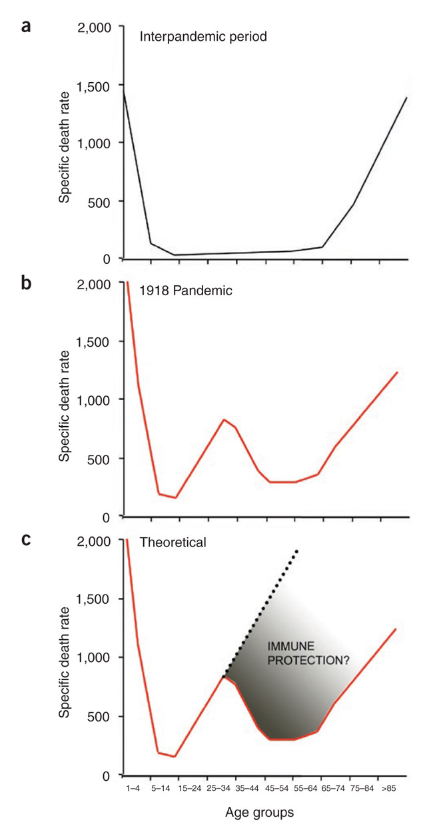
1918 (and possibly SwOrH1n1) mortality curves suggest previous exposure
The “U” shaped curve of regular influenza infection demonstrates the highest mortality among children (naïve) and the elderly (immunocomprimised)
The 1918 pandemic had a “W” shaped curve, with a spike in deaths among young adults—immunopathology or prior protection for ~40 year olds?

Slide 15

Predictions of the 2009/H1N1 pandemic
The 2009 H1N1 pandemic emerged as a particularly novel threat: an antigenic shift event between two swine viruses, without the “human” virus component expected to be required
The initial rapid spread bred fears of an equally high incidence of severe morbidity and mortality (~90,000 deaths in the US, ~1.8 million hospitalizations)

Slide 16
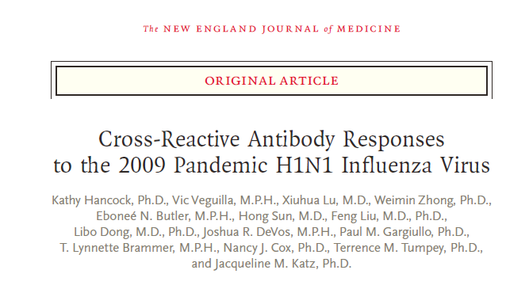
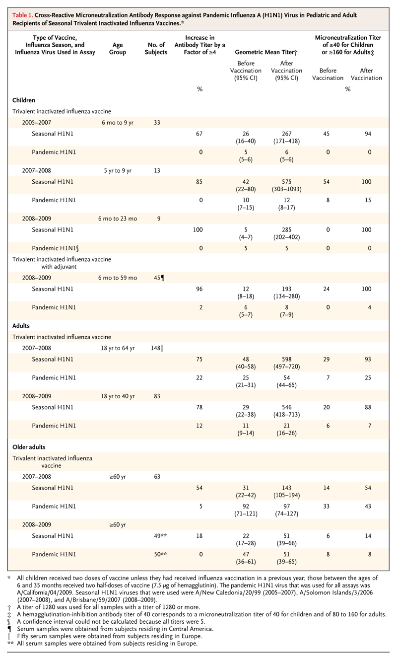
Pre-Exisitng Cross-reactive Immunity to 2009/H1n1

Slide 17
Table Continued

Slide 18
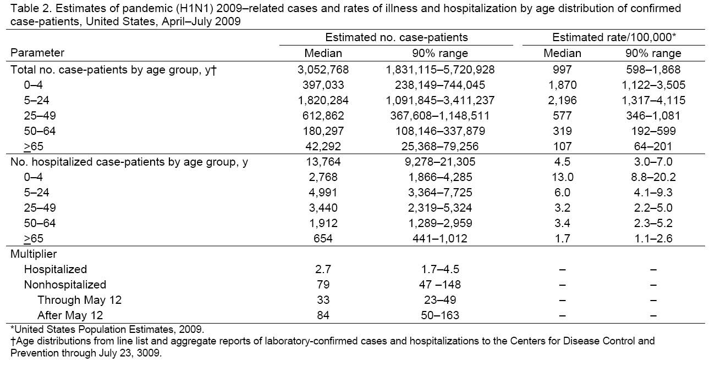
early pandemic H1N1: April – July 2009
Reed C, Angulo FJ, Swerdlow DL, Lipsitch M, Meltzer MI, Jernigan D, et al. Estimates of the prevalence of pandemic (H1N1) 2009, United States, April–July 2009. Emerg Infect Dis. 15 (12): 2004-7.

Slide 19
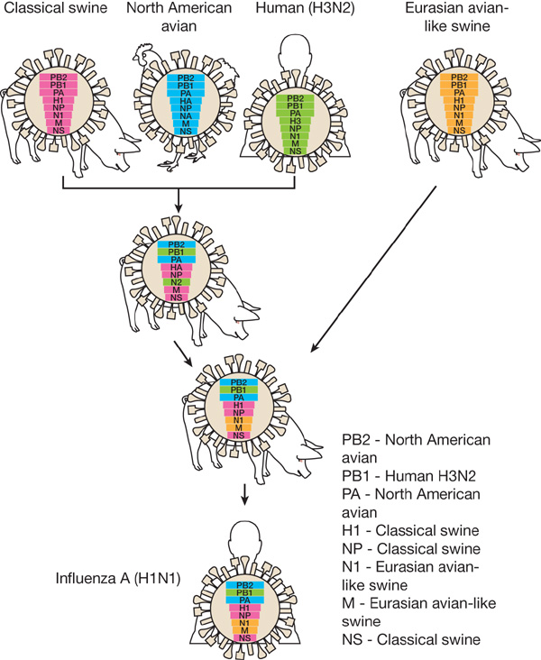
2009 Pandemic H1N1
2009/H1N1 resulted from the recombination of two viruses (American and Eurasian Swine)
The American Swine virus was itself a recombinant of three viruses that established itself in 1998
These viruses are genetically distant from the human seasonal H1N1 (reference strain A/Brisbane/59/07)
A/SW/Italy/13901-2/95
A/SW/NC18161/02
A/CA/4/2009
A/TN/1-560/2009

Slide 20
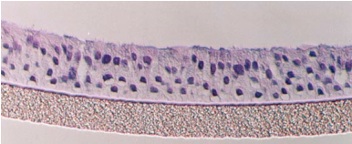
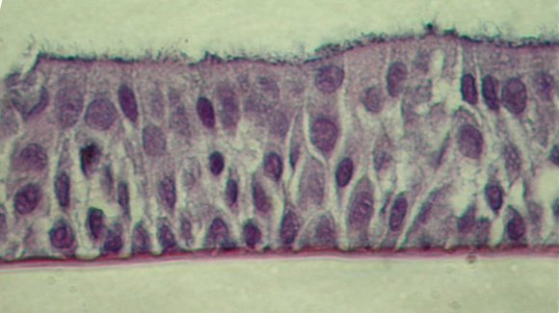
H1N1 Swine Flu studies: response in human cells
Measures:
Infectivity and growth of virus (TCID₅₀, immunofluorescence)
Secretion of inflammatory mediators from apical and basolateral surfaces (multiplexed immunoassay)
Transcriptional response over the first 24 hours (Exon arrays, fluidigm analysis)
Confirm results by “swapped viruses” made by reverse genetics
EpiAirwayTM, MatTek
P

Slide 21
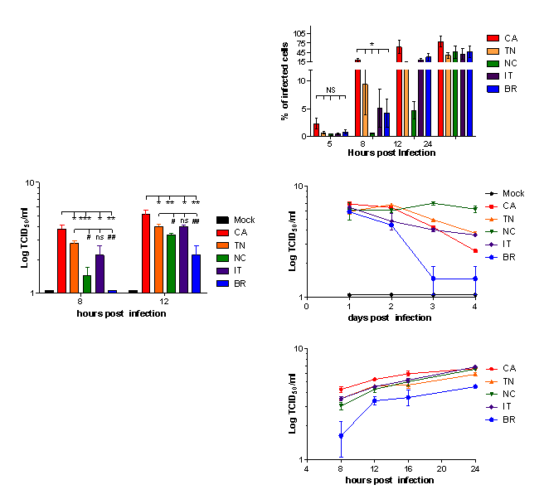
Viral growth kinetics in HAE cells
Human primary
Swine primary
Human primary
All continued shedding from healthy monolayers for >3 weeks
0.01 moi

Slide 22
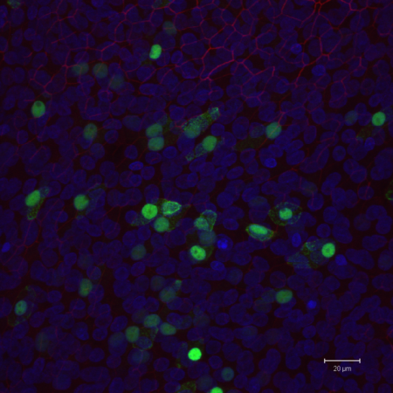
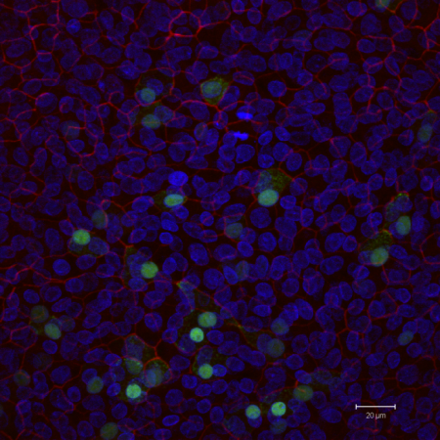
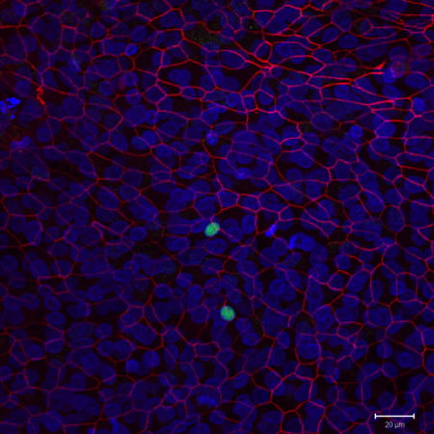
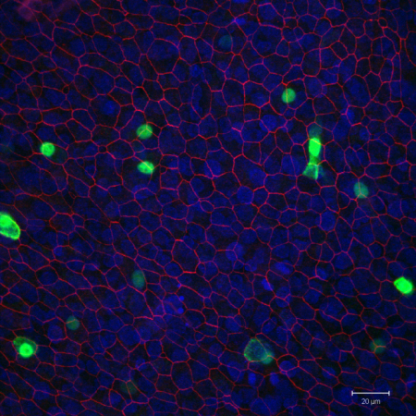
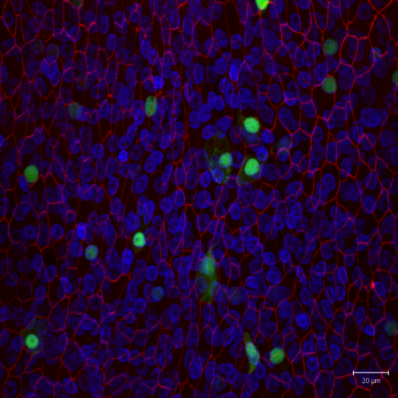
Influenza NP detection in 3D HAE cultures
viral growth kinetics in HAE cells
CA/04/2009
TN/1-560/2009
NC/2002
influenza NP
DAPI (nucleus)
ZO-1 (tight-junctions)
Italy/1995
Brisbane/2007
8 hr post infection- 0.01 moi

Slide 23
More rapid colonization of culture by Pandemic and Esw virus
By 12 hours, pandemic strains and Italy have infected ~50%-75% of the culture

Slide 24
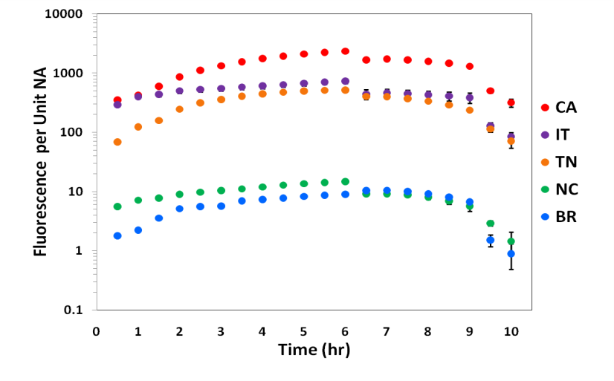
Higher NA activity in Pandemic and ESw
NA activity measured as ability to convert sialic acid containing substrate
Results normalized to functional viral titer, so NA activity/infectious virion
Higher NA activity may relate to ability of virus to spread efficiently

Slide 25
GROWTH SUMMARY
The pandemic virus acquired a rapid growth phenotype in human cells similar to the Esw virus
This phenotype associates with both the NA and M of Esw virus
The Esw virus transmits more efficiently in ferrets
Titer and infected cell number can be de-coupled across infections/individuals

Slide 26
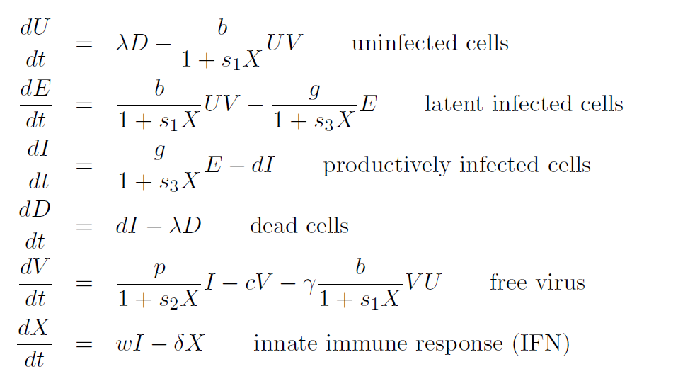
ODE model of influenza infection—Andreas Handel, UGA
Why wasn’t the Esw virus a pandemic?

Slide 27
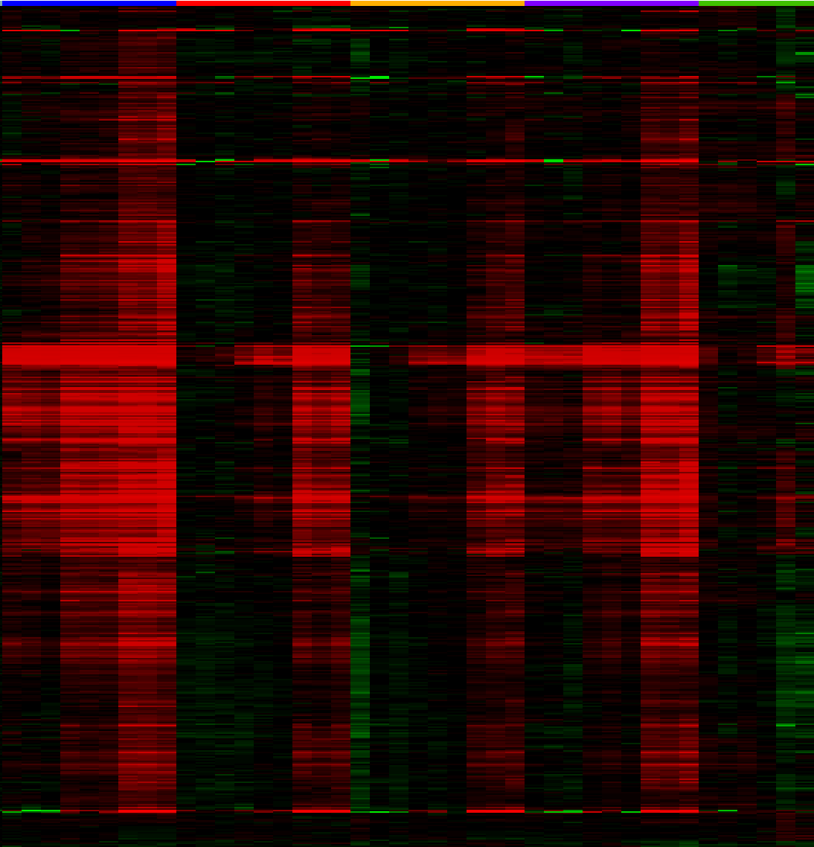
Transcriptome analysis of pandemic virus infected HAE cultures
mRNA expression in hAE cultures infected at MOI=0.01
North Carolina
Brisbane
California
Tennessee
Italy
BIC applied to k-means clustering:
2 clusters
271 upregulated in all
24 downregulated or differential
Time (hours p.i.)
12 16 24

Slide 28
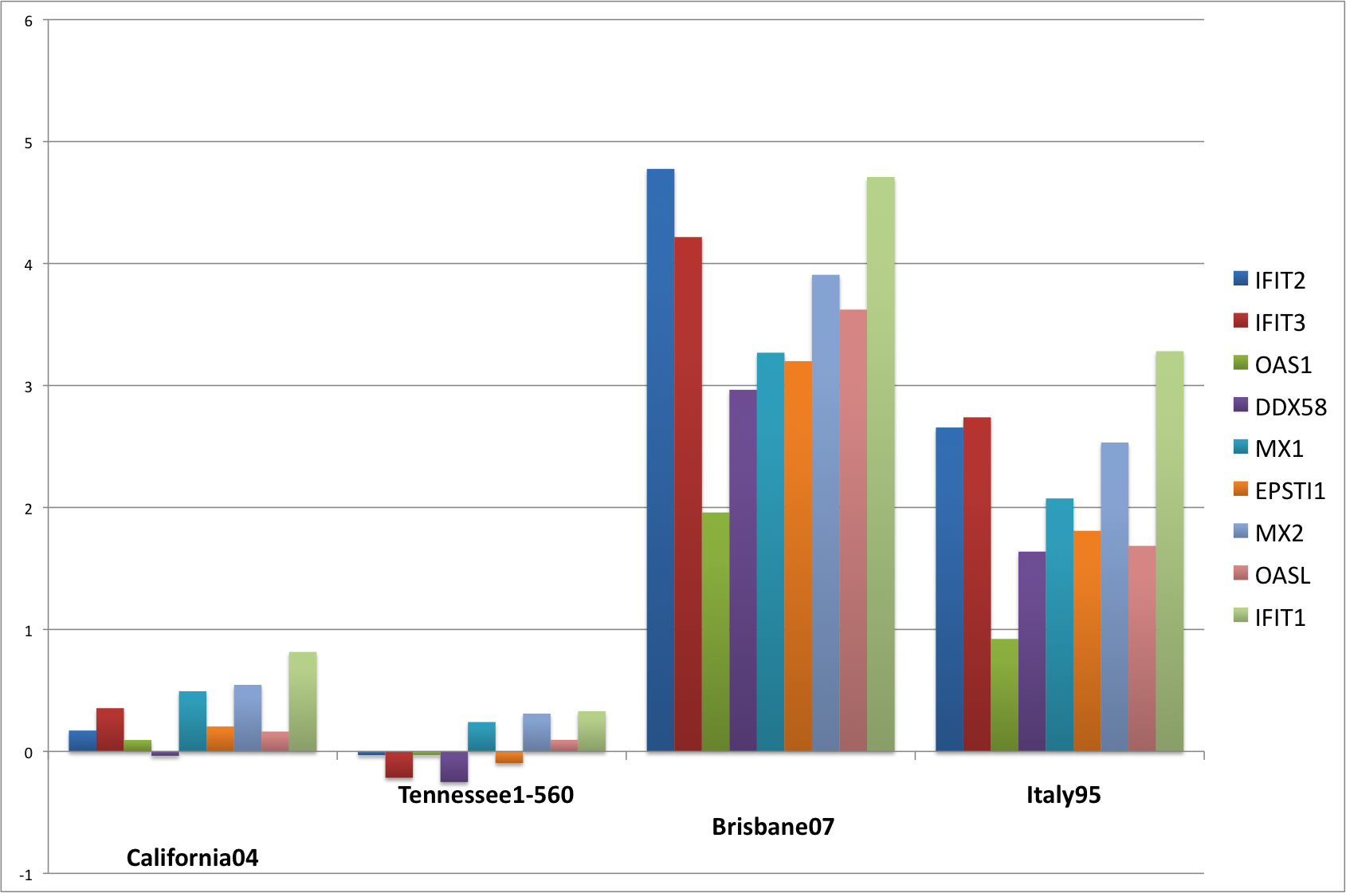
Top 9 most significant differentially expressed genes 12 hours post-infection with A/Brisbane/59/2007(H1N1)
A

Slide 29
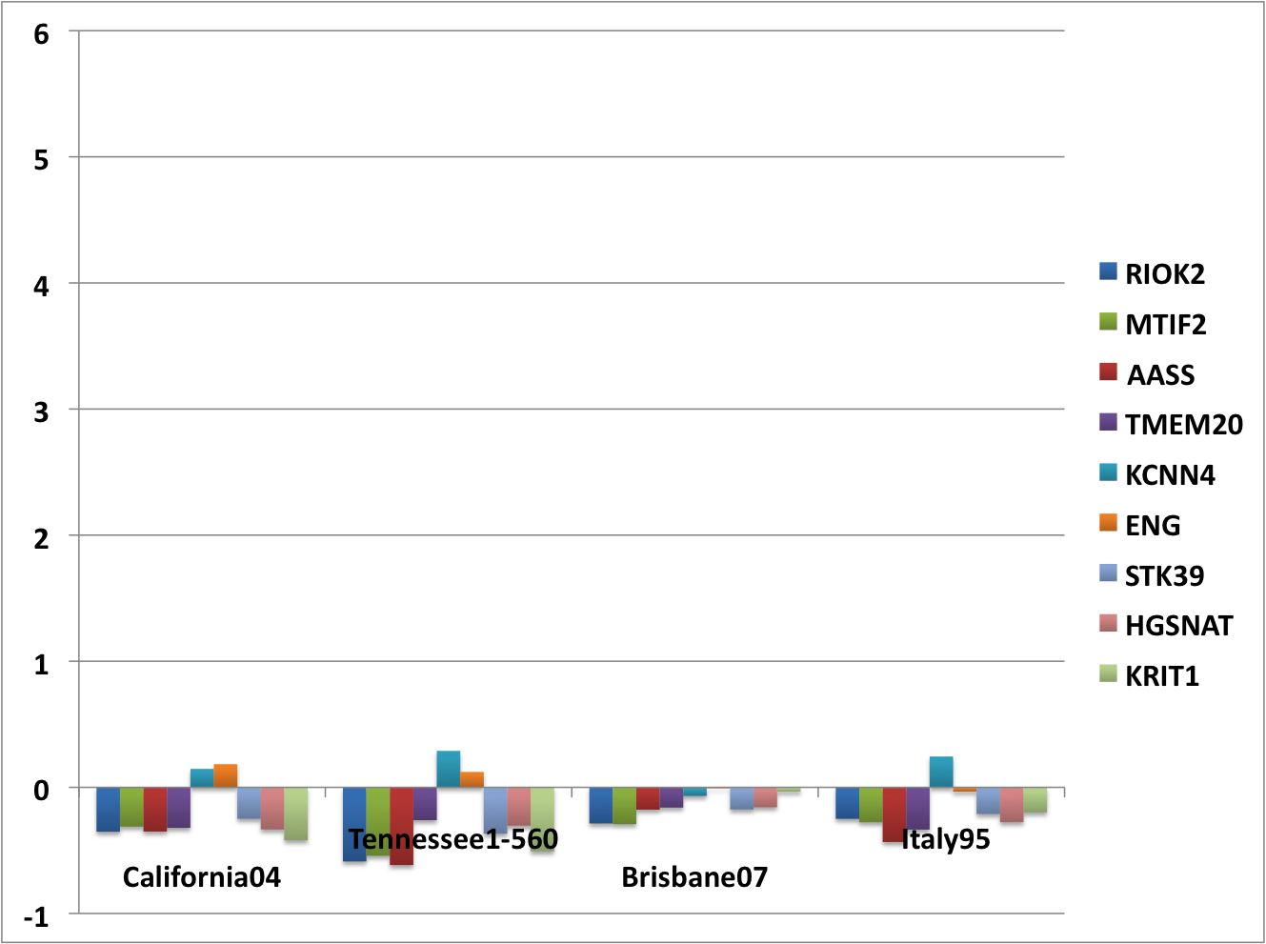
Top 9 most significant differentially expressed genes at 12 hours post-infection with A/California/04/2009(H1N1)
Does the TRIG backbone (Asw) induce a “stealthy” response?
A

Slide 30
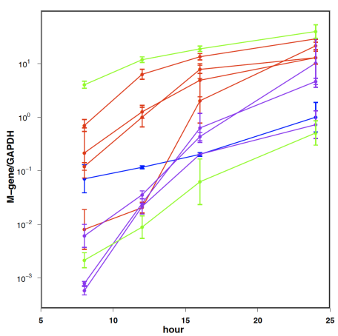
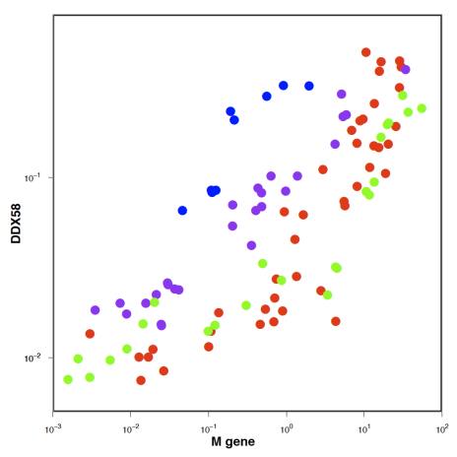
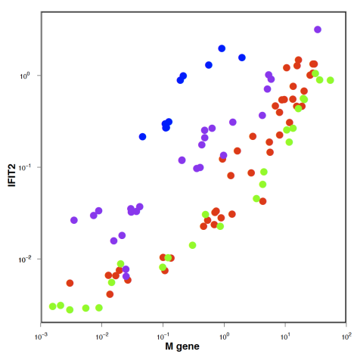
Host response as a function of virus
Fluidigm Real Time PCR from primary human cell infections (2 donors)
Brisbane
California
Italy
North Carolina

Slide 31
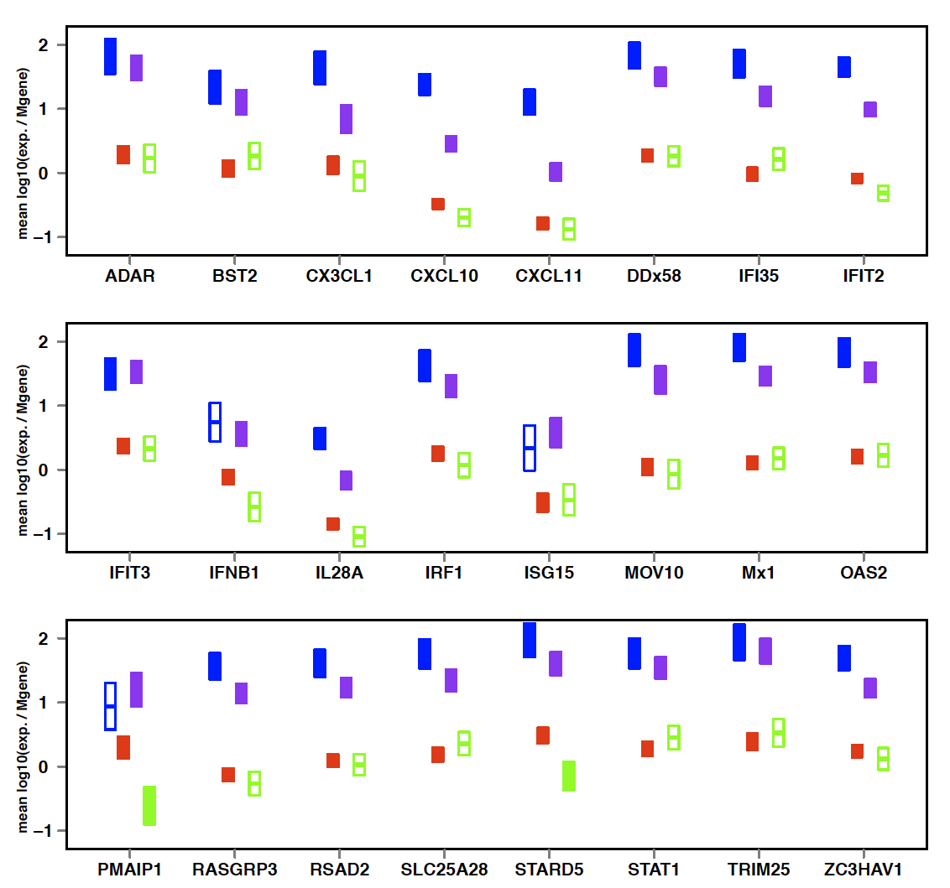

Host response as a function of virus II
Brisbane
California
Italy
North Carolina

Slide 32
Swaps
rgCA/09
rgCA/IT_{HA}
rgCA/IT_{NP}
rgCA/IT_{M}
rgCA/IT_{NAM}
rgCA/IT_{HANAM}
rgCA/IT_{NS}
rgCA/Br_{PA}
rgCA/Br_{PB2PB1PA}
rgCA/NC_{M}
rgCA/NC_{NAM}
rgCA/NC_{HANAM}
PB2
PB1
PA
HA
NP
NA
M
NS
CA
IT
BR
NC
What’s the mechanistic basis of the stealthy (or noisy) phenotype?
rgNC/02
rgNC/CA_{HA}
rgNC/CA_{NA}
rgNC/CA_{M}
rgNC/CA_{NAM}
rgNC/CA_{HANAM}
rgNC/IT_{PB2}
rgNC/IT_{HA}
rgNC/IT_{NP}
rgNC/IT_{NA}
rgNC/IT_{M}
rgNC/IT_{NAM}
rgNC/IT_{HANAM}
rgNC/Br_{NP}
PB2
PB1
PA
HA
NP
NA
M
NS
CA
IT
BR
NC

Slide 33



Slide 34
Average amplitude across all genes normalized to M-gene

Slide 35
Amplitude (“A”) normalized to M-gene
log10(AMaxNorm)

Slide 36

The pandemic strain is efficient and stealthy
Rapid + stealthy growth = Pandemic
The set of genes induced by diverse viruses is largely equivalent in the first 24 hours— “the flu program”
The pandemic strategy is distinct from the well-adapted human seasonal virus
Kinetic differences in the first ~18 hours of infection are critical to the quality and quantity of the later response
The stealthy phenotype ismediated by contriubtions of the P-gene complex, with potential roles for NP and NS

Slide 37
ODE model of influenza infection

Slide 38
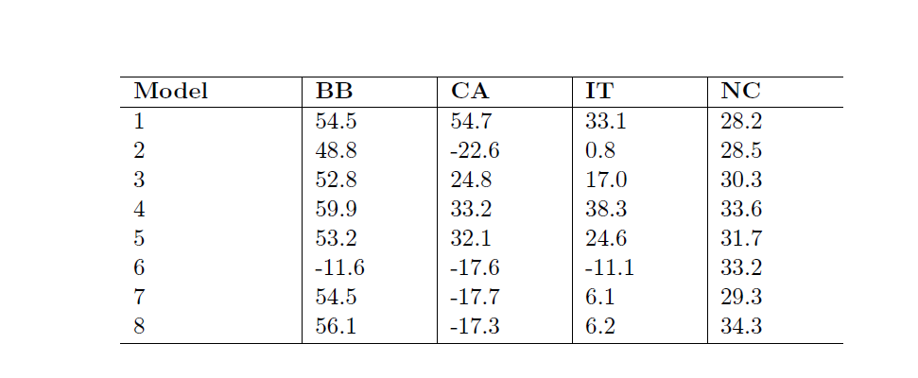
AICc values of 8 different models
No IR and no cell-regrowth
No IR, with cell-regrowth
With IR reducing virus production, no cell-regrowth
With IR reducing infection rate, no cell-regrowth
With IR prolonging latency, no cell-regrowth
With IR reducing virus production, with cell-regrowth
With IR reducing infection rate, with cell-regrowth
With IR prolonging latency, with cell-regrowth

Slide 39
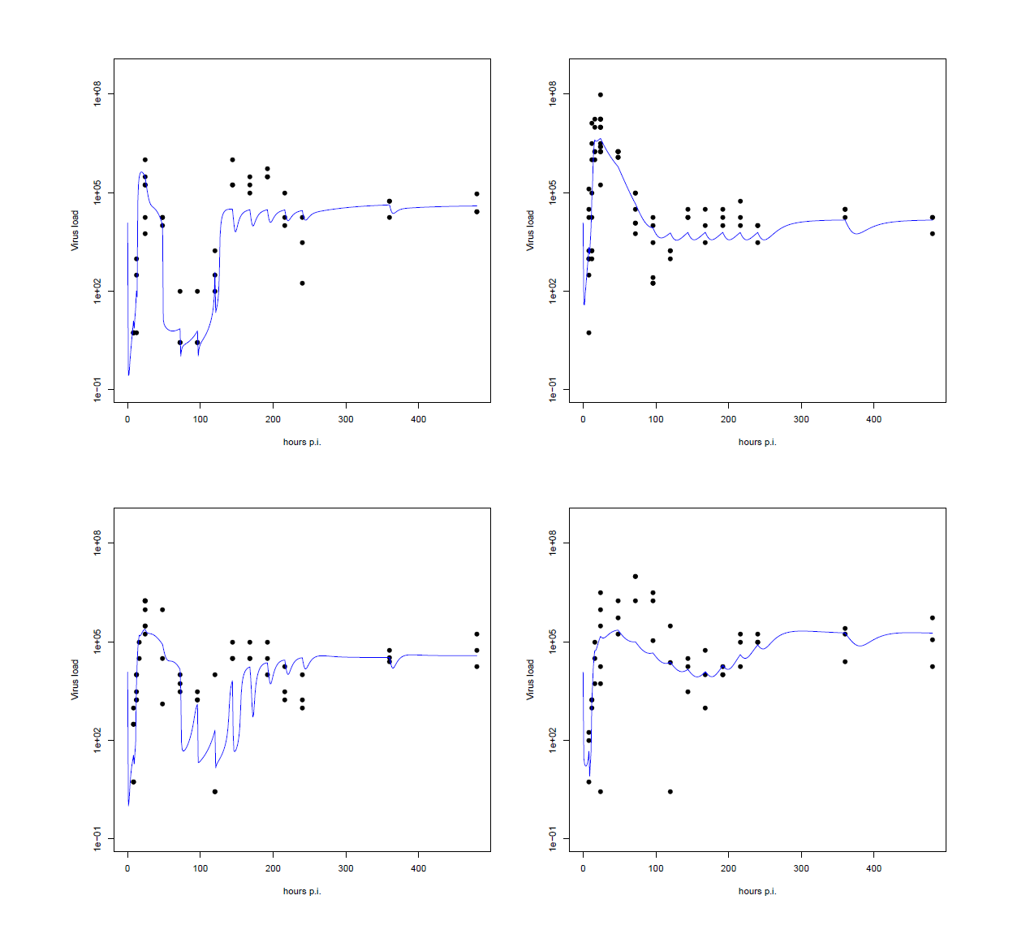
Fits for Model 6—IR reduces virus production and cells regrow
BR
CA
IT
NC

Slide 40
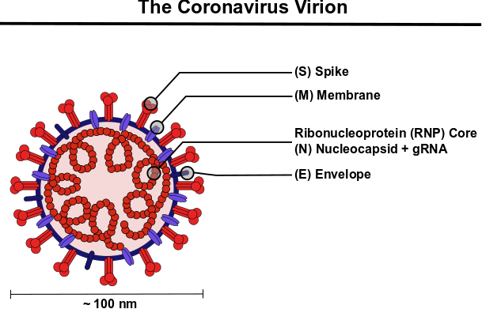
SARS-CoV-2 vs. Influenza virus
The Influenza Virus Virion
(HA) Hemagglutinin
NA (Neuraminidase)
~100 nm
(+) ssRNA genome ~28-32 Kb
29 proteins
(-) segmented ssRNA genome ~28-32 Kb
~14 Kb, 10-14 proteins

Slide 41
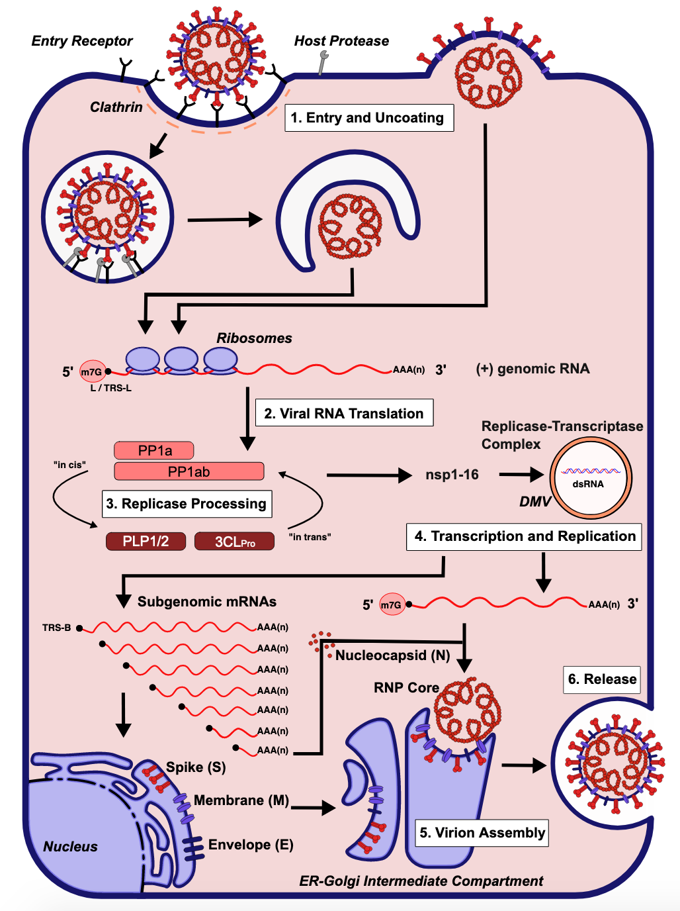
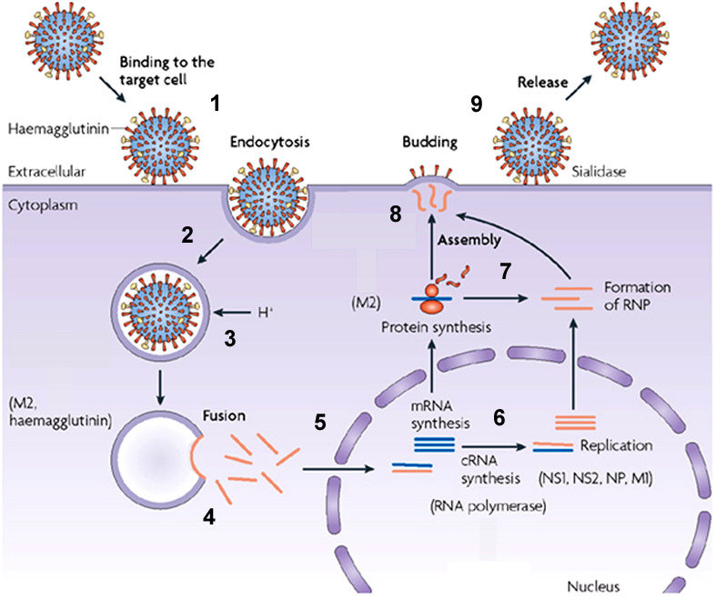
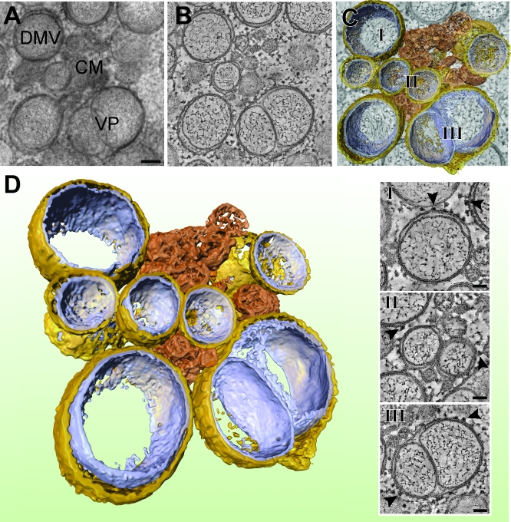
Coronavirus and influenza virus replication cycles
Coronavirus
Influenza virus

Slide 42
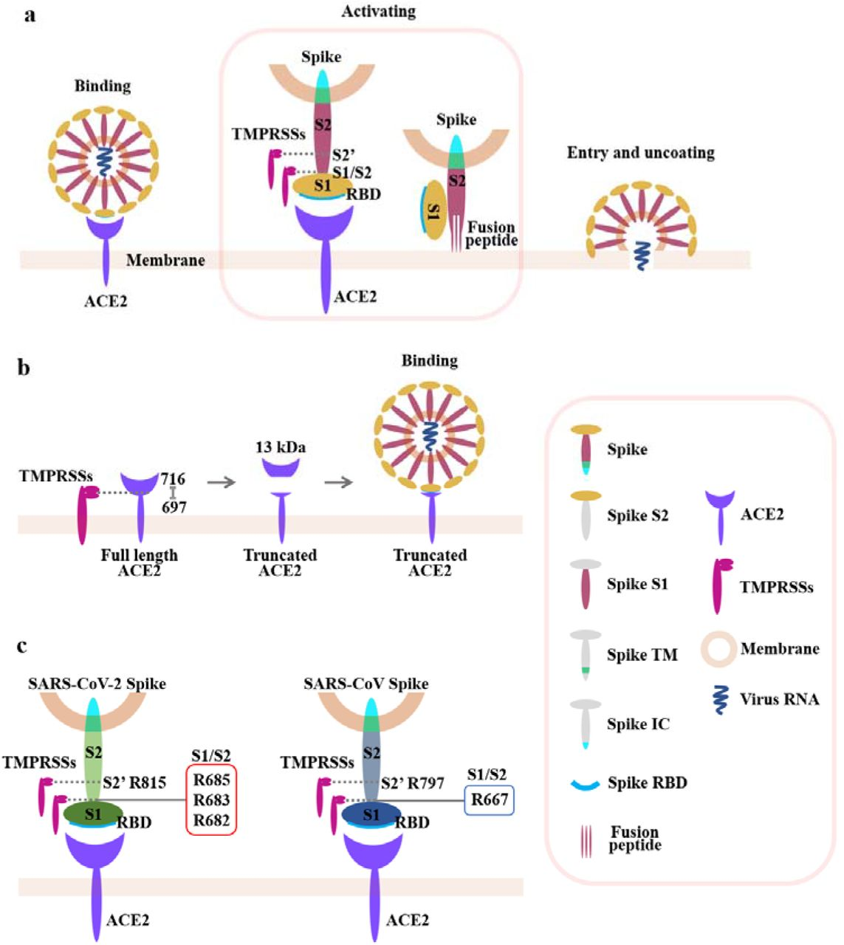
Distinct receptor binding features of SARS vs. influenza viruses
Coronavirus
Influenza virus
Influenza HA binds to sialic acid residues on diverse surface proteins
https://doi.org/10.1101/2020.02.08.926006

Slide 43
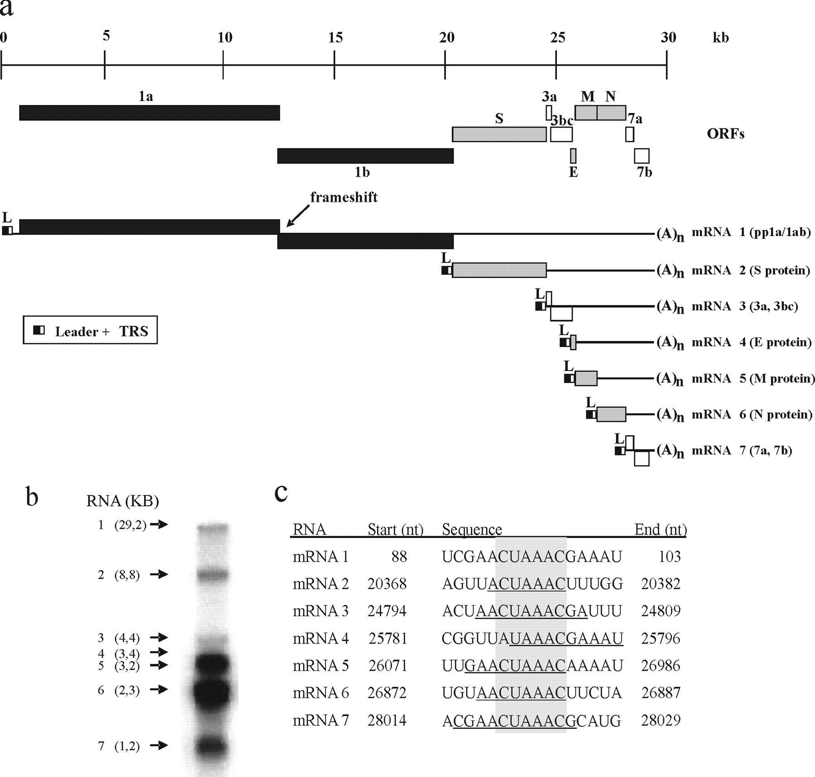
Coronavirus Genome Encodes Several IFN Antagonists
Structural and Accessory
Non-Structural Replicase
1. Non-Structural Proteins (nsp1-16)
Conserved across CoVs
Various, required functions
IFN antagonists: nsp1, PLP2 (nsp3)
2. Accessory Proteins
Unique to subfamilies and species
Function dispensable for replication
Encode virulence factors

Slide 44
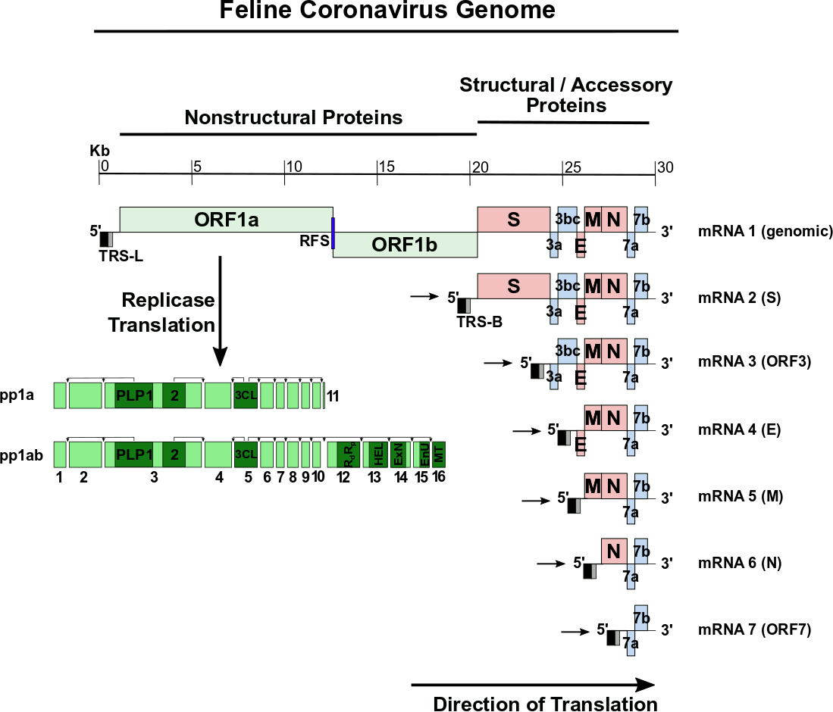
Coronavirus Genome Structure and Duplication
Notes:
*nsp14 is an exonuclease with “proof-reading” function

Slide 45
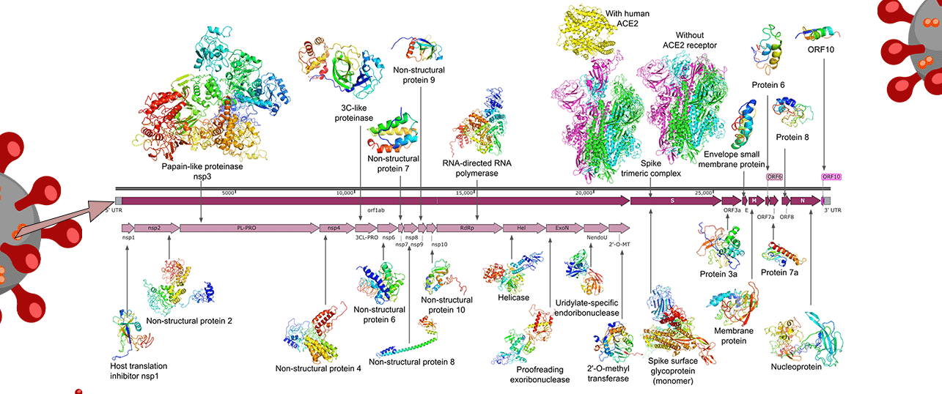
Large SARS-Cov-2 proteome contains many immunomodulatory non-structural proteins
Notes:
https://zhanglab.ccmb.med.umich.edu/COVID-19/
Really nice for visualization

Slide 46
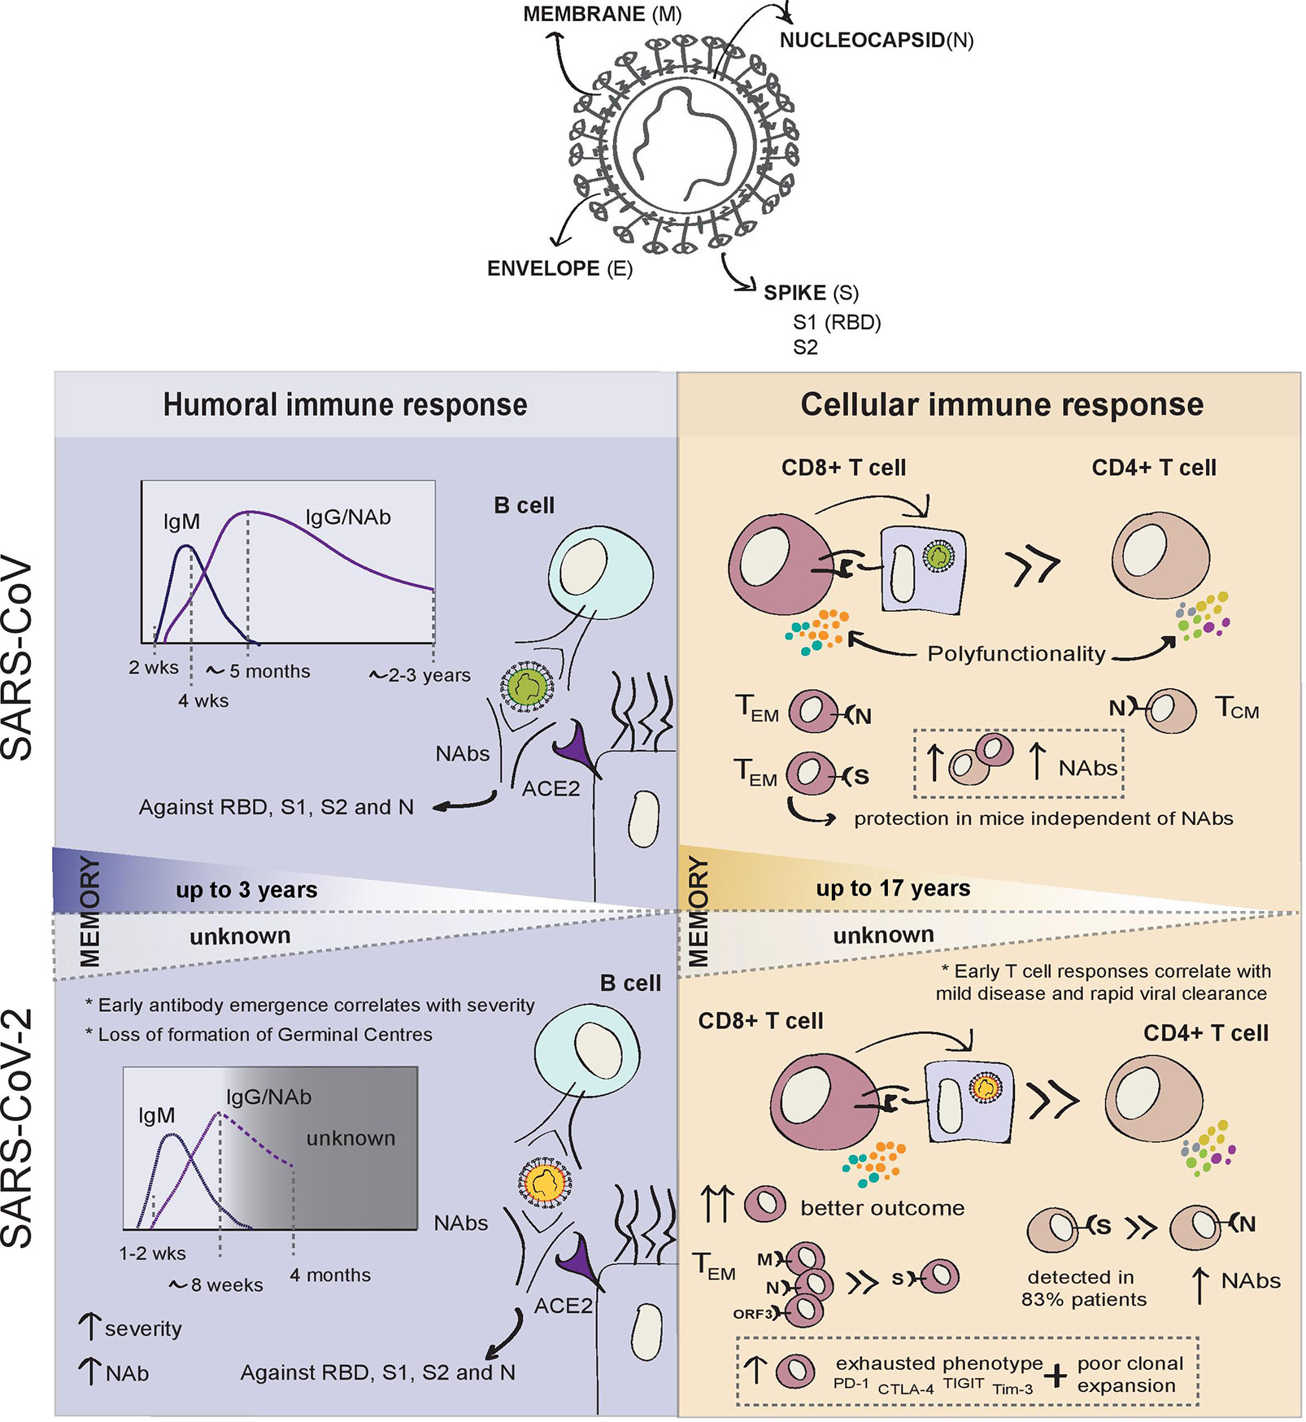
Protective Immunity against SARS-CoV-2
https://www.frontiersin.org/files/Articles/571481/

Slide 47
SARS-CoV-2 vs. influenza virus summary
SARS-CoV-2
Influenza virus
RNA virus (+ sense)
Single segment
Large genome
Multiple immune antagonists
Specific receptor (ACE2)
RNA virus (- sense)
8 segments
Much smaller genome (than CoV)
Single immune antagonist (ds RNA sequestration)
Non-specific receptor

Slide 48
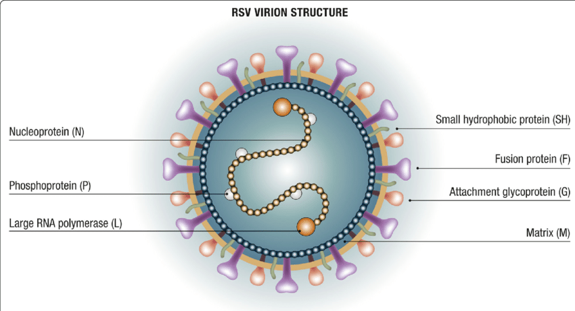
RSV Virion Structure
Epidemiology and prevention of respiratory syncytial virus infections in children in Italy. Italian Journal of Pediatrics. 47. 198. 10.1186/s13052-021-01148-8.

Slide 49
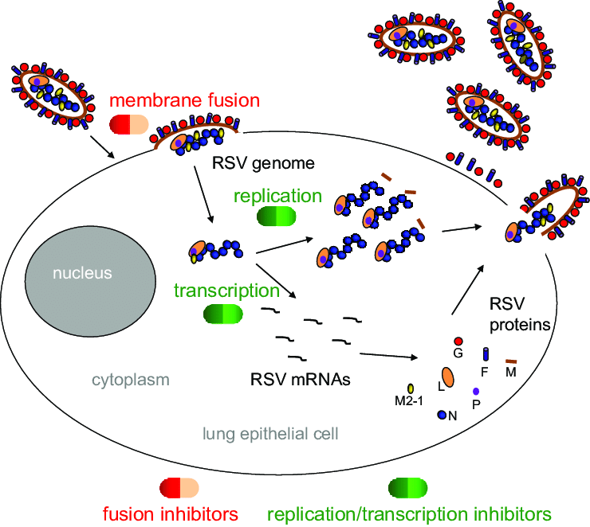
RSV Replication
New antiviral approaches for respiratory syncytial virus and other mononegaviruses: Inhibiting the RNA polymerase

Slide 50
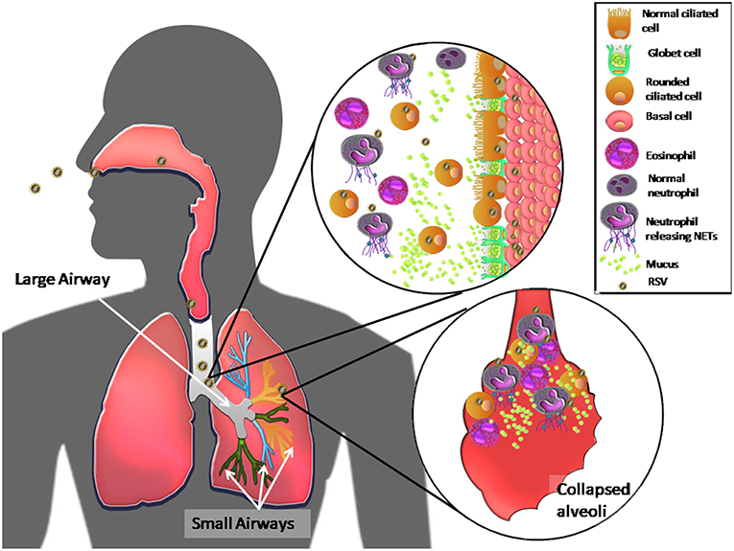
Unique Features of RSV pathogenesis
https://www.frontiersin.org/files/Articles/450448

Slide 51
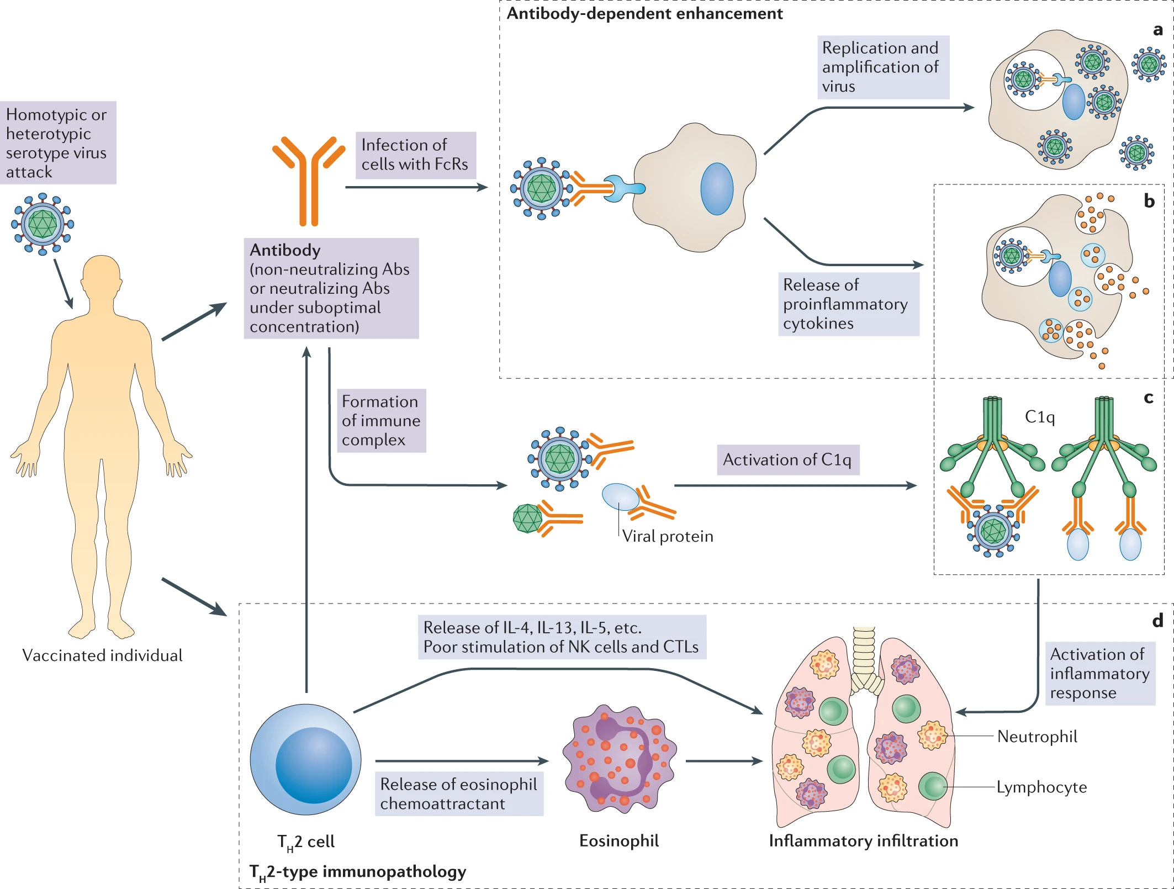
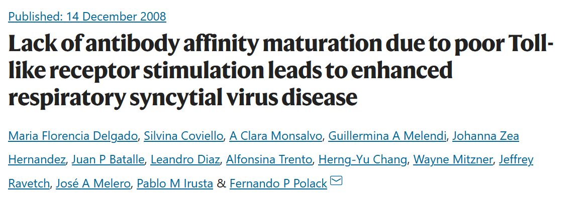
RSV Vaccination Failure
1960 era vaccine
80% of children suffered severe disease after infection
Two deaths

