Slide 1
Complex Pathogens, Helminths and Immunology
Paul Thomas
Paul.Thomas@stjude.org
Department of Immunology
St. Jude Children’s Research Hospital

Slide 2
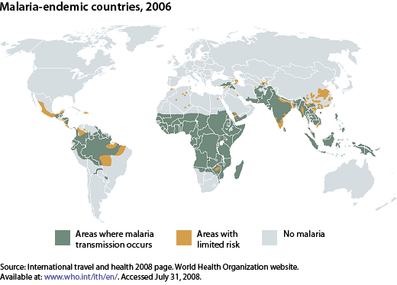
Malaria Prevalence
~350-500 million infections/year
1-2 million deaths/year, most of them among children under 5

Slide 3
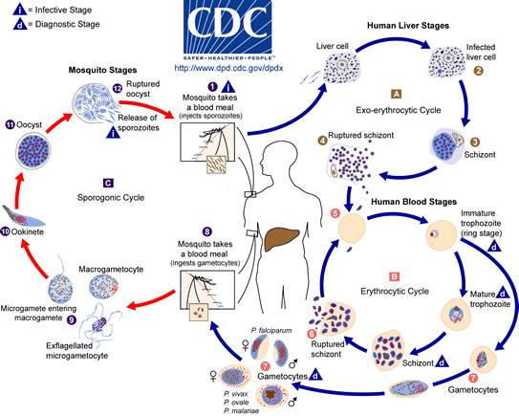
Malaria life cycle

Slide 4
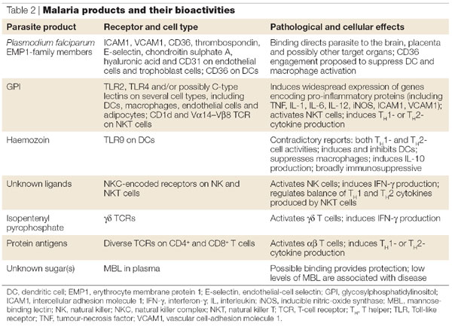
Immune Responses mediate plasmodium pathology

Slide 5
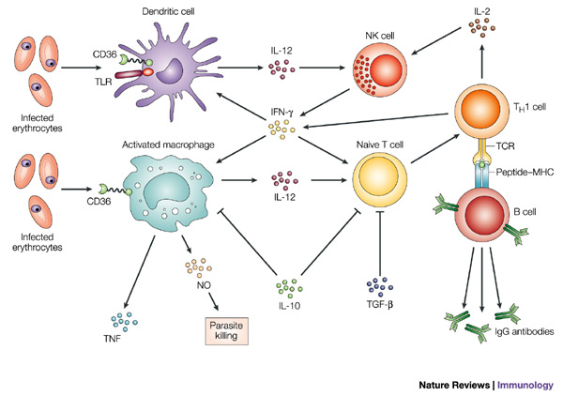
Typical “Th1-Type” immunity contributes to malaria protection and pathology
In infected mice, antigen is presented in the spleen where Th1 cells regulate innate and adaptive immune responses, including stimulating anti-parasite antibody and effector mechanisms such as ROI and RNI

Slide 6
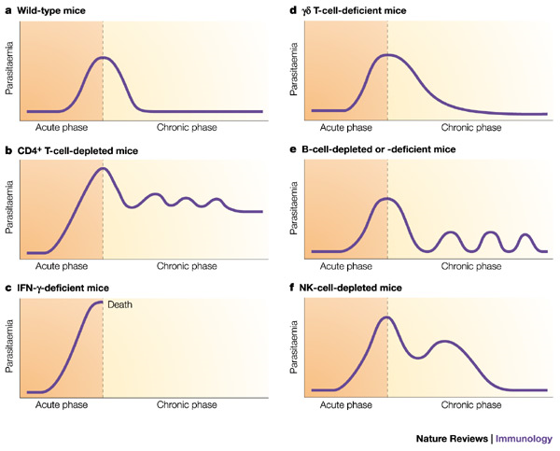
Immune mechanisms to control malaria
Antibodies block invasion of sporozoites into liver cells
Interferon- (IFN-) and CD8⁺ T cells inhibit parasite development in hepatocytes
Antibodies block invasion of merozoites into erythrocytes
Antibodies prevent sequestration of infected erythrocytes by preventing binding to adhesion molecules on the vascular endothelium
IFN- and CD4⁺ T cells activate macrophages to phagocytose intra-erythrocytic parasites and free merozoites
Antibodies neutralize parasite glycosylphosphatidylinositol and inhibit induction of the inflammatory cytokine cascade
Antibodies mediate complement-dependent lysis of extracellular gametes, and prevent fertilization of gametes and the development of zygotes
Mary M. Stevenson & Eleanor M. Riley
Nature Reviews Immunology 4, 169-180 (March 2004)

Slide 7
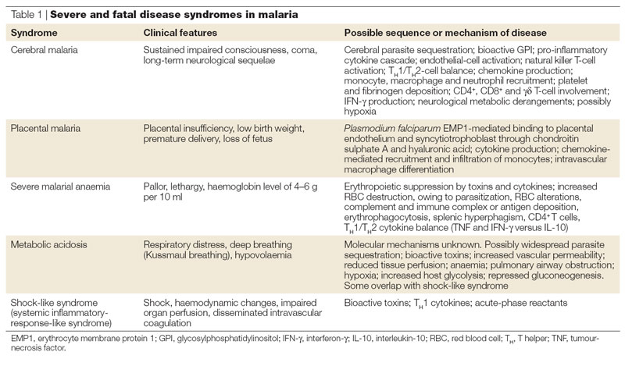
Fatal Disease in malaria infection

Slide 8
Vector Control
Vector control efforts range from basic bed nets, to spraying insecticides externally and on house walls, to more sophisticated “vector engineering” efforts to produce malaria-resistant mosquitoes, among many others
Math modeling of infectious spread has led to some hypotheses about which of these methods are the most effective (bed nets, house wall spraying) and which are unlikely to be effective (releasing resistant mosquitoes)

Slide 9
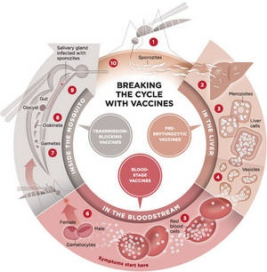
Malaria Vaccine Targets
Three types of vaccines have been proposed, with variations in each group:
Pre-erthyrocytic vaccines: the only truly “sterilizing” protection, but hard to generate enough antibody immunity (to prevent any infection) or CD8 immunity (to clear every single infected liver cell)
Blood-stage vaccine: designed to enhance clearance of infected red blood cells, therapeutic but not sterilizing
Gametocyte vaccines: Potentially strong antigen candidates and immune complexes can be carried to the mosquito—”altruistic vaccine”

Slide 10
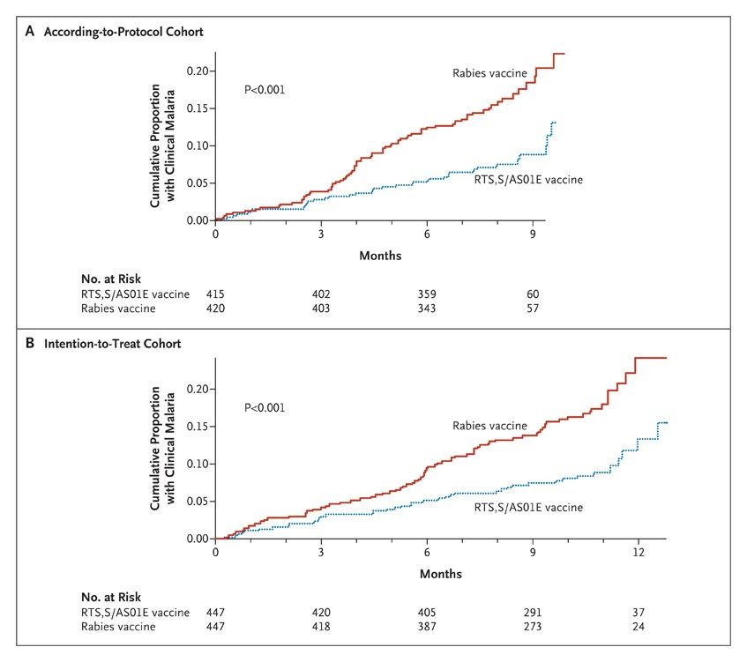
RTS,S Vaccine Approved for Stage III in Infants
The vaccine candidate farthest along is RTS,S, a pre-erythrocytic vaccine against the circumsporozite protein
Mechanism is presumed to be antibody, but cellular responses have been shown
Vaccine is adjuvanted and protein is linked to hepatitis B antigen

Slide 11
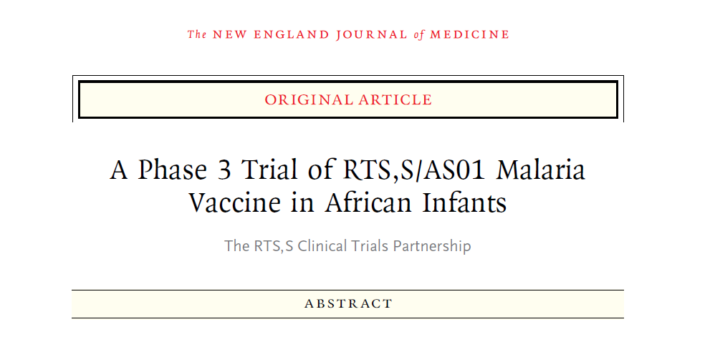
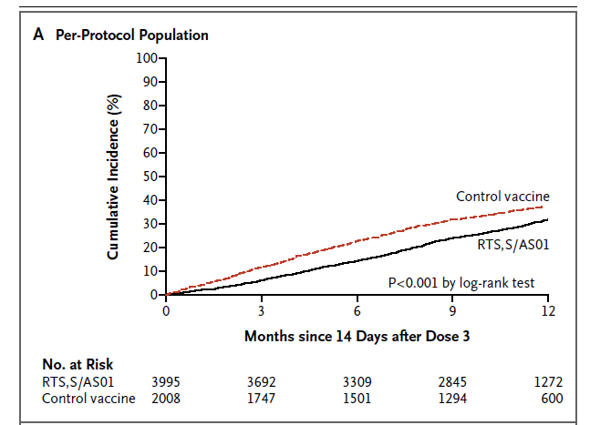
RTS,S showed modest efficacy in infants
~30% efficacy shown in latest trial
Generally viewed as disappointing, but still moving forward (previous trial had ~61% efficacy, but was much smaller and in a different transmission area)
Late 2013 results—47% efficacy in children over longer follow up
2019—target rollout in 3 sub-Saharan countries for childhood vaccination

Slide 12
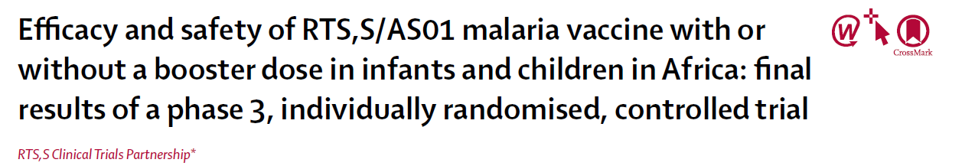
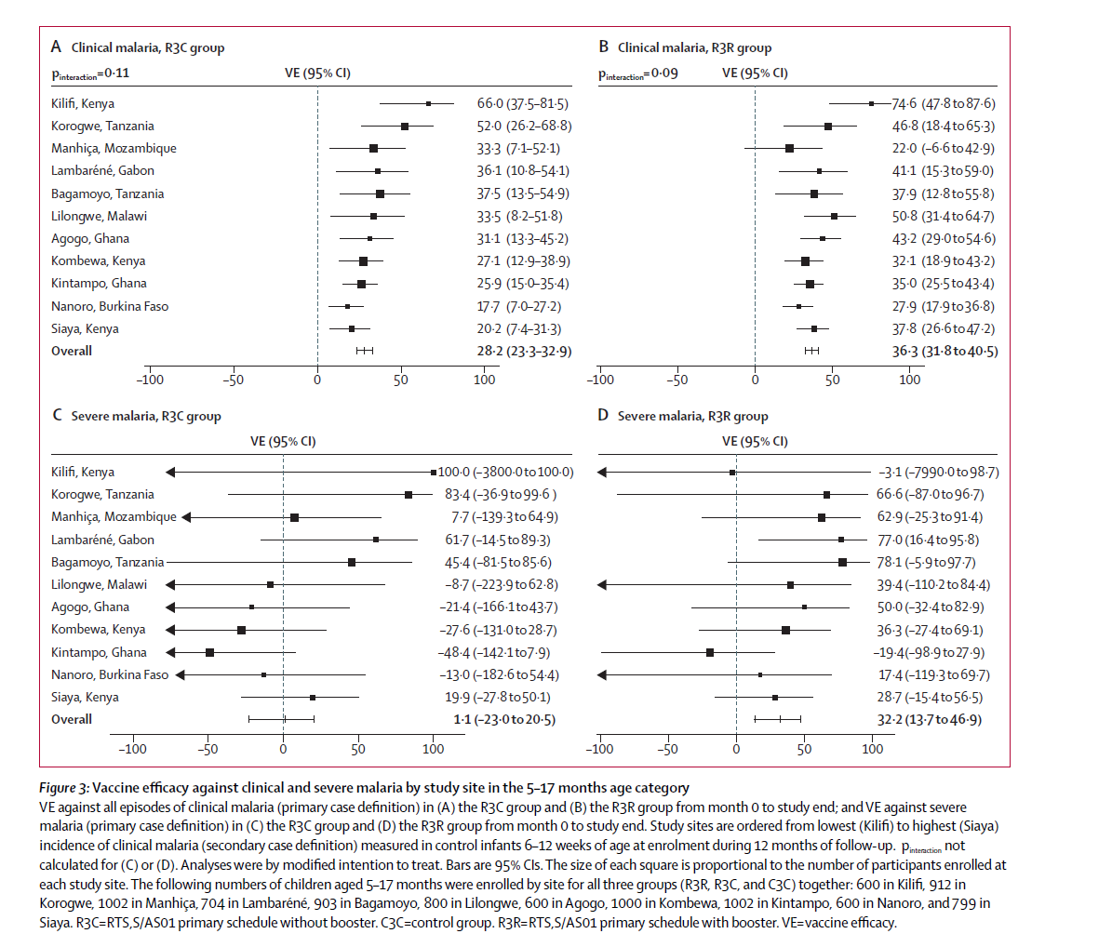

Slide 13
Math Modeling and Malaria
Transmission models have contributed substantially to the understanding of malaria control
Within host modeling is crucial to determine the potential efficacy of the three types of vaccine candidates
The “threshold” effects of malaria infection (immunity is helpful in endemic regions, but requires frequent low grade re-infection) are particularly suited to a quantitative approach

Slide 14
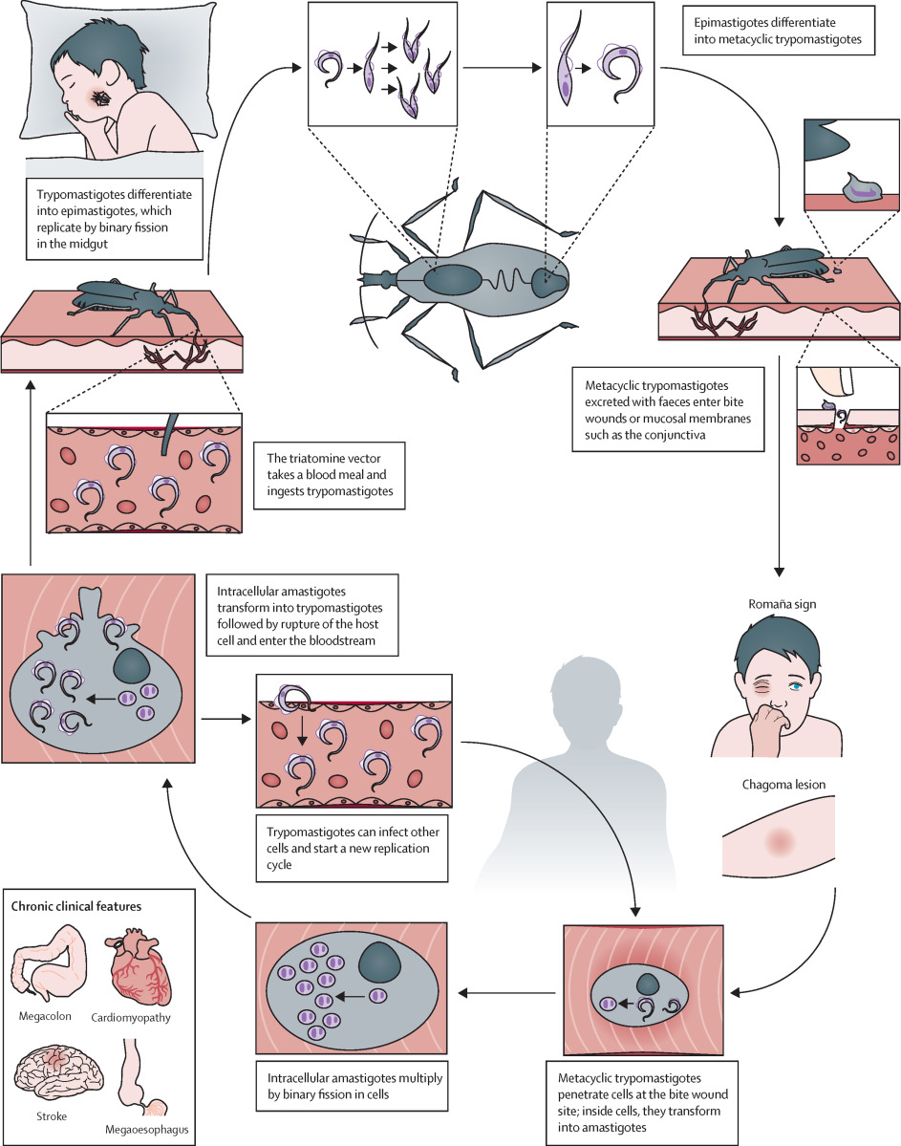
Trypanasoma Cruzi
Protozoan parasite
Complex life cycle initiated by triatomine bite
Long term causative agent of cardiomyopathy
Limited treatment options and confusion over pathogenesis

Slide 15
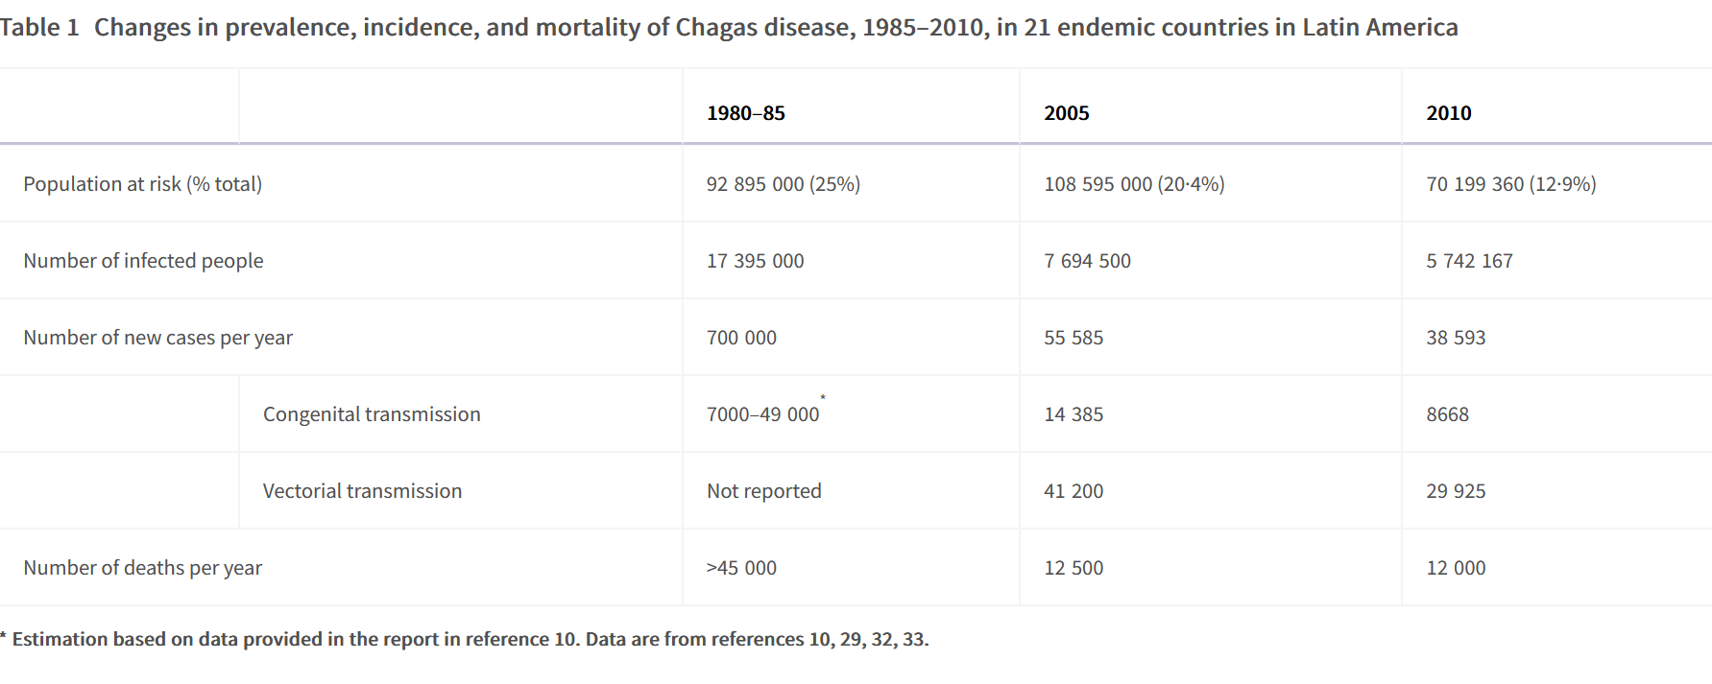

Slide 16
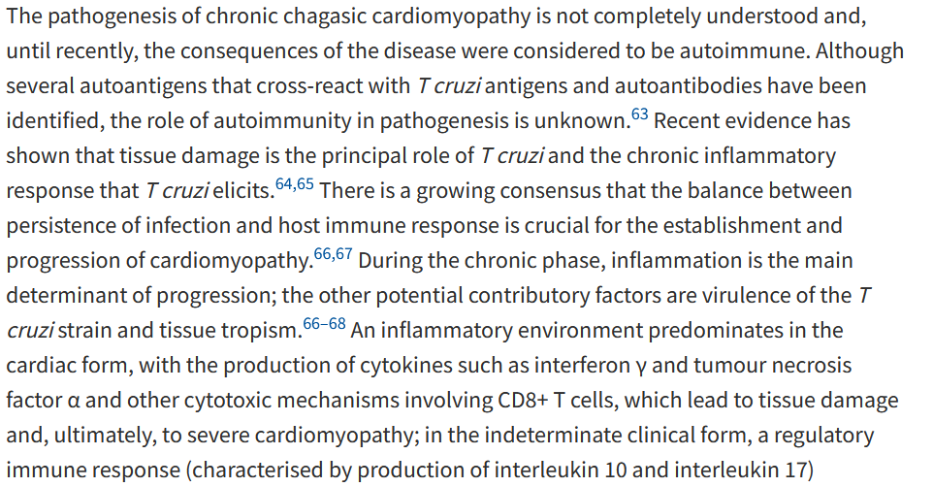
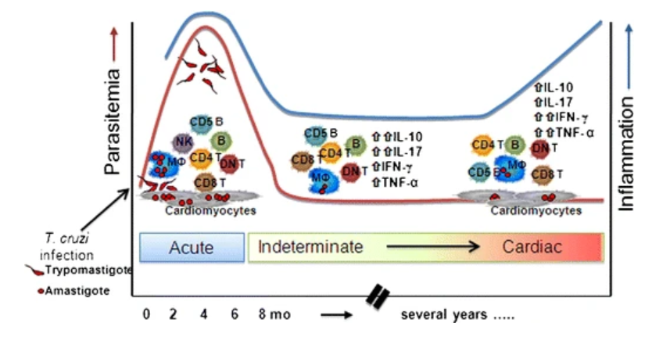

Slide 17
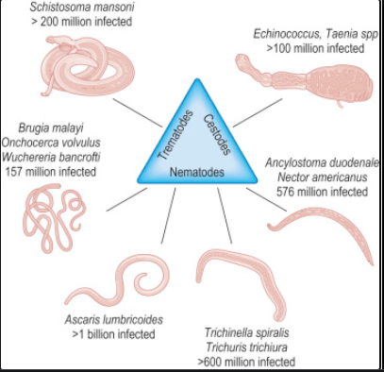
The Burden of Helminth Infections
After malaria, helminths represent the biggest DALY-impact of a parasitic infection in human populations
Multiple life cycles drive distinct pathological outcomes

Slide 18
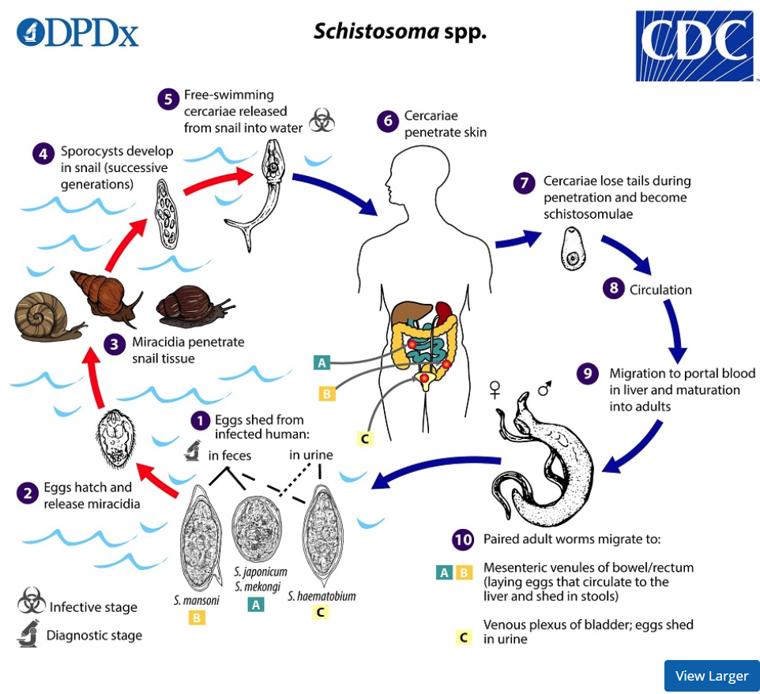
Schistosoma Life Cycle

Slide 19
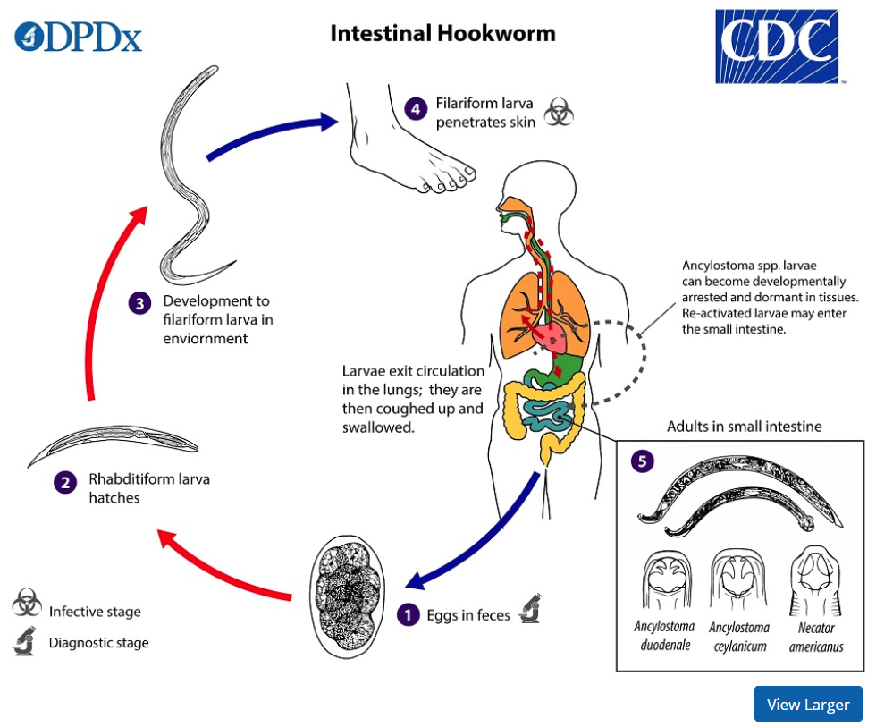
Hookworm Life Cycles

Slide 20
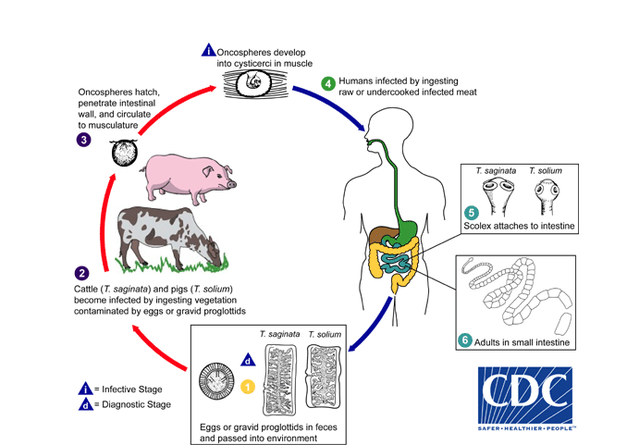
Taenia Life cycle

Slide 21
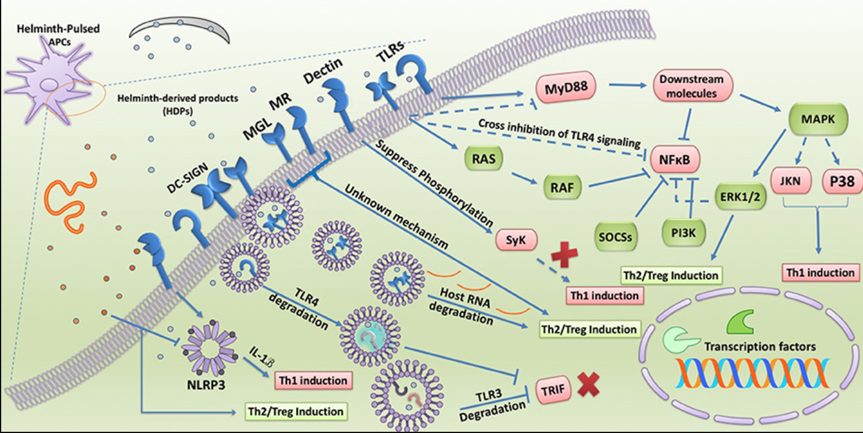
Innate signaling in response to helminth-derived products

Slide 22
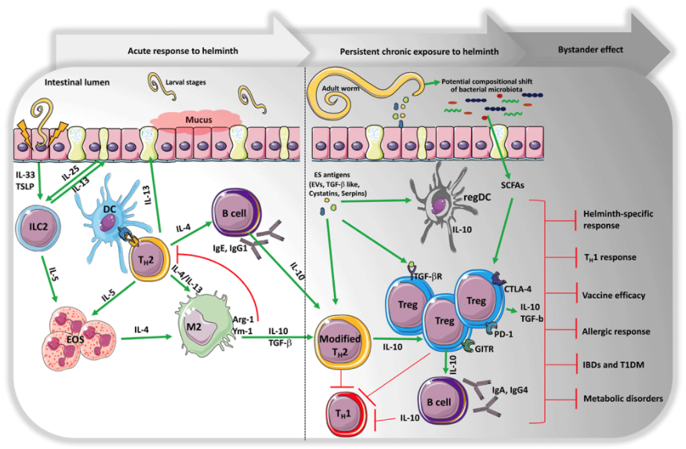

Slide 23
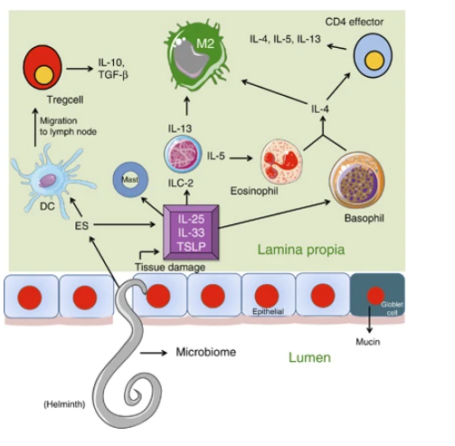
Local Tissue induction of regulatory responses
Mucosal Immunology volume 7, pages753–762 (2014)

Slide 24
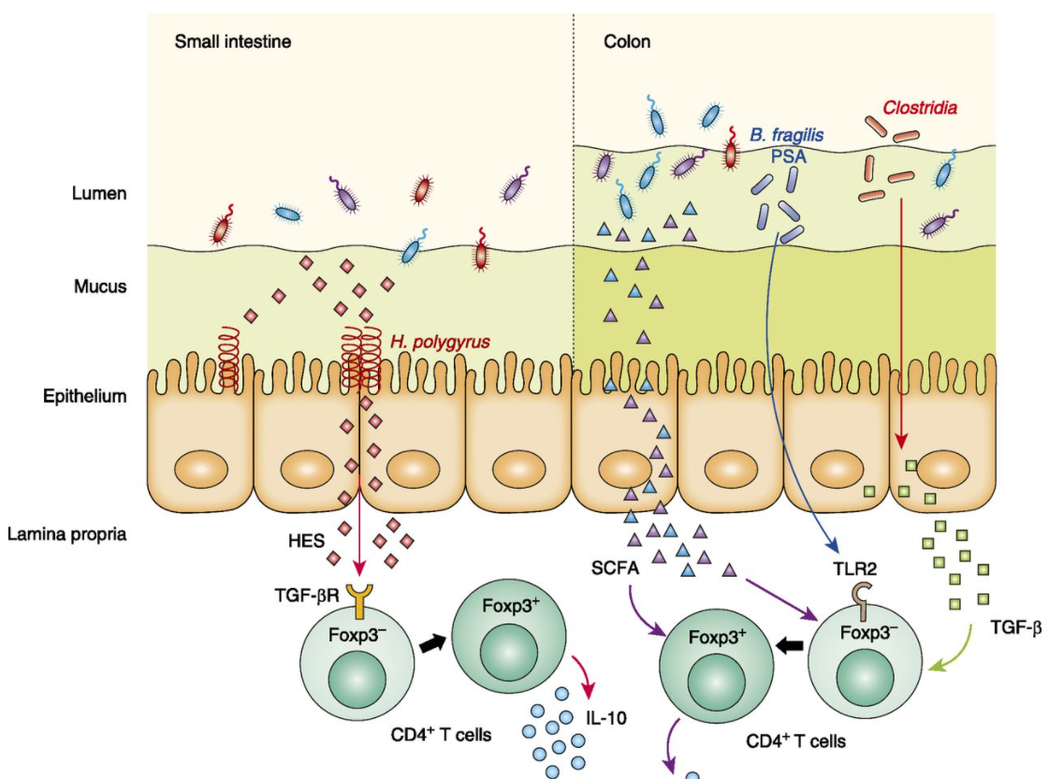
Helminth Interaction with the Microbiome
Microbiome components and helminths likely co-evolved
Similar effector and host manipulation pathways
Immune tolerance vs. immune resistance
J Immunol November 1, 2015, 195 (9) 4059-4066; DOI: https://doi.org/10.4049/jimmunol.1501432

Slide 25
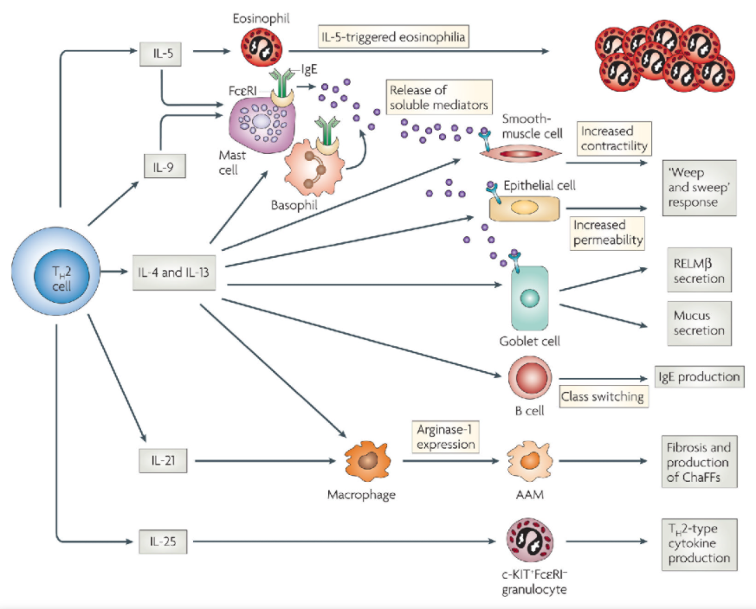
The Th2 response is the main effector of Helminth clearance

Slide 26
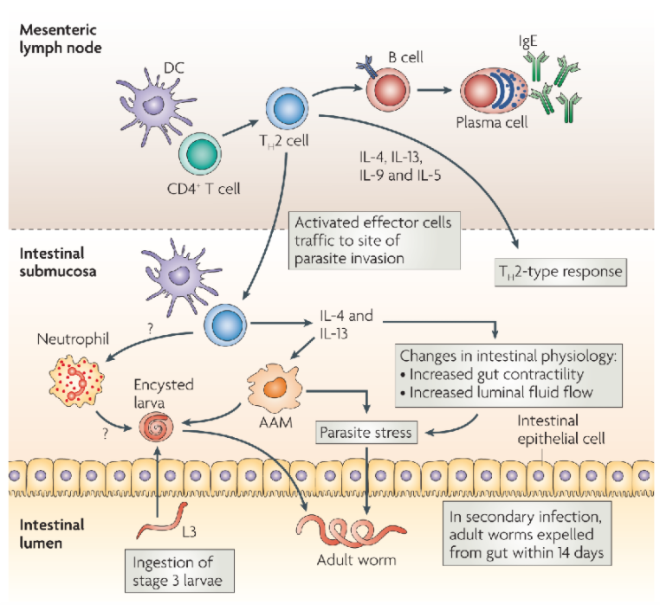
Effector Mechanisms for Helminth Damage and Clearance
CD4 T cell orchestrate the response against helminths
Th2 responses involve multiple effector mechanisms, not all fully understood
Cell based an mechanical disruptions lead to worm death and explusion

Slide 27
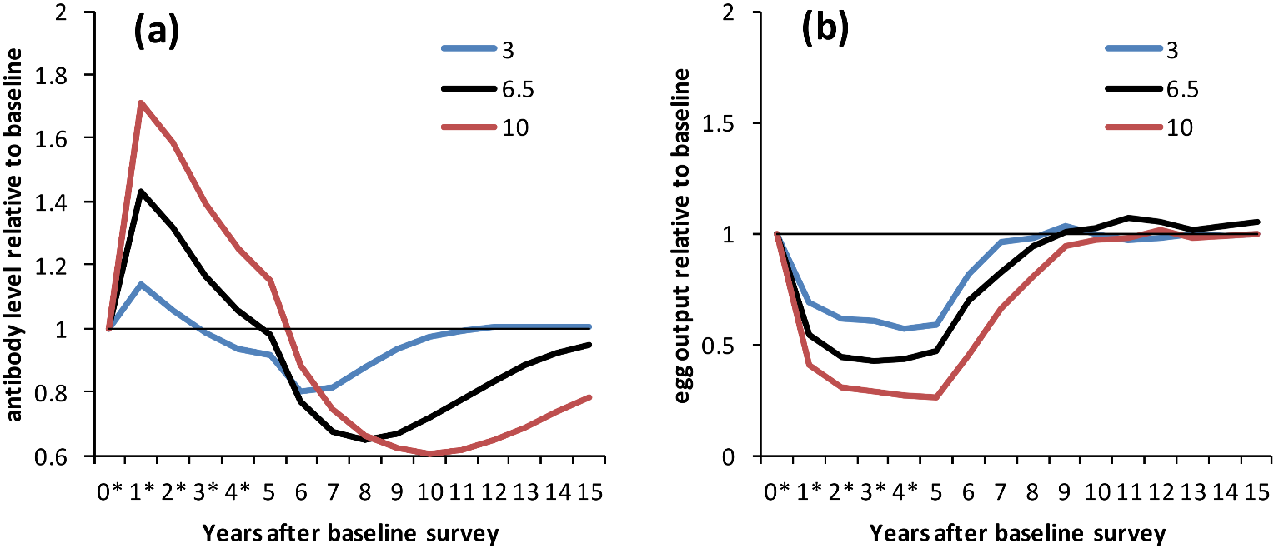
Some Evidence for Protective Immunity
IgE levels correlate with egg burdens and rates of re-infection
https://doi.org/10.1371/journal.pntd.0003059

Slide 28
Conclusions/Discussion Points
Parasitic helminths represent a major evolutionary burden on human development
An entire arm of the immune response is dedicated to response to worm infections, but in many populations it fails to be engaged
Evolutionary “assumption” may have led to increases of atopic conditions, such as allergy, resulting from lack of helminth targets

Slide 29
Immunological Considerations in Co-infections

Slide 30
HIV
Two directions of interaction
HIV on other infections
Other infections on HIV
What are the underlying mechanisms of each?
Immune dysregulation, no CD4 cells
Systemic bias away from protective immunity and viral control

Slide 31
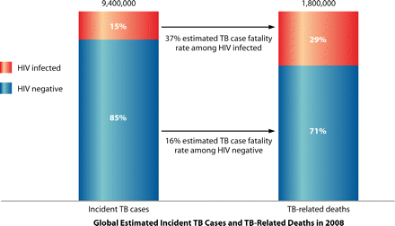
HIV and TB

Slide 32
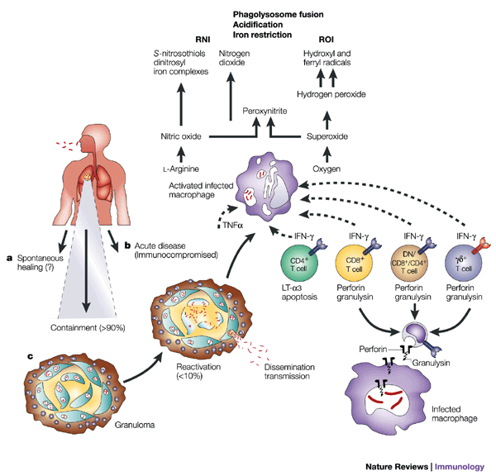
Control of Mtb

Slide 33
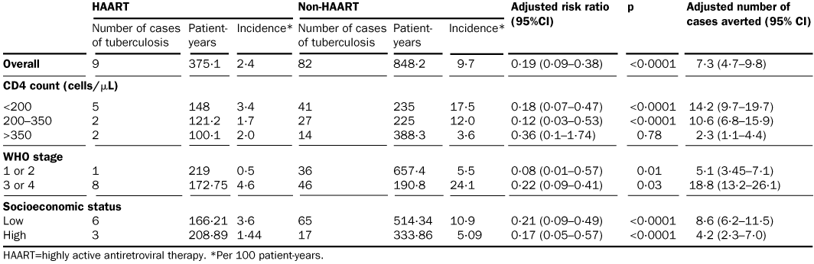
Treatment of HIV prevents TB
Disease often manifests in non-traditional ways—extra pulmonary (not necessarily a breakdown of the lung granuloma?)

Slide 34
HIV and malaria
Several studies report increased presentation in children and adults of severe malaria correlating with HIV co-infection
These studies are not particularly robust or consistent—seems like there should be an association
Studies difficult to do and loaded with confounding variables

Slide 35
Malaria immunological control

Slide 36
What about the other direction?
Mechanistically, more clear how malaria could increase HIV production
Robust epidemiological data suggesting greater transmission (viral load? susceptibility?) in malaria endemic areas

Slide 37
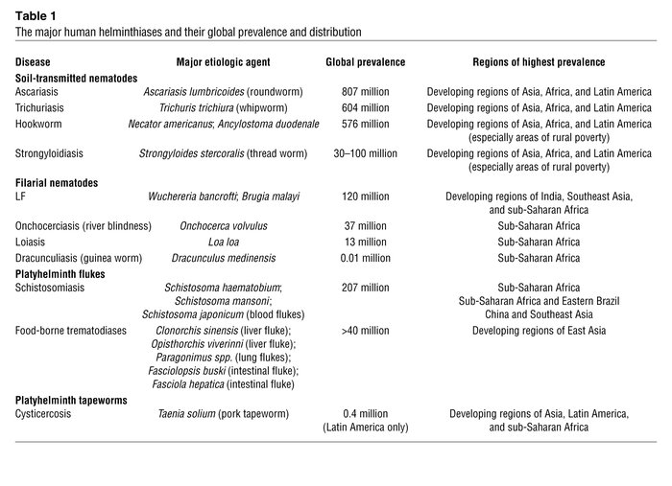
Helminth co-infections

Slide 38
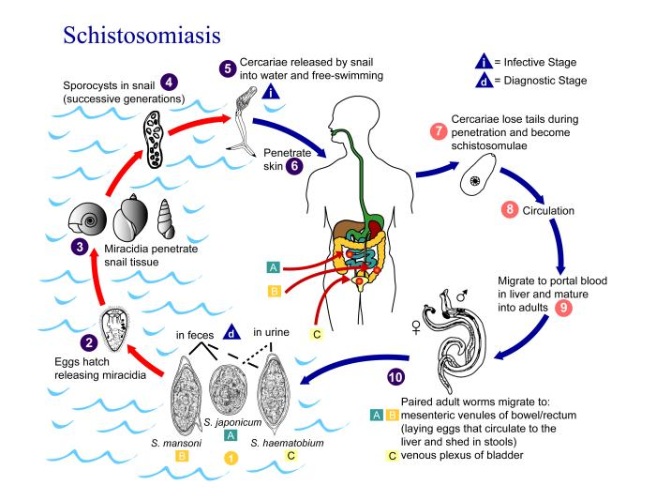

Slide 39
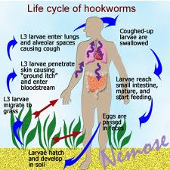
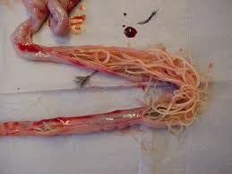

Slide 40
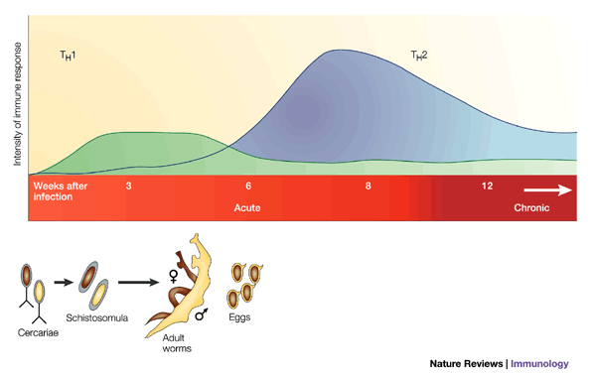
Progression of schistosome disease

Slide 41
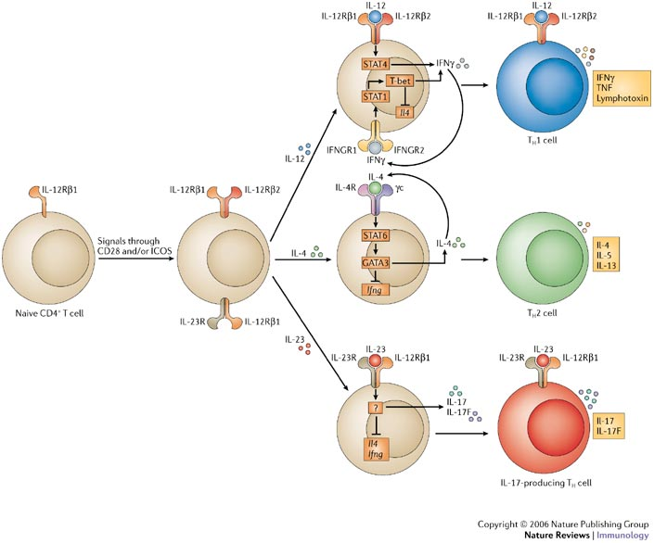

Slide 42
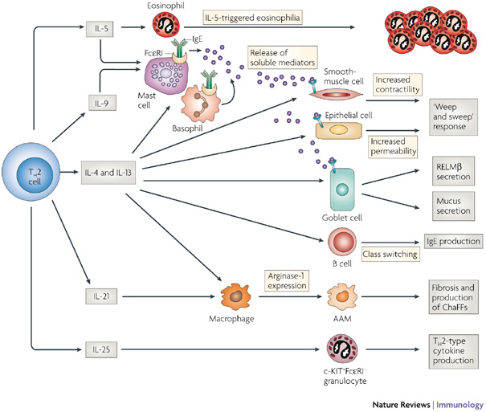
Protective immunity to helminths

Slide 43
How do we assess HIV’s effects on worms?
The natural process of worm clearance is slow and difficult to observe epidemiologically
Worm burden/egg burden can be measured in endemic areas
Often, treatment studies are done to measure HIV’s relationship to drug efficacy
Drugs require antibody/immune competence
Overall, very limited effects observed

Slide 44
Effects of helminths on HIV
Total number of HIV positive participants | Number infected and helminth species | Effect of co-infection with helminths on CD4⁺ T cell count | Effect of co-infection with helminths on viral load | Country (ref) | Comments
111 | 54 All species (predominant species: Ascaris and hookworm) | Higher (P = 0·02) | NS | Zambia (51)
185 | 143 Schistosomiasis | NS | Not done | Zimbabwe (38) | Compared subjects with and without schistosomiasis
539 | 290 All species | NS | Higher (P = 0·03)ª | Uganda (52) | ª(NS afteradjustment for potential confounding factors)
 | Hookworm | Higher (P = 0·007) | NS
 | S. mansoni | NS | NS
 | Strongyloides | NS | Higher (P = 0·02)ª
 | Mansonella | Higher (P = 0·04)ª | NS
108 | 39 All species (predominant species: S. mansoni and hookworm) | Higher (P = 0·005) | NS | Uganda (53)
56 | 31 All species (predominant species: Trichuris and Ascaris) | NS | NS | Ethiopia (54)
365 | 161 All species^{b} (predominant species:Ascaris,Strongyloides,Trichurisand hookworm) | NS | Lower (P = 0·02) | Brazil (42) | ^{b}‘All species’ includes protozoa; information for all helminths without protozoa not given

Slide 45
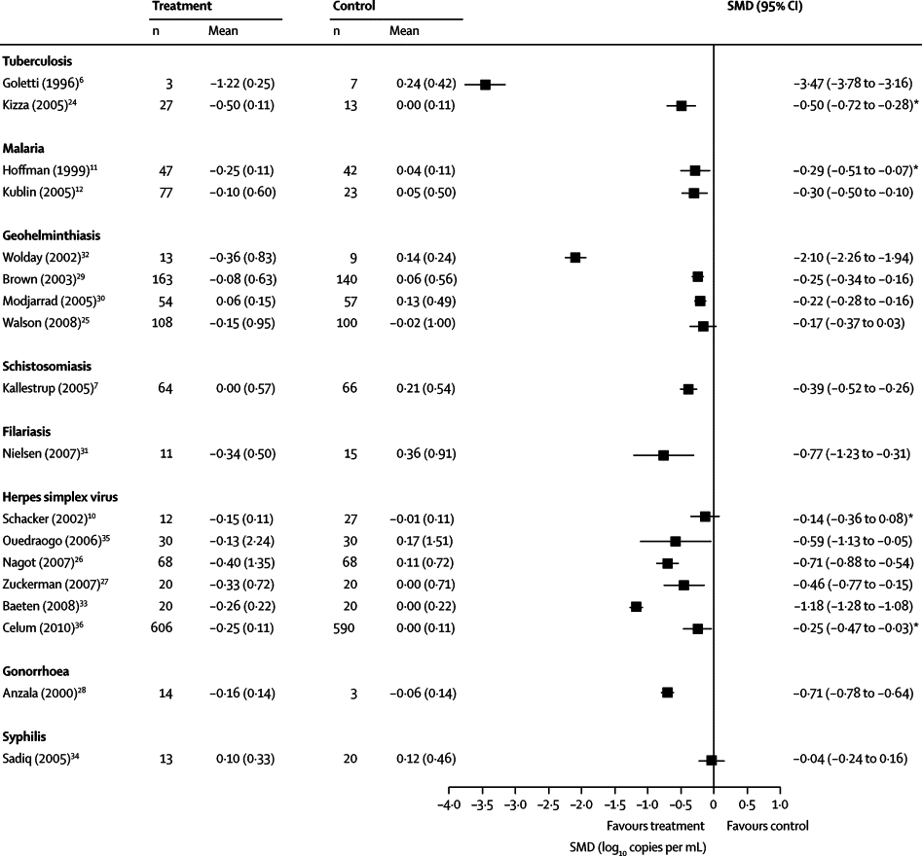
HIV and co-infection
The Lancet Infectious Diseases, Volume 10, Issue 7, Pages 455 - 463, July 2010

Slide 46
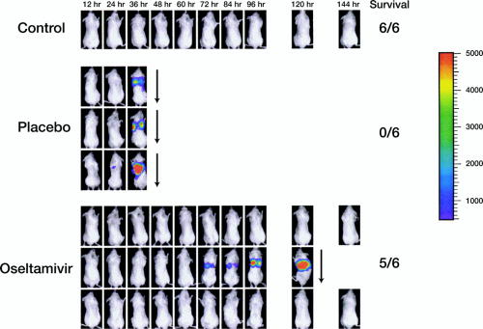
Influenza and bacteria
These effects have to be exquisitely timed: usually 3-7 days after influenza infection for most models

Slide 47
Proposed mechanisms
Epithelial damage by the virus (killing, NA activity) creating more hospitable niches for the bacteria
Innate immune alterations—suppressive environment (corticosteroids, Treg activity, innate recognition refraction)
Loss of “tolerance”

Slide 48
Schistosomiasis modeling
Between-host:
Chan et al (1995) Epid Inf, Chan et al (1996) Acta Tropica, Chan et al (1996) Am J Trop Med Hyg, French et al (2010) PLoS Neg Trop Dis, Gurarie et al (2005) Parasitology, Liang et al (2002) Acta Tropica, Liang et al (2005) Trop Med Int Health, Liang et al (2005) PNAS, Riley (2008) PloS Med, Anderson & May (1991) (book), Liang et al (2008) PLoS Med (review), Woolhouse (1991) Acta Tropica (review)
Within-host:
Chiyaka et al (2010) Comp Math Meth Med, ???

