Slide 1






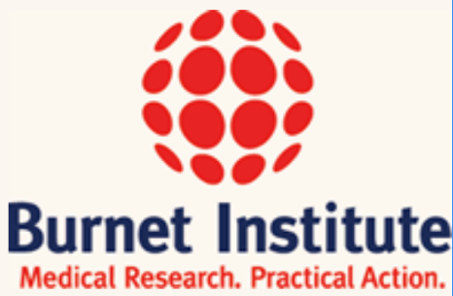




Notes:
Multi-model exercise coordinated by the TB Modelling and Analysis Consortium. A global call went out

