Slide 1
Fitting Basics EPID/ECOL/IDIS 8515 – Fall 2015
Andreas Handel Department of Epidemiology and Biostatistics College of Public Health, University of Georgia
ahandel@uga.edu

Slide 2
What we did so far
We built various mechanistic, dynamical models
We used the models for different purposes
Understanding: We can use mechanistic models to gain conceptual insights into a system’s behavior such as “how do the various components of a system interact to affect overall outcomes of interest (e.g. prevalence/incidence)”
Prediction & What-if scenarios: We can make specific testable predictions and perform virtual experiments that would be unfeasible or hard to do (costly, lengthy, unethical). For instance we can make predictions about the impact of a vaccine on incidence/prevalence.

Slide 3
Our models and data
Our models are formulated based on known biology.
Values of model parameters are chosen based on known biology.
If we trust that the model is a good approximation of reality, we can take results “serious”.
We can (qualitatively) compare model results with data/known facts.
Ultimately, models should be tested against data in a rigorous (quantitative, statistical) manner.

Slide 4
Close contact of models and data
We can use rigorous statistical approaches to bring models and data in contact with each other
This allows us to statistically discriminate between alternative models.
Since our models are mechanistic, we therefore discriminate between alternative mechanisms.
Each model represents a hypothesis about specific mechanisms, we can therefore use models for hypothesis testing.

Slide 5
Hypothesis testing - Example
Norovirus can cause infection through a common source (e.g. food), or transmit person-to-person. It’s often not clear what role each route of transmission plays for a given outbreak.
The Question: For a given Norovirus outbreak, is transmission purely person-person, or is there a common environmental source? (Hypothesis: person-person transmission is the only transmission mechanism for a given outbreak)

Slide 6
Hypothesis testing - Example
Answering the question: Formulate alternative mathematical models that explicitly include the postulated mechanisms.
Fit models to data and see which one performs best.
External source

Slide 7
Hypothesis testing - Example
Model with constant source (λ>0 for duration of outbreak) did not perform better than no source (λ=0).
Model with extra source between Dec 10-12 (λ>0 between 12/10-12/12, λ =0 otherwise) did best (AIC comparison).

Slide 8
Parameter estimation - Example
In addition to hypothesis/mechanism testing, fitting models to data can be used for parameter estimation.
Those parameters often have direct biological meaning and it is therefore useful to know them. For instance what would be the interpretation if we found as best fit value d=0.5?
What’s wrong with this?

Slide 9
Model fitting – some terminology
By “model” we now mean both our usual mechanistic dynamical model and some statistical model.
In the previous example, we employed a statistical model describing the error between the differential equation model and data. We’ll get into that in more detail.
The terms “model fitting” or “statistical inference” are used interchangeably.

Slide 10
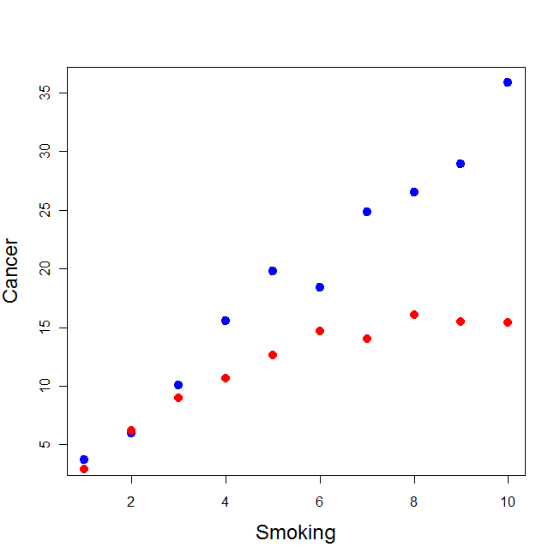
Non-mechanistic models
You might be familiar with fitting of simple, non-mechanistic, non-dynamical models.
We use those models to find correlations, or more generally, patterns in the data.
Most statistical models are non-mechanistic.

Slide 11
Non-mechanistic models - Advantages
Finding correlations/patterns is (relatively) simple.
Sometimes we can go from correlation to causation.
We don’t need to understand the underlying mechanisms. We can determine that input is correlated with (causes) output (e.g. smoking causes cancer) without having to understand how.

Slide 12
Non-mechanistic models - Disadvantages
The jump from correlation to causation is always tricky since so many things can go wrong (bias/confounding/systematic errors).
Even if we can assume a causal relation, we do not gain any mechanistic insights (e.g. we don’t know how smoking causes cancer).

Slide 13
Model fitting - comparisons
Compare these sets of models
We can use both to draw conclusions from our data
The mechanistic models are more “explicit/direct”

Slide 14
How to fit models to data
Get yourself some data, write down one (several) model(s).
For the model, we usually need to specify two parts:
Deterministic (or stochastic) “real” model
A model describing the distribution of the data to account for mis-matches between the model and data

Slide 15
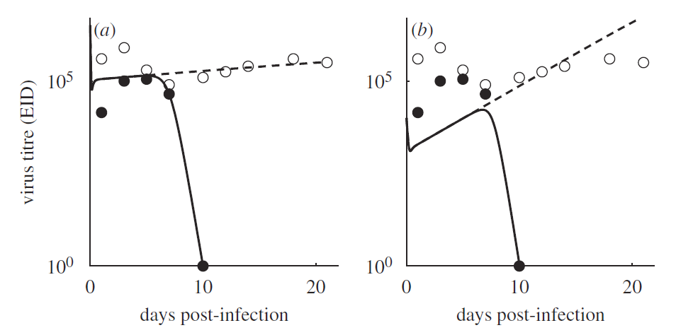
How to fit models to data
Goal: To “match” data and model as best as possible, i.e. find a model that describes the data well.
Handel et al. (2010), Journal of the Royal Society Interface

Slide 16
How to fit models to data
Choose initial guesses for the model parameters that you want to fit. Note: For fitting, unknown initial conditions of variables are treated like unknown parameters.
Compute model results for the given parameters. If you have a dynamical model, simulate your model (e.g. integrate the differential equations).
Determine the quality of your fit.
Change the values for some/all parameters, evaluate model again, re-evaluate differences between model and data.
Keep doing this until changing parameters does not further improve the match between data and model. You (hopefully) found the best fit.

Slide 17
Possible fitting outcomes – “Failure”
If a model does not fit the data well, we suspect that the hypotheses/biological mechanisms underlying the model (or our implementation of them) are not correct.
If we built our model(s) based on biologically reasonable assumptions, we have learned something useful.
Model rejection can sometimes be very insightful – maybe even more so than having a model that fits well.

Slide 18
Possible fitting outcomes – “Success”
If a model fits the data well, it lends support to our hypotheses about certain mechanisms/causal relations underlying the biological system.
But: It is possible to produce models that describe/fit the data very well but are wrong or useless. For instance a polynomial model with enough parameters can pretty much always fit, but is useless for the purpose of gaining mechanistic insights.
(Large) mechanistic models are often so flexible that they can fit all kinds of data, without allowing one to conclude that the mechanisms included in the model are actually the ones important for the real system.
“With four parameters I can fit an elephant, and with five I can make him wiggle his trunk.” — John von Neumann

