Slide 1
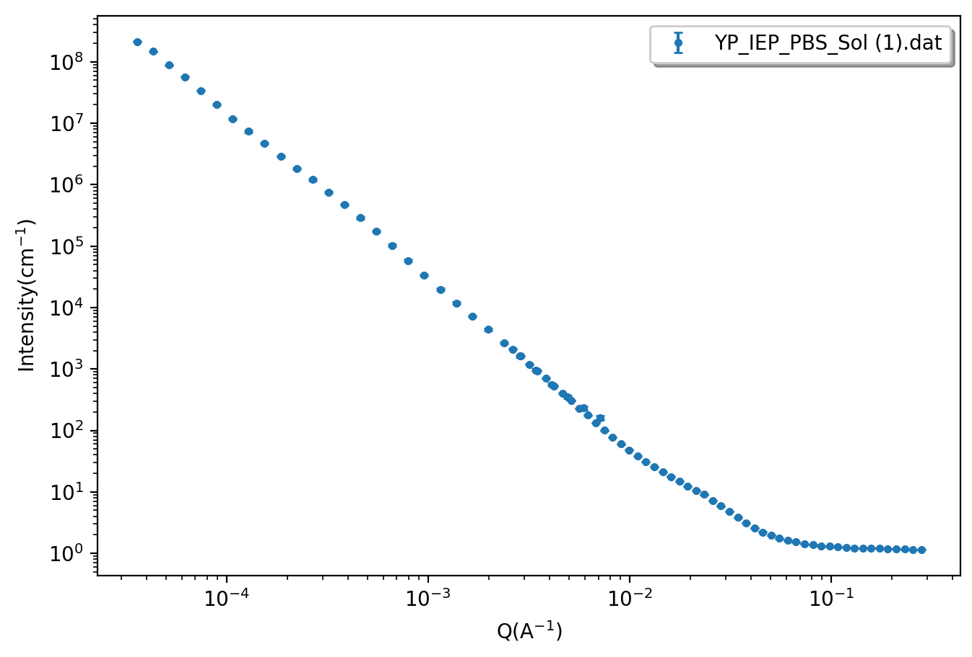
Slope
Guinier
Background

