Slide 1
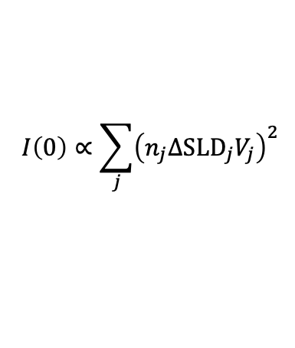
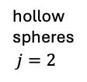
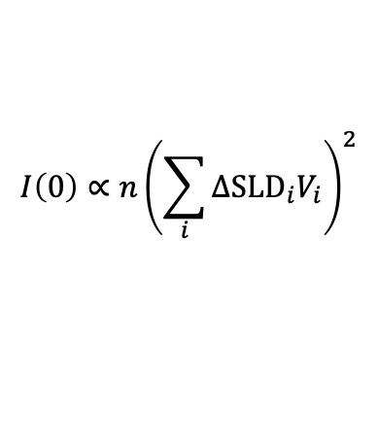
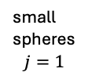


parts of particle with different ΔSLD
mix of particles with different ΔSLD
shell: $i=2$
small
spheres
$$j=1$$
hollow
spheres
$j=2$
core: $i=1$
$$I\left(0\right)∝{n\left(\sum_{i}{ΔSLD_{i}V_{i}}\right)}^{2}$$
$$I\left(0\right)∝\sum_{j}{{\left(n_{j}ΔSLD_{j}V_{j}\right)}^{2}}$$

