Slide 1
scoring.dance
Judging Tablet System
Complete Guide for Judges
Tablet Training

Slide 2
What is scoring.dance?
scoring.dance is a modern, professional tablet-based judging system for dance competitions worldwide.
• Real-time Scoring - Continuous sync with central system
• Multiple Modes - Scale, RAW, and TheOpen judging methods
• WSDC Compliant - Full adherence to registry event rules
• Constantly Development – New features every month
• Saves logs directly on the tablets
📹 Video Tutorial: https://www.youtube.com/watch?v=_3484YFtm7A

Slide 3
Getting Started
⚠️ CRITICAL: Keep all liquids away from tablets!
Receiving Your Tablet
• Tablets are distributed at the Judge Meeting Point
• Handle with care - use two hands when moving
• Report any damage immediately to Head Judge
• Never place near liquids or on unstable surfaces
After Each Round
• Return immediately to Judge Meeting Point
• Hand directly to official - never leave unattended

Slide 4
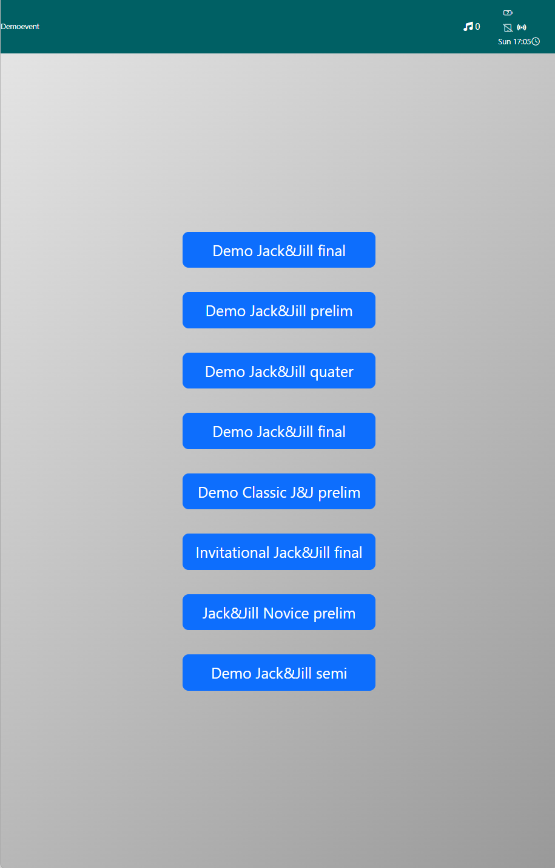
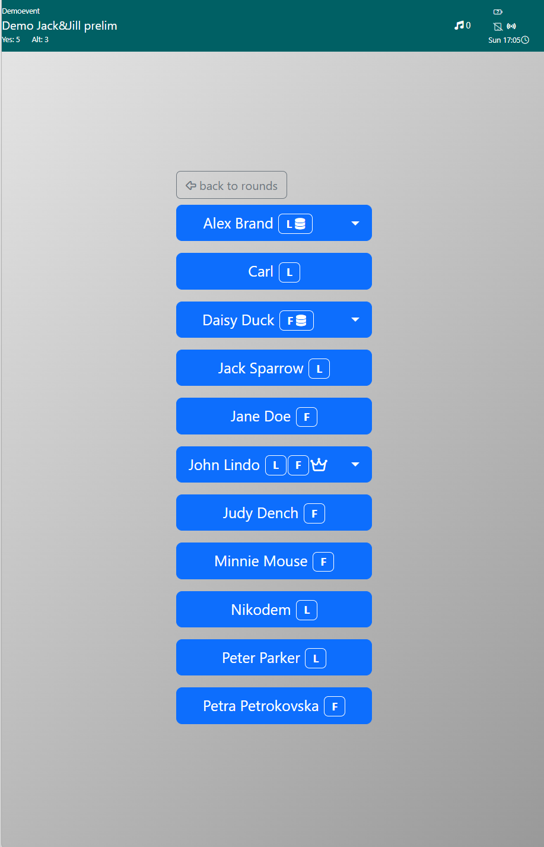
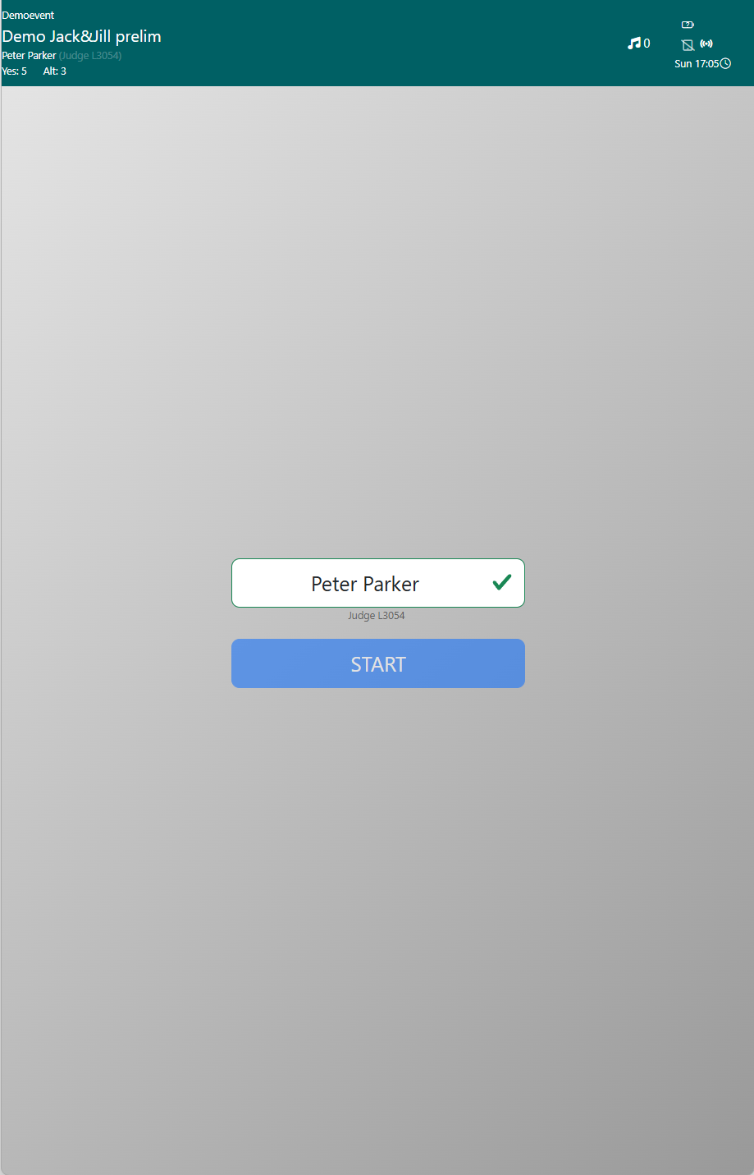
Login Process - 4 Simple Steps
1. Select Competition - Tap your assigned event from the list
2. Select Judge Name - Find and tap your name or replacement
3. Verify Name - Check spelling, modify if needed
4. START - Begin judging the round

Slide 5
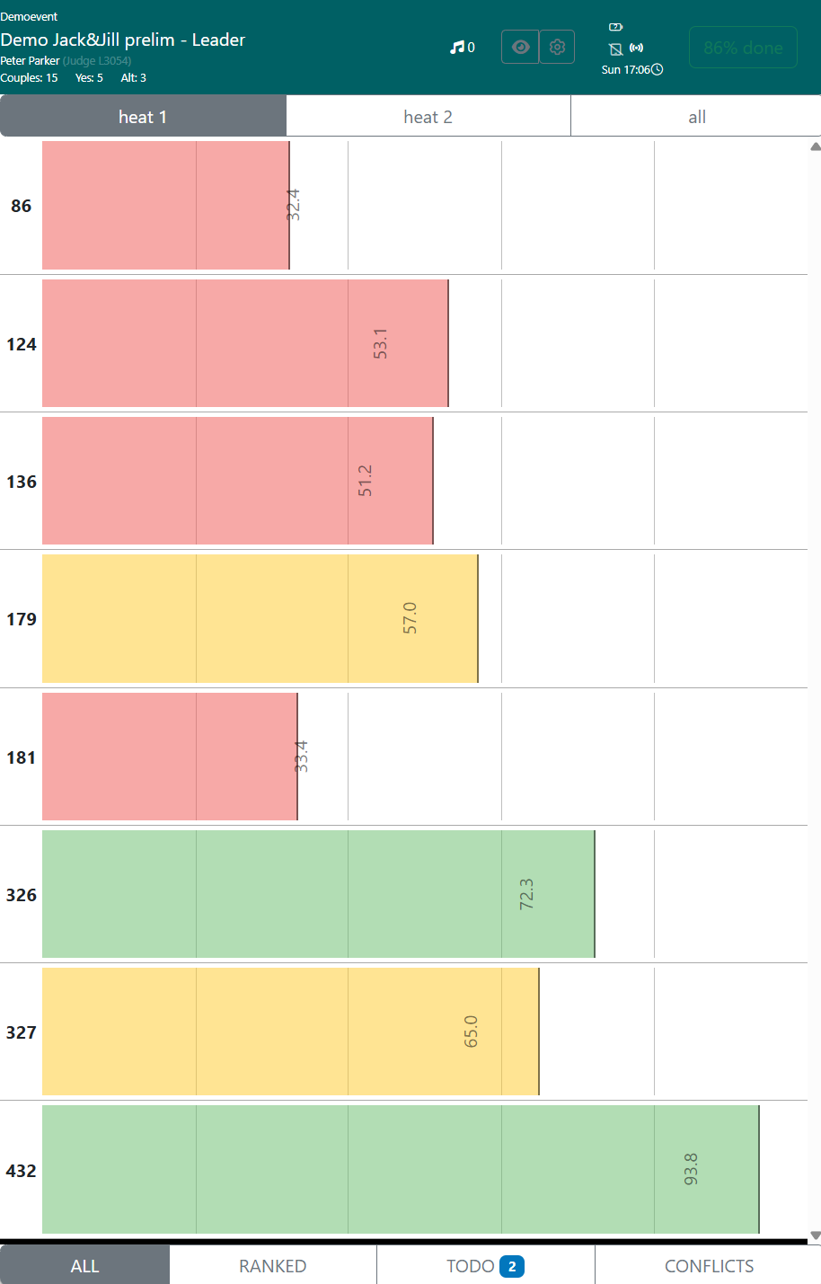
Main Screen Overview
Screen Sections
• Header: Event name, round, your name & Judge ID, cuts, time
• Heat Tabs: heat 1, heat 2, all (combined view)
• Scoring Area: BIB numbers, names, role (L/F), scores
• Controls: 👁️ Privacy, ⚙️ Settings, ✅ DONE button
Bottom Navigation Tabs
• ALL - Primary judging location (RECOMMENDED)
• TODO - Find remaining dancers to score
• RANKED - NOT recommended (confusing)

Slide 6
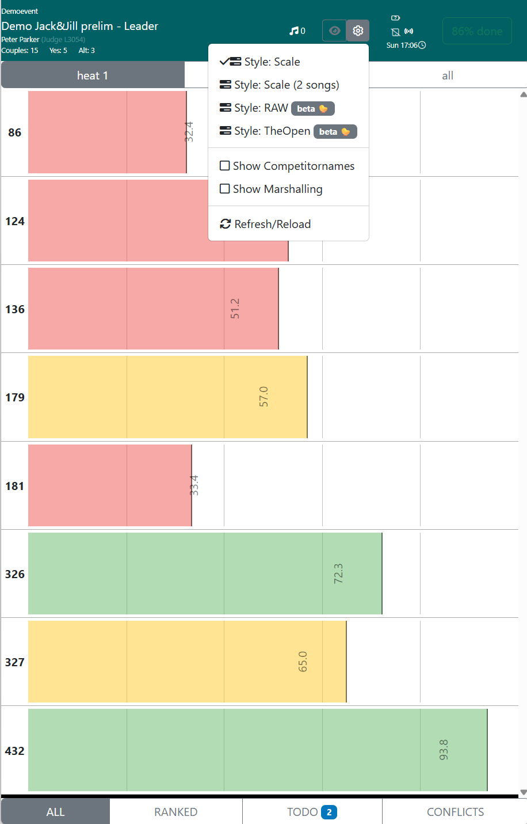
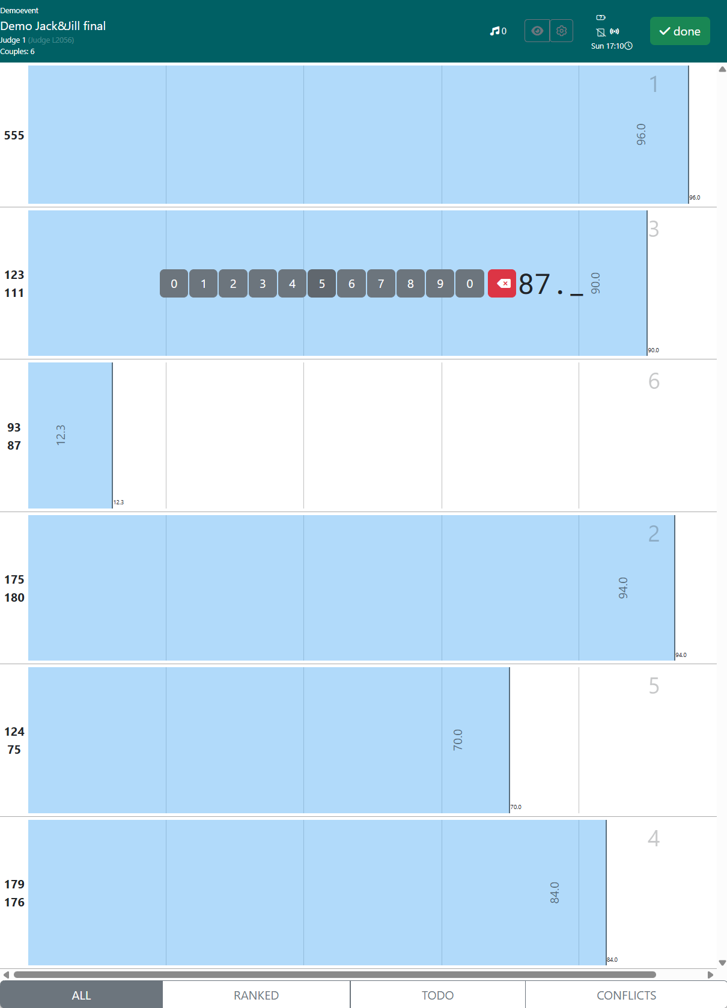
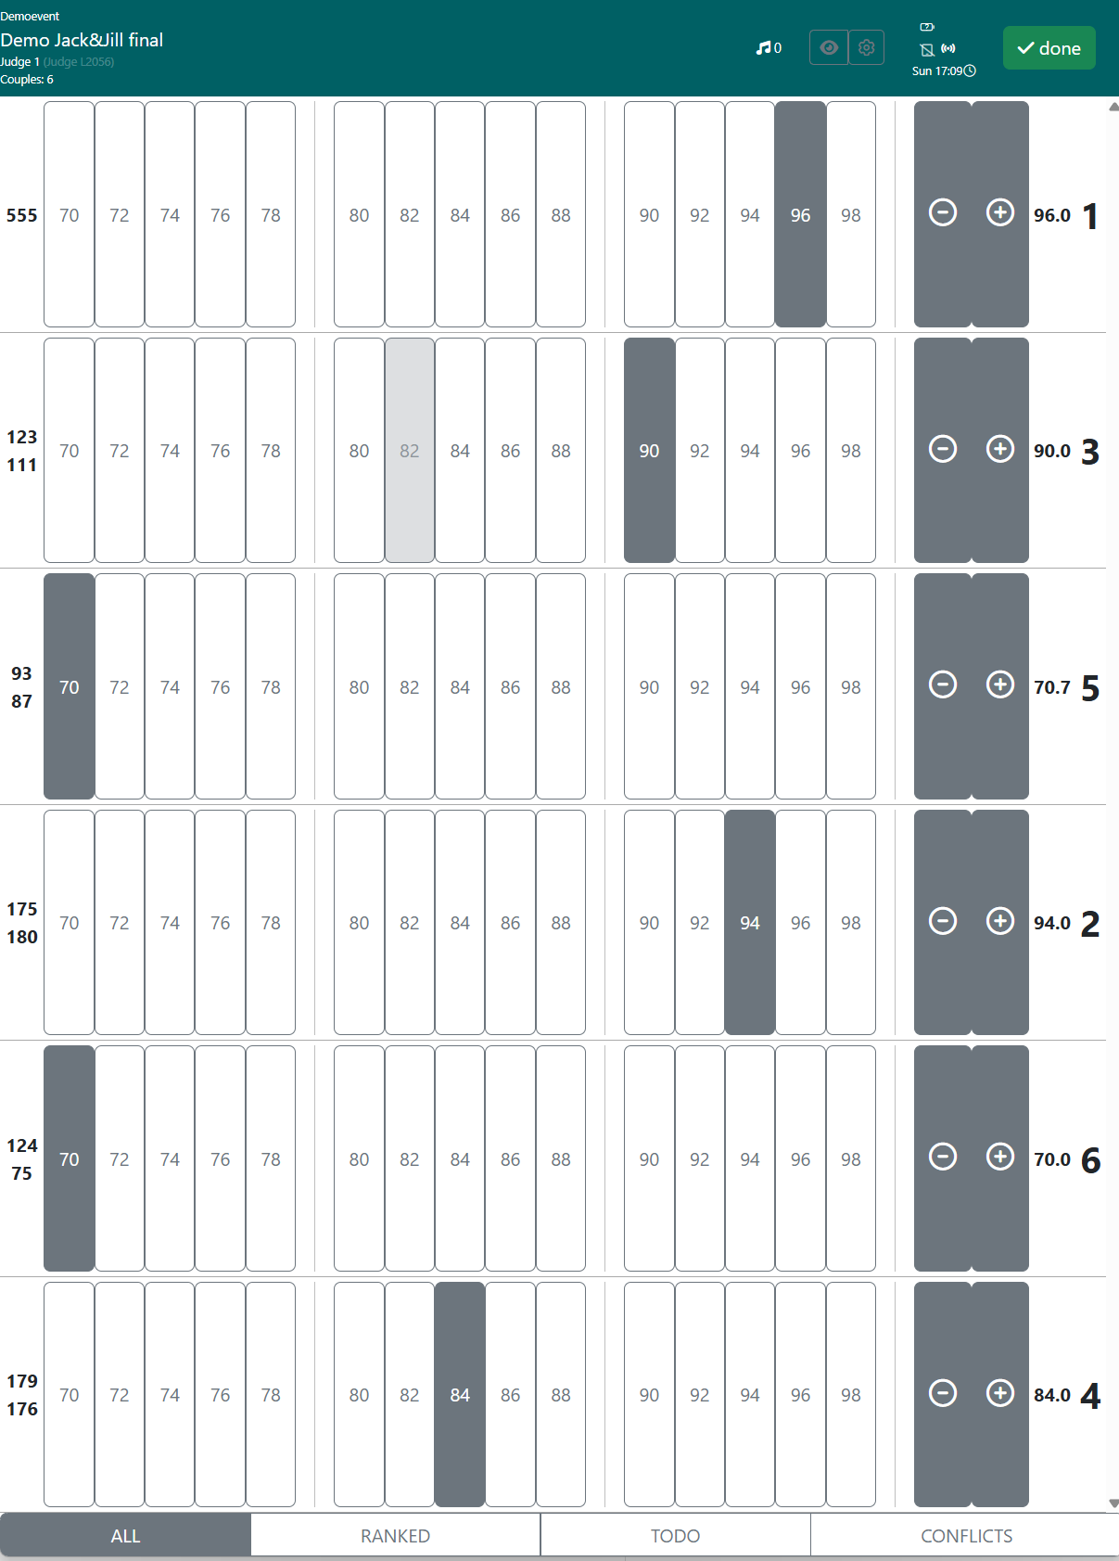
Judging Modes
Scale Mode (RECOMMENDED)
Double-click on horizontal scale from left (bad) to right (good).
7-decimal precision means no duplicate scores!
RAW Mode
TheOpen Mode
Scale (2 songs)
Manual 3-digit entry
Can create conflicts
Range 70-100
+/- fine-tuning
For spotlights
with 2 songs
Scale (2 songs) Mode: For spotlight finals - automatically averages both scores

Slide 7
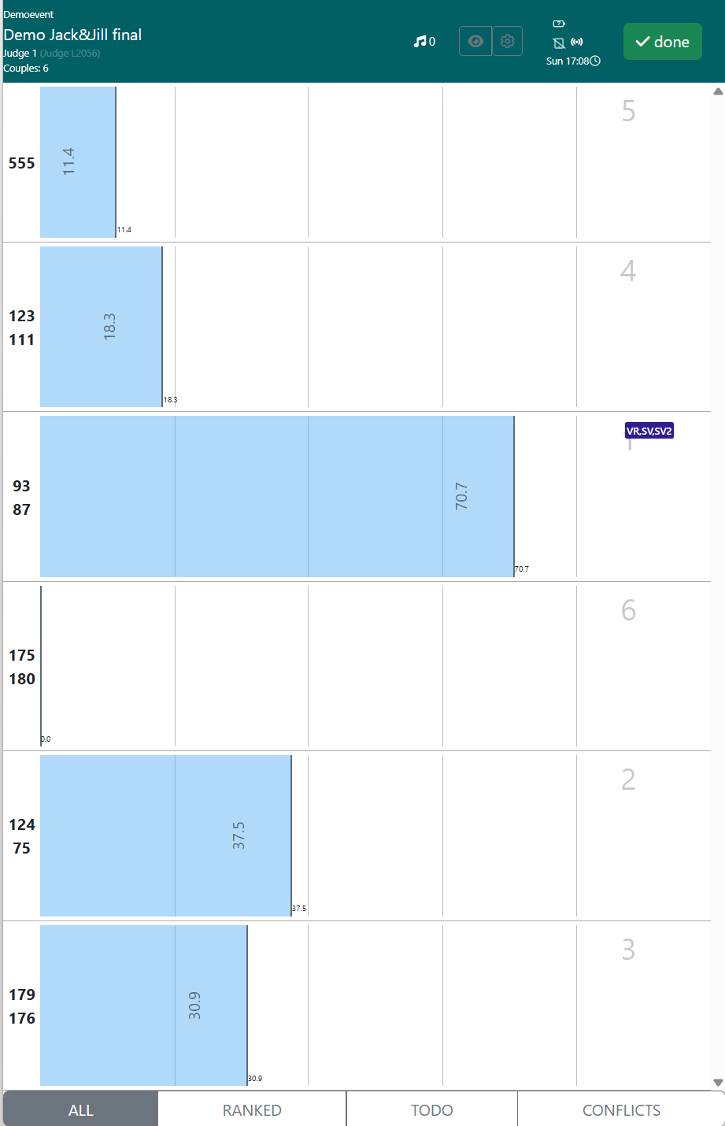
Finals Rounds (Placements)
How Finals Work:
1. Score each competitor
2. System sorts by raw scores
3. Highest = 1st, second = 2nd, etc.
4. All judges combined via Relative Placement

Slide 8
Best Practices ⭐
✅ DO
❌ DON'T
• Use ALL tab for judging
• Use RANKED tab for judgging
• Use TODO at 80-90%
• Place liquids near tablets
• Judge independently
• Compare scores with other judges
• Check before DONE
• Rush judgments
Judge fairly, independently, and to the best of your ability

Slide 9
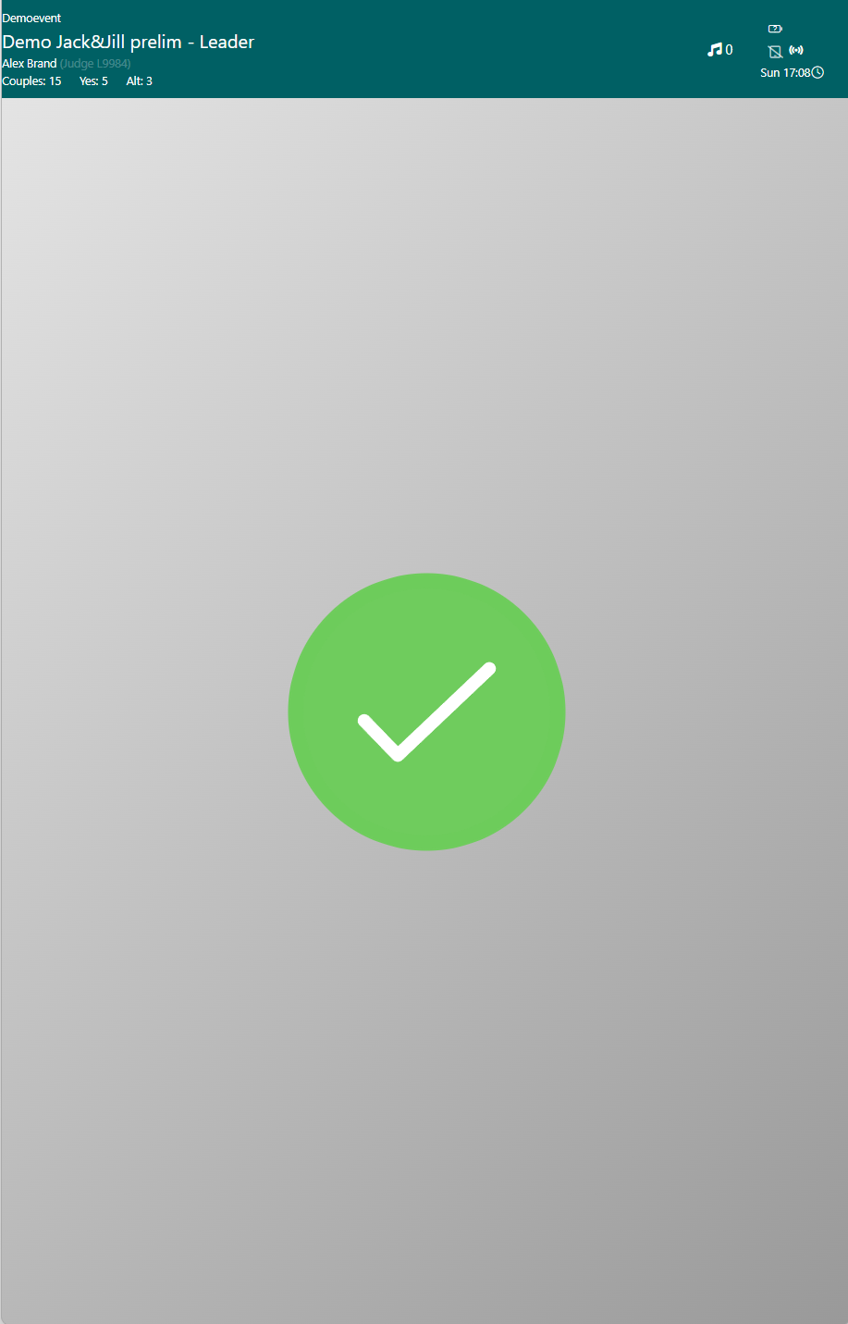
Completing Your Judging
• 0-99%: Gray button - keep scoring!
• 100%: GREEN button - ready to submit!
• OFFLINE: Red - wait for connection
Submission Process:
1. Click DONE button
2. Confirm "Absolutely sure?"
3. Scores sent to server
4. Green checkmark ✓ appears
⚠️ Green checkmark = scores finalized (your digital signature)

Slide 10
Quick Troubleshooting
❌ Wrong dancer scored
✓ Score again - latest overwrites
❌ Won't reach 100%
✓ Use TODO tab, check all heats
❌ Screen blank
✓ Eye icon - tap anywhere
❌ Duplicate scores
✓ CONFLICTS tab - change by 0.1
🔴 OFFLINE: Continue scoring (saved locally). Auto-syncs when online.

Slide 11
Resources & Questions
📹
Video Tutorial Available
https://www.youtube.com/watch?v=_3484YFtm7A
Quick Reference:
• Use ALL tab for primary judging
• Scale Mode recommended (no conflicts)
• TODO tab finds remaining dancers
• 100% + Green DONE = submit
• Return tablet after green checkmark
scoring.dance

