Slide 1


The Programmers Team Project: Student Management

Slide 2
The Student Management System
The Programmers Team is a group of 4 college students on their 1st year of study computer & network technician.
Our names are :
Simos , Antreas , Matheos , Mahmout.
We came up with the idea to create a student management system to help our college to contribute to the student and professors records data management!

Slide 3
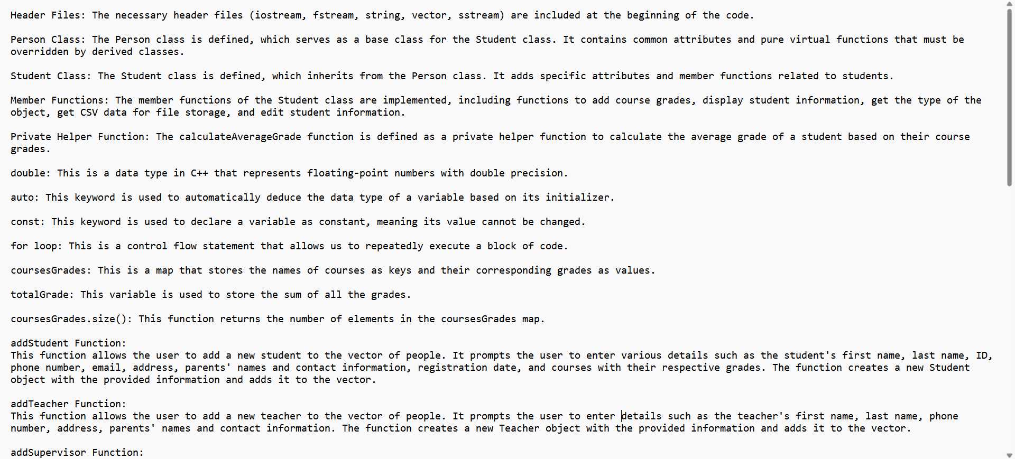

Code Explained

Slide 4
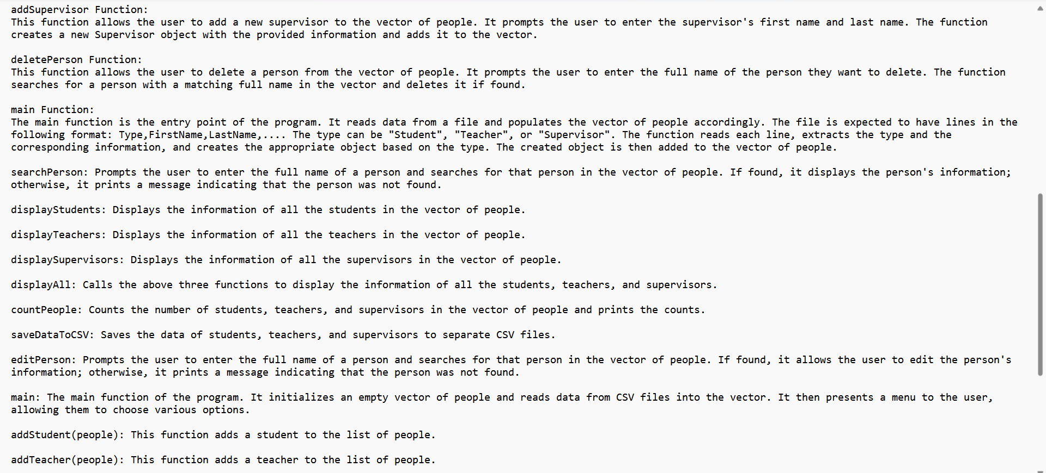
Code Explained

Slide 5
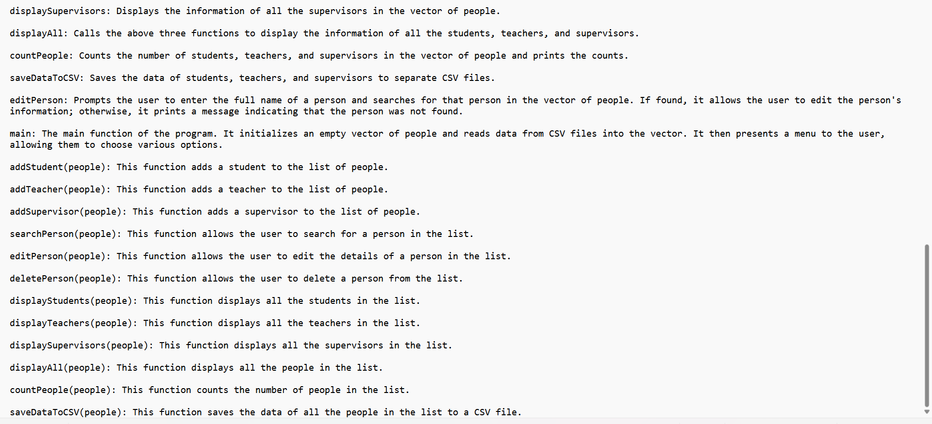
Code Explained

Slide 6
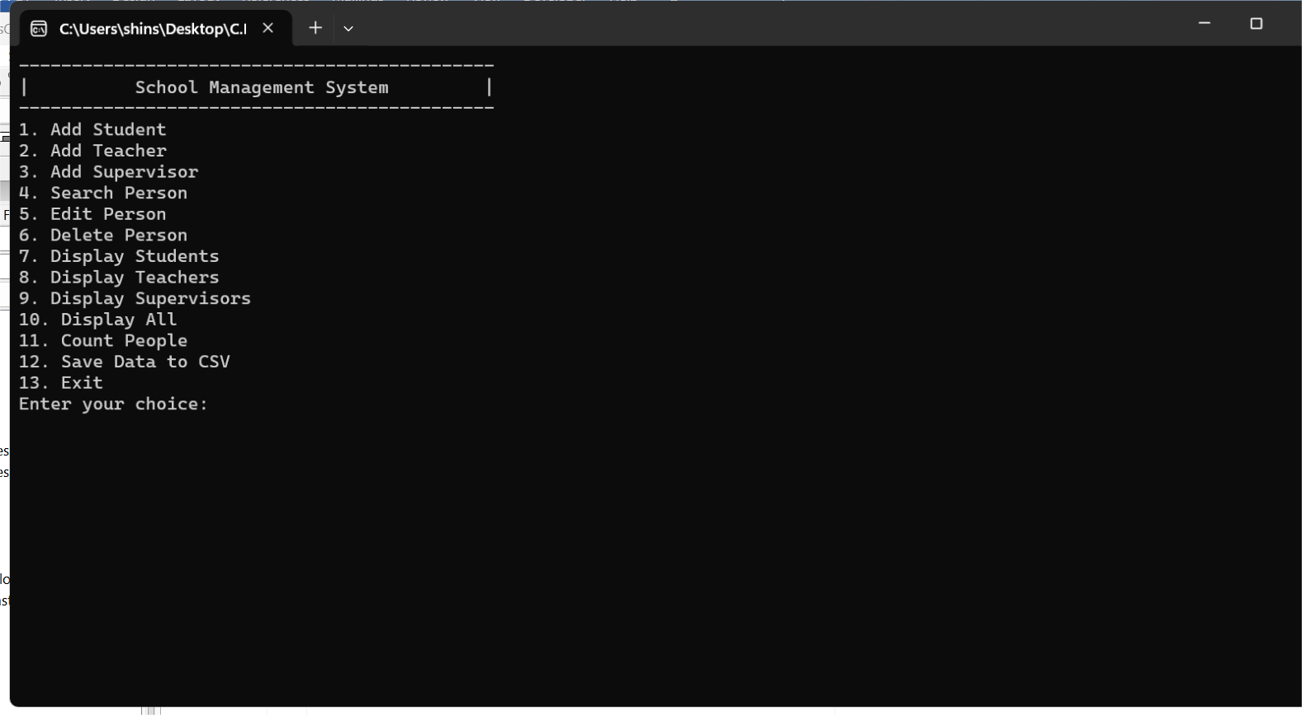

Slide 7

The Programmers Team
Thank you very much

