Slide 1

WP5 | T5.1
Outdoor UAV
configuration
XTRACT 7th General Assembly
Online | 14 October 2026
Andreas Lefkatis
T5.1 Task Lead | ACCELIGENCE
andreas.lefkatis@acceligence.cy
Drone provision and platform validation
This project has received funding from the European Union’s Horizon Europe Research and Innovation Programme under Grant Agreement no. 101138432
Notes:
SPEAKER NOTES
Our WP5 contribution focuses on providing the outdoor UAV platform and demonstrating its flight capability. I will show the platform evolution, the completed design and testing work, and our collaboration with USAL. ACCELIGENCE provides the drone; the sensor results and their analysis belong with USAL. Detailed pilot scenarios are covered in WP8.
SOURCE / CONFIRMATION
Latest user instruction defines the ACCELIGENCE/USAL roles. Grant Agreement, Annex 1, T5.1, PDF pages 71–72: Airborne tailings assessment – Satellite-based augmentation systems, M19–M30. Presenter details: September update. Meeting branding/date: supplied 7th GA template.
PRESENTER UPDATE
The earlier progress presentations call this task Robotics for mining automation and show M06–M18. This deck uses the WP5/T5.1 identifier and a precise outdoor-platform subtitle, and does not repeat the conflicting task name, duration or deliverable references.

Slide 2
T5.1 – Outdoor platform evolution
From completed assembly to field testing and the final mine demonstration
01
02
03
June 2026
September 2026
Final Björkdal pilot
›
›
Assembly & lab checks
Field-tested platform
Mine demonstration
• Frame and systems assembled
• Outdoor configuration finalised
• Outdoor flights performed
• Power and avionics integrated
• Multiple field-test campaigns
• Multispectral camera onboard
• Lab and initial flight tests
• Flights with multispectral camera
• Detailed findings: USAL / WP8
Outdoor UAV platform completed, field-tested and deployed in the final pilot.
EU Horizon Europe | GA 101138432
XTRACT 7th GA | Online | 14 October 2026
2
Notes:
SPEAKER NOTES
The outdoor platform has moved through three clear stages. In June, the structure and systems were complete, with laboratory checks and field testing underway. By September, the configuration was finalised and multiple field campaigns, including flights with the multispectral camera, had been conducted. The final Björkdal pilot has now included the outdoor configuration. These are platform and deployment achievements; USAL presents the sensor-derived findings.
SOURCE / CONFIRMATION
June WP5 GA deck: slides 2–4. September WP5 update: slide 4. User WP8 update confirms outdoor flights with the multispectral camera at Björkdal.
PRESENTER UPDATE
This completes the evidenced outdoor platform work. Sensor calibration, scientific interpretation and formal acceptance of related results remain separate from the platform achievements reported here. The task lead confirmed the presentation scope after reviewing the earlier remaining-activity list.

Slide 3
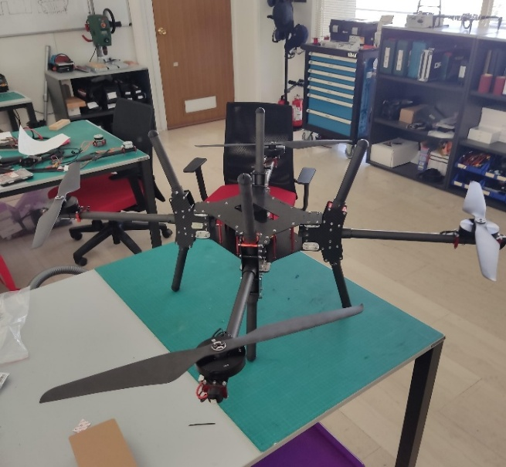
T5.1 – Outdoor configuration completed
ACCELIGENCE provides the UAV platform for the joint sensing missions
Structure & manufacturing
Mechanical layout completed; frame manufactured and assembled.
Integrated flight systems
Propulsion, power distribution, communications and flight control integrated.
Mission payload support
Platform prepared for payload integration; multispectral-equipped flights completed.
Outdoor UAV assembly • previous GA
Completed contribution: outdoor UAV design, manufacturing, assembly and flight capability.
EU Horizon Europe | GA 101138432
XTRACT 7th GA | Online | 14 October 2026
3
Notes:
SPEAKER NOTES
Our contribution is the drone and its readiness for the joint missions. The mechanical design and manufacture are complete, as is assembly of propulsion, electrical, avionics, communication and flight-control systems. The platform supports payload integration, with multispectral-equipped flights already performed. The image shows the actual assembled outdoor configuration from the previous GA.
SOURCE / CONFIRMATION
June WP5 GA deck, slides 2–4: design, manufacture, systems integration and outdoor platform readiness. September update, slide 4: finalised configuration and multispectral-camera flights.
PRESENTER UPDATE
Do not present the earlier assembly photograph as a final Björkdal pilot photograph. Avoid quoting endurance, maximum payload, rotor count or power configuration as measured or accepted specifications without the confirmed as-built data.

Slide 4
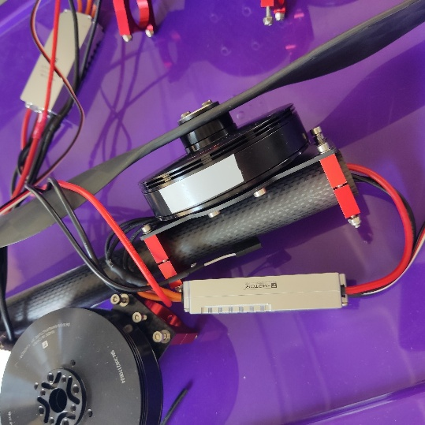
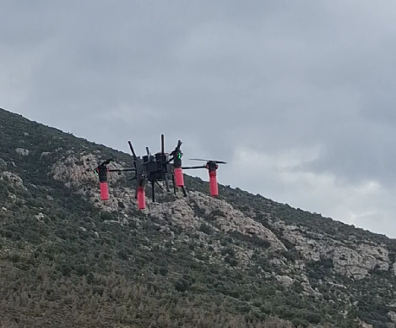
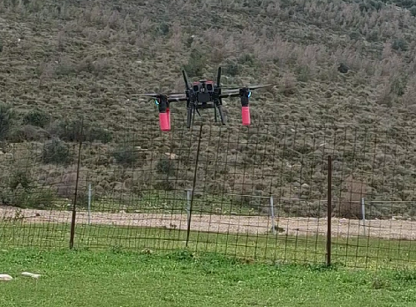
T5.1 – Platform testing and validation
Laboratory checks, progressive outdoor flights and mission-load simulation
Laboratory checks
Outdoor flight tests
Payload simulation
Thrust, current and
thermal behaviour checks.
Controller and propulsion
tuning in outdoor flights.
2.5 kg dummy payload
for mission-load simulation.
The test programme supported platform readiness for the joint USAL missions.
EU Horizon Europe | GA 101138432
XTRACT 7th GA | Online | 14 October 2026
4
Notes:
SPEAKER NOTES
The test programme covered the vehicle itself: laboratory thrust, current and thermal behaviour checks, outdoor flight campaigns, and tuning of flight control and propulsion response. The 2.5 kg dummy payload simulated the mission load. This is evidence of flight behaviour under load; it does not establish scientific sensor performance.
SOURCE / CONFIRMATION
June WP5 GA deck, slides 2–3, documents laboratory tests, controller/propulsion tuning and 2.5 kg dummy-payload flights. All three images are from the previous GA deck.
PRESENTER UPDATE
No quantitative stability, endurance, survey accuracy or sensor-validation result has been invented. Photographs represent earlier laboratory/field work, not the October Björkdal demonstration.

Slide 5
T5.1 – Joint missions with USAL
Drone provision and flight capability support the sensor results reported by USAL
ACCELIGENCE
USAL
UAV platform
Sensor results
• Outdoor configuration and assembly
Joint flight
campaigns
• Coordination of sensing requirements
• Drone provision and flight readiness
• Sensor data processing and analysis
• Platform testing and payload support
• Interpretation and reporting of results
Björkdal: outdoor flights with the multispectral camera completed.
Detailed pilot scenarios: WP8. Sensor results and interpretation: USAL.
EU Horizon Europe | GA 101138432
XTRACT 7th GA | Online | 14 October 2026
5
Notes:
SPEAKER NOTES
The role distinction is central to our WP5 presentation. ACCELIGENCE provides the drone, its outdoor configuration and the tested flight platform. We collaborate with USAL on the sensing requirements and the joint flight activities. The sensor data, analysis and interpretation of results are reported by USAL. For Björkdal, the task-level update is that outdoor flights with the multispectral camera have been completed; WP8 covers the pilot scenarios in detail.
SOURCE / CONFIRMATION
Latest user instruction explicitly assigns drone provision to ACCELIGENCE and the results to collaborating partner USAL. Previous GA slide 5 documents integration coordination with USAL; user WP8 update confirms the Björkdal outdoor/multispectral flights.
PRESENTER UPDATE
This slide describes responsibilities, not a signed-off data transfer. Do not claim that all data have already been delivered, analysed or accepted. Add detailed flight findings after the team debrief and keep sensor conclusions attributed to USAL.

Slide 6
T5.1 – Risks and mitigations
Managed platform risks; pilot-specific lessons to be consolidated after the debrief
Risk / constraint | Potential impact | Mitigation implemented | Evidence / follow-up
Payload loading | Added mass affects flight behaviour | Thrust evaluation; outdoor flights with a 2.5 kg dummy payload. | Laboratory checks and mission-load simulation
Electrical / thermal behaviour | Excess current or overheating | Current and thermal monitoring during laboratory propulsion checks. | Lab test campaign completed
Payload integration | Interfaces or sensor readiness delay missions | Coordination with USAL; progressive integration and multispectral-equipped flights. | Multispectral flights completed; sensor results reported by USAL
Outdoor deployment | Field conditions affect platform operation | Progressive controller tuning and repeated outdoor flight campaigns. | Björkdal flights completed; detailed feedback pending
Add the confirmed Björkdal issues, fixes and residual limitations after the team debrief.
EU Horizon Europe | GA 101138432
XTRACT 7th GA | Online | 14 October 2026
6
Notes:
SPEAKER NOTES
Our recorded risks concern the platform and its integration into the mission. We examined loading effects through dummy-payload tests and monitored propulsion current and thermal behaviour in the laboratory. We addressed integration readiness through coordination with USAL and progressive flight campaigns. Outdoor field testing and controller tuning supported deployment. Detailed issues encountered at Björkdal and their mitigations will be added after the flight team provides feedback.
SOURCE / CONFIRMATION
June WP5 GA slides 2–3: thrust, current, thermal behaviour, field tuning and dummy-payload testing. June progress update slide 7: battery/endurance/modularity constraints. September update slide 4: multispectral-equipped flights. User confirms the completed Björkdal outdoor campaign.
PRESENTER UPDATE
These are platform risks, not the official project risk register. Formal risk numbers, likelihood, residual levels, severe-weather ratings and numerical test conclusions are not available. Dummy-payload flights validate platform loading behaviour; sensor-derived findings remain with USAL.

Slide 7
T5.1 – Next steps
Before Christmas | pilot feedback and joint reporting
01
Align the reporting with USAL
Connect ACCELIGENCE platform evidence with the sensor results and analysis reported by USAL.
02
Consolidate the pilot feedback
Record platform findings, observed issues and mitigations after the flight-team debrief.
03
Prepare the platform evidence
Compile configuration, testing and deployment evidence for WP5 reporting and the Final Review.
Outdoor platform completed; next steps concern feedback and reporting.
XTRACT 7th GA | Online | 14 October 2026
7
Notes:
SPEAKER NOTES
The outdoor UAV platform is complete. The next steps are coordination and reporting: align the platform evidence with USAL, gather pilot feedback, and prepare the configuration and testing record for the Final Review. Sensor results and their interpretation remain with USAL.
SOURCE / CONFIRMATION
Latest user clarification sets the scope as completed outdoor UAV provision and the confirmed multispectral pilot flights. The supplied template requests a before-Christmas next-steps slide; this is a reporting window, not a newly invented contractual deadline.
PRESENTER UPDATE
Add actual operational lessons once the flight team has debriefed. This slide proposes no additional platform development or flight campaign. Keep the scientific result claims attributed to USAL.

Slide 8
T5.1 – Final Review preparation
Until the end of the project | platform evidence and partner alignment
Completed outdoor UAV
Record the final platform configuration, integration interfaces and operating setup.
Testing and deployment
Link laboratory checks, dummy-payload tests, field campaigns and the Björkdal flights.
Joint WP5 story with USAL
Connect drone provision to the sensor results presented by USAL; keep pilot detail in WP8.
ACCELIGENCE provides the drone; USAL presents the sensor results.
XTRACT 7th GA | Online | 14 October 2026
8
Notes:
SPEAKER NOTES
The review narrative should explain the completed outdoor UAV and the evidence showing that it supports the sensing missions. Our platform contribution is backed by assembly, integration, laboratory checks, field campaigns and the final pilot deployment. USAL provides the sensor results and analysis. We should align our evidence and terminology while keeping the detailed pilot scenarios in WP8.
SOURCE / CONFIRMATION
User-defined partner responsibilities and presentation scope. Grant Agreement T5.1, PDF pages 71–72, includes vehicle selection and integration for airborne assessment. Prior progress decks and user updates document the platform milestones.
PRESENTER UPDATE
The evidence package is proposed for reporting; no formal deliverable acceptance, calibrated geophysical performance or completed USAL analysis is asserted.

Slide 9
This project has received funding from the European Union’s Horizon Europe Research and Innovation Programme under Grant Agreement no. 101138432
Andreas Lefkatis | ACCELIGENCE
andreas.lefkatis@acceligence.cy
Outdoor UAV: completed, tested and deployed
info@xtract-project.eu
https://xtract-project.eu/
https://www.linkedin.com/company/xtract-project/
https://www.youtube.com/channel/UC9eNoqHV2BLXc37Q_CTwFuQ
https://twitter.com/xtract_project
Notes:
SPEAKER NOTES
The outdoor UAV has evolved from assembly and laboratory testing to a finalised, field-tested configuration and deployment at Björkdal. ACCELIGENCE provides the drone; USAL reports the sensor results. We will consolidate pilot feedback and the platform evidence for the Final Review.
SOURCE / CONFIRMATION
Completed platform work is documented in the June/September decks. Björkdal outdoor flights and the ACCELIGENCE/USAL role distinction are confirmed by the user. Official branding and contact links retained from the supplied template.

