Slide 1

T7.3
Robotics for
mining automation
XTRACT 7th General Assembly
Online | 14 October 2026
Andreas Lefkatis
T7.3 Task Lead | ACCELIGENCE
andreas.lefkatis@acceligence.cy
Indoor configuration: from design to deployment
This project has received funding from the European Union’s Horizon Europe Research and Innovation Programme under Grant Agreement no. 101138432
Notes:
SPEAKER NOTES
Today I will focus on the evolution of the indoor configuration. The T7.3 technical activities are complete. We have moved from platform preparation to underground testing and demonstration at Björkdal. Detailed pilot scenarios and results are reserved for WP8.
SOURCE / CONFIRMATION
Presenter details: September 2026 progress deck, slide 1. Meeting date and branding: uploaded 7th GA template. Completion and Björkdal deployment: task-lead confirmation in this conversation.

Slide 2
T7.3 – From preparation to deployment
Indoor configuration completed; underground testing and demonstration performed
01
02
03
Previous GA | June 2026
Progress update | September 2026
Björkdal | October 2026
›
›
Design & preparation
Lavrion flight tests
Mine demonstration
• Indoor design and assembly
• Both configurations finalised
• Indoor activities completed
• Motor–ESC alternatives tested
• Indoor flights with and without payload
• Payload + SLAM/mapping demonstrated
• LiDAR/RGB/Jetson kit prepared
• Joint test activities with USAL
• Indoor and outdoor pilot scenarios
T7.3 technical activities completed — remaining work concerns results and reporting.
XTRACT 7th GA | Online | 14 October 2026
2
Notes:
SPEAKER NOTES
The main change since the previous General Assembly is the transition from a prepared indoor platform to a deployed system. At the previous GA, the design was finalised and the payload kit was ready, while final preparation was ongoing. By September, Lavrion flights had been completed with and without payload. We have now completed the indoor pilot activities at Björkdal, including payload and SLAM/mapping demonstration.
SOURCE / CONFIRMATION
June WP7 deck: slides 2–5. September WP5/T5.1 update: slide 4 documents indoor progress. User confirms no unfinished T7.3 technical activities; payload and SLAM/mapping demonstrated at Björkdal. Exact pilot dates and quantitative results are not assumed.
PRESENTER UPDATE
Core task completion is confirmed by the task lead. This is not a claim that every performance KPI, fragmentation result or deliverable has been formally accepted.

Slide 3
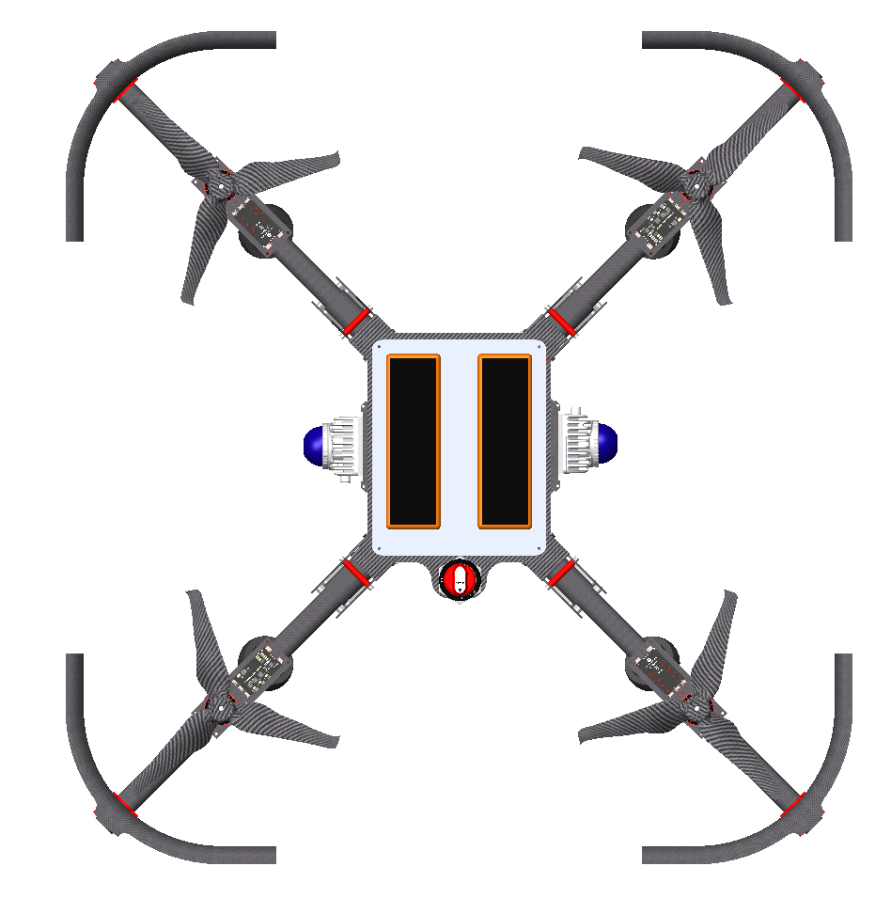
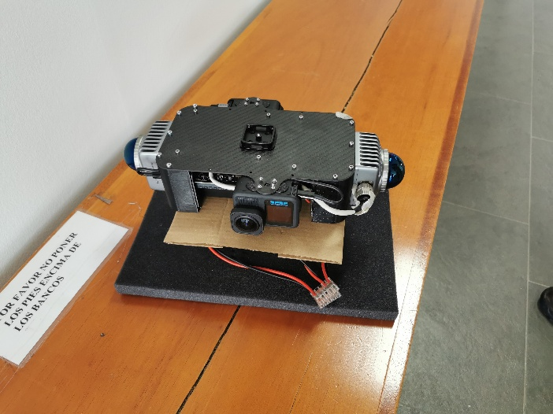
T7.3 – Indoor configuration completed
A compact mining configuration built on the modular XTRACT UAV architecture
Compact & protected
Reduced footprint and propeller guards for confined operations.
Modular architecture
Shared platform with configurable arms and payload interfaces.
LiDAR/RGB/Jetson payload kit
Prepared with USAL
Integrated payload
Designed • assembled
Tested • demonstrated
LiDAR, RGB and onboard computing; demonstrated at Björkdal.
Indoor configuration • design view
Completed platform work: design, manufacturing, assembly and indoor payload integration.
XTRACT 7th GA | Online | 14 October 2026
3
Notes:
SPEAKER NOTES
The indoor configuration uses the same modular platform architecture, with a compact layout and protective guards for confined spaces. The mechanical parts and payload kit were manufactured and assembled. The LiDAR, RGB and Jetson combination prepared with USAL has now been demonstrated at the pilot. These are platform achievements; the algorithm-level navigation results belong with the related USAL work.
SOURCE / CONFIRMATION
Grant Agreement: Annex 1, T7.3, PDF page 76. June WP7 deck: slide 2 for manufacturing, propulsion and payload kit. September update: slides 4 and 6, design image and Lavrion photographs. Integrated payload demonstration confirmed by the user.
PRESENTER UPDATE
The Grant Agreement describes an intended coaxial arrangement, while the progress-deck metrics list four motors. Do not assert rotor count, measured endurance, payload capacity or certified environmental protection without the as-built specification. The kit photograph is a preparation image from the previous GA, not a Björkdal pilot photograph.

Slide 4
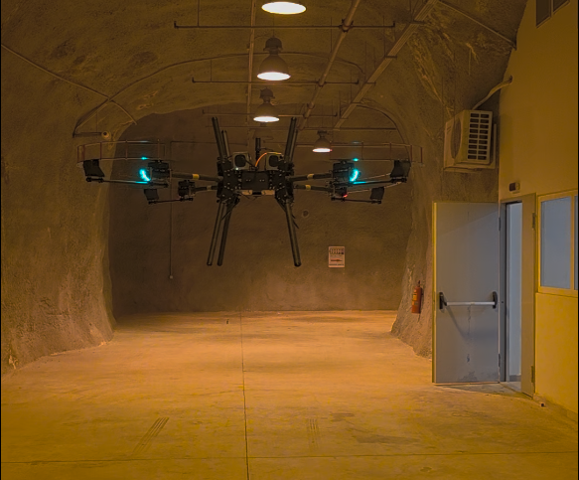
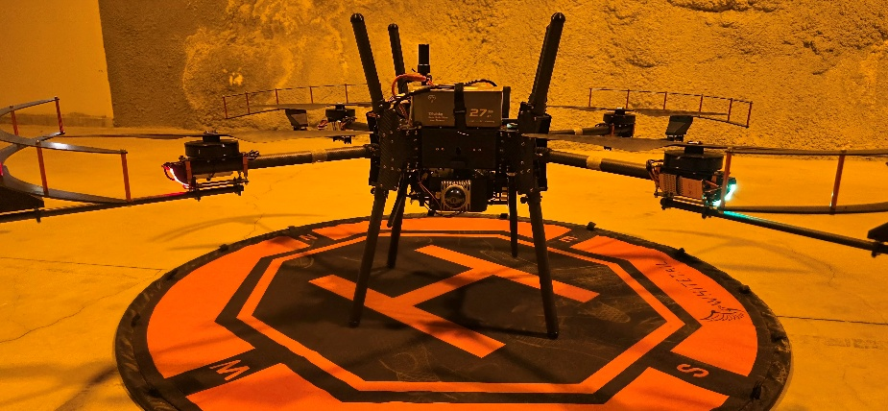
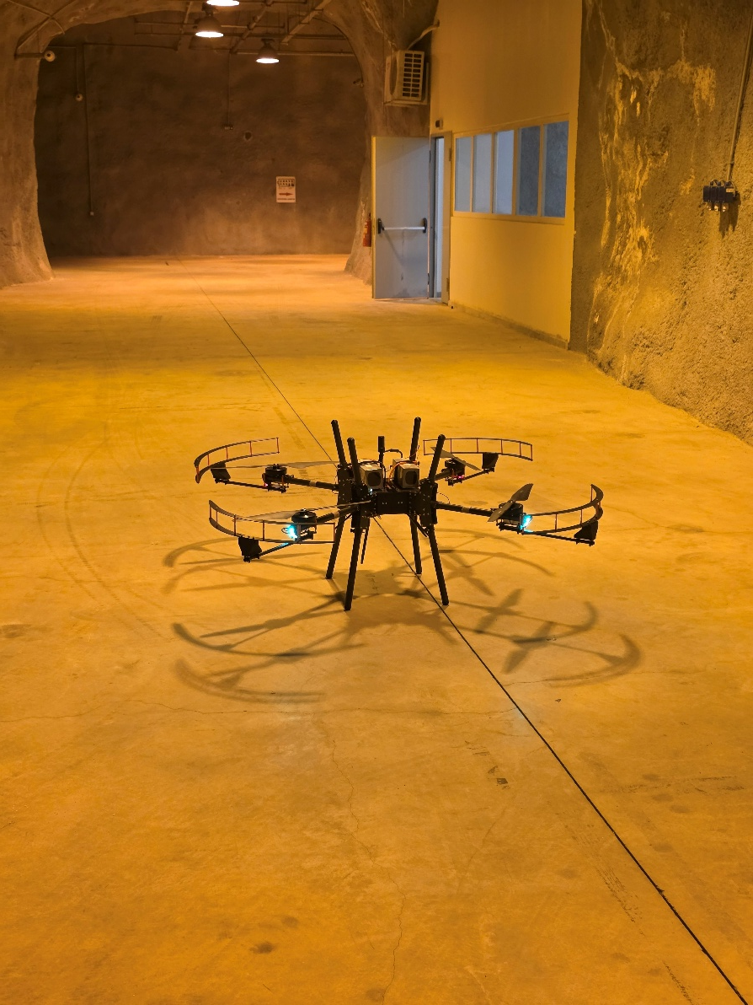
T7.3 – Indoor testing at Lavrion
Flights with and without payload, performed in collaboration with USAL
Platform + payload checks
A staged test campaign before mine deployment.
Indoor UAV in flight
Lavrion underground test environment
Progress achieved: the indoor platform moved from preparation to completed flight tests.
XTRACT 7th GA | Online | 14 October 2026
4
Notes:
SPEAKER NOTES
Lavrion provided the staged indoor test environment before deployment to the mine. We performed flights both without payload and with payload, together with USAL. This gave us practical flight evidence for the integrated configuration. The images are from the Lavrion campaign. I will not quote endurance, accuracy or other quantitative metrics here because those values have not been verified in the supplied material.
SOURCE / CONFIRMATION
September WP5/T5.1 update: slide 4 explicitly confirms Lavrion flight tests with and without payload, in collaboration with USAL. Slide 6 supplies these three photographs. The photographs are not individually labelled as with-payload or without-payload configurations.

Slide 5
T7.3 – Björkdal: deployment completed
A brief task-level update; detailed pilot scenarios and results will be presented in WP8
From indoor preparation to mine operation
COMPLETED
• Indoor activities performed
Indoor activities
Payload + SLAM/mapping demo
The indoor configuration was deployed in the mine pilot.
• Payload + SLAM/mapping demonstrated
RESULTS TO CONSOLIDATE
Integrated sensing and navigation demonstrated underground.
Fragmentation results pending.
Team feedback to be added after debrief.
• Multiple pilot scenarios completed
The overall campaign included indoor and outdoor activities.
T7.3 technical activities are complete; pilot evidence and lessons feed the Final Review.
XTRACT 7th GA | Online | 14 October 2026
5
Notes:
SPEAKER NOTES
I will keep the Björkdal update brief because the pilot has its own WP8 presentation. Our indoor activities are complete and the payload and SLAM/mapping workflow were demonstrated. The overall campaign covered several indoor and outdoor scenarios. Fragmentation results still need to be consolidated, and the detailed lessons learned will be added once the team has debriefed.
SOURCE / CONFIRMATION
Direct user confirmation: indoor and outdoor activities performed, multiple scenarios; all T7.3 technical activities completed; payload and SLAM/mapping demonstrated; fragmentation results pending. User states colleagues finished the pilot on 9 October 2026 and feedback will be added on Monday, 12 October.
PRESENTER UPDATE
Add the confirmed pilot feedback on 12 October. Do not add invented scenario counts, mapping accuracy, flight duration, autonomy claims or successful fragmentation metrics. No older mine photograph is presented as evidence of the October campaign.

Slide 6
T7.3 – Risks and mitigations
Development risks addressed through component testing, site assessment and staged flights
Risk / constraint | Potential impact | Mitigation implemented | Evidence / follow-up
Motor–ESC behaviour | Unreliable propulsion or control response | Alternative motors and ESCs selected and tested before platform deployment. | Component tests → indoor flight campaign
Confined spaces | Obstacle contact and limited manoeuvring room | Compact platform, protective guards and staged underground tests. | Completed configuration; Lavrion flights
Payload integration | Payload mass and interfaces may affect flight behaviour | Payload kit prepared with USAL; flights with and without payload. | Lavrion tests; Björkdal payload demonstration
GNSS-denied mine conditions | Dust, fog, water and no GNSS affect sensing | Site and connectivity assessed; LiDAR/RGB/Jetson workflow demonstrated. | Björkdal SLAM/mapping demo; lessons after debrief
Björkdal debrief update (12 October): add observed issues, fixes and any residual limitations.
XTRACT 7th GA | Online | 14 October 2026
6
Notes:
SPEAKER NOTES
These are the development and operating risks we managed as the indoor system matured. Propulsion behaviour was addressed through testing alternative motor and ESC combinations. Confined-space operation was addressed through the compact configuration, guards and underground testing. Payload effects were investigated in flights with and without payload. The Björkdal site assessment informed preparation for GNSS-denied mine operation. Pilot-specific problems and their fixes will be added after the team debrief; I am not claiming that every environmental risk has been eliminated.
SOURCE / CONFIRMATION
June WP7 deck: slides 2–3, propulsion tests, alternatives, site constraints and underground Wi-Fi assessment. September update: slides 4 and 6, payload/no-payload flights and guard photographs. User confirms integrated payload and SLAM/mapping demonstration at Björkdal.
PRESENTER UPDATE
Editable area for Monday 12 October: replace the orange band with one or two actual pilot lessons once colleagues provide feedback. The table is a task-level summary, not the official project risk register; no formal risk IDs, probability scores or residual risk ratings have been invented. Do not imply waterproofing, dust certification, universal connectivity or fully autonomous navigation.

Slide 7
T7.3 – Next steps
Before Christmas | results consolidation and reporting
01
Capture the Björkdal debrief
Add the confirmed operational lessons, encountered issues and mitigations.
02
Consolidate fragmentation results
Bring together the pending analysis results with the responsible partners.
03
Prepare the task evidence
Compile configuration, test and demonstration evidence for WP7 reporting and the Final Review.
Technical activities completed; next steps focus on evidence and results.
XTRACT 7th GA | Online | 14 October 2026
7
Notes:
SPEAKER NOTES
There are no unfinished T7.3 technical activities. The remaining steps concern consolidating the pilot feedback, the pending fragmentation results and the evidence needed for reporting and the Final Review. The team debrief comes first, on Monday 12 October. These steps should not be presented as further hardware development or a new test campaign.
SOURCE / CONFIRMATION
User confirms no unfinished technical activities and fragmentation results pending. Grant Agreement: WP7 live documents D7.1/D7.2 led by LTU, PDF pages 89–90. The template requests a before-Christmas next-steps slide; this is a proposed reporting window, not a newly asserted contractual deadline.
PRESENTER UPDATE
Confirm the owner and delivery timing of fragmentation results after the debrief. Provide T7.3 inputs to the WP7 lead as needed; do not claim D7.2 has been submitted or accepted.

Slide 8
T7.3 – Final Review preparation
Until the end of the project | a clear evidence trail
Completed platform
Record the as-built indoor configuration, payload interfaces and operating setup.
Testing and demonstration
Link Lavrion flight evidence with the Björkdal payload and SLAM/mapping demonstration.
Results and lessons learned
Incorporate fragmentation outcomes and confirmed pilot mitigations; align the detail with WP8.
Review message: indoor platform completed, tested and demonstrated.
XTRACT 7th GA | Online | 14 October 2026
8
Notes:
SPEAKER NOTES
For the Final Review, we should tell one consistent story: the indoor configuration is complete, it was tested in Lavrion, and it was demonstrated in the mine with payload and SLAM/mapping. Our evidence package should connect those stages to the T7.3 scope. Quantitative pilot results and scenario detail remain with the WP8 presentation. Fragmentation outcomes and the confirmed lessons learned will be incorporated when consolidated.
SOURCE / CONFIRMATION
Grant Agreement: T7.3 platform adaptation and deployment scope, PDF page 76. Completed configuration and Lavrion flights documented in September update; Björkdal demonstration confirmed by the user. These are proposed evidence-preparation steps, not a statement that the evidence package is already final or accepted.

Slide 9
This project has received funding from the European Union’s Horizon Europe Research and Innovation Programme under Grant Agreement no. 101138432
Andreas Lefkatis | ACCELIGENCE
andreas.lefkatis@acceligence.cy
T7.3: completed, tested and demonstrated
info@xtract-project.eu
https://xtract-project.eu/
https://www.linkedin.com/company/xtract-project/
https://www.youtube.com/channel/UC9eNoqHV2BLXc37Q_CTwFuQ
https://twitter.com/xtract_project
Notes:
SPEAKER NOTES
The indoor configuration has progressed from design and preparation to completed tests and mine demonstration. The technical activities are complete. The final steps are the consolidation of results and lessons learned, together with the evidence for the Final Review.
SOURCE / CONFIRMATION
Completion statement confirmed by task lead. Branding, project contacts and funding acknowledgement retained from the uploaded template.

