Slide 1
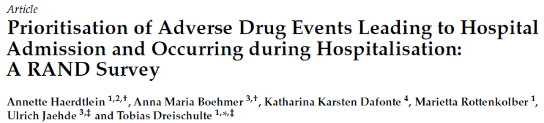
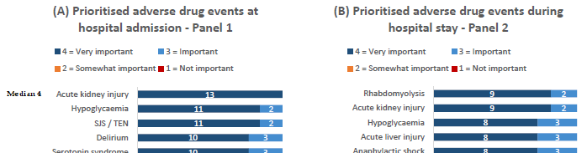

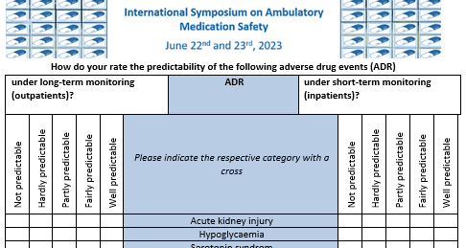

JClinMed22_11_xx_Haerdtlein_35893345
JClinMed23_12_xx_Haerdtlein_36835854

Slide 2
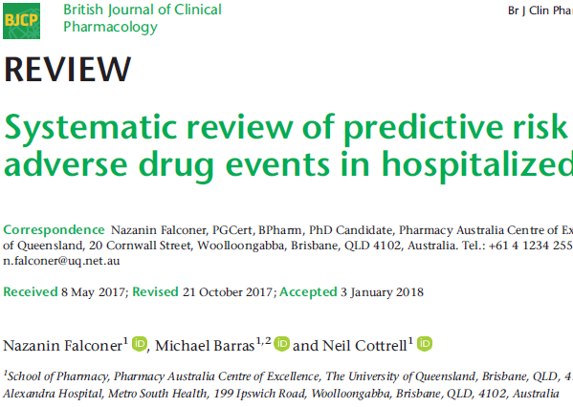
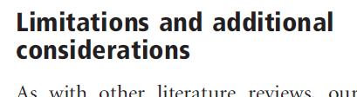

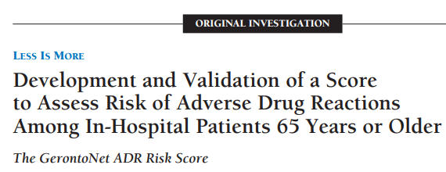

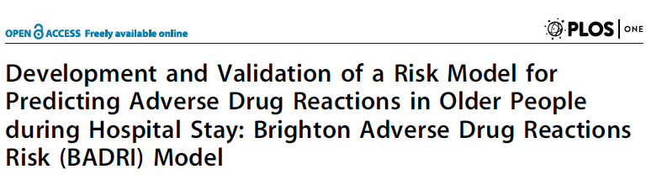


Slide 3
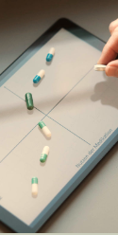


Slide 4
Population module
Outcome module
randomly
mix scenarios
Drug treatment: frequent y/n
Outcome: frequent y/n
Drug effect: strong y/n
Other predictors: frequent y/n
Other predictors: strong y/n
to 8 situations with each 1500 IDs

