Slide 1
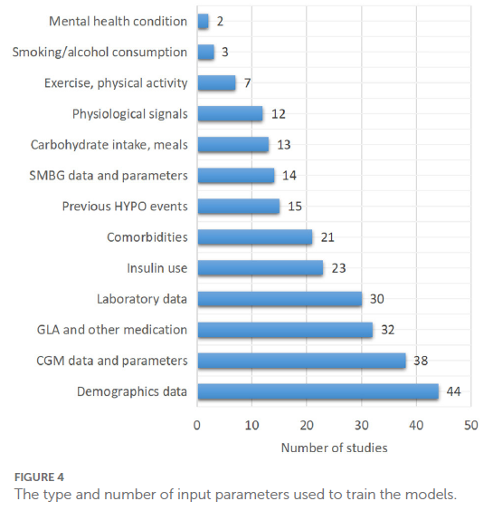
SMBG: self-monitoring of blood glucose
HYPO: hypoglycemia
GLA: glucose-lowering agents
CGM: continuous glucose monitoring

Slide 2
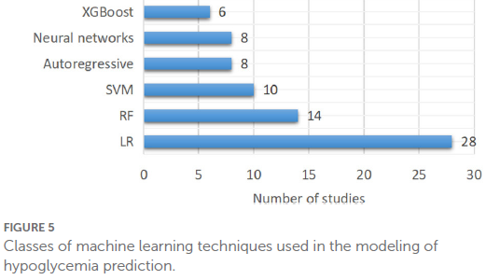
SVM: support vector machines
RF: random forests
LR: logistic regression and related techniques

Slide 3
(+)
sample size, number of outcomes, …
Favors larger data sets
from usually
ubiquituously available
routine data
(-)
(+)
Accuracy
Favors smaller,
usually expert-validated
data sets
(-)

