Slide 1
Understanding diabetes progression
What patient characteristics are associated with change over one year?
442 patients
The data show patterns of association.
They do not show what caused progression.
10 patient characteristics
One-year progression measure
A short analysis for health-service decision-makers
Diabetes progression | Scenario 1 1 / 5

Slide 2
Three measurements stood out
Exploratory correlations with the one-year progression measure
BMI
0.59
Serum measure s5
0.57
Blood pressure
0.44
These are correlations across patients, not estimates of treatment effects.
Diabetes progression | Scenario 1 2 / 5

Slide 3
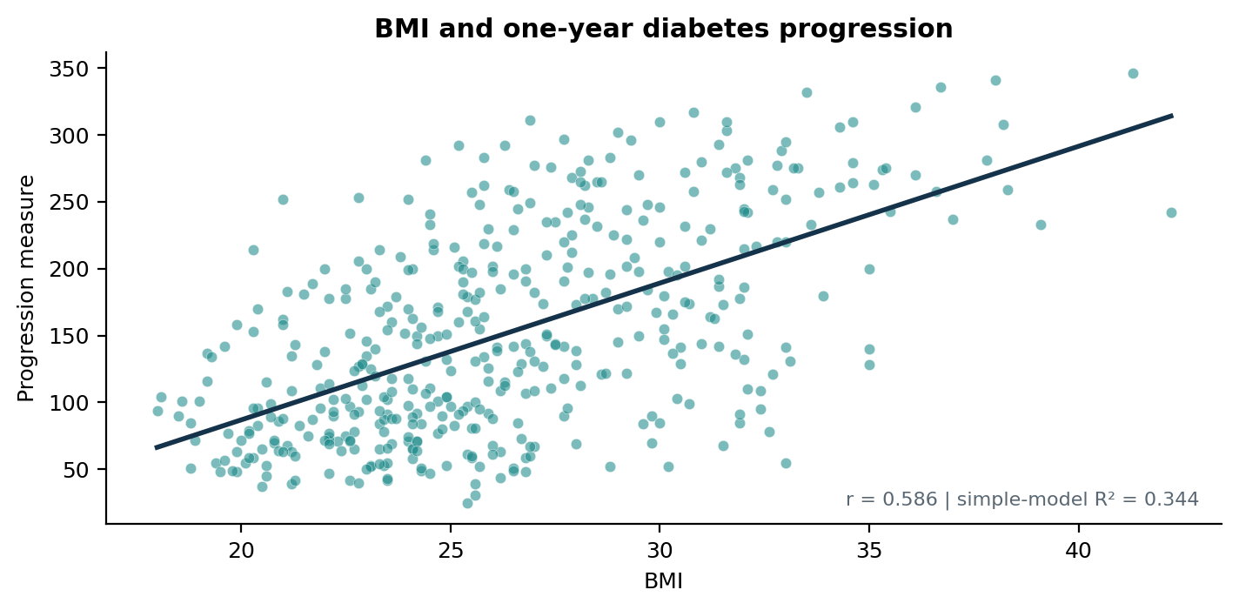
BMI is informative, but not enough
The simple BMI model explained 34% of observed variation
10.23
higher progression units per BMI unit on average in this sample
95% CI: 8.91 to 11.56
R² = 0.344
Considerable variation remains around the fitted line.
Diabetes progression | Scenario 1 3 / 5

Slide 4
Adding two measurements improved model fit
Multiple model: BMI + blood pressure + s5
BMI only
Three predictors
34%
48%
of variation explained
of variation explained
In the multiple model, each coefficient describes an association while the other two measurements are held constant.
Better fit in this sample does not prove better clinical decisions or causal effects.
Diabetes progression | Scenario 1 4 / 5

Slide 5
What a decision-maker should take away
Interpret the findings within their limits
Supported by this analysis
Not established
• BMI, bp and s5 were associated with progression.
• Together they explained about 48% of variation in this dataset.
• That changing one measure will change progression.
• That the model works equally well in other populations.
• That it is ready for clinical decisions.
Observational data, possible confounding and remaining prediction error limit conclusions.
Diabetes progression | Scenario 1 5 / 5

