Slide 1


AI for Smarter Crew Change Operations
Capstone Poject - IronHack - AI Consilting and Intergration - 2026-09-01
Andreas Papachristophorou

Slide 2
AI for Smarter Crew Change Operations
Exploring AI opportunities for a medium-sized ship management company
THE CHALLENGE
CHLEO'S QUESTION
AI OPPORTUNITIES EXPLORED
⚓ Vessel schedules
👥 Crew availability
✈ Travel & airport disruption
🌍 Port & operational constraints
"What is the AI actually doing, and can we trust it?"
Crew Change Risk Copilot ★
AI Operational Briefing & Exception Reporting
AI-Assisted Communication & Document Analysis
Focus: practical operational value while keeping human judgement and accountability.
Crew Change Risk Copilot | Round 1 Presentation | 1
Notes:
For this project, I explored the potential application of AI within crew change operations for a medium-sized ship management company.
Crew changes are operationally complex because they involve several interconnected elements, including vessel schedules, crew availability, travel arrangements and external disruptions.
Rather than starting with a technology, I looked at where AI could provide practical operational value.
I explored three potential use cases. The first is a Crew Change Risk Copilot, which helps identify cases requiring additional attention. The second focuses on automated operational briefings and exception reporting. The third explores AI-assisted communication and document analysis.
The strongest opportunity I identified is the Crew Change Risk Copilot. Importantly, the objective is not to replace operational judgement, but to help people focus their attention and understand potential risks.
At the same time, there is an important concern from our hypothetical CEO, Chleo: what exactly is the AI doing, and can it be trusted? This question influenced how I designed the proof of concept and monitoring approach.

Slide 3
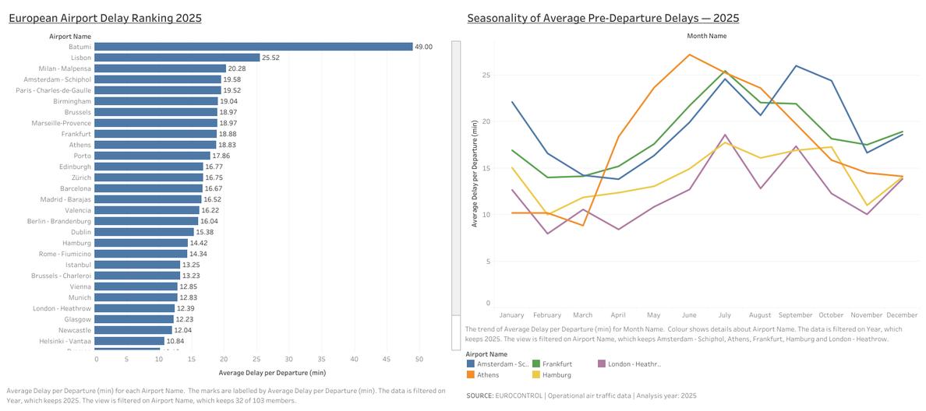
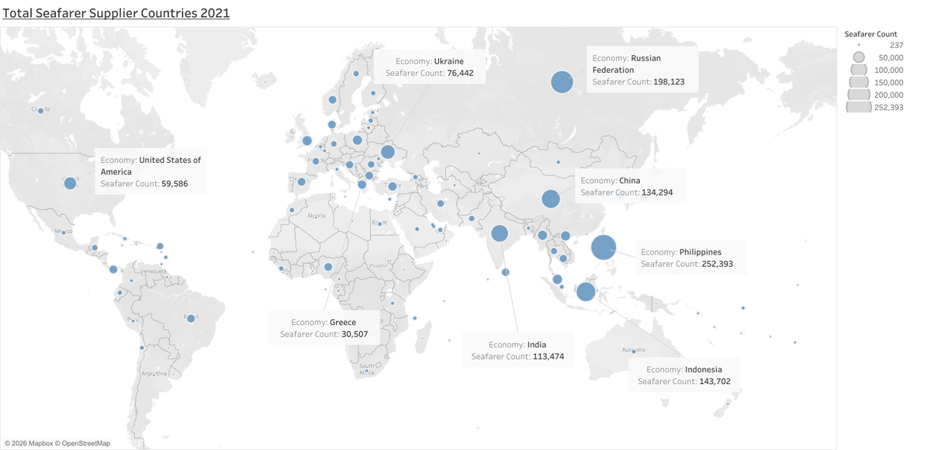
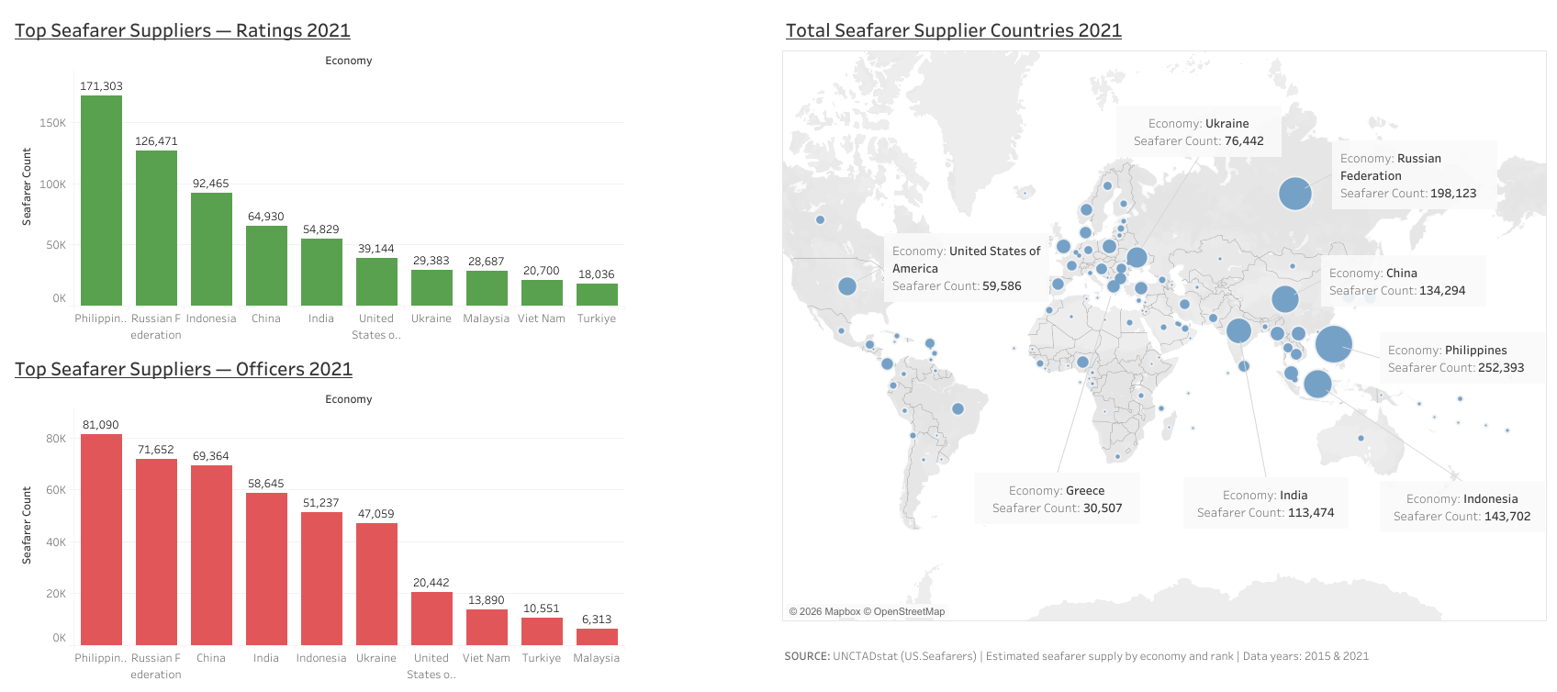
Operational Context: Where Could Disruption Occur?
Using available data to understand workforce and travel-related operational factors
WHY THIS MATTERS FOR CREW CHANGE OPERATIONS
• Crew changes depend on multiple interconnected factors
• Travel disruptions can affect crew mobilisation and repatriation
• Workforce availability varies across different crew source markets
• Operations teams must combine information from multiple sources
• Opportunity for AI-supported monitoring and prioritisation
Crew Change Risk Copilot | Round 1 Presentation | 2
Notes:
Before looking at a specific AI solution, I explored publicly available data that provides useful operational context.
The first dashboard looks at airport delays. Crew changes often depend on flights and connections, so travel disruption is one external factor that can potentially affect planned crew movements. The purpose here is not to predict a specific crew-change failure, but to demonstrate the type of external operational context that could be monitored.
The second dashboard looks at global seafarer supply. This provides a broader workforce perspective, showing differences in seafarer availability across economies and between officers and ratings.
Together, these dashboards illustrate an important point: crew change operations do not exist in isolation. They depend on a combination of workforce, travel and operational information that may come from different sources.
This creates the opportunity for the Crew Change Risk Copilot: instead of expecting operations teams to continuously monitor multiple information sources, AI could help identify relevant exceptions and bring them to human attention.

Slide 4
Crew Change Risk Copilot
AI-supported decision support for proactive identification and review of potential crew-change disruptions
OPERATIONAL INPUTS
CREW CHANGE RISK COPILOT
HUMAN REVIEW
• Crew change plans
• Travel information
• External context
→
• Monitors
• Identifies
• Summarises
• Explains
→
• Prioritise cases
• Assess context
• Make decisions
IDENTIFY
EXPLAIN
SUPPORT
Potential cases requiring additional attention
Factors contributing to the operational concern
Human decision-making, not autonomous decisions
Crew Change Risk Copilot | Round 1 Presentation | 3
Notes:
Based on the research and the operational context shown in the dashboards, my recommended use case is the Crew Change Risk Copilot.
The concept is designed as an AI-supported decision-support tool. It would bring together relevant operational information, such as crew-change plans, travel information and external disruption context.
Rather than requiring operations teams to manually monitor every piece of information, the system would help identify cases that may require additional attention.
Importantly, the AI would not make operational decisions. Its role would be to identify, summarise and explain relevant risk factors.
The final assessment and operational decision would always remain with the Crew Manager or Operations team.
This creates a management-by-exception approach, where human attention is directed towards the cases that may need review.

Slide 5
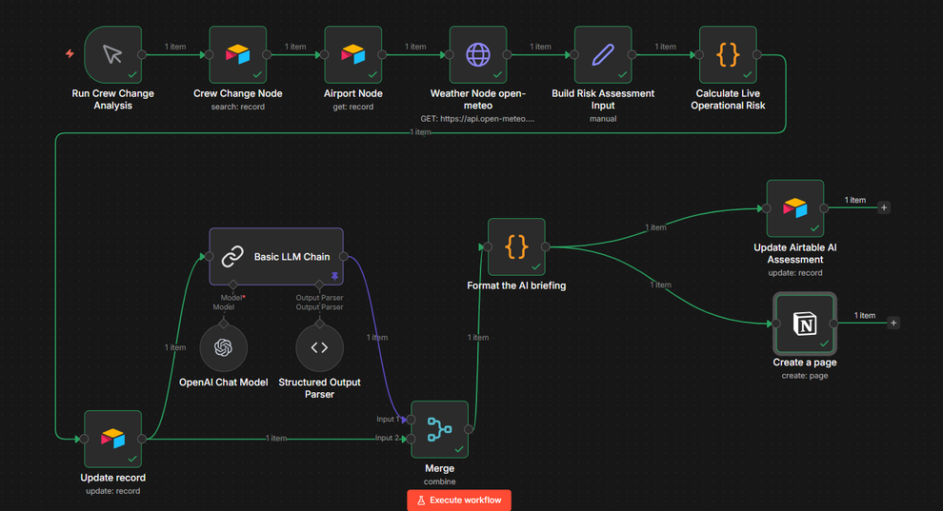
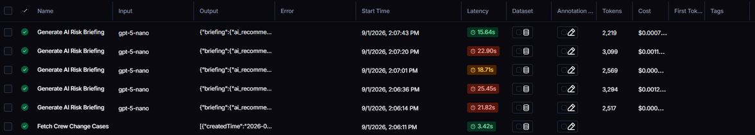
From Concept to Proof of Concept
AI-supported workflow + transparent monitoring
POC WORKFLOW
Crew Change Data
↓
AI Analysis
↓
Risk Briefing
↓
Human Review
MONITORING & TRANSPARENCY
Review inputs and outputs • Monitor system behaviour • Investigate unexpected results
Crew Change Risk Copilot | Round 1 Presentation | 4
Notes:
To test whether the proposed concept could work in practice, I built a simple proof of concept using n8n.
The workflow takes crew change information and passes it through an AI analysis step.
The AI then generates a structured Crew Change Risk Briefing, highlighting relevant operational factors that may require human attention.
The purpose of this POC is not to prove predictive accuracy or create an autonomous risk engine. It demonstrates the workflow logic and how AI could support the process.
However, Chleo's main concern was transparency. Producing an AI output is not enough—we also need to understand and monitor how the system behaves.
For this reason, I also explored LangSmith as a monitoring and observability layer.
This makes it possible to review system inputs and outputs and investigate unexpected behaviour.
This is still a proof of concept using a simplified workflow and demonstration data. A production system would require integration with validated operational data sources, stronger evaluation and continuous monitoring.

Slide 6
Indicative Cost, Timeline & Next Step
A lean, controlled approach to validating the Crew Change Risk Copilot
INVESTMENT
TIMELINE
NEXT STEP
≈ €31,000
Indicative pilot investment
Based on a focused MVP / controlled pilot
12 WEEKS
Discovery & Planning
Solution Design
MVP Development
UI & Integration
Testing & Refinement
Final Review
CONTROLLED PILOT
Validate:
• Technical feasibility
• Operational value
• User adoption
Before larger-scale deployment
Key assumptions:
Focused scope • Pilot data • Limited integrations
• Small user group • Human oversight
Crew Change Risk Copilot | Round 1 Presentation | 5
Notes:
Based on the initial scope, I developed an indicative cost and timeline estimate for a focused MVP and controlled pilot.
The estimated client investment is approximately €31,000, based on a lean delivery model using a Lead AI and Maritime Consultant supported by specialist freelance resources.
The proposed implementation would take approximately 12 weeks, starting with discovery and requirements definition, followed by solution design, MVP development, integration, testing and final pilot evaluation.
These estimates are based on several assumptions, including the availability of prepared pilot data, limited enterprise integrations, a small group of operational users and mandatory human oversight.
My recommendation would be not to move directly into full-scale deployment. Instead, the next step should be a controlled pilot to validate technical feasibility, operational value and user adoption before making a larger investment.

Slide 7
Crew Change Risk Copilot
AI-supported decision support for smarter and more proactive crew change operations
Use AI to help operations teams identify and understand potential crew-change disruptions — while keeping humans in control.
IDENTIFY
EXPLAIN
SUPPORT
Potential cases
requiring review
Relevant factors
and context
Human judgement,
not autonomous decisions
WHAT I WOULD VALUE YOUR FEEDBACK ON:
Does this use case address a meaningful operational problem and provide a strong enough foundation for a focused MVP?
Crew Change Risk Copilot | Round 1 Presentation | 6
Notes:
To conclude, my recommendation is the Crew Change Risk Copilot: an AI-supported decision-support tool designed to help operations teams identify and understand potential crew-change disruptions earlier.
The key principle is that AI supports human judgement rather than replacing it. The proof of concept demonstrates the workflow, while monitoring provides an initial approach to transparency and observability.
What I would particularly value your feedback on is whether you believe this use case addresses a meaningful operational problem and provides a strong enough foundation to develop into a focused MVP.

Slide 8


Thank you
Andreas Papachistophorou
andreasmp77@gmial.com

