Slide 1
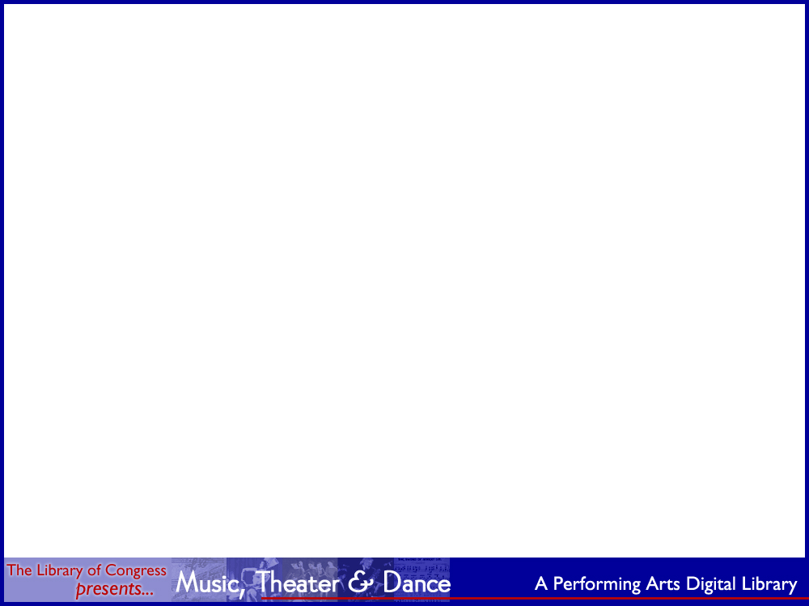
Using METS and MODS
to Create an
XML Standards-based
Digital Library Application
Morgan Cundiff
Network Development and
MARC Standards Office
Library of Congress
Notes:
Out topic is…
METS and MODS to express data for digital objects
Library of Congress Presents Music, Theater, and Dance is the digital library web application
I will be talking mainly about the first part (the data) and Nate will be talking more about the
LC Presents digital library application

Slide 2
Who are we?
NDMSO Technical Team
Morgan Cundiff
Nate Trail
Betsy Miller
Glenn Gardner
Corey Keith
LC Presents Team (Music Division)
Karen Lund
Pat Padua
James Wolf
Paul Fraunfelter
Mike Ferrando
Notes:
Acknowledge colleagues who worked on the project

Slide 3
XML is the lingua franca of the Web
Increasingly used for data exchange and messaging in the business world
Web pages are increasingly based on XHTML
Family of technologies to leverage (XML Schema, XSLT, XPath, and XQuery)
Software tools widely available (for storage, editing, parsing, validating, transforming and publishing XML) – much of this software is open source and free – and it is constantly and actively being improved.
Microsoft Office 2003 supports XML as document format (WordML and ExcelML)
“Web 2.0” heavily based on XML (AJAX, Semantic Web, Web Services, etc.)
Notes:
Background perspective:
Using XML is the larger issue
More and more data is being stored in XML format.
When XQuery becomes a W3C recommendation, Xpath/Xquery will become the way to query XML. When that occurs there will quickly follow a wave of new products for storing and searching XML data.

Slide 4
XML
“XML has become the de-facto standard for representing metadata descriptions of resources on the Internet.”
Jane Hunter
Working towards MetaUtopia - A Survey of Current Metadata Research
Notes:
Writing about metadata for Web resources, Jane Hunter made this statement back in 2003

Slide 5
The Importance of Standards
“In moving from dispersed digital collections to interoperable digital libraries, the most important activity we need to focus on is standards… most important is the wide variety of metadata standards [including] descriptive metadata… administrative metadata…, structural metadata, and terms and conditions metadata…”
Howard Besser
The Next Stage: Moving from Isolated Digital Collections to Interoperable Digital Libraries
Notes:
And speaking about standards (also in 2003) Howard Besser made this statement:
Howard was exactly right. We have heard various people speak against the creation of new “stovepipes”. By that they mean creating standalone applications that have no ability to communicate or “interoperate” with other applications. These are the “dispersed” collections that Besser refers to.
We also hear Dr. Billington and others speak about creating a World Digital Library. The World Digital Library is a vision for digital library interoperabilty on a very grand scale and it is very noble and powerful vision. Again, I think Howard Besser was right when he said, the most important activity we need to focus on, to realize that vision, is metadata standards. And that is exactly what we are doing in our work to build digital library collections that are based on METS and the other members of the family of standards that have emerged from the digital library community.

Slide 6
XML in the Digital Library Community
Family of XML data standards: METS, MODS, MIX, PREMIS, TEI, and EAD
METS Implementations: LC, OCLC, RLG, California Digital Library, Harvard, Princeton, National Library of Portugal, National Library of Wales, University of Indiana, Stanford, New York University, University of Göttingen, Oxford University, etc etc…
METS Software Tools: Harvard METS Toolkit, Harvard DRS METS Archive Tool (Dmart) for Audio Deposit, CDL 7train METS Generation Tool, MEX Authoring Tools (Das Bundesarchiv), ContentE (Biblioteca Nacional Digital, Portugal), METS Navigator (Indiana University Digital Library Program) ResCarta Metadata Creation Tool (ResCarta Foundation) etc
METS listserv: 530 subscribers
Notes:
XML in our “domain” the digital library community
Since about 2002 there has been steady and increasing “uptake” of a family of XML standards for digital library metedata
NDMSO has been very involved in this development- maintenance agency for METS, MODS, MIX, MARCXML, PREMIS, and EAD

Slide 7
XML Standards at LC: A little historical perspective …
1995 – first American Memory web collections released (not XML-based)
1998 – XML 1.0 becomes a W3C Recommendation
2002 – METS and MODS released
2002 – Digital Audio-Visual Preservation Prototyping Project (led by Carl Fleischhauer, first use of METS, MODS, and MIX at LC)
2003 – “Patriotic Melodies” (first use of METS and MODS in production at LC)
2003 – Veterans History Project released
2004 – I Hear America Singing released (since renamed to LC Presents)
2004 – Justice Blackmun Papers collection released
2006 – National Digital Newspaper Project (LC and partners, first use of METS, MODS, MIX, PREMIS) as repository submission package at LC- September launch)
2006 – Ser2Dig (Digital Serials workgroup, METS for multi-volume monographs)
2006 – Draft METS profile for “article-level” historical newspapers
Notes:
Historical perspective at LC

Slide 8
What is METS?
(a quick primer)
METS is an XML Schema designed for the purpose of creating XML document instances that express the hierarchical structure of digital library objects, the names and locations of the files that comprise those objects, and the associated metadata. METS can, therefore, be used as a tool for modeling real world objects, such as particular document types.
Notes:
METS is used to express the structure of the document and the associated metadata.

Slide 9
What is MODS?
(a quick primer)
MODS is an XML Schema designed for expressing bibliographic data. MODS can be seen as an alternative to the MARC format. It is especially useful for XML-based digital library projects. MODS can be used as an “extension schema” to METS.
Note to catalogers: MODS does not make you obsolete. The same knowledge and skills (mastery of cataloging rules and controlled vocabularies, subject knowledge, etc) are still necessary. It is just a different syntax (i.e. different from MARC) for making bibliographic data machine-readable.
Notes:
I do not know how fast the ILS world will move to XML though I think it is inevitable. In the meantime there continues to be an unfortunate divide between digital library projects and the cataloging operation here at LC. We are hoping to begin having music catalogers assist with LC Presents in the near future.

Slide 10
What are the 7 Sections of a METS Document?
<mets>
<metsHdr/>
<dmdSec/>
<amdSec/>
<fileSec/>
<structMap/>
<structLink/>
<behaviorSec/>
</mets>

Slide 11
The Descriptive Metadata Section with mdWrap
<mets>
<dmdSec>
<mdWrap>
<xmlData>
<!-- insert data from different namespace here -->
</xmlData>
</mdWrap>
</dmdSec>
<fileSec></fileSec>
<structMap></structMap>
</mets>

Slide 12
The Descriptive Metadata Section with MODS as extension schema
<mets:mets>
<mets:dmdSec>
<mets:mdWrap>
<mets:xmlData>
<mods:mods></mods:mods>
</mets:xmlData>
</mets:mdWrap>
</mets:dmdSec>
<mets:fileSec></mets:fileSec>
<mets:structMap></mets:structMap>
</mets:mets>

Slide 13
The Descriptive Metadata Section with MODS and relatedItem elements
<mets:mets>
<mets:dmdSec>
<mets:mdWrap>
<mets:xmlData>
<mods:mods>
<mods:relatedItem type=“constituent”>
<mods:relatedItem type=“constituent”></mods:relatedItem>
</mods:relatedItem>
</mods:mods>
</mets:xmlData>
</mets:mdWrap>
</mets:dmdSec>
<mets:fileSec></mets:fileSec>
<mets:structMap></mets:structMap>
</mets:mets>

Slide 14
METS document with two hierarchies (logical and physical)
<mets:mets>
<mets:dmdSec>
<mets:mdWrap>
<mets:xmlData>
<mods:mods>
<mods:relatedItem>
<mods:relatedItem></mods:relatedItem>
</mods:relatedItem>
</mods:mods>
</mets:xmlData>
</mets:mdWrap>
</mets:dmdSec>
<mets:fileSec></mets:fileSec>
<mets:structMap>
<mets:div>
<mets:div></mets:div>
</mets:div>
</mets:structMap>
</mets:mets>

Slide 15
MODS relatedItem type=“constituent” element
Child element to MODS
relatedItem element has same content model as mods (titleInfo, name, subject, physicalDescription, note, etc)
The relatedItem element makes it possible to create very rich analytic descriptions for contained works within a MODS records
relatedItem element is repeatable and it can be nested recursively (thus making it possible to build a hierarchical tree structure)
relatedItem elements make it possible to associate descriptive data with any structural element.

Slide 16
<mods:mods>
<mods:titleInfo>
<mods:title>Bernstein conducts Beethoven and Mozart</mods:title>
</mods:titleInfo>
<mods:name>
<mods:namePart>Bernstein, Leonard</mods:namePart>
</mods:name>
<mods:relatedItem type="constituent">
<mods:titleInfo>
<mods:title>Symphony No. 5</mods:title>
</mods:titleInfo>
<mods:name>
<mods:namePart>Beethoven, Ludwig van</mods:namePart>
</mods:name>
<mods:relatedItem type="constituent">
<mods:titleInfo>
<mods:partName>Allegro con moto</mods:partName>
</mods:titleInfo>
</mods:relatedItem>
<mods:relatedItem type="constituent">
<mods:titleInfo>
<mods:partName>Adagio</mods:partName>
</mods:titleInfo>
</mods:relatedItem>
</mods:relatedItem>
</mods:mods>
Notes:
Here is a simple illustration of a logical hierarchy created with relatedItems.

Slide 17
Linking in METS Documents
(XML ID/IDREF links)
DescMD
mods
relatedItem
relatedItem
AdminMD
techMD
sourceMD
digiprovMD
rightsMD
fileGrp
file
file
StructMap
div
div
fptr
div
fptr

Slide 18
Linking in METS Documents
(XML ID/IDREF links)
DescMD
mods
relatedItem
relatedItem
AdminMD
techMD
sourceMD
digiprovMD
rightsMD
fileGrp
file
file
StructMap
div
div
fptr
div
fptr

Slide 19
Linking in METS Documents
(XML ID/IDREF links)
DescMD
mods
relatedItem
relatedItem
AdminMD
techMD (mix)
sourceMD
digiprovMD
rightsMD
fileGrp
file
file
StructMap
div
div
fptr
div
fptr

Slide 20
Linking in METS Documents
(XML ID/IDREF links)
DescMD
mods
relatedItem
relatedItem
AdminMD
techMD (mix)
sourceMD
digiprovMD
rightsMD
fileGrp
file
file
StructMap
div
div
fptr
div
fptr

Slide 21
Linking in METS Documents
(XML ID/IDREF links)
DescMD
mods
relatedItem
relatedItem
AdminMD
techMD (mix)
sourceMD
digiprovMD
rightsMD
fileGrp
file
file
StructMap
div
div
fptr
div
fptr

Slide 22
Linking in METS Documents
(XML ID/IDREF links)
DescMD
mods
relatedItem
relatedItem
AdminMD
techMD (mix)
sourceMD
digiprovMD
rightsMD
fileGrp
file
file
StructMap
div
div
fptr
div
fptr

Slide 23
What is a METS Profile?
“METS Profiles are intended to describe a class of METS documents in sufficient detail to provide both document authors and programmers the guidance they require to create and process METS documents conforming with a particular profile.”
A profile is expressed as an XML document. There is a schema for this purpose. The profile expresses the requirements that a METS document must satisfy.
A sufficiently explicit METS Profile may be considered a “data standard”.
Note: A METS Profile is a human-readable prose document and is not intended to be “machine actionable”.
Notes:
You might think of the METS Profile document as something analogous to the LCRI

Slide 24
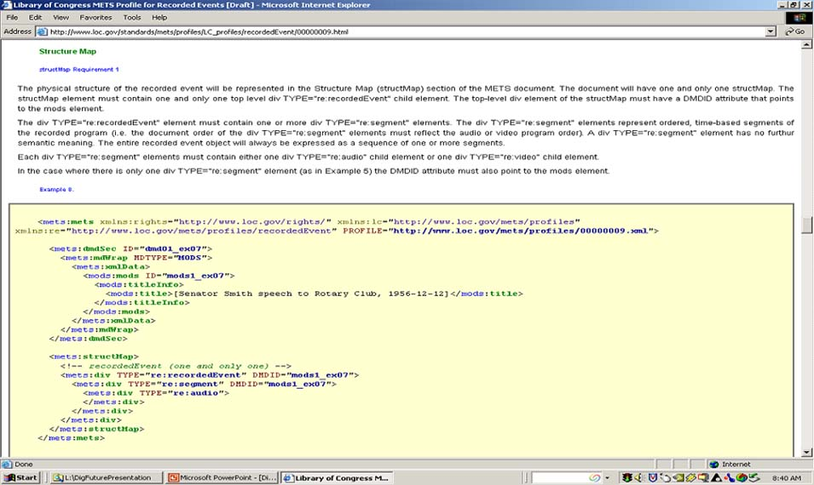

Slide 25
METS Profiles in use in LC Presents
Sheet Music
Musical Score (may be a score, score and parts, or a set of parts only)
Print Material (books, pamphlets, etc)
Music Manuscript (score or sketches)
Recorded Event (audio or video)
PDF Document
Bibliographic Record
Photograph
Compact Disc
Collection

Slide 26
Multiple Inputs to Common Data Format
New digital items
Legacy database
Harvest of American Memory Collection
Profile-based METS/MODS object
(A common data set for searching and display)
Web publication (LC Presents)
Notes:
One of the realities we face is that we have valuable data especially bib data in many different formats and systems. We also have bib data that is in no system at all- it is in an old procite database or a word perfect or an even older print document.

Slide 27
Example 1: New digital object
METS musical score profile
Library of Congress march / John Philip Sousa [musical score and parts]
Example of “routine” METS-making

Slide 28
Example 2: New digital object
METS Recorded Event Profile
Juilliard String Quartet / Juilliard String Quartet [sound recording]
Example of “routine” METS-making

Slide 29
Example 3: from “random” database
METS Bibliographic Record Object
  DUKE ELLINGTON AND HIS ORCHESTRA (1962) [motion picture]
Example of “database of bib data” source
Conversion from Filemaker Pro database
to
Filemaker XML dump (1 XML file)
XSLT to
14,000 METS/MODS records
amd XSL to PDF (1 file)

Slide 30
Example 4: American Memory Collection
METS Photograph Object
Harvest of William P. Gottlieb Collection
Portrait of Louis Armstrong, Carnegie Hall, New York, N.Y., ca. Apr. 1947] / William P. Gottlieb [photograph]
File of 1600 MARC records
marc4j to
XML modsCollection (1 file)
XSLT to
METS photograph profile (1600 files)

Slide 31
Logical (MODS)
Physical (structMap)
<mets:structMap>
<mets:div TYPE="photo:photoObject" DMDID="MODS1">
<mets:div TYPE="photo:version“DMDID="ver01” >
<mets:div TYPE="photo:image">
<mets:fptr FILEID="FN10081"/>
</mets:div>
</mets:div>
<mets:div TYPE="photo:version" “ DMDID=“ver02“>
<mets:div TYPE="photo:image">
<mets:fptr FILEID="FN10090"/>
</mets:div>
<mets:div TYPE="photo:version" “DMDID="ver03”>
<mets:div TYPE="photo:image">
<mets:fptr FILEID="FN1009F"/>
</mets:div>
</mets:div>
</mets:div>
</mets:div>
</mets:structMap>
<mods:mods ID=“ver01”>
<mods:titleInfo>
<mods:title>Original Work (vesion 1)</mods:title>
</mods:titleInfo>
<mods:relatedItem type=“otherVersion" ID=“ver02">
<mods:titleInfo>
<mods:title>Derivative Work 1</mods:title>
</mods:titleInfo>
</mods:relatedItem>
<mods:relatedItem type=“otherVersion" ID=“ver03">
<mods:titleInfo>
<mods:title>Derivative Work 2</mods:title>
</mods:titleInfo>
</mods:relatedItem>
</mods:mods>
mods element and relatedItem type =“otherVersion” elements
Sequence of 3 nodes
div TYPE=“photo:version” elements
Corresponding sequence of 3 nodes linked to logical sequence by ID/IDREF

Slide 32
METS Profiles makes possible 3 levels of validation for METS objects
Valid XML (well-formed)
Valid METS/MODS (XML Schema)
Valid METS Profile

Slide 33
Aggregation Example 1
METS Collection Object
http://lcweb2.loc.gov/cocoon/ihas/loc.natlib.ihas.200031146/default.html

Slide 34
Aggregation Example 2
MODS relatedItem type=“host”
http://lcweb2.loc.gov/cocoon/ihas/search?query=%2BmemberOf:"Baseball%20sheet%20music%20collection"&start=0&view=thumbnail

Slide 35
Aggregation Example 3:
“See also”
MODS relatedItem (no type)
http://memory.loc.gov/cocoon/ihas/loc.natlib.ihas.200003800/default.html

Slide 36
Administrative Metadata Example
Use of PREMIS and MIX
for digital images
louis.xml

Slide 37
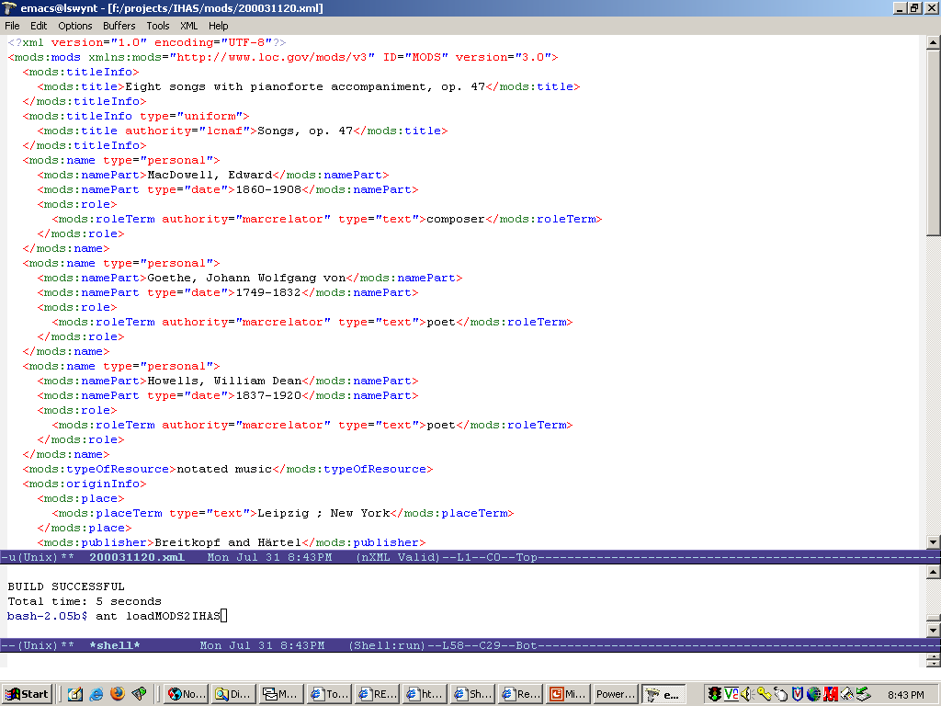

Slide 38
METS and MODS software tools
(open source XML toolkit)
Emacs (text editor) - edit MODS
- nxml-mode (Emacs plug-in for schema-aware XML editing)
- XML Schemas for METS, MODS, MIX, PREMIS
- cygwin – bash shell command line and tools
- Saxon (XSLT transformations)
- Xerces (XML validation)
- mysql-jdbc-connector (connect to natlib mySQL database)
- SRU (retrieve records from ILS)
- Cocoon facilities to retrieve and load records, retrieve xml version of a file system, etc
- Ant – used to automate all of the above tasks and create pipelines of multiple tasks and run from Emacs

Slide 39
Parting thoughts: Advantages of METS/MODS-based approach
Ability to model complex objects
Easy to change, extend (both the data and the application)
Use modern, non-proprietary software tools
Leverage use of XSLT for legacy data conversion, for batch METS creation and editing, and for Web displays and behaviors
Common syntax: XML for data creation/editing/storage/searching
Output to HTML, PDF for display
Easy to edit single records or selected batches of records
Ability to validate data
Ability to aggregate disparate data sources
Improved ability to manage data and publish data now and …
Well positioned for Future: new web application (Web 2.0), repository submission, cooperative project (test interoperability), provide METS for OAI harvesting …

