Slide 1

How to Build, Display and Find METS Objects
Nate Trail
Network Development &
MARC Standards Office
8/1/2006
With help from Sydney Olive

Slide 2
Outline
A little about the technology
How we use it
Searching and Lucene
Cocoon Tools
Future Directions
Conclusions
Notes:
In the context of “Library of Congress Presents and Veterans history project,
The Technology we use
How we use the technology
Searching
Cocoon tools in building and maintaining the application
Future Directions
Conclusions about our standards prototyping

Slide 3
Technology Used
XML documents (METS, MODS, etc.)
    METS Object
XSL processes
    Transformation or display
Cocoon framework (and a little Java)
Notes:
XML is data marked up according to a schema, laid out with tags of elements and attributes and data, but self defined.
METS and HTML can be examples of XML
XSL is also an XML file, but it is a set of processing instructions that transform an xml document from one format to another, or display it in a browser
Cocoon is a web processing framework that allows us to work with URLs on the web and on UNIX instead of on PCs.
Java is used to enhance our searching and breadcrumb tracking.

Slide 4
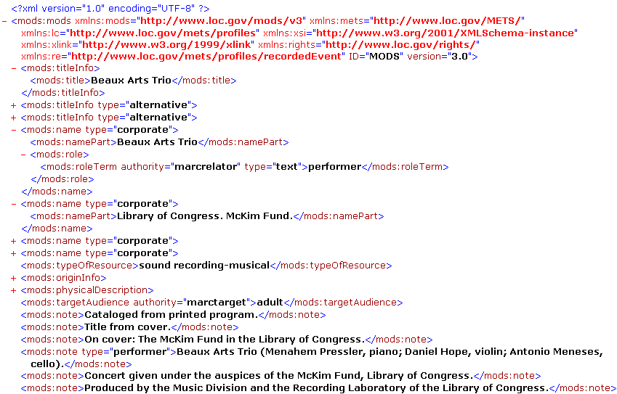
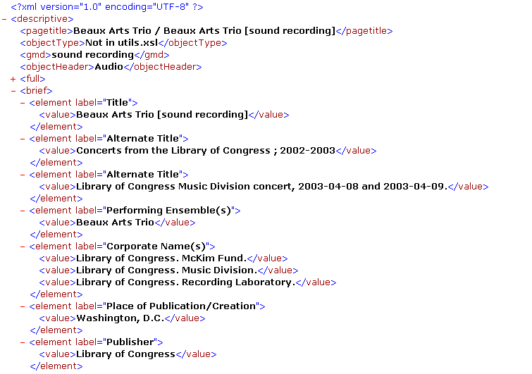
XSL for Transformation
Notes:
A little about XSL.
As a transformation tool, we use it to convert a mods record, with it’s layers and complexity, to a flattened structure that’s easier to display: elements with labels and values.

Slide 5
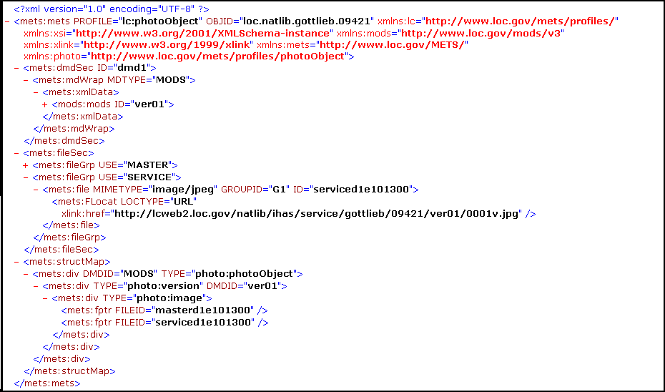
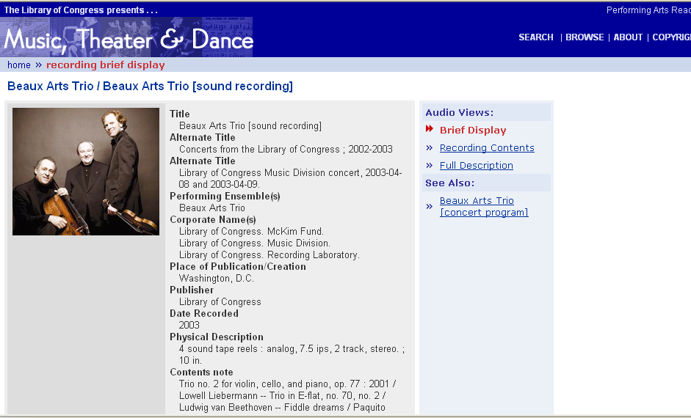
XSL for Display
Notes:
XSL for display is really also just a transformation because HTML is a standardized xml structure that a browser reads and interprets.

Slide 6
Cocoon Concepts (1)
User input via URL matches
–<map:match pattern="navigation/*">
<map:generate src="cocoon:/{1}/mets.xml"/>
<map:transform src="navigation.xsl"/>
<map:serialize type="xml"/>
–</map:match>

Slide 7
Cocoon Concepts (2)
Combine small matches to create
  a pipeline
Separate Data from Action and Design

Slide 8
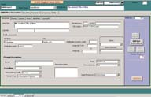
How we use it (1)
Database SQL processing
MySQL extract
MODS (SRU)
(Three masters LC publication)
Notes:
How we use the technology:
SQL processing:
We have a data entry form for manual entry of object descriptions. We extract bibliographic data from MySQL
We also have automated processes that get MODS records from other sources, and we insert those records back into our database using Cocoon. Here we have a little SRU pipeline that grabs Voyager records by LCCN, for insertion into the database. We’ll see the object later in our search pages
Three masters

Slide 9
How we use it (2)
METS making pipeline:
MySQL extract MODS
ObjectType, Files, MODS, rights data
METSMaker stylesheet uses ObjectType to create links among files and descriptive metadata, based on METS profile: METS
Notes:
A major tool is our METS Maker pipeline, which consists of several steps:
The previous slide shows getting data out of the database; another step is to convert that to MODS using a stylesheet
Then another cocoon pipeline combines a query of the object type, the files on the server, the mods data and rights metadata into a file called “data”
And our metsmaker stylesheet processes that file according to the object type to build a METS object.

Slide 10
How we use it (3)
Cocoon for Display
  Navigation, Description, Pageturning
  xml data for display
  add header, footer,
  breadcrumbs
  VHP presentations
Notes:
Given that we’ve built METS files for every object we have, we then build Display pipelines for the METS object profiles.
We combine together navigation, metadata, and page images (if any) to build an xml file that represents everything we’ll need from the object for display.
We then add branding and breadcrumbs to create the final display in a final step in the pipeline.
The display and all the intermediate files are virtual pages; no HTML is actually written.
Why add the header and footer separately? We want to have multiple views of the same object. In VHP, some of our veterans stories are featured in “Experiencing War”, so they need to look like that in the main presentation, but when they are found as a result of the search page, they need to look like a regular VHP item.
(next is search/lucene)

Slide 11
Searching and Lucene
We have XML objects, so we need an XML based search system.
Cocoon comes with Lucene.
Lucene indexes are easy to configure and modify: METS → Indexed item
Notes:
So we have this set of 12-14 object types, and thousands of objects, and we needed a search tool. Cocoon comes with Lucene, and it’s XML based, so we have a natural fit.
Lucene allows you to build your index files any way you want, and changing it is just making a change to an XSL stylesheet.
(next is search page)

Slide 12
Searching
Search page
  limit search to certain object types,
  search certain fields only, or
  search all (default)
Canned search as collection presentation tool (LC Publications, baseball)
New browsing capability
Notes:
Our advanced search page (we have a one-box search on the main LCP page) allows filtering and some more advanced selection. [search for cd with subject piano] We are pondering adding fields, formats, special searching functions. For any search entered by the user, we translate the search into a query that Lucene understands. We add word stemming, case insensitivity, and other functionality to the indexing as well as the searching.
Canned search is home, LC Publications: a new way of showcasing virtual collections.
(next is cocoon tools)

Slide 13
Cocoon Tools (1)
METS Profile Validation (fs01)
SQL : query any Oracle, MySQL tables from the browser to get back XML
Notes:
We use Cocoon to build a lot of tools that aid our processes.
Morgan mentioned profile validation. I have a validator that works interactively for the CD Profile, but we have not yet integrated it into the METS creation process. See fs01. We state all the rules, and the violation, so that you can tell the context of your error. For integration, we’d filter it down to a report of pass/fail, with this document as backup. We’ll write a validator for each METS profile as we have time.
(more cocoon tools)
We do a lot of SQL using Cocoon; I showed how we extract MODS from Voyager, but we can also do any query from Voyager or from any MySQL database (the rights metadata isn’t in MODS, but we retain it in a table in MySQL)

Slide 14
Cocoon Tools (2)
Site administration, enhancement of processes
  Get IDs for some set of the database for extraction, cleanup
  Convert from MARC to MODS (input) or MODS to MARC: (extract)
  Convert HTML to XML
  Detect deletions of objects
  Link checking
  Search for MARC records using SRU
Notes:
For application administration, I have built a lot of tools.
We often need to query or update a whole set of our MODS records, so I have a utility that gets those IDs.
We convert data among various standard formats.
Sometimes, the data we ingest is only in an HTML presentation page, so we need to convert that HTML to true XML first, so we can write stylesheets that transform it into a useful fielded format. (Next is Future)
We found we needed to track not only the presence of a METS file but it’s absence when an item was withdrawn or mistakenly added.
We have set up cocoon pipelines to check URLs on our sites.
I created a tool that gets MARC records and converts them to whatever format the user wants, or leaves it as an SRU result set.
88602559

Slide 15
Future Directions
New Behaviors, Profiles (Article OCR) (Multivolume Monograph / rarebook source)
RSS
Integrate profile validation with METS building
Integrate JHOVE file inspection tool (MIX)
Investigate using JPEG2000 file format for image manipulation enhancement
Submit objects to a repository
Exchange objects with another entity
Notes:
We’re always looking for new behaviors and profiles: Here’s a prototype of a full-text, article-level markup of a historical newspaper. Note the use of the coordinates (supplied by the OCR vendor.). Note the full text is added to MODS, with links to coordinates.
Here’s a prototype for a multivolume monograph. Actually two object types: a collection object that brings together all the volumes (showing a as a Table of Contents view), and the individual volume objects, which are much like a single book object, but with a link back to the parent.
Read the rest.
(next is conclusions)

Slide 16
Conclusions
What are we learning from building this application?

Slide 17

Conclusions
The METS standard is flexible enough to describe multiple kinds of complex objects

Slide 18
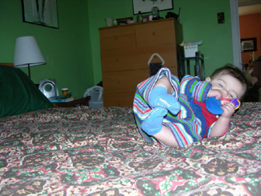
Conclusions
METS Profiles help define an object and it’s range of behaviors
Notes:
The way we do that is through rigorously defined profiles that lay out what an object looks like in METS.

Slide 19
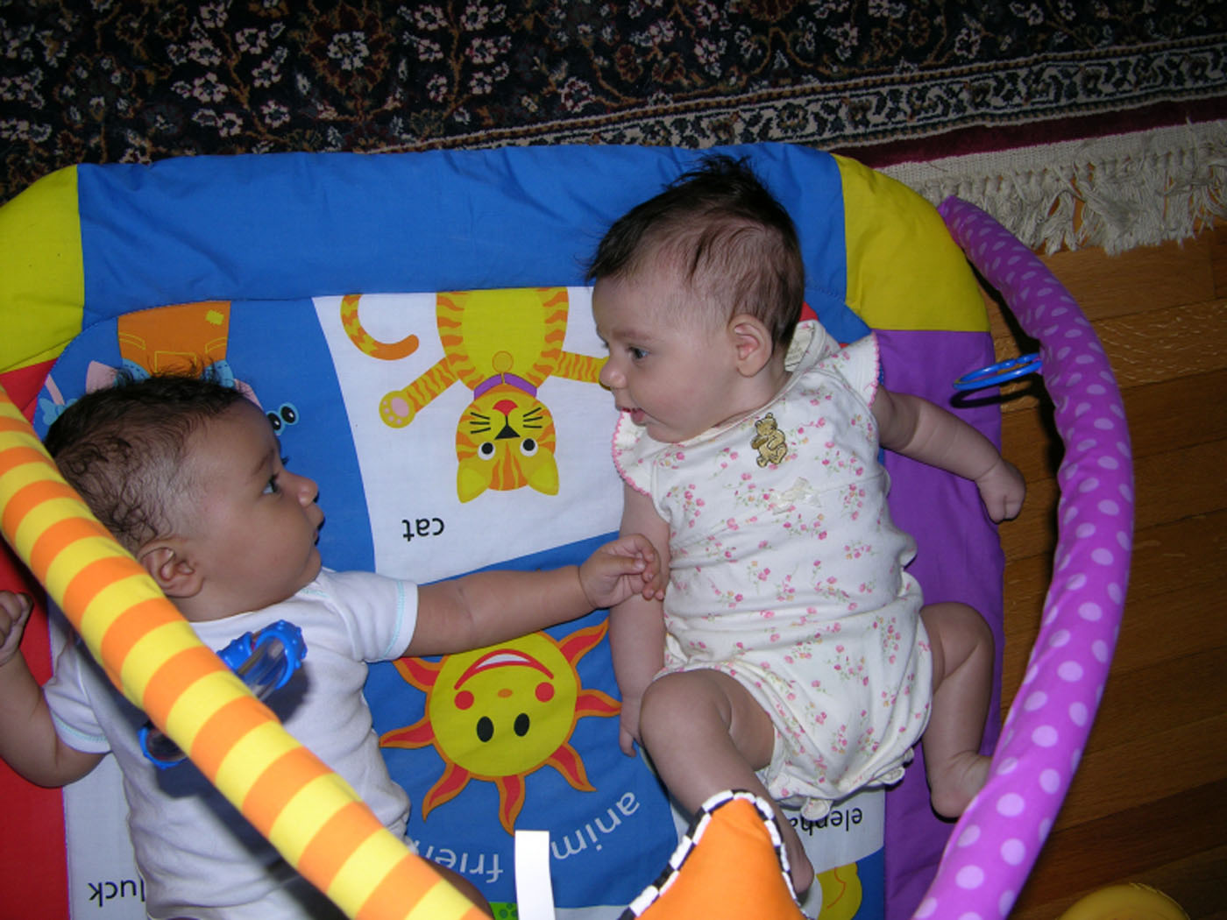
Conclusions
METS and MODS play well together.

Slide 20
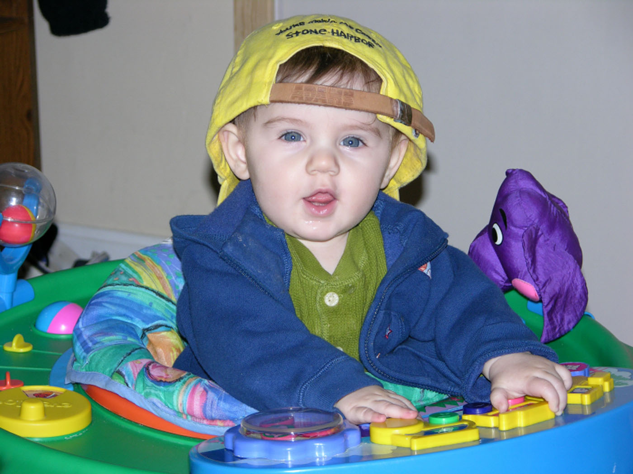
Conclusions
  METS files can be built automatically.

Slide 21
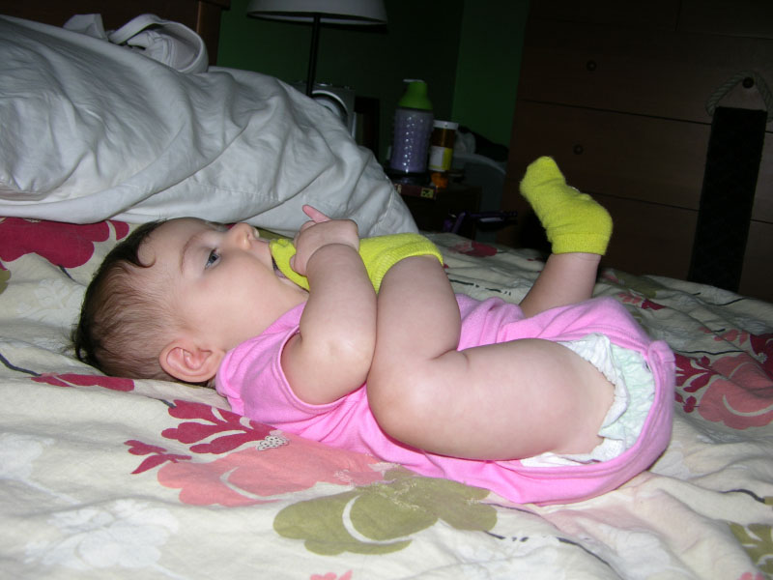
Conclusions
It may look hard, but METS objects can be parsed, validated and used without difficulty

Slide 22

Conclusions
  MODS is extremely powerful as a structural tool, not just a bibliographic tool
    (but good, consistent, authoritative cataloging makes search and display
    much more reliable)

Slide 23
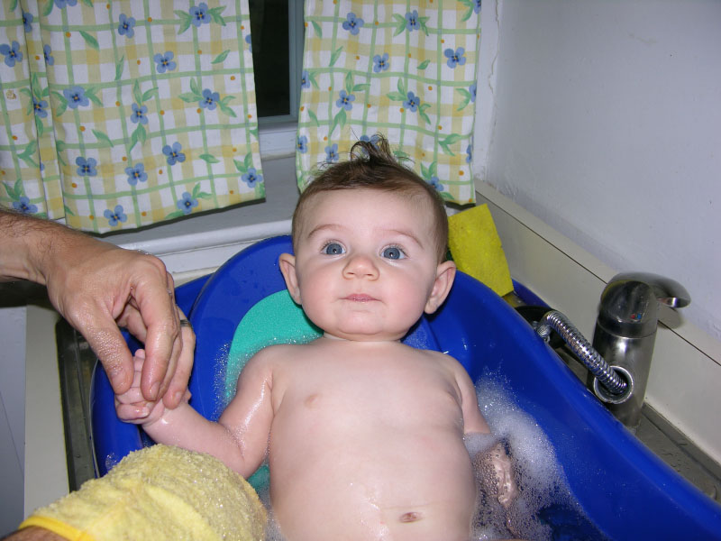
Conclusions
Display is for today only; well structured data lasts.
Notes:
All of our object display pages don’t really exist. So redesign is a comparatively easy task, if we got our data right. We take the data from the stage where we know everything about the object, and apply a new design to that.

Slide 24

Conclusions
Without standardized structures, we end up with egg on our face.
Notes:
Last one.

Slide 25
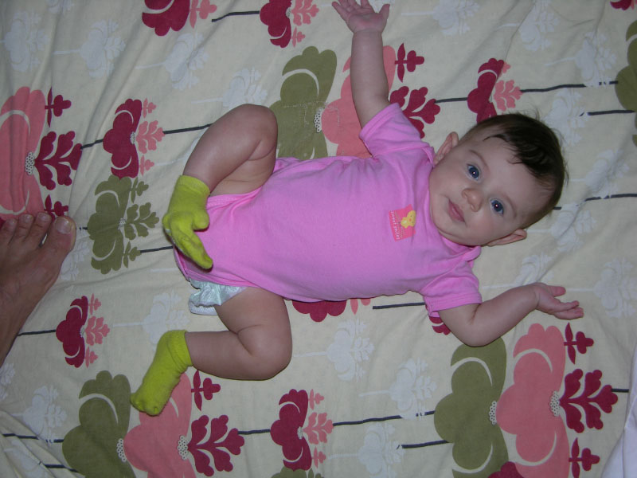
Any Questions?
Nate Trail
ntra@loc.gov
7-2193
Photos © 2006 Nate Trail

Slide 26

Get back to work!!
Photos © 2006 Nate Trail

