Slide 1


ContentE
Flexible Publication of Digitised Works with METS
Gilberto Pedrosa
José Luís Borbinha

Slide 2
The Problem: Digitised Works
1 million images were digitised in 2006 (more than 25.000 titles)
The result is a group of TIFF image files, which need yet to be processed so they can be stored and published
Doing that manually would be a very complex and expensive task
An automated solution was needed

Slide 3
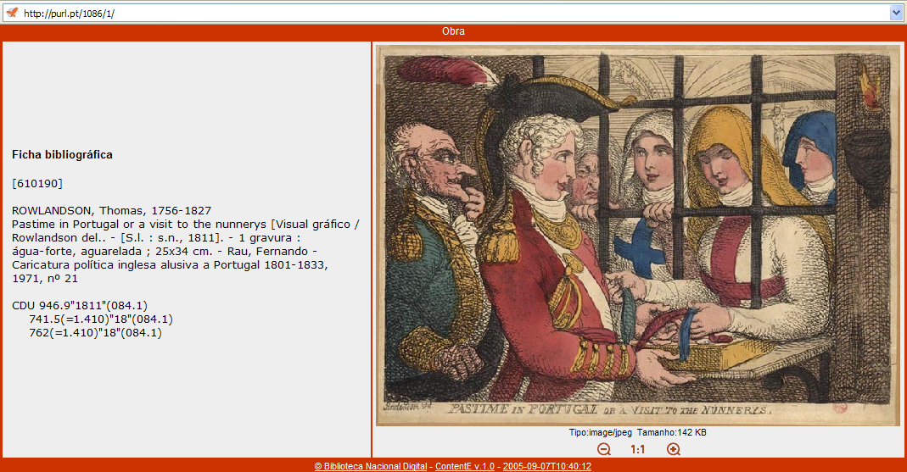
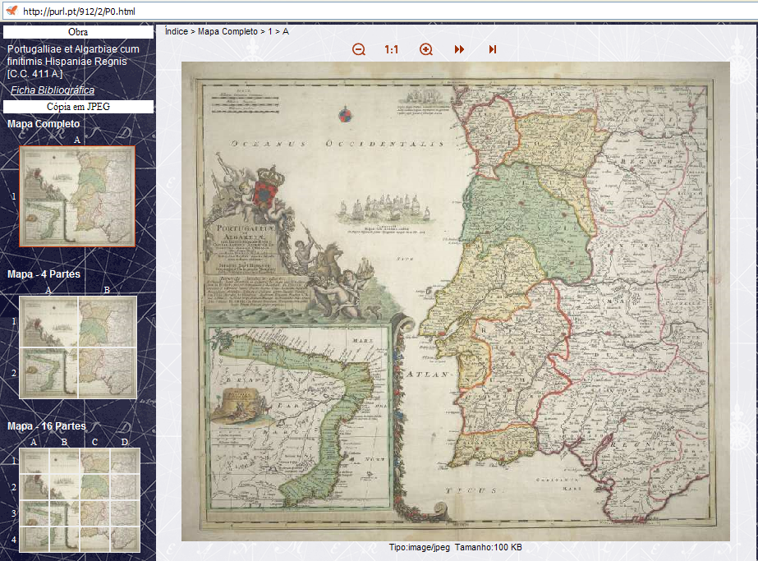


BND has a wide range of artefacts
Manuscripts
Books
Newspapers
Posters
Drawings
Maps
…

Slide 4
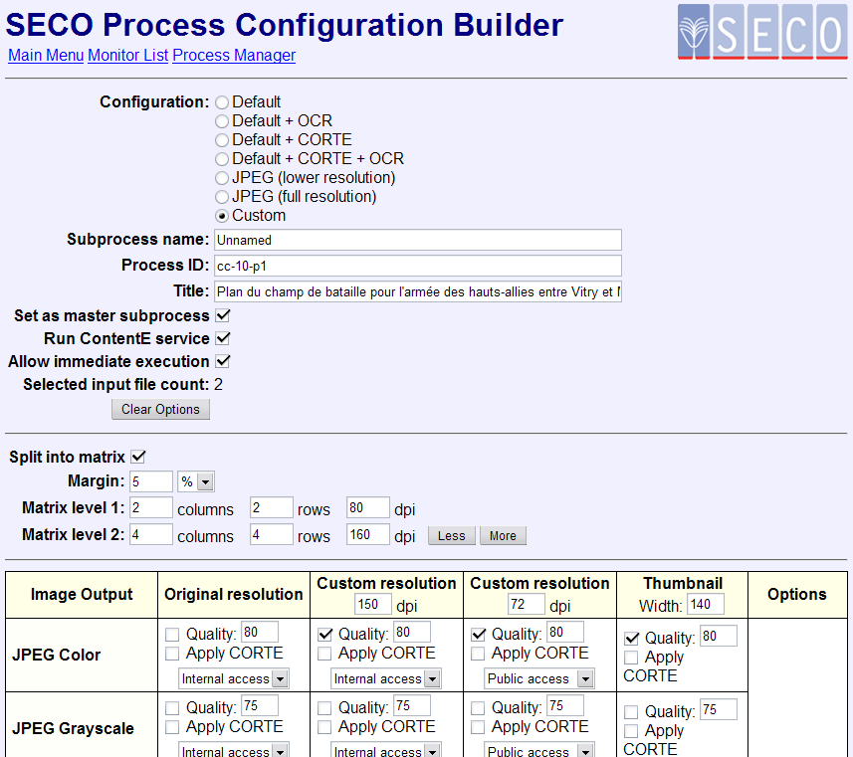
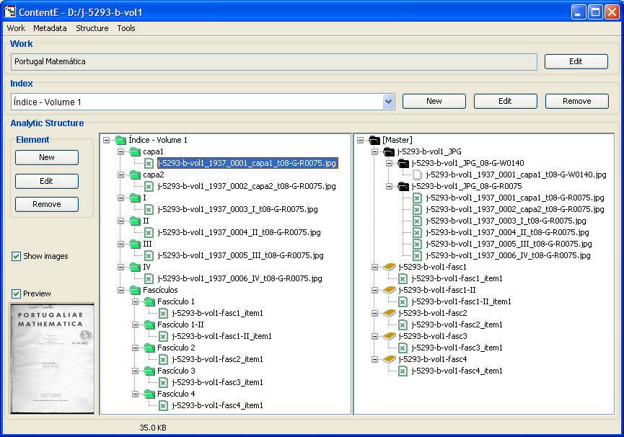
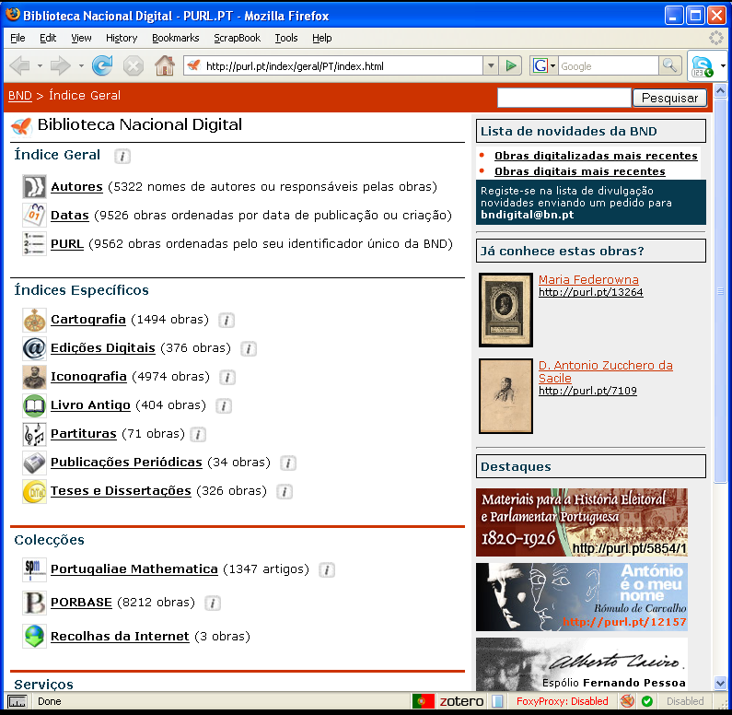
Workflow
An automated process was defined and deployed to create both master items and access items of the digitized works, and also to support its storage and access.
  That process is based on 3 systems:
  SECO
    Image and OCR processing
  CONTENTE
    Structuring and item generation
  PURL.PT
    Register and online publishing

Slide 5
ContentE – Content Editor
Supports creating, importing and editing structural descriptions
  Physical structure description
  Customized presentation
Metadata importing or editing
  Descriptive (UNIMARC, MARCXML, Dublin Core, X-ARQ,...)
  Technical (TIFF headers, ...)
  Rights (METS Rights, ...)

Slide 6
ContentE – Content Editor
Architectures
  ContentE Application
  ContentE Library
Output
  All copies are exported with structural metadata using METS schema
  Creates multiple publication copies as multiple XHTML sites (one copy for each MIME type)

Slide 7
ContentE Library
Used automatically by the SECO system
Flat index for fast publishing
Bibliographic record is automatically fetched from PORBASE database
Style is predefined by work type
  Standard styles suit most cases

Slide 8
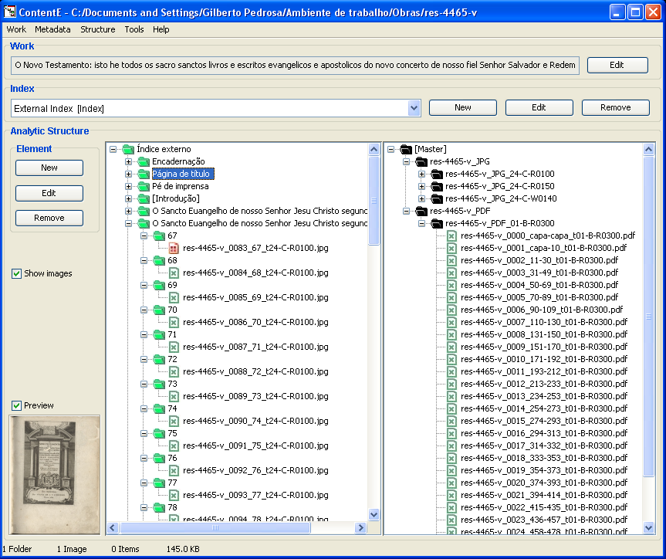
ContentE – Content Editor
The left pane makes it possible to define the structure of the work
The right pane presents the original files (images, documents)
Structuring is done by simple drag-and-drop

Slide 9
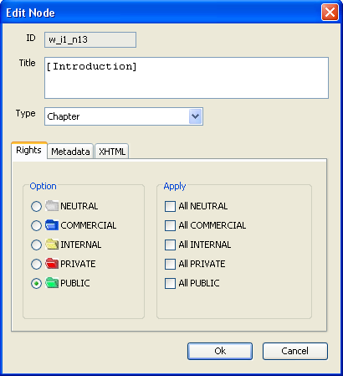
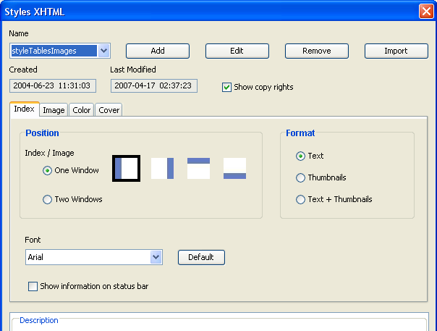
ContentE – Content Editor
  Any metadata can be associated to any structural aggregator (rights, descriptive, technical metadata…)
  The user can also control the publishing style

Slide 10
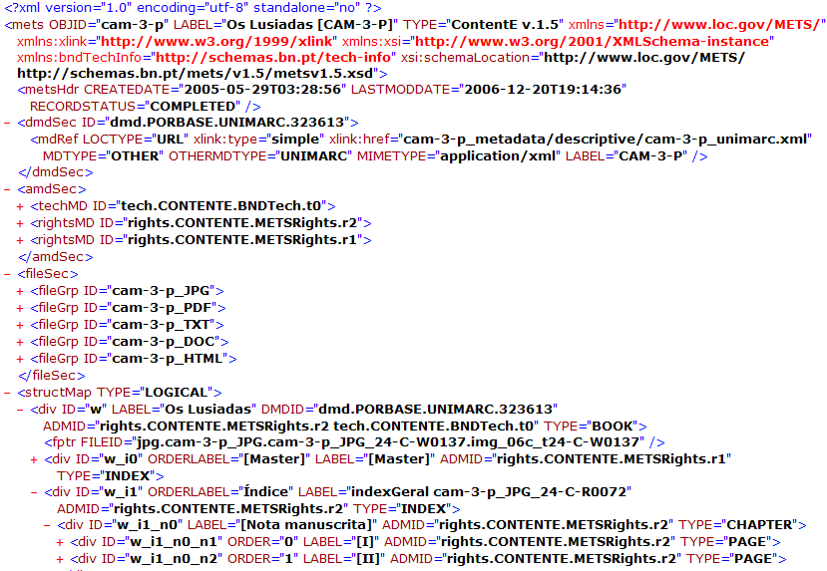
METS
Metadata Encoding and Transmission Standard
XML Schema
Flexible mechanism for :
  Encoding descriptive, administrative, and structural metadata
  Expressing the complex links between metadata
  Exchanging digital objects between repositories
  Associating a digital object with behaviours or services

Slide 11
METS Example
Header
Descriptive Metadata
Administrative Metadata
File Section
Structural Map
Structural Links
Behavior

Slide 12
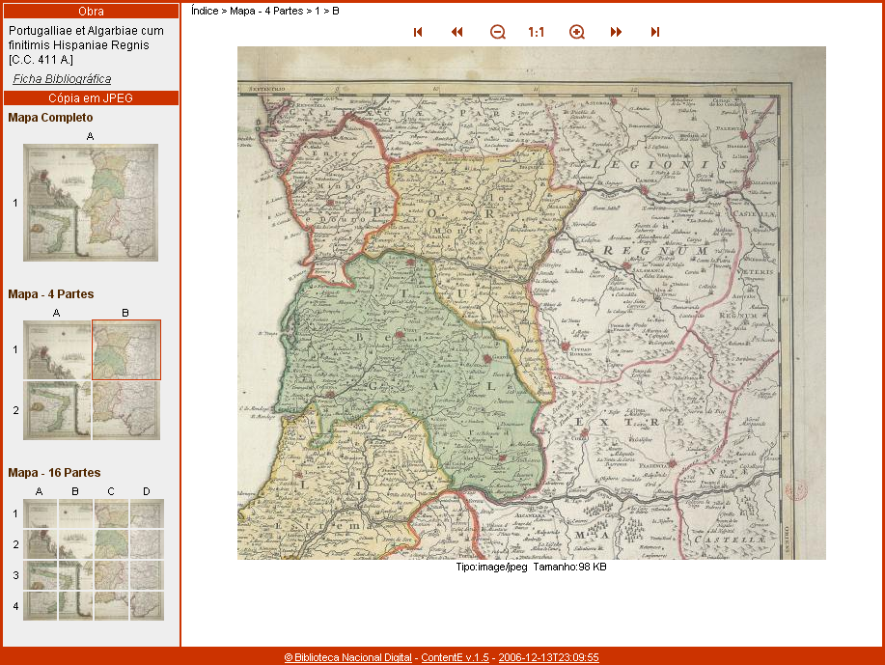
ContentE – High detail images
Matrix generation to present highly detailed maps and drawings

Slide 13
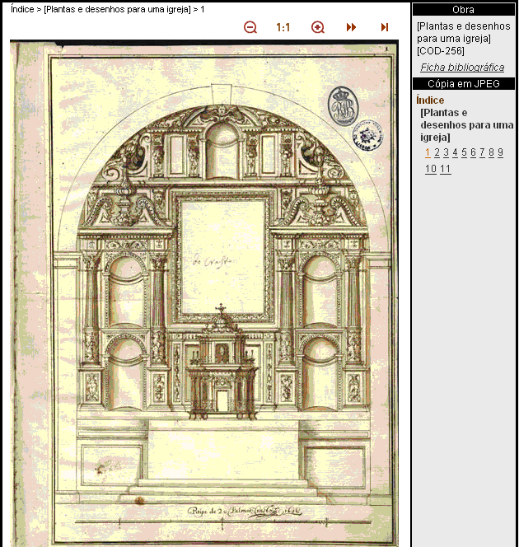
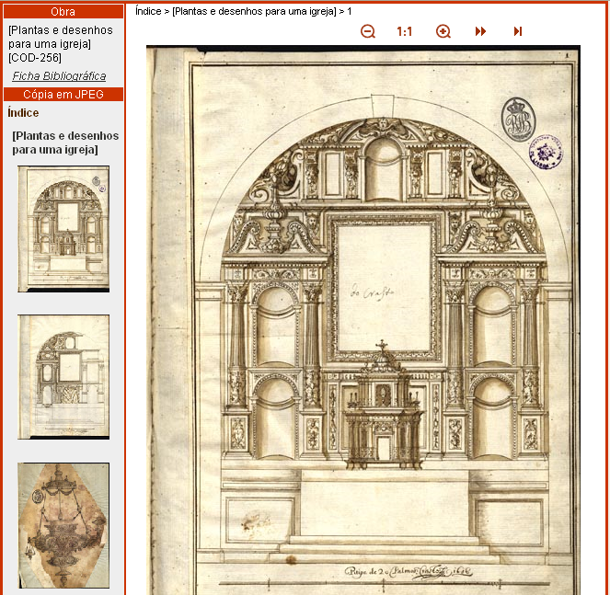
ContentE
XSL visual styles to generate XHTML
Multiple style configuration

Slide 14
Conclusions
More than 9.000 titles published
ContentE is coded in Java and is available as open-source
ContentE has Portuguese and English interface
XHTML is static (not necessary to install any plug-in)
METS is an excellent XML format to store all information
ContentE has been in use at several institutions:
  National Library of Portugal
  Ministry of Finance and Public Administration
  Faculty of Letters, University of Lisbon
  University of Coimbra
  Hemeroteca (CML)
  Centro Cultural de Macau

Slide 15
Work in progress
Add more schemas
  DOCBOOK
  Digital Talking Books defined by DAISY Consortium to process objects with sound, for visual impaired people
  SMIL
  Creative Commons
To translate ContentE interface into other languages (Spanish, French, German…)

Slide 16
ContentE: Further Info
E-Mail:
  gilberto.pedrosa@ist.utl.pt
ContentE Homepage:
  http://bnd.bn.pt/tec/contente/index.html
BND Homepage:
  http://bnd.bn.pt

