Slide 1

Communicating Archival Metadata conference and workshops in Stockholm 28 - 30 June 2011
METS
Karin Bredenberg / 30 – 6 - 2011

Slide 2
Content
METS History
METS Overview
METS Schema and Sections
METS Profiles
Validation
Redundancy
Additional information

Slide 3
What is METS?
METS = Metadata Encoding and Transmission Standard
Maintained by the METS Editorial Board
Schema is hosted at the Library of Congress
Current version 1.9

Slide 4
What is METS? (cont’d)
An XML schema-based specification for encoding “hub” documents for materials whose content is digital.
  Hub doc draws together dispersed but related files
  METS uses XML to provide a vocabulary and syntax for identifying the digital pieces that together comprise a digital entity, for specifying the location of these pieces, and for expressing the structural relationships between them.
    Content files
    Descriptive metadata
    Administrative metadata

Slide 5
METS Editorial Board
The METS Editorial Board is an international group of volunteers committed to maintaining editorial control over METS, its XML Schema, the METS Profile XML Schema, and official METS documentation. The Board promotes the use of the METS specification, maintains a registry of METS Profiles, and endorses best practices in the use of METS as they emerge. Members represent important communities of interest for METS, including members of the Digital Library Federation, its initial sponsor, and the Library of Congress, its maintenance agency.

Slide 6
METS History
Originates in Making of America II initiative
  Making of America II (MOA2) was a Digital Library Federation sponsored initiative that started in 1997. Participants included UCB (lead), Stanford, Penn State, Cornell, and NYPL.
  GOAL: to create a digital object standard for encoding structural, descriptive and administrative metadata along with primary content
  RESULT: MOA2.DTD (an XML DTD)

Slide 7
METS History (cont’d)
UCB Library and CDL adopt MOA2
Other institutions (LC, Harvard) consider
Additional needs emerge
  Support for time-based content
  More flexibility in Descriptive and Administrative metadata
MOA2 revised:
  Starting in February 2001 concerned parties meet to review and revise MOA2
  Outcome: mets.xsd

Slide 8
Main Provisions of METS schema
Identifying the files or parts of files that comprise the content of a digital entity, and expressing the structure or structures of this content
Linking Descriptive metadata with digital content
Linking Administrative metadata with digital content
Linking behavior definitions and program code with digital content and with associated descriptive and administrative metadata
Wrapping digital content, and associated descriptive and administrative metadata as binary data.
Wrapping digital content, and associated descriptive and administrative metadata as XML data.

Slide 9
1. Identifying Content and Expressing Its Structure
METS provides for specifying
  What files constitute the content of a digital object
  How these fit together into a structured whole
What content files? Answer: any:
  Image: jpeg, gif, tiff, sid, etc
  Text/encoded text: txt, sgml, html, xml
  Audio/Video: avi, mpeg, wav, midi
What content structure? Answer: any hierarchical structure (physical, logical) but also web structure

Slide 10
2. Linking Descriptive Metadata with Digital Content
METS does not itself provide a vocabulary and syntax for encoding descriptive metadata (no descriptive metadata elements defined in METS)
METS does provide a means for pointing to external descriptive metadata and/or for including descriptive metadata internally.
METS provides a means for linking this metadata to the digital content of the entity.

Slide 11
3. Linking Administrative Metadata with Digital Content
METS does not itself provide a vocabulary and syntax for encoding administrative metadata (no administrative metadata elements defined in METS)
METS does provide a means for pointing to external administrative metadata and/or for including administrative metadata internally.
METS provides for linking this metadata to the digital content.

Slide 12
4. Coordinating Dissemination Behaviors with Digital Content
METS provides a means for linking digital content with
  an interface that defines the available disseminations and the required parameters for each
  dissemination software that implements this interface

Slide 13
5. Wrapping Binary Content
A METS object can wrap the content of a digital entity as binary data, as well as all associated descriptive and administrative metadata.
This capability of METS gives it great potential for archiving purposes.

Slide 14
6. Wrapping XML Content
A METS object can wrap the content of a digital entity as XML data, as well as all associated descriptive and administrative metadata.
This capability of METS gives it great potential for archiving purposes.

Slide 15
Uses of METS
Transfer syntax
  standard for transmitting/ exchanging digital objects.
  SIP (Open Archival Information Systems Reference Model)
  DSpace SIP Toolkit uses a mandatory METS document
  Fedora supports METS as a ingest package
Functional syntax:
  basis for providing end users with the ability to view and navigate digital content and its associated metadata
  DIP
Archiving syntax
  standard for archiving digital objects.
  combine with PREMIS (PREservation Metadata: Implementation Strategies)
  AIP

Slide 16
Overview of schema and sections

Slide 17
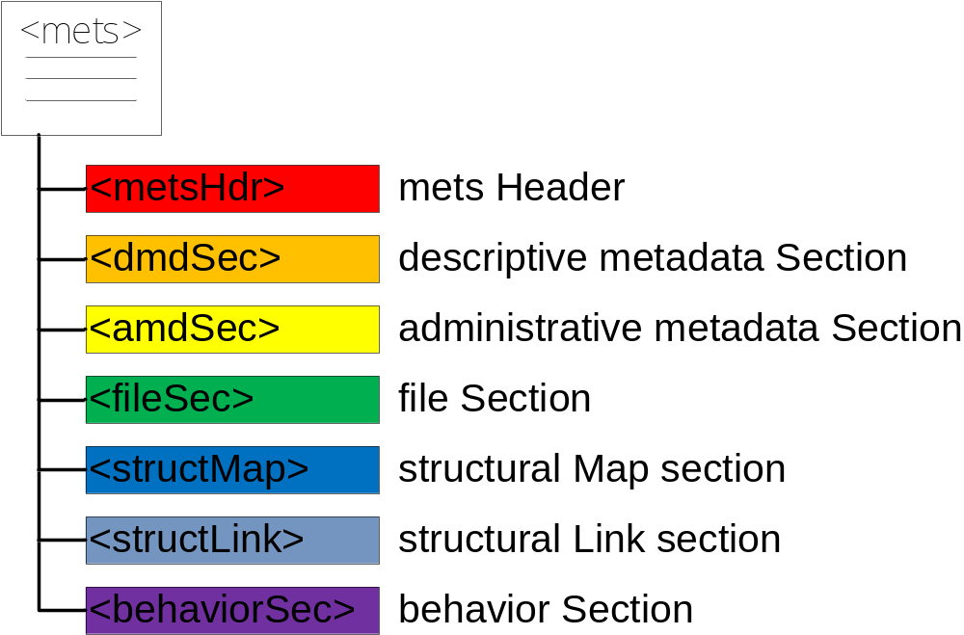
METS first level elements

Slide 18
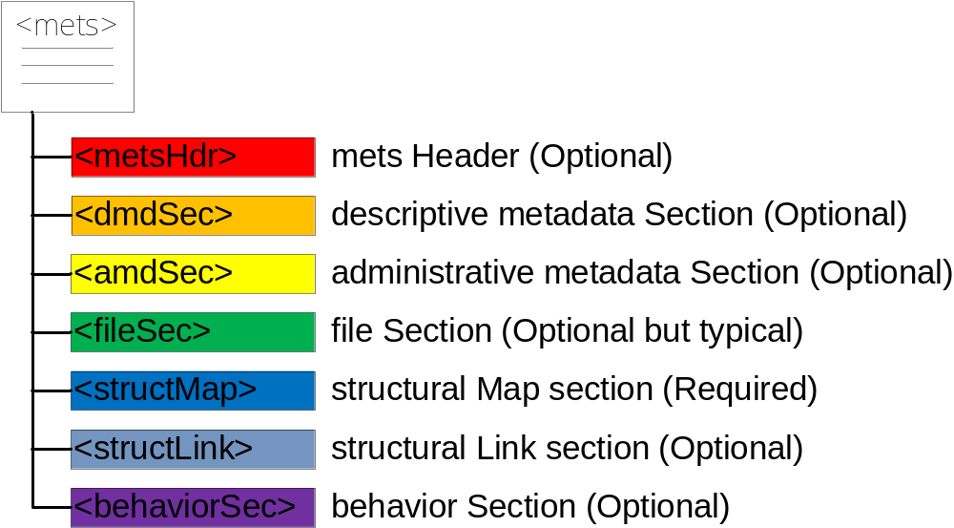
METS first level elements

Slide 19
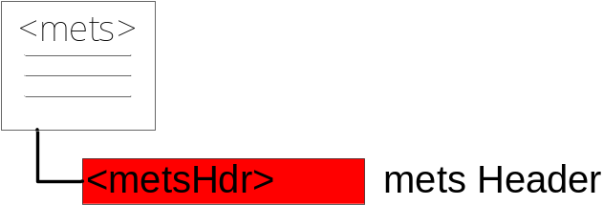
METS Header
Records administrative metadata about the METS document itself such as:
  Author/agent and role
  Alternative identifiers for the METS document
  Creation and update date and times
  Status

Slide 20
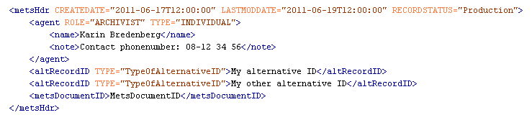
METS Header

Slide 21
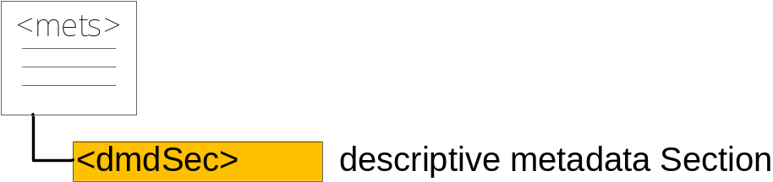
Descriptive Metadata
Can record all of the units of descriptive metadata pertaining to the digital entity represented by METS document
  Descriptive metadata could take any form including MARC record, Finding Aid, Dublin Core record
  Descriptive Metadata may be
    External to the METS document
    Internal to the METS document
    Both external and internal

Slide 22
External Descriptive Metadata
Descriptive metadata element in a METS document may simply identify the type of descriptive metadata it represents (MARC, EAD, etc), and point to this metadata in its external location via a URI Descriptive Metadata

Slide 23

External Descriptive Metadata

Slide 24
Internal Descriptive Metadata
Descriptive metadata may be recorded internally in a METS document in one of two ways
  As XML data using vocabulary and syntax specified in external XML standard. For example, Dublin Core, MARC, MODS.
  As binary data. For example, a standard MARC record could simply be incorporated as binary data into METS document.

Slide 25
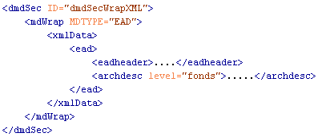
Internal Descriptive Metadata
External XML Standard

Slide 26
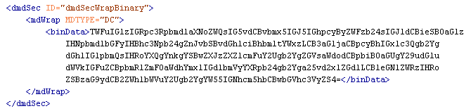
Internal Descriptive Metadata
Binary data

Slide 27
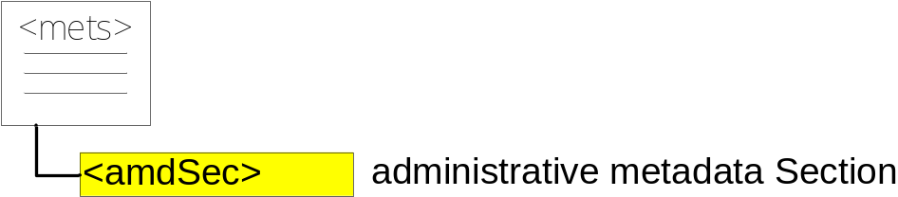
Administrative metadata
Can record all of the units of administrative metadata pertinent to the METS object or its parts

Slide 28
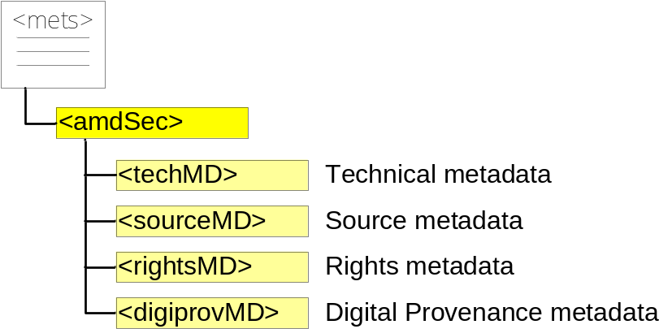
Administrative metadata
Flavors
Administrative metadata elements come in 4 flavors
  Technical metadata
  Source Metadata
  Rights Metadata
  Digital Provenance Metadata
You choose which to use
  All
  Just one
  Any self-chosen number
There are some recommendations of which flavor to use to which type of administrative metadata

Slide 29
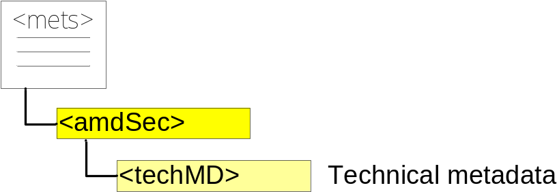
Administrative metadata
Technical metadata
Technical metadata about the content files
Can take any form including MIX, textMD or a locally produced XML schema etc.

Slide 30
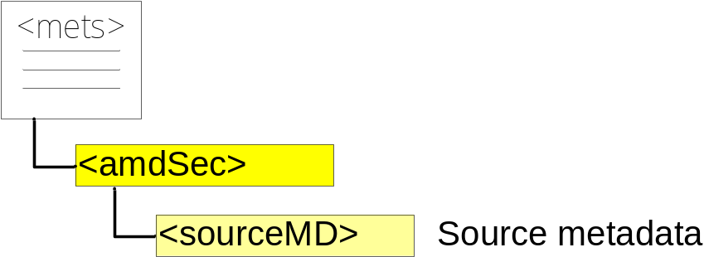
Administrative metadata
Source metadata
Descriptive, technical or rights information about an analog source document used to generate the digital object
Can take any form including audioMD, videoMD, AES (Audio Engineering Society) metadata schemas or a locally produced XML schema etc.

Slide 31
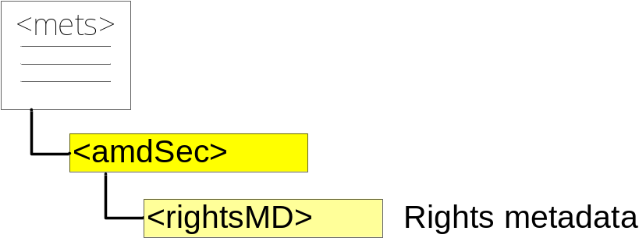
Administrative metadata
Rights metadata
Intellectual property rights information
Can take any form including CopyrightMD, rightsDeclarationMD or a locally produced XML schema

Slide 32
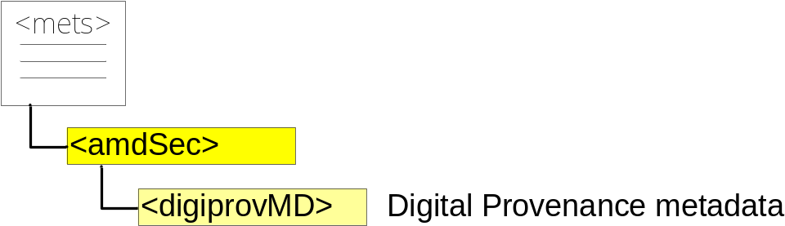
Administrative metadata
Digital Provenance metadata
Digital preservation information, such as information about the digital object’s lifecycle and history
Can take any form including PREMIS (see the guidelines at http://www.loc.gov/standards/PREMIS/guidelines-premismets.pdf) or a locally produced XML schema etc.

Slide 33
Administrative metadata
Administrative metadata may be
  External to the METS document
  Internal to the METS document
  Both external and internal

Slide 34
External Administrative metadata
Administrative metadata element in a METS document may simply identify the type of administrative metadata it represents (NISOIMG, LC-AV, etc), and point to this metadata in its external location via a URI.

Slide 35


External Administrative metadata

Slide 36
Internal Administrative metadata
Administrative metadata may be recorded internally in a METS document in one of two ways
  As XML data using vocabulary and syntax specified in external XML standard.
  As binary data.

Slide 37
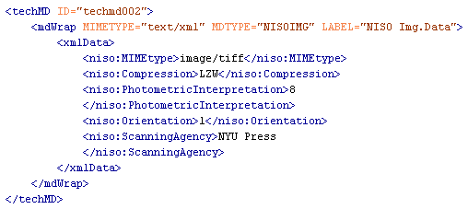
Internal Administrative metadata
External XML Standard

Slide 38
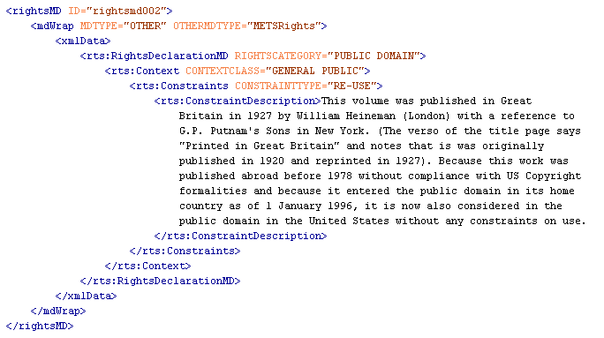
Internal Administrative metadata
External XML Standard

Slide 39
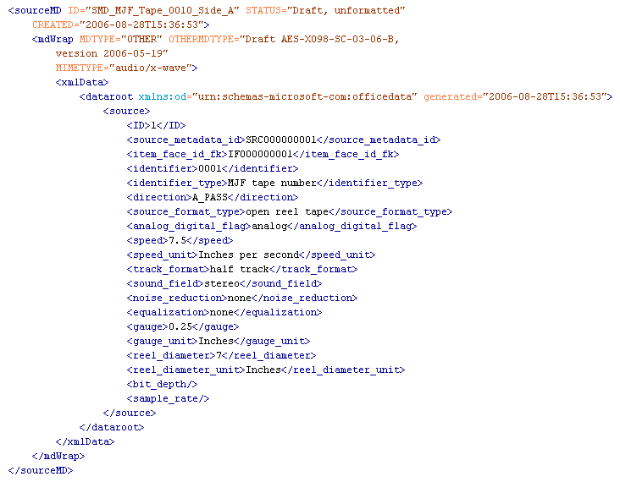
Internal Administrative metadata
External XML Standard

Slide 40
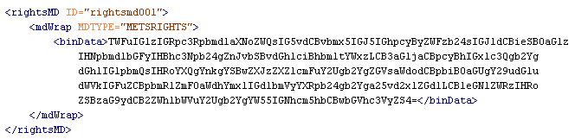
Internal Administrative metadata
Binary data

Slide 41
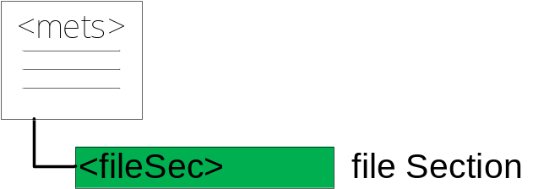
File Section
Records all of the files that together comprise the content of the digital entity represented by the METS document

Slide 42
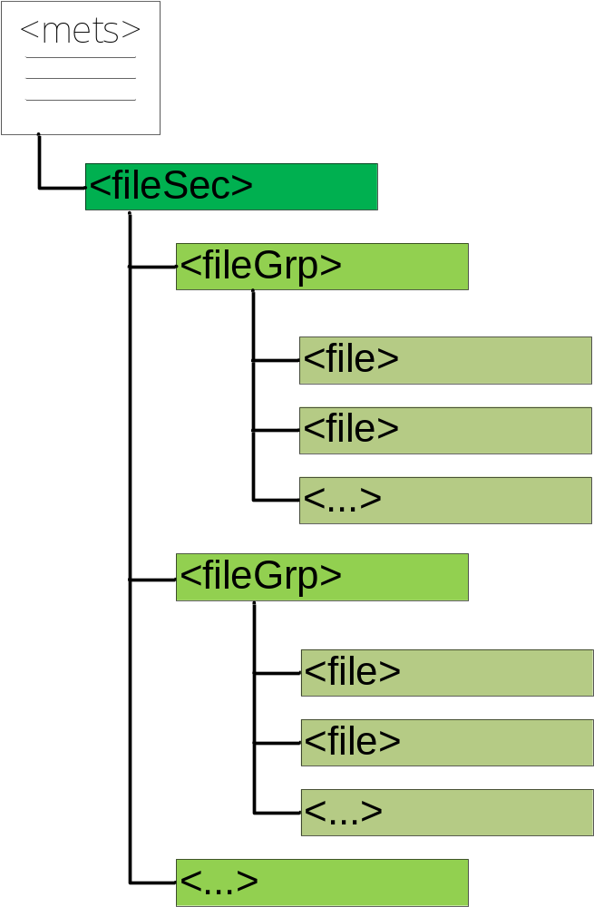
File Section
Filegroups
Files are organized into File Groups based on the grouping you would like to do. One way is to group by format (tiff, hi-res jpeg, med-res jpeg, gif, etc)

Slide 43
File Section
File
A file element can record this metadata.
  Required: ID
  Optional: SEQ, OWNERID, ADMID, DMDID, GROUPID, USE, BEGIN, END, BETYPE, MIMETYPE, SIZE, CREATED, CHECKSUM, CHECKSUMTYPE
Makes it possible to easily check if the file is corrupt

Slide 44
File Section
TransformFile
A file element can include a transformFile-element
The transform file element <transformFile> provides a means to access any subsidiary files listed below a <file> element by indicating the steps required to "unpack" or transform the subsidiary files. This element is repeatable and might provide a link to a <behavior> in the <behaviorSec> that performs the transformation.

Slide 45
File Section
A file element may refer to an external content file, or itself contain the file contents, or both.
  External content file. File element may point to an external content file via a URI.
  Internal content file. File element may itself contain the file contents as binary data or XML data.

Slide 46
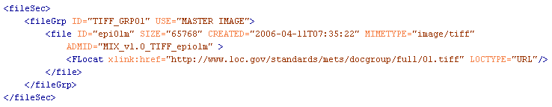
File Section
External content file

Slide 47
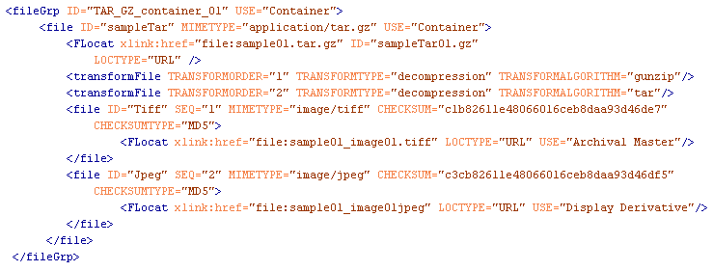
File Section
External content file and transformation example
The following example describes a *.tar.gz file which has two embedded files within it, one a TIFF file and the other a JPEG file of the same image. To use the <fileSec> to describe these files, you could use the <transformFile> element in the following way:

Slide 48
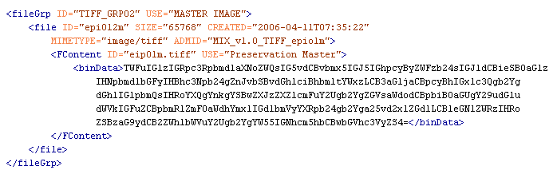
File Section
Internal content file as binary data

Slide 49
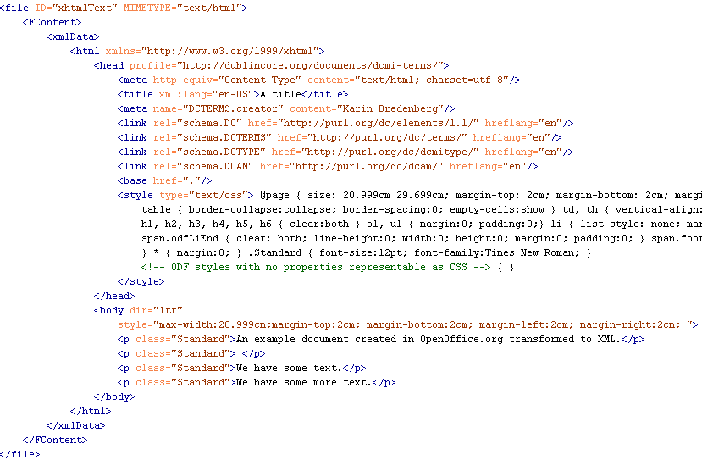
File Section
Internal content file as XML data

Slide 50
Linking Files with Administrative Metadata
Files and File Groups may point to pertinent administrative metadata elements in the Administrative Metadata Section of the METS document. File or file group might point to:
  Technical Metadata element: technical information
  Rights Metadata element: access restrictions, etc
  Source Metadata element: info about original
  Digital Provenance metadata element: transformations that produced the file

Slide 51

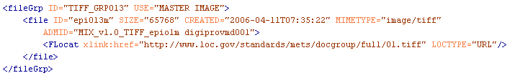
Linking Files with Administrative Metadata

Slide 52
Linking Files with Descriptive Metadata
Files may point to pertinent decriptive metadata elements in the Descriptive Metadata Section of the METS document.

Slide 53
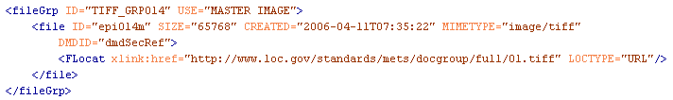
Linking Files with Descriptive Metadata

Slide 54
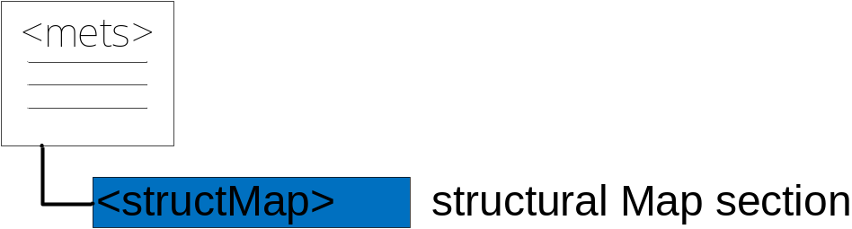
Structural Map Section
Specifies the (hierarchical) structure of the digital entity represented by the METS document.
Specifies how the content files (the files listed in the Files Section) fit into this structure.
More than one structure may be specified. For example: a logical structure and a physical structure, a Webpage structure

Slide 55
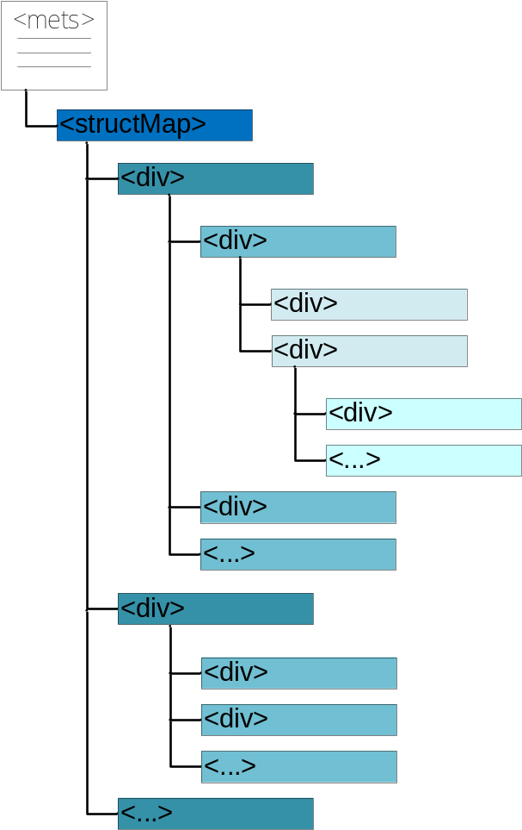
Expressing the Structure
The structural map analyzes a digital object into a hierarchy of Division (div) elements:
  Division (type=“photoalbum”)
  Division (type=“page”)
  Division (type=“photo”)
  Division (type=“photo”)
  Division (type=“photo”)
  Division (type=“page”)
  Division (type=“photo”)
  Division (type=“photo”)

Slide 56
Structural Map Section
Simple content:
  Content is simple when the various manifestations of a division are each represented by a single, whole file. Example: page manifested by a thumbnail, med-res jpeg, and hi-res jpeg.
  Division simply contains a pointer to each file element in the file list that represents a manifestation of the Division

Slide 57
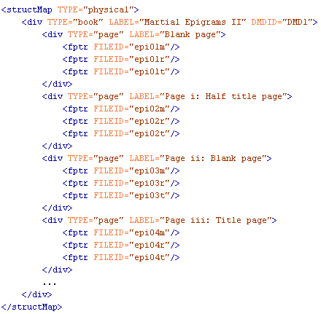
Structural Map Section
Simple content

Slide 58
Structural Map Section
Complex content. METS accommodates various types of complex content.
  Content expressed by subsection of file.
    Division points not just to a file represented in a file list, but to a particular area within in that file.
      Text (transcriptions): references Begin/End ids within structured text.
      A/V: references a BeginTime and EndTime or Extent
      Image/2-D: Internal shape and coordinates

Slide 59
Structural Map Section
Complex content (cont’d):
  Content expressed by files that must be “played/displayed” in sequence
    Division points to a sequence of files or sections of files
  Content expressed by files that must be “played/displayed” at same time
    Division points to set of parallel files or section of files

Slide 60
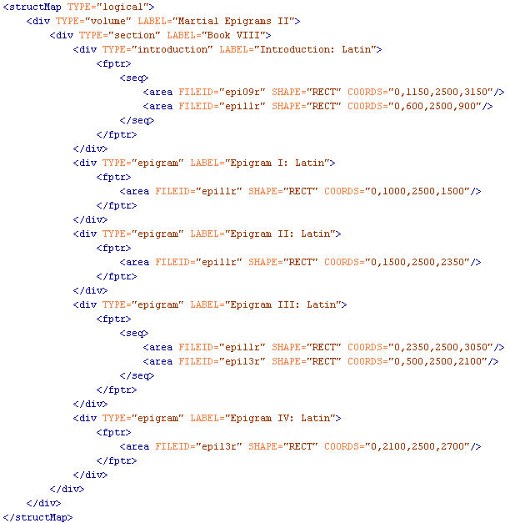
Structural Map Section
Complex content

Slide 61
Structural Map Section
Links to Administrative and Descriptive Metadata
A Division at any level can point to a Administrative Metadata elements within the METS document that contain or point to pertinent administrative metadata.
  Example: the root Division in a METS object that represents a photoalbum, might point to a Rights metadata element that contains copyright and access restrictions for the entire photoalbum.
A Division at any level can point to one or more Descriptive Metadata elements within the METS document that contain or point to the pertinent descriptive metadata.
Links to both in the same div can be done

Slide 62
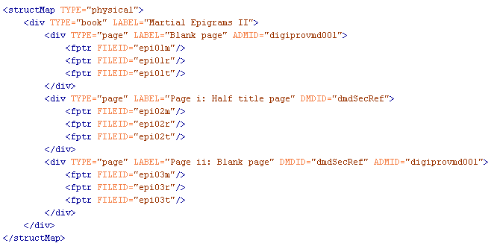
Structural Map Section
Links to Administrative and Descriptive Metadata

Slide 63
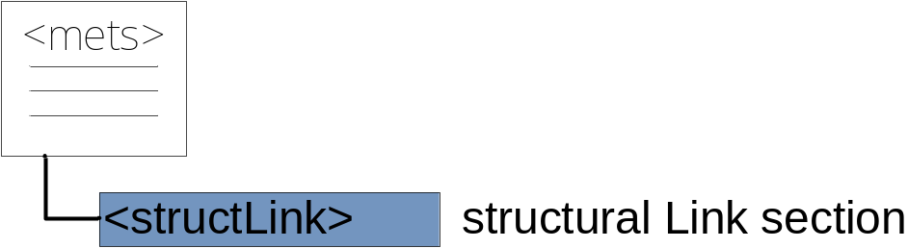
Structural Link Section
Specification for hyperlinks between the different components of a METS structure that are delineated in a structural map.
Used to note the existence of hypertext links between web pages, if you wished to record those links within METS.

Slide 64
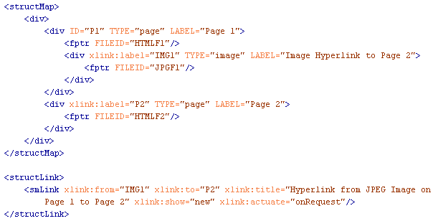
Structural Link Section

Slide 65
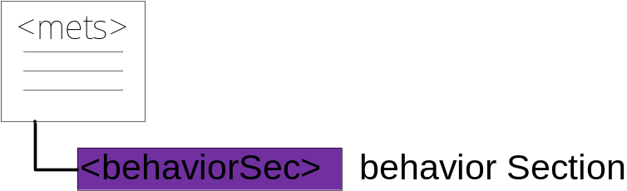
Behavior Section
Can record all of the dissemination behaviors that pertain to a digital entity or its parts. A behavior unit may contain:
  A reference to an external interface definition that defines a set of related behaviors
  A reference to an external executable that implements these behaviors
  A reference to the Division or Divisions of the object structure to which the behaviors apply.

Slide 66
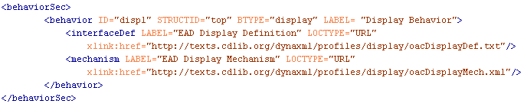
Behavior Section

Slide 67
Behavior Section
The following example illustrates how a METS object will call executable code to 1) display an Encoded Archival Description (EAD) finding aid, and 2) authenticate public access to the finding aid. Pertinent sections of the <structMap> are included in the example.

Slide 68
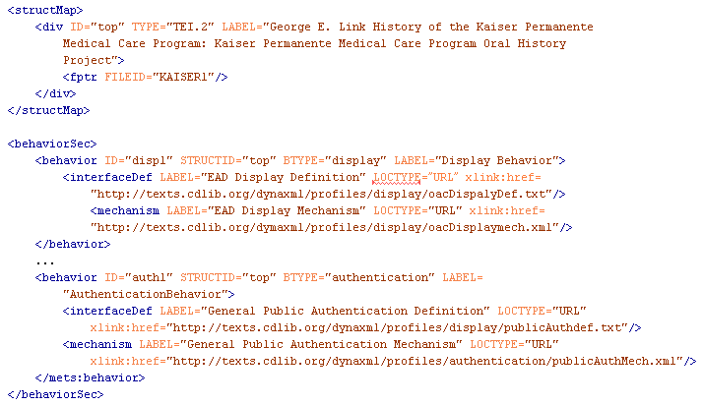
Behavior Section

Slide 69
Using METS
Profiles
Profile registration
Validating
Redundancy

Slide 70
Profiles
An XML document
Defines the rules of how METS is used
One profile can extend another profile

Slide 71
Profiles
Profiles schema version 2.0
General information about who to contact regarding the profile and so on
Element showing if its registered or not
All the rules regarding the use of METS

Slide 72
Profiles Registration
Registration at the METS Editorial Board
June 2011 36 registered profiles
Review period at/by the METS-list
Can be used by others
Others can make an new profile extending an existing profile with their use

Slide 73
Validating
The original schema has just the rules originally in METS
For validating own rules you must edit the schema and add your restrictions

Slide 74
Redundancy
Using METS and other standards sometimes causes redundancy
Same elements in several standards
Same elements mandatory in several standards
Own descisions regarding redundancy in cases when not mandatory in both standards.
Regarding PREMIS and METS see the document mentioned earlier

Slide 75
Additional information
METS official site:
http://www.loc.gov/standards/mets
METS listserv:
METS@LOC.GOV
OAIS
http://nssdc.gsfc.nasa.gov/nost/isoas/
PREMIS
http://www.loc.gov/standards/premis

Slide 76
This presentation compiled with the help of:
Nancy J. Hoebelheinrich, Knowledge Motifs LLC
Rick Beaubien, Library Systems Office, U.C. Berkeley
Joachim Bauer, Senior System Engineer, CCS Content Conversion Specialists GmbH
Jerome McDonough, Asst. Professor, Graduate School of Library & Information Science, University of Illinois at Urbana-Champaign

