Slide 1

METS: An Introduction
Structuring Digital Content

Slide 2
Prospectus
3 main topics
  METS Provisions: a non-technical overview
  METS Mechanisms: specific XML encodings that accomplish provisions
  METS and MOA2: main differences between MOA2 and METS
Main purpose:
  Background for LSO programmers
  Preparation for moving DL work centering on a digital object standard from “research” to “production” mode, from MOA2 to METS

Slide 3
Apology
Know MOA2 and METS pretty well
Limited, spotty, or non-existent expertise in many of the related standards

Slide 4
METS: an Introduction
Part I: METS Provisions

Slide 5
What is METS?
An XML-based standard for encoding “hub” documents for materials whose content is digital.
  XML is a markup language like SGML.
  A hub document draws together dispersed but related digital files and content
  METS uses XML to provide a vocabulary and syntax for identifying the digital pieces that together comprise a digital entity, for specifying the location of these pieces, and for expressing the relationships between these digital pieces

Slide 6
What is METS? (cont’d)
Successor to MOA2
  MOA2 was a DLF funded initiative starting in 1997
  Main goal was to create a digital library object standard for encoding descriptive, administrative and structural metadata along with primary content
  Result: MOA2.DTD. This encoding “standard” is the immediate predecessor of METS by which it will be superseded.

Slide 7
What is METS? (cont’d)
Uses of METS.
  Transfer syntax: standard for transmitting/exchanging digital entities.
  Functional syntax: basis for providing end users with the ability to view and navigate digital content and its associated metadata
  Archiving syntax: standard for archiving digital entities.

Slide 8
Main Provisions of METS
Expressing the structure or structures of a digital entity
Linking Descriptive metadata with digital content
Linking Administrative metadata with digital content
Linking behavior definitions and program code with digital content and with associated descriptive and administrative metadata
Wrapping digital content, and associated descriptive and administrative metadata as binary data.

Slide 9
1. Expressing Structure
METS provides the means for specifying how the files and parts of files that constitute the content of a digital entity fit together into a coherent, hierarchically structured whole.
  What files? Answer: any:
    Image: jpeg, gif, tiff, sid, etc
    Text/encoded text: txt, sgml, html, xml
    Audio/Visual: avi, mpeg, wav, midi
  What structure? Answer: any:
    Physical structure
    Logical structure

Slide 10
2. Linking Descriptive Metadata with Digital Content
METS does not itself provide a vocabulary and syntax for encoding descriptive metadata (no descriptive metadata elements defined in METS)
METS does provide a means for pointing to external descriptive metadata and/or for including descriptive metadata internally. It provides a means for linking this metadata to the digital content of the entity.

Slide 11
3. Linking Administrative Metadata with Digital Content
METS does not itself provide a vocabulary and syntax for encoding administrative metadata (no administrative metadata elements defined in METS)
METS does provide a means for pointing to external administrative metadata and/or for including administrative metadata internally. It provides for linking this metadata to the digital content.

Slide 12
4. Coordinating Dissemination Behaviors with Digital Content
METS provides a means for linking digital content with external software capable of disseminating that content, as well as an interface file that defines the specific disseminations and the required parameters for each.

Slide 13
5. Wrapping Binary Content
METS object can wrap the content of a digital entity as binary data, as well as all associated descriptive and administrative metadata.
This capability of METS gives it great potential for archiving purposes.

Slide 14
Examples: METS as Functional Syntax
Examples actually MOA2 based; but could be METS
Shows ability of MOA2/METS to specify digital content, related metadata, and complex relationships between all of the digital pieces comprising a digital entity
Functionality demonstrated in each example directly provided for by MOA2/METS encoding.

Slide 15
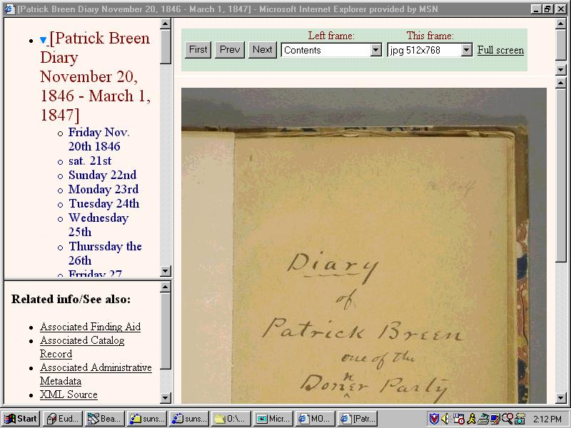

Slide 16
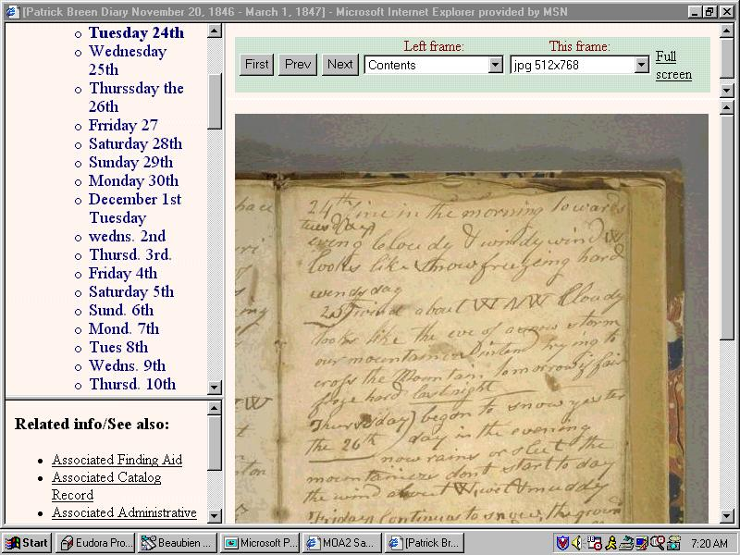

Slide 17
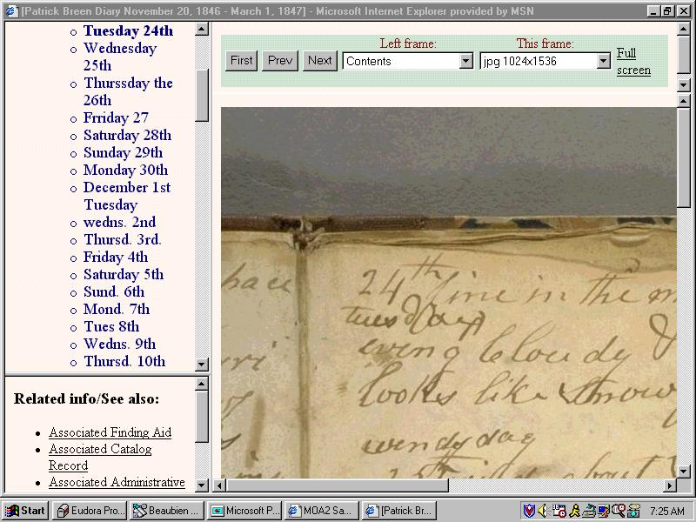

Slide 18
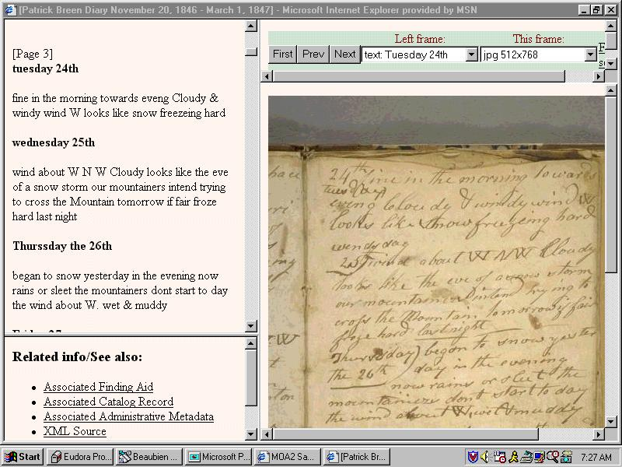

Slide 19
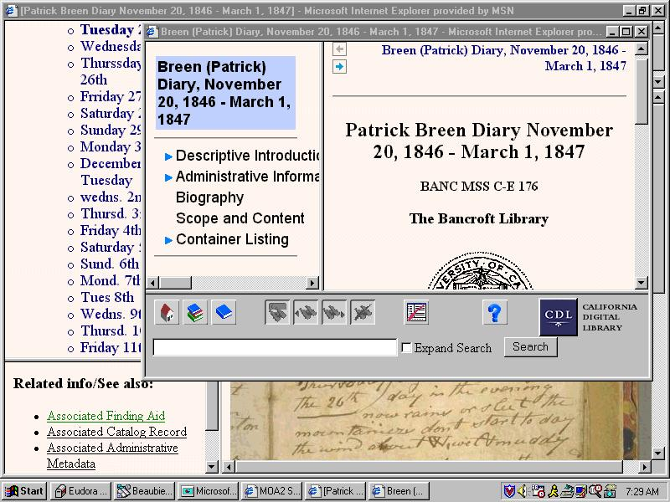

Slide 20
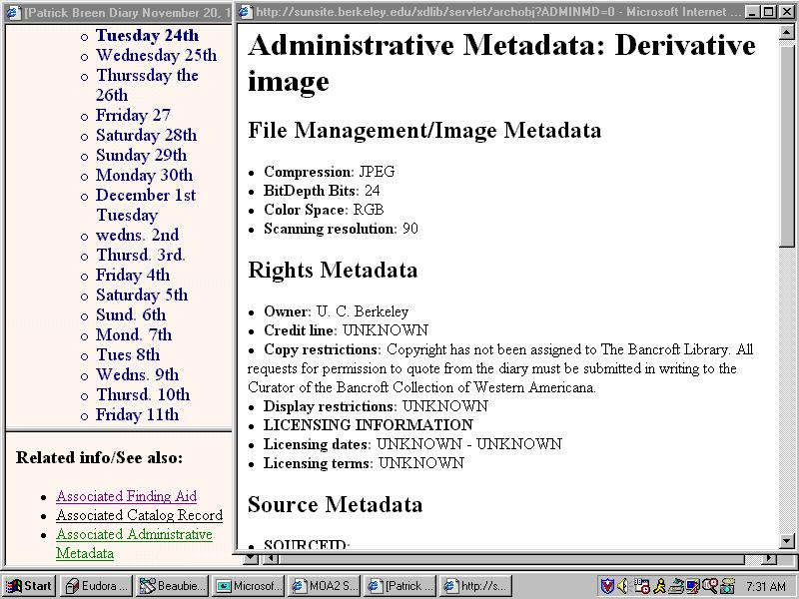

Slide 21
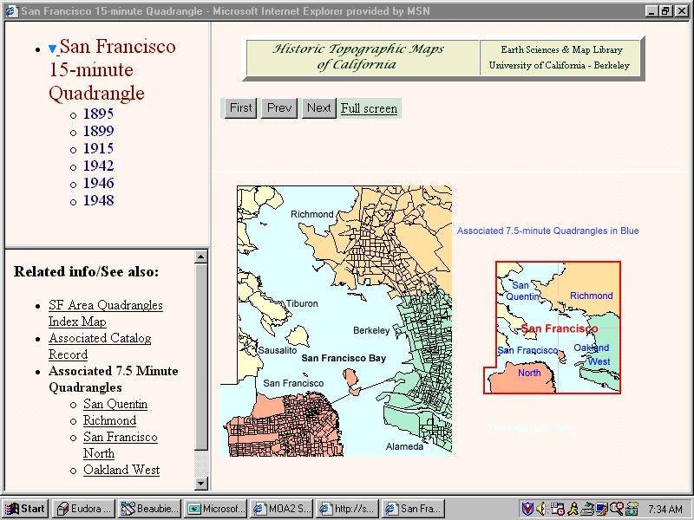

Slide 22
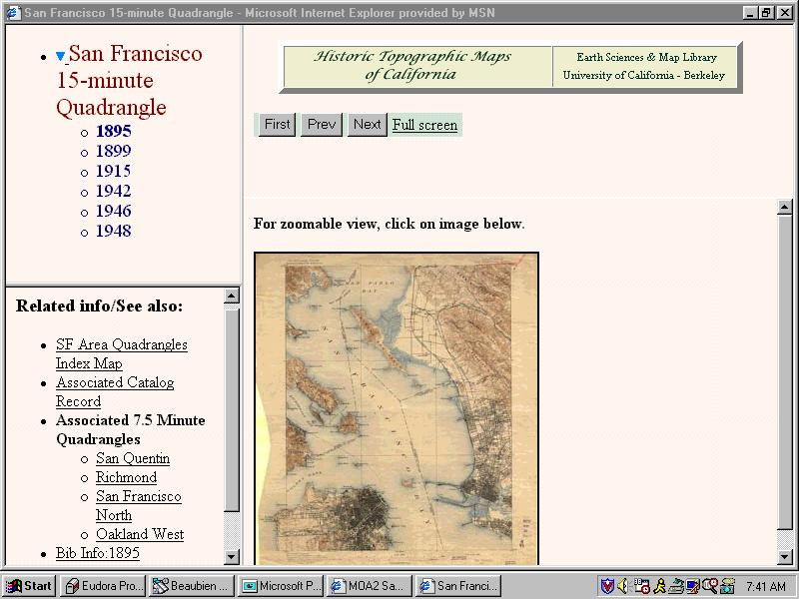

Slide 23
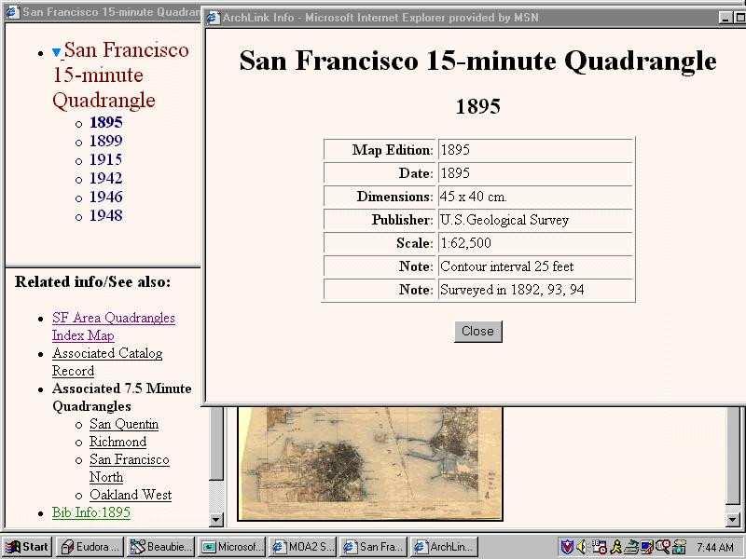

Slide 24
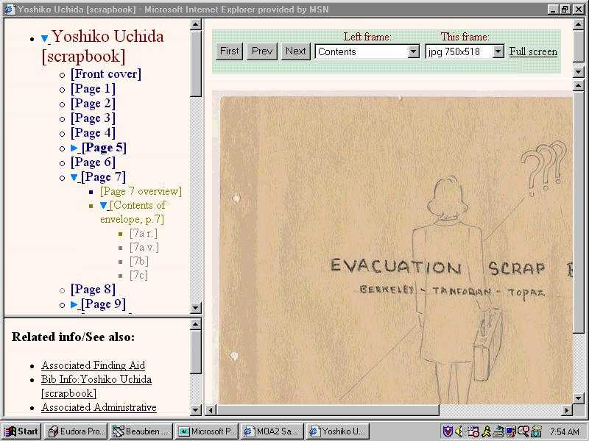

Slide 25
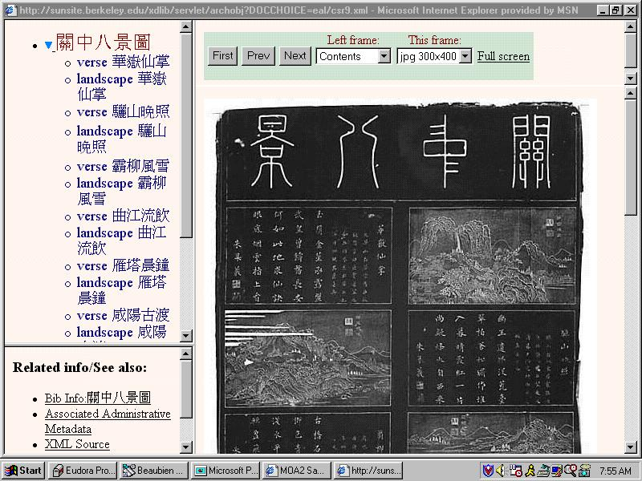

Slide 26
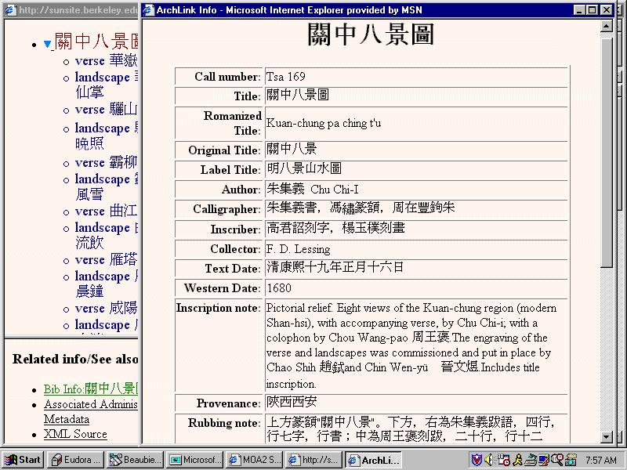

Slide 27
Anatomy of a METS document
METS documents consist of up to 6 sections
  Header
  Descriptive Metadata Section
  Administrative Metadata Section
  File Section
  Structural Map Section
  Behavior section

Slide 28
1. METS Header
Records administrative metadata about METS document itself such as:
  Author/agent & agent role
  Alternate identifiers for METS document
  Creation and update dates and times
  Status

Slide 29
2. Descriptive Metadata Section
Can record all of the units of descriptive metadata pertaining to the digital entity represented by METS document
  Descriptive metadata could take any form including MARC record, Finding Aid, Dublin Core record
  Descriptive Metadata may be
    External to the METS document
    Internal to the METS document
    Both external and internal

Slide 30
External Descriptive Metadata
Descriptive metadata unit in METS document may simply identify the type of descriptive metadata represented (MARC, EAD, etc), and point to this metadata in its external location via a URI

Slide 31
Internal Descriptive Metadata
Descriptive metadata may be recorded internally in a METS document in one of two ways
  Using vocabulary and syntax specified in external XML standard. For example, Dublin Core XML
  As binary data. For example, a standard MARC record could simply be incorporated as binary data into METS document.

Slide 32
3. Administrative Metadata Section
Can record all of the units of administrative metadata pertinent to the METS object or its parts
Administrative metadata units come in 4 flavors
  Technical metadata
  Source Metadata
  Rights Metadata
  Digital Provenance Metadata
Administrative metadata may be
  External to the METS document
  Internal to the METS document
  Both external and internal

Slide 33
External Administrative Metadata
Administrative metadata unit in a METS document may simply identify the type of administrative metadata represented (NISOIMG, LC-AV, etc), and point to this metadata in its external location via a URI.

Slide 34
Internal Administrative Metadata
Administrative metadata may be recorded internally in a METS document in one of two ways
  Using vocabulary and syntax specified in external XML standard.
  As binary data.

Slide 35
4. File Section
Records all of the files that together comprise the content of the digital entity represented by the METS document
Files are organized into File Groups based on format (tiff, hi-res jpeg, med-res jpeg, gif, etc)

Slide 36
File Section (cont’d)
File unit may refer to an external content file, or itself contain the file contents, or both.
  External content file. File unit may point to an external content file via a URI.
  Internal content file. File unit may itself contain the file contents as binary data.

Slide 37
File Section (cont’d)
Files and File Groups may point to pertinent administrative metadata units in the Administrative Metadata Section. File or file group might point to:
  Technical Metadata unit: technical information
  Rights Metadata unit: access restrictions, etc
  Source Metadata unit: info about original
  Digital Provenance metadata unit: transformations that produced the file

Slide 38
5. Structural Map Section
Specifies the (hierarchical) structure of the digital entity represented by the METS document.
Specifies how the content files (the files listed in the Files Section) fit into this structure.
More than one structure may be specified. For example: a logical structure and a physical structure

Slide 39
Expressing the Structure
The structural map analyzes the structure of the digital entity represented by the METS object into a hierarchy of Divisions:
  Division (photoalbum)
  Division (page)
  Division (photo)
  Division (photo)
  Division (photo)
  Division (page)
  Division (photo)
  Division (photo)

Slide 40
Linking Structure with Simple Content
Simple content:
  Various manifestations of a division are each represented by a single, whole file in the file list. Example: page manifested by a thumbnail, med-res jpeg, and hi-res jpeg.
  Division simply contains a pointer to each file in the file list that manifests the Division

Slide 41
Linking Structure with Complex Content
Complex content:
  Content expressed by subsection of file.
    Division points not just to a file in a file list, but to a particular area in that file.
      Text (transcriptions): references Begin/End ids within structured text.
      A/V: references a BeginTime and EndTime or Extent
      Image/2-D: Internal shape and coordinates
  Content expressed by files that must be “played/displayed” in sequence
    Division points to a sequence of files or sections of files
  Content expressed by files that must be “played/displayed” at same time
    Division points to set of files or section of files

Slide 42
Linking Structure with Content
Passing the baton: Contents of a Division may not be expressed by a file or files, but rather by an external METS object. Division would simply point to the external METS object.
  Example: Journal analyzed into Series, each of which is represented by independent METS object. Series is analyzed into Issues, each of which is represented by independent METS object.

Slide 43
Linking Structure with Descriptive Metadata
Division at any level can point to a unit or units in the Descriptive Metadata section that contain or point to pertinent descriptive metadata.
  Example: the root Division in a METS object that represents a photoalbum, might point to the Descriptive Metadata unit that in turn points to the Finding Aid. Descriptive Metadata units associated with the root Division are taken to pertain to the object as a whole
  Example: A Division of the photoalbum that represents a photo might point to a Descriptive Metadata unit that contains information about the photographer, where the photo was taken,when it was taken, who is pictured, etc.

Slide 44
Linking Structure with Administrative Metadata
Division at any level can point to a unit or units in the Administrative Metadata section that contain or point to pertinent administrative metadata.
  Example: the root Division in a METS object that represents a photoalbum, might point to a Rights metadata unit that contains copyright and access restrictions for the entire photoalbum.

Slide 45
6. Behavior Section
Can record all of the dissemination behaviors that pertain to a digital entity or its parts. A behavior unit may contain:
  A reference to an external interface definition that defines a set of related behaviors
  A reference to an external executable that implements these behaviors
  A reference to the Division or Divisions of the object structure to which the behaviors apply.

Slide 46
Conclusion
METS provides the means for
  Recording the files and parts of files that constitute the digital content of a digital entity
  Applying a structure or structures to the digital content
  Linking the content to pertinent descriptive and administrative metadata
  Linking the content and associated metadata to executables that can disseminate it.

Slide 47
Additional Information on METS
Official information about METS and many useful links can be found at
http://www.loc.gov/standards/mets

