Slide 1
METS: An Introduction
Towards a Digital Object Standard
Rick Beaubien
Library Systems Office
U.C. Berkeley

Slide 2
What is METS?
Metadata Encoding and Transmission Standard
An XML schema-based specification for encoding “hub” documents for materials whose content is digital.
  Hub doc draws together dispersed but related files
  METS uses XML to provide a vocabulary and syntax for identifying the digital pieces that together comprise a digital entity, for specifying the location of these pieces, and for expressing the structural relationships between them.
    Content files
    Descriptive metadata
    Administrative metadata

Slide 3
History of METS
Originates in Making of America II initiative
  Making of America II (MOA2) was a Digital Library Federation sponsored initiative that started in 1997. Participants included UCB (lead), Stanford, Penn State, Cornell, and NYPL.
  GOAL: to create a digital object standard for encoding structural, descriptive and administrative metadata along with primary content
  RESULT: MOA2.DTD (an XML DTD)

Slide 4
History of METS (cont’d)
UCB Library and CDL adopt MOA2
Other institutions (LC, Harvard) consider
Additional needs emerge
  Support for time-based content
  More flexibility in Descriptive and Administrative metadata
MOA2 revised:
  Starting in February 2001 concerned parties meet to review and revise MOA2
  Outcome: mets.xsd

Slide 5
Main Provisions of METS Schema
Identifying the files or parts of files that comprise the content of a digital entity, and expressing the structure or structures of this content
Linking Descriptive metadata with digital content
Linking Administrative metadata with digital content
Linking behavior definitions and program code with digital content and with associated descriptive and administrative metadata
Wrapping digital content, and associated descriptive and administrative metadata as binary data.

Slide 6
1. Identifying Content and Expressing Its Structure
METS provides for specifying
  What files constitute the content of a digital object
  How these fit together into a structured whole
What content files? Answer: any:
  Image: jpeg, gif, tiff, sid, etc
  Text/encoded text: txt, sgml, html, xml
  Audio/Video: avi, mpeg, wav, midi
What content structure? Answer: any hierarchical structure (physical, logical)

Slide 7
2. Linking Descriptive Metadata with Digital Content
METS does not itself provide a vocabulary and syntax for encoding descriptive metadata (no descriptive metadata elements defined in METS)
METS does provide a means for pointing to external descriptive metadata and/or for including descriptive metadata internally.
METS provides a means for linking this metadata to the digital content of the entity.

Slide 8
3. Linking Administrative Metadata with Digital Content
METS does not itself provide a vocabulary and syntax for encoding administrative metadata (no administrative metadata elements defined in METS)
METS does provide a means for pointing to external administrative metadata and/or for including administrative metadata internally.
METS provides for linking this metadata to the digital content.

Slide 9
4. Coordinating Dissemination Behaviors with Digital Content
METS provides a means for linking digital content with
  an interface that defines the available disseminations and the required parameters for each
  dissemination software that implements this interface

Slide 10
5. Wrapping Binary Content
A METS object can wrap the content of a digital entity as binary data, as well as all associated descriptive and administrative metadata.
This capability of METS gives it great potential for archiving purposes.

Slide 11
Uses of METS
Transfer syntax
  standard for transmitting/ exchanging digital objects.
  SIP (Open Archival Information Systems Reference Model)
Functional syntax:
  basis for providing end users with the ability to view and navigate digital content and its associated metadata
  DIP
Archiving syntax
  standard for archiving digital objects.
  AIP

Slide 12
Anatomy of a METS document
METS instance documents consist of up to 6 sections
  Header
  Descriptive Metadata Section
  Administrative Metadata Section
  File Section
  Structural Map Section
  Behavior section

Slide 13
Anatomy of a METS document
METS instance documents consist of up to 6 sections
  Header (Optional)
  Descriptive Metadata Section (Optional)
  Administrative Metadata Section (Optional)
  File Section (Optional but typical)
  Structural Map Section (Required)
  Behavior section (Optional)

Slide 14
1. METS Header
Records administrative metadata about METS document itself such as:
  Author/agent & agent role
  Alternate identifiers for METS document
  Creation and update dates and times
  Status

Slide 15
2. Descriptive Metadata Section(s)
Can record all of the units of descriptive metadata pertaining to the digital entity represented by METS document
  Descriptive metadata could take any form including MARC record, Finding Aid, Dublin Core record
  Descriptive Metadata may be
    External to the METS document
    Internal to the METS document
    Both external and internal

Slide 16
External Descriptive Metadata
Descriptive metadata element in a METS document may simply identify the type of descriptive metadata it represents (MARC, EAD, etc), and point to this metadata in its external location via a URI

Slide 17
Internal Descriptive Metadata
Descriptive metadata may be recorded internally in a METS document in one of two ways
  Using vocabulary and syntax specified in external XML standard. For example, Dublin Core, MARC, MODS.
  As binary data. For example, a standard MARC record could simply be incorporated as binary data into METS document.

Slide 18
Descriptive Metadata Section
Descriptive Md
Sections
dmdSec
mdRef
External
DescriptiveMD
mdWrap
dmdSec
mdWrap
dmdSec
mdRef
dmdSec
mdWrap

Slide 19
3. Administrative Metadata Section(s)
Can record all of the units of administrative metadata pertinent to the METS object or its parts
Administrative metadata elements come in 4 flavors
  Technical metadata
  Source Metadata
  Rights Metadata
  Digital Provenance Metadata

Slide 20
3. Administrative Metadata Section(s)
Administrative metadata may be
  External to the METS document
  Internal to the METS document
  Both external and internal

Slide 21
External Administrative Metadata
Administrative metadata element in a METS document may simply identify the type of administrative metadata it represents (NISOIMG, LC-AV, etc), and point to this metadata in its external location via a URI.

Slide 22
Internal Administrative Metadata
Administrative metadata may be recorded internally in a METS document in one of two ways
  Using vocabulary and syntax specified in external XML standard.
  As binary data.

Slide 23
Administrative Metadata Section
Administrative Md
amdSec
External
AdminMD
techMD
mdRef
mdWrap
sourceMD
digiprovMD
rightsMD

Slide 24
4. File Section
Records all of the files that together comprise the content of the digital entity represented by the METS document
Files are organized into File Groups based on format (tiff, hi-res jpeg, med-res jpeg, gif, etc)

Slide 25
4. File Section (cont’d)
A file element may refer to an external content file, or itself contain the file contents, or both.
  External content file. File element may point to an external content file via a URI.
  Internal content file. File element may itself contain the file contents as binary data.

Slide 26
File Section
File Section
fileSec
fileGrp
External
Content
file
Flocat
FContent
file
file

Slide 27
Linking Files with Administrative Metadata
Files and File Groups may point to pertinent administrative metadata elements in the Administrative Metadata Section of the METS document. File or file group might point to:
  Technical Metadata element: technical information
  Rights Metadata element: access restrictions, etc
  Source Metadata element: info about original
  Digital Provenance metadata element: transformations that produced the file

Slide 28
Linking Files with AdminMD
File Section
Administrative Md
fileSec
amdSec
External
AdminMD
fileGrp
techMD
file
mdRef
mdWrap
sourceMD
digiprovMD
rightsMD

Slide 29
5. Structural Map Section(s)
Specifies the (hierarchical) structure of the digital entity represented by the METS document.
Specifies how the content files (the files listed in the Files Section) fit into this structure.
More than one structure may be specified. For example: a logical structure and a physical structure

Slide 30
Expressing the Structure
The structural map analyzes a digital object into a hierarchy of Division (div) elements:
  Division (type=“photoalbum”)
  Division (type=“page”)
  Division (type=“photo”)
  Division (type=“photo”)
  DIvision (type=“photo”)
  Division (type=“page”)
  Division (type=“photo”)
  Division (type=“photo”)

Slide 31
Linking Structure with Simple Content
Simple content:
  Content is simple when the various manifestations of a division are each represented by a single, whole file. Example: page manifested by a thumbnail, med-res jpeg, and hi-res jpeg.
  Division simply contains a pointer to each file element in the file list that represents a manifestation of the Division

Slide 32
Linking Structure with Complex Content
Complex content. METS accommodates various types of complex content.
  Content expressed by subsection of file.
    Division points not just to a file represented in a file list, but to a particular area within in that file.
      Text (transcriptions): references Begin/End ids within structured text.
      A/V: references a BeginTime and EndTime or Extent
      Image/2-D: Internal shape and coordinates

Slide 33
Linking Structure with Complex Content
Complex content (cont’d):
  Content expressed by files that must be “played/displayed” in sequence
    Division points to a sequence of files or sections of files
  Content expressed by files that must be “played/displayed” at same time
    Division points to set of parallel files or section of files

Slide 34
Linking Structure with Content
Structural Map
File Section
structMap
fileSec
div
fptr
fileGrp
External
Content
area
file
seq
Flocat
area
FContent
area
par
file
area
area
file
file
mptr

Slide 35
Linking Structure with Descriptive Metadata
A Division at any level can point to one or more Descriptive Metadata elements within the METS document that contain or point to the pertinent descriptive metadata.

Slide 36
Linking Structure with Descriptive Metadata
Descriptive Md
Sections
Structural Map
dmdSec
structMap
External
DescriptiveMD
mdRef
div
dmdSec
div
mdWrap
div
dmdSec
mdRef
dmdSec
mdWrap

Slide 37
Linking Structure with Administrative Metadata
Division at any level can point to a Administrative Metadata elements within the METS document that contain or point to pertinent administrative metadata.
  Example: the root Division in a METS object that represents a photoalbum, might point to a Rights metadata element that contains copyright and access restrictions for the entire photoalbum.

Slide 38
Linking Structure and Content with Administrative Md
File Section
Administrative Md
fileSec
amdSec
External
AdminMD
fileGrp
techMD
file
mdRef
mdWrap
sourceMD
structMap
digiprovMD
div
rightsMD
Structural Map

Slide 39
6. Behavior Section
Can record all of the dissemination behaviors that pertain to a digital entity or its parts. A behavior unit may contain:
  A reference to an external interface definition that defines a set of related behaviors
  A reference to an external executable that implements these behaviors
  A reference to the Division or Divisions of the object structure to which the behaviors apply.

Slide 40
Who plans to use METS?
CDL
  UCB
Library of Congress (A/V project)
Harvard
NYU
Stanford
MIT
MetaE (Metadata Engine Project: R&D project funded by the European Commission)
British Library

Slide 41
Additional Information on METS
METS official site: http://www.loc.gov/standards/mets
OAIS:
http://www.rlg.org/longterm/oais.html

Slide 42
METS Viewer Example (OAIS DIP)
Shows ability of METS to specify digital content, related metadata, and complex relationships between all of the digital pieces comprising a digital entity
Functionality demonstrated in examples directly provided for by METS encoding
(Examples actually MOA2 based; but could be METS)

Slide 43
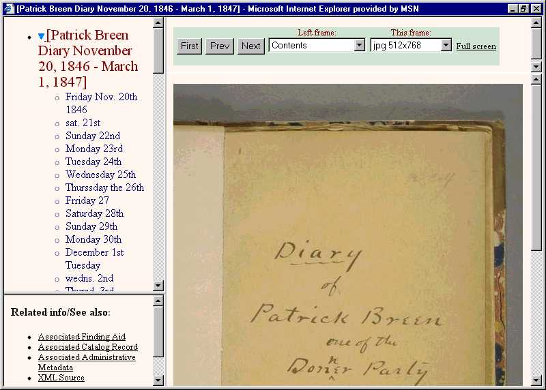

Slide 44
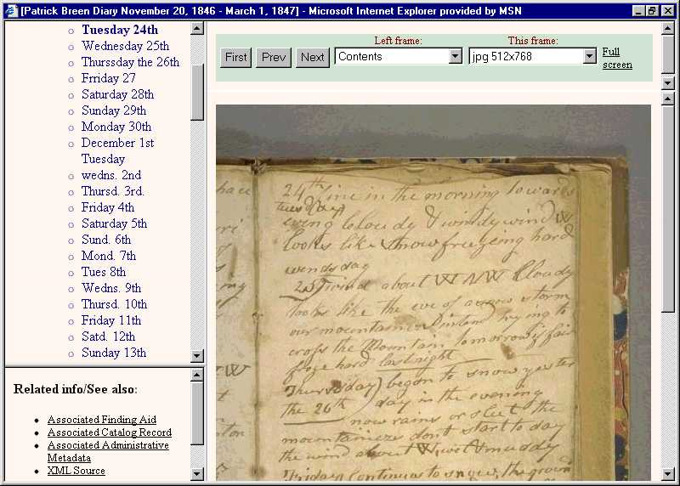

Slide 45
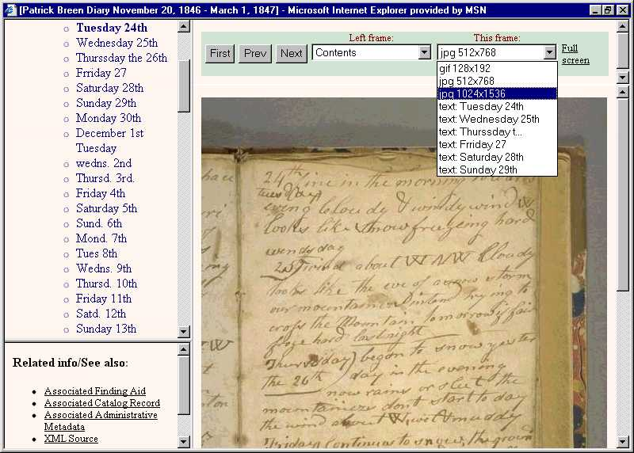

Slide 46
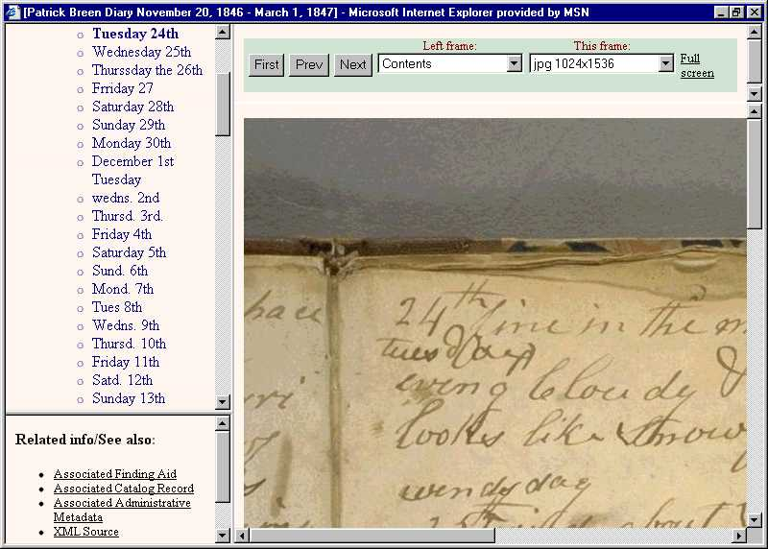

Slide 47
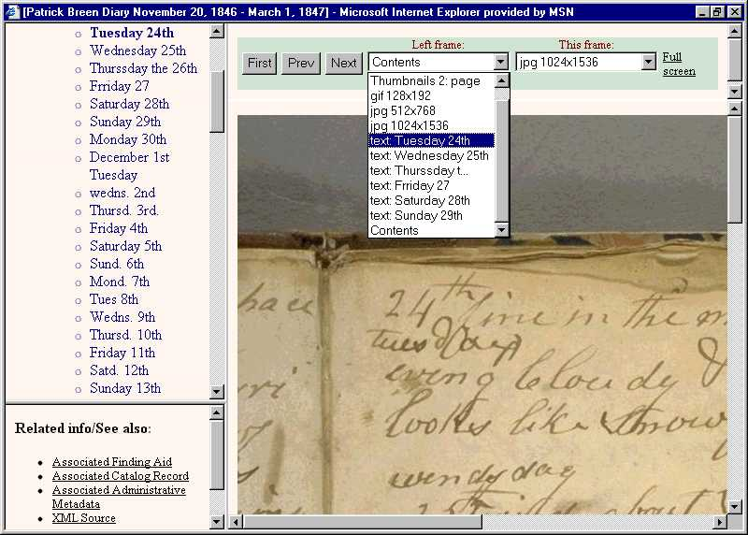

Slide 48
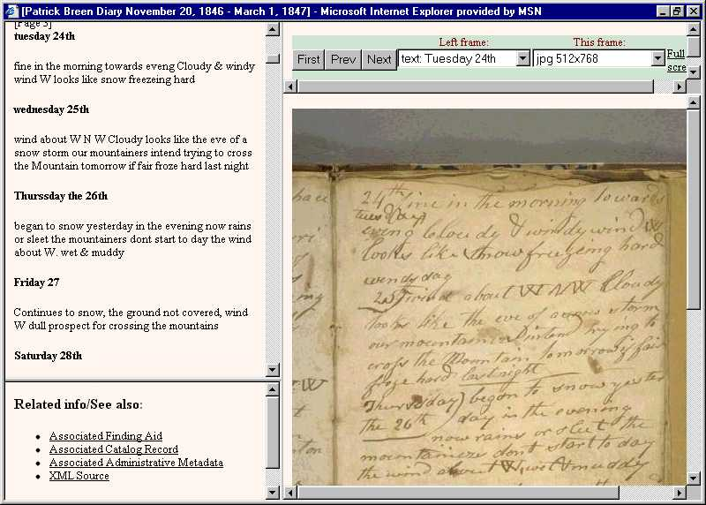

Slide 49
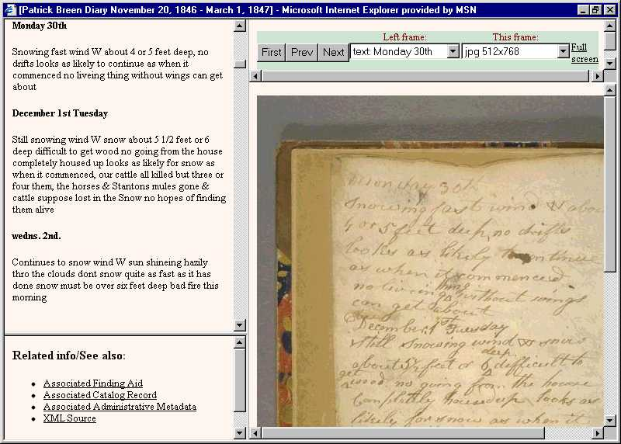

Slide 50
