Slide 1


web based METS creation
Ralf Stockmann (stockmann@sub.uni-goettingen.de)
case study

Slide 2
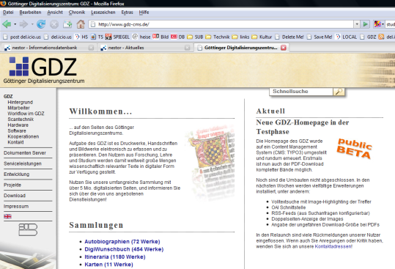
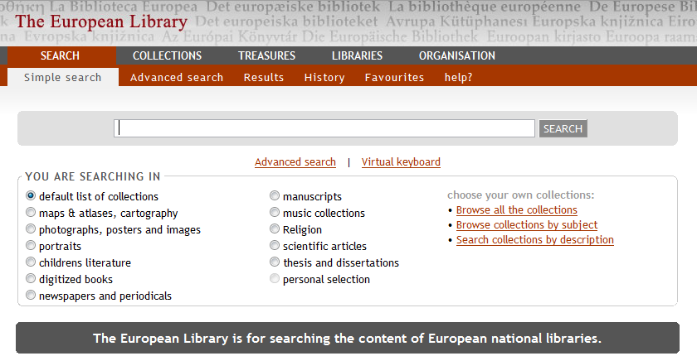
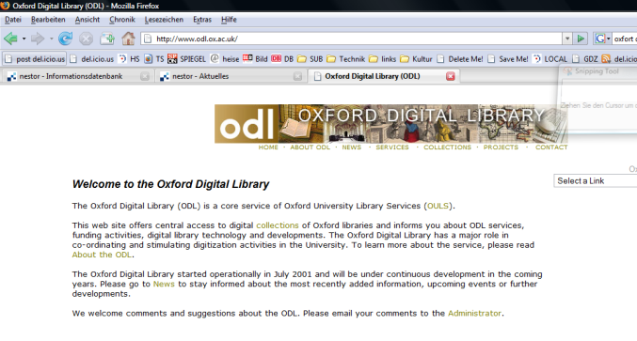
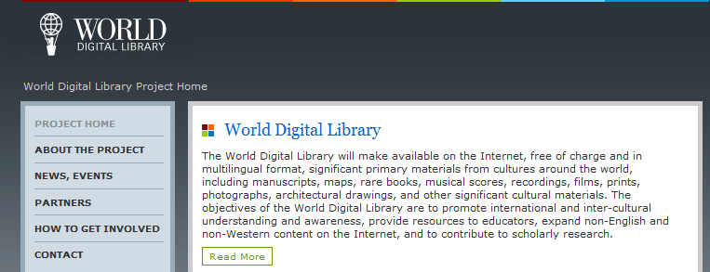
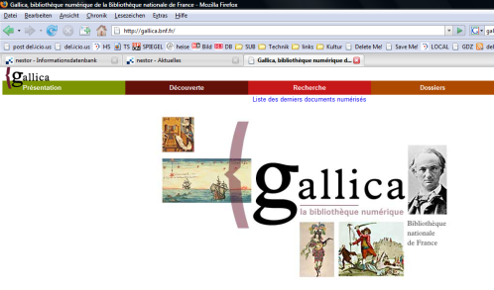
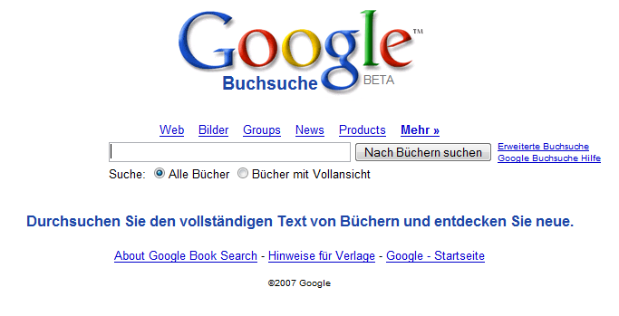
Why METS?
The new paradigm: connecting content
Past
Project Websites
Repositories
Present
Portal Websites
Federated Search

Slide 3

Future
Decentralized Web services
  Relying on
    Personalization
    Social / Scientific Communities
    Semantic Relations
    Grid Computing
  Offering:
    Dynamic Services (private bookshelf, …)
    Tools for Analysis, Annotation, Linking, Rating, Tagging
    Collaborative Workspaces
    Referencing single digital objects, or even parts of them
“Scientific Mashups”
  Online / Offline
  Interfaces and Protocols

Slide 4
Consequences
Shift of Relevance
  Less:
    Originator / host of content
    Low quality images
    “Black Box” software architecture with “vanilla” features
  More:
    Metadata
    Fulltext
    Addressable sub-parts of an object
    High resolution images
    Interfaces
    Specialized, encapsulated, connectable tools
METS
  “Self-Awareness” of every document/file

Slide 5
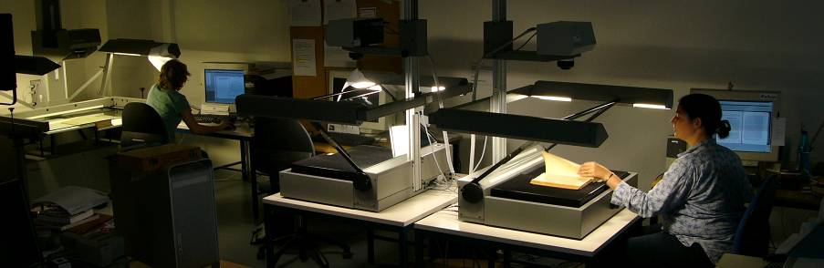
Web bases METS creation for high quality mass digitisation
Easy to use, collaborative web based METS metadata editor
Flexible metadata sets
Workflow orchestration
Access roles and permissions
Presentation and usage
Long term preservation
“Scan to EDL / WDL / …”
Open Source / Collaborative Development

Slide 6
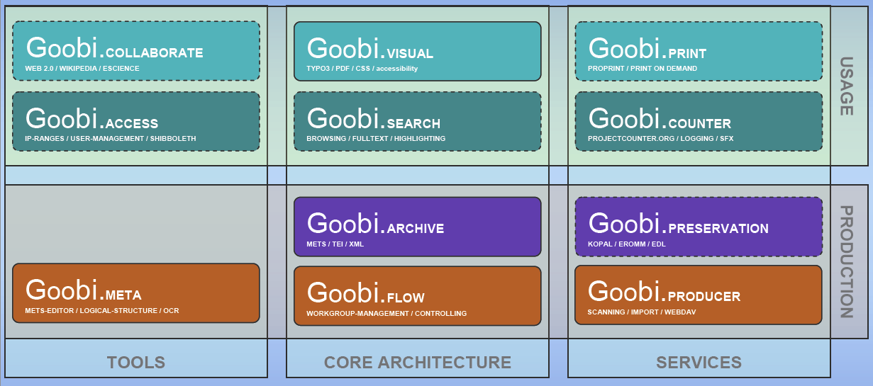

Slide 7
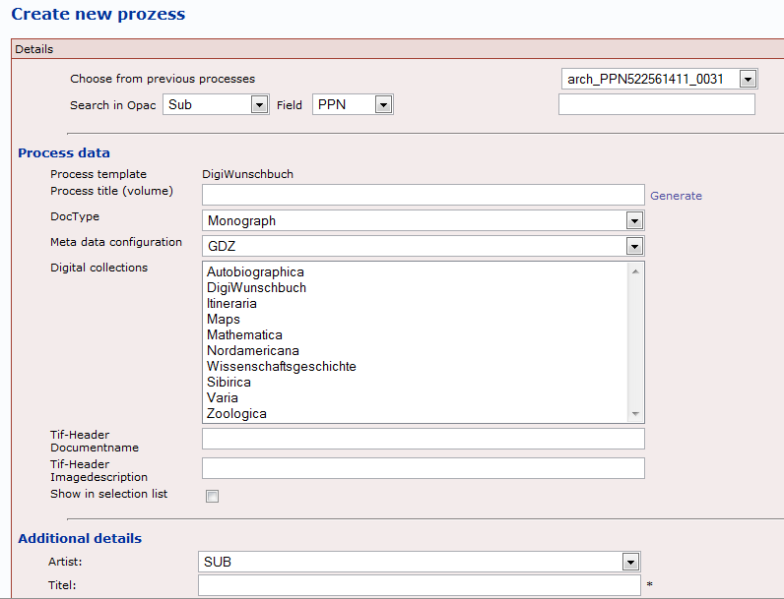
Create volume metadata based on catalog data

Slide 8
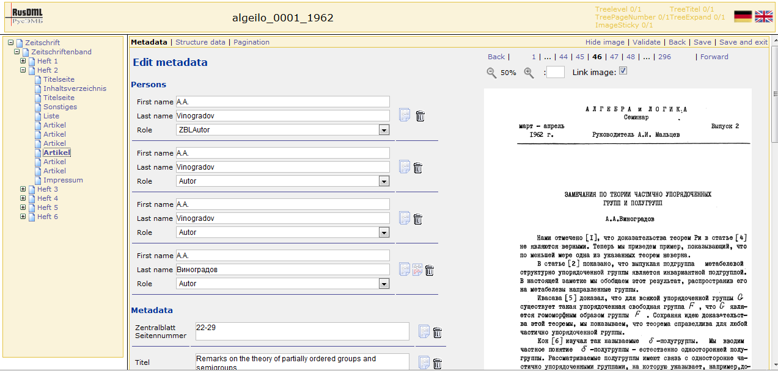

Slide 9
Document model with two structures
Logical structure
Phys. structure
Content files
Monograph
Bound Book
00000001.tif
Page
00000002.tif
Chapter
Page
00000003.tif
Chapter
Page
00000004.tif
Chapter
Page
00000005.tif
page area
00000006.tif
Chapter
Page
00000007.tif
Chapter
Page
00000008.tif
Page
HiRes01.jpg
Page
Thumb01.jpg
Fulltext.xml

Slide 10
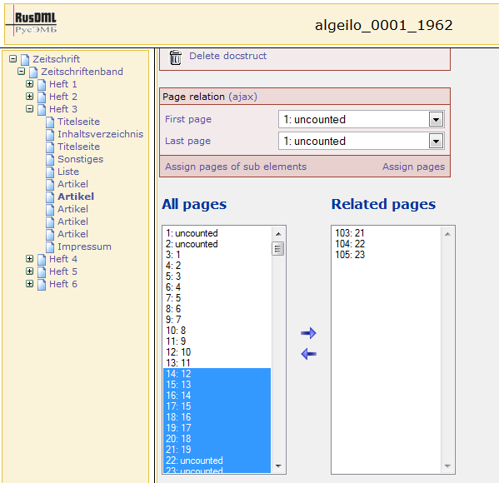
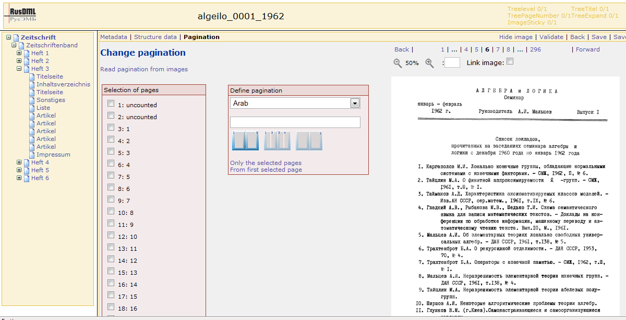
Building logical and physical structures

Slide 11
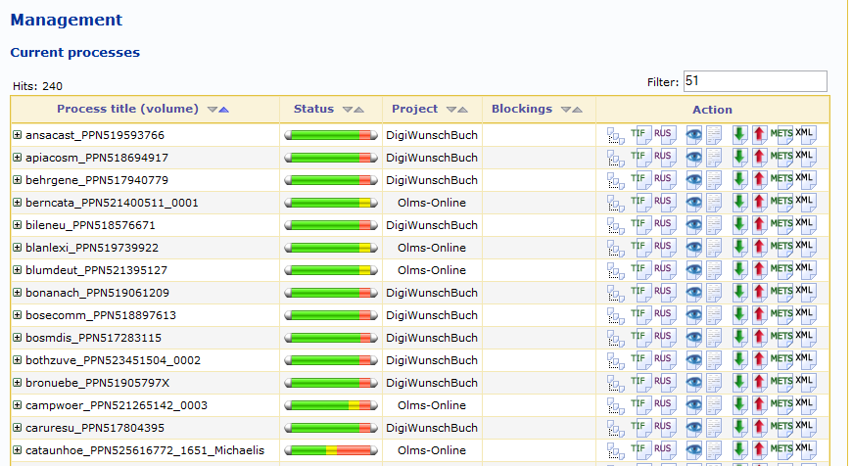
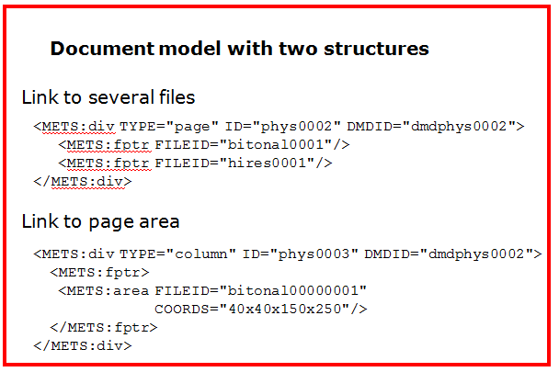
Exporting METS

Slide 12
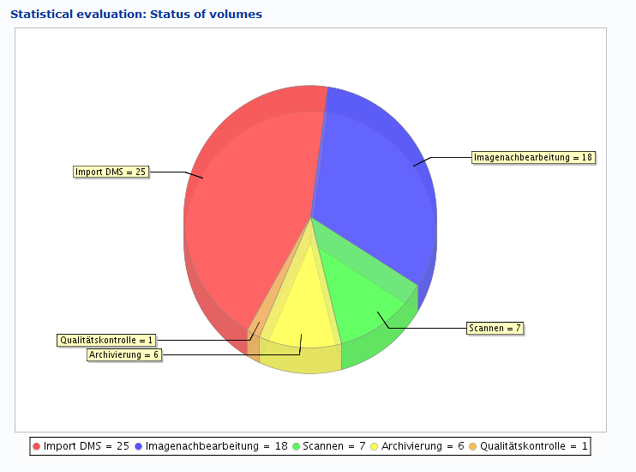
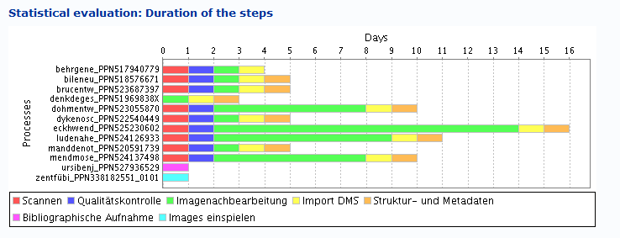
Controlling

Slide 13
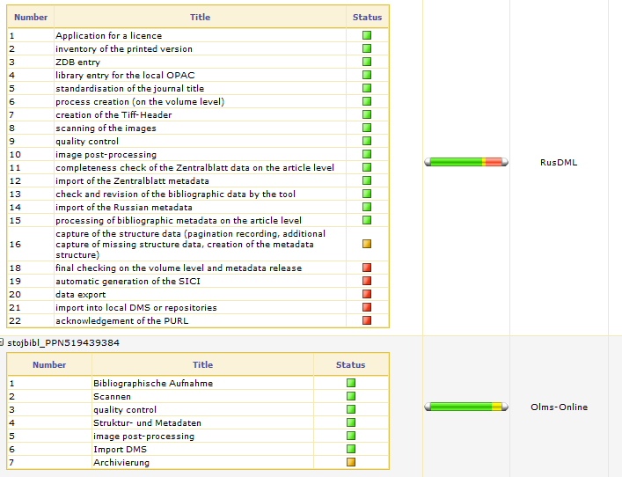
Workflow Orchestration

Slide 14
Visualisation

Slide 15
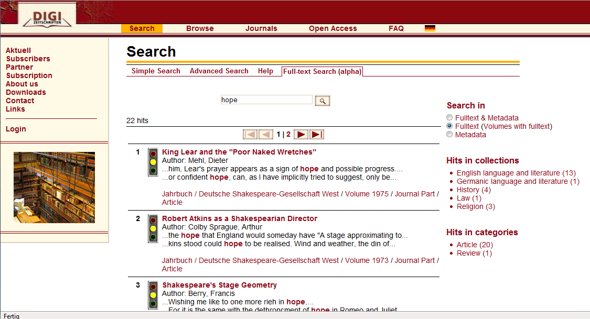
Full Text Search

Slide 16
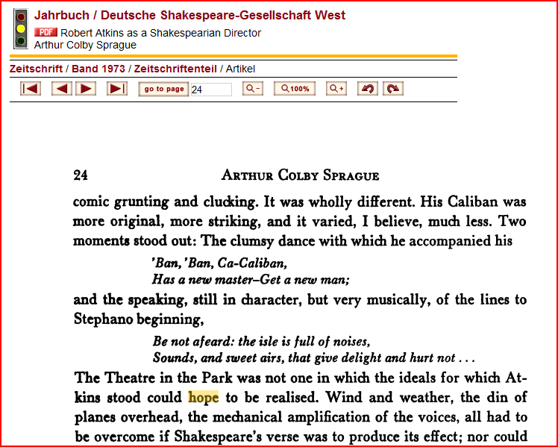
Image Highlighting

Slide 17
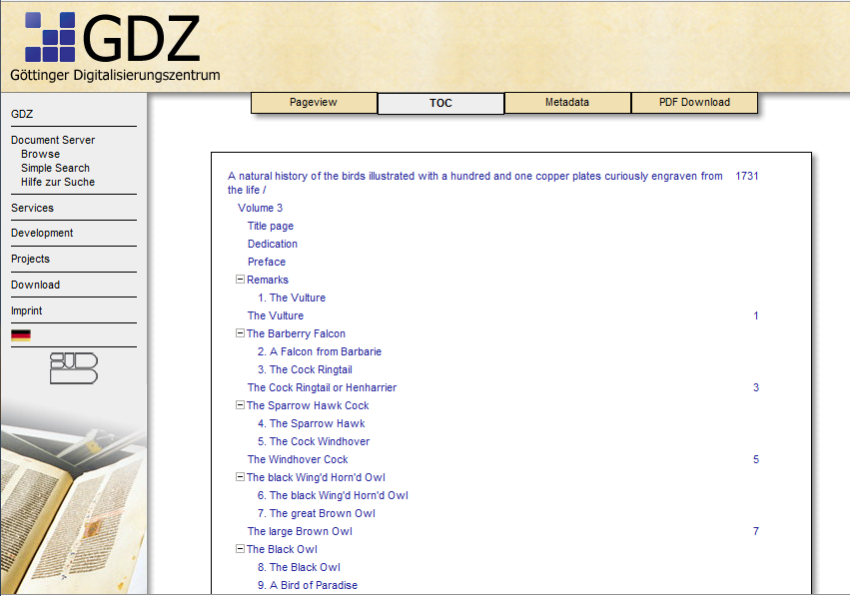
Table of Content

Slide 18
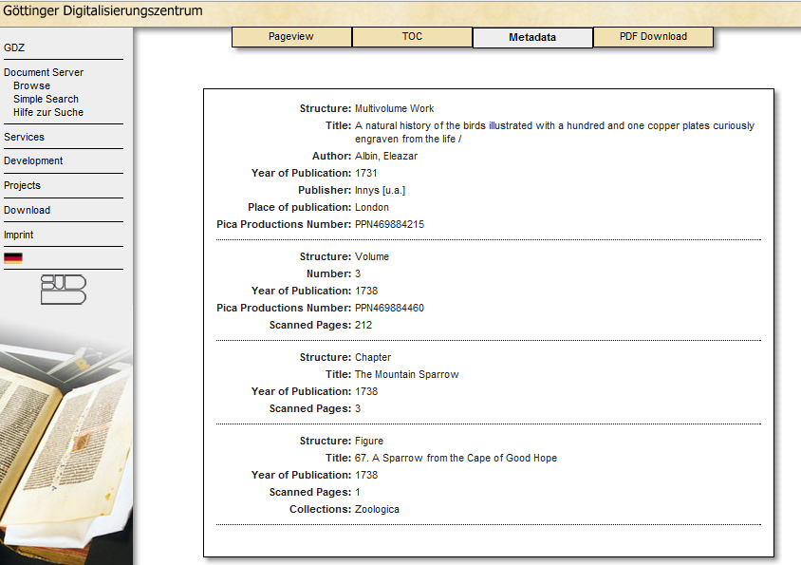
Metadata

Slide 19
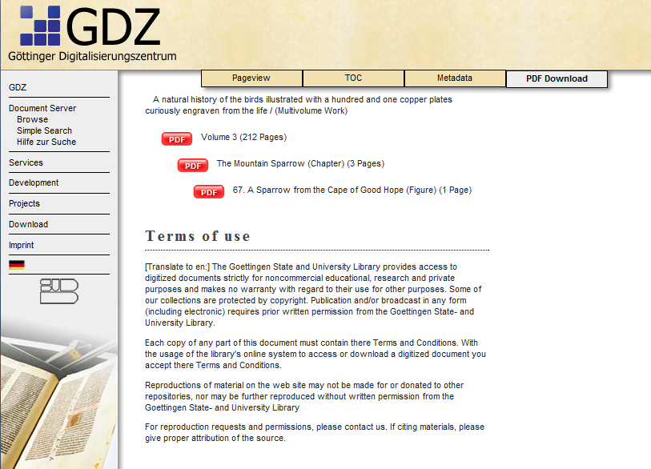
PDF Download

Slide 20
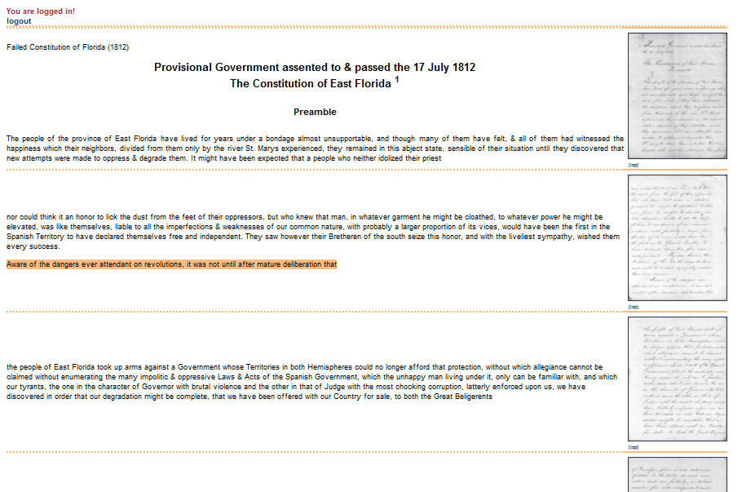
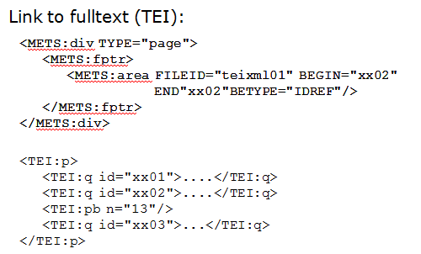
Presenting (TEI) Full Text

Slide 21
Handling Metadata and METS
Fulltext is referenced, not embedded in METS file due to file sizes.
  METS file is about 2 – 3 MB
  Fulltext is about 20 MB
Use MODS for descriptive metadata for logical structure entities
PREMIS preservation metadata
Own descriptive metadata schema for physical structure entities – storing page numbers

Slide 22
Availability
Offering a full-flavored framework for digital libraries
Open Source
Components
  LINUX / UNIX Filesystem
  JAVA (min 1.5)
  Tomcat & Apache
  MYSQL
  TYPO3 (PHP)
  WebDAV
  LDAP
Subversion Server
Work in progress: support model

Slide 23

Join us!

