Slide 1




The Universal Object Format - A METS Profile for an archiving and exchange format for digital objects

Slide 2
Overview
Project kopal
Long-term preservation Metadata for Electronic Resources (LMER)
Universal Object Format: Structure
Universal Object Format: METS Profile

Slide 3
Project kopal
German project: Co-operative Development of a Long-Term Digital Information Archive (2004 – 2007)
Core: OAIS-compliant DIAS by IBM (Content Manager, DB2, Tivoli Storage Manager, Websphere, Java components)
Tools to generate technical metadata (using JHOVE), create ingest packages and migrate objects: Open source koLibRI (kopal Library for Retrieval and Ingest) by Deutsche Nationalbibliothek and SUB Göttingen
Multi-user support
Generic SIP & DIP: Universal Object Format (UOF)
Long-term accessibility based on format migration

Slide 4



System overview
Deutsche
Nationalbibliothek
(Frankfurt)
GWDG
(Göttingen)
Locale Software
DIAS by IBM
Account 1
SUB Göttingen
Account 2
Locale Software

Slide 5
LMER
Long-term preservation metadata for electronic resources
Developed in 2003, current version: 1.2
Based on data model for preservation metadata by National Library of New Zealand
XML Schemas for
  Object: Logical archiving and exchange unit, consists of one or more files
  File: Metadata about every file incl. generic “black box” for format specific metadata (e. g., JHOVE output)
  Process: History of file and object changes (e. g., migrations)
  Modification: History of metadata changes

Slide 6
Universal Object Format: Structure
Generic description of packages for archiving and exchanging of digital objects
Based on METS and LMER
No limitations on file formats and file numbers
One packed file (e. g., ZIP or tar) per logical object, containing one METS file with descriptive metadata (e. g., Dublin Core) and technical metadata for long-term preservation (LMER)
In kopal:
  Used as SIP and DIP (OAIS)
  Metadata (Dublin Core and LMER) is stored in Data Management of DIAS
  mets.xml stored as content, can be requested separately

Slide 7
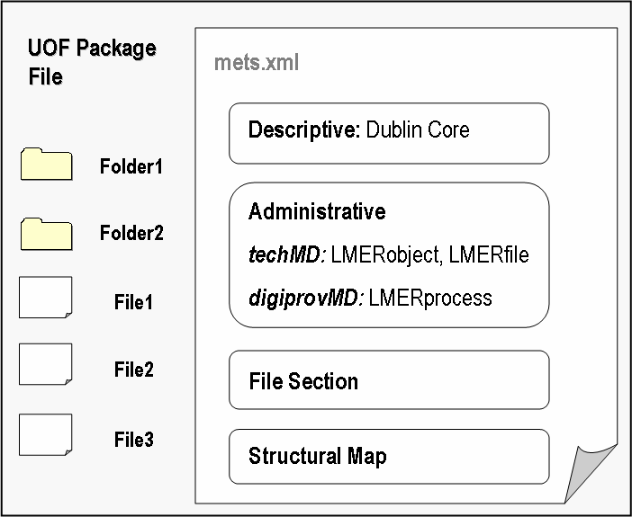
Generic structure

Slide 8
Universal Object Format: METS Profile (1)
METS 1.4, LMER 1.2 (Object, File, Process)
No restrictions on integration of other XML metadata
Only inline XML metadata, no inline content files
No specs for Behaviour Section and Structural Map Linking
LMER in METS: No use of LMER elements if there are similar METS elements (especially in the file section)
One LMER object section (in amdSec/techMD) per mets.xml
A LMER file section (in amdSec/techMD) per file in File Section

Slide 9
Universal Object Format: METS Profile (2)
METS Header
  OBJID: internal ID in DIP
  internal ID = object instance (original or migration)
  external ID = persistent identifier (same for original and migration)
  CREATEDATE = creation/update of mets.xml
  <agent>, ROLE, TYPE, <name>: Creating institution for a SIP, archiving institution for a DIP

Slide 10
Universal Object Format: METS Profile (3)
Descriptive Metadata
  Optional
  More than one allowed
  Every inline XML, e. g., DC, MODS, MABxml
  ID of dmdSec must be referenced in structural map of the type “ASSET”
  In kopal (DIAS): Up to five sections, DC is stored in Data Management

Slide 11
Universal Object Format: METS Profile (4)
Administrative Metadata
  At least one techMD for the whole archive object and one techMD for each file belonging to the object
  LMER-Object: persistentIdentifier, groupIdentifier, objectVersion, startFile, numberOfFiles
  LMER-File: format (REGISTRYNAME), linkedTo, xmlData (further technical metadata in an arbitrary XML schema, e. g., in kopal the output of JHOVE)
  digiprovMD for object or for certain files
  LMER-Process: oldMetadataRecordCreator, oldObjectIdentifier
  All ID’s of techMD’s and digiprovMD’s must be referenced in File Section

Slide 12
Universal Object Format: METS Profile (5)
File Section
  Only one <fileGrp>
  No embedded files, only relative links
  For every <file> one <Flocat>, LOCTYPE=“URL”, starting with “file://./”
  Mandatory: ID, MIMETYPE, CREATED, SIZE, CHECKSUM, CHECKSUMTYPE
  ADMID of <fileGrp>: ID of techMD with LMER-Object and/or LMER-Process
  ADMID of <file>: ID of techMD with LMER-File and/or LMER-Process

Slide 13
Universal Object Format: METS Profile (6)
Structural Map
  More than one allowed
  One Structural Map with TYPE=“ASSET” is defined as
  one <div TYPE=“ASSET”> with a list of <fptr> for each file,
  FILEID = ID in File Section,
  DMDID of <div> = ID’s of all dmdSec’s
  <mptr>: external ID’s of other archive objects linked technically to the object (e. g., an XML schema)

Slide 14
Thank you!
Visit http://kopal.langzeitarchivierung.de
Download of koLibRI (beta)
Specifications of the Universal Object Format

