Slide 1
METS at UC Berkeley
Part I: Generating METS Objects

Slide 2
Background
Kinds of materials:
  primarily imaged content & tei encoded content
    archival materials: manuscripts and pictorial collections
    oral histories
Kinds of Metadata
  Structural metadata: physical structure
  Descriptive metadata
  BasicTechnical metadata about digital files and how they were produced

Slide 3
Tools For Producing METS Objects
GenDB
  Gathers structural, descriptive and technical metadata
GenX
  Generates METS objects from GenDB

Slide 4
GenDB
Consists of:
  Relational database (Currently SQL Server)
  Locally developed software for gathering metadata and facilitating digital processing

Slide 5
GenDB Database Structure
Structural Metadata
Structural Md Table
Object 1
Div 1
(root)
Object 1
Div 1
Div 2
Div 3
Div 2
(parent = div 1)
Div 3
(parent = div 1)
…
Object 2
Div 1
(root)
Object 2
Div 1
Div 2
Div 3
Div 4
Div 2
(parent = div 1)
Div 3
(parent = div 2)
Div 4
(parent = div 2)
Notes:
At core of Database structure is a structural metadata Table
Entries in the structural metadata Table correspond to divisions of METS structMap.
Divisions pertaining to the same Object are bound together by a common Object ID
Each division contains a pointer to its parent division. This enables the divisions pertaining to a particular Object to be reorganized into a hierarchically structured METS structMap

Slide 6
GenDB Database Structure
Descriptive Metadata
Structural Md Table
Name Table
Object 1
Div 1
Core Desc Md
Name 1
Div 2
Core Desc Md
Name 2
Div 3
Core Desc Md
Name 3
Object 2
Div 1
Core Desc Md
Note Tables
Div 2
Note 1
Core Desc Md
Div 3
Core Desc Md
Note 2
Div 4
Core Desc Md
Note 3
Notes:
There are many descriptive metadata tables and linking tables in GenDB
Structural metadata table itself contains core descriptive metadata pertaining to each div reprsented.
Divs in the Structural metadata table link to descriptive metadata tables via their div ids.
Entries in some descriptive metadata tables are shared across objects and divs. For example, divs in different objects can link to the same entry in the name table.
Entries in some descriptive metadata tables, like the note tables, are specific to a particular div.

Slide 7
GenDB Database Structure
Content File/Technical Md
Master Image Table
Structural Md Table
Mstr 1
Technical Md
Object 1
Div 1
Mstr 2
Technical Md
Div 2
Div 3
Derivative Image Table
Drv 1
Technical Md
Drv 2
Technical Md
Drv 3
Technical Md
Drv 4
Technical Md
Notes:
Diagram just shows provision for image content files
Entry for each div in the Structural Metadata table can link to an entry for its associated Master image in the Master Image Table
Entry for each master image in the Master table links to entries for its associated derivative images in the derivative tables
Entries in the Master and derivative tables contain the content file names and associated technical metadata pertaining to the image

Slide 8
Populating the Database Tables
Web interface: manual input of structural and descriptive metadata
Digitization Management modules
  Generate work orders to guide digitization process
  Import content file information and technical metadata coming out of digitization process
Batch loader: batch input based on TEI encodings, legacy metadata

Slide 9
Web Interface: WebGenDB
Java Server
Web
Interface
jdbc
SQL Server
Database
rmi
Java Servlet
XML Config
Files
Notes:
Web-based WebGenDB interface supports manual input of structural and descriptive metadata, as well as processing information.
Java servlet drives the web interface on basis of XML configuration files
XML Configuration files allow the user interface to be configured differently for each repository participating in a project; and for each object type the repository needs to input.
Java server mediates between the database and the user interface, and constitutes the logic layer. It extracts the metadata from the database and packages it up in a more user-comprehensible format. It receives the updated metadata, and commits the updates to the database.
This effectively shields the user from the complexities of METS, MODS, MIX.
Includes tools to facilitate the analysis of object structure.

Slide 10
Digitization Management Modules
Vendor
Imaging/
Transcription
WorkOrders
Web
Interface
Technical MD
Spreadsheets
Java Server
Java Servlet
SQL Server
Database
Notes:
WebGenDB Digitization management modules support the digitization process, as well as gathering content file and technical metadata coming out of this process.
Using the WebGenDB web interface, project managers generate imaging or transcription work order for an objects in the database that are ready for processing.
Work Order and material goes to Imaging and/or transcription vendor.
Vendor does imaging/transcription and produces spreadsheet with the content filenames and technical metadata about digitization process.
Technical metadata and content file names imported back into the database.

Slide 11
SQL Server
Database
Batch Loader
Java Server
Web
Interface
TEI Docs
XSLT
Java Servlet
Java Batch
Loader
XML Batch
Load File
Notes:
Descriptive, structural, and content file metadata may enter the database via a batch load.
Batch load file must be in XML format defined by a locally developed schema.
One possible source of a batch load file would be a set of existing TEI documents for which we want to enhance the descriptive metadata, and wrap in METS objects. Such a batch load file would be generated via an xslt transformation run against the TEI documents.
Another possible sources of a batch load would be an export from a legacy database.
Project manager can invoke the batch loader from the WebGenDB web interface, and initiate the batch load process.
Batch loader loads the data and metadata from the batch load file using same GenDB server program and calls as are used for manual input (as shown on previous slide)

Slide 12
Relationship of GenDB to METS
Metadata not directly stored in METS, MODS or MIX schema formats.
  Much of the database structure was developed before these standards emerged
  Database structure and content adjusted to be compatible with all these formats

Slide 13
GenX: From GenDB to METS
Allows Digital Publishing Group staff to select the objects in the GenDB database that are ready for export and to export them as METS objects.

Slide 14
GenX Architecture
App
Interface
Java Application
METS XML
Repository
JDBC
GenDB
Notes:
GenX consists of a Java application with an application interface.
Using this application our Digital Publishing Group staff can review the database and select those objects that are ready for export.
GenX uses JDBC calls to gather the metadata for objects to be exported from the GenDB database and packages these up into METS objects.

Slide 15
GenX Output
METS output corresponding to version 1.3
Descriptive metadata exported to METS descMD in MODS 2.0 format
Technical Metadata exported to METS techMD in MIX format
Planned:
  Text technical md to METS descMD in NYU TextMD
  Rights to METS rightsMD in ODRL subset ?

Slide 16
GenDB Technology Summary
Java Server
Java Servlet running in Tomcat engine
RMI
JDBC
Unicode
XSLT processed by Xalan
JDOM
FOP

Slide 17
Links
GenDB Web Interface Demo
  http://sunsite2.berkeley.edu/GenDB
  login: demo
  password: demo
Developers:
  rbeaubie@library.berkeley.edu
  ghill@library.berkeley.edu
  jhassan@library.berkeley.edu

Slide 18
Appendix: WebGenDB Interface
Selected Screen Shots

Slide 19
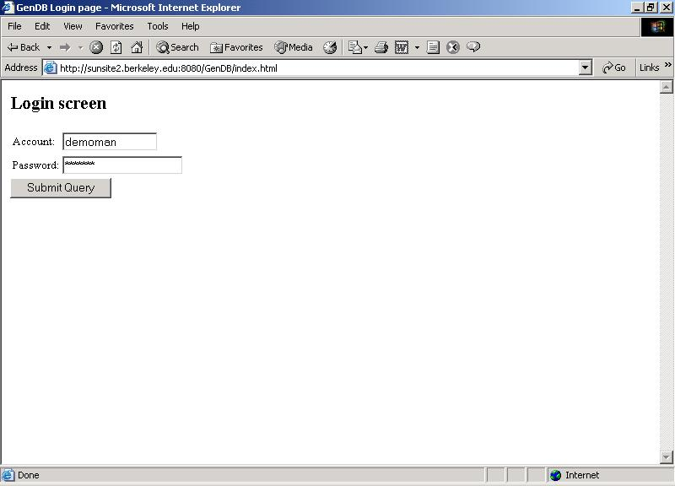

Slide 20
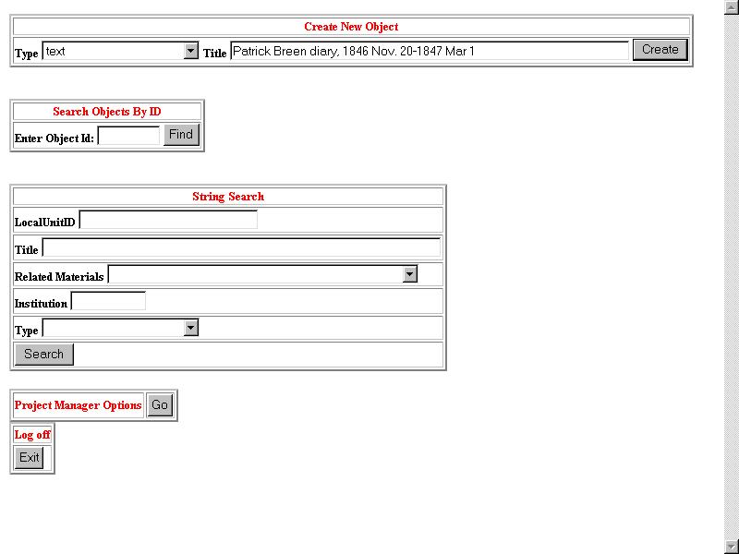

Slide 21
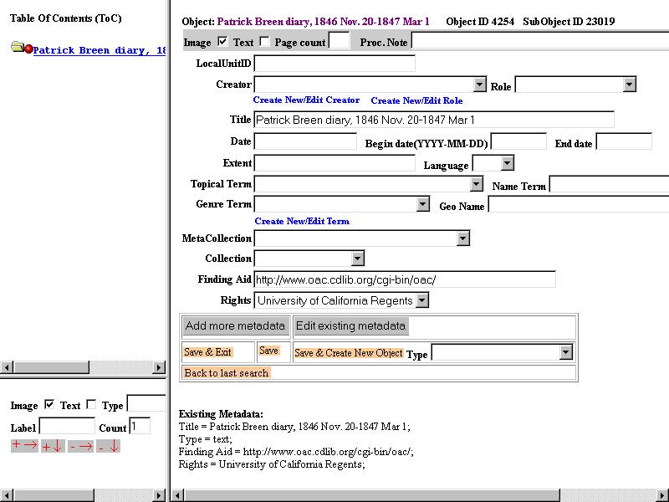

Slide 22
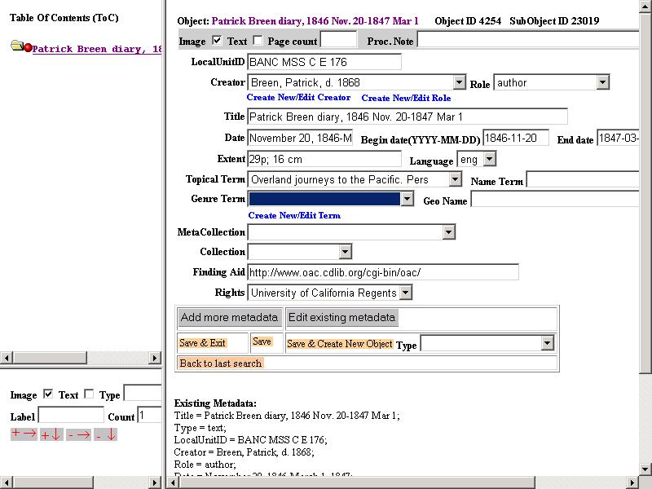

Slide 23
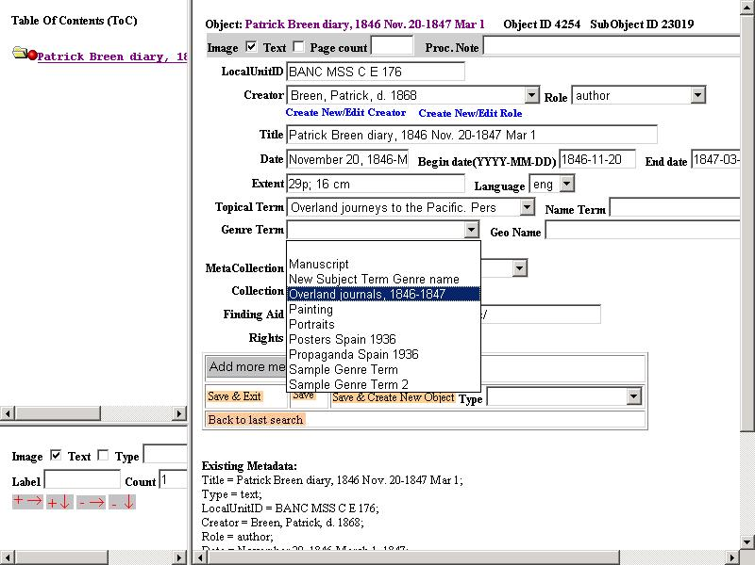

Slide 24
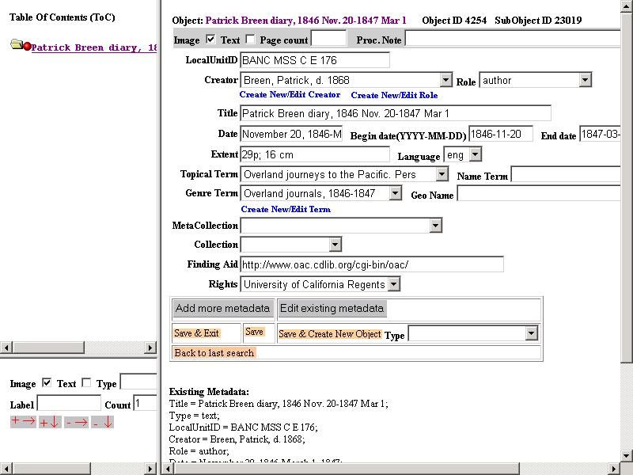

Slide 25
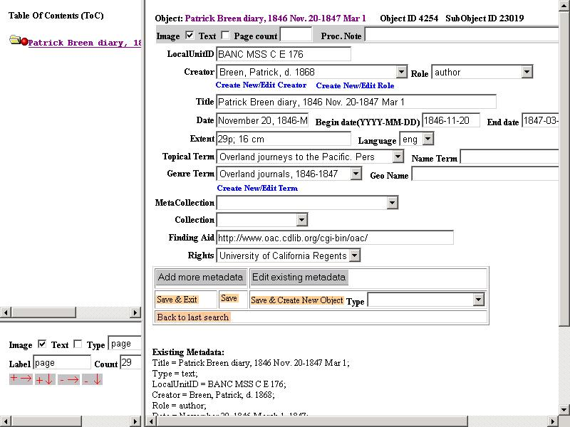

Slide 26
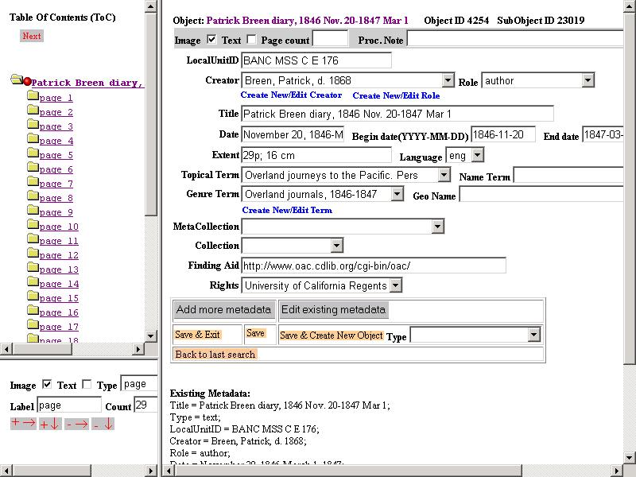

Slide 27
