Slide 1
METS at UC Berkeley
Part II: Viewing METS Objects via GenView

Slide 2
History of GenView
Originates in Making of America II (1997)
  XSLT in infancy
  Web Services non-existent
  CORBA/RMI and servlet technology were “hot”
GenView originally supported MOA2 objects
GenView adapted to accommodate METS
  handles MOA2 legacy objects and METS
  no alteration to basic architecture

Slide 3
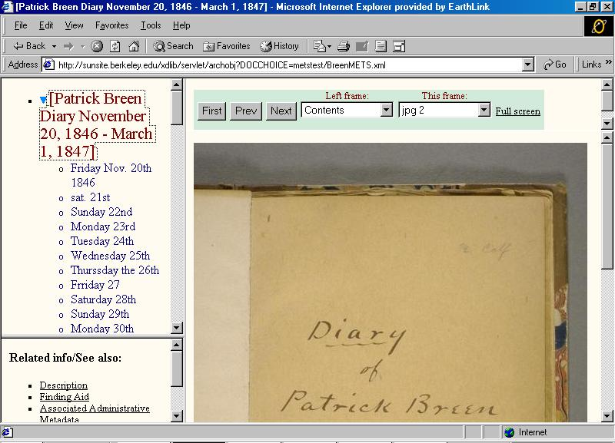

Slide 4
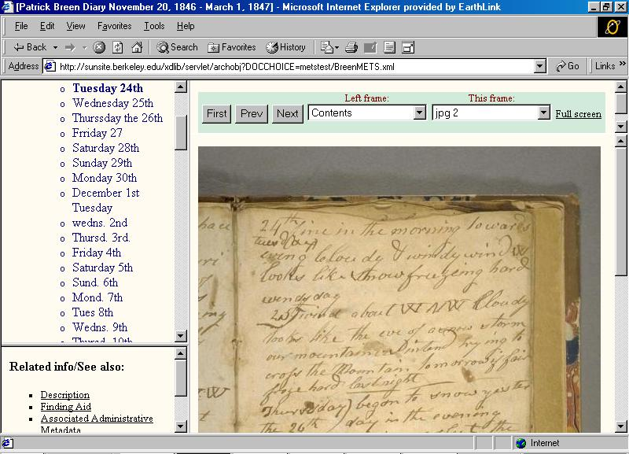

Slide 5
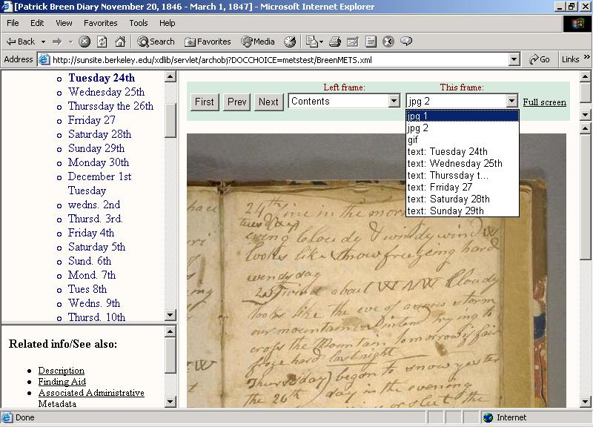

Slide 6
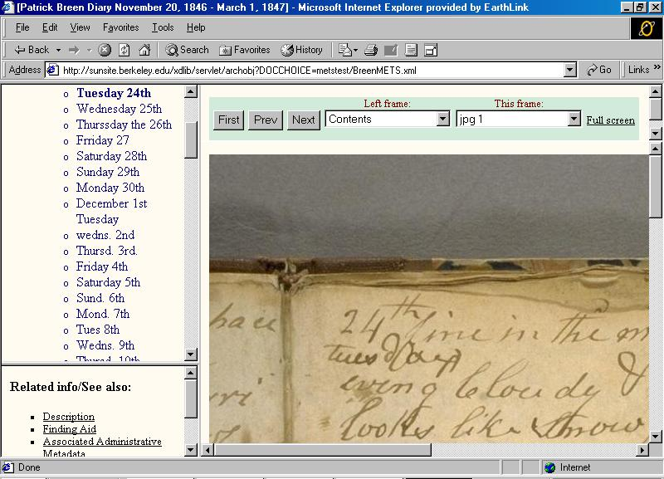

Slide 7
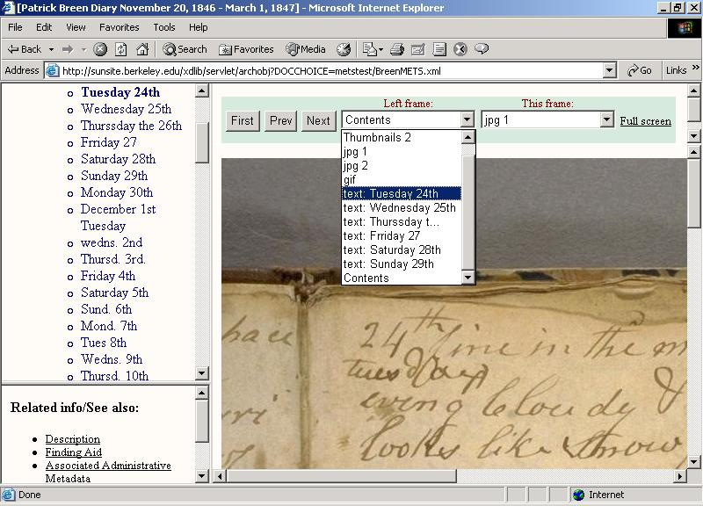

Slide 8
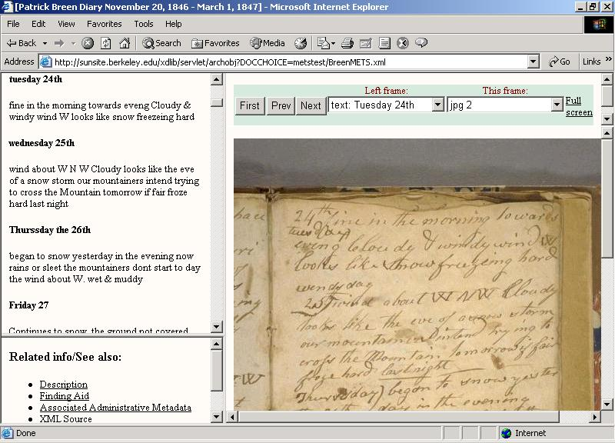

Slide 9
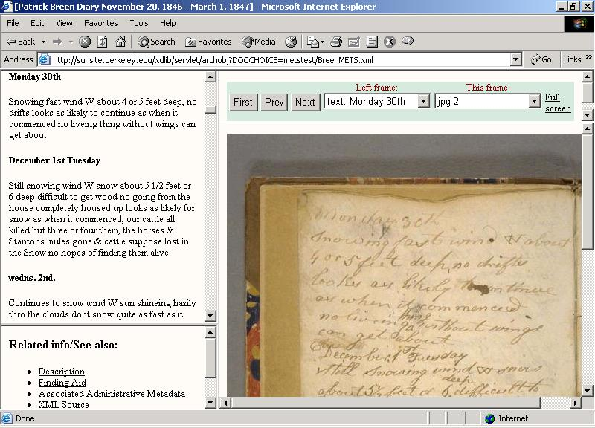

Slide 10
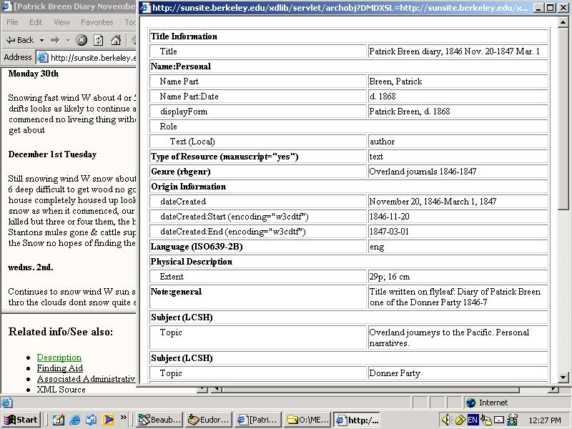

Slide 11
GenView: Basic Architecture
Java Servlet
Web
Interface
RMI
Repository Manager (java)
METS Java
Object
METS Java
Repository

Slide 12
GenView: Generating METS Java Objects
MOA2
XML Doc
METS
XML Doc
Java MOA2
Pre-processor
(Jdom)
Java METS
Pre-processor
(Jdom)
METS Java
Repository
METS Java
Object
Notes:
Preprocessor uses Jdom classes to extract information that is dispersed throughout the METS Source file.
It reorganizes this information into a format designed to facilitate and optimize navigation.

Slide 13
Anatomy of METS Java Object
Consists primarily of Resource Objects representing resources
Three main types of Resource Objects
  Content
  Descriptive Metadata
  Administrative Metadata
Notes:
As far as a GenView METS Java Object is concerned, content files, descriptive metadata and administrative metadata are all resources.

Slide 14
Content Resource Object
Roughly equivalent to METS fptr (+)
Draws together information dispersed in the METS XML source file
  file element: URI, associated AdminMD elements
  div element: resource label, associated DescMD elements
  area element: begin and end markers if pertinent
  techMD element: file dimensions

Slide 15
Descriptive and AdminMD Resource Objects
Contain:
  URI of descMD or adminMD represented
    URI may reference source METS XML file if descMD or adminMD is embedded
  Begin marker (IDREF) if descMD or adminMD is embedded
  Label identifying descMD or adminMD represented

Slide 16
Organization of Resources
Grouped (analogous to METS fileSec/fileGrp):
  Image Master
  Reference
  Thumbnails
  Transcription
  Description
  Tech/Admin
Linked
  3 main linked organizations
Notes:
METS Java Object maintains various organizations of its resource objects.
METS Java Object maintains a grouped organization of its resource objects that is analogous to METS fileSec/fileGrp organization
More importantly for navigation purposes, METS Java Object maintains 3 linked organizations of its Resource Objects.

Slide 17
Hierarchical Tree Structure Links
(structMap)
Content
Resource
Content
Resource
Content
Resource
Content
Resource
Content
Resource
Content
Resource
Content
Resource
Notes:
METS Java Object organizes Content Resources into a hierarchical tree structure equivalent to the METS structMap
Each Content Resource knows where it fits into to the overall Content hierarchy, who its parent is, who its siblings are and who its children are

Slide 18
Alternate Version Links
(sibling fptrs)
Content
Resource
(Version 1)
Content
Resource
(Version 2)
Content
Resource
(Version 3)
Notes:
Each Content Resource Object maintains links to any Content Resource Objects that represent alternate versions of the same content.
Thus a Content Resource Object represent a tif master image would know about all Content Resource Objects representing jpeg and gif images derived from the tif master.
This organization is based on sibling fptrs appearing under div elements in the METS structMap.

Slide 19
DescMD/AdminMD Links
(div/@DMDID, div/@ADMID, file/@ADMID)
Content
Resource
DescMD
Resource
AdminMD
Resource
AdminMD
Resource
Notes:
Each Content Resource Object maintains links to all associated Descriptive Metadata Resource Objects and Administrative Metadata Resource Objects.
This organization is based on the DMDID and ADMID attributes appearing in div elements of the METS structMap, and ADMID attributes appearing in the file element of the METS fileSec.
Each Content Resource knows what Descriptive Metadata Resources and what Administrative Metadata Resources are associated with it.

Slide 20
Goal: Facilitating Navigation
Resource organizations allow METS java object efficiently to deliver to client:
  summary of object hierarchy (Table of Contents)
  resource(s) associated with any level of hierarchy
  alternate manifestations of active content resource
  descriptive and administrative metadata resources associated with active content resource

Slide 21
Main limitations of GenView
Provides mainly for browser-supported content
  primarily designed for imaged content
  some support for launching auxiliary apps
One size fits all solution
  limited configuration options for different repositories and projects

Slide 22
GenView Technology Summary
Java Server
Java Servlet running in Tomcat engine
RMI
XSLT processed by Xalan
JDOM
Unicode

Slide 23
Links
Developers
  Rick Beaubien (preliminary architecture & development)
    rbeaubie@library.berkeley.edu
  Garey Mills (ongoing development)
    gmills@library.berkeley.edu

