Slide 1


An Introduction to METS
Metadata Encoding and Transmission Standard
Morgan Cundiff
Network Development and MARC Standards Office
Library of Congress

Slide 2
XML
“XML has become the de-facto standard for representing metadata descriptions of resources on the Internet.”
Jane Hunter
Working towards MetaUtopia - A Survey of Current Metadata Research

Slide 3
The Importance of Standards
“In moving from dispersed digital collections to interoperable digital libraries, the most important activity we need to focus on is standards… most important is the wide variety of metadata standards [including] descriptive metadata… administrative metadata…, structural metadata, and terms and conditions metadata…”
Howard Besser
The Next Stage: Moving from Isolated Digital Collections to Interoperable Digital Libraries

Slide 4
Who is responsible for METS?
Initiative of the DLF
The principle author is Jerry McDonough (New York University)
LC NDMSO is Maintenance Agency (http://www.loc.gov/standards/mets/)
The METS Editorial Board is responsible for schema content

Slide 5
What is METS? (schema)
METS is an XML Schema designed for the purpose of creating XML document instances that express the hierarchical structure of digital library objects, the names and locations of the files that comprise those objects, and the associated metadata.

Slide 6
What is METS? (document)
unit of storage
transmission format
OAIS information package
“active information source” (application)

Slide 7
What are some characteristics of METS?
METS is:
  an open standard
  non-proprietary
  developed by the library community
  (relatively) simple
  extensible
  modular

Slide 8
What are the Main Sections of a METS Document?
<mets>
<dmdSec/>
<amdSec/>
<fileSec/>
<structMap/>
</mets>

Slide 9
Linking in METS Documents
(XML ID/IDREF links)
DescMD
mods
relatedItem
relatedItem
AdminMD
techMD
sourceMD
digiprovMD
rightsMD
fileGrp
file
file
StructMap
div
div
fptr
div
fptr

Slide 10
Linking in METS Documents
(XML ID/IDREF links)
DescMD
mods
relatedItem
relatedItem
AdminMD
techMD
sourceMD
digiprovMD
rightsMD
fileGrp
file
file
StructMap
div
div
fptr
div
fptr

Slide 11
Linking in METS Documents
(XML ID/IDREF links)
DescMD
mods
relatedItem
relatedItem
AdminMD
techMD
sourceMD
digiprovMD
rightsMD
fileGrp
file
file
StructMap
div
div
fptr
div
fptr

Slide 12
Linking in METS Documents
(XML ID/IDREF links)
DescMD
mods
relatedItem
relatedItem
AdminMD
techMD
sourceMD
digiprovMD
rightsMD
fileGrp
file
file
StructMap
div
div
fptr
div
fptr

Slide 13
Linking in METS Documents
(XML ID/IDREF links)
DescMD
mods
relatedItem
relatedItem
AdminMD
techMD
sourceMD
digiprovMD
rightsMD
fileGrp
file
file
StructMap
div
div
fptr
div
fptr

Slide 14
METS Extension Schemas
Two sections (dmdSec and amdSec) serve as “wrappers” or “sockets” where elements from other schemas, called "extension schemas” can be plugged in. This is the mechanism by which METS is extensible. It is accomplished by using the XML Schema facility for combing vocabularies from different Namespaces.
METS Editorial board has endorsed extension schemas for bibliographic data (MARCXML, MODS, DC), for technical metadata for still images (MIX), and technical metadata for text (TextMD).

Slide 15
The Structure Map
<mets>
<structMap>
<div>
<div></div>
</div>
</structMap>
</mets>
Example 1

Slide 16
The File Section (fileSec)
<mets>
<fileSec></fileSec>
<structMap></structMap>
</mets>
Example 2

Slide 17
The Descriptive Metadata Section (dmdSec)
Two methods: Reference and Wrap
<mets>
<dmdSec></dmdSec>
<fileSec></fileSec>
<structMap></structMap>
</mets>

Slide 18
The Descriptive Metadata Section with mdRef
<mets>
<dmdSec>
<mdRef/>
</dmdSec>
<fileSec></fileSec>
<structMap></structMap>
</mets>
Example 3

Slide 19
The Descriptive Metadata Section with mdWrap
<mets>
<dmdSec>
<mdWrap>
<xmlData>
<!-- insert data from different namespace here -->
</xmlData>
</mdWrap>
</dmdSec>
<fileSec></fileSec>
<structMap></structMap>
</mets>
Example 4
Example 5
Example 6

Slide 20
Administrative Metadata Section with mdWrap
<mets>
<amdSec>
<techMD>
<mdWrap>
<xmlData>
<!-- insert data from different namespace here -->
</xmlData>
</mdWrap>
</techMD>
</amdSec>
<fileSec />
<structMap />
</mets>
Example 7
Example 8

Slide 21
What is a METS Application Profile?
“METS Profiles are intended to describe a class of METS documents in sufficient detail to provide both document authors and programmers the guidance they require to create and process METS documents conforming with a particular profile.”
A profile is expressed as an XML document. There is a schema for this purpose.

Slide 22
What is a “class of documents”?
An open question
At LC we are making a one-to-one relationship between a document class, or “object type” and a typical library item, e.g. a book, a photograph, a compact disc, etc., and…
“Collection objects”
Collection Example

Slide 23
How does one get started with Profiles?
Download the documentation
Download the XML Schema for Profiles
Download the example Profile document
http://www.loc.gov/mets

Slide 24
What are the 13 components of a Profile?
Unique URI
Short Title
Abstract
Date and time of creation
Contact Information
Related profiles

Slide 25
What are the 13 components? (cont’d)
Extension schemas
Rules of description
Controlled vocabularies
Structural requirements
Technical requirements
Tools and applications
Sample document

Slide 26
Summary: Application Profiles
Provide guidance for the creation on METS documents
Aid machine processing of METS documents (software tool building)
A step towards interoperability of digital libraries
METS “frontier”

Slide 27
Software Tools for METS and MODS
Conversion Tools (XSLT Stylesheets)
Database (output to XML)
XML Editors and Validators

Slide 28
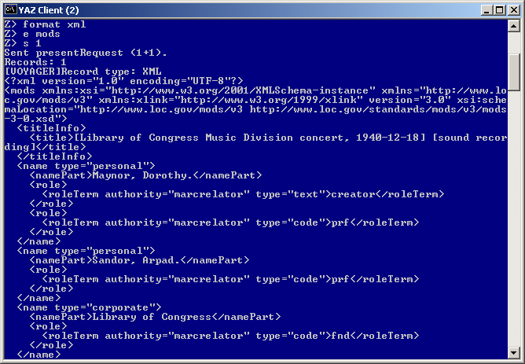

YAZ Search of ILS for a MODS Record

Slide 29
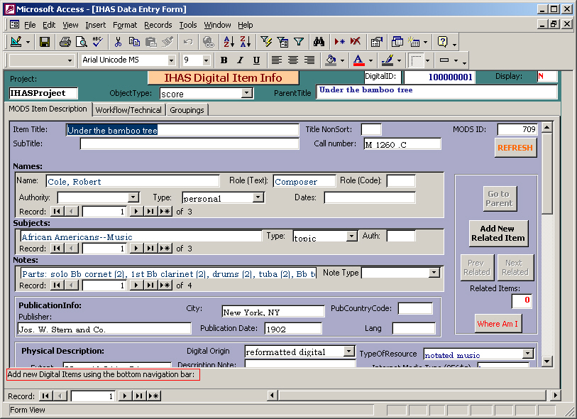
Natlib Database for MODS Input

Slide 30
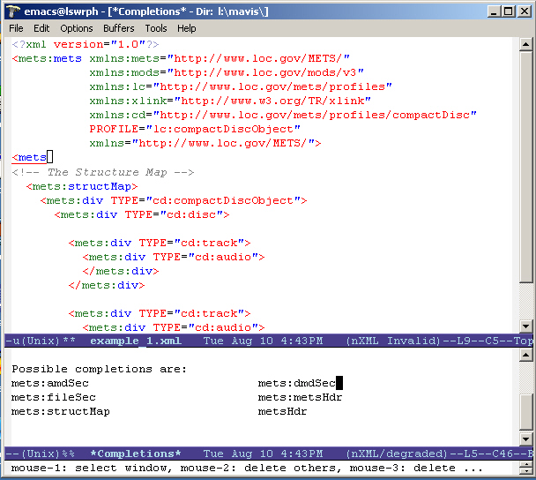
Emacs Text Editor with nxml-mode plug-in

Slide 31
Where is METS being used?
California Digital Library
Harvard University Library
National Library of Wales
MIT DSpace
OCLC Digital Archive
RLG Cultural Materials

Slide 32
Where is METS being used?
Stanford University Library
University of California, Berkeley
University of Chicago Library
University of Graz, Austria
National Library of Portugal
And …

Slide 33
The Library of Congress
I Hear America Singing
Veterans History Project
Justice Harry S. Blackmun Papers

