Slide 1
METS Creation in a production environment
METS Opening Day
Corey Keith
ckeith@loc.gov

Slide 2
Introduction
Evolution of Tools
Demo
Notes:
Don’t make the mistakes we did

Slide 3
Carl’s Talk
METS Editor
  Pros
    Create and edit all METS
  Cons
    Too much METS knowledge needed for production staff
    Too slow for volume production

Slide 4
Just Enough Approach
Appropriate tools product appropriate metadata
  Extract Technical

Slide 5
Version 1.0
Access DB -> XML via XML Spy
Filesystem directory structure -> XML via Perl Script
XSLT builds METS object
  PROFILE + Filenaming Conventions = Structmap
Extract technical metadata from files
Descriptive from DB
Notes:
Lots of Access Skills at LOC
Is this needed

Slide 6
Pros
Production staff understood the database
Higher Throughput
“METS Creation” and profiles controlled by generation

Slide 7
Cons
DB wasn’t normalized
Multiple copies of DB
Little constraints on DB data
Scalability
Weak descriptive metadata
Notes:
DB was designed by production staff

Slide 8
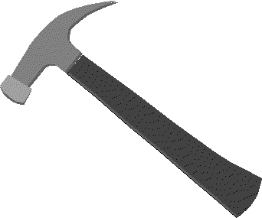

Version 2.0
MYSQL DB
MS Access Frontend
Apache/Tomcat
Cocoon
XML/XSLT
Notes:
Roy Tennet XML4LIB XML/XSLT as a hammer
I look at XML/XSLT as a hammer -- once you have it,
> and know how to use it, you find all kinds of uses for it that would
> not necessarily have occurred to you without that tool in your hand. I
> liken this to Perl (insert your favorite web scripting language here),
> which once you know it, you find all kinds of uses to which to put it.
Cocoon in later dissemintation presentation

Slide 9
Demo

Slide 10
Pros
Multiple interfaces to back end DB
Centralized DB & Application Code
Better support for MODS
Controlled
Instant feedback XML generation on the fly
Profile Validation

Slide 11
Cons
Still using Access for front end
  Efficient data entry from web based forms?

Slide 12
What you need to take away from this presentation
Avoid developing your own METS editor
Use your best hammer for the job
  Perl, Java, XSLT
Tradeoffs between expressing features of METS and usability
Specialized tools appropriate for the complexity of the profile
Notes:
Use XML Spy
Hammer = PERL/JSP/XML|XSLT
Keep the user in mind

