Slide 1
METS Dissemination
METS Opening Day
Corey Keith
ckeith@loc.gov

Slide 2
Introduction
History
Overview

Slide 3
Challenges
Generic vs Specific Viewer
Allowing web designers to do their work
Polymorphic behavior across similar profiles
  How to turn pages?
  Reuse Code
Multiple namespace XSLT

Slide 4
Architecture
METS XML on file system
Apache/Tomcat
Cocoon

Slide 5
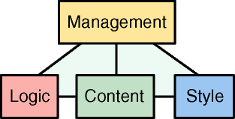
Cocoon
XML Publishing Framework (Toolbox)
  Generate
    From files (or URLS)
    From databases
    From code (XSP, JSP, PHP)
  Transform
    XSLT
  Serialize
    XML, HTML, PDF, SVG, MIDI?
  Caching
Notes:
Supports a variety of xslt engines

Slide 6
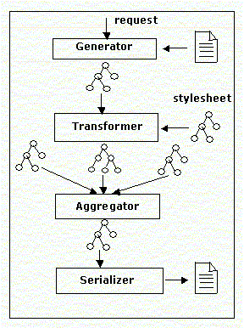
Cocoon
Flexible Pipeline Configuration
Well Supported Open Source (Apache Project)
Notes:
Supports a variety of xslt engines

Slide 7
Pros
Allows web designers to design in XHTML
  Separation of Concerns
Fast
  No preprocess of XSLT
Notes:
Can be used to preprocess

Slide 8
Cons
Changes to web design require updates to XSLT

Slide 9
The Future
PROFILES!
  Generic Viewer HARD
  Specs for Tools
User Centered Design
  Different views for different classes of users
Searching
  Lucene
FEDORA
  Object oriented approach
  Interfaces

Slide 10
Insert Demo Here!

