Slide 1
Introduction to METS
(Metadata Encoding and Transmission Standard)
Jerome McDonough
New York University
jerome.mcdonough@nyu.edu

Slide 2
What was MOA2?
Concept phase
  Whitepaper published by CLIR
Testbed phase
  Use of ideas generated in the concept phase by real life participants (http://sunsite.berkeley.edu/moa2/)
  Included metadata capture DB, Java object browser, and MOA2 DTD

Slide 3
Who was MOA2?
MOA2 whitepaper
  Hurley, Price-Wilkin, Proffitt, Besser
MOA2 testbed participants
  Cornell University Library
  New York Public Library
  Penn State University Library
  Stanford University Library
  University of California, Berkeley Library

Slide 4
Why MOA2?
A common object format allows us to share the effort of developing tools/services
A common object format ensures interoperability of digital library materials as they are exchanged between institutions (including vendors)

Slide 5
Transition to METS
Continuing need to share, archive & display digital objects but:
Need more flexibility for varying descriptive and administrative metadata
Need to support audio/video/other data formats

Slide 6
Who is METS?
Community-based development process
  UC Berkeley, Harvard, Library of Congress, Michigan State University, METAe, Australian National Library, RLG, California Digital Library, Cornell, University of Virginia (not a complete list)….
  METS Editorial Board (UC, Harvard, LC, MSU, RLG, DCMI, MIT, NYU, OCLC, PFA, Stanford, Oxford, British Library, U. Toronto)

Slide 7
Library of Congress as Maintenance Agency
Provides hosting for developing standard
Documentation
Website
Listserv
Vocabulary/Profile Registries

Slide 8
The METS Format
Create a single document format for encoding digital library objects which can fulfill roles of SIP, AIP and DIP within the OAIS reference model
Initial scope limited to objects comprised of text, image, audio & video files
Promote interoperability of descriptive, administrative and technical metadata while supporting flexibility in local practice

Slide 9
Technical Components
Primary XML Schema
Extension Schema
Controlled Vocabularies

Slide 10
METS XML Schema
METS Document
Header
Admin. MD
Link Struct.
Behaviors
Descript. MD
File List
Struct. Map

Slide 11
Structural Map
Object modeled as tree structure (e.g., book with chapters with subchapters….)
Every node in tree can be associated with descriptive/administrative metadata and…
Individual/multiple files (or portions thereof) or
Other METS documents

Slide 12
Structural Map
<div type=“book” label=“Hunting of the Snark”>
<div type=“chapter” label=“Fit the First”>
<fptr>…</fptr>
</div>
<div type=“chapter” label=“Fit the Second”>
<fptr>…</fptr>
</div>
…
</div>

Slide 13
Link Structure
Records all links between nodes in structural map
Uses XLink/Xptr syntax
Caveat Encoder: make sure your structural map supports your link structure

Slide 14
Content Files Listing
Records file specific technical metadata (checksum, file size, creation date/time) as well as providing access to file content
Files are arranged into groups, which can be arranged hierarchically
Files may be referenced (using Xlink) or contained within the METS document (in XML or as Base64 Binary)

Slide 15
Descriptive Metadata
Non-prescriptive/Multiple instances
Desc. metadata associated with entirety of METS object or subcomponents
Desc. metadata may be internal (XML or binary) or external (referenced by XLink) to METS document

Slide 16
Administrative Metadata
4 Types: Technical, Rights, Source Document, Digital Provenance
Non-prescriptive/Multiple instances
associated with entirety of METS object or subcomponents
may be internal (XML/binary) or external (XLink) to METS document

Slide 17
METS Header
Metadata regarding METS document
Creation/Last Modification Date/Record Status
Document Agents (Creator, Editor, Archivist, Preservation, Disseminator, Rights Owner, Custodian, etc.)
Alternative Record ID values

Slide 18
Behaviors Section
Multiple Behaviors allowed for any METS document
Behaviors may operate on any part of METS document
May provide information on API, service location, etc.

Slide 19
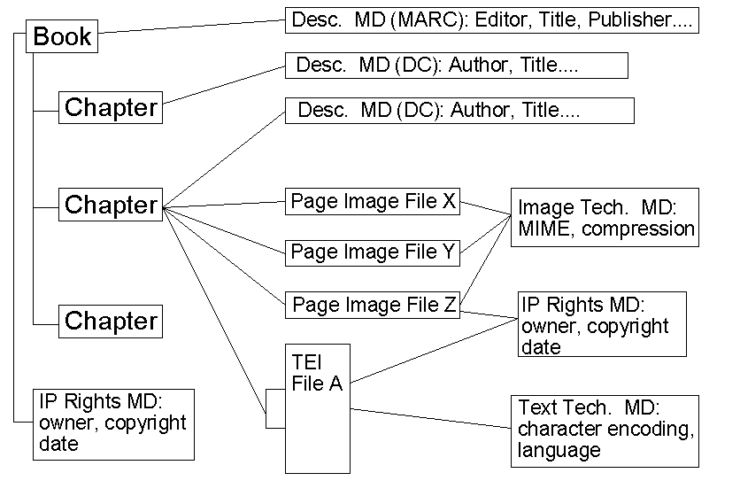
METS Structure

Slide 20
METS Structure
Oral History
MODS Record
Introduction
Q1 & Answer
AIFF Master
AES/EBU
Tech. Metadata
Q2 & Answer
TEI Tran-scription
Text Tech.
Metadata
Time Code Link
IDREF Link

Slide 21
METS Extension Schema
Descriptive Metadata (DC, MARC, MODS)
Administrative Metadata
  Technical (image, text, audio, video)
  IP Rights (XrML, ODRL, MPEG 21, DRM Core)
  Digital Provenance (capture/migration)

Slide 22
METS Controlled Vocabularies
Known metadata types
Known file address types (xptr, time code, etc.)
METS profiles

Slide 23
METS: Development Status
Version 1.3 Complete
Formally endorsed by DLF this year; anticipate NISO registration shortly
Editorial Board working on further development of schema, extension schema, controlled vocabularies, registries, documentation and education

Slide 24
METS: Development Status
Harvard Java Toolkit http://hul.harvard.edu/mets/
Library of Congress object browser
NYU object browser
XSLT:
  NYU Page turner
  CDL MOA2METS converter
  MSU METS2SMIL

Slide 25
METS: Next Steps
Better documentation
More Opening Days (all over the place)
Tool development (particularly open source)
Encourage development of METS Profiles
Continue registry of METS repositories
Help spark extension schema development (video tech. metadata, IP rights, digital provenance)
Work on controlled vocabularies for use in METS

Slide 26
METS: Further Info
METS Web Site: http://www.loc.gov/standards/mets
METS Mailing List: mets@loc.gov
…or contact me at jerome.mcdonough@nyu.edu

