Slide 1
METS@MIT
MacKenzie Smith
Associate Director for Technology
MIT Libraries

Slide 2
METS Uses
Encapsulates metadata for
  Simple Digital Objects
    Single files, e.g. PDF or TIFF image
  Complex Digital Objects
    Scanned documents, multi-part objects
Records structure for Digital Objects

Slide 3
METS Uses
Digital Object Packaging Standard
  OAIS SIP/AIP/DIP
  Repository interoperability
NOT Digital Object modeling schema
  e.g. ABC Harmony or CIDOC

Slide 4
METS Uses
Application data, e.g.
  Page turners
  Multimedia players
  Map viewers

Slide 5
METS@MIT
DSpace Institutional Repository (tomorrow)
  OAIS DIP/AIP/SIP
  Exit strategy
  Interoperability with other repositories
Digitization Production Workflow
  Archival and special collections
  E-theses

Slide 6
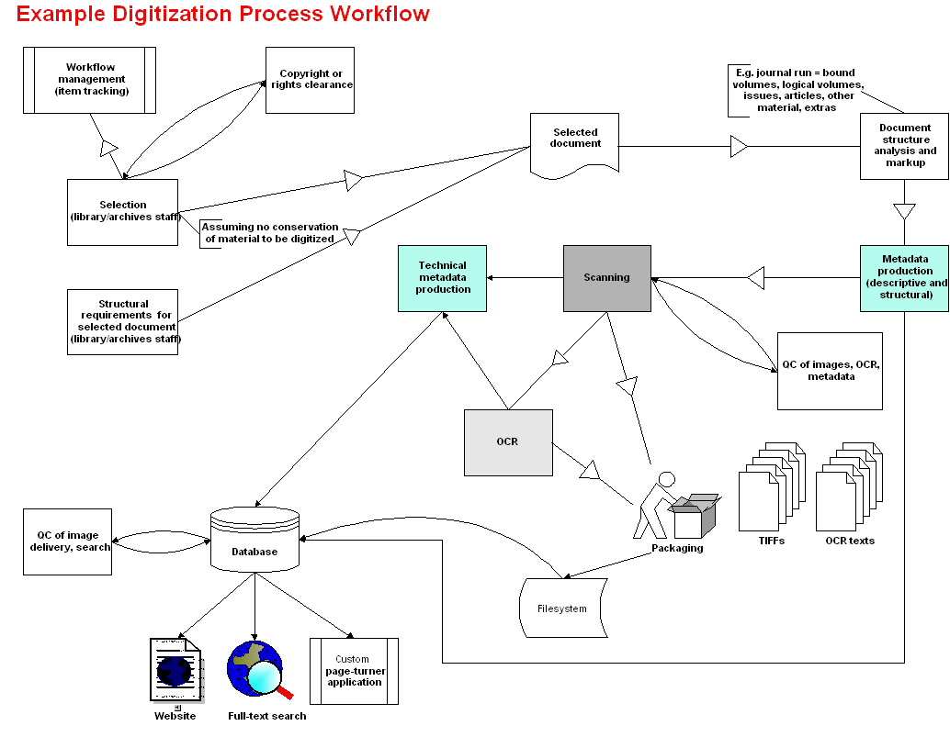

Slide 7
Digitizing Workflow
Complex (many steps)
Labor-intensive
Error prone
Requires custom programming
  For METS creation
  For METS applications

Slide 8
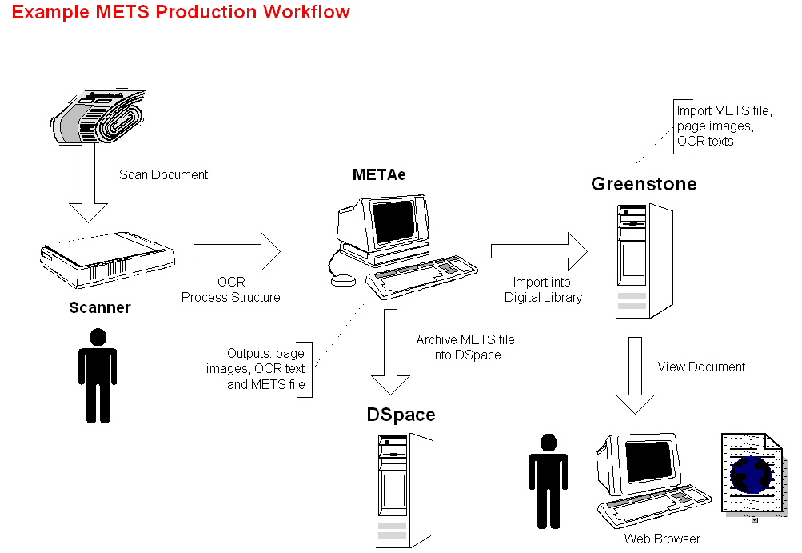

Slide 9
Application Architecture
Scanning
  Local or outsourced to vendor
OCR
  METAe engine
Structural analysis
  METAe engine (trained to appropriate grammar)

Slide 10
Application Architecture
METS production
  METAe engine
Access and Delivery
  Greenstone digital library system
    Indexing and retrieval of descriptive metadata
    Rendering (Page turner, etc.)
Archive
  DSpace or other digital archive

Slide 11
Issues
METAe
  METS profile for given document grammar
  Payment model
  Unnecessary features (e.g. bitmap indexes)
Alternative: METAe “lite”
  open source METS production engine
  OCR included
  Structural analysis?

Slide 12
Issues
METS support in Greenstone
  University of Chicago experiment
  Standard profile definitions for common Digital Object types: book, journal, report, image set
METS support in DSpace
  More tomorrow…

