Slide 1

METS repositories: DSpace
MacKenzie Smith
Associate Director for Technology
MIT Libraries

Slide 2
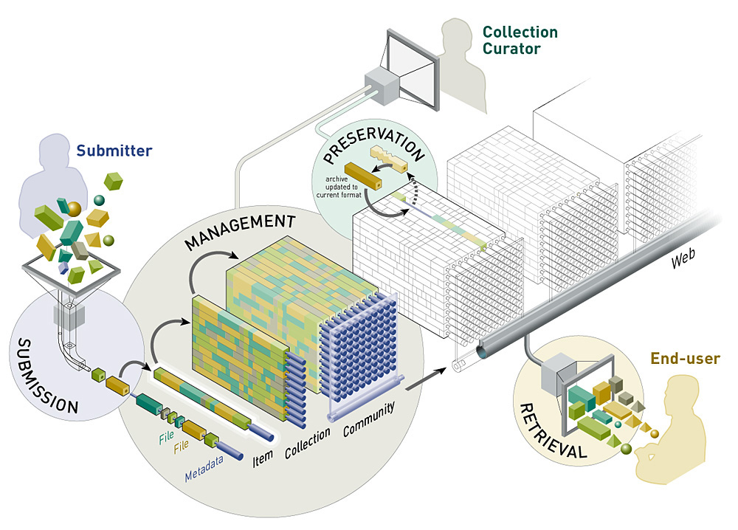
DSpace
Open source dynamic digital repository
Visual Explanations by Dynamic Diagrams

Slide 3


Institutional Repository
Institution-based
Scholarly material in digital formats
Cumulative and perpetual
Open and interoperable

Slide 4
The DSpace Repository
Institutional Repository created at MIT for faculty digital research materials
MIT Libraries - Hewlett Packard Research Labs collaborative development
Open Source system
Federated system
Preservation archive platform

Slide 5
DSpace
Captures
  Digital research material in any formats directly from creators (e.g. faculty)
Describes
  Descriptive, technical, rights metadata
  Persistent identifiers
Distributes
  Searches metadata
  Delivers via Web, with necessary access control
Preserves
  Large-scale, stable, managed long-term storage

Slide 6

Possible Content
Preprints, articles
Technical Reports
Working Papers
Conference Papers
E-theses
Datasets
  e.g. statistical, geospatial, scientific
Images
  visual, scientific, etc.
Audio files
Video files
Learning Objects
Digitized library collections

Slide 7
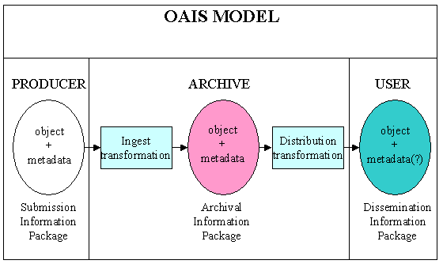
OAIS framework

Slide 8
METS and OAIS
Submission Information Package (SIP)
    METS as transfer syntax
Dissemination Information Package (DIP)
    METS as tranfer syntax
    METS as input to display applications
Archival Information Package (AIP)
    METS stored internally in archive

Slide 9
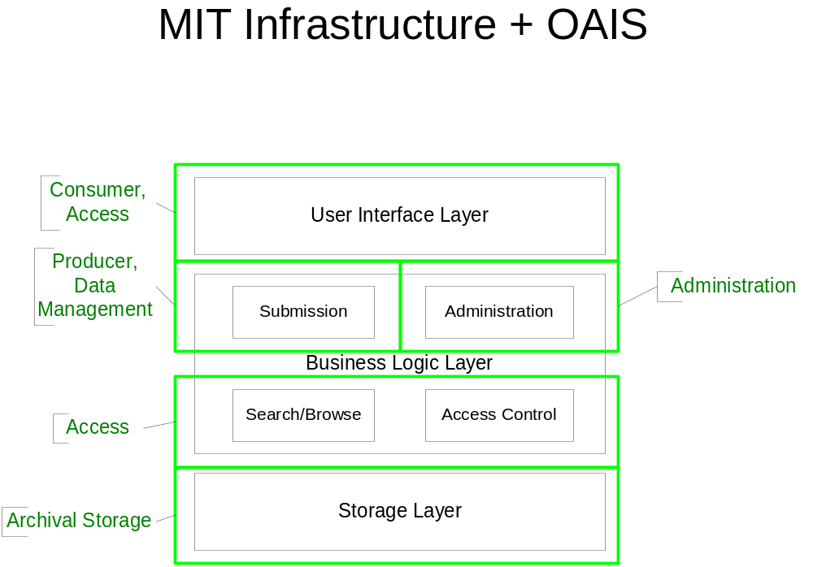

Slide 10
OAIS at MIT
OAIS influence on Dspace design
  DSpace repository to contains AIPs
  AIPs contain
    Descriptive Information (Dublin Core metadata)
    Representation Information (technical metadata about digital files)
    Content Information (digital objects)
  DSpace AIP = METS file

Slide 11
DSpace Information Model
Communities
  Research units of the organization
Collections (in communities)
  Distinct groupings of like items
Items (in collections)
  Logical content objects; receive persistent identifier
Bitstreams (in items)
  Individual files; receive preservation treatment

Slide 12

DSpace Metadata
Descriptive metadata
  Qualified Dublin Core
    Based on Library Application Profile
Administrative metadata
  Minimal information in DC metadata
Technical/preservation metadata
  Mime type, file name, file size, create date, MD5 checksum

Slide 13
DSpace METS Profile
METS instances map to DSpace items
<METS:mets
OBJID="DspaceID"
TYPE="mime/type"
LABEL="DSpace item">

Slide 14
METS Header
<metsHdr
CREATEDATE="2002-10-20T15:40:00">
<agent ROLE="AIP“ TYPE="ORGANIZATION">
<name>Massachusetts Institute of Technology</METS:name>
</agent>
</metsHdr>

Slide 15
Descriptive Metadata
<dmdSec ID="DMD DSpaceID">
<mdWrap>Qualified Dublin Core metadata </mdWrap>
</dmdSec>
Need an “extension schema” for DC using the Library Application Profile

Slide 16
Administrative Metadata
<amdSec ID="TMD DSpaceID">
<techMD>DSpace technical metadata </techMD>
<rightsMD>DSpace use license</rightsMD>
<digiprovMD>DSpace administrative and technical metadata</digiprovMD>
</amdSec>
Need an extension schema for DSpace tecfhnical metadata elements (e.g. mime-type, file name, file size, checksum)

Slide 17
Provenance Metadata
METS digiprovMD maps to DSpace history subsystem metadata
  use the ABC Harmony schema as the METS digiprovMD extension schema
  tracks the item over time
  history system records can be dropped into a digiprovMD/mdWrap section as plain XML or RDF/XML

Slide 18
File Inventory
File inventory maps to a DSpace bundle
<fileSec>
<fileGrp id=“DSpaceID” ownerid=“MIT” mimetype=“mime/type” seq="1" created=“2002-10-20T16:00:00” size=“nnn” checksum=“nnnnnnnnnn” admid=“ADMDSpaceID” use=“preview”>
<file id=x>preview PDF</file>
</fileGrp>
<fileGrp use=”full view”>
<file id=y>full PDF</file>
</fileGrp>

Slide 19
File Inventory
<fileGrp use=“image master”>
<file id=a>page 1 TIFF</file>
<file id=b>page 2 TIFF</file>
</fileGrp>
<fileGrp use=“text master”>
<file id=j>page 1 OCR</file>
<file id=k>page 2 OCR</file>
</fileGrp>
</fileSec>

Slide 20
File Inventory
In this example the TIFF and OCR files were used to create PDF deliverables, but are kept as archival masters, not displayed to the public.
In practice, sets of TIFF and/or OCR files can be deposited as a single zip file in a separate bundle (i.e. filegrp) and suppressed from public display based on “use” value.
If a TIFF page turner is available, a separate structmap for that view can be created with a hierarchy of divs to model the item sections.

Slide 21
Structure Map
DSpace item bundles map to a structMap for public display (i.e. a logical item view)
<structMap ID="DSpaceID" type=”logical”>
<div><fptr fileid=x/></div>
</structMap>
<structMap type=”logical”>
<div><fptr fileid=y/></div>
</structMap>

Slide 22
Structure Map
Separate structMaps for each bundle will simplify production of DIPS for different logical views of the item.

Slide 23
DSpace METS AIPs
METS files will be produced on installation into the DSpace assetstore

Slide 24
Content packaging
Content can be embedded into a METS file or packaged together with METS file
AIP should have content embedded (very large files result)
SIP and DIP should keep content files separate for ease of transmission
Possible alternatives: IMS Content Packaging specification

Slide 25
DSpace METS SIPs
OpenCourseWare
  e.g. IMS Content Packages converted to METS
Imports from other DSpace instances
  e.g. to aid in assetstore replication for backup
Imports from other Institutional Repositories
  e.g. FEDORA, Eprints, Greenstone,
  Publishers?

Slide 26
DSpace METS DIPs
Manage custom “delivery applications”
  Take a DSpace AIP
  Modify or simply as needed
  Send to custom rendering application
    Could be internal or external (e.g. remote Web Service)

