Slide 1
Gathering Audio Metadata for the Monterey Jazz Festival Concerts
OLAC 2006
By Nancy J. Hoebelheinrich, Stanford University Libraries

Slide 2
Workshop Goals
Surface issues associated with gathering MD req’s for access & long term preservation of audio files
Demonstrate how to use METS for content packaging &
  MODS for description & retention of logical & physical structures of digital audio objects
  PREMIS for preservation MD
  AES Draft Data Dictionary & JHove for Format MD

Slide 3
Monterey Jazz Festival Project Description
Multi-year, multi-part project initiated jointly by Stanford University Libraries and the Monterey Jazz Festival
Goal to preserve and provide access to approximately 750 original audio and 92 original video recordings
Recordings
  Date from 1958 to present
  Document the world's longest running jazz festival

Slide 4
Project Description, cont.
Grant funding provided by:
  Grammy Foundation
  National Historic Publications and Records Commission
  Save America’s Treasures.
Current timeline: October 1, 2005 – September 31, 2008.

Slide 5
Collection Description
Complete collection currently comprises over
  1,200 sound recordings
  370 moving image materials
  130 linear feet of paper-based records of the founding organization
Forms a unique collection of historic recordings of high research value, currently inaccessible to scholars due to the condition and format of the materials
Approximately 750 tapes have been selected to be digitized
Formats: ¼” and ½” analog reel tape, audiocassette, and digital audio tape. (only audio for this project)

Slide 6
Intentions for Collection
Creation of master and derivative digital audio files
Augmentation of existing descriptive MD to access component level files
Entire digital collection will be accessible to listeners on Stanford campus
MD made accessible to the public via the SULAIR web; [selected sound clips may also be available]
Deposit into preservation repository (SDR)
Notes:
On-site access to audio files only via use copies on CD (and possibly also MP3 files on a listening station).

Slide 7
Descriptive / Structural MD Req’s per curator & SDR
Retain relationships among “tracks” or segments, tape-side and tape to allow physical access to analog artifact
Replicate physical structure, but also provide direct access to the logical structure
“Find”, “identify” & “select” by tape, performer(s), performance, date

Slide 8
Minimal MD Req’s for SDR
Structural
Descriptive enough for minimal access
Admin
  Technical for Audio
  Preservation
  Rights
MD Packaged with its resource

Slide 9
FM Pro MD @ beginning of project
Field tags =
  Tape number
  Performer (of all on given tape) by group with individual & instrument also listed
  Performance (of all songs on the tape, differentiated by performer)
  Date of performance

Slide 10
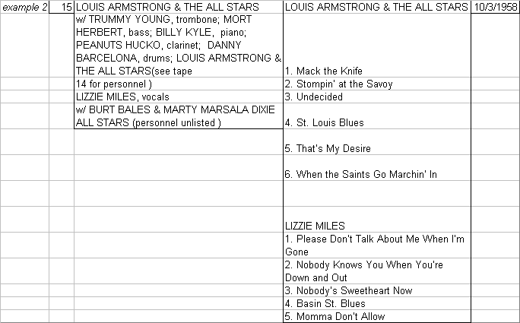

Slide 11
Extra performers

Slide 12
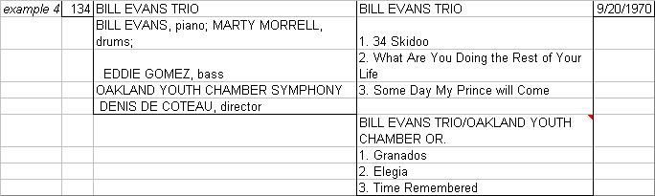

Slide 13
Extra group performer

Slide 14
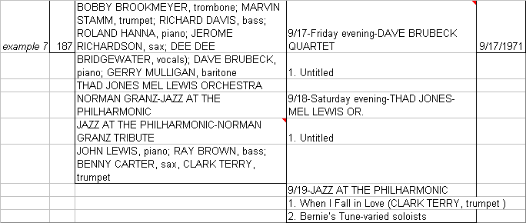

Slide 15
Date #1
Date #2
Date #3

Slide 16
The plot thickens…
How to [retain] link between Descriptive MD and “digital-physical” files??
  Assigned “markers” = virtual BE / END determined by timestamps
  Files & structural naming conventions

Slide 17

Why worry about digital object structure?
So many files
No inherent order to their order
Just streams of bits

Slide 18
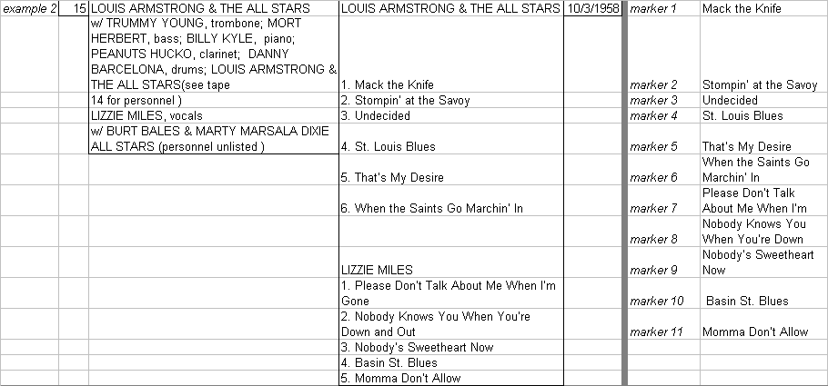

Slide 20
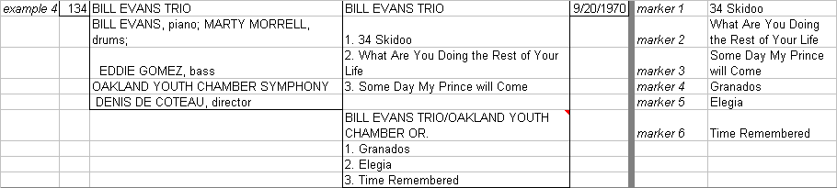

Slide 22
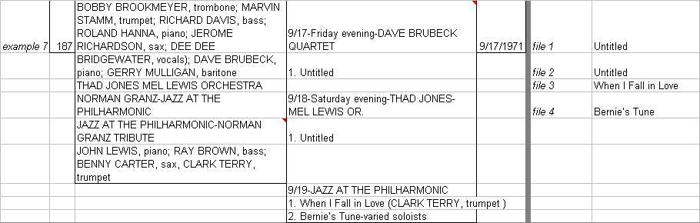

Slide 24
Physical structure by naming convention, hmm….
0001pm.wav
0001pm.sfk
0001pm.wav.gpk
0001pm.wav.mem
0001sh.wav
0001sh.mrk
0001sh.cd
0001sh.wav.gpk
0001sh.wav.mem

Slide 25
Physical structure by file naming w/ directories
sul-dl-nas1\mjf\Batch01\040606\
PM\
0001pm.wav
0001pm.sfk
0001pm.wav.gpk
0001pm.wav.mem
SH\
0001sh.wav
0001sh.mrk
0001sh.cd
0001sh.wav.gpk
0001sh.wav.mem

Slide 26
Long term storage bets
Different naming conventions
Different directory structures, if any
Need for device & OS independence
Value in “packaging” of metadata & content together even if stored separately

Slide 27
What to do?
Packaging = Descriptive + Structure
METS = (Logical structure expressed as) Descriptive MD + (Physical Structure expressed as) Structural Map

Slide 28
How does METS work?
Initial scope limited to objects comprised of text, image, audio & video files
Technical Components
  Primary XML Schema
  Extension Schema
  Controlled Vocabularies
  Community based profiles

Slide 29
METS XML Schema
METS
Document
METS
Descriptive
Administrative
Content File
Structural
Behaviors
Structural Link
Header
Metadata
Metadata
Inventory
Map

Slide 30
Structural Map is key
Digital Object modeled as logical or physical tree structure (e.g., book with chapters with subchapters, image file with encoded text transcription file and audio file of oral interview….)
Every node in tree can be associated with descriptive/administrative metadata and…
Individual/multiple files (or portions thereof) or
Other METS documents

Slide 31
Associated Metadata
Descriptive
  Endorsed XML schemas of these standards to date: MARCXML, Dublin Core simple, MODS; can use others such as FGDC, VRA, etc.
Administrative
  Technical (Z39.87 for still images, Text endorsed),
  Rights, Source
  Digital Provenance (PREMIS endorsed)
Can be associated with entire digital object or subcomponent(s)
Can be multiple instances; type used is not prescribed
Can be contained internally (as XML or binary files)
Can be contained externally by reference (using Xlink)
Provides controlled vocabularies for tags and declaration of standards used

Slide 32
Ex., simple METS Object
Desc MD (MARC or DC or MODS)
Book
Tech MD: Image
FileX=Pg1
Admin MD (Digiprov)
FileY=Pg2
Tech MD: Image
Admin MD (Digiprov)
Admin MD: Rights
Notes:
SIP representation

Slide 33
Ex., Audio METS Object
Desc MD ( MARC or DC or MODS)
Audio Tape- side
Desc MD for Track - (DC or MODS)
Tech MD: Audio
FileX=Track1
Admin MD (Digiprov)
FileY= Track2, Track3
Tech MD: Audio
Admin MD (Digiprov)
Admin MD: Rights
Notes:
SIP representation

Slide 34
First, descriptive
FMPro ➔ qDC ➔ MODS
finalDMDTemplate PDF

Slide 35
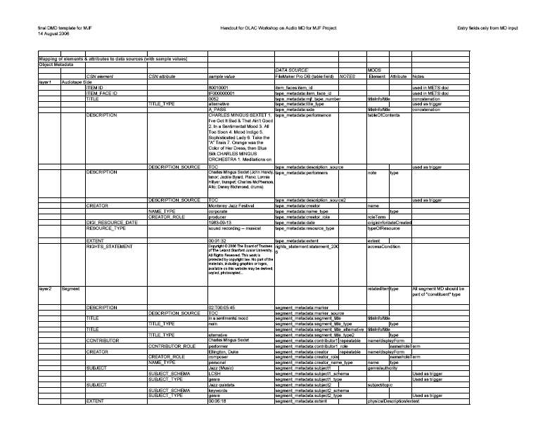

Slide 36
Taking advantage of the technologies
Mechanism for keeping tracks (segments) connected to tape-side
  using mods:relatedItem to nest, or not
  Retaining IDs from data provider – SDR
Using subfields / attributes to trigger code events, e.g., subject/genre & title information

Slide 37
Viewing the XML
See dmdSec
See fileSec
See structMap

Slide 38
Administrative MD
rightsMD using PREMIS Rights
sourceMD used AES draft data dictionary elements
techMD for format specific MD
  Preservation Master (Broadcast wave, uncompressed) (AES & Jhove)
  Service High (Broadcast wave, compressed) (AES & Jhove)

Slide 39
Viewing the XML
See amdSec
  rightsMD
  sourcMD
  techMD
    For file
    For format

Slide 40
Questions, Comments?
References:
Monterey Jazz Festival http://www.montereyjazzfestival.org/50th/
Archive of Recorded Sound MJF Collection,
Stanford University Libraries http://library.stanford.edu/depts/ars/collections/jazz.html
METS http://www.loc.gov/standards/mets/
Dublin Core Metadata Initiative http://uk.dublincore.org/schemas/xmls/
MODS http://www.loc.gov/standards/mods/
PREMIS http://www.oclc.org/research/projects/pmwg/
Audio Preservation information, see http://palimpsest.stanford.edu/bytopic/audio/
JHove JStor / Harvard Object Validation Environment
http://hul.harvard.edu/jhove/
Acknowledgements
Special thanks and acknowledgement to Hannah Frost, Media Preservation Librarian at SULAIR
Contact:
Nancy Hoebelheinrich
nhoebel@stanford.edu
And, why are we doing this???
MFOO29-BillieH
MF00229-BillieH2

