Slide 1
OCLC’s Digital Archive – Disseminating with METS
Jay Goodkin
Software Engineer
Digital Collection and Preservation Services

Slide 2
Today’s Presentation
OCLC Digital Archive Overview
Dissemination Workflow
OCLC’s METS Implementation for Dissemination
Notes:
To start with, I will provide a quick overview of the Digital Archive and its features.
Next, I will provide a short walkthrough of the Dissemination Workflow of the Digital Archive.
Finally, I will concentrate on the structure of our Dissemination Package structure and the specifics of our METS implementation.

Slide 3
OCLC Digital Archive - Overview
Functions include:
  Harvest
  Ingest
  Content Group Management
  Rights Group Management
  Viewing
  Dissemination
  Reports
  Periodic Audits of Objects in the Archive
  Frequent Backups and Disaster Prevention
Dissemination Information Packages based on METS schema
Notes:
The primary focus of the Digital Archive (currently) is capturing web-based documents, storing them, and preserving them for the long term.
The current customer base of the Digital Archive consists mainly of State Libraries and Government Agencies. For example, The State Library of Connecticut and GPO, the Government Printing Office.
The Digital Archive supports Metadata Creation for each Digital Object and Content Management.
It Provides Discovery of archived objects in a variety of ways, including OCLC’s Connexion and FirstSearch services and local Catalogs.
As you can see, the functions include Harvest (process of capturing document from web), Ingest, Content Group Management, Rights Group Management, Viewing, Dissemination, Reports and Periodic Audits and Backup/Disater Prevention Services.
Our Dissemination Packages are, of course, based on METS.

Slide 4
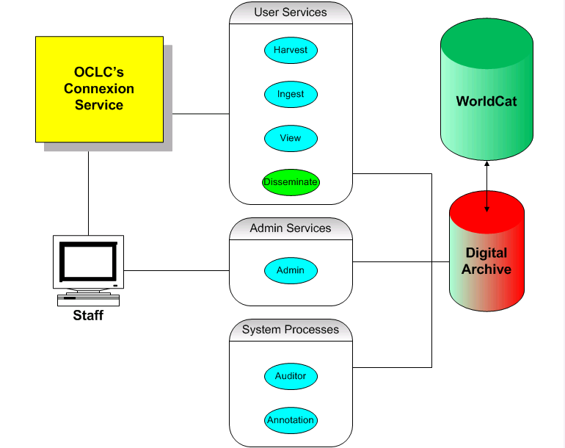
Digital Archive Services
Notes:
The Digital Archive Services are shown here. As mentioned before, most of these services are made available through OCLC’s Connexion interface.
In addition to the Connexion interface, users with Admin privileges will access the Digital Archive Admin service directly. The Admin Service allows users to organize objects into Content Groups, create and assign Rights Groups to objects and create Rights Statements.
System Processes include an Auditor which runs period checks on the integrity of objects in the archive. We are currently working on an Annotator which extracts technical metadata from images and stores that metadata.

Slide 5
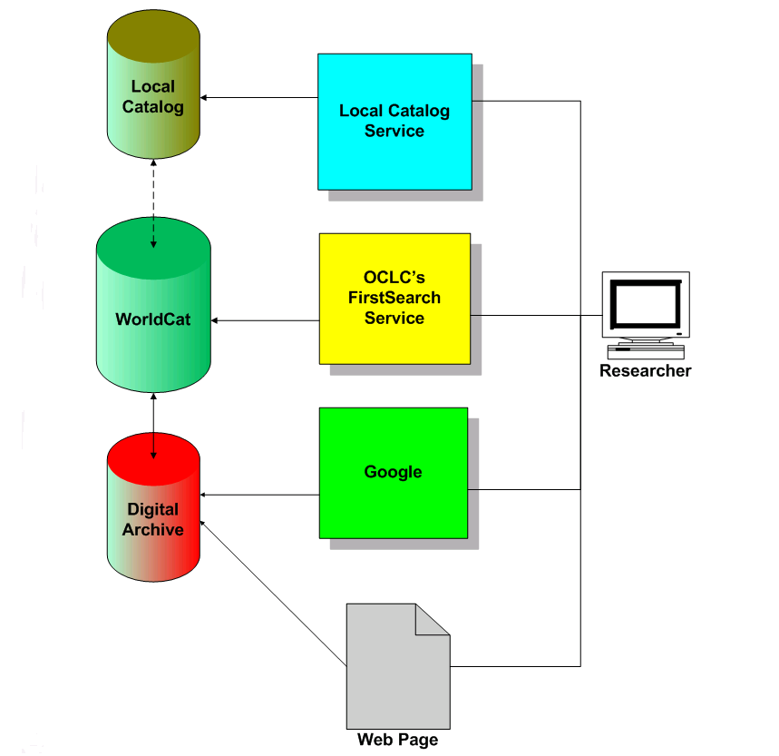
Discovery Services
Notes:
One an object has been ingested into the Digital Archive, there are a variety of ways for users to discover them.
Since each Digital Object in the Archive also has an associated Bibliographic Record in WorldCat, any means of searching WorldCat can be used to discover Digital Archive content. OCLC’s FirstSearch and Local OPACs fall into this category.
The bib record associated with a Digital Archive Object will contain a link to that object in the Digital Archive repository.
Links to Digital Archive objects can also be embedded on web pages.

Slide 6
Digital Archive Record
Contains the Metadata for each Digital Object in the Archive
Extension of Dublin Core
Entered and Maintained using OCLC’s Connexion Service
Starting Point for Most Functions in the Archive
Please see http://www.oclc.org/support/documentation/digitalarchive/da_metadata_elements/ for a detailed description of our metadata elements
Notes:
The Digital Archive Record contains mimimal descriptive and full preservation metadata about the Digital Object. These records are only editable by the owning institution of a Digital Object. In that sense, this record is owned along with the Digital Object.
The descriptive potion of this record may be crosswalked from a bib record in WorldCat. This crosswalk also sets up the link between the Bib record and the Digital Archive record.
Most of the archive functionality is launched from the Digital Archive record, including harvest, ingest and dissemination.

Slide 7
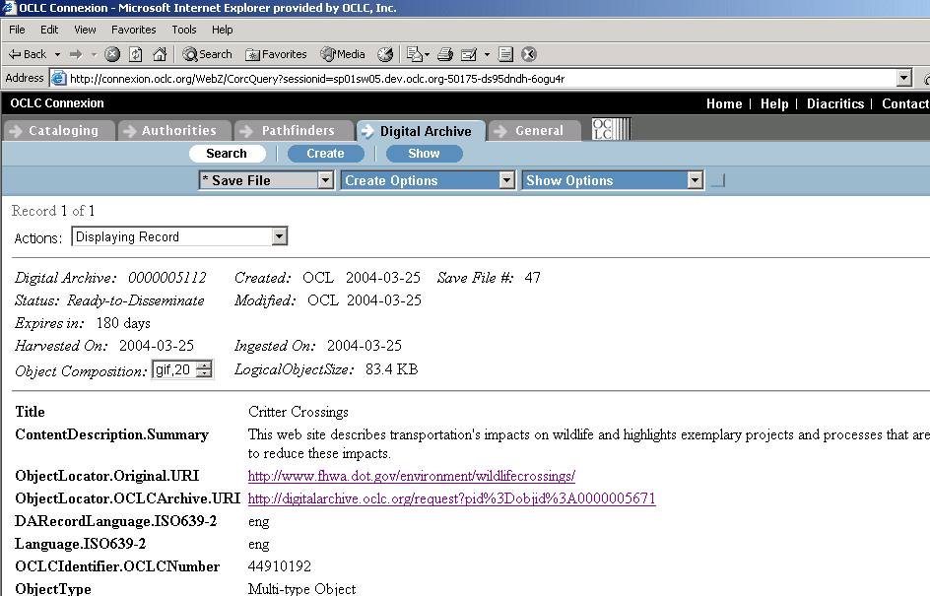
DA Record in Connexion
Notes:
This is a simple Screenshot of what a typical Digital Archive Record will look like.
Our metadata set was created by looking at a variety of existing metadata standards including NLA’s Pandora archive and CEDARS. In addition, internal OCLC Research contributed to this data set.
OCLC is currently participating in the PREMIS (Preservation Metadata Implementation Strategies). So our metadata will likely evolve along with any preservation metadata standards.

Slide 8
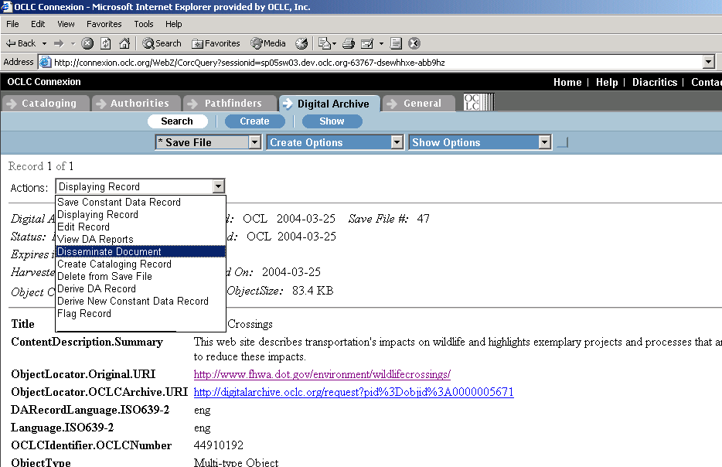
Disseminating an Object
Notes:
Like I mentioned before, disseminating a Digital Object starts with a Digital Archive Record.
As you can see, there are several Functions listed in the Drop Down. Depending on where the object is in the archival process, different functions will appear in the list. For example, this object has already been harvested from the web and ingested into the archive, so those functions do not appear here.
Once the Dissemination action is selected, a Dissemination Options Page will be presented.

Slide 9
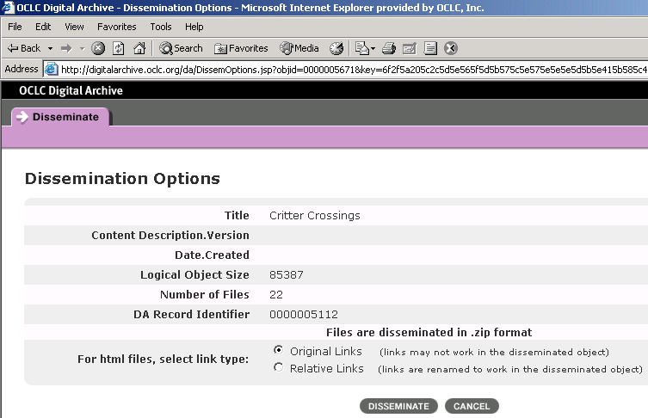
Dissemination Options
Original Links – Disseminate Original HTML Pages as Captured from the Web
Relative Links – Disseminate a Locally Viewable Object
Notes:
This Page Provides a Brief overview of the Object as a double-check.
In addition it shows the Logical Object Size and Number of Files.
The Link Type Option is interesting because it allows the user to specify whether to Disseminate the Pages in their Original Form as captured from the Web, or in a Locally Viewable form.
With Original Links, web pages will be disseminated exactly as they were captured from the web – with links unmodified.
With Relative Links, locally viewable derivatives of the Original Pages will be add to the DIP such that when Files are extracted, they can be viewed properly with a file browser.
Once the Disseminate button is clicked, the Dissemination process will start.

Slide 10
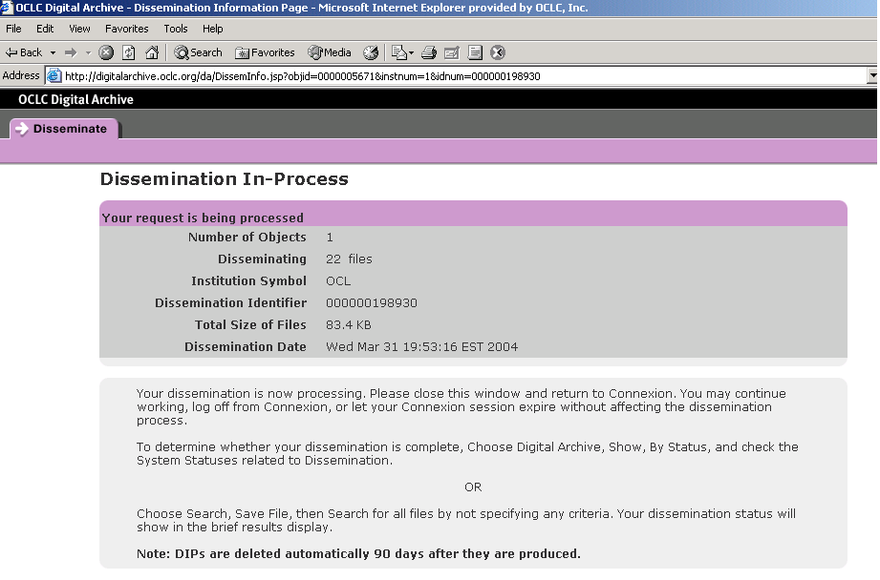
Dissemination Confirmation
Notes:
This page indicates to the User that the Dissemination Process has started.
The Dissemination Process is asynchronous, and the user can periodically check on its progress in Connexion.
In the meantime, the user can continue working on other tasks in the Digital Archive or in the Cataloging System.

Slide 11
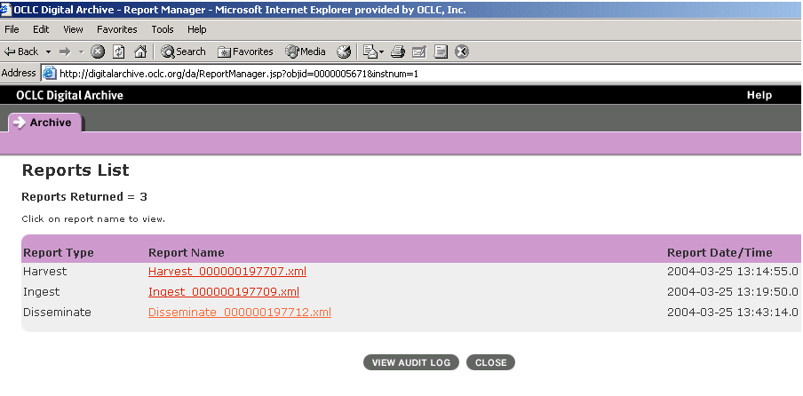
Reports
Each Object has a List of Associated Reports
Harvest, Ingest and Disseminate Reports shown
Notes:
Each Dissemination will result in the creation of the Dissemination Package itself and a Dissemination Report.
All Reports for a Specific Object will show on this screen.

Slide 12
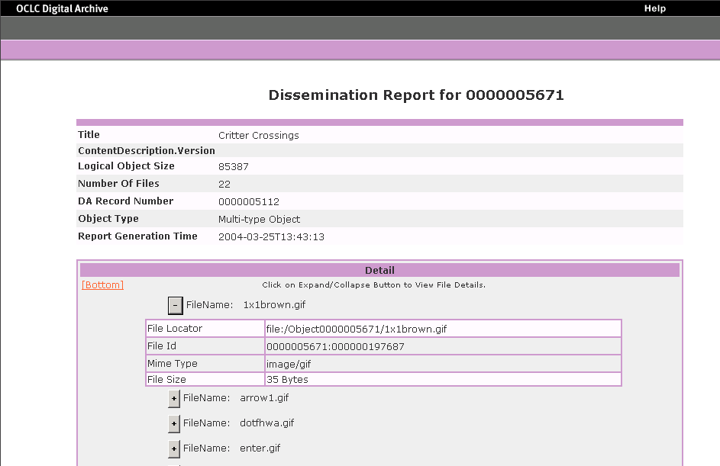
Dissemination Report
Notes:
This is an example of the Dissemination Report.
The Header contains familiar information from the Object that was Disseminated.
Each File included in the Dissemination Package is listed in the Report. An expand/contract button is provided to display or hide the detailed information about each file.

Slide 13
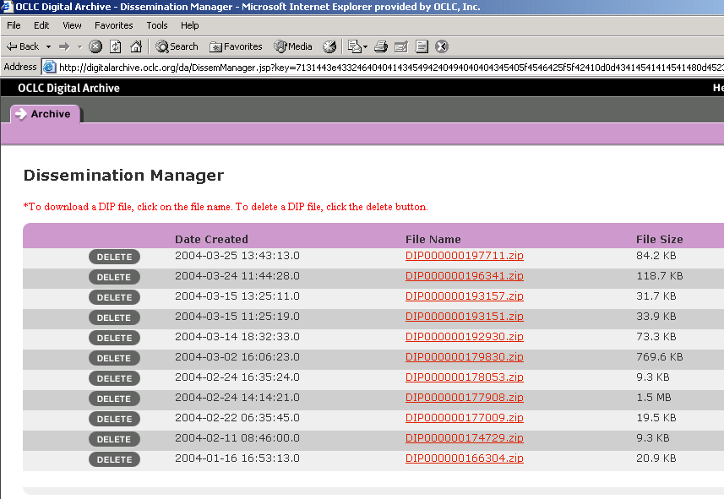
Dissemination Manager
Notes:
All of the current DIPs created by an Institution will be available in the Dissemination Manager, with the most recent sorting to the top.
Currently, the Digital Archive packages each DIP as a ZIP file.
Clicking the hyperlink will allow the DIP to be delivered to the local machine via HTTP. We decided to use HTTP to start with for its simplicity. We will likely add FTP access as the demand for it arises.

Slide 14
Inside OCLC’s DIP
Supports Multiple Objects
Contains all Content Files for each Object
Contains one METS Manifest
Contains all Object-Level METS Documents
Notes:
Currently, the Connexion interface allows only one object to be disseminated at a time, but OCLC’s DIP structure was designed to handle multiple objects.
We have an internal interface to create multiple-object DIPs, which I will show an example of later.
Each DIP will contain all of the Content Files for each Digital Object. All content and metadata for a Digital Object in a DIP will be organized into a folder for that Object.
Also, each DIP will contain a Manifest File, encoded in METS.
In addition, each Object will contain a METS descriptor file.

Slide 15
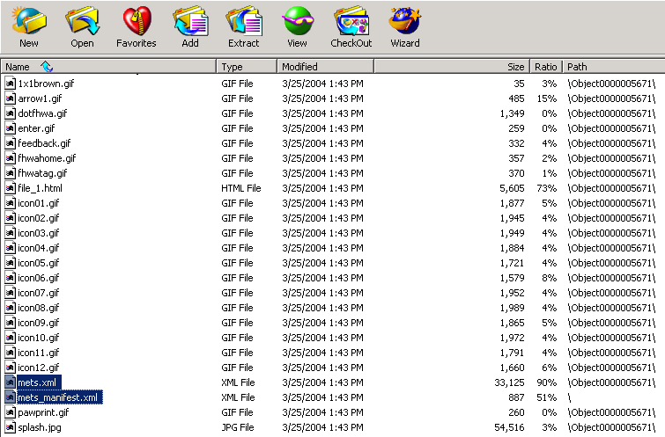
WinZIP View of the DIP
Notes:
This is a WinZIP view of the DIP created in our earlier example.
The two METS files mentioned earlier are highlighted. The mets_manifest will always appear in the root, and contains an inventory of all Digital Objects included in the DIP.
Each object-level mets.xml file will appear in the appropriate object folder within the ZIP.

Slide 16
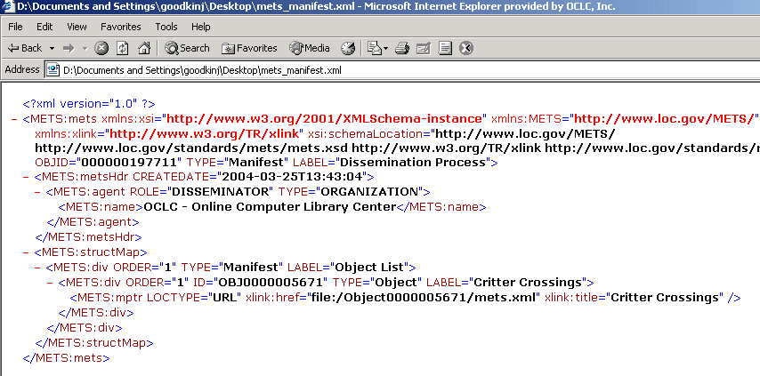
METS Manifest
Uses mptr to point to all Object-Level METS Documents included in the DIP
Notes:
As you can see, the METS manifest is a very simple document that points to all of the Object-Level METS documents included in the DIP. It uses the mptr structure provided by METS.

Slide 17
OCLC’s METS Profile
Header - No extension
Descriptive Metadata Section - OCLC descriptive schema http://digitalarchive.oclc.org/schemas/oclc_dm.xsd
File Section - No extension
Structural Map Section - No extension
Behavior Section - No extension
Notes:
In the next two slides, I’ll quickly cover the OCLC METS Profile for Dissemination.
We do have an OCLC-specific extension schema for Descriptive Metadata that encompasses the metadata on the DA Record shown earlier.
We have no extensions for the Header, File Section, Struct Map or Behavior Sections.

Slide 18
METS Profile Continued
Administrative Metadata Section –
MIX schema http://www.loc.gov/standards/mix/mix.xsd
textMD schema http://dlib.nyu.edu/METS/textmd.xsd
OCLC provenance schema http://digitalarchive.oclc.org/schemas/oclc_prov.xsd
Notes:
For Administrative Metadata, we use the MIX metadata schema for image Technical Metadata.
We have implemented the TextMD standard for Text Documents.
Also, we have created an OCLC-specific extension for handling Provenance Metadata – which in our case consists of Fixity and Virus Detection Metadata.

Slide 19
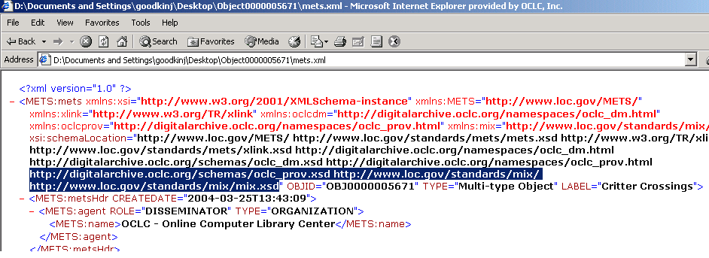
METS Header
References OCLC Extensions
References Industry Standard Extensions – e.g. Mix
Notes:
This is the METS header for the previous Dissemination.
You can see from the highlighted text, that we have added some OCLC-specific Metadata extensions, as well as an industry standard extension, which is the Mix Image Metadata standard.
We created the oclcprov (Provenance) schema to acommodate metadata for our Fixity Checksums and Virus Checking statuses.
In addition, we include Mix metadata for images, when available.

Slide 20
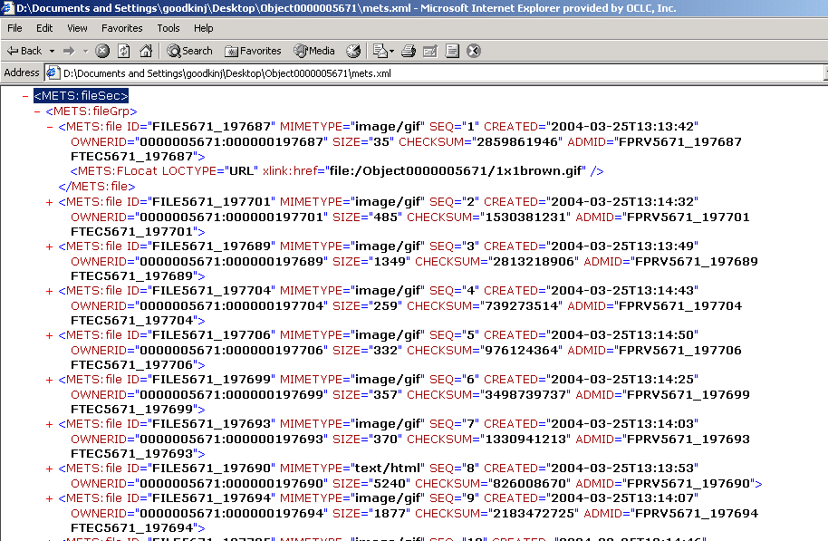
METS File Group
Lists all Content Files for a given Object
Points to Technical/Provenance Metadata for each File
Notes:
This is a Screenshot of the File Group portion of our METS document for the object previously disseminated.
You might notice that each file disseminated references an ID for a Provenance Metadata section and a Technical Metadata Section. I will show examples of these shortly.
Also, a link to the corresponding content file within the DIP package is included for each file using the Flocat subelement. This is only visible in the first expanded file element. We use “FILE” URLs to reference the content.

Slide 21
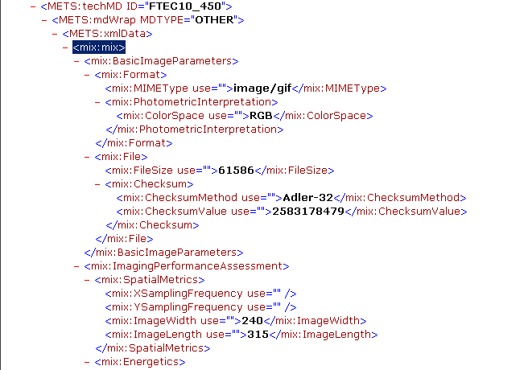
TechMD Mix Example
Notes:
As mentioned before, each file references an ID to a Technical Metadata section. In this example, we show a technical metadata section for an image, encoded in the Mix standard.

Slide 22
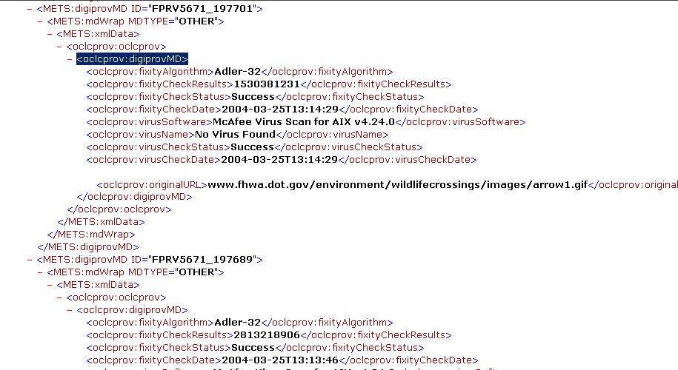
ProvMD Mix Example
Notes:
Similarly to the previous example, you can see that each file also has an OCLC-devised Provenance Metadata Section. Here you can see the metadata relating to Fixity and Virus Detection.
All content in the archive is checked for viruses at Harvest time. In addition, periodic Fixity and Virus checks are performed periodically after an object has been ingested into the archive. This is performed by the Auditor service mentioned before.

Slide 23
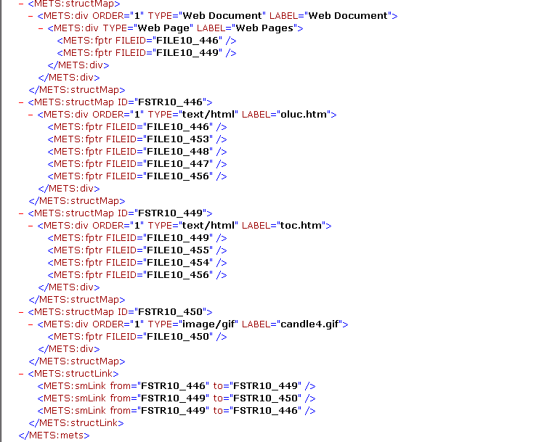
StructMap Example
Notes:
This printscreen illustrates the Struct Map section of an OCLC Web Document.
This is the part of the METS creation that we struggled with the most. Trying to fit the complex structure of linked documents into the structMap has proven to be very challenging.
Currently, what we have done is list each of the HTML files with a separate structMap.
Then all of files that make up that page: The Page Itself and its Dependencies (I.e. Images, Stylesheets, Javascript files) are listed next.
Then the structLink section shows the pages that link together.
One idea would be to separate the main page, its dependencies, and its links, but we haven’t had any pressure to change this structure as of yet.

Slide 24
StructMap & Web Documents
Fitting Web Documents into div Structure
Issues with representing Links and Offsets
structLink shows which Pages link together but not where the Links occur
Considered using the <par><area> structure
Notes:
As mentioned previously, we had difficulty trying to fit our web document struture into the METS structMap.
In the Digital Archive, we maintain metadata about each HTML file, that contains a list of links, offsets and the ID for the file that each link represents.
The structLink allows us to show which pages link together, but not where on a given page each link occurs.
The likely solution would be to have a standardized METS profile for web documents with an extension schema that handles this complex metadata.

Slide 25
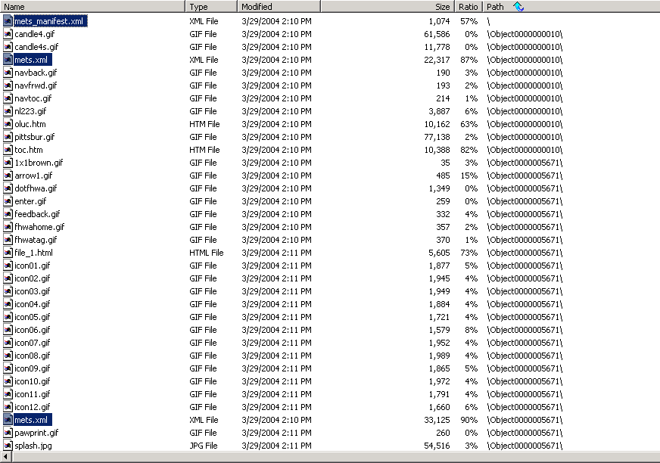
Multi-Object DIP
Notes:
This is an example of a DIP that contains two Digital Objects.
Again, you can see the METS manifest, and two Object-Level METS documents.
You can also see how the files are segregated into object folders.

Slide 26
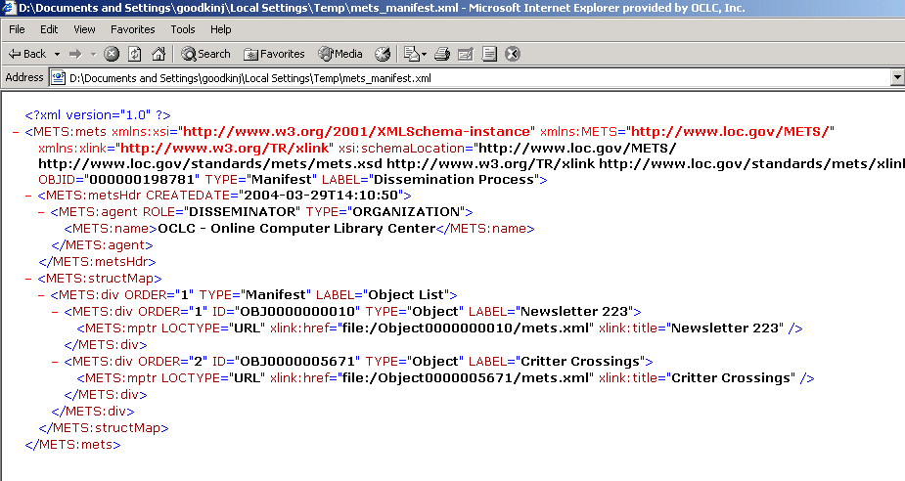
Multi-Object Manifest
Notes:
This is an example of a METS manifest for a DIP that contains two objects.
As you can see, there are two div sections with mptr references to each Object-Level METS document.

Slide 27
Issues with Dissemination
Interoperability of OCLC’s DIP
Issues with encoding large Digital Objects into a METS package
Standardization of Extension Schemas Web Documents
Notes:
When we first decided to develop a DIP, the idea was to try to create something that was as standards-based as possible.
Our use of METS was the first step in that direction. Now what we want to do now at OCLC is continue to evolve our DIP to the point where it is interoperable with other archives- an industry standard if you will.
We decided not to use METS for packaging the content itself, because we may eventually have VERY large Digital Objects, and parsing the METS XML would be too cumbersome. For example, one of our test batchloads had a digitized book that was 40GB in size for a single Digital Object.
So what we are interested in for the future is the development of a standardized METS profile for Web Documents, or an extension schema that accommodates the complex metadata for linked documents.

Slide 28
Future Plans
Use METS to Integrate with other Digital Repositories
  CONTENTdm
  Olive
  DSpace
  Etc.
Redesign Digital Archive Storage Layer based on METS
Notes:
Our future plans include the ability to integrate with other Repositories using our DIP. OCLC currently has relationships with Olive and CONTENTdm, so those products would be a logical starting point.
Because of DSpace’s popularity, that would be another good possibility in the future.
Another idea in the works is that the next generation architecture for the Digital Archive would be completely file-based at the core. And we would use METS as the primary storage format for metadata. METS provides good mechanisms for linking to other metadata documents so we could make good use of that.
We are currently in the process of an Annotator Project that is based on this model.

Slide 29
Contacts at OCLC
Please visit our Web site at:
http://www.oclc.org/digitalarchive/
Contacts:
Pam Kircher – Product Manager
kircherp@oclc.org
Shweta Rani – Software Developer
ranis@oclc.org
Jay Goodkin – Software Developer
goodkinj@oclc.org
Notes:
If you would like more information about the OCLC Digital Archive,
Please visit our web site at http://www.oclc.org/digitalarchive/
Also, please feel free to email Pam, Shweta and I with any questions or ideas.
In conclusion, I want to say that the Digital Archive staff is committed to continue to develop the archive based on standards and evolve our dissemination process to keep up with those standards. Certainly, METS will continue to be a major part of that effort.
Thank you very much for your time.

Slide 30
Questions
Please see our Tutorial at:
http://www.oclc.org/support/training/digitalarchive/
Questions?
Notes:
If you would like more information about the OCLC Digital Archive,
Please visit our web site at http://www.oclc.org/digitalarchive/
Also, please feel free to email Pam, Shweta and I with any questions or ideas.
In conclusion, I want to say that the Digital Archive staff is committed to continue to develop the archive based on standards and evolve our dissemination process to keep up with those standards. Certainly, METS will continue to be a major part of that effort.
Thank you very much for your time.

