Slide 1
Create and Manage
METS
in retrodigitization
Markus Enders
Goettingen State and University Library
www.sub.uni-goettingen.de/GDZ

Slide 2
Digitization Center
Located at
State and University Library Göttingen
Founded in 1997
Funded by DFG
Build infrastructure
Set up production line for digitization

Slide 3
Digitization Center
Production line
3 bw/greyscale book scanners
2 color digitization working places
Quality control
Image enchancement
Production line for all inhouse digitization projects
Ca. 1.000.000 pages / year

Slide 4
Digitization Center
Infrastructure
Software to create contents
Software to manage contents
Software to present content on the web
Hardware to store contents

Slide 5
Digitization Center
Infrastructure
Software to create content
}
Software to manage content
DMS
Software to present content on the web
Hardware to store and manage content

Slide 6
Document model
Logical struture
Monograph, chapters, articles etc...
Physical structure
only pages; no metadata for pages

Slide 7
Document model
Logical struture
Monograph, chapters, articles etc...
<METS:structMap TYPE="LOGICAL">
<METS:div TYPE="Monograph" ID="log0001" DMDID="dmdlog0001">
<METS:div TYPE="TitlePage" ID="log0002"/>
<METS:div TYPE="Dedication" ID="log0003"/>
<METS:div TYPE="CurriculumVitae" ID="log0005"/>
</METS:div>
</METS:structMap>

Slide 8
Document model
Logical struture
Monograph, chapters, articles etc...
Physical structure
only pages; no metadata for pages
<METS:structMap TYPE="PHYSICAL">
<METS:div TYPE="BoundBook" ID="phys0001">
<METS:div TYPE="page" ID="phys0002" DMDID="dmdphys0001">
<METS:fptr FILEID="bitonal0001"/>
</METS:div>
...
</METS:div>
</METS:structMap>

Slide 9
Document model
Logical struture
Monograph, chapters, articles etc...
Physical structure
only pages; no metadata for pages
<METS:structLink>
<!--Monograph -->
<METS:smLink from="log0001" to="phys0001"/>
<!--Titelseite-->
<METS:smLink from="log0002" to="phys0002"/>
...
</METS:structLink>

Slide 10
Document model
Logical struture
Monograph, chapters, articles etc...
Physical structure
only pages; no metadata for pages
Descriptive Metadata
MODS
extension – own namespace

Slide 11
Document model
Logical struture
Monograph, chapters, articles etc...
Physical structure
only pages; no metadata for pages
Descriptive Metadata
Fulltext
with coordinates for words
separate TEI/XML file, linked to METS

Slide 12
Document model
Logical struture
Monograph, chapters, articles etc...
Physical structure
only pages; no metadata for pages
Descriptive Metadata
Fulltext
Problem TEI:
tag physical structure in TEI (TEI only support page- and column breaks.

Slide 13
Document model
Logical struture
Monograph, chapters, articles etc...
Physical structure
only pages; no metadata for pages
Descriptive Metadata
Fulltext
Solution:
Tag smallest physical structure in fulltext:
text-blocks (<q> element)

Slide 14
Document model
Logical struture
Monograph, chapters, articles etc...
Physical structure
only pages; no metadata for pages
Descriptive Metadata
Fulltext
with coordinates for words
One image per page

Slide 15
Production (Metadata)
Excel spreadsheet
Bibliographic information
Structure information with metadata
Pagination information

Slide 16
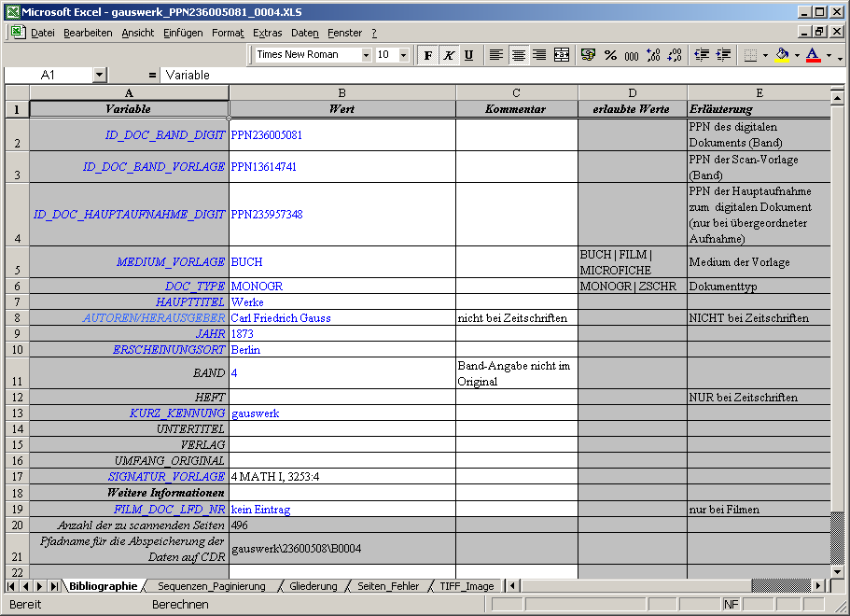
Excel spreadsheet – bibliographic information
on
Monograph
level

Slide 17
Excel spreadsheet – pagination information
Columns A and C:
counted pages start and end, logical page numbers
Columns D and E:
uncounted pages start and end
Columns M and N:
calculated physical page numbers

Slide 18
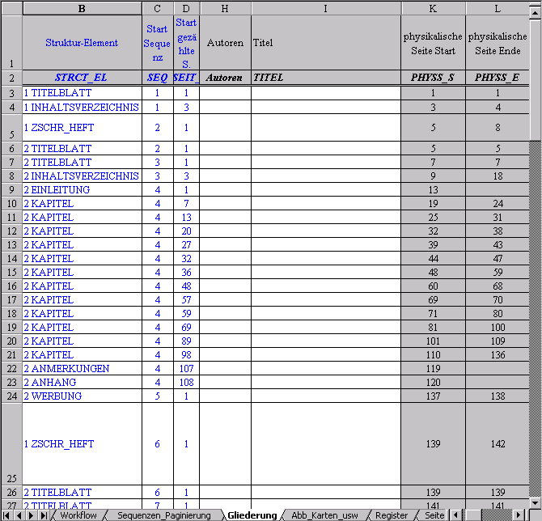
Excel spreadsheet – structural information
Column B:
type of structure element
Columns C and D:
start location of strucutre element (sequence and page)
Columns H and I:
Author and Title of structure element

Slide 19
Excel spreadsheet:
Conversion of content to XML-file using a visual basic script
RDF-XML based file

Slide 20
Excel spreadsheet:
Conversion of content to XML-file using a visual basic script
RDF-XML based file
Conversion of content
to METS using JAVA (POI library)
METS file
still in beta-test

Slide 21
AGORA Editor
Commercial program
Structural and bibliographic metadata
Images are displayed during capturing
Pagination information
is captured „automatically“

Slide 22
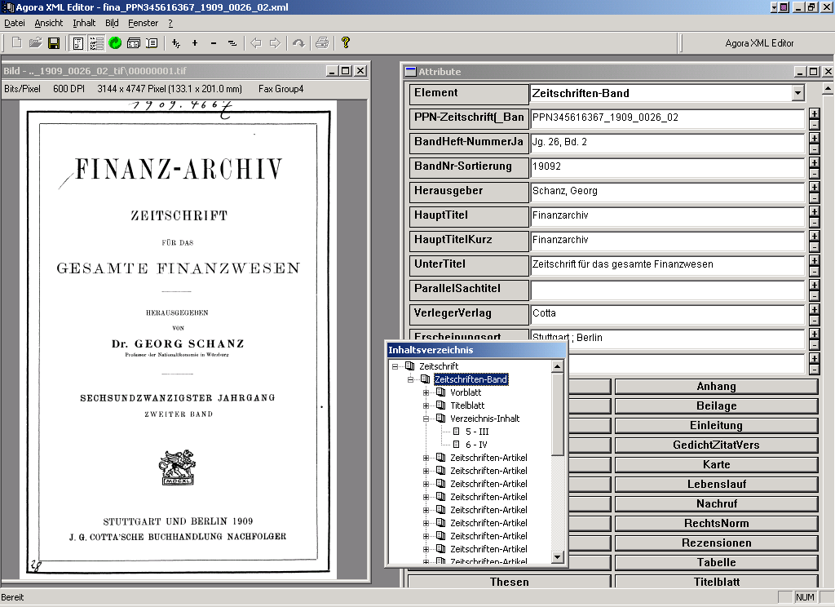
AGORA Editor

Slide 23
AGORA Editor
Writes RDF/XML based file
Converted to METS using Java program

Slide 24
Production (Metadata & fulltext)
docWorks
Software by CCS
Structure data,
Metadata
and fulltext
Direct METS output (no conversion necessary)
Testing started in june

Slide 25
Production
METS:
Only docWorks has direct METS output
For other solutions:
Java program will convert output to METS
Excel -> METS
RDF/XML -> METS
Can be used to migrate old data to METS

Slide 26
Management
and Presentation
Document Management System
One platform for all digitization projects
Development began in 1998
Defining own RDF/XML based format
Cooperation with external company:
„Satz-Rechen-Zentrum“, Berlin

Slide 27
Document
Management System “AGORA”
Java based server
Windows Administration client
Java based system; uses relational database
Verity search engine for:
metadata
fulltext

Slide 28
Document
Management System “AGORA”
Data storage:
Metadata, Structure data and fulltext
in relation database
Images stored in file-system

Slide 29
Document
Management System “AGORA”
Import:
RDF/XML files (metadata; structure)
Image data from file system
TEI/XML for fulltext (stored in database)
METS support in August-release
Batch-import possible (hotfolder)

Slide 30
Document
Management System “AGORA”
Access:
Web-Frontend
HTML Templates (webmacro)
XML-output possible (via webmacro)
Caching of HTML pages -> high performance

Slide 31
Document
Management System “AGORA”
Access:
Web-Frontend
www.webmacro.org
HTML Templates (webmacro)
XML-output possible (via webmacro)
Caching of HTML pages -> high performance

Slide 32
Document
Management System “AGORA”
Access:
Web-Frontend
HTML Templates (webmacro)
XML-output possible (via webmacro)
Caching of HTML pages -> high performance

Slide 33
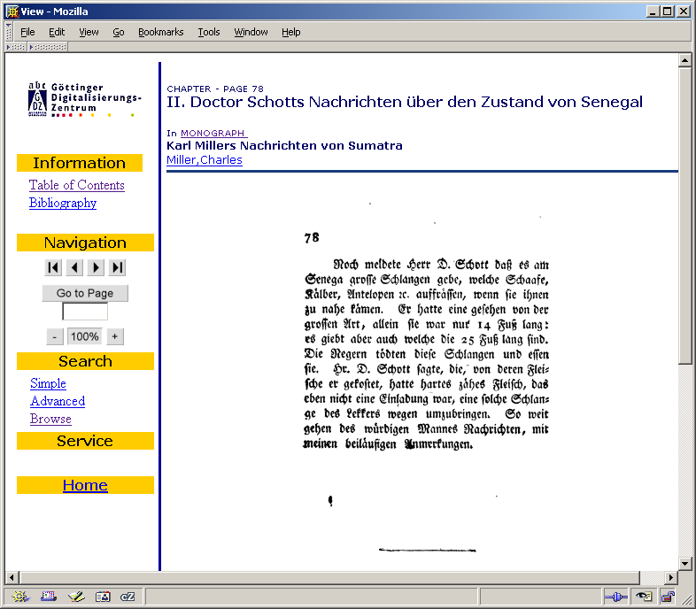
DMS
“AGORA”
Page view:
zoom with
on-the fly
conversion
of images

Slide 34
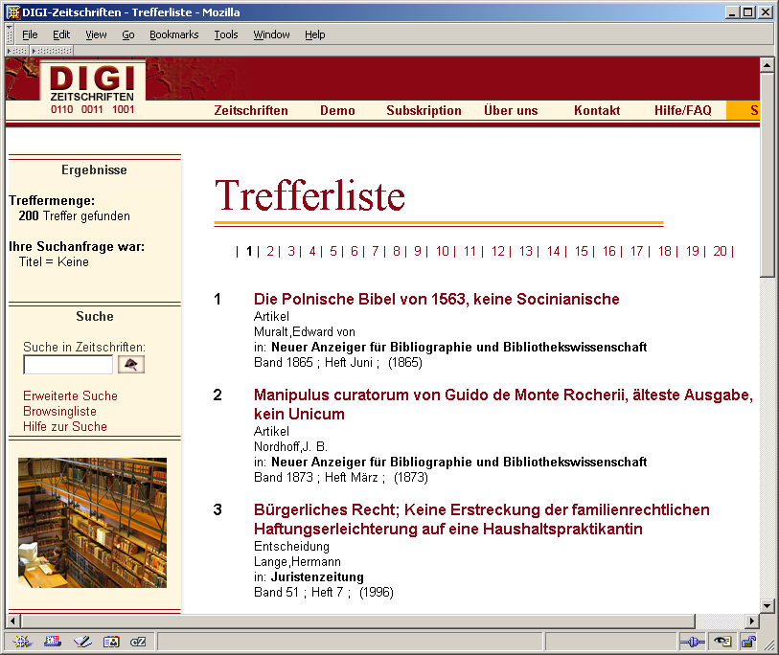
DMS
“AGORA”
Hitlist:

Slide 35
DMS
“AGORA”
Hitlist:
Image
highlighting
possible
(fulltext search)

Slide 36
Document
Management System “AGORA”
Access:
JAVA API
Full functionality available:
Add, update, read and delete elements
retrieval
OAI-PMH implementation based on API

Slide 37
Document
Management System “AGORA”
Export:
XML export (with images)

Slide 38
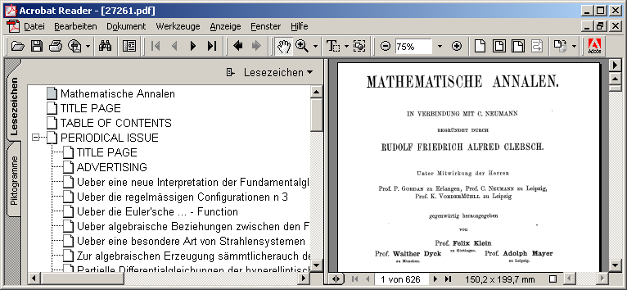
Document
Management System “AGORA”
PDF-Export – logical structure as bookmarks:

Slide 39
Future document model
Logical struture
Monograph, chapters, articles etc...
Physical structure
Pages, columns...
Descriptive Metadata
Technical Metadata
for images: NISO / MIX
Fulltext
Derivates of content files (images)

Slide 40
Future document model
Metadata production line (using METS)
docWorks
AGORA Editor
METS Converter
AGORA DMS
Archive

Slide 41
Further information
GDZ
http://gdz.sub.uni-goettingen.de
DigiZeitschriften (example)
http://www.digizeitschriften.de
AGORA
http://www.agora.de

