Slide 1
Creating METS files in the Oxford Digital Library
Richard Gartner

Slide 2
The ODL and its rationale
Integrate all digital library projects within a single framework, which means a single metadata framework!
Images
ODL
Legacy projects
Text
Multimedia

Slide 3
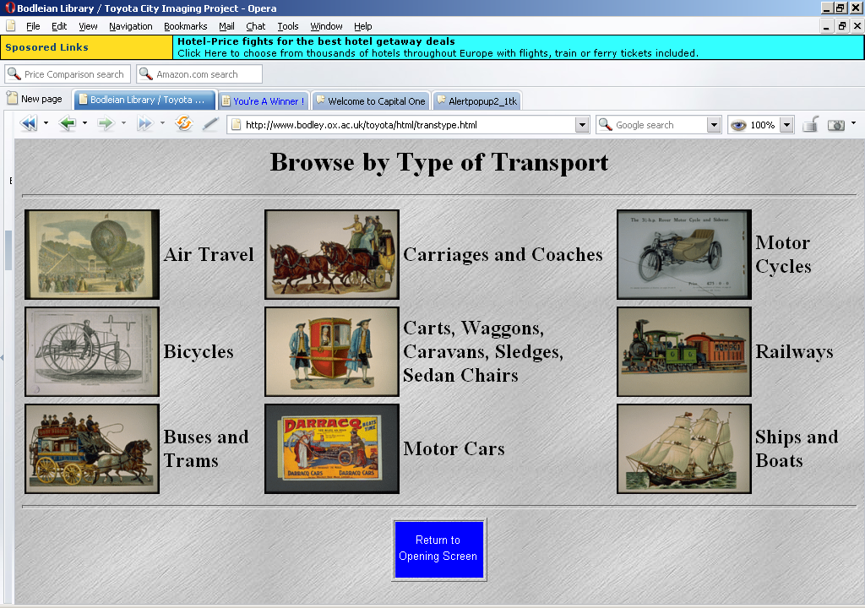
Previous approaches to metadata at Oxford
SGML (TEI and plain text files)

Slide 4
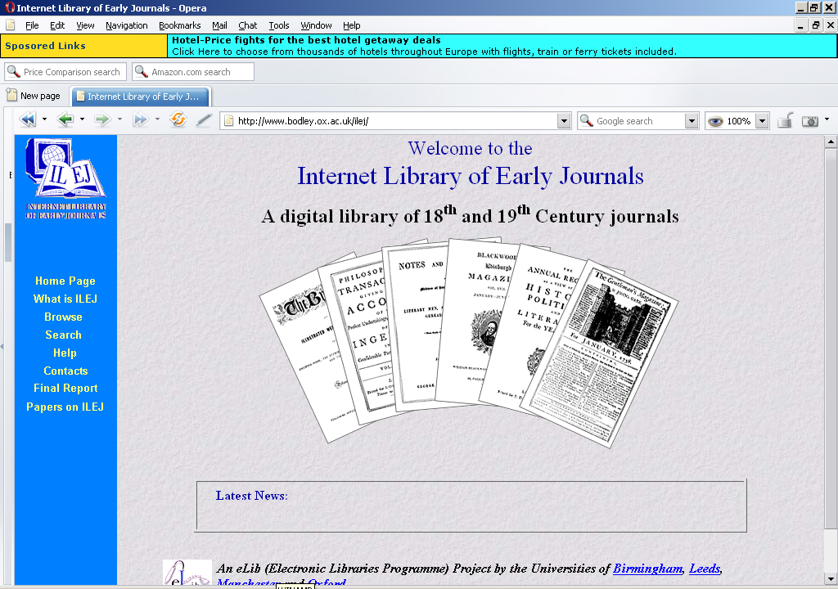
Previous approaches to metadata at Oxford
SGML (TEI and EAD)

Slide 5
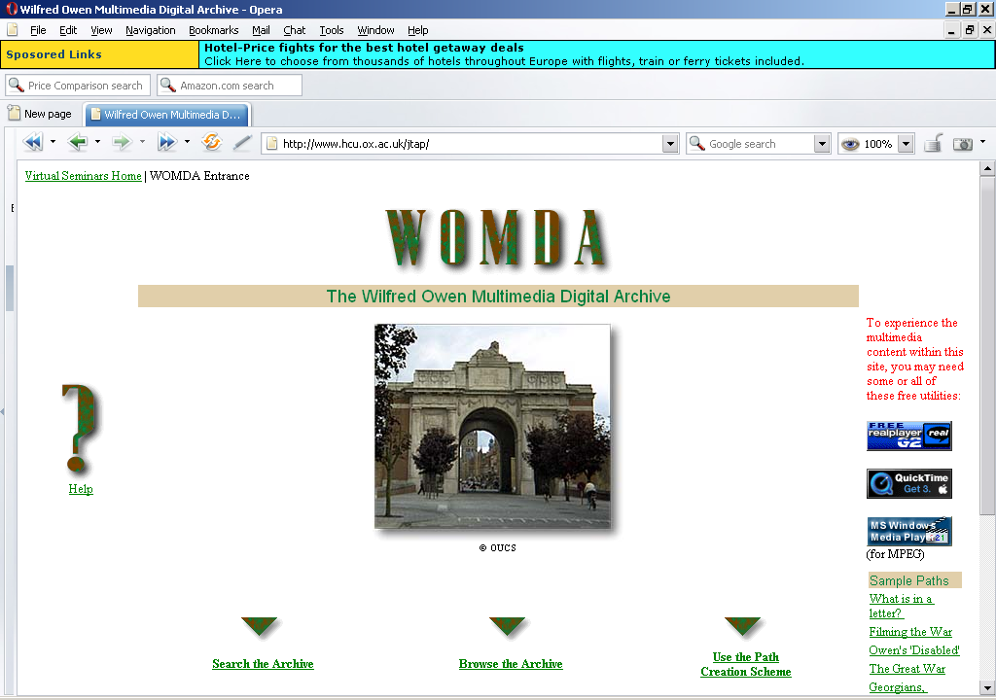
Previous approaches to metadata at Oxford
SGML (modified TEI)

Slide 6
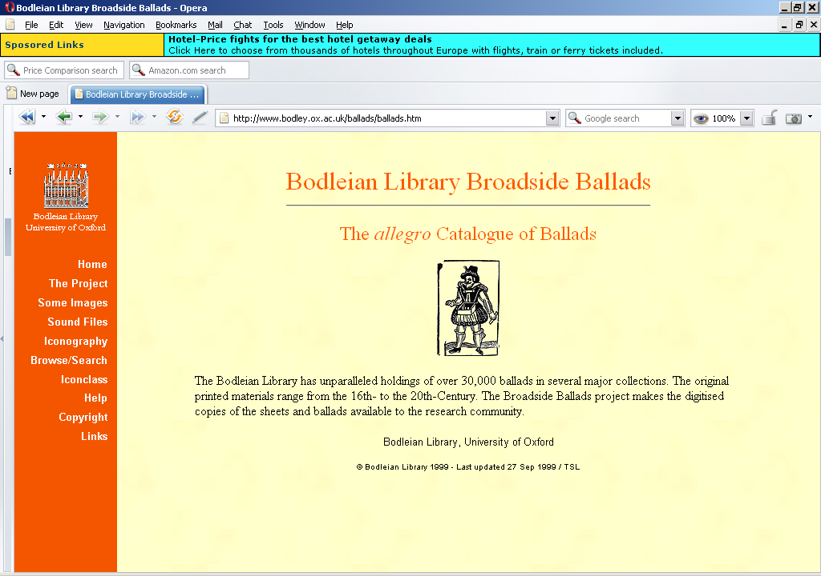
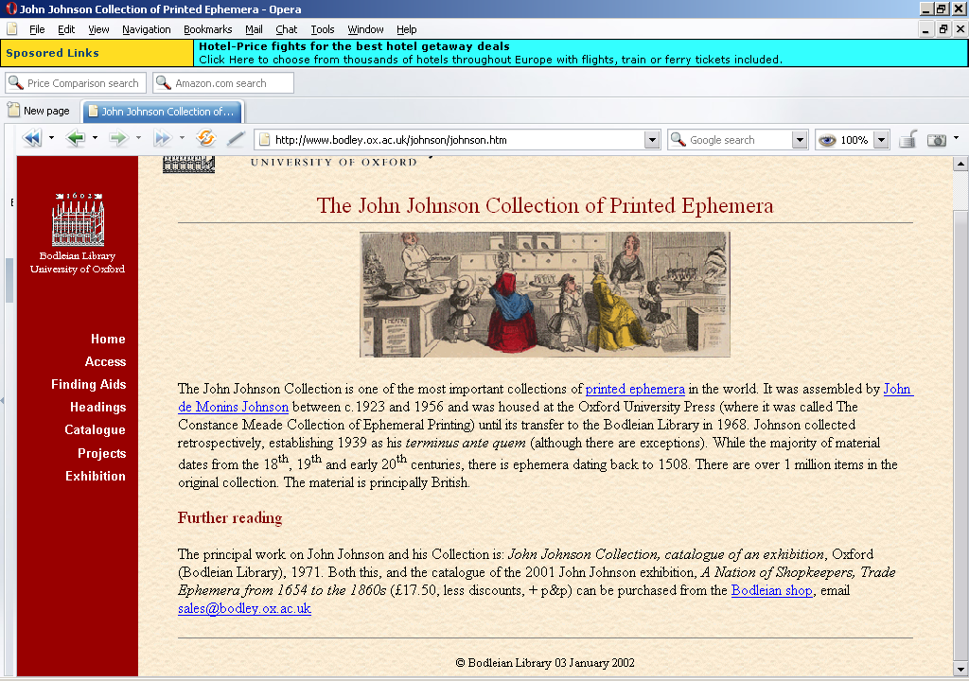
Previous approaches to metadata at Oxford
Home grown database fields using Allegro

Slide 7
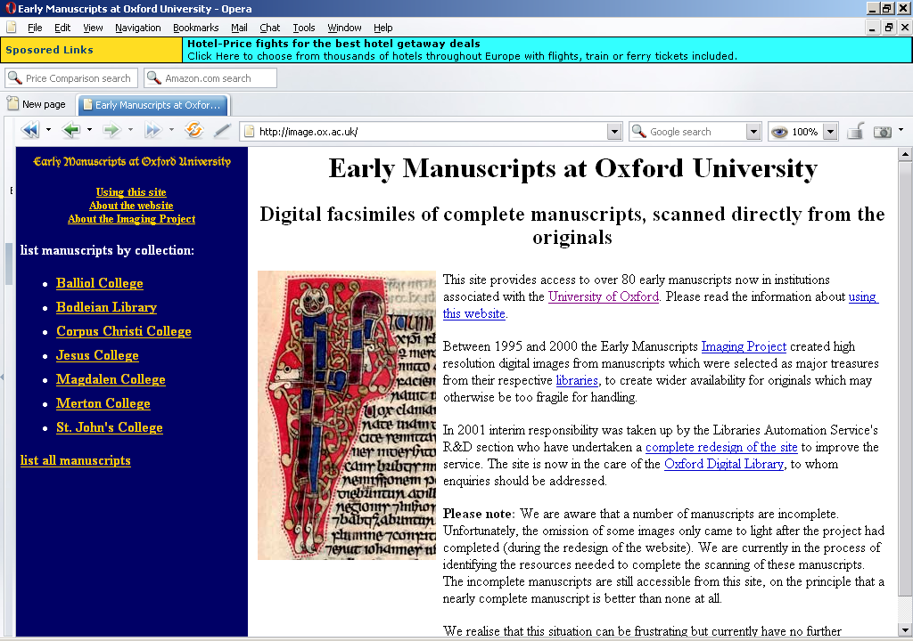
Previous approaches to metadata at Oxford
Initially HTML, latterly home-grown XML

Slide 8


What's wrong with this?
Multiple interfaces
No cross-searching
No cross-browsing
The hassle of maintaing multiple delivery systems
No name authorities, or common subject access
No integration with our online catalogue (hybrid library? - forget it!)
A headache!

Slide 9
METS in Oxford
A single METS profile for all projects, extended if necessary for facets of new projects, but always backwards compatible
Uses MODS for descriptive metadata, and home- designed DTD for administrative metadata (will move to MIX sometime)
Integrates TEI files (following TEI in Libraries Guidelines) for full-text objects

Slide 10
Creating METS objects
Webform interface using php and mySql to create basic METS files, which can then be amended to incorporate full-text etc.
Each project allocated a nine-character ID which is used for every object and component, and all METS IDs

Slide 11
IDs in the ODL
munahi010
Filenames
METS files: munahi010-aaa.xml
Image files: munahi010-aaa-0001-3.tif
TEI files: munahi010-aaa-TEI.xml
Directory structure: all data and
metadata for a project in a single directory tree
All IDs within
METS files

Slide 12
<METS OBJID="munahi010-aab">
<dmdSec ID="munahi010-aab-dmd-0001">
<amdSec ID="munahi010-aab-amd-0001">
<techMD ID="munahi010-aab-tmd-0001-0">
<fileGrp ID="munahi010-aab-fgrp-0002">
<file GROUPID="0" ID="munahi010-aab-0002-0">
<div ID="munahi010-aab-div.1">
<div ID="munahi010-aab-div.1.1">

Slide 13
The MySql backend
aaaaaa
aaaaab
munahi010
politi001
modpol001

Slide 14
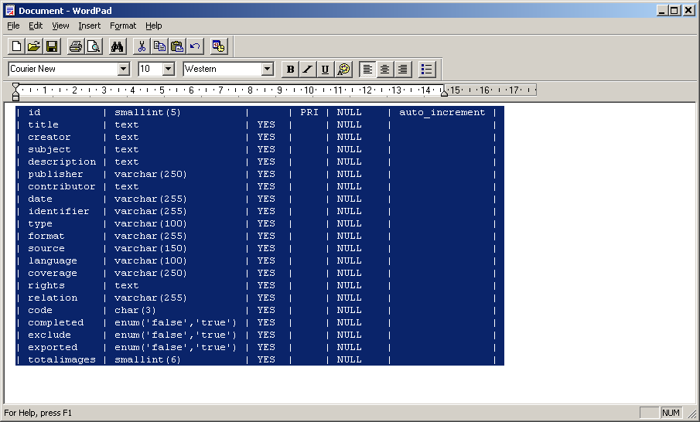

Slide 15
The MySql backend
aaaaaa
aaaaab
munahi010
politi001
modpol001
munahi010aaa
munahi010aab
munahi010aac

Slide 16
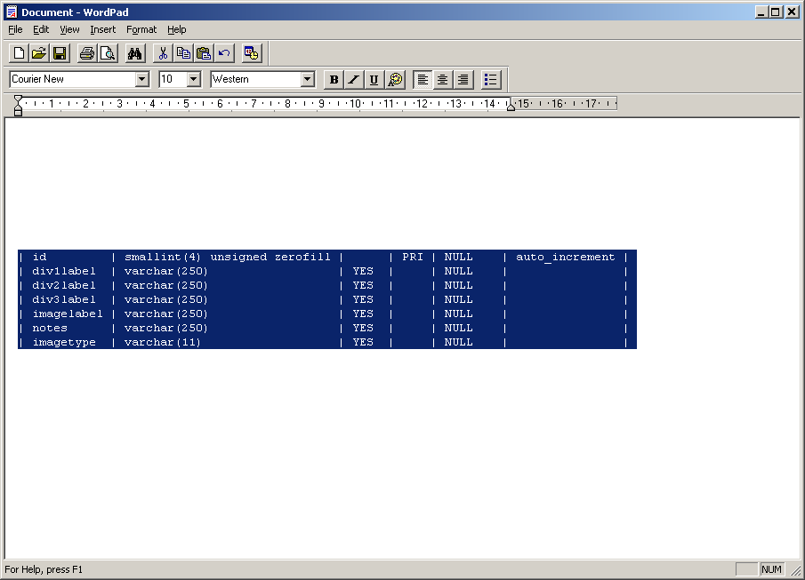

Slide 17
Further information
http://www.odl.ox.ac.uk
http://www2.odl.ox.ac.uk/guidelines
http://www2.odl.ox.ac.uk/guidelines/odl-mets-profile.xml
richard.gartner@sers.ox.ac.uk

