Slide 1
docWORKS/METAe
The Engine for Automated Metadata Extraction and XML Tagging
Claus Gravenhorst
Content Conversion Specialists

Slide 2
CCS – Offices
What is docWORKS/METAe?
Production tool for conversion of printed documents into fully tagged digital objects
The METAe edition of docWORKS is the result of the EU-funded project METAe
Start of project: September 2000
End of project: August 2003
Product launch: March 2003, CeBIT exhibition

Slide 3
CCS – Offices
The project group
Leopold-Franzens-Universität Innsbruck (Co-ordinator), Austria
Universität Linz, Institut für Angewandte Informatik, University of Linz, Austria
Mitcom Neue Medien GmbH (ABBYY Europe), Germany
CCS Compact Computer Systeme, Germany
Universidad de Alicante, Spain
Friedrich-Ebert-Stiftung, Germany
Cornell University Library. Department of Preservation and Conservation, USA
Bibliothèque nationale de France
The National Library of Norway, Rana division, Norway
Biblioteca Statale A. Baldini, Italy
Dipartimento di Sistemi e Informatica, University of Florence, Italy
Karl-Franzens-Universität Graz, Universitätsbibliothek, Austria
Scuola Normale Superiore, Centro di Ricerche Informatiche per i Beni Culturali, Italy
Higher Education Digitisation Service HEDS, UK

Slide 4
CCS – Offices
Challenges
Digitization and retro-conversion of printed or textual material is getting more and more important:
Keep knowledge and cultural heritage alive
Preserve the origin
Enable quick and enhanced access by high structured documents
Open up new dimensions of research
Provide standardized output formats

Slide 5
CCS – Offices
Goals
Automate the conversion process
Make digitization more effective and safer
Increase the added value of digitized collections
Provide a standardized output format in order to allow transformation of metadata into various applications and systems

Slide 6
CCS – Offices
docWORKS – System Overview
Input
docWORKS engine
Output
Scanning
Image Pre-Processing
Correction
METS/ALTO
METS/TEI
PDF
TIFF, JPEG
document
Layout Analysis
Import
Character Recognition
Export
Structural Analysis
Rules
DB

Slide 7
CCS – Offices
docWORKS – recording as much metadata as possible!
 | Available data | Descriptive metadata | Administra- tive metadata | Structural metadata - logical | Structural metadata - physical
Formats | Library records, e.g. MARC TIFF Images | METS DC or MODS linking to catalogue record | METS incl. NISO (mix) | METS Structural map | ALTO (Analyzed Layout and Text Object)
docWORKS engine | Import of subsets, linking to record | Creates descriptive records for articles, pictures,… | Records metadata | Suggests labels of logical elements and structures | Provides suggestion for physical structure
User mode | Automated | Semi- automated Correction recommended | Fully- automated after defining a profile | Automated Correction recommended | Automated Correction in special cases

Slide 8
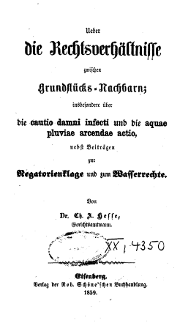
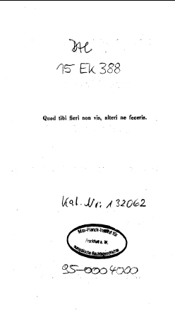
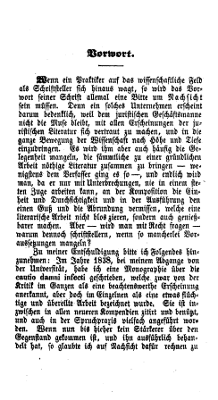
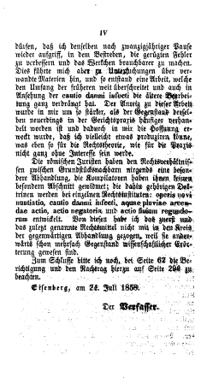
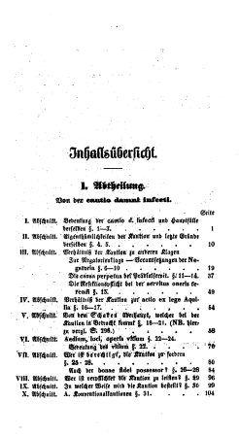
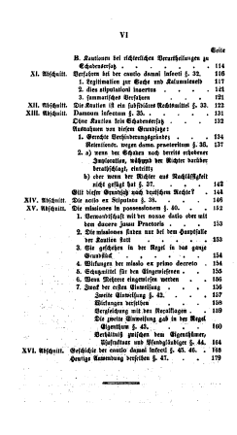
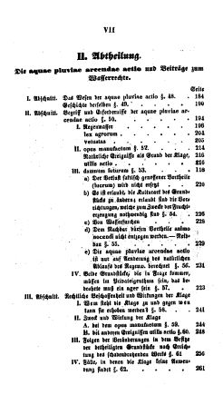
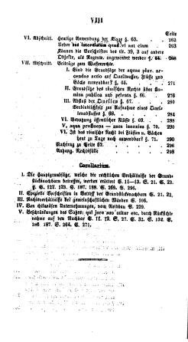
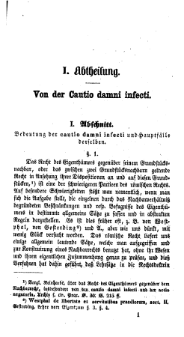
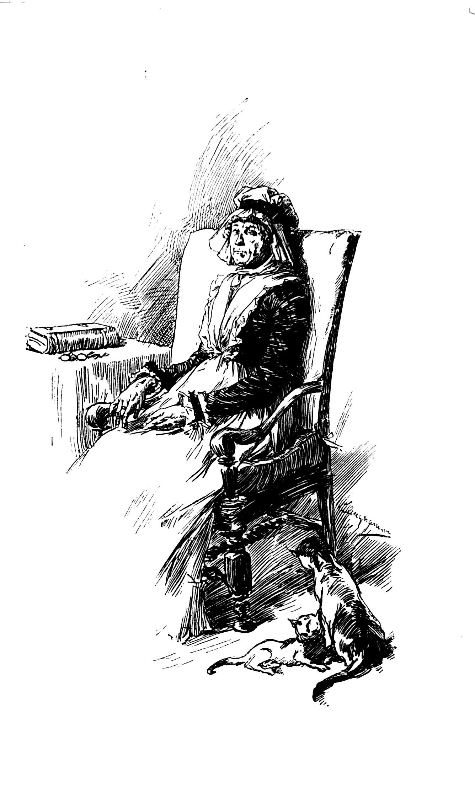
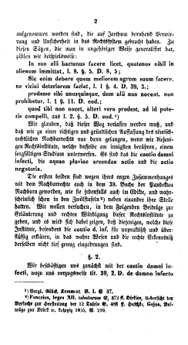
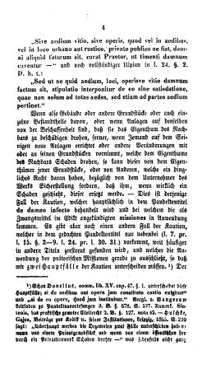

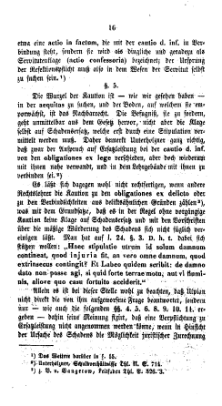
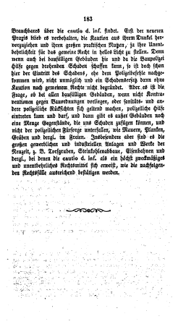
CCS – Offices
docWORKS – Matching of Image Files and Page Numbers
Image-file | Pagination | Page-Number
000001.tif | Not counted | Np
000002.tif | Not counted | Np
000003.tif | Counted | I
000004.tif | Counted | II
000005.tif | Counted | III
000006.tif | Counted | IV
000007.tif | Counted | V
000008.tif | Counted | VI
000009.tif | Counted | 1
000010.tif | Counted, not paginated | (2)
000011.tif | Counted | 3
000012.tif | Counted | 4
placeholder | Missing page | 5
placeholder | Missing page | 6
000013.tif | Counted | 7
000014.tif | Counted | 8

Slide 9
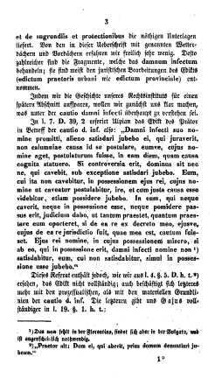
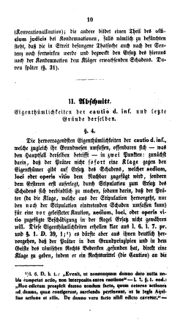
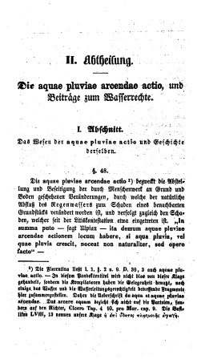
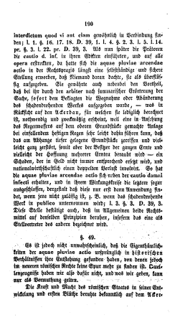
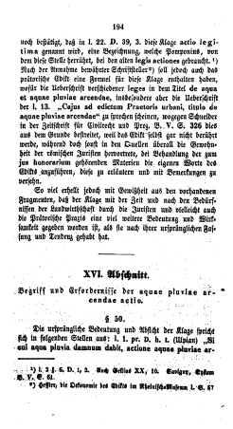
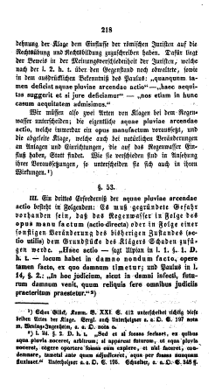
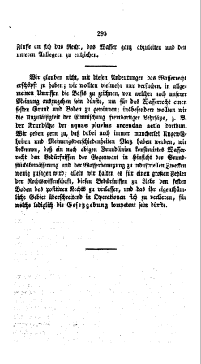
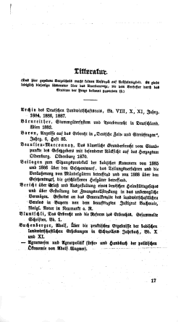
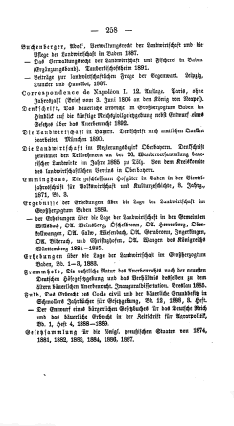
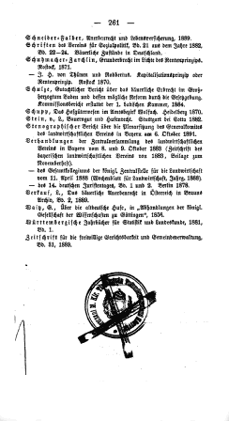
CCS – Offices
docWORKS – Structural Analysis
FRONT
MAIN
BACK

Slide 10
CCS – Offices
docWORKS – Structural Analysis
Subchapter 1
Subchapter 2
Chapter 1
Chapter 2

Slide 11
CCS – Offices
docWORKS – Structural Analysis
Preface
Title
page
Statement page
Table of contents

Slide 12
CCS – Offices
docWORKS – Document layers
Various document layers are differentiated automatically and while using certain levels enable well directed searches as well as the presentation of electronic text without unnecessary items
Body text independently from its presentation
Margin notes, footnotes
Pictures and captions
Advertisement
Annex and supplements
Navigation layer: Table of contents, running title, document index , page number, volume index
Book: Separation of „intellectual“ and „artifical“ content

Slide 13
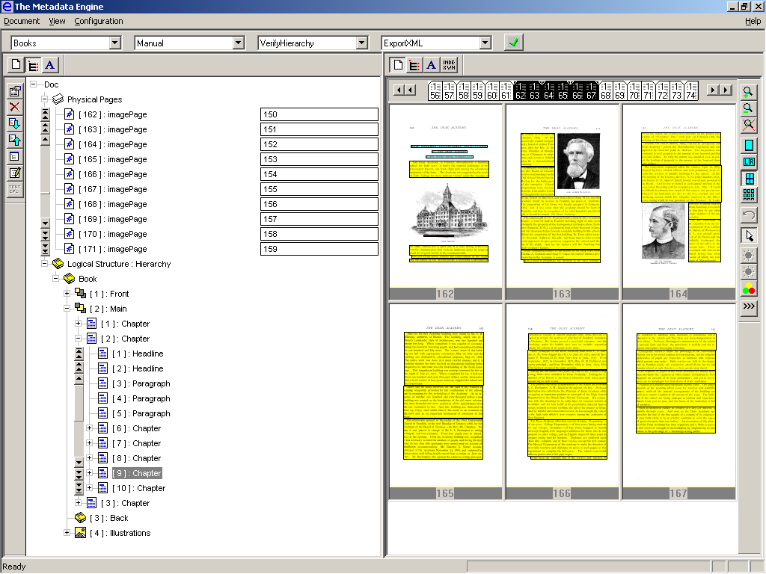
CCS – Offices
docWORKS – Digitization of books and journals (METAe)

Slide 14
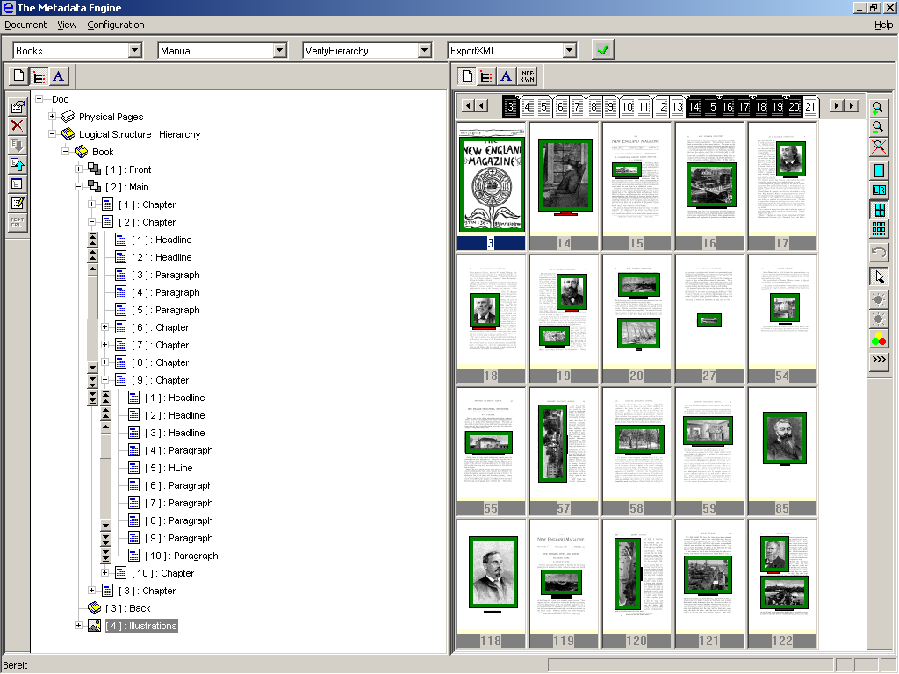
CCS – Offices
docWORKS – Digitization of books and journals (METAe)

Slide 15
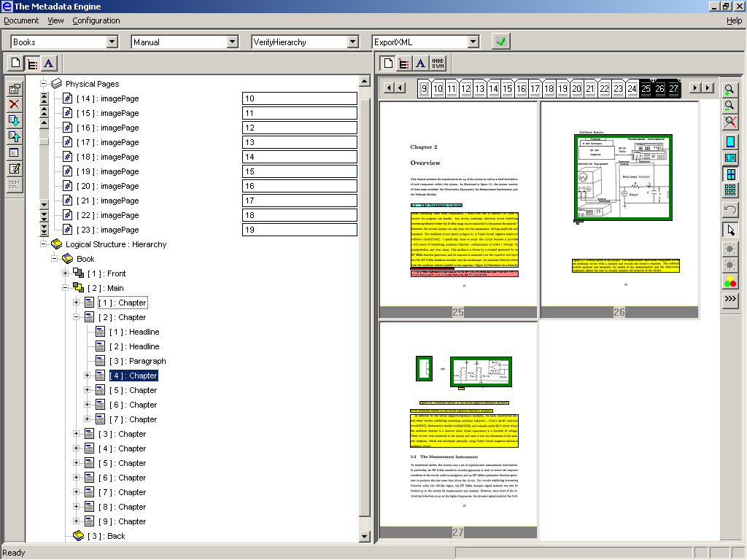
CCS – Offices
docWORKS – Digitization of scientific documents

Slide 16
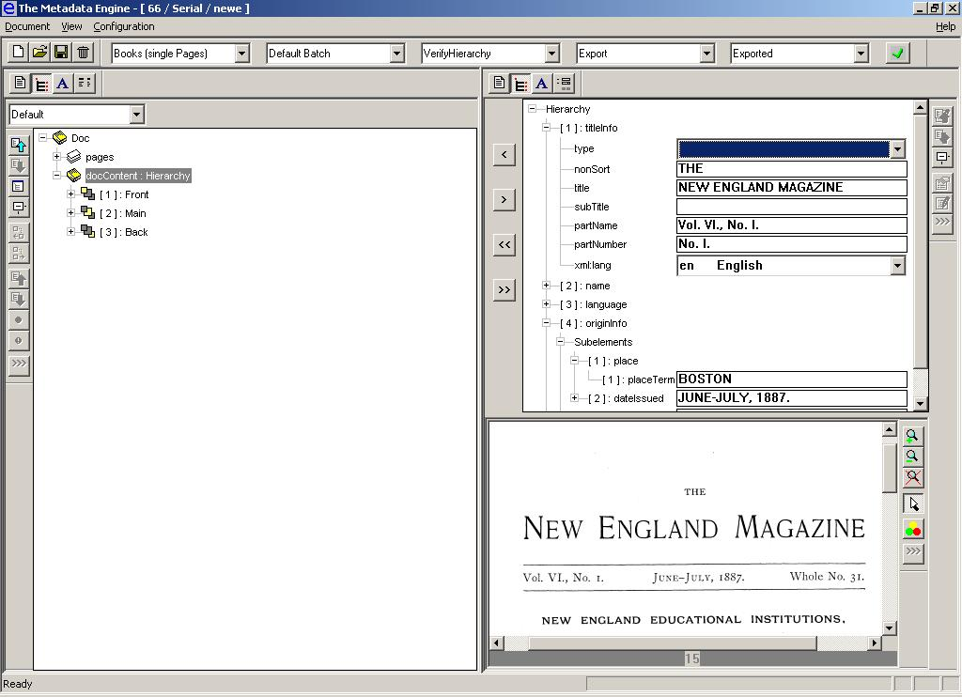
CCS – Offices
docWORKS – Manual editing of descriptive metadata / volume

Slide 17
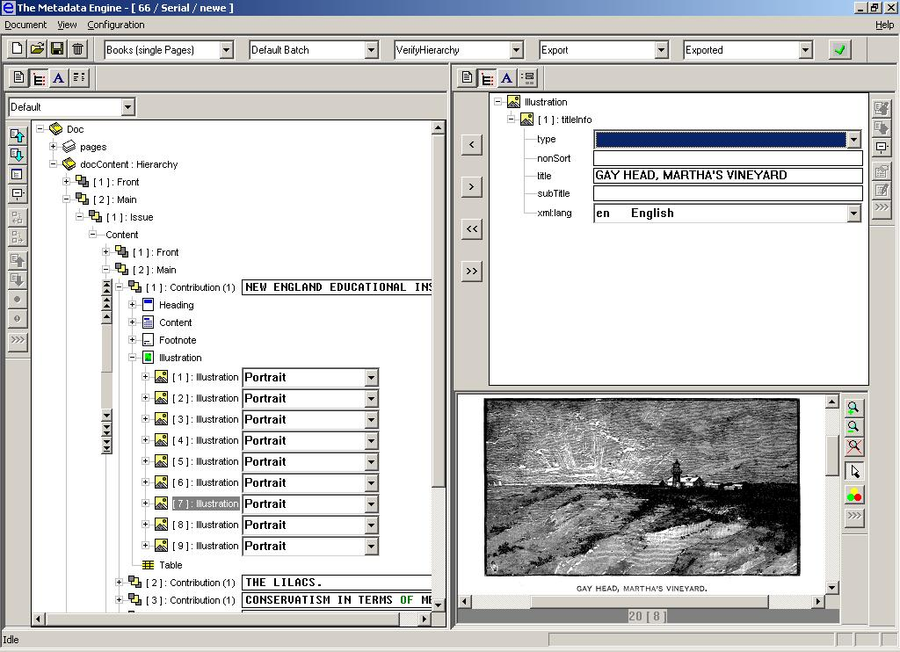
CCS – Offices
docWORKS – Manual editing of descriptive metadata / illustration

Slide 18
CCS – Offices
docWORKS – Basic Workflow
Digitization
Scanning
Quality Control
Images
Conversion
Quality Control
Output
Export
Presentation
XML/METS
PDF
DB
OPAC
MARC

Slide 19
CCS – Offices
docWORKS – Scalable Client / Server architecture
Server 1
Server 2
Server 3
....
Server n
Auto-Import
Image Preprocessing
Layout Analysis
OCR
Structural Analysis
Export
Scan
Import
Quality
Control

Slide 20
CCS – Offices
docWORKS – METS / ALTO
document
METS
TIFF
ALTO
ALTO – Analyzed Layout and Text Object

Slide 21
CCS – Offices
docWORKS – METS
Header
MODS or DC, descriptive metadata
NISO 39.087 (mix), technical metadata
Structural Map: Physical Structure
Structural Map: Logical Structure

Slide 22
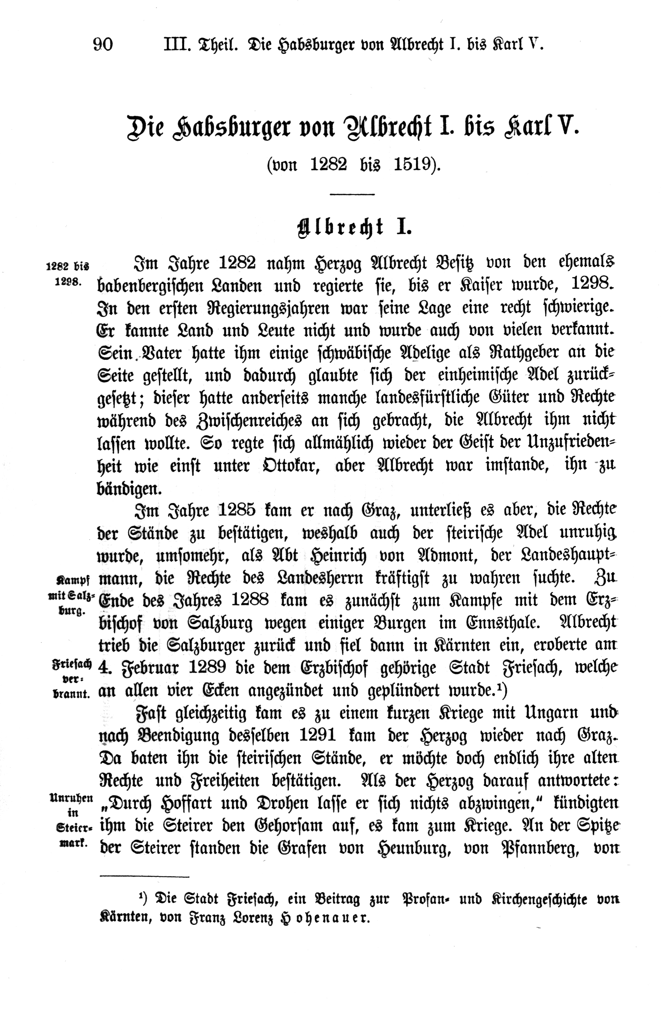
CCS – Offices
docWORKS – ALTO
Styles
- Paragraph (alignment, linespacing, etc.)
- Font (name, size, bold, italic, etc.)
Layout
- Printspace
- TopMargin
- InnerMargin
- OuterMargin
- BottomMargin
Objects in 5 areas above:
- Text block
- Text lines
- Strings [coordinates, string (as
printed), substitution (hyphenation)]
- Spaces
- Composed block
- Picture
- Table
- Formula

Slide 23
CCS – Offices
docWORKS – METS / physical structure
METS
DC
DC
FILEGRP
ORDER
1
2
3
4
5
6
7
8
9
10
11
12
13
14
15
16
…
LABEL
II
III
IV
V
VI
2
3
4
5
6
…
ORDERLABEL
I
II
III
IV
V
VI
1
2
3
4
5
6
…
FILEGRP
PHYS
PHYS
LOGICAL
LOGICAL

Slide 24
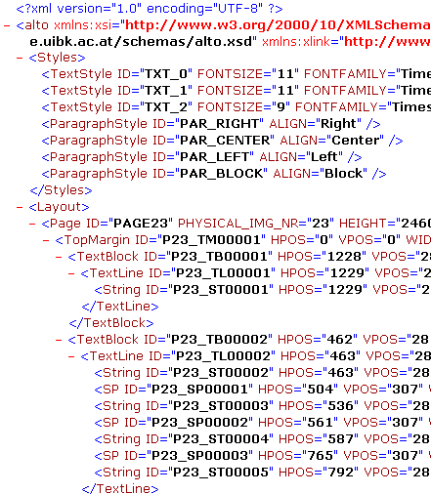
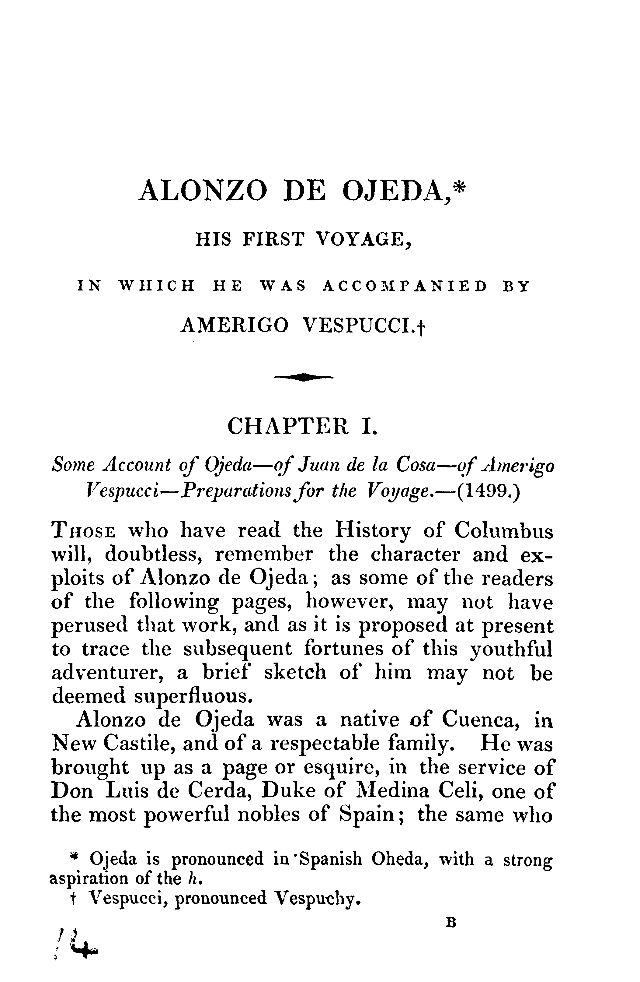
CCS – Offices
docWORKS – METS / physical structure
METS
DC
ALTO
FILEGRP
PHYS
DIV
(page)
FILEID
par
FILEID
fptr
fptr
IMAGE
LOGICAL

Slide 25
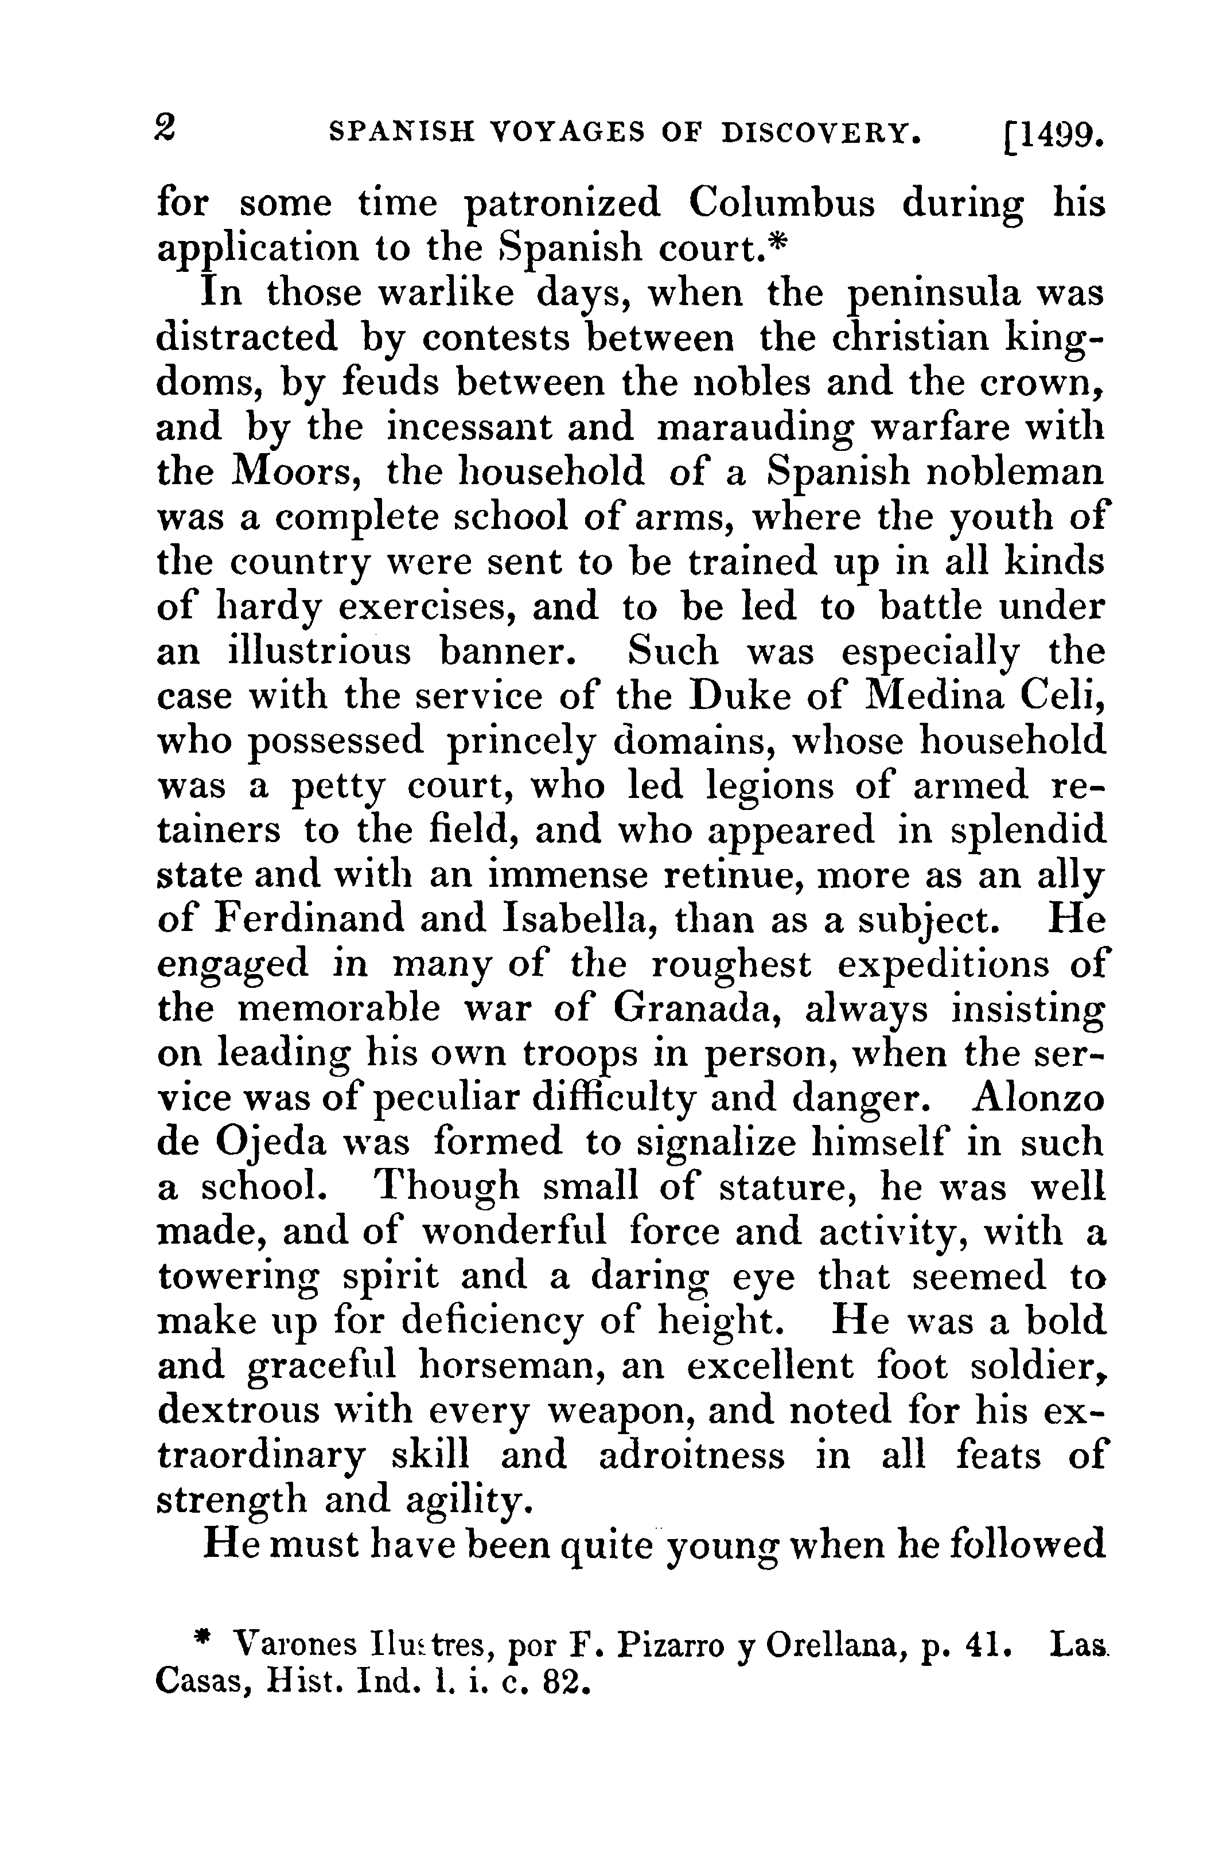
CCS – Offices
docWORKS – METS / logical structure
METS
DC
FILEID
ALTO
FILEGRP
text block
PHYS
Coordinates
LOGICAL
FILEID
DIV
(volume)
FILEID
DCMD_PHYS
DCMD_ELEC
FILEID
DIV
(issue)
ALTO
DCMD_ISSUE#
DIV
(contrib.)
Coordinates
DCMD_#CONT#
text block
DIV
(chapter)
DCMD_CHAP#
BEGIN
DIV
(paragraph)
seq
BEGIN
XSLT
XSLT
fptr
fptr
Those who have read the History of Columbus will, doubtless, remember the character and exploits ...

Slide 26
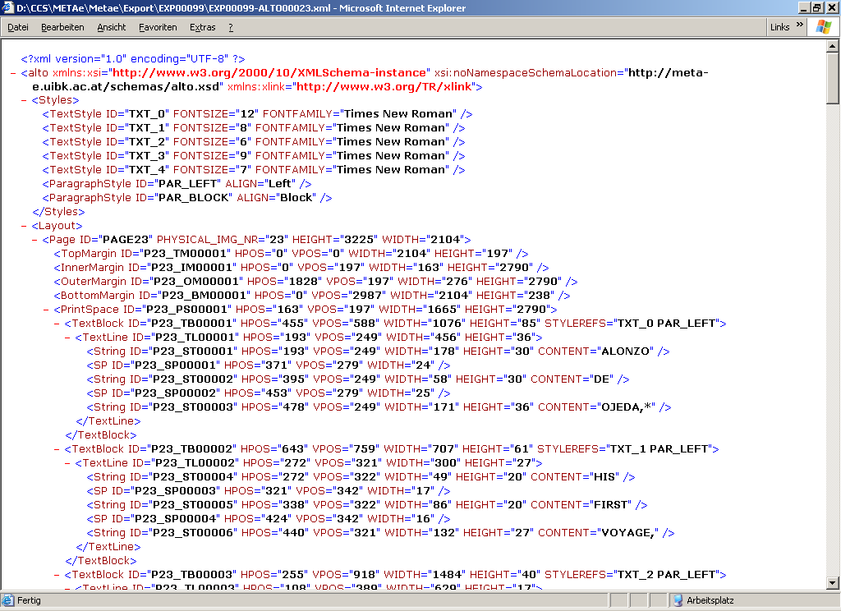
CCS – Offices
docWORKS – ALTO / page layout and text content

Slide 27
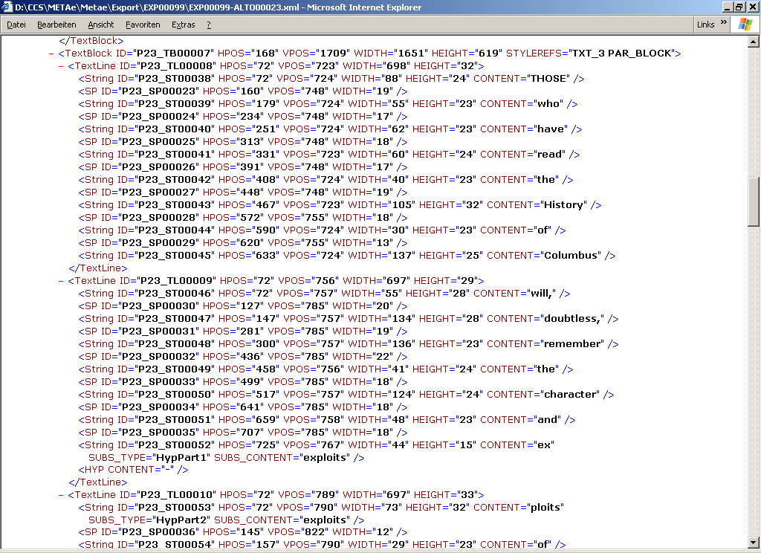
CCS – Offices
docWORKS – ALTO / hyphenated word

Slide 28
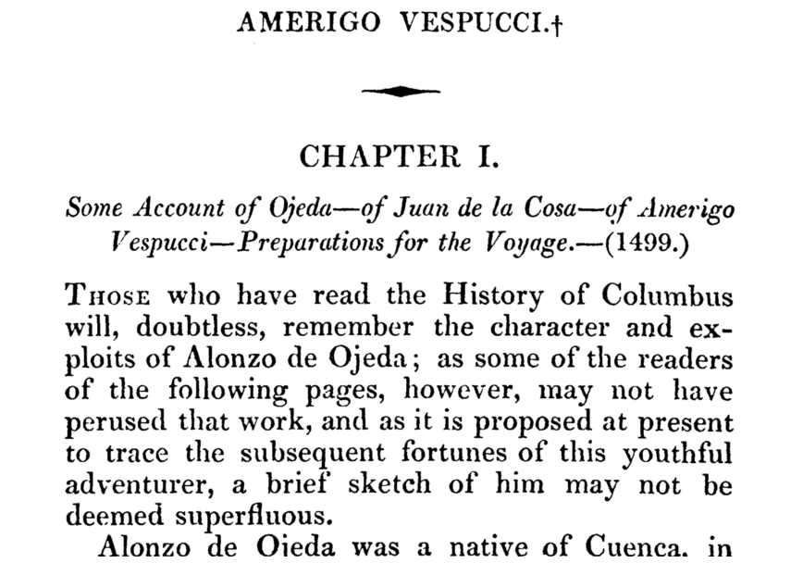
CCS – Offices
docWORKS – ALTO / hyphenated word

Slide 29
CCS – Offices
docWORKS – Workshop UK 2004
University Library of Southampton
September 28/29, free of charge
1st day
Product information
Output, metadata standards
Workflow, use cases
2nd day
„Hands on“ – Working with your own samples
Individual consultancy sessions
Contact
Simon Brackenbury - s.c.brackenbury@soton.ac.uk
Hartmut Janczikowski - hartmut.janczikowski@ccs-gmbh.de

Slide 30
CCS – Offices
Thank you!
Claus Gravenhorst
claus.gravenhorst@ccs-gmbh.de
Content Conversion Specialists
www.ccs-gmbh.de
http://meta-e.uibk.ac.at/

