Slide 1

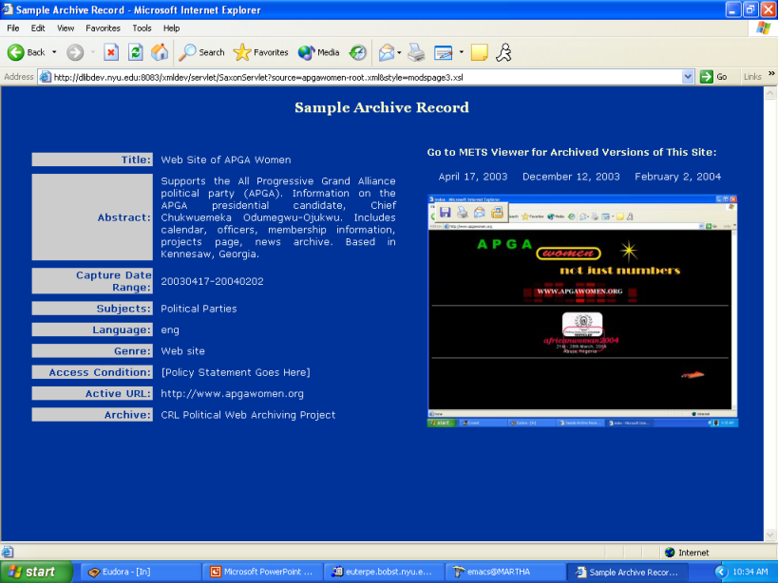
Case Study: Using METS as a DIP to Navigate Archived Websites
Leslie Myrick, NYU
METS Opening Day / UK
The British Library
12 July, 2004

Slide 2
Political Communications Web Archive Project (PCWA)
Under auspices of CRL and Mellon
Participants: Cornell University, Stanford University, UT Austin, NYU
Focus: SE Asia, Sub-Saharan Africa, Latin America, Western Europe
Radical political born-digital “ephemera”
Content: Internet Archive (.arc files)

Slide 3
Today’s Topics
Background: challenges of web archiving
How METS can address some of these challenges
How to construct a METS website object
How METS instances can be used to control and navigate website objects in an archive

Slide 4
Basic METS Recipe
fileSec
structMap
structLink
dmdSec
amdSec

Slide 5
Web Archiving Challenges I:
Definition and Taxonomy
Definition of the object “website” and its boundaries
  what to do with external links? “near files”?
Complex nature of website structure
  which structure?
Complex “symphonic” nature of a web page itself

Slide 6
<METS:fileSec>

Slide 7
File inventory
<METS:fileSec>
<METS:fileGrp>
<METS:file ID="FID18" MIMETYPE=" text/html" ADMID="ADM1">
<METS:FLocat LOCTYPE="URL" xlink:href="www.apgawomen.org/" />
</METS:file>
<METS:file ID="FID113" MIMETYPE="text/html” ADMID="ADM2">
<METS:FLocat LOCTYPE="URL" xlink:href="www.apgawomen.org/officers.htm" />
</METS:file>
<METS:file ID="FID120" MIMETYPE="text/html” ADMID="ADM3">
<METS:FLocat LOCTYPE="URL" xlink:href="www.apgawomen.org/calender.htm" />
</METS:file>
<METS:file ID="FID154" MIMETYPE="text/html" ADMID="ADM4">
<METS:FLocat LOCTYPE="URL" xlink:href="www.apgawomen.org/newsarchives.htm" />
</METS:file>
<METS:file ID="FID1059" MIMETYPE="text/html" ADMID="ADM5">
<METS:FLocat LOCTYPE="URL" xlink:href="www.apgawomen.org/home.htm" />
</METS:file>
,,,
</<METS:fileGrp>
</METS:fileSec>

Slide 8
<METS:structMap>

Slide 9
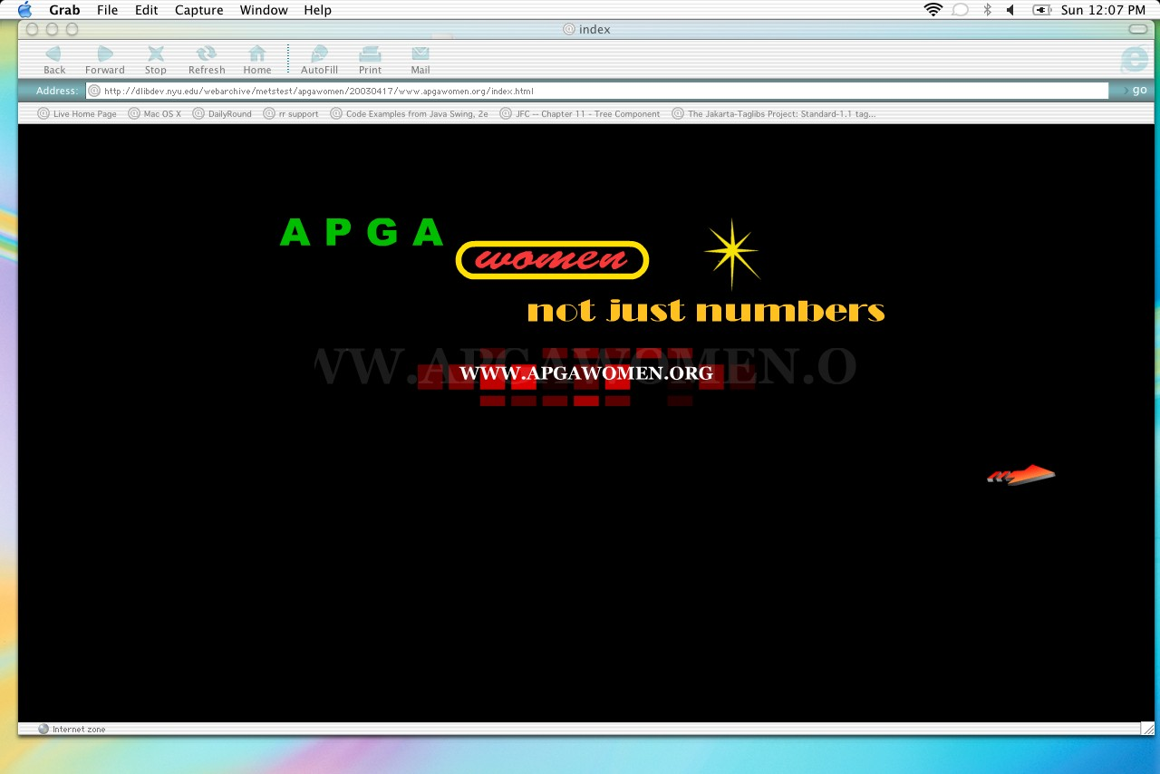

Slide 10
<html>
<head><title>index</title><meta http-equiv="Content-Type" content="text/html; charset=iso-8859-1"></head>
<body bgcolor="#000000">
<table width="100%">
<tr><td>
<div align="center"><object classid="clsid:D27CDB6E-AE6D-11cf-96B8-444553540000" codebase="http://download.macromedia.com/pub/shockwave/cabs/flash/swflash.cab#version=4,0,2,0" width="700" height="150">
<embed src="notjust.swf" quality=high pluginspage="http://www.macromedia.com/shockwave/download/index.cgi?P1_Prod_Version=ShockwaveFlash" type="application/x-shockwave-flash" width="700" height="150">
</embed>
</object></div>
</td></tr>
</table>
<table width="100%">
<tr> <td>
<div align="center"><object classid="clsid:D27CDB6E-AE6D-11cf-96B8-444553540000" codebase="http://download.macromedia.com/pub/shockwave/cabs/flash/swflash.cab#version=4,0,2,0" width="600" height="64">
<embed src="apgawnew.swf" quality=high pluginspage="http://www.macromedia.com/shockwave/download/index.cgi?P1_Prod_Version=ShockwaveFlash" type="application/x-shockwave-flash" width="600" height="64">
</embed>
</object></div>
</td> </tr>
</table>
<p>&nbsp;</p><div align="center"> <table width="85%">
<tr><td>
<div align="right"><a href="home.htm"><img src="enterarrow.gif" width="80" height="27" border="0"></a></div>
</td></tr>
</table>
</div>
</body>
</html>

Slide 11
METS structMap view of an HTML page
HTML wrapper around embedded files and hyperlinks:
<div> for the HTML page
<fptr>
<par>
<area>for page + each embedded “parallel” element -- .css, .js, images etc.
(with ID-IDREF to file ID in fileSec)
<div> for each (internal) hyperlinked page

Slide 12
<METS:div DMDID="DM1" TYPE="web page" ID="page18"
LABEL="http://dlibdev.nyu.edu/webarchive/metstest/www.apgawomen.org/index.html ">
<METS:fptr>
<METS:par>
<METS:area FILEID="FID18"/> [index.html ]
<METS:area FILEID="FID1036"/> [notjust.swf]
<METS:area FILEID="FID1043"/> [apgawnew.swf]
<METS:area FILEID="FID1075"/> [enterarrow.gif]
</METS:par>
</METS:fptr>
<METS:div TYPE="hyperlink" ID="LINK1" LABEL="home">
<METS:fptr>
<METS:area BEGIN="000" BETYPE="BYTE" END="111" FILEID="FID18"/>
</METS:fptr>
</METS:div>

Slide 13
METS structMap for a Website
Flattened logical tree hierarchy:
<div> entry page, “index.html”
<div> each HTML page
<div> each hyperlink to a page internal to the site

Slide 14
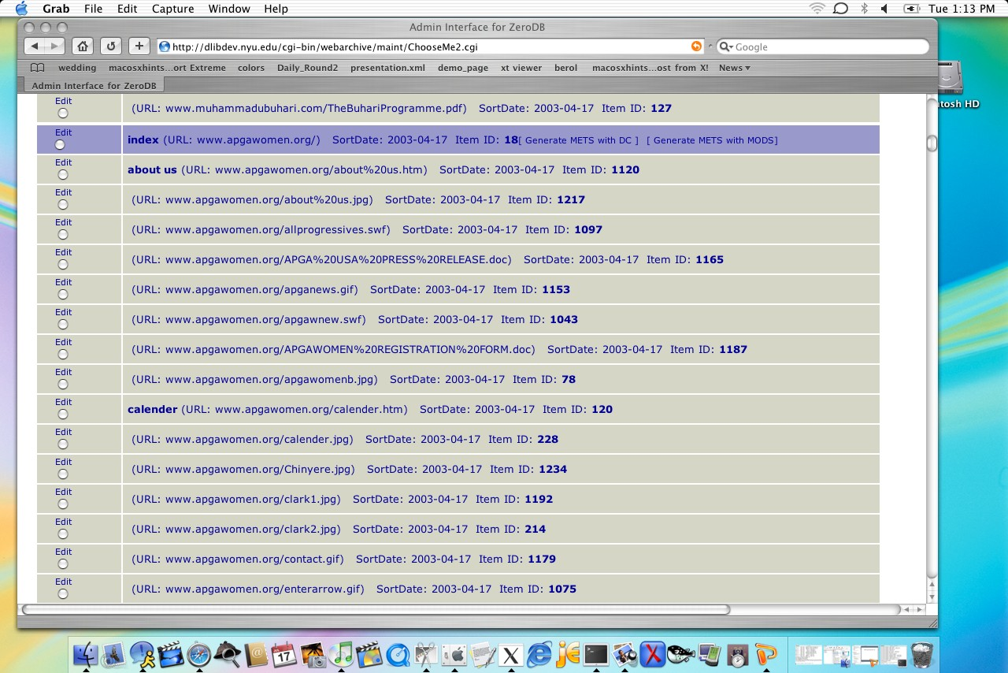
METS DB view of site structure

Slide 15
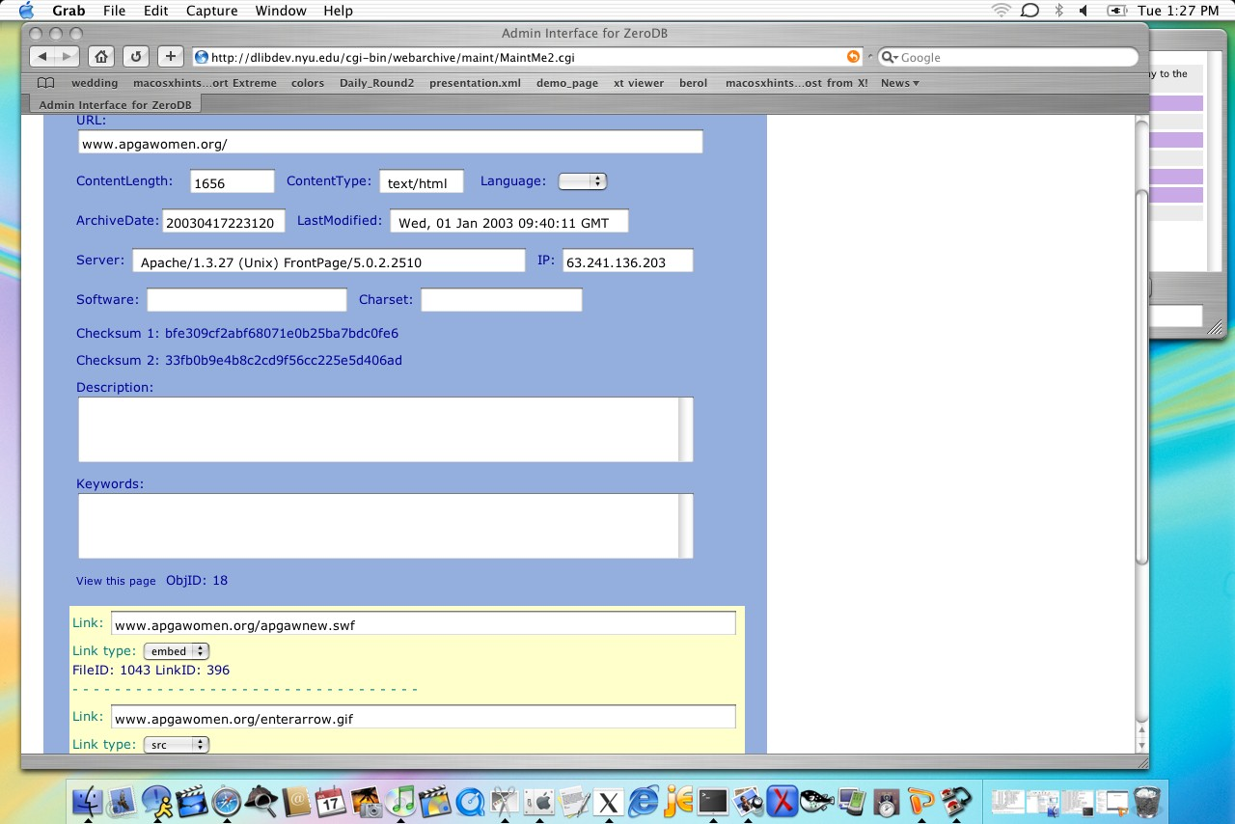
DB View of Page Structure

Slide 16
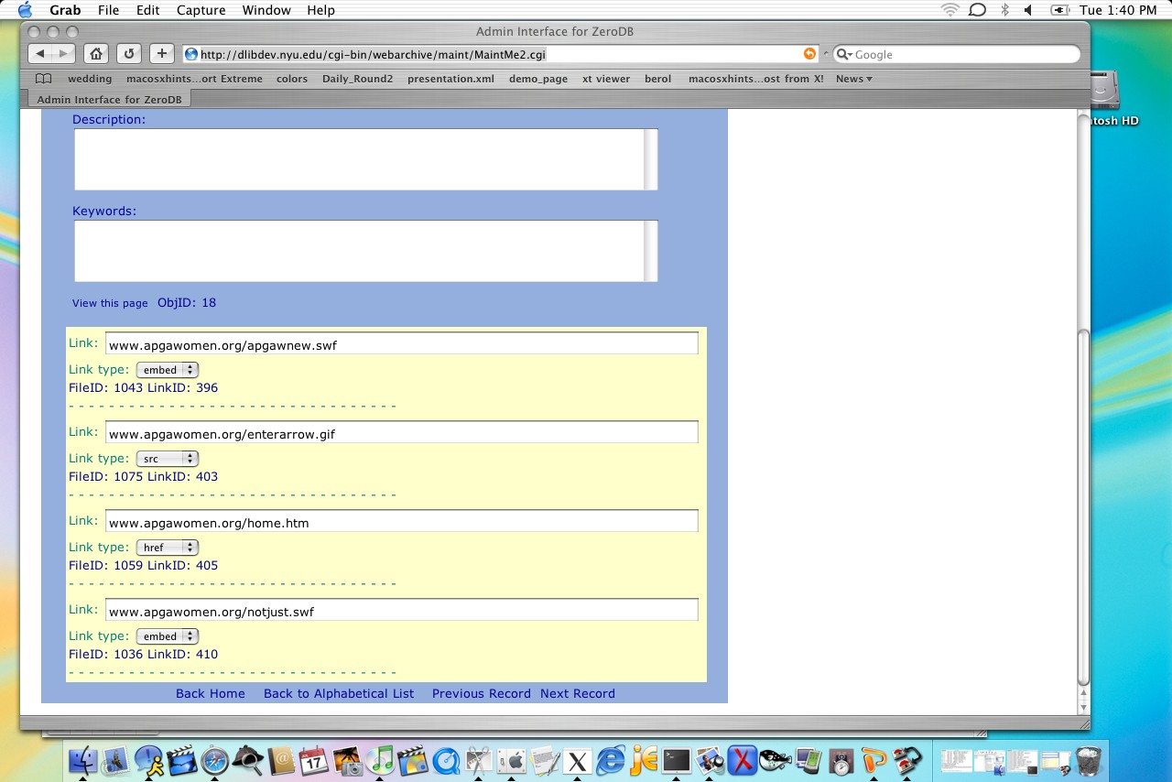
DB View of Embedded Elements

Slide 17
<METS:structLink>

Slide 18
Mapping Hyperlink Structure
<div>s (via div ID) in structMap cross-referenced to <smLink>s in structLink:
<METS:structLink>
<METS:smLink from="LINK1" to="page1059" xlink:title="home"/>
<METS:smLink from="LINK2" to="page113" xlink:title=”officers"/>
<METS:smLink from="LINK3" to="page102" xlink:title=”calendar"/>
</METS:structLink>

Slide 19
Web Archiving Challenges II:
Extracted vs Human-catalogued Metadata
Lack of influence over content production
Questionable embedded metadata from producers of web pages, e.g. <title> <meta> tags
  Technical metadata is “safe” because it can be programmatically extracted from the file itself
  Do we want to take descriptive metadata wholesale from <title>, <meta> tags?
  Really?

Slide 20
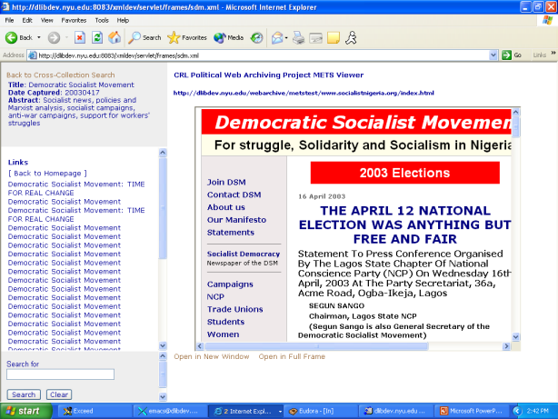

Slide 21
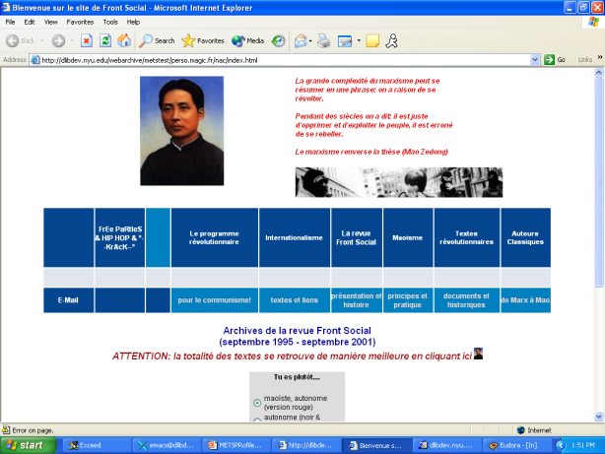
The Case of the Purloined Metadata

Slide 22
The Case of the Purloined Metadata, continued
<snip>
<HTML>
<!-- saved from url=(0041)http://www.sport.de/spart/sk1/ski006.php3 -->
<HEAD>
<TITLE>Bienvenue sur le site de Front Social</TITLE>
<META CONTENT="text/html; charset=windows-1252" HTTP-EQUIV="Content-Type">
<META CONTENT="Sport sports Baseball Basketball Beach-Volleyball Bob Boxen Bundesliga Bundesligavereine Championsleague DEL DFB DFB-Pokal Eishockey Ergebnisse Europameisterschaft Europapokal Fernsehen Football Formel1 Formel3 Fußball Golf Hallenmasters Handball Hockey Inline-Skating Leichtathletik Motorbike Motorrad Motorsport Nationalmannschaft NBA NFL NHL Reiten Rodeln Schwimmen Skifahren Skispringen Snowboard Sportarten Sportnachrichten Surfen Tennis Tischtennis Turniere Uefa-Cup US Open Vereine Volleyball Wassersport WBA WBC WBO Weltmeisterschaft Weltrangliste Wimbledon Fußball Motorsport Radsport Volleyball Sport Eishockey Skisport Boxen Handball Leichtathletik Pferdesport Schwimmen" NAME="keywords">
<META CONTENT="Sport Sportnachrichten Sportvereine Ergebnisse Tabellen Ranglisten Bundesliga DEL Formel 1 Tennis" NAME="description">
<META CONTENT="thu, 30 mar 2000 12:00:00 GMT" HTTP-EQUIV="date">
<SCRIPT language="JavaScript" SRC="sport_fichiers/sidiscript.js">
<SCRIPT language="JavaScript">
<!--
var on = "/ima/pfeil_weiss2.gif";
var off = "/ima/pfeil_weiss.gif";
</snip>

Slide 23
Whence Web Archive Metadata?
Programmatically extractable metadata provided by crawlers
  Found in logs, .arc + .dat files, files themselves
Balance to be struck between automated metadata extraction and human cataloguing (especially for descriptive metadata)

Slide 24
<METS:dmdSec>

Slide 25
Case study:
Metadata from an Alexa .arc
Typical Alexa / IA SIP = .arc and .dat files along with byte offset .ndx file
  IA .arc = 100 MB .gz archive file packed with files from web crawl along with server’s HTTP response headers for each file.

Slide 26
Typical IA .arc snippet
<snip>
[ crawler’s file header]
http://www.apgawomen.org:80/calender.htm 63.241.136.203 20030417223125 text/html 2570
[http headers]
HTTP/1.1 200 OK
Date: Thu, 17 Apr 2003 21:35:43 GMT
Server: Apache/1.3.27 (Unix) FrontPage/5.0.2.2510
Last-Modified: Sun, 26 Jan 2003 04:05:37 GMT
ETag: "3b01d2-8fb-3e335e91"
Accept-Ranges: bytes
Content-Length: 2299
Connection: close
Content-Type: text/html
[file itself]
<html>
<head>
<title>calender</title>
<meta http-equiv="Content-Type" content="text/html; charset=iso-8859-1">
</head>
<body bgcolor="#FFFFFF">
</snip>

Slide 27
What is extractable (dmdSec)?
HTTP/1.1 200 OK
Date: Thu, 17 Apr 2003 21:35:43 GMT
Server: Apache/1.3.27 (Unix) FrontPage/5.0.2.2510
Last-Modified: Sun, 26 Jan 2003 04:05:37 GMT
ETag: "3b01d2-8fb-3e335e91"
Accept-Ranges: bytes
Content-Length: 2299
Connection: close
Content-Type: text/html
<html>
<head>
<title>calender</title>
<meta http-equiv="Content-Type" content="text/html; charset=iso-8859-1">
</head>
<body bgcolor="#FFFFFF">
</snip>

Slide 28
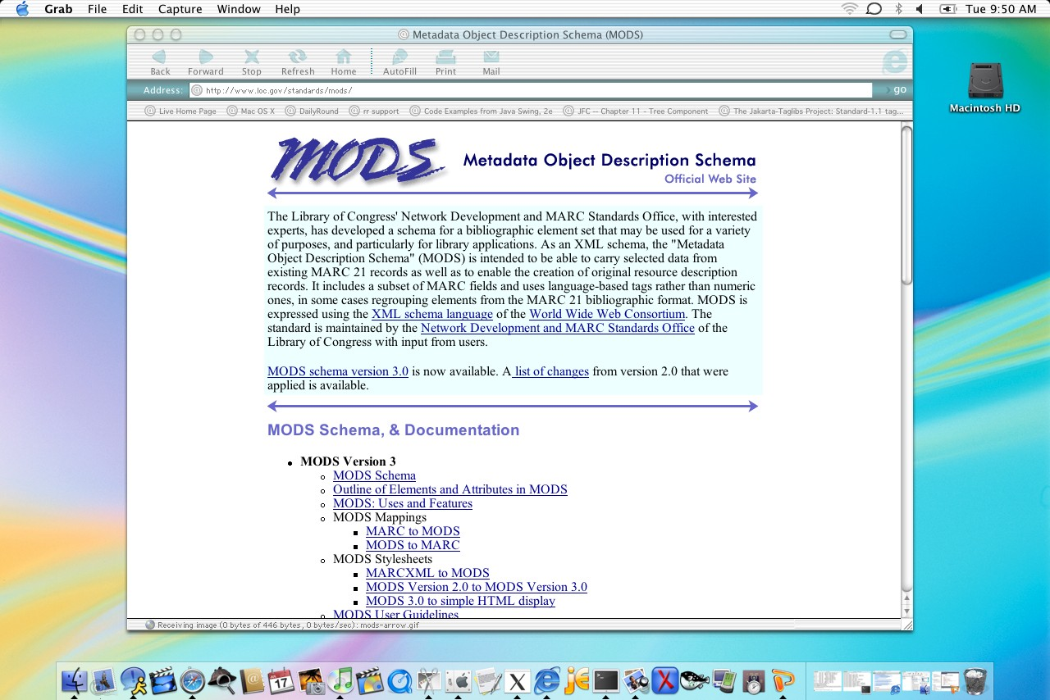
LC Metadata Object Description Schema

Slide 29
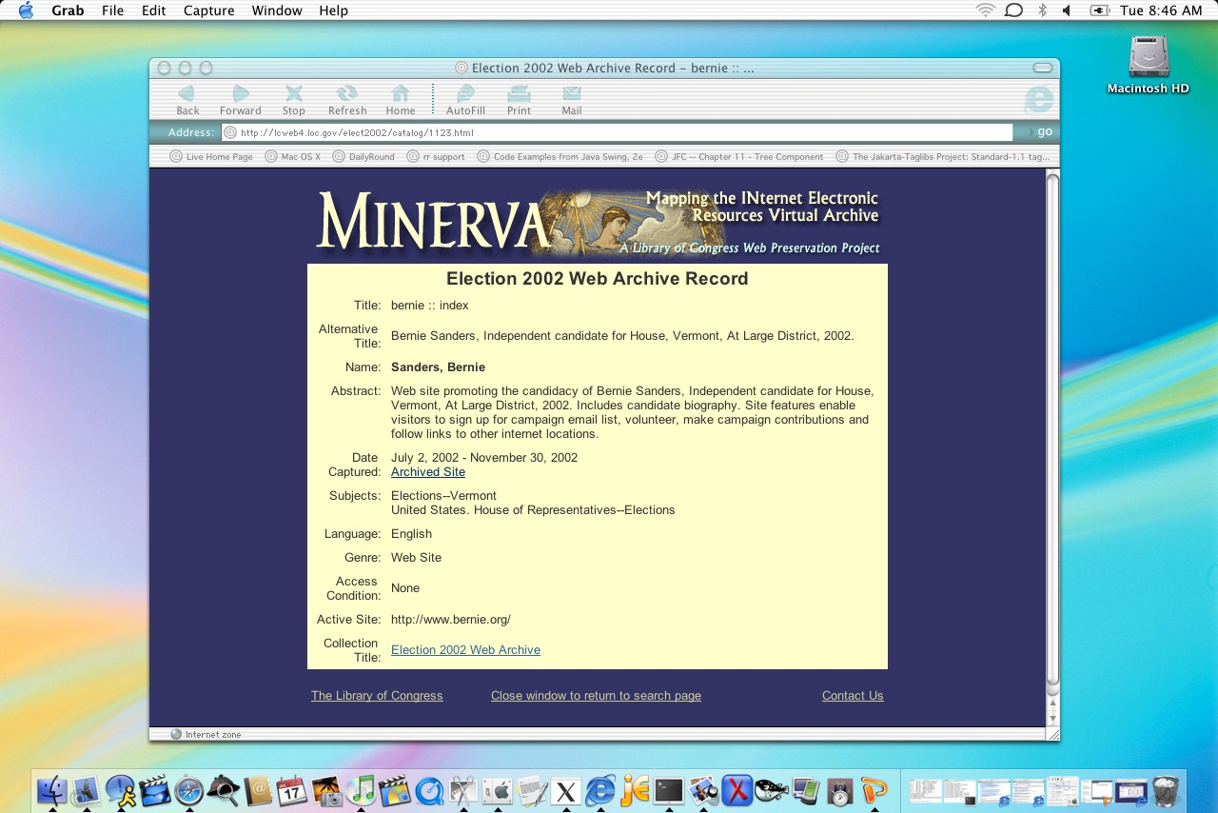
MINERVA MODS Display

Slide 30
Top-Level MODS
<mods:mods>
<mods:titleInfo>
<mods:title>Website of the APGA Women</mods:title>
</mods:titleInfo>
<mods:genre>Web site</mods:genre>
<mods:originInfo>
<mods:dateCaptured encoding="iso8601">20030417</mods:dateCaptured>
</mods:originInfo>
<mods:language authority="iso639-2b">eng</mods:language>
<mods:physicalDescription>
<mods:internetMediaType>text/html</mods:internetMediaType>
<mods:internetMediaType>image/jpg</mods:internetMediaType>
<mods:internetMediaType>image/gif</mods:internetMediaType>
<mods:internetMediaType>application/msword</mods:internetMediaType>
<mods:internetMediaType>application/x-shockwave-flash</mods:internetMediaType>
</mods:physicalDescription>
<mods:abstract>Supports the All Progressive Grand Alliance political party (APGA). Information on the APGA presidential candidate,
Chief Chukwuemeka Odumegwu-Ojukwu. Based in Kennesaw, Georgia.</mods:abstract>
<mods:subject>
<mods:topic>Political Parties</mods:topic>
<mods:geographic>Africa</mods:geographic>
<mods:geographic>Nigeria</mods:geographic>
</mods:subject>
<mods:relatedItem type="host">
<mods:titleInfo>
<mods:title>CRL Political Web Archiving Project</mods:title>
</mods:titleInfo>
<mods:identifier type="uri">http://www.crl.edu/content/PolitWeb.htm</mods:identifier>
</mods:relatedItem>
<mods:identifier displayLabel="Archived site" type="uri">http://dlibdev.nyu.edu/webarchive/metstest/apgawomen/20030417/www.agpawomen.org
/</mods:identifier>
</mods:mods>

Slide 31
Page-Level MODS
<METS:dmdSec ID="DM1">
<METS:mdWrap MDTYPE="MODS">
<METS:xmlData>
<mods:mods>
<mods:titleInfo>
<mods:title>officers</mods:title>
</mods:titleInfo>
<mods:originInfo>
<mods:dateCaptured>20030417223125</mods:dateCaptured>
</mods:originInfo>
<mods:identifier type="uri">www.apgawomen.org/officers.htm</mods:identifier>
<mods:physicalDescription>
<mods:extent>3252</mods:extent>
</mods:physicalDescription>
<mods:genre>Web page</mods:genre>
</mods:mods>
</METS:xmlData>
</METS:mdWrap>
</METS:dmdSec>

Slide 32
<METS:amdSec>
<METS:techMD>

Slide 33
Technical Metadata Sources (.arc)
Crawler frontier application
  metadata about the harvest itself, the archive file
Host server’s HTTP response headers
  metadata about the host server, files
Captured files themselves
  file headers; IPTC headers -- human input
  Post-processing with ImageMagick etc.

Slide 34
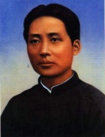
ImageMagick dump for Mao1925.jpg
Image: Mao1925.jpg
Format: JPEG (Joint Photographic Experts Group JFIF format)
Geometry: 142x185
Class: DirectClass
Type: true color
Depth: 8 bits-per-pixel component
Colors: 11423
Resolution: 300x300 pixels
Filesize: 8115b
Interlace: Plane
Background Color: grey100
Border Color: #DFDFDF
Matte Color: grey74
Iterations: 0
Compression: JPEG
signature:
8c173bd33c3e5667d27e51aee539afcd58ccbc8d4a11ab76b127408905f598fd
Tainted: False

Slide 35
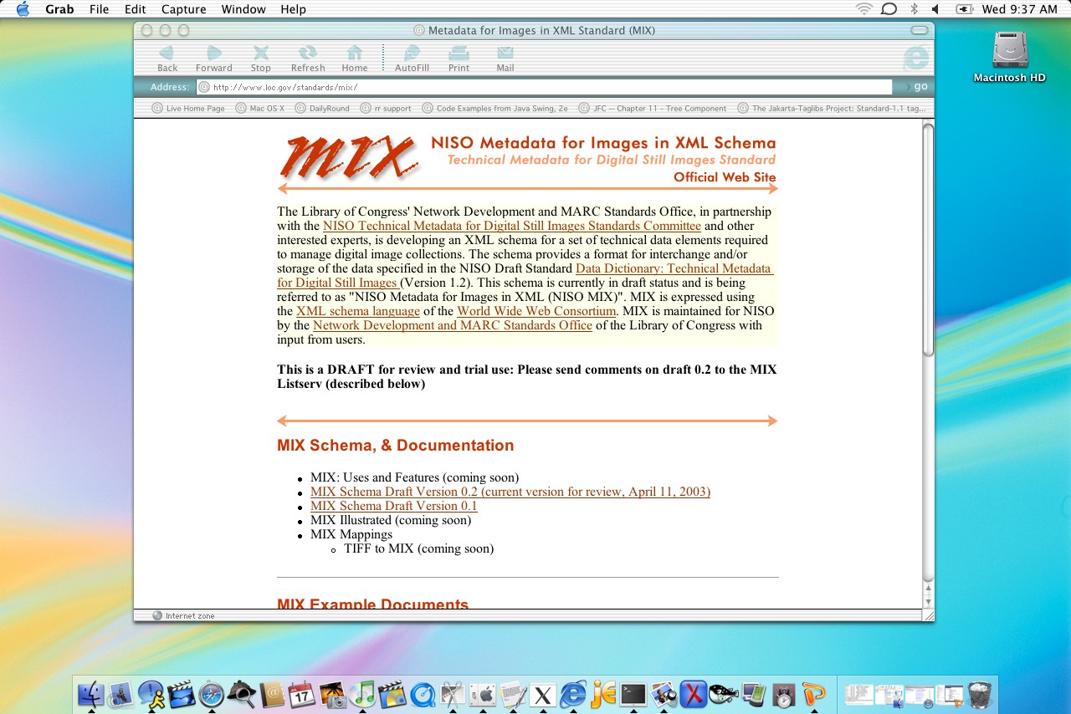
NISO Metadata for Images in XML Schema (MIX)

Slide 36
<mix:mix>
<mix:BasicImageParameters>
<mix:Format>
<mix:MIMEType>image/jpeg</mix:MIMEType>
<mix:ByteOrder>little-endian</mix:ByteOrder>
<mix:Compression>
<mix:CompressionScheme>5</mix:CompressionScheme>
<mix:CompressionLevel>0</mix:CompressionLevel>
</mix:Compression>
<mix:PhotometricInterpretation>
<mix:ColorSpace/>
</mix:PhotometricInterpretation>
</mix:Format>
<mix:File>
<mix:ImageIdentifier>perso.magic.fr/images/Mao1925.jpg</mix:ImageIdentifier>
<mix:FileSize>8115</mix:FileSize>
</mix:File>
<mix:PreferredPresentation/>
</mix:BasicImageParameters>
<mix:ImageCreation/>
<mix:ImagingPerformanceAssessment>
<mix:SpatialMetrics>
<mix:ImageWidth>142</mix:ImageWidth>
<mix:ImageLength>185</mix:ImageLength>
</mix:SpatialMetrics>
<mix:Energetics>
<mix:BitsPerSample>8</mix:BitsPerSample>
</mix:Energetics>
</mix:ImagingPerformanceAssessment>
<mix:ChangeHistory/>
</mix:mix>

Slide 37
Web Archiving Challenges III:
Structuring and Managing Versions
Version control-related storage and access issues in a continuous archive:
Creator-driven changes: successive harvests and versions
Repository-driven changes: refreshing, migration, other changes

Slide 38
Modeling Website Objects with METS in a Continuous Archive
One possibility:
Root level METS (web site X as intellectual object) with <mptr>s down to
Intermediary METS (web site X as harvested on April 17, 2003) with <mptr>s down to
Leaf node METS (single web page in web site X harvested on April 17, 2003)

Slide 39
APGA Women Websites
April 17, 2003
December 12, 2003
February 2, 2004
home
home
about
home
about
about
officers
officers
officers
news

Slide 40
APGA Women Websites
April 17, 2003
December 12, 2003
February 2, 2004

Slide 41
Aggregator / Single Capture Model
METS for top level aggregation that uses <mptr>s to point to either another intermediary aggregator or to more than one captured version of a web site.
METS for single standalone captured site, whether part of successive harvests or a one-off capture.

Slide 42
METS Website Aggregator
Contains single MODS record describing the aggregation as an intellectual object
  e.g. Election 2004; JohnKerry.com (Nov 1-10)
Contains no amdSec, fileSec or structLink
Contains a root <div> for the aggregation
  nesting <div>s with <mptr>s to each subsidiary aggregation or captured version

Slide 43
MINERVA Election 2004
Kerry
Bush
Nader
Nov 1
Nov 1
Nov 2
Nov 1
Nov 2
Nov 3
Nov 2
Nov 3
Nov 3

Slide 44
MINERVA Election 2004
November 1, 2004
November 3, 2004
November 2, 2004
Kerry
Kerry
Nader
Nader
Kerry
Nader
Bush
Bush
Bush

Slide 46
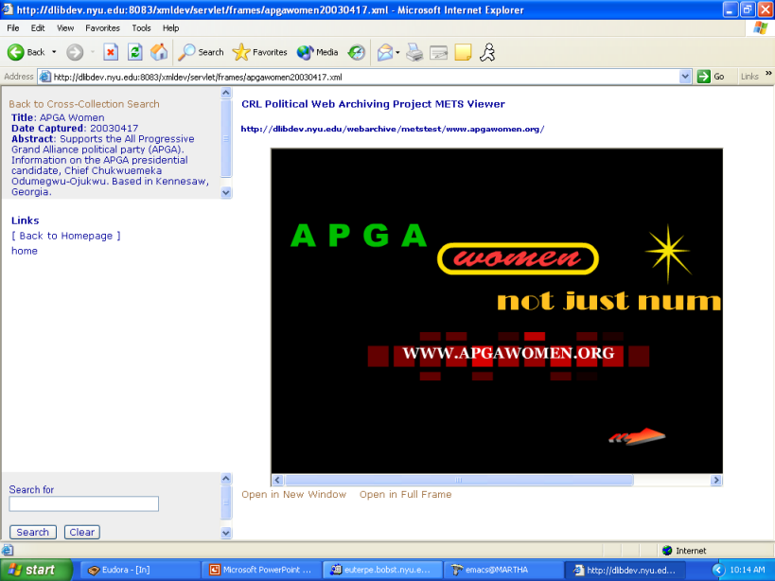

Slide 47
Web Archiving Challenges IV:
Keeping archived websites hermetically sealed

Slide 48
How websites escape from archives
External links
Internal links not parsed out of FLASH
Internal links not parsed out of javascript
.php files not converted to static HTML
.js runners or applets with date() functions

Slide 49
Sealing the archive
What Crawlers Can Do
  rewrite internal links to relative links
  repair producer-generated relative links
  leave external links live? Or create custom 404s?
  rewrite dynamic extensions e.g. .php to .html
  successfully parse out javascript, FLASH URLs

Slide 50
Sealing the Archive
What Applications can do:
  PANDAS
  METS Viewer

Slide 51
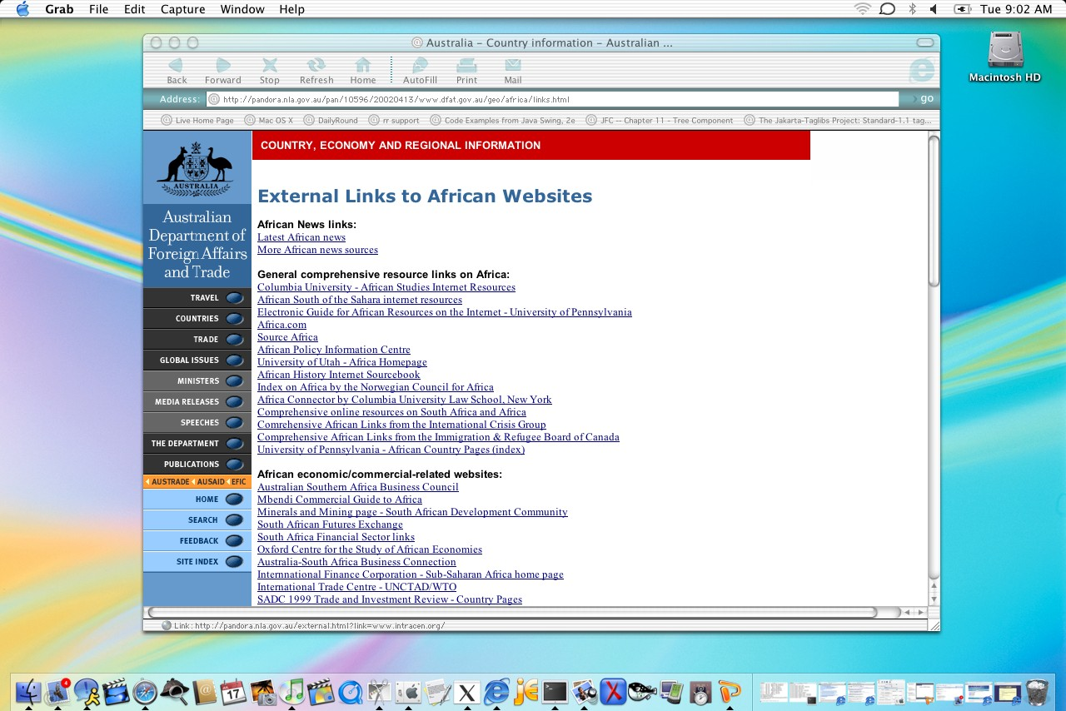

Slide 52
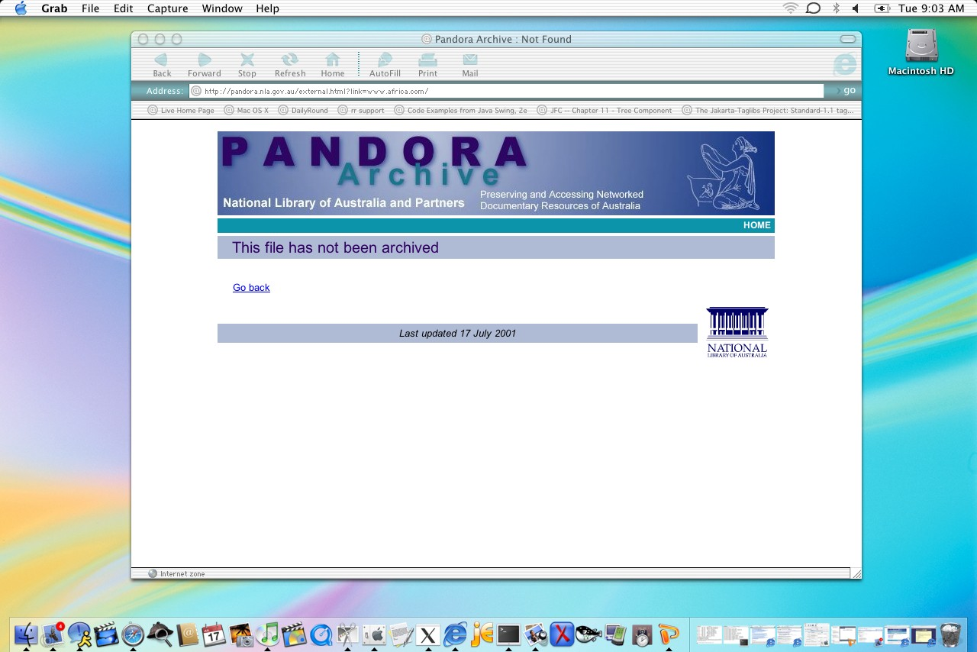

Slide 53
PANDORA Treatment of External Links
<h1>External Links to African Websites</h1>
<p><b>African News links:</b>
<a href="/external.html?link=www-sul.stanford.edu/depts/ssrg/africa/news.html"><br>
Latest African news</a><br>
<a href="/external.html?link=kahn.interaccess.com/intelweb/africa.html">More African news
sources</a></p>
<p><b>General comprehensive resource links on Africa:
</b><a href="/external.html?link=www.columbia.edu/cu/libraries/indiv/area/Africa/"><br>
Columbia University - African Studies Internet Resources</a>
<a href="/external.html?link=www-sul.stanford.edu/depts/ssrg/africa/guide.html"><br>
African South of the Sahara internet resources</a><br>
<a href="/external.html?link=www.sas.upenn.edu/African_Studies/Home_Page/AFR_GIDE.html">
Electronic Guide for African Resources on the Internet - University of Pennsylvania</a><br>
<a href="/external.html?link=www.africa.com/">Africa.com</a><br>
<a href="/external.html?link=www.sourceafrica.com/">Source Africa</a><br>
<a href="/external.html?link=www.africapolicy.org/">African Policy Information Centre</a><br>
<a href="/external.html?link=www.cc.utah.edu/~pks1019">University of Utah - Africa Homepage</a>
<br>
<a href="/external.html?link=www.fordham.edu/halsall/africa/africasbook.html">African
History Internet Sourcebook</a><br>

Slide 54
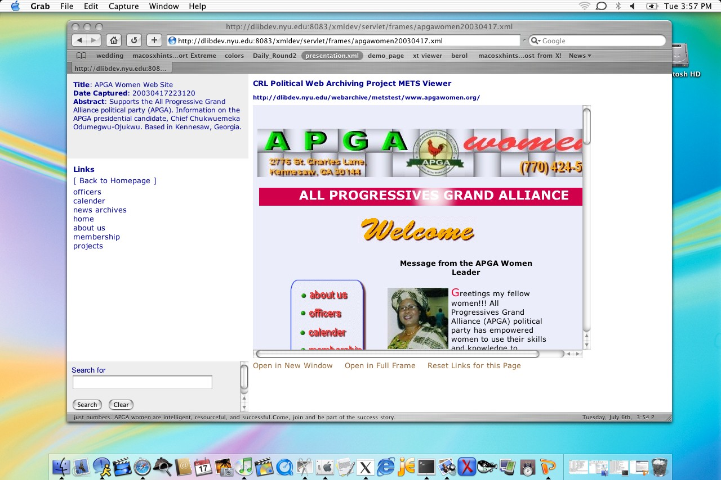
METS Viewer

Slide 55
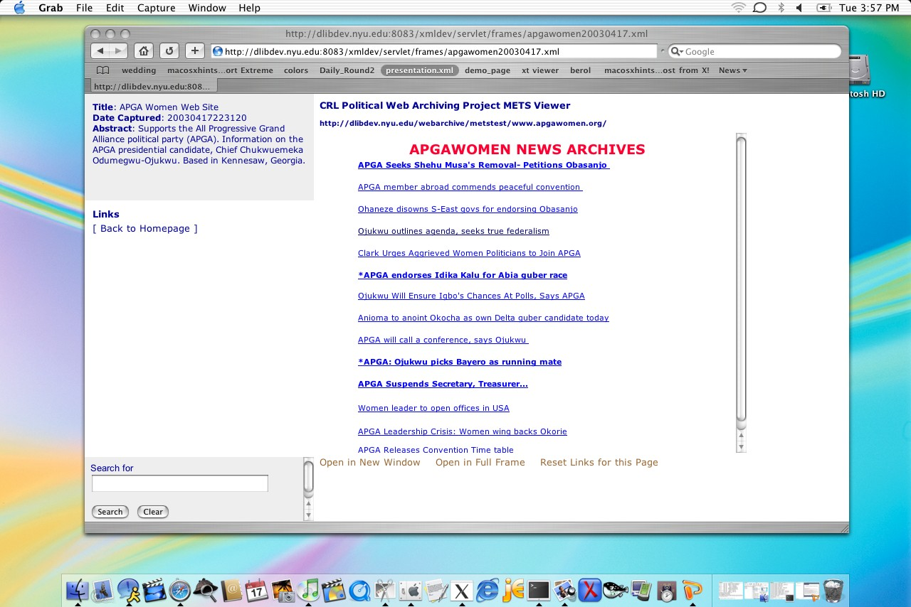
METS Viewer External Links

