Slide 1
Case Studies in Implementing METS: Stanford University Libraries
METS Opening Day Canada
October 15, 2005
by Nancy J. Hoebelheinrich

Slide 2
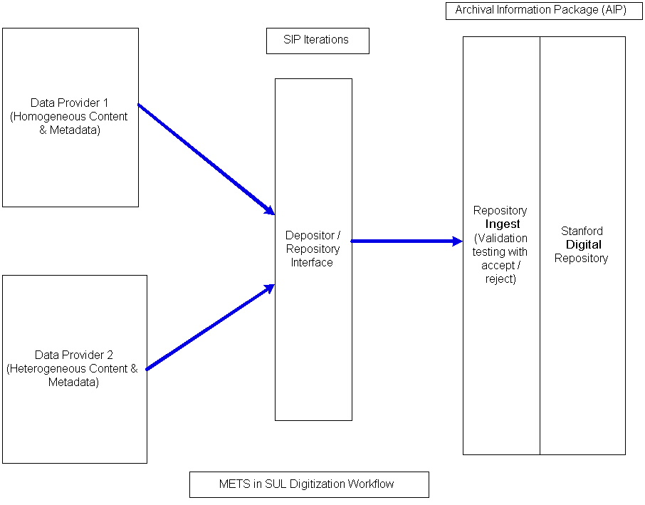
Role within Common Workflows

